Slide 1
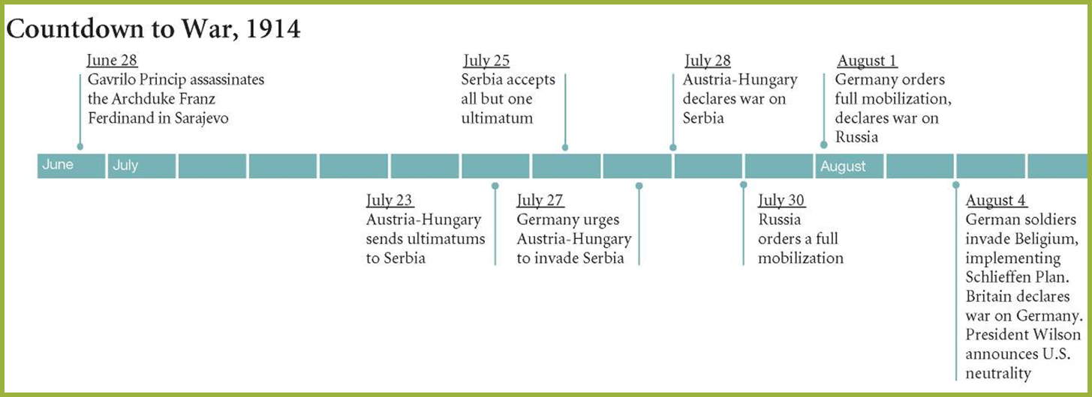
“We must be impartial in thought, as well as action,” Woodrow Wilson, 1914

Slide 2
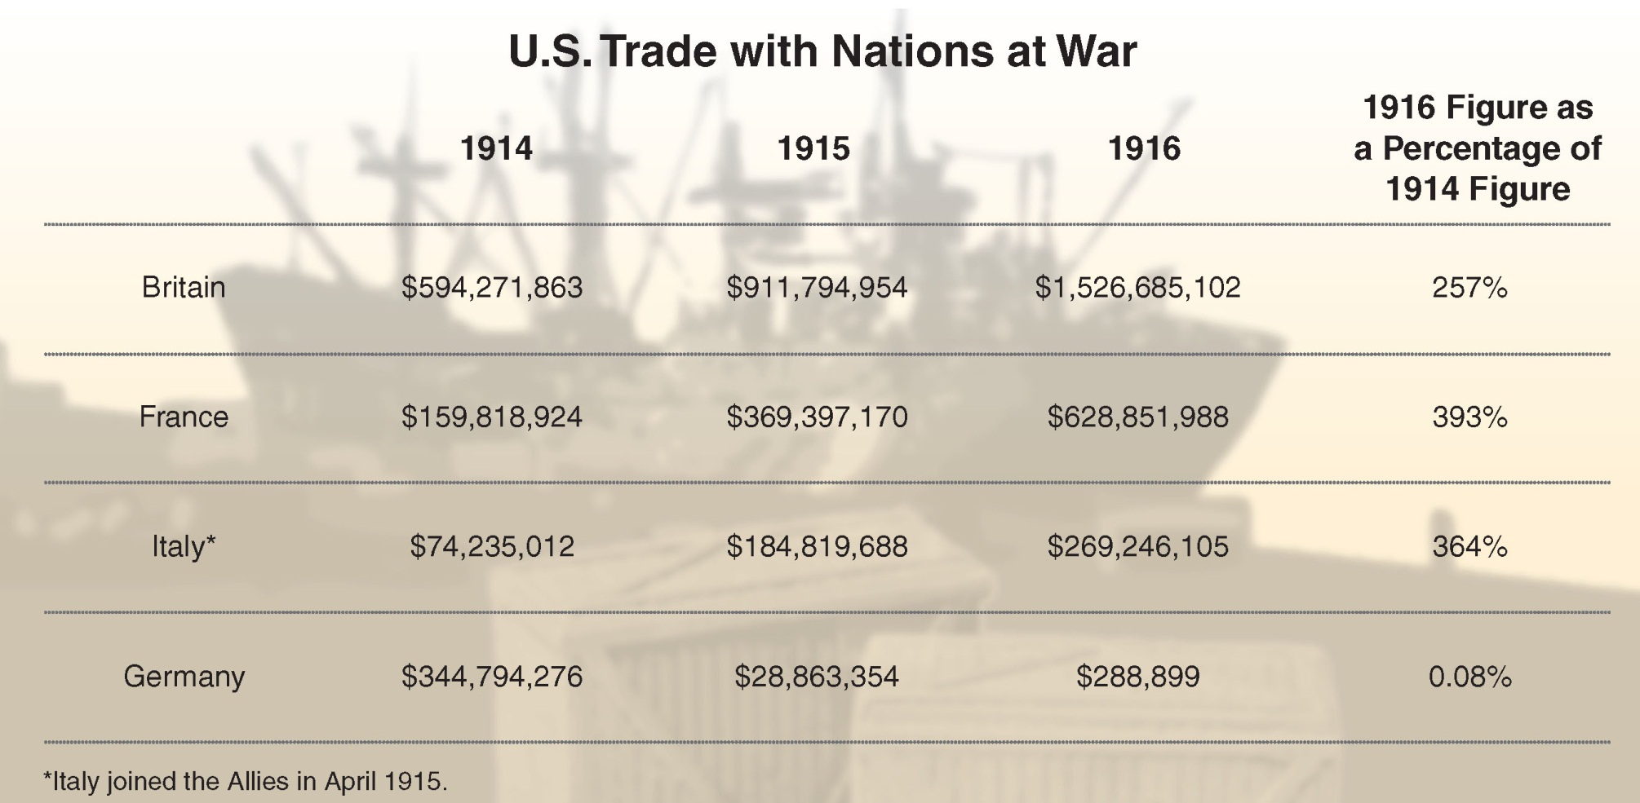
Economic Consequences of Total War
Trade with no one: banning loans
Trade with everyone
Notes:
2
20.3 U.S. Exports to Europe, 1914–1917
The nation’s robust trade with Britain, France, and Italy—allied nations fighting Germany—provoked debate among Americans holding conflicting
visions of neutrality.

Slide 3
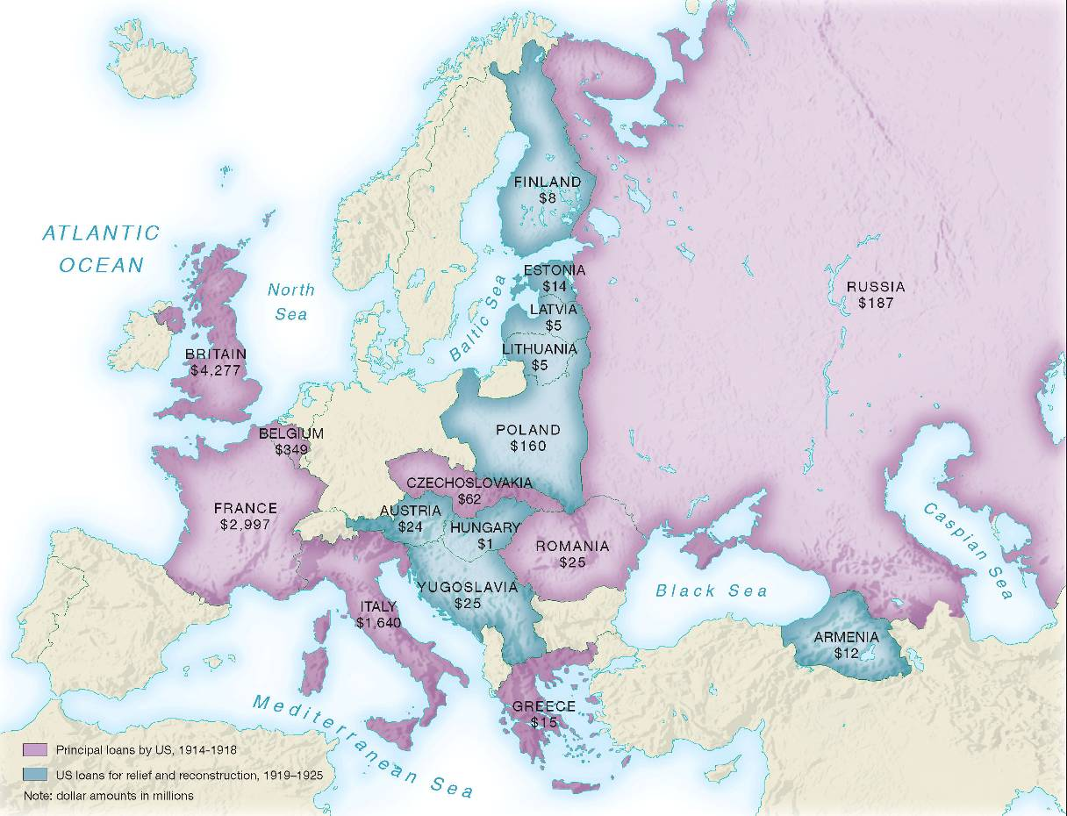

Slide 4
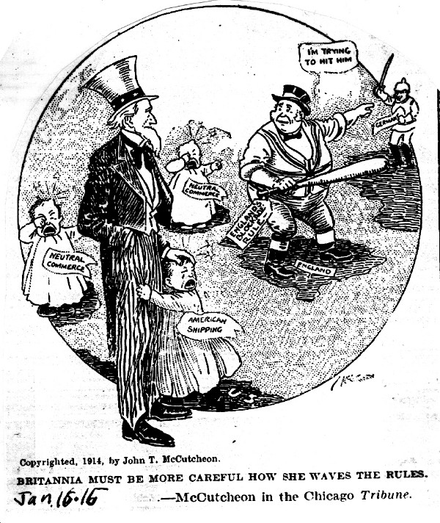

Slide 5
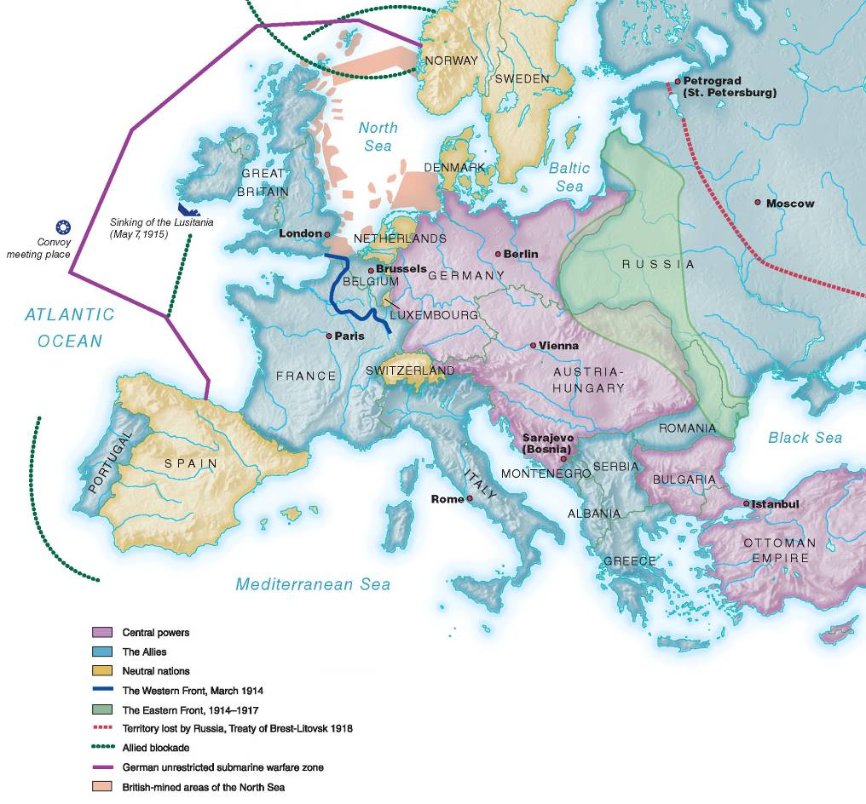

Slide 6
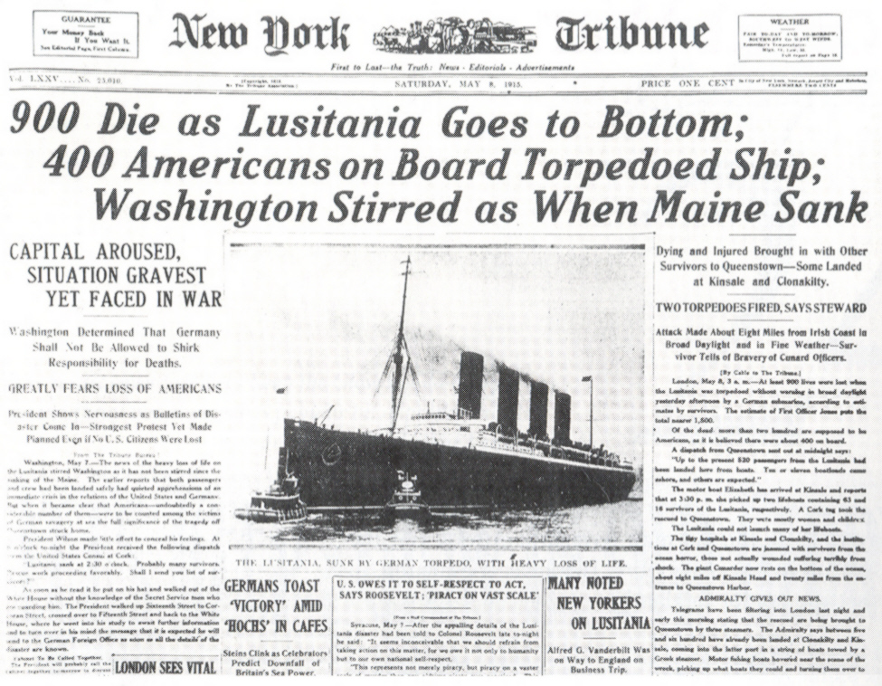

Slide 7
Lusitania, May 7, 1915

Slide 8
Choices and Consequences
DEFINING NEUTRALITY
Responding to the 1915 Lusitania sinking
Prohibit Americans
from sailing on ships headed to the war
zone.
Demand that
Germany pay
reparations and
accept the right
of Americans
to travel and
trade where they wished or risk hostilities.
Break diplomatic
relations and
ask Congress to
declare war on
Germany.

Slide 9
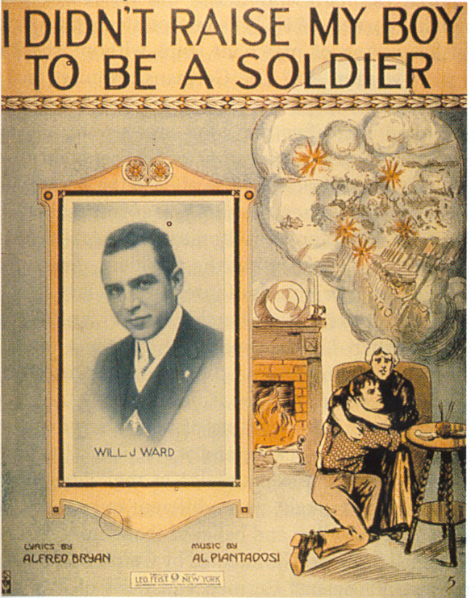
A Divided Nation
“I brought him up to be my pride and joy/
Who dares to place a musket on his shoulder/
To shoot some other mother’s boy.”
Lyrics from the 1916 hit song “I Didn’t Raise My Son to be a Soldier”

Slide 10
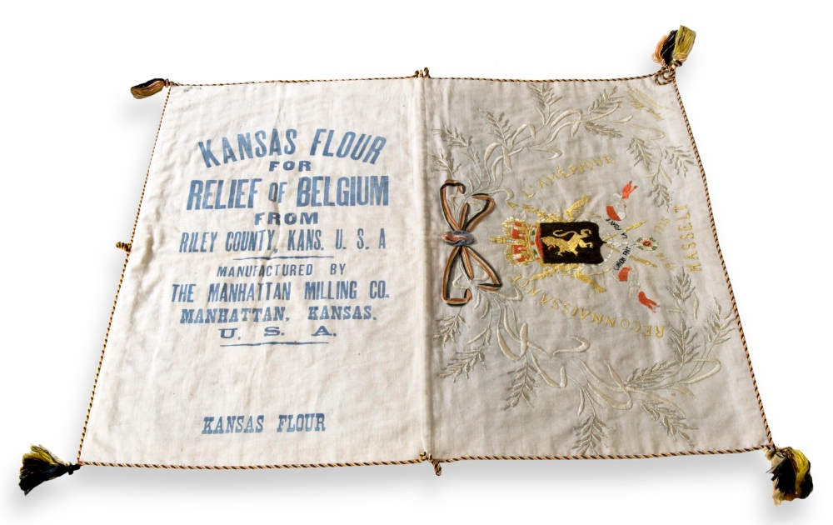

Slide 11
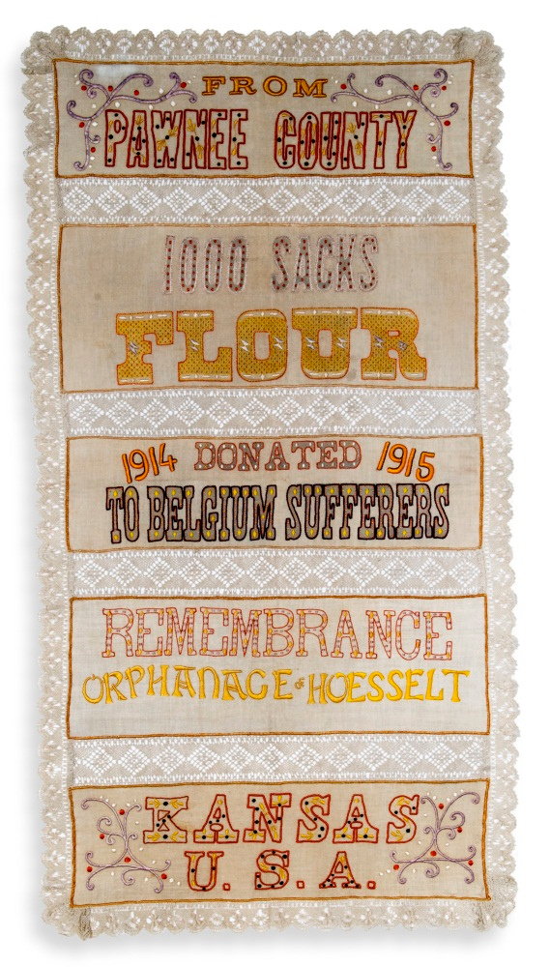

Slide 12
Wilson’s “Peace Without Victory” Speech, January 22, 1917
“Is the present war a struggle for a just and secure peace, or only for a new balance of power?”
“It must be a peace without victory…Only a peace between equals can last.”
“I am proposing that all nations henceforth avoid entangling alliances… government by the consent of the governed…freedom of the seas…moderation of armaments.”
“These are American principles, American policies. We could stand for no others. And they are also the principles and policies of forward looking men and women everywhere, of every modern nation, of every enlightened community. They are the principles of mankind and must prevail.”

Slide 13
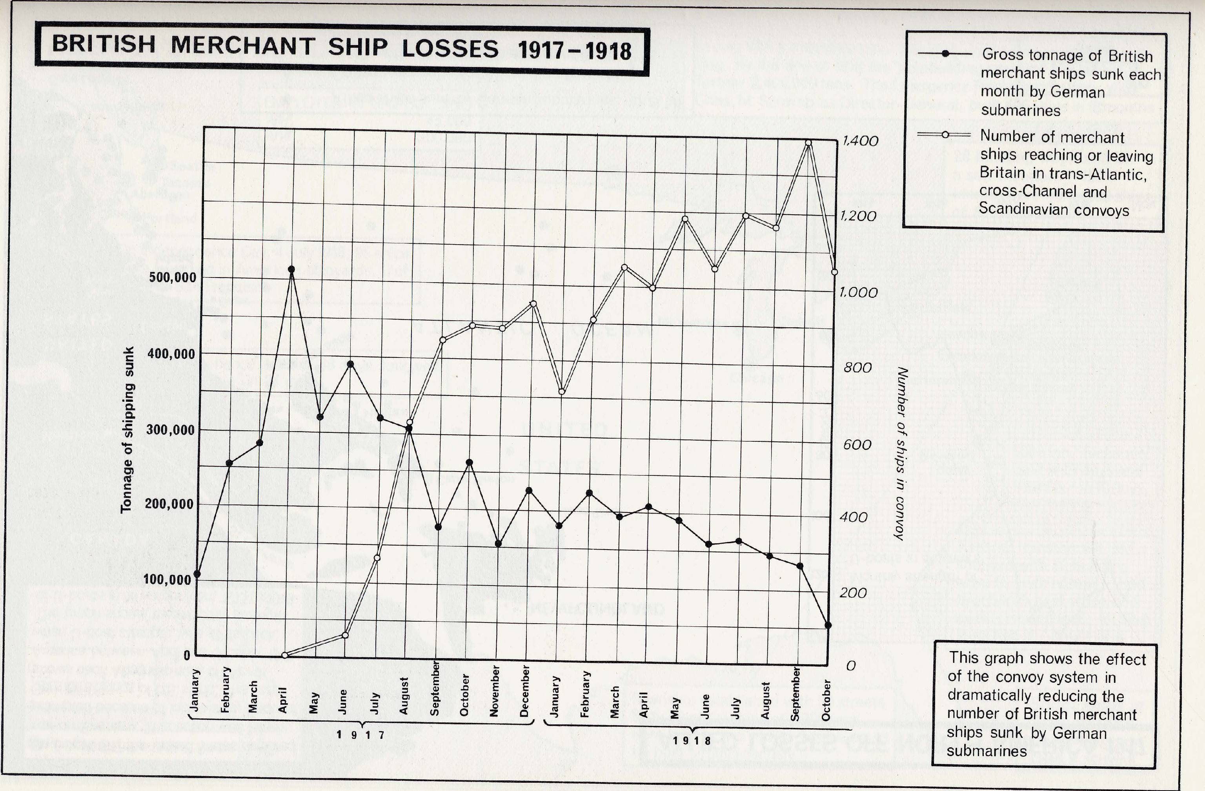

Slide 14
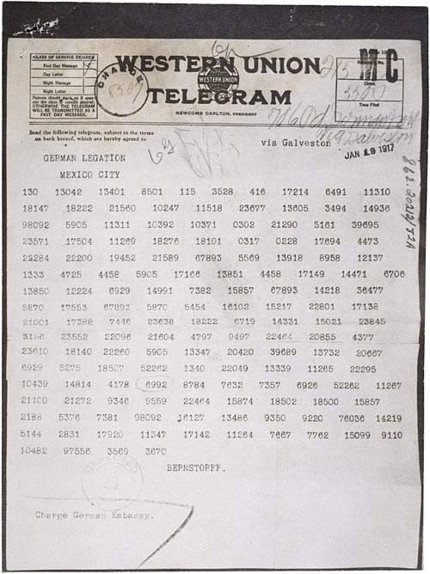
Received by US, February 24, 1917
Released to public March 1, 1917
Convinces Congress to authorize arming of merchant ships:
“armed neutrality”

Slide 15
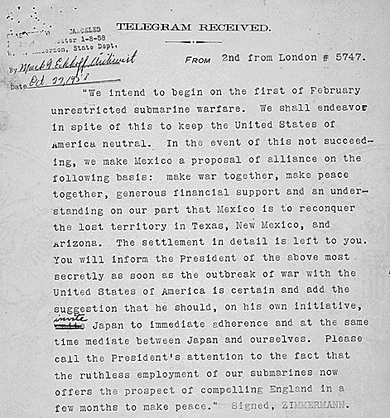
Is this a credible threat to the United States?

Slide 16
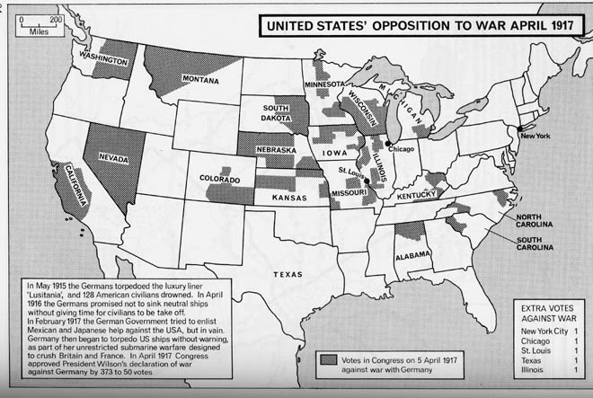
. “I shall always believe we could and ought to have kept out of this war,”
House majority leader Claude Kitchin, a Democrat from North Carolina.

