Slide 1
Election of 1800: Origins of American Political Parties

Slide 2
Essential Question
In what ways did the election of 1800 signify that political parties had become an important part of national politics?

Slide 3
Key Ideas
The election of 1800 was dominated by disputes between two competing visions for America’s future which were represented by two different political parties.
The Federalist vision: Strong central government; pro-British foreign policy; economic policies that boosted American manufacturing; growth of cities and centers of manufacturing and commerce
The Democratic-Republican vision: Small, limited government; pro-French foreign policy; economic policies that benefited small farmers, rather than merchants; rural, agrarian-based economy
The election of 1800 saw the first large-scale examples of active political campaigning.
After the election was ultimately sent to the House of Representatives to determine the winner, the election of 1800 resulted in the first orderly and peaceful transition of power from one political party to another.

Slide 4
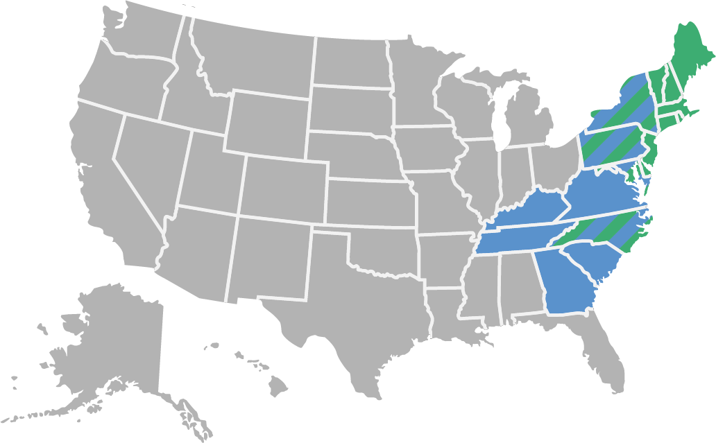
Candidates and Outcome
Jefferson 73 Adams 65
John Adams (Federalist)
Thomas Jefferson (Democratic-Republican)
Aaron Burr (Democratic-Republican)
Charles Pinckney (Federalist)
John Jay (Federalist)

Slide 5
Warm-Up
Tally of Electoral Votes
Annals of Congress, House of Representatives,
6th Congress, 2nd Session 1801

Slide 6
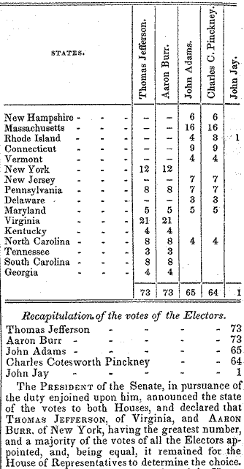
Tally of Electoral Votes Annals of Congress, House of Representatives, 6th Congress, 2nd Session 1801
“Proceedings February 11, 1801.” Annals of Congress. House of Representatives, 6th Congress, 2nd Session, 1023- 1024. Washington: Gales and Seaton, 1849. From Library of Congress. https://memory.loc.gov/cgi-bin/ampage?collId=llac&fileName=010/llac010.db&recNum=509.

