Slide 1
Election of 1828: Andrew Jackson and an Expanded Electorate

Slide 2
Essential Question
How accurate is the characterization of this period in U.S. history as the era of the “common man”?

Slide 3
Key Ideas
Results from the previous presidential election in 1824, in which Andrew Jackson won the popular vote but did not win the presidency, left many people upset that a corrupt elite had, allegedly, rigged the outcome. This led to calls to change the way voting worked in the United States.
Changes on several levels saw more people able to participate in elections:
The end of property requirements to vote meant that more men were eligible to vote.
The increase in the number of states choosing presidential electors by popular votes rather than by vote of the state legislators contributed to the increasingly democratic nature of elections.

Slide 4
Key Ideas
Changes in campaign styles made political contests public events that involved spectacle and debates, manipulation of candidates’ images to appeal to voters, and broadened use of the press.
The 1828 campaign was particularly personal. Character attacks were as common as policy-based campaigning. Some described the campaign as pitting a “president who writes” against a “president who fights.” Others, on both sides, warned of the danger of emerging tyranny.

Slide 5
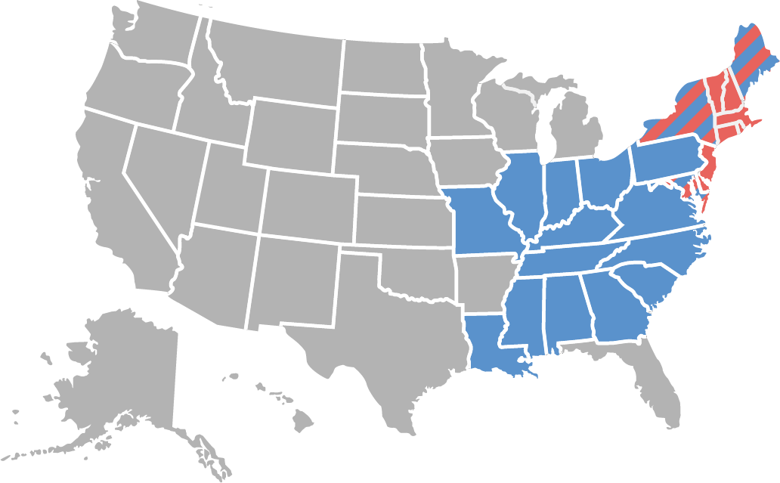
Candidates and Outcome
Jackson 178 Adams 83
Andrew Jackson (Democrat)
John Quincy Adams (National Republican)

Slide 6
Warm-Up
Resolution No. 5
Acts Passed at the Regular Session of the
Sixteenth General Assembly of the State of Tennessee
October 7, 1825

Slide 7
Resolution No. 5 Acts Passed at the Regular Session of the Sixteenth General Assembly of the State of Tennessee October 7, 1825
No. 5
RESOLUTION, relative to the reception of general Jackson.
Resolved, as an evidence of the respect and attachment entertained by this Legislature, in common with our fellow-citizens, towards general ANDREW JACKSON, for his high personal qualifications, and numerous and important services rendered to his country, that the two branches of this General Assembly will receive him on the day next after his arrival at the seat of government, at 12 o’clock, in the representative hall.
Resolved, That one or both of the speakers, on behalf of the two houses, shall deliver, at such time, to general Jackson, an address expressive of their high personal regard, and the great satisfaction they feel in relation to the course he pursued, during the pending of the late presidential election.
Resolved, That a joint select committee be appointed to wait upon general Jackson, on his arrival at the seat of government, to inform him of the foregoing resolution, and conduct him within the bar of the house of representatives.
WM. BRADY,
Speaker of the House of Representatives.
Speaker of the Senate.
J.P. ERWIN,
Clerk, of the H. Rep.
Clerk of the Senate.
Adopted October 7, 1825.
Acts Passed at the Regular Session of the Sixteenth General Assembly of the State of Tennessee, 363-364. (Knoxville, TN: Weiskell & Brown and A.P. Maury, 1826).

