Slide 1
Election of 1876: The End of Reconstruction

Slide 2
Essential Question
How did the election of 1876 solve an immediate political crisis, and did that solution indicate that the Reconstruction amendments had failed to achieve their goals?

Slide 3
Key Ideas
The presidential election of 1876 resulted in a contested outcome that was not resolved for months following the election. Neither candidate met the constitutional requirements for election. That failure forced Congress to create a tribunal to determine a winner.
The tribunal’s choice of Republican Rutherford B. Hayes created enormous controversy because of the process used to select him and highlighted the fact that sectional tensions between the North and the South remained present after the Civil War.

Slide 4
Key Ideas
The controversy was resolved only by a “compromise” agreement that ended Northern military intervention in the South. Military troops were the last obstacle to Southern Democrats reassertion of racial control over the South’s free Black population. Their removal effectively ended Reconstruction.
The end of Northern intervention created new political problems as the promises of citizenship and suffrage made to the formerly enslaved by the 14th and 15th Amendments were replaced by segregation and Jim Crow laws.

Slide 5
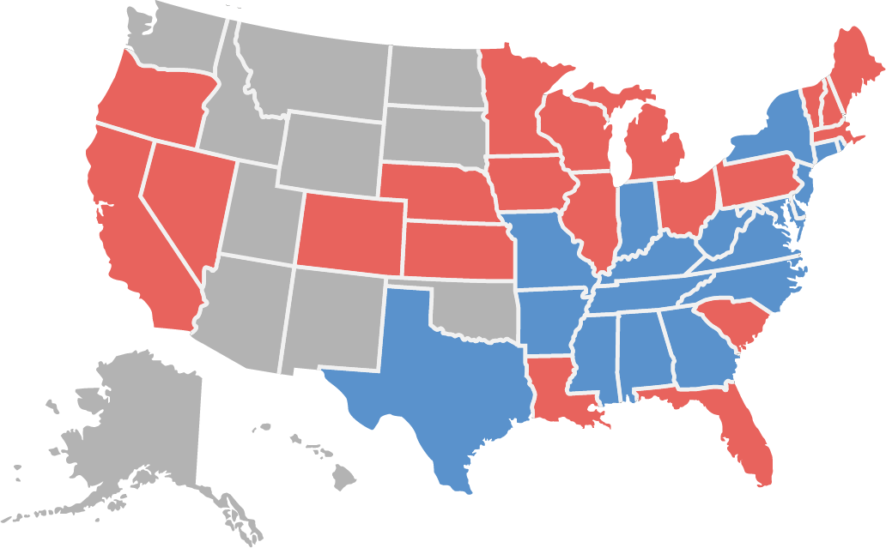
Candidates and Outcome
Hayes 185 Tilden 184
Samuel Tilden (Democrat)
Rutherford B. Hayes (Republican)

Slide 6
Warm-Up
“Of Course He Wants to Vote the Democratic Ticket!”
A. B. Frost, Harper’s Weekly
October 21, 1876

Slide 7
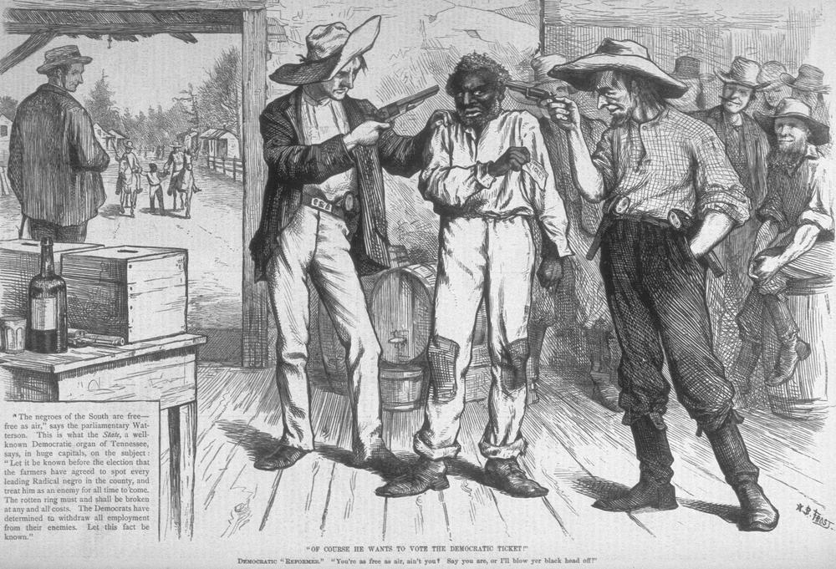
“Of Course He Wants to Vote the Democratic Ticket!” A. B. Frost, Harper’s Weekly October 21, 1876
Frost, A.B. “Of Course He Wants to Vote the Democratic Ticket.” Harper's Weekly, October 21, 1876. From Indiana University, Bloomington, Presidential Campaigns: A Cartoon History, 1789–1976. https://collections.libraries.indiana.edu/presidentialcartoons/items/show/132.

