Slide 1
Election of 1896: The Populist Movement

Slide 2
Essential Question
What were the political and economic issues that led to the beginnings of Populism, and how did the emergence of the Populist Party impact U.S. society?

Slide 3
Key Ideas
The election of 1896 revealed significant sectional differences as the agricultural regions of the United States clashed with the industrial Northeast for power. Industry and agriculture were in direct competition for land use, creating tensions on both sides.
Called the first “modern” presidential campaign by some historians, the election of 1896 saw the first broad use of nation-wide campaigning by candidates and supporters.
An agrarian-focused party, the Populist Party was a short-lived but significant third party. Their support of unlimited silver coinage, a progressive income tax, and greater workers’ rights were all designed to increase the power of farmers and bring them economic parity with business and industry. Some Populist ideas were later championed by Progressive Era reformers.

Slide 4
Key Ideas
The Democratic Party co-opted a number of Populist ideas and even nominated the same candidate.
The Republican Party won the support of the heavily populated, industrial Northeast through their support of the gold standard and enforcing immigration laws, and with that support came to dominate the American political system for the next three decades.

Slide 5
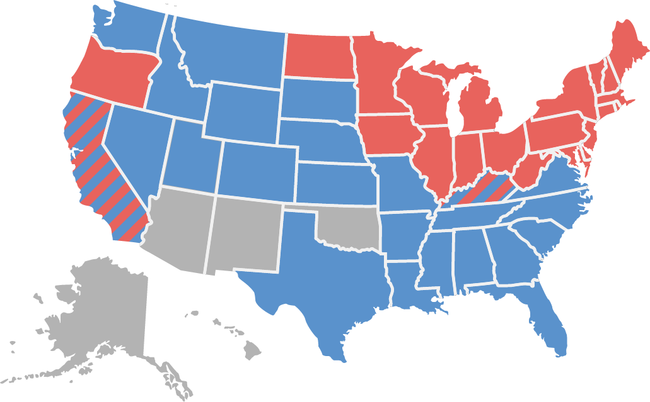
Candidates and Outcome
McKinley 271 Bryan 176
William Jennings Bryan (Democrat and Populist)
William McKinley (Republican)

Slide 6
Warm-Up
Excerpt from the Populist Party Platform
Populist Party
1896

Slide 7
Excerpt from the Populist Party Platform Populist Party 1896
… We realize that, while we have political independence, our financial and industrial independence is yet to be attained by restoring to our country the Constitutional control and exercise of the functions necessary to a people's government, which functions have been basely surrendered by our public servants to corporate monopolies. … Executive power and patronage have been used to corrupt our legislatures and defeat the will of the people, and plutocracy has thereby been enthroned upon the ruins of democracy. To restore the Government intended by the fathers, and for the welfare and prosperity of this and future generations, we demand the establishment of an economic and financial system which shall make us masters of our own affairs and independent of European control, by the adoption of the following:
The Finances
FIRST. We demand a National money, safe and sound, issued by the General Government only, without the intervention of banks of issue, to be a full legal tender for all debts, public and private; a just, equitable, and efficient means of distribution, direct to the people, and through the lawful disbursements of the Government.
SECOND. We demand the free and unrestricted coinage of silver and gold at the present legal ratio of 16 to 1, without waiting for the consent of foreign nations. …
SEVENTH. We demand a graduated income tax, to the end that aggregated wealth shall bear its just proportion of taxation, and we regard the recent decision of the Supreme Court relative to the income-tax as a misinterpretation of the Constitution and an invasion of the rightful powers of Congress over the subject of taxation. …
Populist Party National Convention (St. Louis, Missouri). Platform of the Populist Party, 1896. In National Party Platforms, 1840-1972, edited by Donald Bruce Johnson and Kirk Harold Porter, 104 (University of Illinois Press, 1973). From University of Houston Digital History. https://www.digitalhistory.uh.edu/disp_textbook.cfm?smtID=3&psid=4067.

Slide 8
Excerpt from the Populist Party Platform Populist Party 1896
Railroads and Telegraphs
FIRST. Transportation being a means of exchange and a public necessity, the Government should own and operate the railroads in the interest of the people and on a non-partisan basis, to the end that all may be accorded the same treatment in transportation, and that the tyranny and political power now exercised by the great railroad corporations … may be destroyed. …
The Public Lands
FIRST. True policy demands that the National and State legislation shall be such as will ultimately enable every prudent and industrious citizen to secure a home, and therefore the land should not be monopolized for speculative purposes. …
The Referendum
We favor a system of direct legislation through the initiative and referendum, under proper Constitutional safeguards.
Direct Election of President and Senators by the People
FIRST. We demand the election of President, Vice-President, and United States Senators by a direct vote of the people….
Populist Party National Convention (St. Louis, Missouri). Platform of the Populist Party, 1896. In National Party Platforms, 1840-1972, edited by Donald Bruce Johnson and Kirk Harold Porter, 104 (University of Illinois Press, 1973). From University of Houston Digital History. https://www.digitalhistory.uh.edu/disp_textbook.cfm?smtID=3&psid=4067.

Slide 9
Excerpt from the Populist Party Platform Populist Party 1896
A Fair Ballot
Believing that the elective franchise and an untrammeled ballot are essential to a government of, for, and by the people, the People's party condemns the wholesale system of disfranchisement adopted in some States as unrepublican and undemocratic, and we declare it to be the duty of the several
State legislatures to take such actions as will secure a full, free and fair ballot and an honest count. …
Populist Party National Convention (St. Louis, Missouri). Platform of the Populist Party, 1896. In National Party Platforms, 1840-1972, edited by Donald Bruce Johnson and Kirk Harold Porter, 104 (University of Illinois Press, 1973). From University of Houston Digital History. https://www.digitalhistory.uh.edu/disp_textbook.cfm?smtID=3&psid=4067.

