Slide 1
Election of 1932: The Great Depression

Slide 2
Essential Question
How did the Great Depression shape the election of 1932, and how did the election foreshadow an expanded role for the federal government in U.S. society?

Slide 3
Key Ideas
The election of 1932 occurred amidst the greatest economic crisis in United States history. After the stock market crash, factories slashed production, employers drastically cut wages, and unemployment soared to record highs leading to home foreclosures, bankruptcies, and dire conditions for many Americans.
The presidential candidates representing the two major political parties presented vastly different views on how government should respond to this economic and social crisis.
Roosevelt, the Democratic candidate, advocated an active government role.
Hoover, the Republican candidate, favored individual self-reliance.

Slide 4
Key Ideas
Faced with the choice between these differing views, the American public overwhelmingly chose Franklin Roosevelt and his promise of a “new deal.”
Roosevelt’s election realigned the party system, bringing the working class and racial minorities into the Democratic party.
Roosevelt did not provide specific details for his “new deal,” but it was clear he envisioned a much different (and more active) role for government than Hoover did.

Slide 5
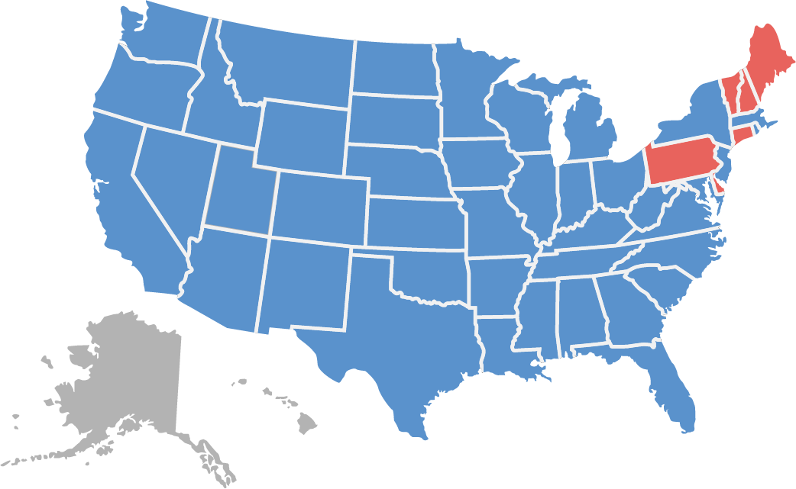
Candidates and Outcome
Wilson 472 Hoover 59
Franklin Delano Roosevelt (Democrat)
Herbert Hoover (Republican)

Slide 6
Warm-Up
Brother Can You Spare a Dime?
Lyricist: Yip Harburg, Composer: Jay Gorney
1932

Slide 7
Brother Can You Spare a Dime? Lyricist: Yip Harburg, Composer: Jay Gorney 1932
… They used to tell me I was building a dream
And so I followed the mob
When there was earth to plow or guns to bear
I was always there right on the job
… They used to tell me I was building a dream
With peace and glory ahead
Why should I be standing in line
Just waiting for bread?
… Once I built a railroad, I made it run
Made it race against time
Once I built a railroad, now it's done
Brother, can you spare a dime?
… Once I built a tower up to the sun
Brick and rivet and lime
Once I built a tower, now it's done
Brother, can you spare a dime?
… Once in khaki suits, gee we looked swell
Full of that yankee doodly dum
Half a million boots went sloggin' through hell
And I was the kid with the drum
… Say, don't you remember, they called me Al
It was Al all the time
Why don't you remember, I'm your pal
Say buddy, can you spare a dime?
… Once in khaki suits, ah gee we looked swell
Full of that yankee doodly dum
Half a million boots went sloggin' through hell
And I was the kid with the drum
… Oh, say, don't you remember, they called me Al
It was Al all the time
Say, don't you remember, I'm your pal
Buddy, can you spare a dime?
Harburg, Yip. “Brother Can You Spare a Dime?,” 1932. From Kennedy Center, “Brother Can You Spare a Dime”: The Story Behind the Song. https://www.kennedy-center.org/education/resources-for-educators/classroomresources/ media-and-interactives/media/music/story-behind-the-song/the-story-behind-the-song/brother-can-yousparea-dime/.

