Slide 1
Election of 1968: Conservative Response

Slide 2
Essential Question
In what way can the election of Richard M. Nixon be understood as a response to the growing discontent about race relations and U.S. involvement in Vietnam?

Slide 3
Key Ideas
The period between John F. Kennedy’s election in 1960 and the election of 1968 proved to be one of tremendous social unrest and discontent across the globe.
By 1968, the American people confronted a disillusioning reality that included assassinations of major political leaders, destructive racial unrest in major American cities, a seemingly unending stalemate in Vietnam, and widespread anti-war protests on college campuses and elsewhere.
In 1968, the American people elected Richard Nixon, who promised to answer growing cynicism and public displays of dissent, with “law and order” on the streets and “peace with honor” in Vietnam. Nixon’s campaign claimed to represent the “silent majority” who believed that change had gone too far and revived the call for a commitment to law and order.

Slide 4
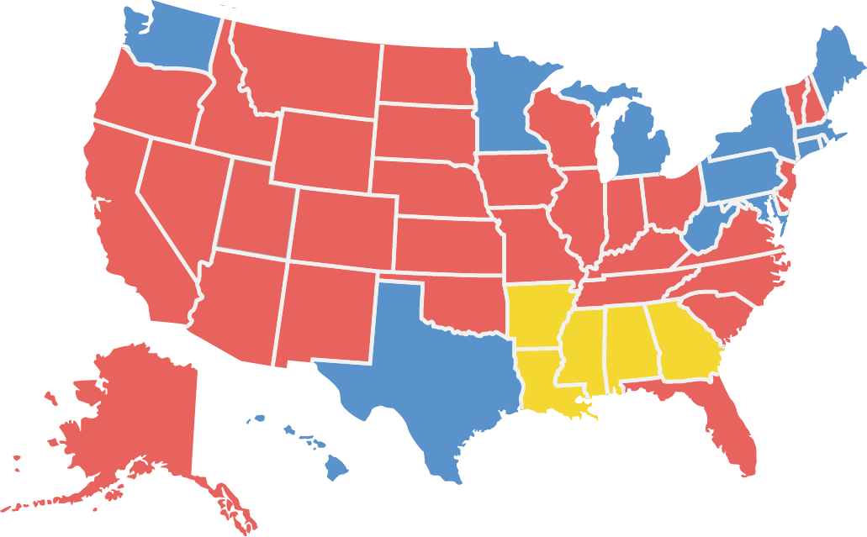
Candidates and Outcome
Nixon 301 Humphrey 191 Wallace 46
Richard Nixon (Republican)
Hubert Humphrey (Democrat)
George Wallace (American Independent)

Slide 5
Warm-Up
“Someday Son All This Will Be Yours”
William E. Papas
1968

Slide 6
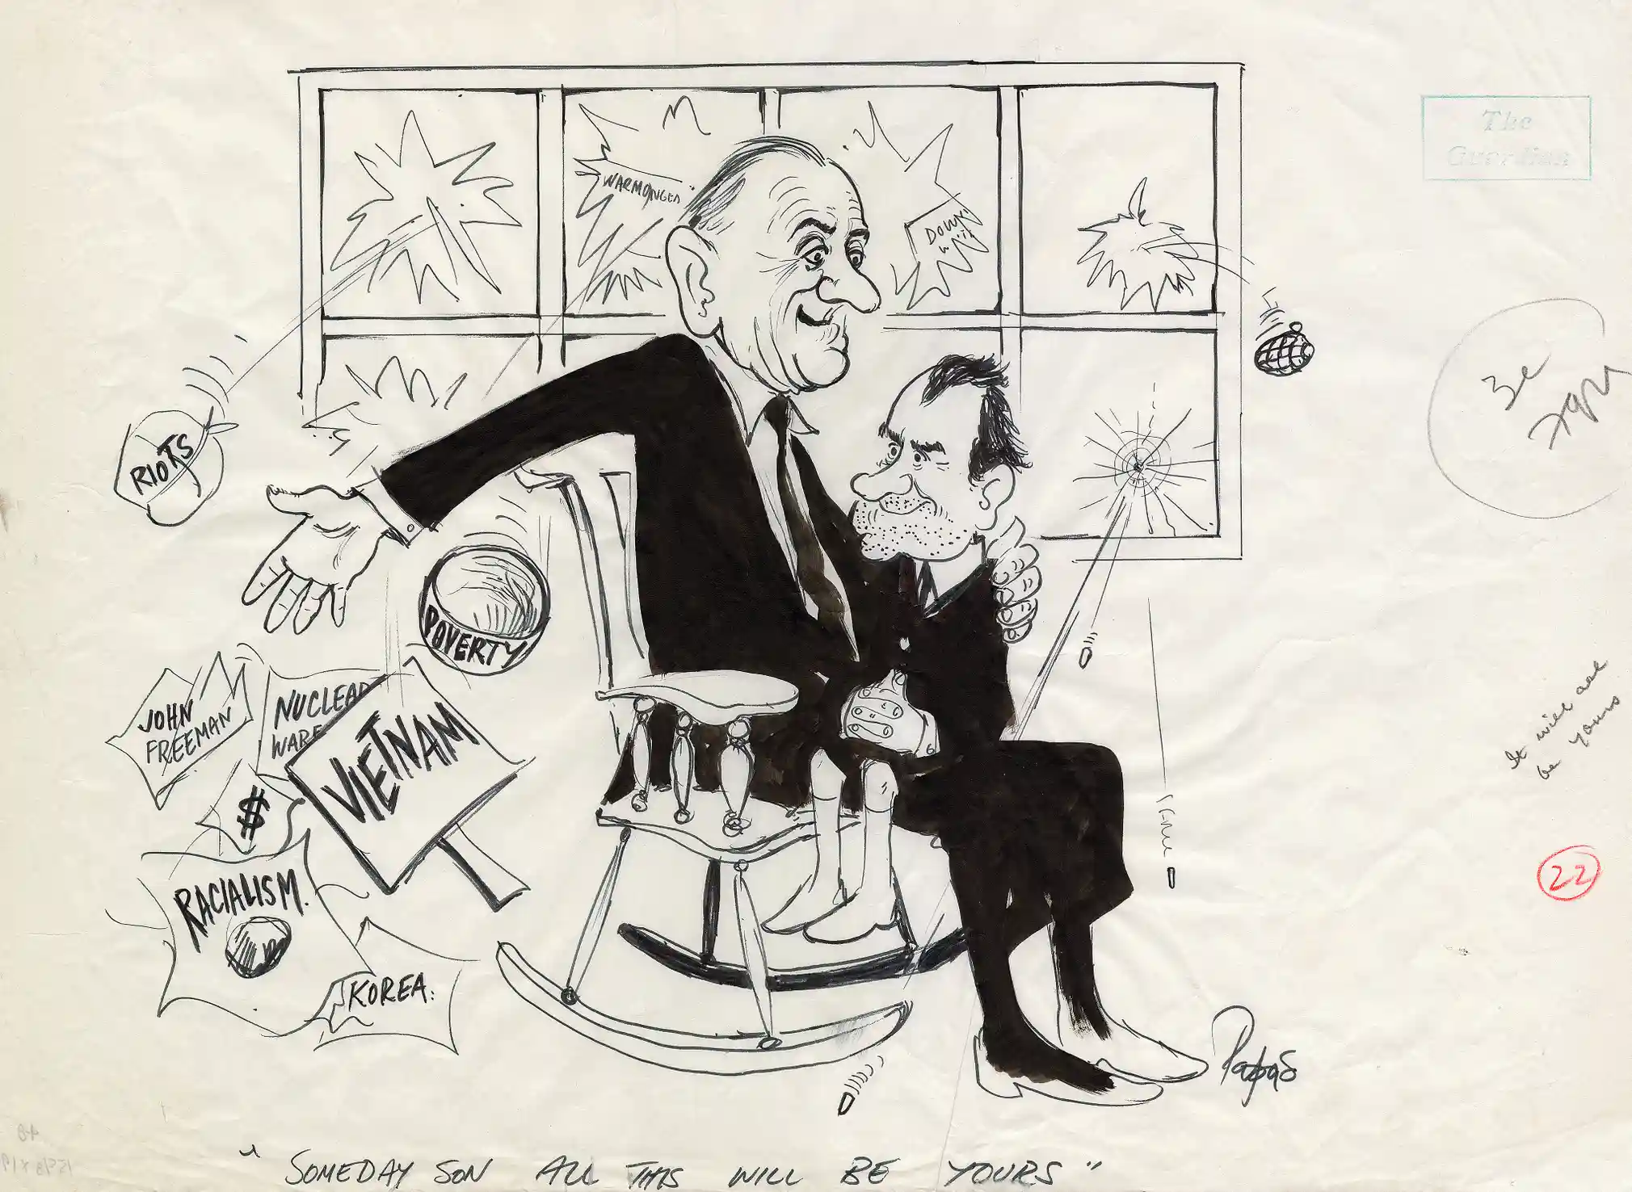
“Someday Son All This Will Be Yours” William E. Papas 1968
Papas, William E. “Someday Son All This Will Be Yours.” The Guardian, November 12, 1968. From The Guardian online. https://www.theguardian.com/gnm-archive/gallery/2016/oct/18/from-the-archive-us-presidential-elections-in-pictures.

