Slide 1
Election of 1980: Conservative Resurgence

Slide 2
Essential Question
In what ways did Reagan’s victory in the presidential election of 1980 represent a resurgence of conservative values and the end of the New Deal coalition in U.S. society?

Slide 3
Key Ideas
Between 1964 and 1980, social, political, and economic unrest created significant upheaval throughout America. The Vietnam War and escalating Cold War tensions contributed to that unrest until détente in the 1970s. Throughout much of the 1970s, rising inflation, the oil crisis, the decline of manufacturing industries, and economic stagnation created one economic crisis after another. These issues influenced voters.
Leading up to and following this election, political allegiance became more and more based on social and cultural issues. The increasingly polarized and competing perspectives provided the foundation for what many historians have since deemed the “culture wars.”

Slide 4
Key Ideas
Reagan’s victory signaled the end of the New Deal coalition that had been responsible for eight Democratic presidential victories since 1932 and Democratic control of Congress for most of the previous five decades.
With the support of a growing number of conservative organizations, Reagan sought to limit the scope of government and to promote conservative values by rolling back spending on social programs, reducing taxes, and increasing military funding.

Slide 5
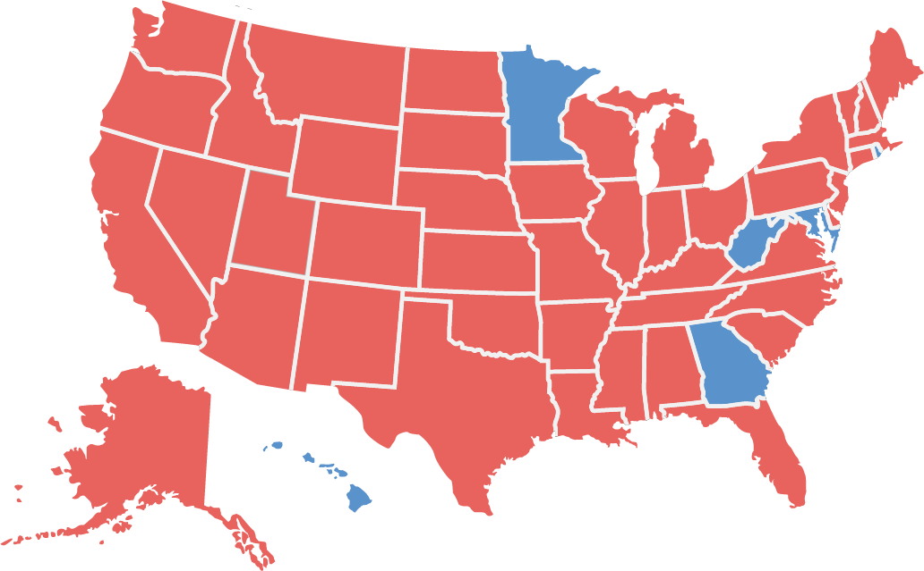
Candidates and Outcome
Reagan 489 Carter 49
Ronald Reagan (Republican)
Jimmy Carter (Democrat)

Slide 6
Warm-Up
America: Reagan Country
Creator Unidentified
1980

Slide 7
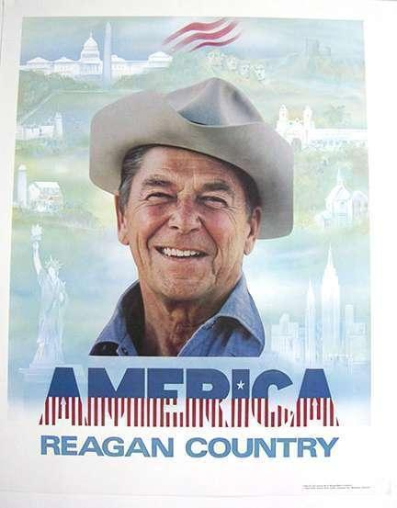
America: Reagan Country Creator Unknown 1980
Creator unidentified. “America: Reagan Country.” Poster. 1980. From National Archives, Ronald Reagan Library Museum Collection. https://www.docsteach.org/documents/document/america-reagan-country.

