Slide 1
Election of 2000: The Supreme Court and the Presidency

Slide 2
Essential Question
How did the outcome of the election of 2000 represent the evolving relationship among the legislative, executive, and judicial branches of government?

Slide 3
Key Ideas
The election of 2000 was one of the closest presidential elections in U.S. history, with Bush receiving 271 electoral votes, just one vote more than Constitutionally required to be declared the winner.
Whichever candidate won the popular vote in the state of Florida would win the election. Out of more than five million votes cast there, the difference, and margin of victory, between Bush and Gore was only 537 votes.
Controversies surrounded the vote in Florida including contested ballots and inaccurate or incomplete voter registrations. These controversies and the outcome of the election were eventually decided by the United States Supreme Court in the case Bush v. Gore (2000). This is the only time that the judicial branch has determined the outcome of a presidential election.

Slide 4
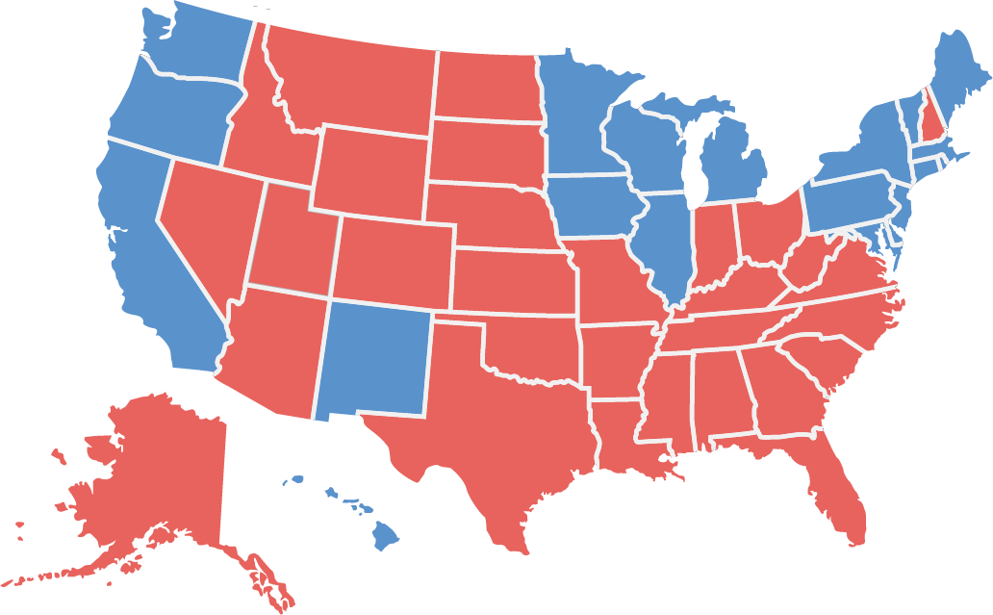
Candidates and Outcome
Bush 271 Gore 266
Al Gore (Democrat)
George W. Bush (Republican)
Ralph Nader (Green)

Slide 5
Warm-Up
Cover Image
Peter de Sève, The New Yorker
November 20, 2000

Slide 6
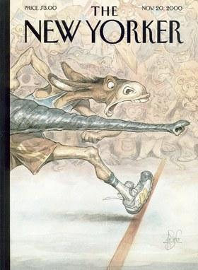
Cover Image Peter de Sève, The New Yorker November 20, 2000
de Sève, Peter. “Cover Image.” The New Yorker. November 20, 2000. From The New Yorker online. https://www.newyorker.com/magazine/2000/11/20.

