Slide 1
TEACH. PREPARE. INSPIRE.
A National History Day Workshop
“It’s not just a day, it’s an experience!”

Slide 2
NATIONAL HISTORY DAY
National History Day is an exciting academic program that focuses on historical research, analysis, interpretation, and creative expression.

Slide 3
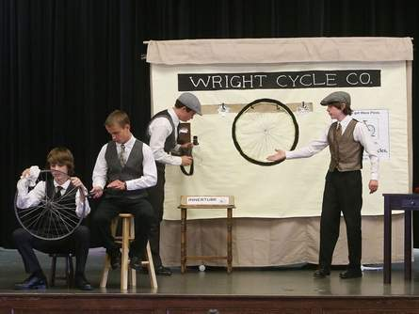
NATIONAL HISTORY DAY
National History Day is:
Project-Based Learning
Personalized Learning
Authentic Learning
NHD Performance NHD.org

Slide 4
NATIONAL HISTORY DAY
National History Day provides a
framework for success.
Students learn to analyze historical information, organize and present their research, use technology, and develop effective communication skills through clear writing and oral presentation.
Research and Reading Skills
Problem Solving Skills
Critical Thinking Skills
Self-Esteem and Confidence

Slide 5
NATIONAL HISTORY DAY
NATIONAL HISTORY DAY
THE PROCESS

Slide 6
STEP 1
SELECTING A TOPIC

Slide 7
NHD THEME
NATIONAL HISTORY DAY
THEME
Themes are chosen for their broad application to all eras of history - State, National, World History.
A theme helps students:
Focus their research
Increase historical understanding
Place information in correct context
See connections over time
See the theme narrative in the 2024 Theme Booklet

Slide 8
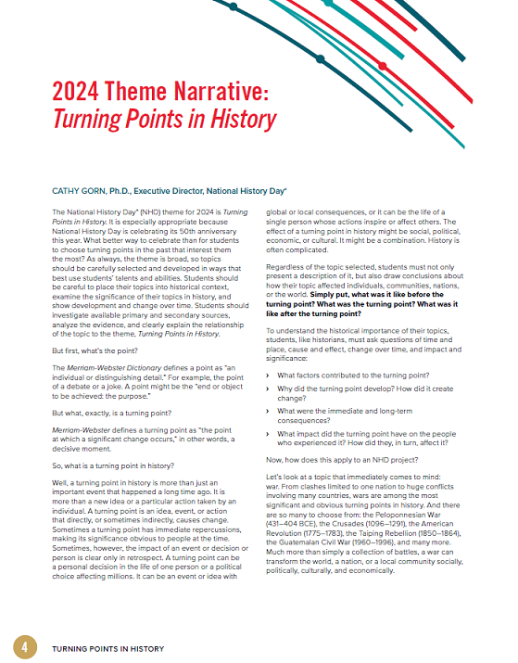
NHD THEME
2023– 2024 THEME
To get a better understanding, read the theme narrative, pages 4-6 in the theme booklet. The full theme booklet can be found at www.nhd.org

Slide 9
“IN HISTORY”
The main topic should be at least 20 years old.
Why?
So that enough time has passed to analyze the impact of the event.

Slide 10
THEME
WEAVE THEME THROUGHOUT THE PROJECT
BEFORE
HOW WAS IT DIFFERENT BEFORE THE EVENT?
WHAT IMPACT DID THE EVENT HAVE?
DURING
WHAT HAPPENED?
THE BASICS:
WHO? WHAT?
WHERE? WHEN?
WHY?
AFTER
HOW DID IT
CHANGE
HISTORY?
SHORT TERM
AND LONG TERM
CHANGE

Slide 11
CHOOSING A TOPIC
TOPIC TIPS FOR STUDENTS
Is the topic interesting to you?
You want the time spent researching and creating your project to be interesting and enjoyable.
Are research materials available?
You need both primary and secondary sources to have balanced research.
Is the topic the right size?
Topics that are too narrow may lack historical importance. Broad topics may be too complex for NHD.

Slide 12
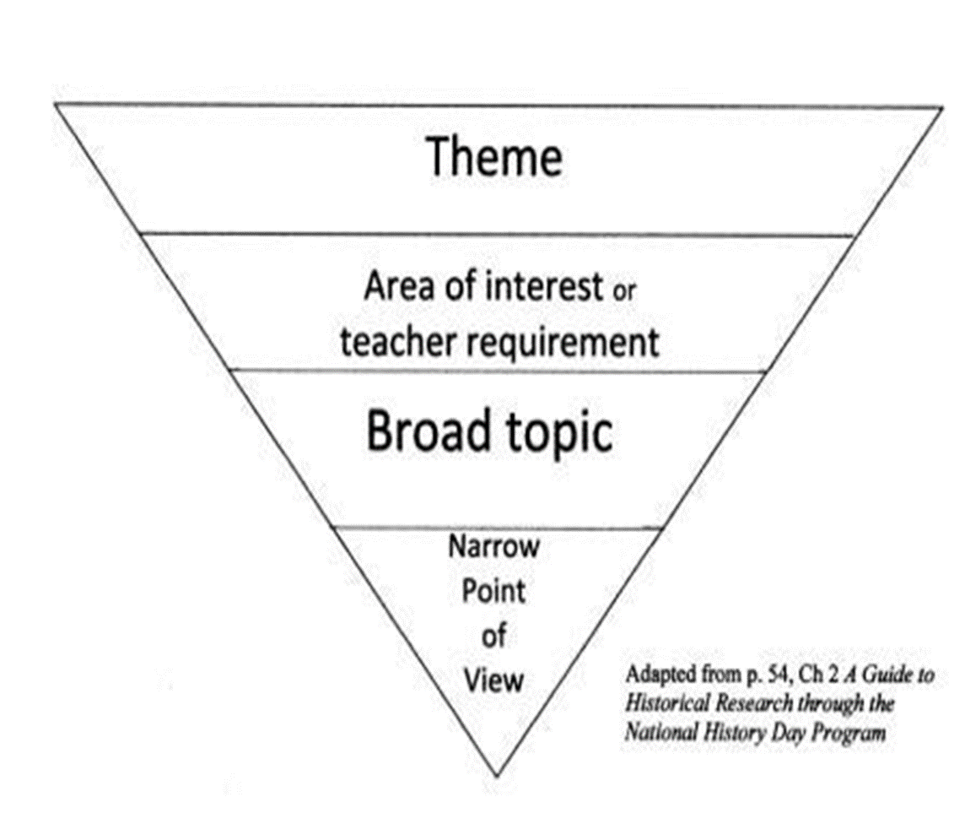
NARROW THE TOPIC

Slide 13
STEP 2
RESEARCHING THE TOPIC

Slide 14
RESEARCH
SECONDARY SOURCES
You should start with secondary sources to get a
basic understanding of your topic.
Reference Books
Biographies
History textbooks
Magazine and newspaper articles written after the event
Websites

Slide 15
HISTORICAL ARGUMENT
WRITING A THESIS (Historical Argument)
Creating a well-written thesis is critical to a successful National History Day project. A thesis statement is a central thought that holds the project together. It should be written after doing preliminary research and then revised as the process continues.
A well-written thesis statement will:
address the topic
relate to the theme
explain the impact of the topic
Thesis = Topic + Theme + Impact.

Slide 16
RESEARCH
PRIMARY SOURCES
You should next gather, read, and analyze primary sources that will help you prove your thesis statement
and explain the impact of your topic in history.
Interviews (with people involved)
Journals
Letters
Documents
Magazine and newspaper articles written at the time of the event

Slide 17
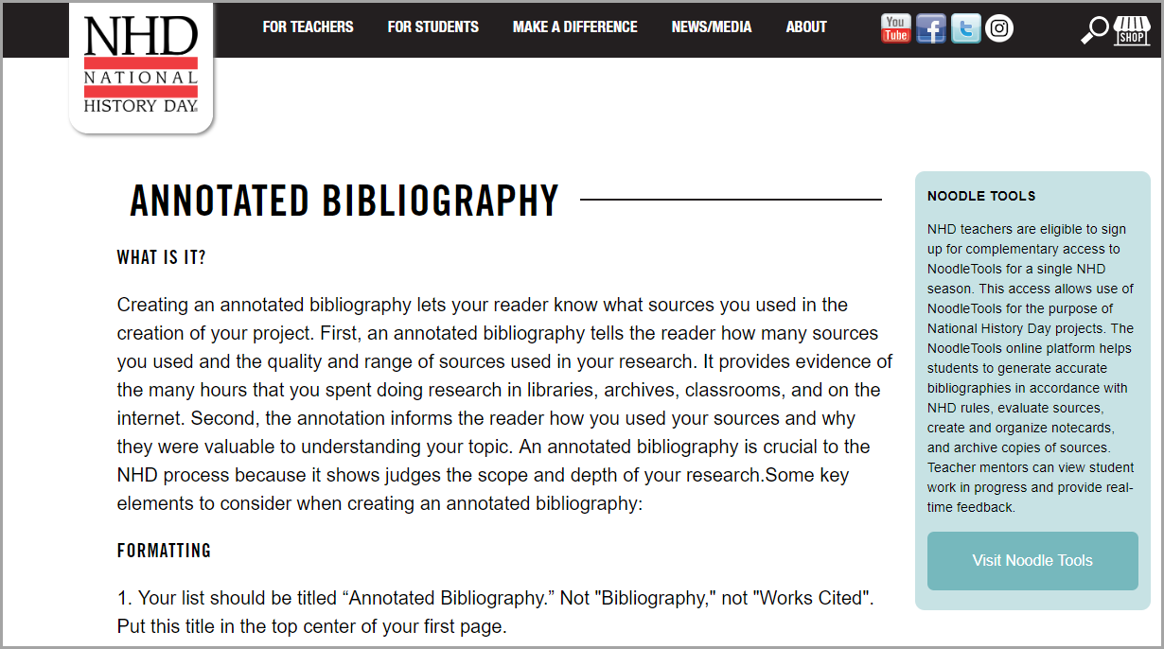
CREDIT SOURCES
ANNOTATED BIBLIOGRAPHY
Entry must include an annotated bibliography using one of these style guides:
Chicago Manual of Style
or
MLA Handbook
The annotation explains how the student used each source and must not be any longer than three sentences.
Primary and secondary sources are listed separately in the bibliography.

Slide 18
STEP 3
CREATING
THE PROJECT

Slide 19
PROJECT CATEGORIES
Students develop a project in one of the following categories:
HISTORICAL PAPER
EXHIBIT
DOCUMENTARY
PERFORMANCE
WEBSITE
Completed as an individual or in a group of 2-5, except for papers

Slide 20
CATEGORY RULES
Each of the categories has specific rules concerning word count, size of exhibit, length of documentary or performance, etc.
Students, teachers and parents are encouraged to read the rules carefully.
Rule book NHD.org

Slide 21
HISTORICAL PAPER
Historical Papers are 1,500 – 2,500 words in length and include footnotes or endnotes (no internal citations).
Papers must have a process paper like the other categories.
Explanations in the footnotes, picture captions and appendices are included as part of the word count

Slide 22
EXHIBIT
Exhibits have size limits and a limit of 500 student composed words.
Visuals must be credited on the exhibit.

Slide 23
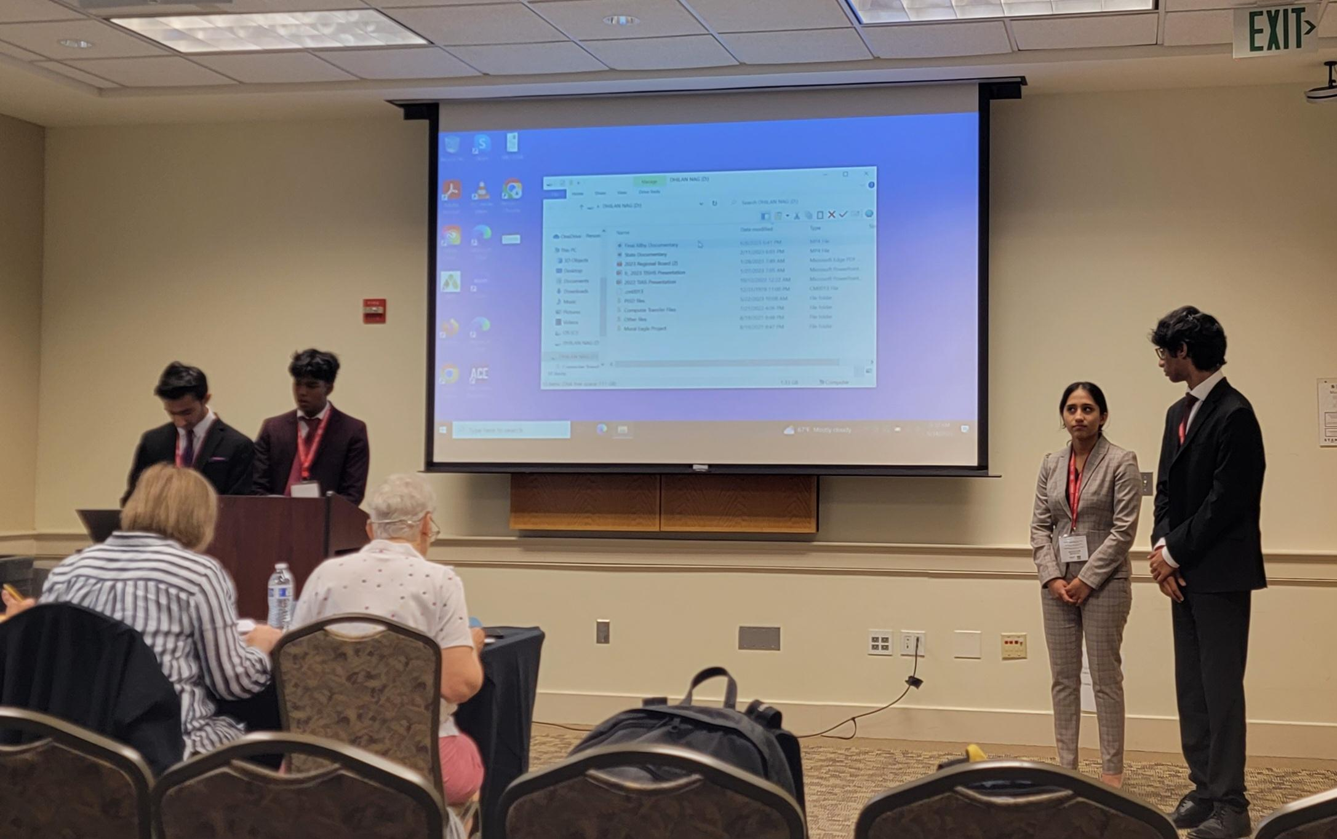
DOCUMENTARY
Students use video editing software to combine still pictures, video clips, and their narration to produce a 10 minute documentary.

Slide 24
PERFORMANCE
NHD Performance NHD.org
Students research and write their own script to perform live at the contest. Performances are limited to 10 minutes.

Slide 25
WEBSITE
Websites have a word count limit (1200) and
multi-media clips time limit (3 minutes).
Students are required to use the NHDWebCentral platform to create their website.

Slide 26
THE “SO WHAT” FACTOR
In their presentation students should consider time and place, cause and effect, change over time, impact, and significance.
They should do more than just tell a story.
So What facebook.com
Students should draw conclusions and present their analysis of the impact of the topic in history.

Slide 27
FINAL PAPERWORK
PROCESS PAPER
All entries require a process paper that is limited to 500 words. It should include the following:
How did you choose your topic and how does it relate to the theme?
How did you conduct your research?
How did you create your entry?
What is your historical argument?
In what ways is your topic significant in history?
Paperwork (these should be stapled together)
At least four copies should be brought to contest.
Title Page
Process Paper
Annotated Bibliography

Slide 28
NHD Contests
Regional - February or March 2024
Registration Deadline - Check with Regional Coordinator
Check to see what categories are due when, sometimes the deadline varies.
State - April 20, 2024
CONTESTS
Bullock Museum and on the University of Texas campus
National - June 9-13, 2024
University of Maryland campus near Washington, D.C.

Slide 29
CONTESTS
How are the entries judged at the contest?
Entries are judged by a team of three judges who use the NHD rubric to reach a consensus based on the following criteria:
Historical Quality (80%)
Clarity of Presentation (20%)
During the judging process, students are interviewed by the team of judges who ask general questions such as “Why did you choose this topic?” or “What was your best primary source?” Judges may also ask specific questions related to the topic of the entry.

Slide 30
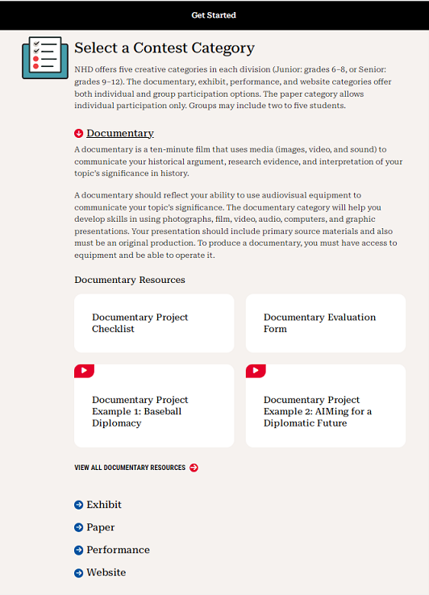
RESOURCES
National History Day website
https://nhd.org/en/contest/theme/
https://nhd.org/en/contest/get-started/

Slide 31
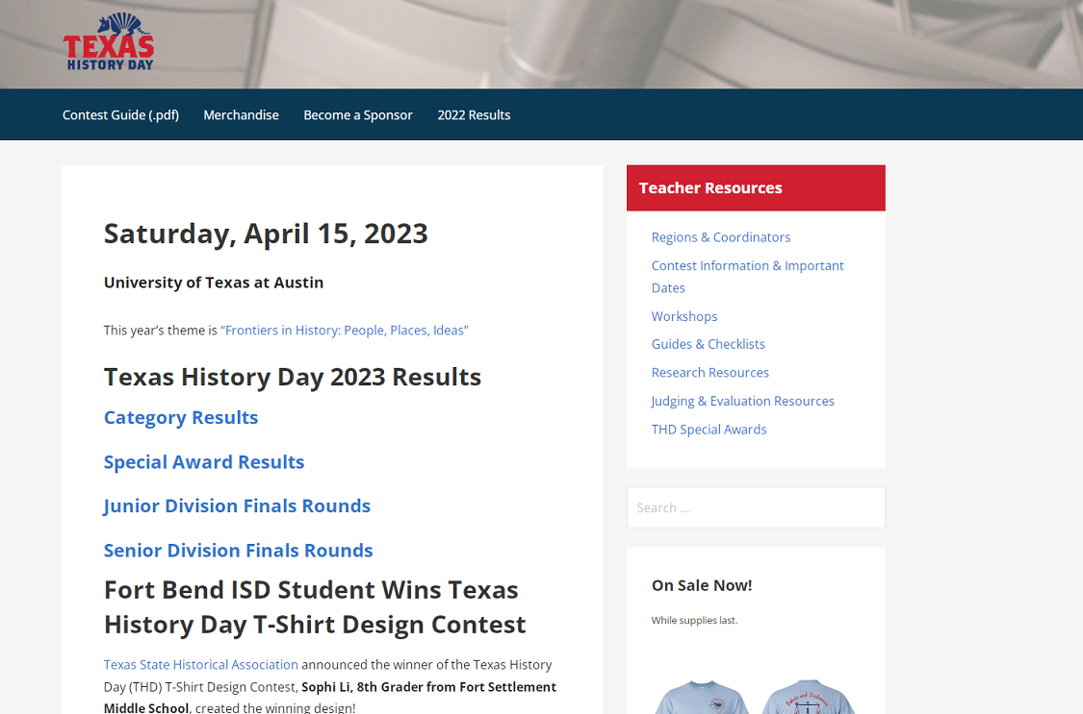
RESOURCES
Texas History Day website
https://texashistoryday.com/

Slide 32
WHERE DO WE START?
Make a Plan to Implement NHD
at your school
Teachers – Create a Game Plan – see worksheet
Teachers – Create a Time Line
Teachers – Introduce the theme to students
Students – Select topics to research (with Teacher guidance)
Students – Research their topics thoroughly
Students – Create their projects
Students – Prepare for Contest

Slide 33
CONTACT INFO
Do you have questions?
or need more information?
CONTACT:
Regional Contest:
Find the Coordinator for the Region nearest you at texashistoryday.com
State Contest:
Lisa Berg, Director of Education Services
Lisa.Berg@tshaonline.org
or
Danny Corbett, THD Co-Coordinator
THD@tshaonline.org

