Slide 1
African American Literature: Defining American Identity Texas Humanities: Teaching Literature July 16, 2020 *** Darryl Dickson-Carr Department of English Southern Methodist University

Slide 2
Charles W. Mills, The Racial Contract (1997) White Supremacy:
“[T]he unnamed political system that has made the modern world what it is today. You will not find this term in introductory, or even advanced, texts in political theory…And this omission is not accidental. Rather, it reflects the fact that standard textbooks and courses have for the most part been written and designed by whites, who take their racial privilege so much for granted that they do not even see it as political, as a form of domination” (1)
“Racial Contract”:
An implicit agreement between whites, specifically, to classify themselves as fully human, and those unlike them as less than human, and therefore less deserving of rights or privileges.

Slide 3
Phillis Wheatley (c. 1753-1784)

Slide 4
On Being Brought from Africa to America
By Phillis Wheatley
'Twas mercy brought me from my Pagan land,
Taught my benighted soul to understand
That there's a God, that there's a Saviour too:
Once I redemption neither sought nor knew.
Some view our sable race with scornful eye,
"Their colour is a diabolic die."
Remember, Christians, Negros, black as Cain,
May be refin'd, and join th' angelic train.

Slide 5
Frederick Douglass (c. 1818-1895)

Slide 6
Frederick Douglass, “What to the Slave is the Fourth of July?” (July 5, 1852)
Fellow-citizens, pardon me, allow me to ask, why am I called upon to speak here to-day? What have I, or those I represent, to do with your national independence? Are the great principles of political freedom and of natural justice, embodied in that Declaration of Independence, extended to us? and am I, therefore, called upon to bring our humble offering to the national altar, and to confess the benefits and express devout gratitude for the blessings resulting from your independence to us?
…

Slide 7
Frederick Douglass, “What to the Slave is the Fourth of July?” (July 5, 1852)
But, such is not the state of the case. I say it with a sad sense of the disparity between us. I am not included within the pale of this glorious anniversary! Your high independence only reveals the immeasurable distance between us. The blessings in which you, this day, rejoice, are not enjoyed in common. — The rich inheritance of justice, liberty, prosperity and independence, bequeathed by your fathers, is shared by you, not by me. The sunlight that brought life and healing to you, has brought stripes and death to me. This Fourth [of] July is yours, not mine. You may rejoice, I must mourn. To drag a man in fetters into the grand illuminated temple of liberty, and call upon him to join you in joyous anthems, were inhuman mockery and sacrilegious irony.

Slide 8
Near the end of Chapter II of Narrative of the Life of Frederick Douglass, An American Slave, Written by Himself (1845)
Few privileges were esteemed higher, by the slaves of the out-farms, than that of being selected to do errands at the Great House Farm. It was associated in their minds with greatness. A representative could not be prouder of his election to a seat in the American Congress, than a slave on one of the out-farms would be of his election to do errands at the Great House Farm.
…
The competitors for this office sought as diligently to please their overseers, as the office-seekers in the political parties seek to please and deceive the people. The same traits of character might be seen in Colonel Lloyd’s slaves, as are seen in the slaves of the political parties.

Slide 9
Gullah Geechee…
https://gullahgeecheecorridor.org/thegullahgeechee/

Slide 10
Dr. W.E.B. Du Bois

Slide 11
From “Of Our Spiritual Strivings” (W.E.B. Du Bois, The Souls of Black Folk, 1903)
After the Egyptian and Indian, the Greek and Roman, the Teuton and Mongolian, the Negro is a sort of seventh son, born with a veil, and gifted with second-sight in this American world,—a world which yields him no true self-consciousness, but only lets him see himself through the revelation of the other world. It is a peculiar sensation, this double-consciousness, this sense of always looking at one’s self through the eyes of others, of measuring one’s soul by the tape of a world that looks on in amused contempt and pity. One ever feels his twoness,—an American, a Negro; two souls, two thoughts, two unreconciled strivings; two warring ideals in one dark body, whose dogged strength alone keeps it from being torn asunder.

Slide 12
From “Of Our Spiritual Strivings” (W.E.B. Du Bois, The Souls of Black Folk, 1903)
The history of the American Negro is the history of this strife,—this longing to attain self-conscious manhood, to merge his double self into a better and truer self. In this merging he wishes neither of the older selves to be lost. He would not Africanize America, for America has too much to teach the world and Africa. He would not bleach his Negro soul in a flood of white Americanism, for he knows that Negro blood has a message for the world. He simply wishes to make it possible for a man to be both a Negro and an American, without being cursed and spit upon by his fellows, without having the doors of Opportunity closed roughly in his face.

Slide 13
Ida B. Wells-Barnett

Slide 14
James Weldon Johnson

Slide 15
Zora Neale Hurston

Slide 16
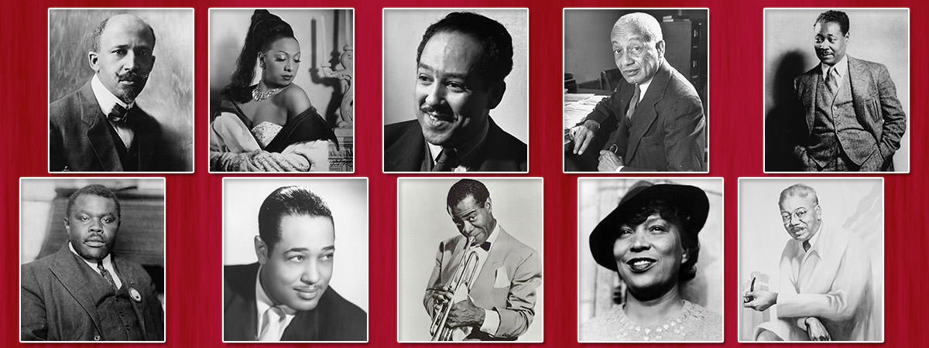
Notable Figures of the Harlem Renaissance

Slide 17
Louis Armstrong Clip

Slide 18
Thank You!

