Slide 1
Abolition and Women’s Rights Before the Civil War
Dr. Michelle Kuhl
University of Wisconsin Oshkosh

Slide 2
Road Map
Guiding Question
Context of 19th Century Reform Movements
Abolition
Women’s Rights

Slide 3
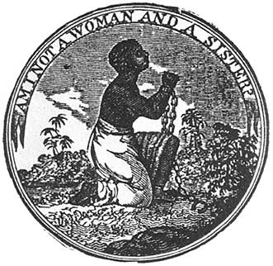
Guiding Question: In what ways were the abolition and women’s rights movements connected?
Notes:
George Bourne, Slavery Illustrated in Its Effects upon Women (1837)—Prints and Photographs Division, Library of Congress;

Slide 4
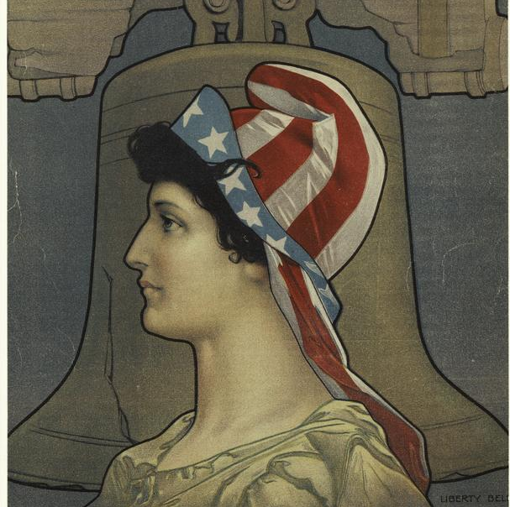
Context of 19th Century Reform Movements
The American Revolution
The Second Great Awakening
The Market Revolution
Notes:
The Miriam and Ira D. Wallach Division of Art, Prints and Photographs: Picture Collection, The New York Public Library. "Liberty Bell." New York Public Library Digital Collections. Accessed February 19, 2021. https://digitalcollections.nypl.org/items/510d47e1-157d-a3d9-e040-e00a18064a99

Slide 5
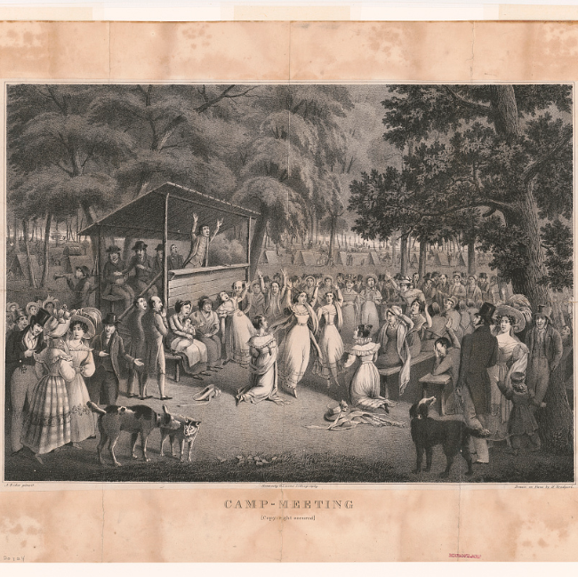
Second Great Awakening
Individual salvation
Active conversion
Sharing your story
Millennial beliefs
Notes:
Bridport, Hugh, Approximately 1868, Lithographer, Alexander Rider, and Publisher Kennedy & Lucas'S Lithography. Camp-meeting / A. Rider pinxit ; drawn on stone by H. Bridport. , ca. 1829. Kennedy & Lucas Lithography. Photograph. https://www.loc.gov/item/96510018/.

Slide 6
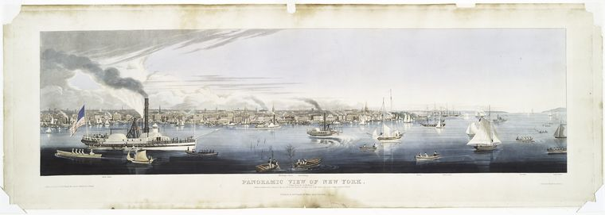
Market Revolution
Notes:
The Miriam and Ira D. Wallach Division of Art, Prints and Photographs: Print Collection, The New York Public Library. "Panoramic view of New York (taken from the North River)." New York Public Library Digital Collections. Accessed February 19, 2021. https://digitalcollections.nypl.org/items/510d47d9-7c60-a3d9-e040-e00a18064a99

Slide 7
Changes in three realms after the American Revolution
 | Before the American Revolution |  | After the American Revolution
Economics | Mercantilism | London gets rich | Capitalism | Anyone can get rich
Politics | Monarchy | Crown inherited | Democracy | Anyone can be president
Religion | Puritan/Anglican/Catholic | Salvation determined by God or by the Church | Evangelical Christianity | Anyone can go to Heaven

Slide 8
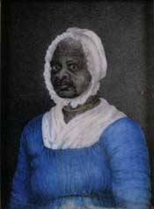
Abolition
African American initiatives
Quakers
Garrison
Sarah and Angelina Grimke
Notes:
Miniature portrait, Massachusetts Historical Society

Slide 9
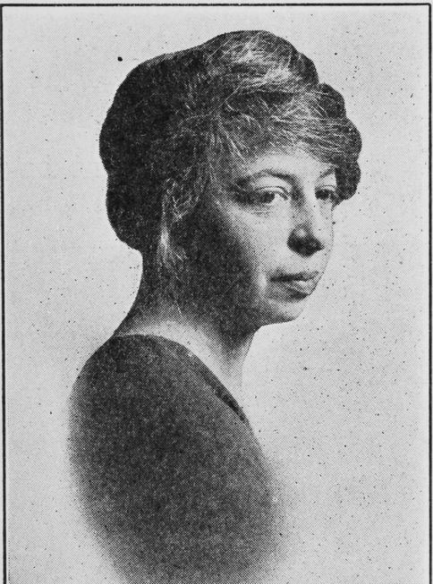
Grimke Sisters
Sarah and Angelina
From slaveholding family in South Carolina
Converted to Quakerism
Became Abolitionist speakers 1836
Notes:
Schomburg Center for Research in Black Culture, Jean Blackwell Hutson Research and Reference Division, The New York Public Library. "Angelina W. Grimké." New York Public Library Digital Collections. Accessed February 19, 2021. https://digitalcollections.nypl.org/items/510d47df-1ecf-a3d9-e040-e00a18064a99

Slide 10
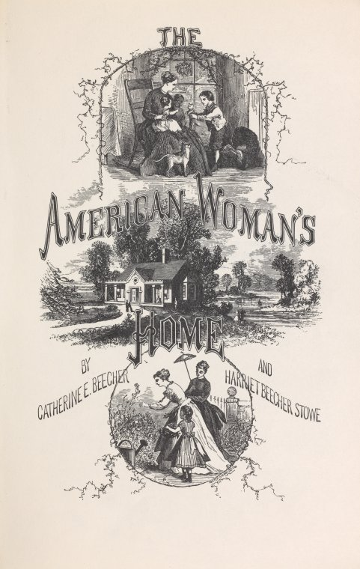
Catharine Beecher
“Woman is to win every thing by peace and love; by making herself to much respected, esteemed and loved, that to yield to her opinions and to gratify her wishes, will be the free-will offering of the heart. But this is to be all accomplished in the domestic and social circle . . . . All the sacred protection of religion, all the generous promptings of chivalry, all the poetry of romantic gallantry, depend upon woman’s retaining her place as dependent and defenceless. . . .”
Notes:
Catharine E. Beecher “Essay on Slavery and Abolitionism, with Reference to the Duty of American Females” in Kathryn Kish Sklar, ed, Women’s Rights Emerges within the Antislavery Movement 1830-1870 (Boston: Bedford St. Martins, 2000) p.108.

Slide 11
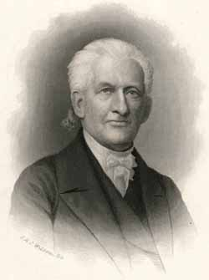
Pastoral Letter of 1837
We invite your attention to the dangers which at present seem to threaten the female character, with wide spread and permanent injury. . . .
The power of woman is in her dependence, flowing from the consciousness of that weakness which God has given her for her protection. . . .
But when she assumes the place and tone of man as a public reformer, our care and protection of her seem unnecessary; we put ourselves in self-defence against her; she yields the power which God has given her for protection, and her character becomes unnatural.
If the vine, whose strength and beauty is to lean upon the trellis work and half conceal its clusters, thinks to assume the independence and the overshading nature of the elm, it will not only cease to bear fruit, but fall in shame and dishonor into the dust.
Notes:
Lyman Beecher, Engraving by J.A.J. Wilcox, Massachusetts Historical Society

Slide 12
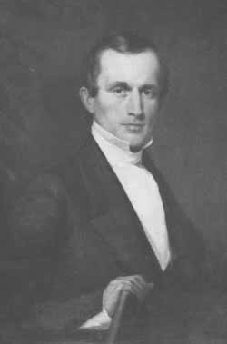
Letter to Amos Phelps
August 1837
“The clergy have done an infinite injury to woman. . .”
“To close the doors now against our brethren wd. be a violation of our fundamental principle that man & woman are created equal, & have the same duties & the same responsibilities as moral beings.”
“We should regret that a brother whom we esteem so highly should identify himself with the men who sent forth the Pastoral Letter, a letter which aims to tear from the woman her dearest rights & substitute the paltry privilege of leaning upon the fallen creature [man] instead of the strong arm of the Almighty God.”
Notes:
Massachusetts Historical Society

Slide 13

Theodore Weld, letter to the Grimke sisters, August 1837
“there is no reason why woman should not make laws, administer justice, sit in the chair of state, plead at the bar or in the pulpit, if she has the qualifications, just as much as tho she belong to the other sex.”
“Let us all first wake up the nation to lift millions of slaves of both sexes from the dust, and turn them into MEN and then . . . It will be an easy matter to take millions of females from their knees and set them on their feet.”
Notes:
Theodore Dwight Weld, -1895, bust portrait, facing slightly left. , 1885. Photograph. https://www.loc.gov/item/2006687237/.

Slide 14
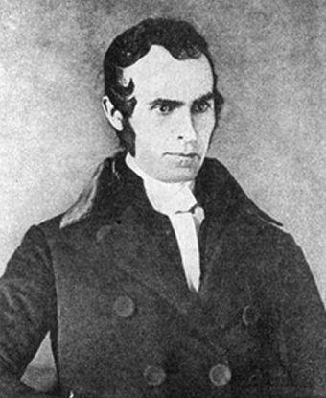
John Greenleaf Whittier, Letter to Grimke Sisters, August 1837
“Does it not look, dear sisters, like abandoning in some degree the cause of the poor and miserable slave. . . .”
Notes:
National Park Service, https://www.nps.gov/people/john-greenleaf-whittier.htm

Slide 15
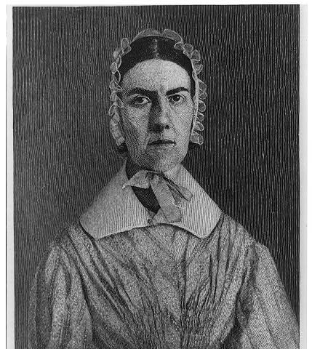
Angelina Grimke, letter to Weld and Whittier, August 1837
“The time to assert a right is the time when that right is denied.”
“And can you not see that women could do, & would do a hundred times more for the slave if she were not fettered?”
Notes:
Angelina Emily Grimké -1879. , . [No Date Recorded on Caption Card] Photograph. https://www.loc.gov/item/2003653379/.

Slide 16
Angelina Grimke letter to Catharine Beecher, August 1837
“When I look at human beings as moral beings, all distinction of sex sinks into significance and nothingness. . . .”
“My doctrine then, is that whatever it is morally right for man to do, it is morally right for woman to do.”
“I recognize no rights but human rights—I know nothing of men’s rights and women’s rights; for in Christ Jesus, there is neither male nor female . . . .”
“Now, I believe it is her rights to be consulted in all the laws and regulations by which she is to be governed, whether in Church or State, and that the present arrangement of Society, on those points, are a violation of human rights. . . .”

Slide 17
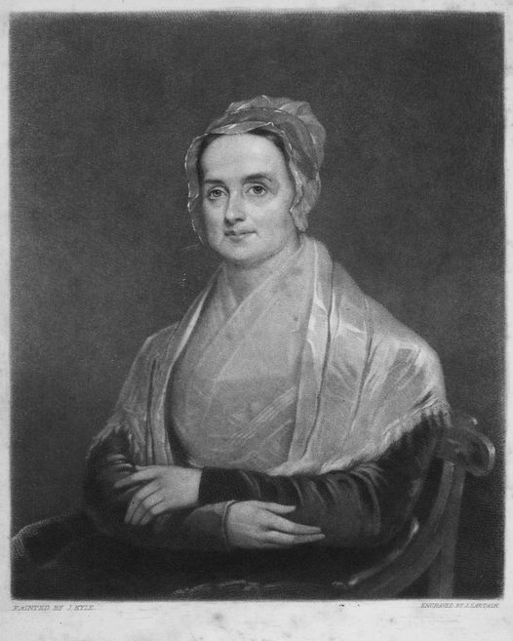
Lucretia Mott
Quaker preacher in Philadelphia
Respectable looking
Radical thinker
Committed to Abolition and anti-racism
Methods
  Free Produce
  Petitions
  Fund-raising
  Support of African American schools
  Traveling speaker

Slide 18
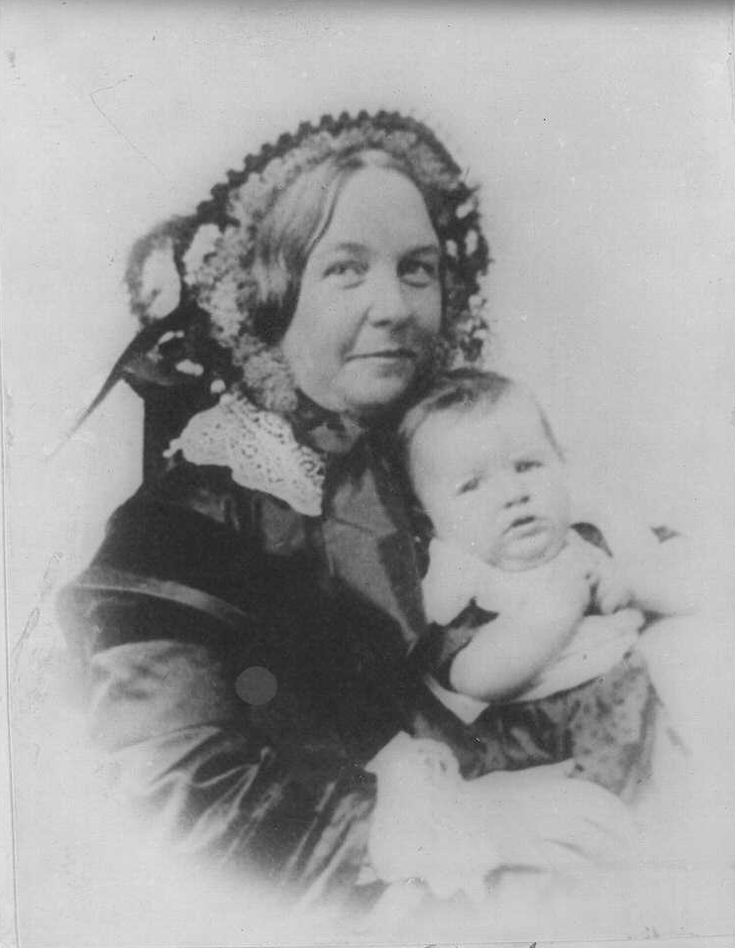
Elizabeth Cady Stanton
London, June 1840, meets Lucretia Mott at Anti-Slavery Convention
“On the following Sunday I went to hear Mrs. Mott preach in a Unitarian church. Though I had never heard a woman speak, yet I had long believed she had the right to do so, and had often expressed the idea in private circles; but when at last I saw a woman rise up in the pulpit and preach earnestly and impressively, as Mrs. Mott always did, it seemed to me the realization of an oft-repeated, happy dream.”
Notes:
Elizabeth Cady Stanton and her daughter, Harriot--from a daguerreotype. , None. [Between 1890 and 1910 of daguerreotype taken 1856] Photograph. https://www.loc.gov/item/97500106/.

Slide 19
Elizabeth Cady Stanton
London, June 1840, meets Lucretia Mott
“I found in this new friend a woman emancipated from all faith in manmade creeds, from all fear of his denunciations. Nothing was too sacred for her to question, as to its rightfulness in principle and practice.”
Notes:
Elizabeth Cady Stanton and her daughter, Harriot--from a daguerreotype. , None. [Between 1890 and 1910 of daguerreotype taken 1856] Photograph. https://www.loc.gov/item/97500106/.

Slide 20
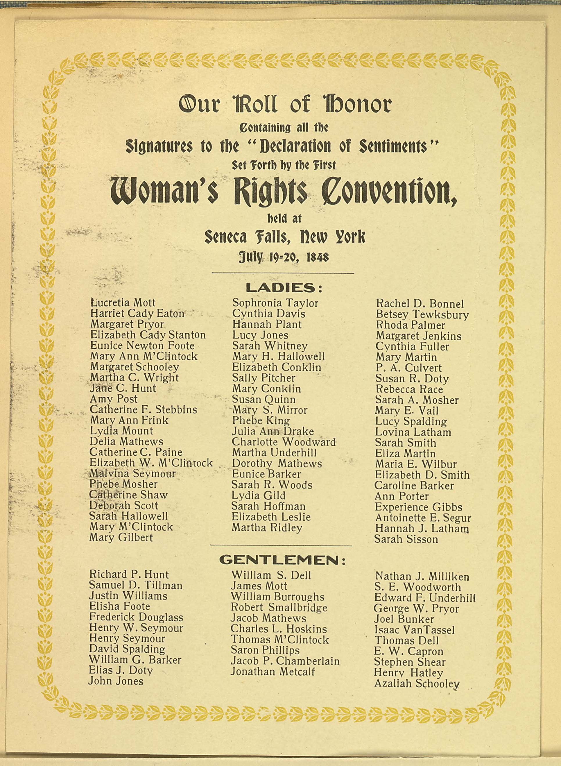
Seneca Falls Declaration of Sentiments, 1848

Slide 21
Guiding Question: In what ways were the abolition and women’s rights movements connected?
Ideology of individual rights
People active in both causes
Religious influences
Methods
Backlash
Notes:
George Bourne, Slavery Illustrated in Its Effects upon Women (1837)—Prints and Photographs Division, Library of Congress;

