Slide 1
The Age of Jackson
Brian P. Luskey
West Virginia University
February 10, 2021

Slide 2
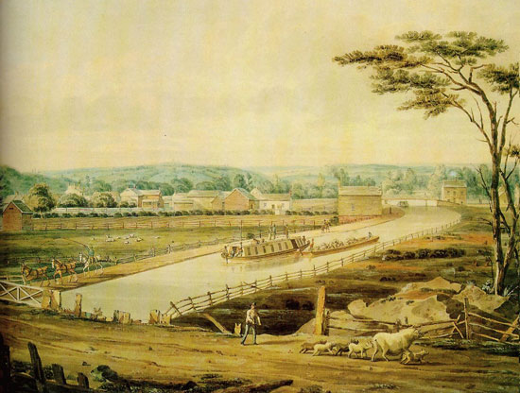
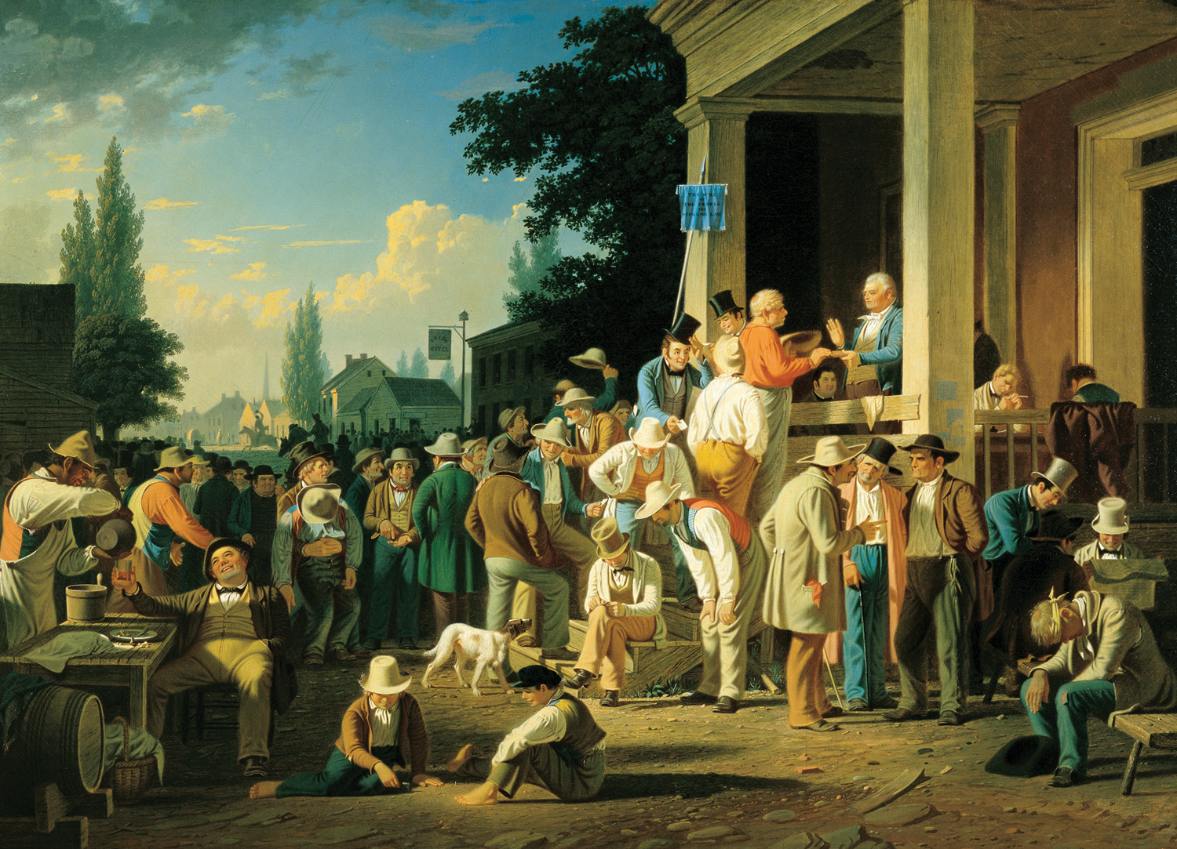
The Market Revolution and Jacksonian Democracy
Debates about opportunity and citizenship,
slavery and race
Notes:
The economic and political transformations of the 1820s and 1830s—represented here by images of the transportation infrastructure deemed necessary for prosperity and Jacksonian Democracy—fostered often vehement and violent debate because Americans could agree that they were connected to each other couldn’t agree about who benefited from them. Tonight I want to chart those debates for you and show that they often revolved around slavery—its centrality to the American economy as a whole and arguments about its abolition—and racial identity.

Slide 3
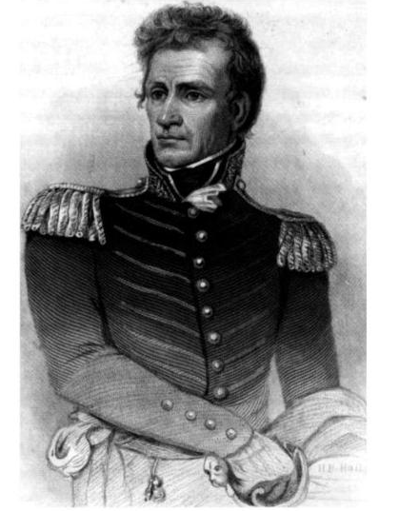
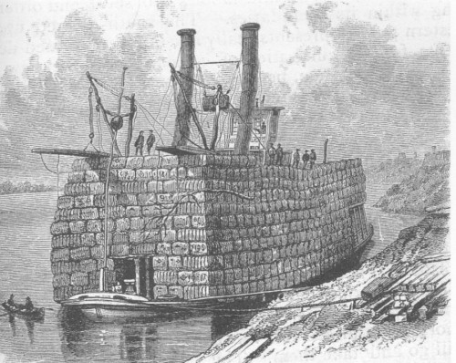
Creating an Empire for Liberty in the Southwest
Andrew Jackson
Notes:
In Early Republic, citizens were landholders and household heads, virtuous and incorruptible because of property ownership, ruling and protecting dependent ppl in HH; to expand liberty to the next generation, republic needed to become an empire.
Jackson’s exploits to establish US sovereignty over British and Native American territories: War of 1812, Seminole War, Indian Removal
Slavery and the creation of a transatlantic economy in cotton (largest export by the 1830s). Individualistic scramble for land, slaves, and profit in SW embodied and was at the heart of nation’s economic transformation—integrating US in transatlantic cotton economy funded by control over the labor of enslaved people, the access to credit and capital from banks because slaveholders owned human commodities they could use as collateral, and the capital running through the system enriched not only southern slaveholders and slave traders but also New York financiers and shipping magnates, New England and England’s textile manufacturers.
Accommodation and Resistance
“You asked us to throw off the hunter and warrior state. We did so. You asked us to form a republican government. We did so, adopting your own as our model. You asked us to cultivate the earth, and learn the mechanic arts. We did so. You asked us to learn to read. We did so. You asked us to cast away our idols and worship your god. We did so. Now you demand we cede to you our lands. That we will not do.”—John Ross, 1836

Slide 4
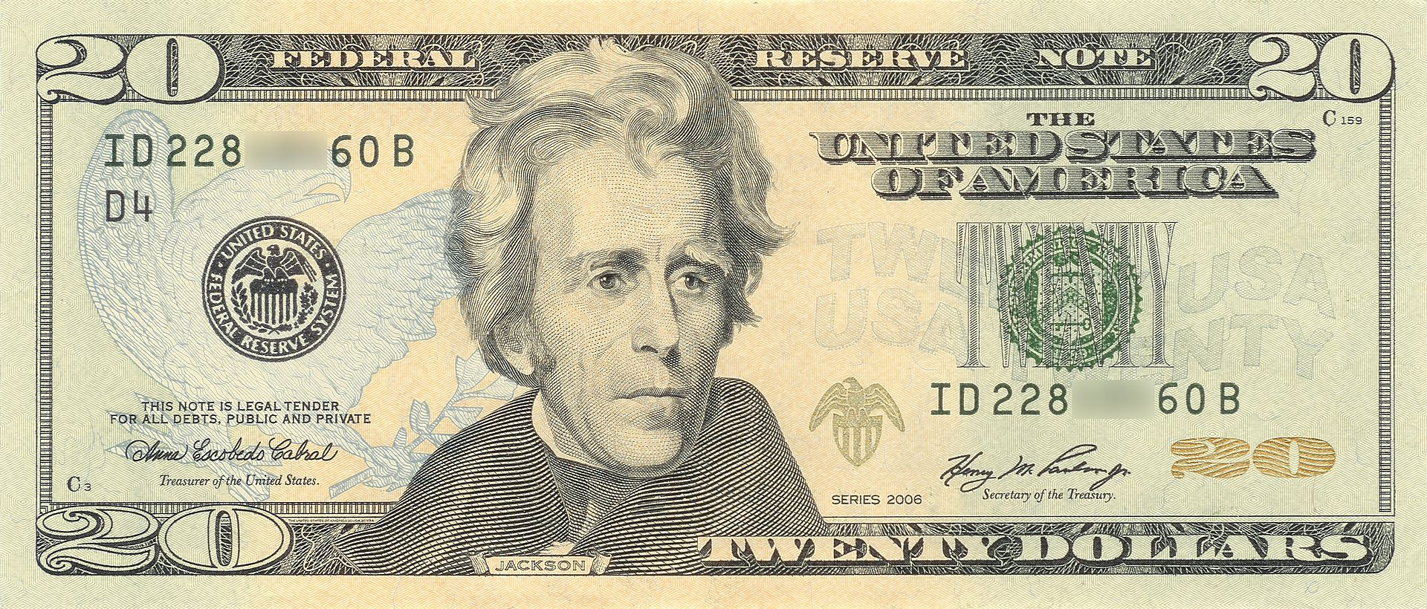
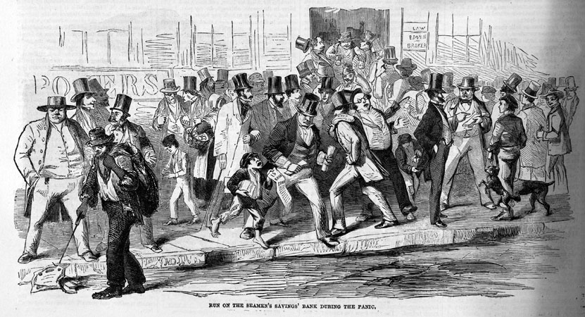
The Market Revolution:
The Problem of Trust in a World of Strangers
Notes:
The individualistic and competitive economy had ups and downs, booms and busts. At the heart of the economy was trust—could you trust the men you didn’t know but had to deal with in the market; could you trust the value of bank notes? Reading money—hundreds of banks, printing paper representing gold and silver in vault, counterfeit, distant banks’ solvency, discounting. When everyone did trust, there were flush times in which everyone could get credit and capital; when they lost trust, there was constricting credit and panics as you see here, hard times. In the Panic of 1837, southern banks and southern states defaulted, didn’t pay their debts, mainly to northern creditors--GTT. Slave families broken up to pay off the bad bets that white ppl made.

Slide 5
Universal White Manhood Suffrage as
Jacksonian Democracy
Notes:
Political transformation that we call democracy emerged out of egalitarian ideologies of early republic but also out of concern that property ownership could no longer be the basis of voting rights because fewer men had enough property to qualify in an age of market competition. In an era of emancipation in the North, it was galling for white men to watch black propertyholders vote, and so they clamored to revise state constitutions. One by one, with just a few exceptions, states North and South rewrote constitutions getting rid of property qualifications for voting and stating explicitly that only adult white men could vote. Elections like the one depicted here showcased American political equality, democracy, but suffrage was only universal for white men, grounded in racial and gender exclusions.

Slide 6
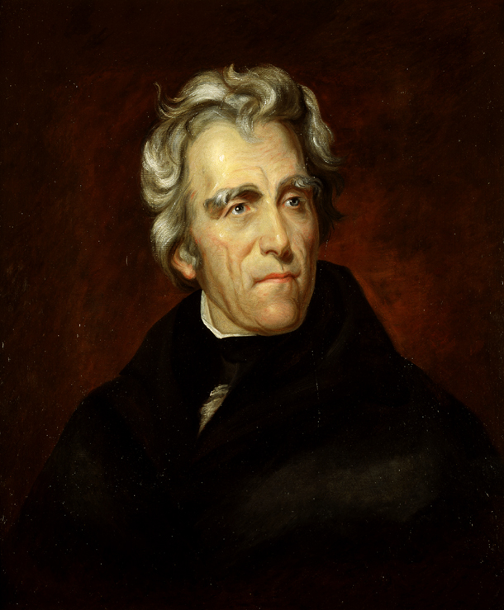
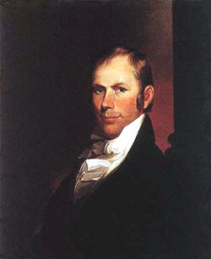
Debating the Role of Government in the Economy
Jackson and the Democrats
Henry Clay and the Whigs
Notes:
Universal white manhood suffrage shaped the boisterous political culture of the period, heightening partisanship between Jackson’s Democratic Party and their challengers, the Whigs led by Henry Clay. The parties had different views on the Market Revolution. “In Kentucky, almost every manufactory known to me, is in the hands of enterprising and self-made men, who have acquired whatever wealth they possess by patient and diligent labor.”—Henry Clay, 1832.
Clay and Rechartering of the Second Bank of the US as political issue in 1832 election
artificial distinctions,... to make the rich richer and the potent more powerful, the humble members of society–the farmers, mechanics, and laborers–who have neither the time nor the means of securing like favors to themselves, have a right to complain of the injustice of their Government.”—Andrew Jackson, 1832

Slide 7
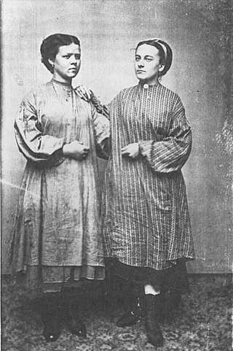
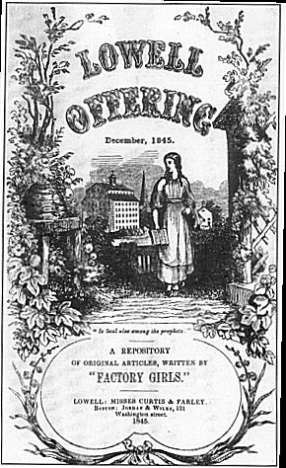
The Lowell Mill Girls:
Self-Making or
“Wage Slavery”?
Notes:
“Independent daughters of freemen”
“Oh! isn’t it a pity, such a pretty girl as I-
Should be sent to the factory to pine away and die?
Oh ! I cannot be a slave,
I will not be a slave,
For I’m so fond of liberty
That I cannot be a slave.”
-Song from 1836 Lowell Mill Girl Strike

Slide 8
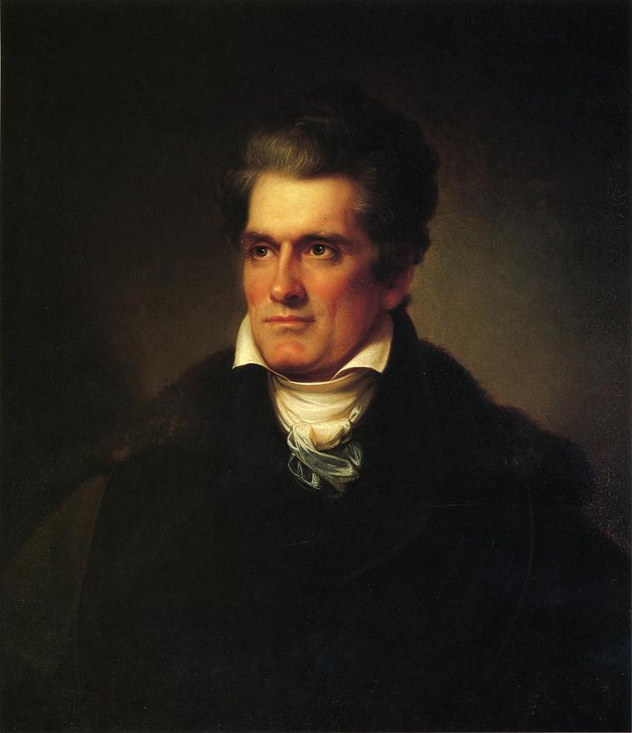
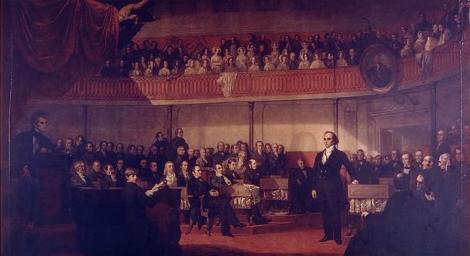
Democracy as Threat: Slaveholders on the American System and Nullification
John C. Calhoun
Daniel Webster
Notes:
“Let [my] last feeble and lingering glance…behold the gorgeous ensign of the republic, now known and honored throughout the earth, still full high advanced, its arms and trophies streaming in their original lustre, not a stripe erased or polluted, not a single star obscured, bearing for its motto, no such miserable interrogatory as ‘What is all this worth?’ nor those other words of delusion and folly, ‘Liberty first and Union afterwards’; but everywhere, spread all over in characters of living light, blazing on all its ample folds, as they float over the sea and over the land, and in every wind under the whole heavens, that other sentiment, dear to every true American heart, - Liberty and Union, now and for ever, one and inseparable!”—Daniel Webster, 1830

Slide 9
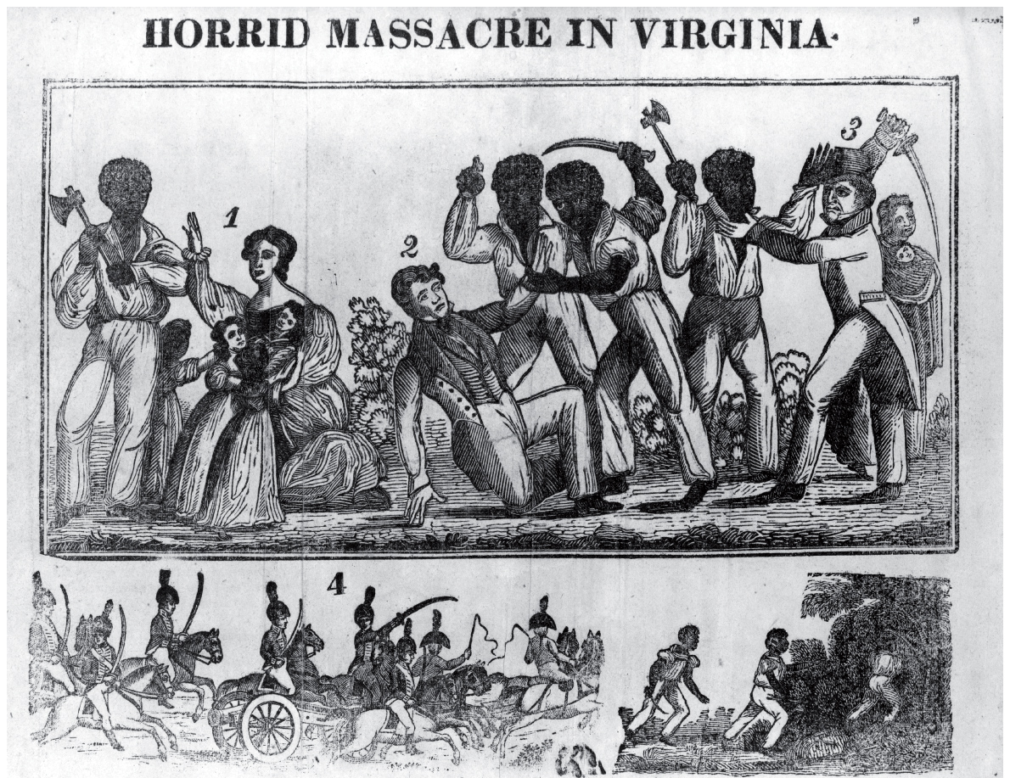
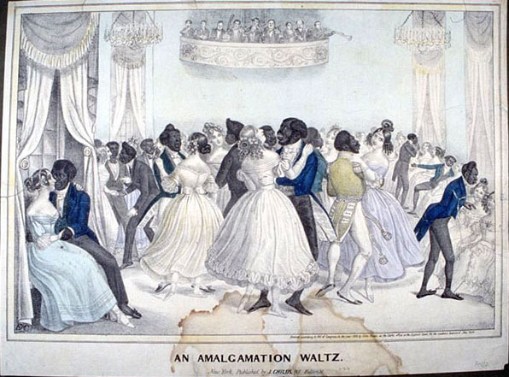
Abolitionism and Nat Turner’s Rebellion (1831)
Notes:
“The slaves need no incentives at our hands. They will find them in their stripes—in their emaciated bodies—in their ceaseless toil—in every field, in every valley, on every hill-top and mountain, wherever you and your fathers have fought for liberty.”—The Liberator, September 3, 1831.

Slide 10
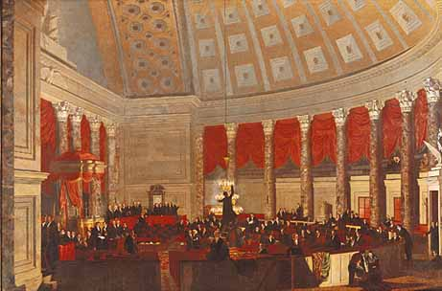
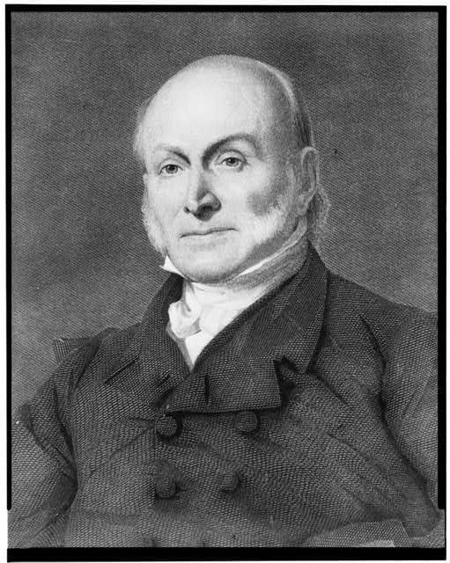
Anti-Slavery Petitions
and the Gag Rule of the “Slave Power”
John Quincy Adams

Slide 11
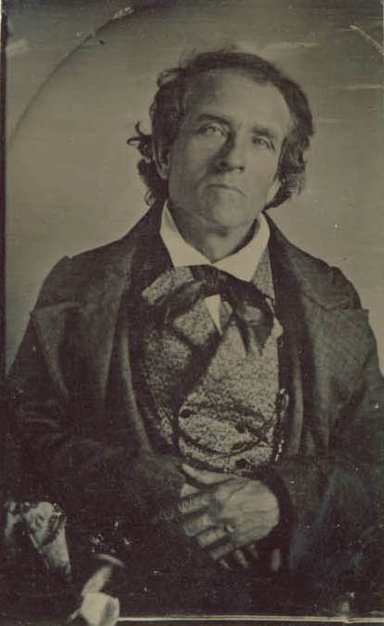
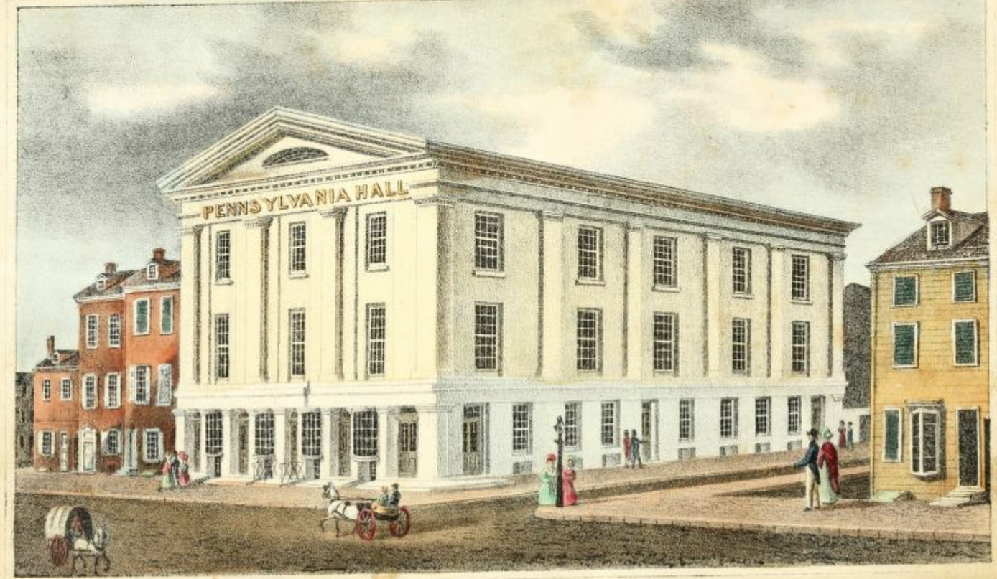
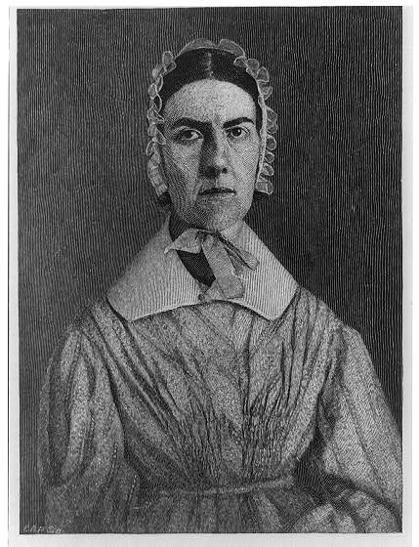
Debates about Slavery and Citizenship:
Pennsylvania Hall, May 1838
Theodore Dwight Weld and Angelina Grimké Weld
Notes:
What if the mob should now burst in upon us, break up our meeting, and commit violence against our persons? Would this be anything compared with what the slaves endure?”—Angelina Grimké Weld, at the Anti-Slavery Convention of American Women, May 16, 1838.

Slide 12
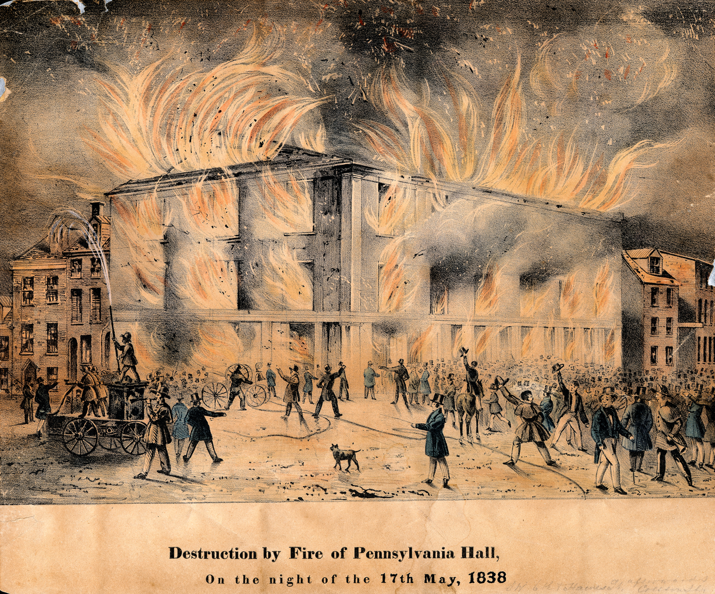

Slide 14
