Slide 1
Teaching the American Literary Tradition
American Literature of the 1920s
Michael Soto
Associate Vice President for Academic Affairs
and Professor of English
July 8, 2020

Slide 2
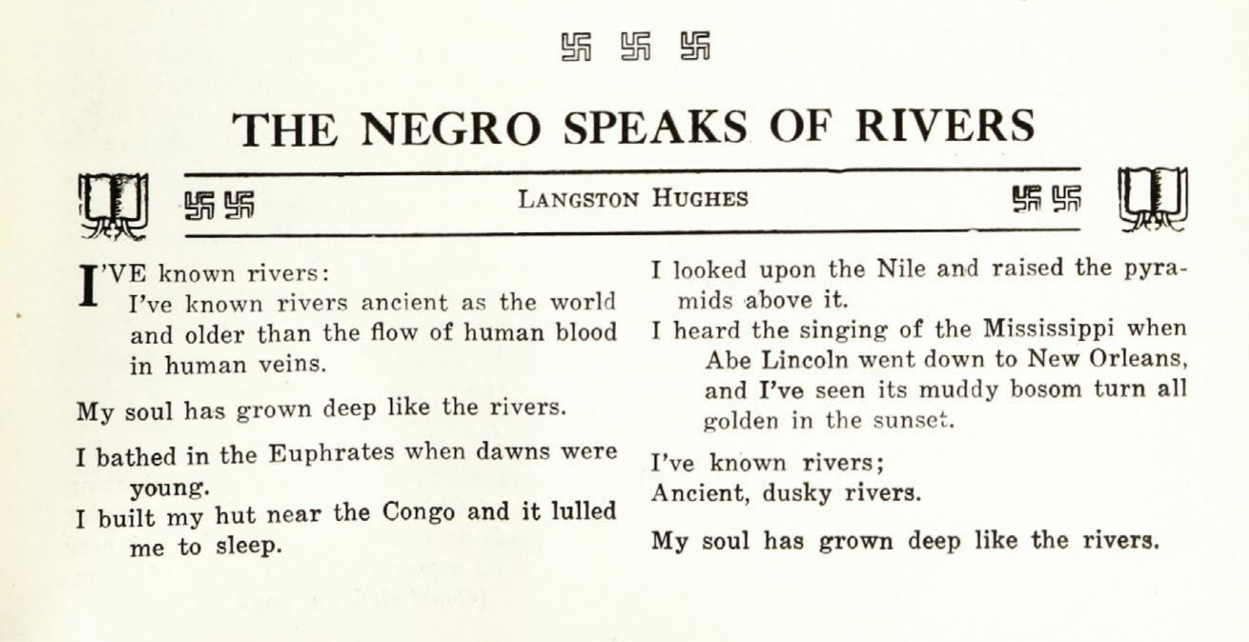
“The Negro Speaks of Rivers”
Crisis magazine (June 1921)

Slide 3
TEKS and Literary Analysis
traditional, contemporary, classical, and diverse texts
use of text structure to achieve the author’s purpose
stanzas, line breaks, speaker, and sound devices in poems
Why five stanzas? Ten lines? Organizing principles?
Why are lines/sentences coterminous?
What happens when we change key words with near matches (“known,” “soul”)?
Who is “I”? speaker/tone/performance

Slide 4
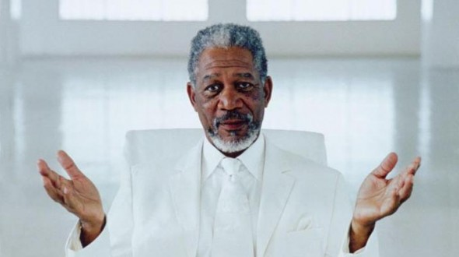
Morgan Freeman will be their answer
so be prepared to tell them why they’re right.

Slide 5
“Rivers” as 1920s poem
transnational, transhistorical subject as U.S. civil rights document
Red Summer (1919): Red Scare + returning soldiers + racial terrorism
NAACP nationalizes civil rights cause
Harlem Renaissance (or “Negro Renaissance”)

Slide 6
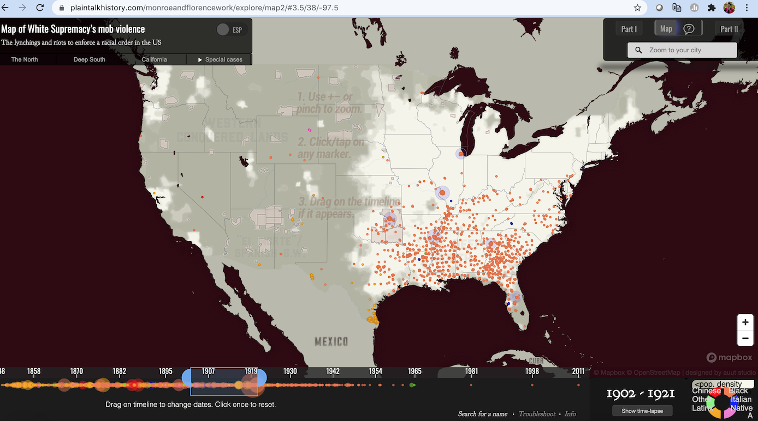
Lynchings during Hughes’s youth
(1902-1921)
https://plaintalkhistory.com/monroeandflorencework/

Slide 7
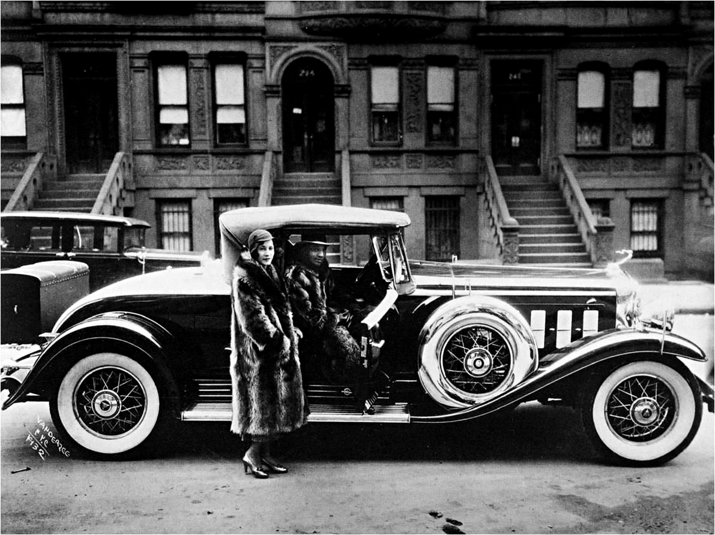
The Harlem Renaissance
From “Old Negro” Stereotype to “New Negro” Innovation
James Van Der Zee, Couple, Harlem (1932)
Library of Congress

Slide 8
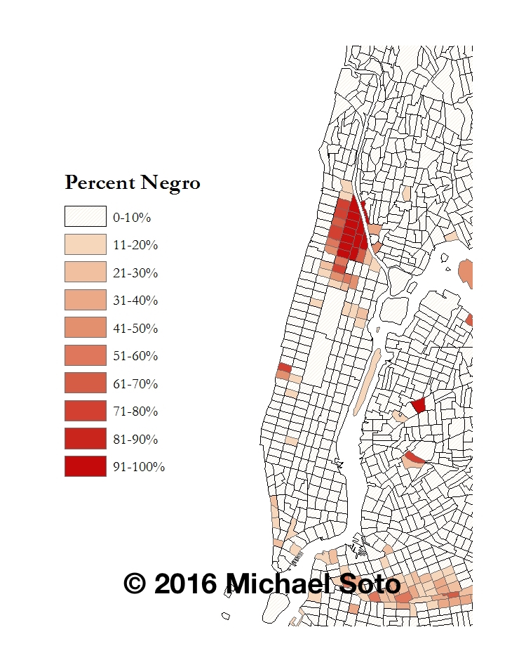
Residential Segregation in NYC (1930)
Percent Negro by Census Tract

Slide 9
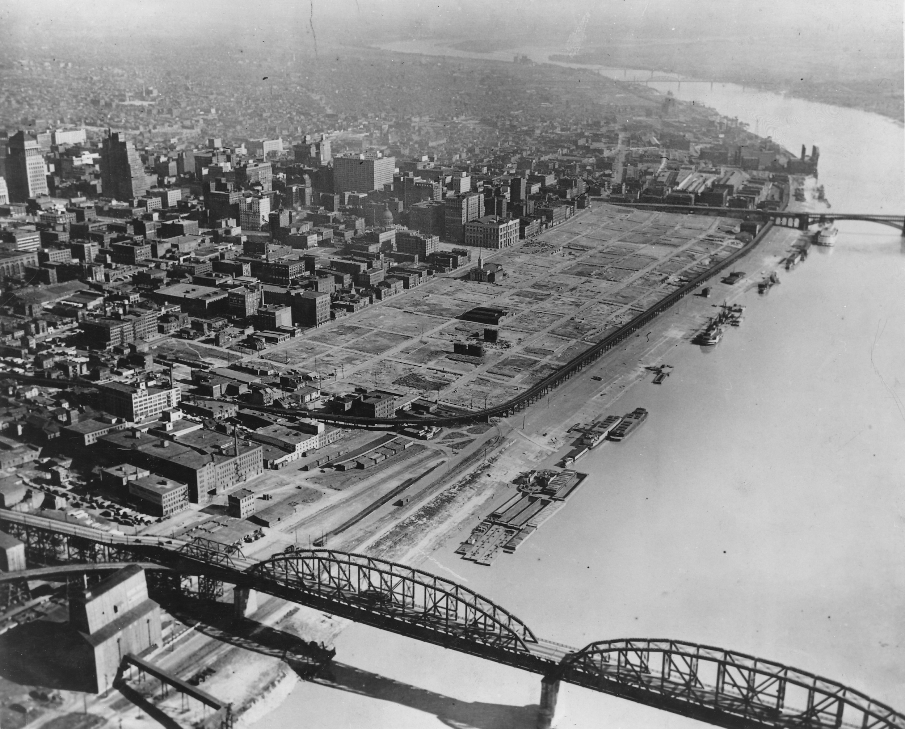
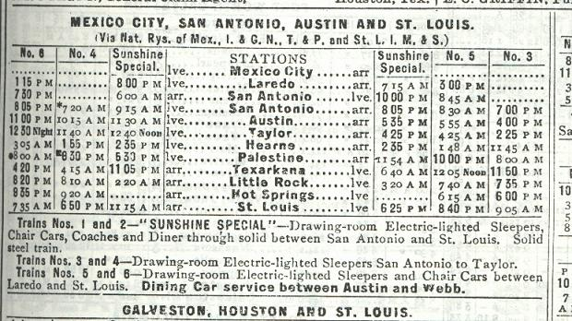
The Birth of a Poem
“The Negro Speaks of Rivers”
www.txtransportationmuseum.org

Slide 10
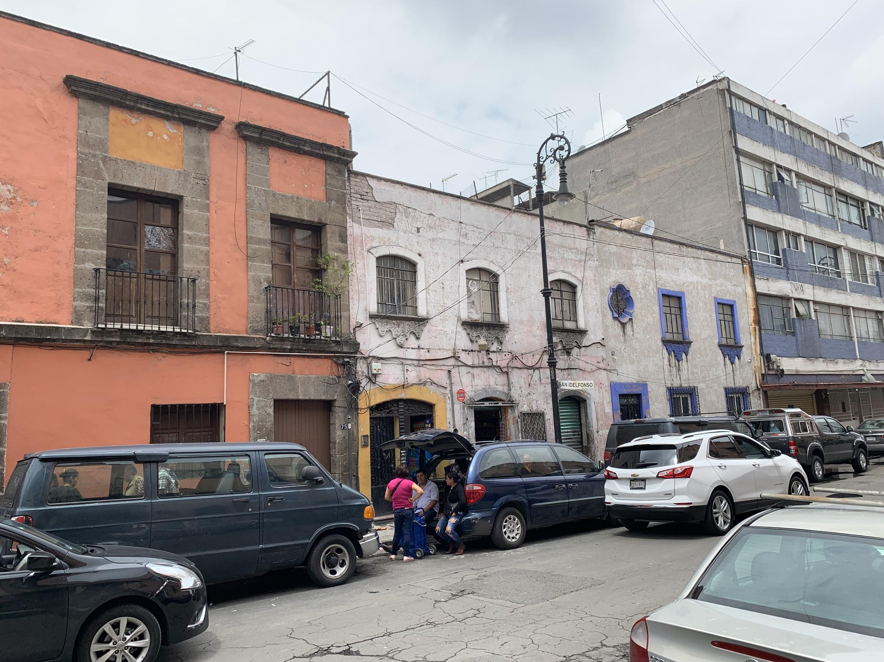
Langston Hughes in Mexico City
Apartment near the Zócalo (public square in city center)
Photo by Michael Soto (2019)

Slide 11
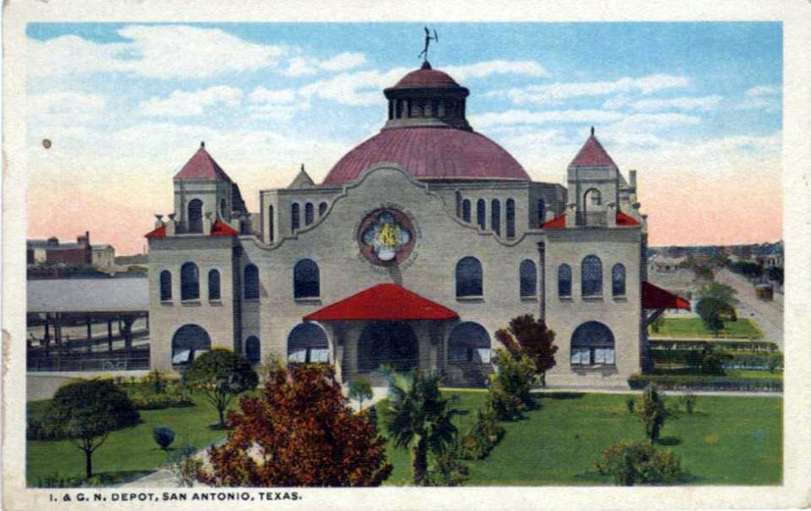
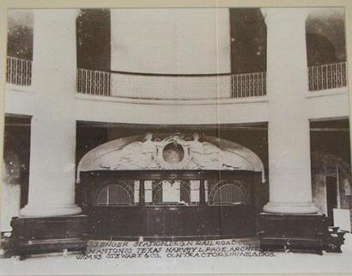
International and Great Northern Railroad
Today: VIA Multimodal Transit Center
www.txtransportationmuseum.org

Slide 12
The Negro Speaks of Rivers
I’ve known rivers:
I’ve known rivers ancient as the world and older than the flow of human blood in human veins.
My soul has grown deep like the rivers.
I bathed in the Euphrates when dawns were young.
I built my hut near the Congo and it lulled me to sleep.
I looked upon the Nile and raised the pyramids above it.
I heard the singing of the Mississippi when Abe Lincoln went down to New Orleans, and I’ve seen its muddy bosom turn all golden in the sunset.
I’ve known rivers:
Ancient, dusky rivers.
My soul has grown deep like the rivers.

Slide 14
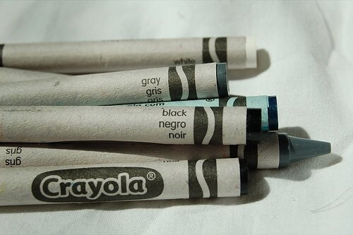
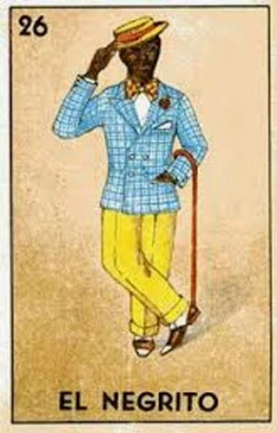

Slide 15
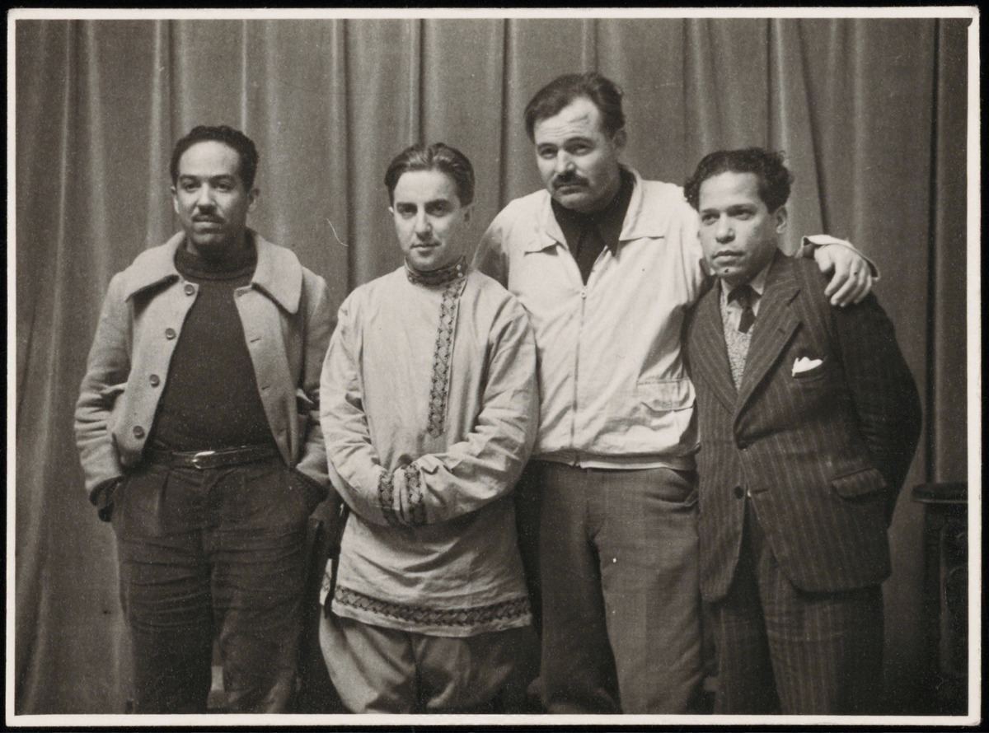
Hughes in Spain
Hughes, Michael Koltyov, Ernest Hemingway, Nicolas Guillen
Yale University Beinecke Library

Slide 16
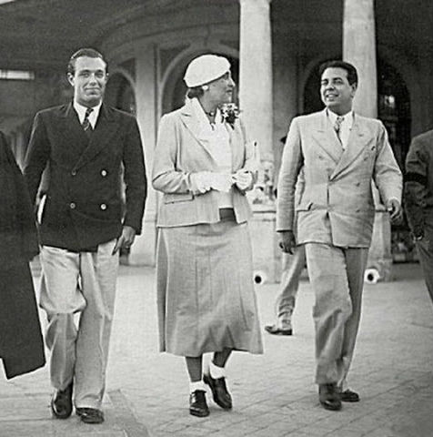
Borges and Sur
Adolfo Bioy Casares, Victoria Ocampo, and Jorge Luis Borges (1934)
El País

Slide 17
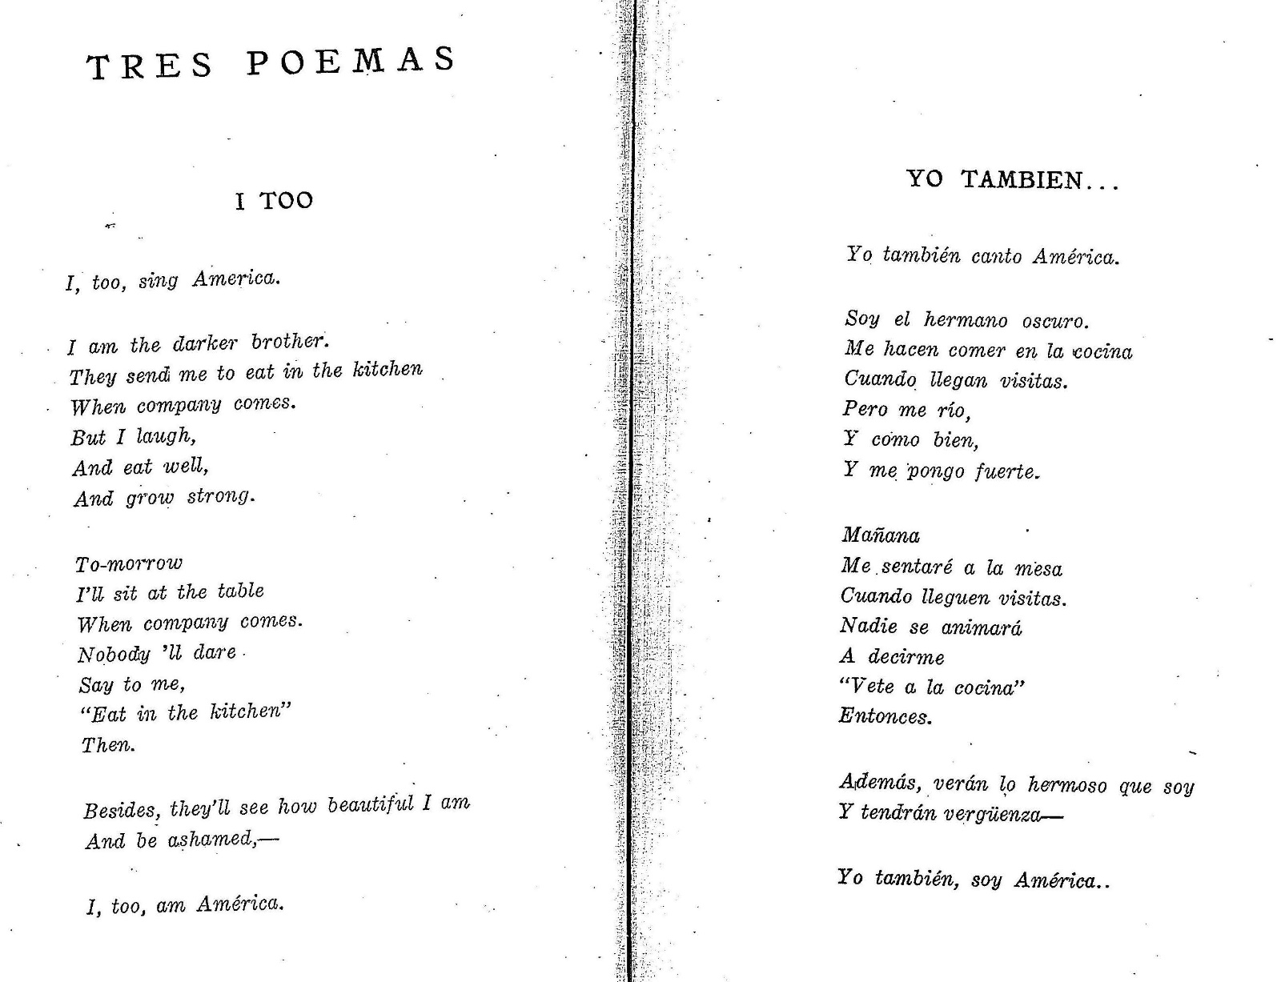
Jorge Luís Borges translates Hughes
Sur magazine (1931)

Slide 18
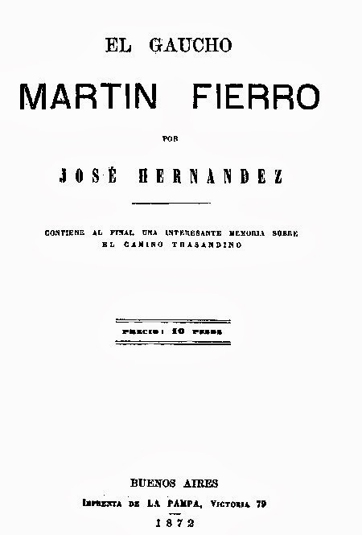
Langston Hughes, gaucho poet
in the hands of Jorge Luis Borges
darker brother → hermano oscuro
grow strong → me pongo fuerte
Nobody ’ll dare → Nadie se animará
“Eat in the kitchen” → “Vete a la cocina”
ellipses
America → América
Whitman → Hernández
Aquí me pongo á cantar
Al compás de la vigüela...

