Slide 1
“American Society during the Founding Period”
Humanities Texas
2020
Zara Anishanslin, University of Delaware
please join me on Twitter @ZaraAnishanslin

Slide 2
“We hold these truths to be self evident,
that all men are created equal.”
Thomas Jefferson, Declaration of Independence, 1776

Slide 3
“A republic, if you can keep it”
Notes:
Who knows these women? Each played important roles in rev and/or early republic. Why not better remembered?

Slide 4
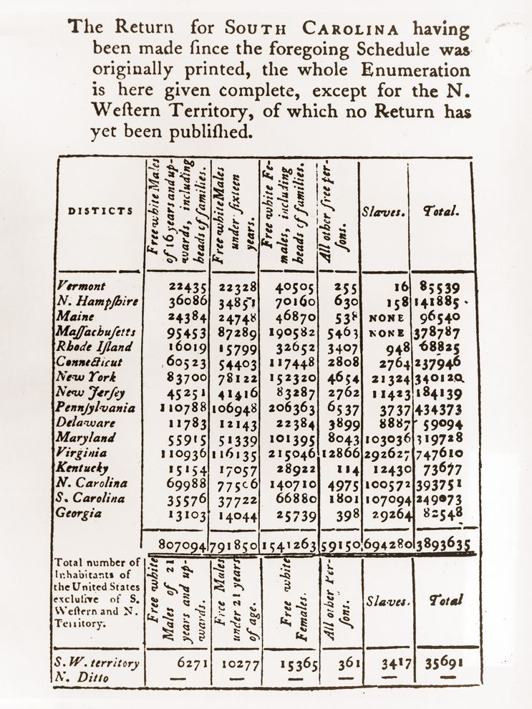

Slide 5
“A republic, if you can keep it”
Notes:
Who knows these women? Each played important roles in rev and/or early republic. Why not better remembered?

Slide 6
“A republic, if you can keep it”

Slide 7
“a lady remarkable for her understanding and wit”

Slide 8
“the all important Subject was frequently discussed at our House”
“Lord Carlisle, with his three mistresses, is quartered at Mr. Powel’s the late mayor, the family having retreated to the back building.”
The Pennsylvania Packet

Slide 9
”McHenry wrote that when Benjamin Franklin emerged from the building that day, he was accosted by a certain Mrs. Powell of Philadelphia. Whether she was a young women or a dowager we don’t know. He was then eighty-one years old, the oldest delegate. . . . for all we know, he knew this now-mythical and otherwise forgotten Mrs. Powell, who has come to stand for all of America since the day when she spoke to Franklin in a tone that seems to bespeak some degree of familiarity.”
-Eric Metaxas, If You Can Keep It (2016)

Slide 10
“The Republican Court”
“The Republican Court”
“The men possess the more ostensible powers of making and executing laws ... [but] the women in every free country, have an absolute control of manners; and it is confessed, that in a republic, manners are of equal importance with laws.”
James Tilton, M.D.,
“An Oration Pronounced on the 5th
July, 1790,” The Universal Asylum
& Columbian Magazine, 5 (Dec. 1790)

Slide 11
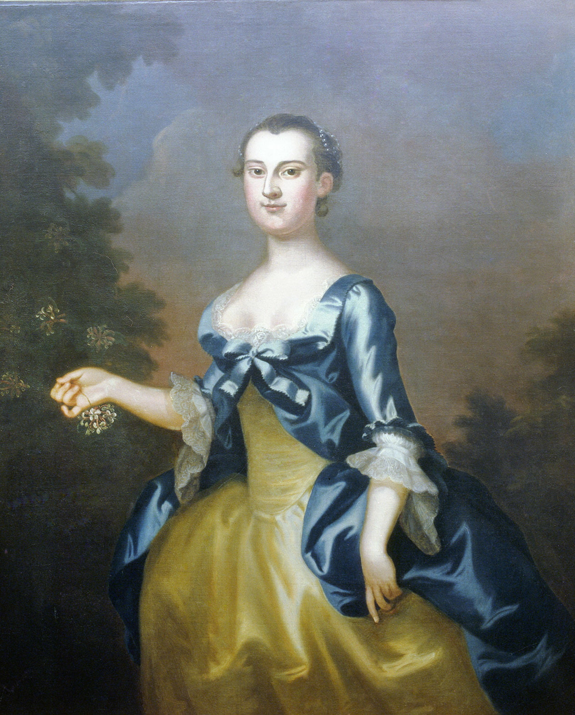
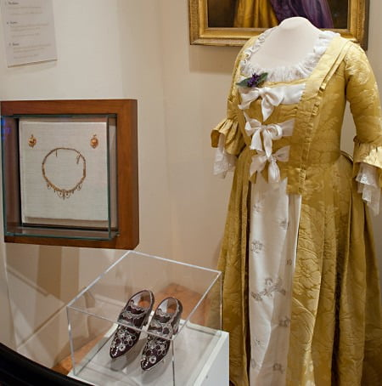
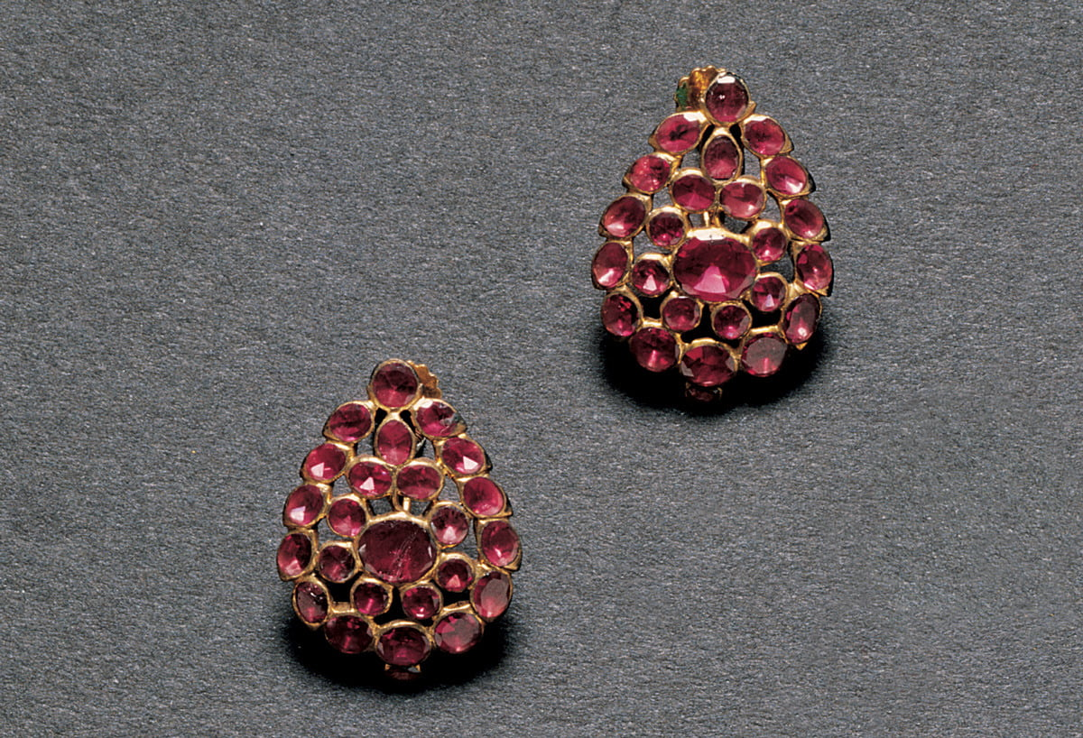

Slide 12
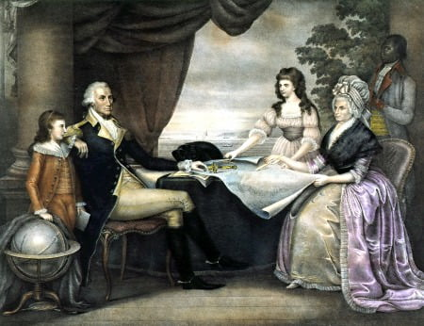
“... her wishes coincide with my own as to simplicity of dress and everything which can tend to support propriety of character without partaking of the follies of luxury and ostentation.”
George Washington to Catharine Macaulay Graham,
January 9, 1790

Slide 14
Ona Judge
“handy and useful to her being perfect Mistress of her needle”
George Washington to [Oliver Wolcott,]
The Secretary of the Treasury, September 1, [1796]

Slide 15
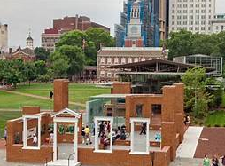
“under pretext that may deceive both them and the Public”
George Washington to Tobias Lear, April 12, 1791
“The Blacks are so bad in their nature that they have not the least grat[i]tude for the kindness that may be shewed to them.”
Martha Washington, 1795

Slide 16
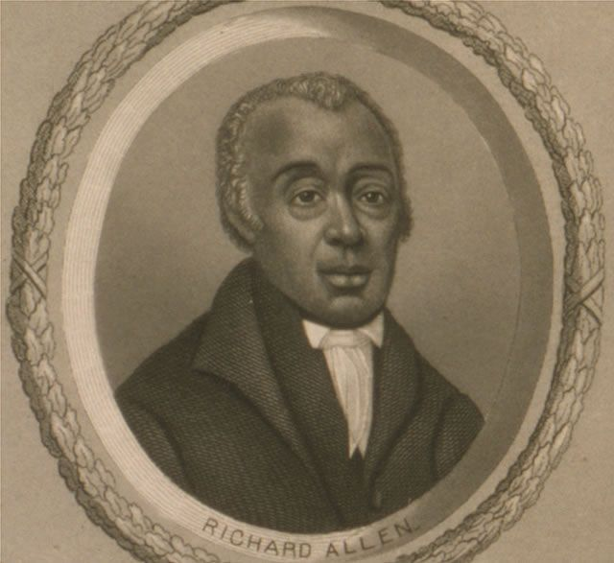
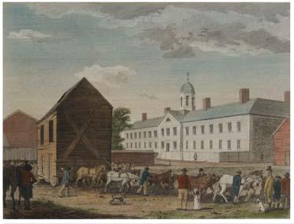
Goal in Walnut Street Philadelphia (the original Mother Bethel can be seen in the left-hand side of the frame being pulled by horses to its home at 6th and Lombard, 1794), W. Birch and Son, Historical Society of Pennsylvania.

Slide 17
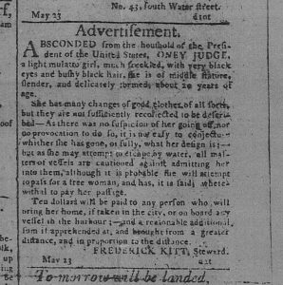

Slide 18
Mercy Otis Warren
History of the Rise, Progress, and Termination of the American Revolution (1805)—three volumes
Notes:
History of the Rise, Progress, and Termination of the American Revolution was finally published in 1805, three volumes (based on her personal experience, started gathering materials in 1775)--Now a fierce anti-Federalist, Mercy used this opportunity to contrast the virtuous self-sacrifice of the revolutionaries with what she saw as a postwar lapse in revolutionary principles (she had been distressed by Constitution—supporter of Bill of Rights)

Slide 19
Adams on Warren:
"History is not the Province of the Ladies."
Notes:
Adams on Warren:
"History is not the Province of the Ladies."
Mercy Otis Warren died not long after this feud ended, in the fall of 1814. Her history, especially because of the feud with Adams, has been largely ignored. David Ramsey, on the other hand, got much more play…just as more Americans 19th century read Puritan writing than Spanish Cabeza de Vaca (particularly as the 19th century saw elite New Englanders like Francis Parkman take the lead in crafting colonial histories)

Slide 20
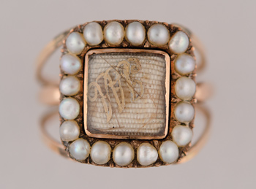
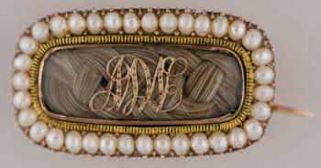
Adams ring give to Mercy Otis Warren
Gold, seed pearls, crystal, gold foil, JA and AA hair, circa 1812
1.6 cm x 2 cm x 2.4 cm;
Jewelry 01.040
Mercy Otis Warren Brooch given to AA
fold, seed pearls, crystal, gold foil, MOW hair, circa 1812
1.3 cm x 2.5 cm x 1.1 cm
Jewelry 01.041

