Slide 1
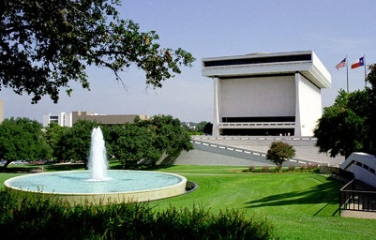
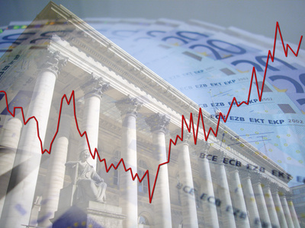
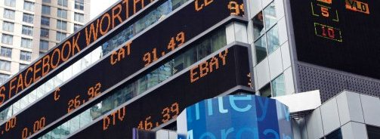
Cause of the Great Depression America in the 1920s and 1930s The LBJ Presidential Library – Humanities Texas June 13, 2018
Michael W. Brandl, PhD
The Ohio State University, Department of Economics

Slide 2
Overview
The Economics Causes of the Crash of 1929 and the Great Depression.
What we used to think.
What we know now.
Q&A

Slide 3
What we used to think
Stock market crash caused banks to fail was the cause of the Depression.
Commercial banks lent money to stock market speculators.
Speculation & attempts to corner the market push prices up.
When stock market crashed speculators could not repay loans to banks and thus banks lost depositors money.
Depositors attempted to withdraw funds as panic ensues only to find banks don’t have funds.
Roulette wheels in bank lobby analogy.
There is some truth to this, but reality is more complicated.
Just like life…

Slide 4
What we know today
Speculation was part of an “asset bubble”
The irrational increase in the market price of an asset.
Greater fool theory
Easy access to credit
Weak or no regulation
Long history of these, very difficult to predict…
But when they pop increases in liquidity are needed
Confidence needs to be restored.
Poor risk analysis of bankers was NOT limited to Wall Street.
Many banks in small towns and rural areas also failed.
Bad agricultural loans
Crony capitalism

Slide 5
More what we know today
Collapse of international trade
Both US and Europe follow Mercantilist policies.
Idea: exports > imports will lead to prosperity.
Fact: they work in short run, but are a disaster in long run.
The failure of the Federal Reserve
Established in 1913 to be the lender of last resort during financial panics…response to Panic of 1907.
Death of Benjamin Strong in Oct. 1928
Fed follows the dogma of “Real Bills” doctrine
Main idea: just because we have institutions in place, does not mean they will function properly.

Slide 6
More of what we know today
The financial multiplier.
Collapses in financial markets can and do have larger and longer lasting impacts than other causes of economic downturns.
Financial collapse worse than natural disasters or even political disruptions.
Deflationary death spirals.
Negative expectations can be self fulfilling prophesies.
In many ways FDR’s “Fear itself” was economically accurate.
But controlling “fear” without institutional changes will not be enough.

Slide 7
Q&A
Ask questions about anything…
Feel free to contact me:
michael.brandl@rice.edu
michael.brandl
@michaelbrandl
7

