Slide 1
British Postwar Policy and Growing Separation
Dr. William Meier
Texas Christian university
October 2019

Slide 2
Seal of the Colony of Massachusetts, circa 1775
- “Ense petit placidam sub libertate quietem”
- [“Seek with the sword a quiet peace under liberty”]

Slide 3
Seven Years War & French and Indian War, 1754-1763
1759: The “Year of Victories”
Source: Royal Museums Greenwich MEC 1137

Slide 4
Silver medal commemorating the British capture of Pondicherry, 1761
Source: National Army Museum 1980 -02 -82 1

Slide 5
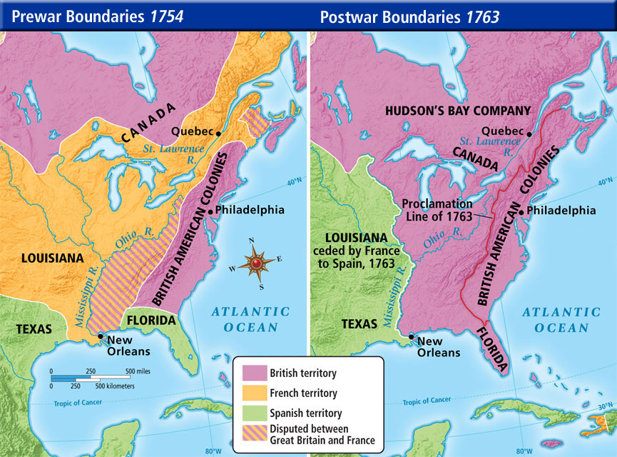

Slide 6
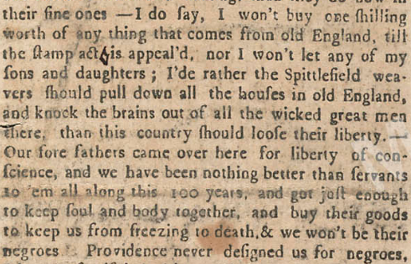
Stamp Act, 1765
George Grenville vs. William Pitt
“When were they made slaves?”
Repeal, 1766
Declaratory Act, 1766
‘Humphrey Ploughjogger’ [John Adams], Boston Gazette, 14 Oct. 1765

Slide 7
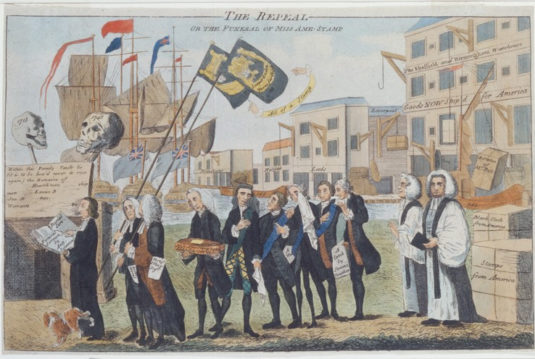
Benjamin Wilson, “The Repeal” (1766)

Slide 8
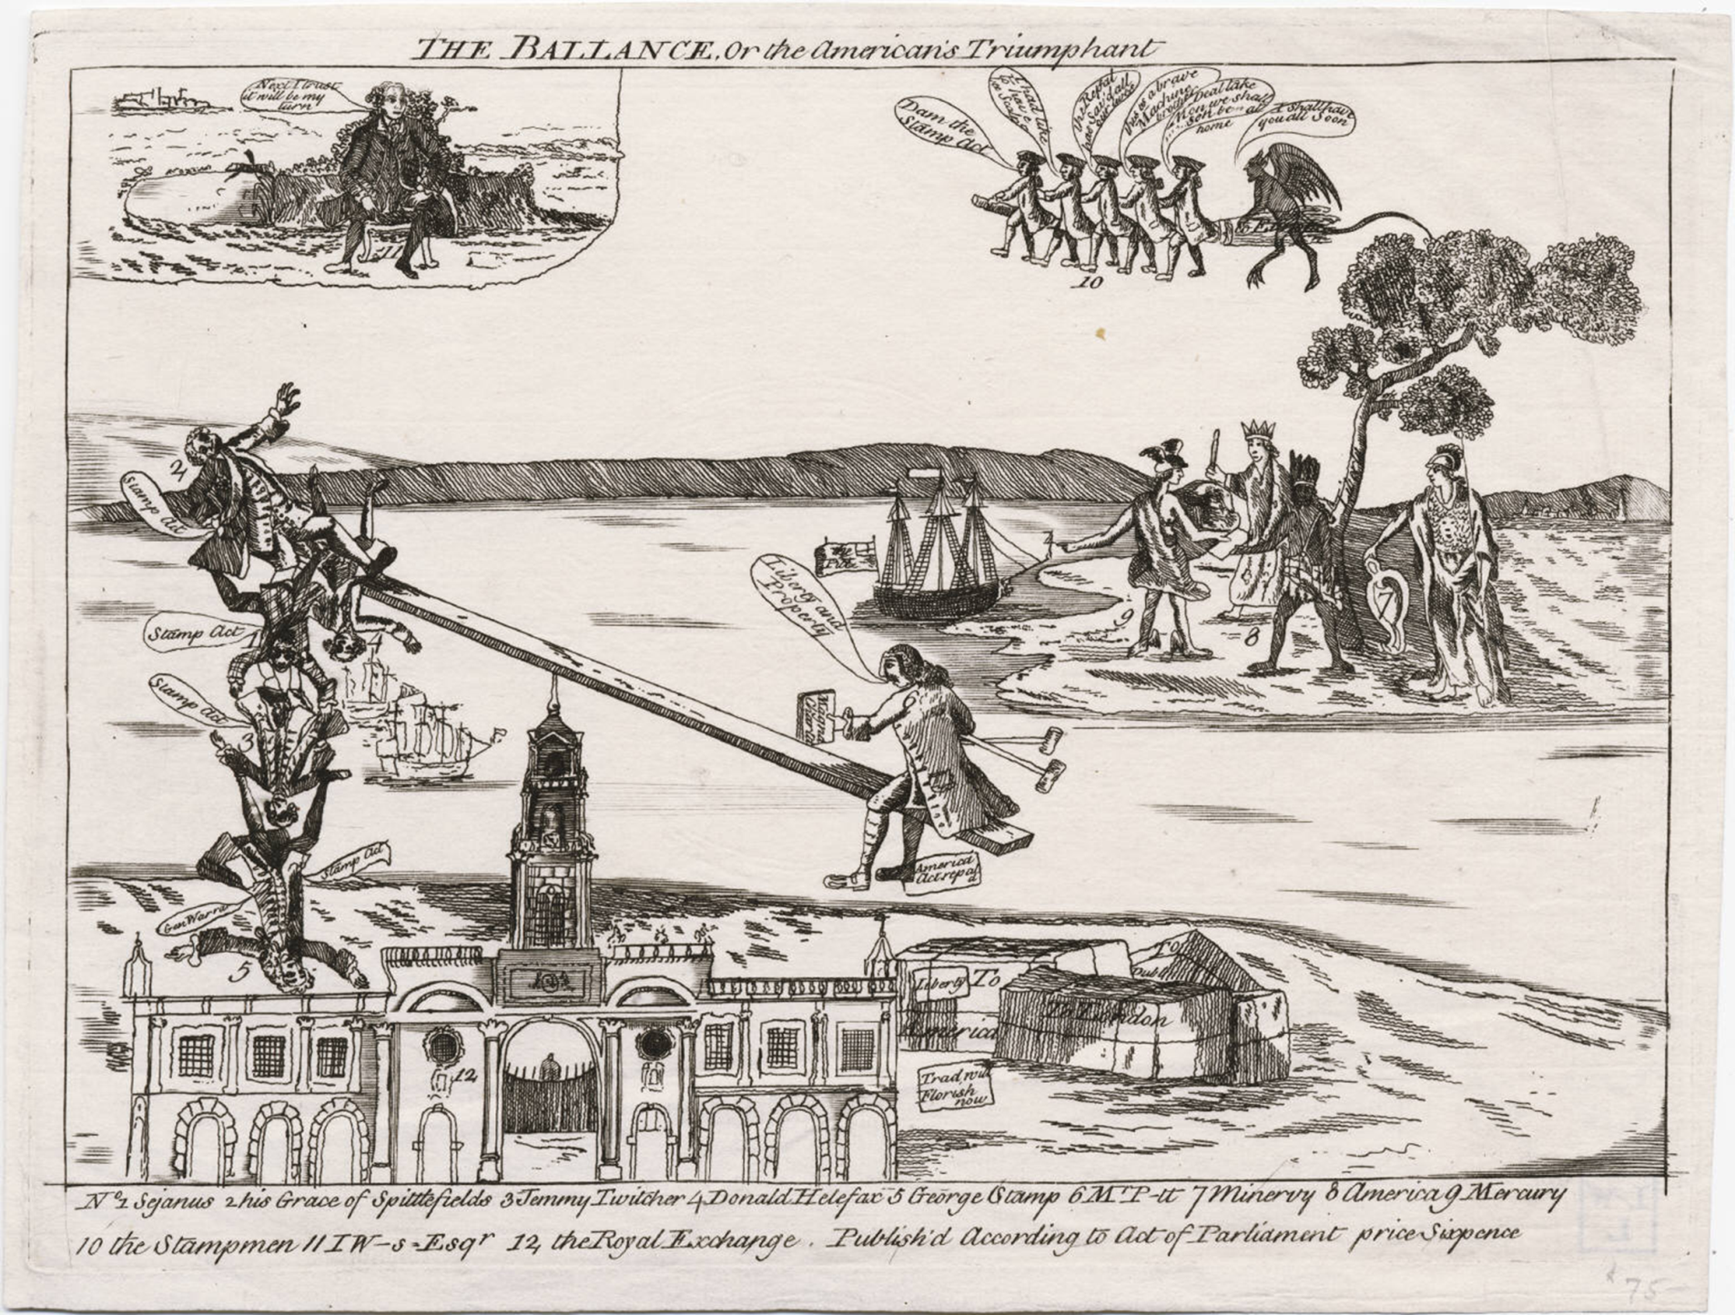
Source: Lewis Walpole Library LWLPR02585

Slide 9
Detail from “Liberty Triumphant; or, The Downfall of Oppression” (London, 1774)
Source: John Carter Brown Library, Political Cartoons 31573

Slide 10
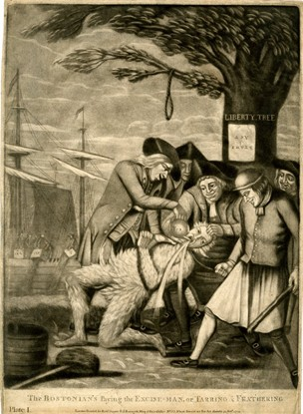
Intolerable actions
Sources: British Museum 2010,7081.851 & 1855,0609.1926

Slide 11
Violence
Source: British Museum 2010,7081.350
Source: JCB Political Cartoons 29454

