Slide 1
The Bill of Rights
Kate Brown
Western Kentucky University

Slide 2
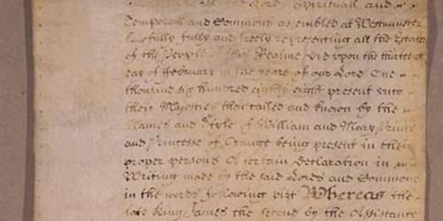
Argument: Bill of Rights originally meant to be for majority’s rights, states’ rights—not individual rights
Context and Influences:
(English) Bill of Rights (1689)
State constitution making (1776-1780)
Federalism
Popular Sovereignty (“We the People…”)

Slide 3
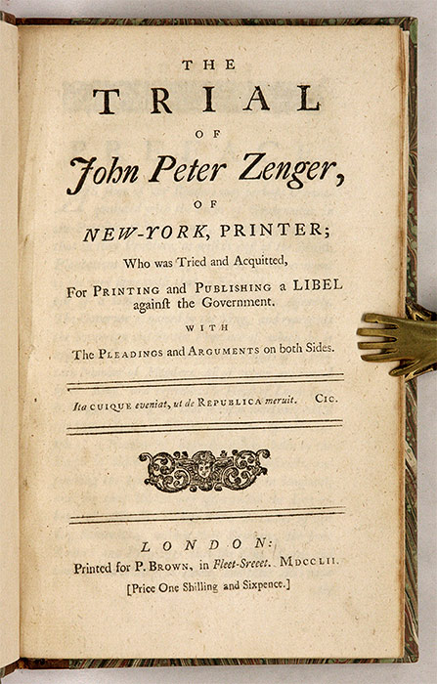
Institutions Central to the Bill of Rights
Militias
Churches
Juries (the most important)
Example: John Peter Zenger’s case (N.Y., 1735)
(Freedom of the press + jury oversight combined)
Reconstruction, the 14th Amendment and Incorporation

Slide 4
Primary Source Discussion
Rights of the Majority
Rights of the Individual

