Slide 1
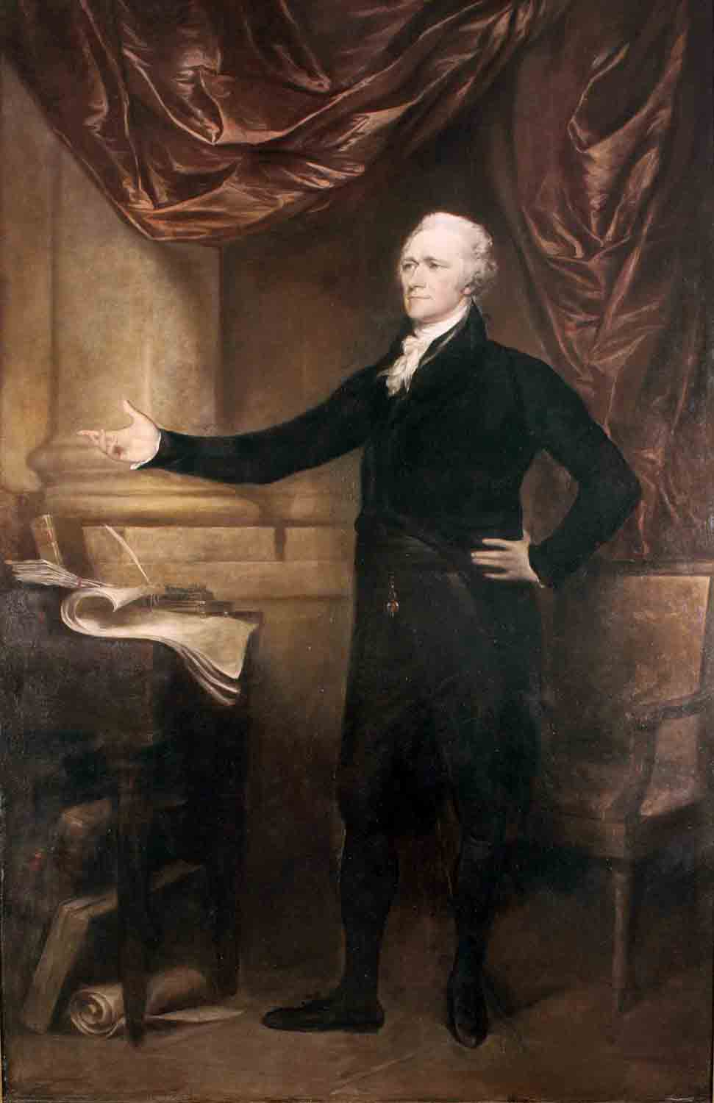
Alexander Hamilton and the Development of the US Economic System
Kate Elizabeth Brown
Western Kentucky University

Slide 2
Developing the US Economic System
Connects with Big Themes of Early Republic History:
Political economy
The relationship between the national and state governments (federalism)
The US relationship with Great Britain
Political factions

Slide 3
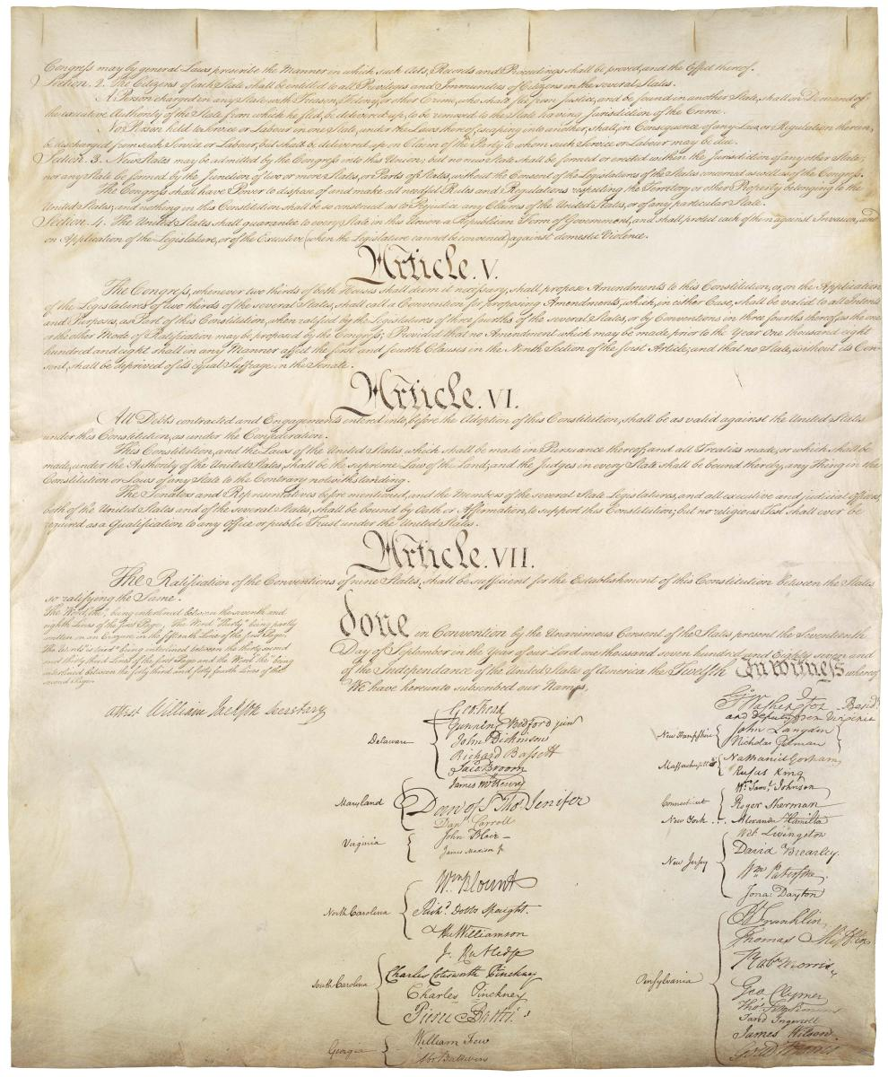
Backstory: the 1780s
Backstory: the 1780s
Economic problems: Debt and the Articles of Confederation
U.S. Constitution: creates a government of robust, but limited and enumerated, powers
Bedrock of the US economic system under Hamilton: restore the public credit
Do it in three phases

Slide 4
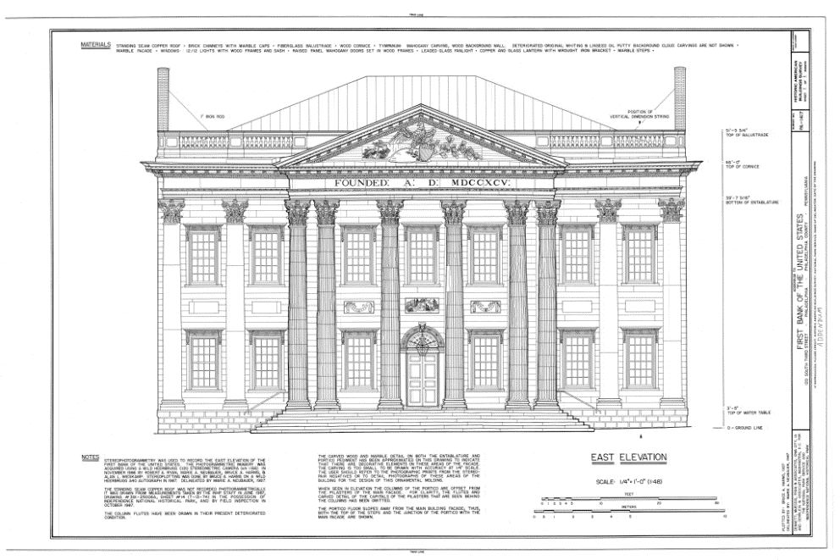
Hamilton’s Plan: Restore the Public Credit
Phase 1: Short (Immediate!) term
Funding (taxing & refinancing) of Revolutionary War debts
Assumption of state debts into the national debt
Phase 3: Long term
Encourage manufacturing
Phase 2: Intermediate term—connecting phase 1 to phase 3
Establish a central bank
The story continues with primary sources!

Slide 5
Primary Sources
Is Hamilton’s Proposed Bank Constitutional?
Discussed Here:
Article I, section 8 (US Constitution)
Excerpts from Jefferson’s Argument
Excerpts from Hamilton’s argument

Slide 6
U.S. Constitution: Article I, section 8
“The Congress shall have power to lay and collect taxes…
To borrow money…
To coin money, regulate the value thereof…
To regulate commerce with foreign nations, and among the several states…
To make all laws which shall be necessary and proper for carrying into execution the foregoing powers…”

Slide 7
Jefferson on the Constitutionality of the Bank
Jefferson argues:
“The general phrase is ‘to make all laws necessary and proper for carrying into execution the enumerated powers.’ But they can all be carried into execution without a bank. A bank therefore is not necessary, and consequently not authorised by this phrase.”

Slide 8
Hamilton on the Constitutionality of the Bank
Hamilton counters:
“To understand the word [necessary] as the Secretary of State does, would be to depart from its obvious & popular sense, and to give it a restrictive operation; an idea never before entertained…Such a construction would beget endless uncertainty & embarrassment…
…If the end be clearly comprehended within any of the specified powers, & if the measure have an obvious relation to that end, and is not forbidden by any particular provision of the constitution—it may safely be deemed to come within the compass of the national authority.”

Slide 9
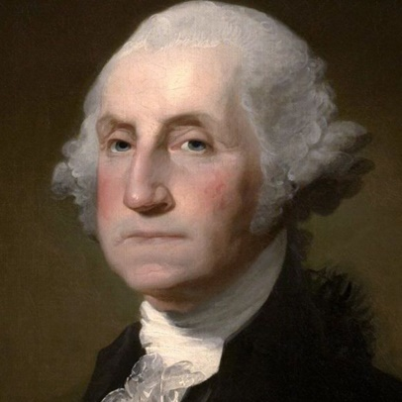
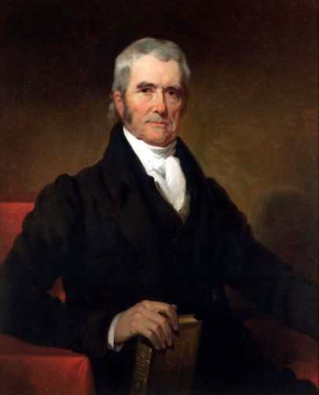
Is the BUS Constitutional?
Round 1: George Washington sides with Hamilton
Round 2: The US Supreme Court sides with Hamilton
McCulloch v. Maryland (US, 1819)
Two issues: is the 2BUS constitutional? Can a state tax the bank?

Slide 10
Bonus Primary Source: Federalist No. 32
Hamiltonian concurrence (Federalist No. 32):
Premise: states retain their pre-existing sovereignty under the US Constitution
“This exclusive delegation, or rather this alienation, of State sovereignty, would only exist in three cases:
[1] where the Constitution in express terms granted an exclusive authority to the Union;
[2] where it granted in one instance an authority to the Union, and in another prohibited the States from exercising the like authority;
[3] and where it granted an authority to the Union, to which a similar authority in the States would be absolutely and totally CONTRADICTORY and REPUGNANT.”

