Slide 1
Federalists vs. Antifederalists
Denver Brunsman
George Washington University

Slide 2
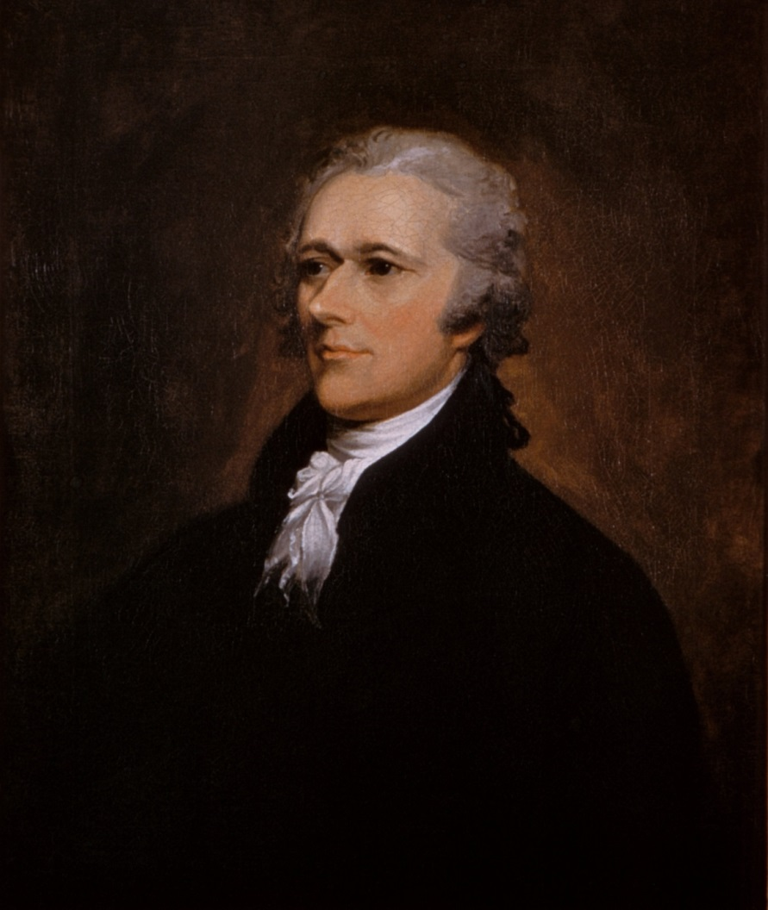
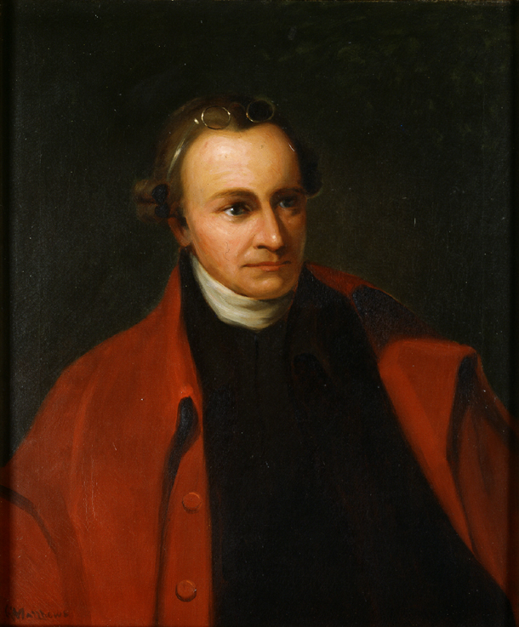
Cosmopolitans (Feds) Localists (Antifeds)
Alexander Hamilton Patrick Henry

Slide 3
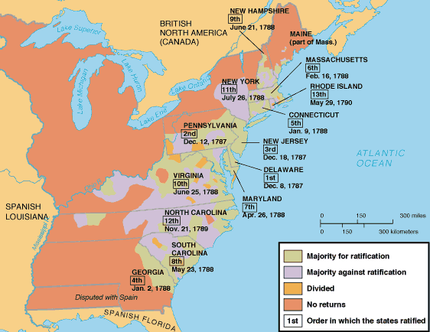

Slide 4
Order of Ratification
1. Delaware: December 7, 1787
2. Pennsylvania: December 12, 1787
3. New Jersey: December 18, 1787
4. Georgia: January 2, 1788
5. Connecticut: January 9, 1788
6. Massachusetts: February 6, 1788
7. Maryland: April 28, 1788
8. South Carolina: May 23, 1788
9. New Hampshire: June 21, 1788 (Constitution became legal)
10. Virginia: June 25, 1788
11. New York: July 26, 1788
12. North Carolina: November 21, 1789
13. Rhode Island: May 29, 1790

Slide 5
Top Antifederalist Arguments against the Constitution
1. No Bill of Rights
2. “Consolidated” central government (not true federalism)
3. Lack of direct representation (congressional districts of 30,000)

Slide 6
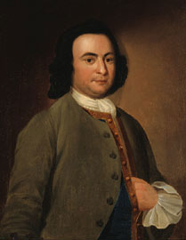
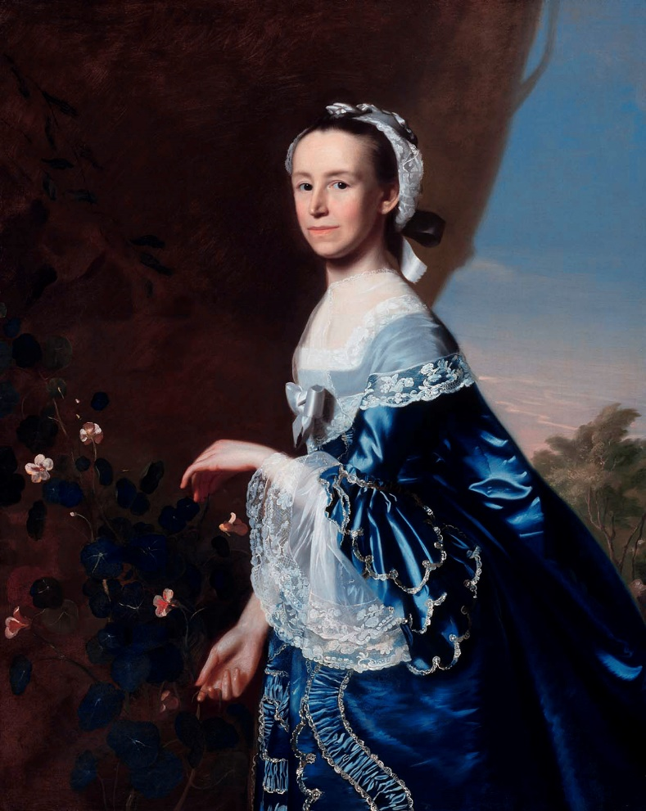
Antifederalists
George Mason Patrick Henry Mercy Otis Warren

Slide 7
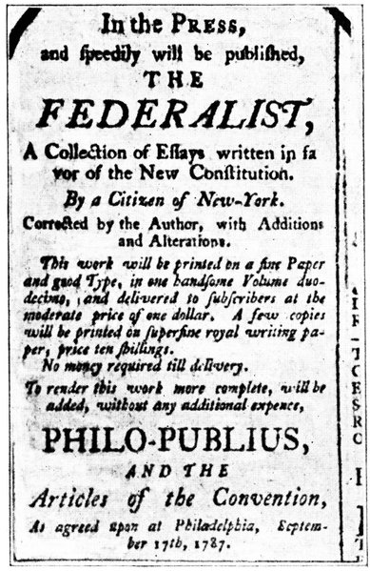
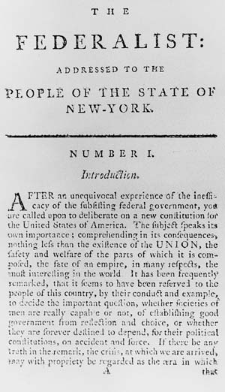
The Federalist (1787-88)

Slide 8
Order of Ratification
1. Delaware: December 7, 1787
2. Pennsylvania: December 12, 1787
3. New Jersey: December 18, 1787
4. Georgia: January 2, 1788
5. Connecticut: January 9, 1788
6. Massachusetts: February 6, 1788
7. Maryland: April 28, 1788
8. South Carolina: May 23, 1788
9. New Hampshire: June 21, 1788 (Constitution became legal)
10. Virginia: June 25, 1788
11. New York: July 26, 1788
12. North Carolina: November 21, 1789
13. Rhode Island: May 29, 1790

Slide 9
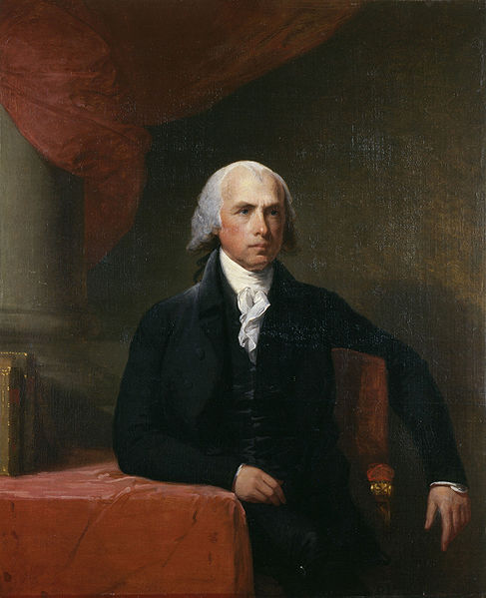
James Madison
Gilbert Stuart
(c. 1805-07)

Slide 10
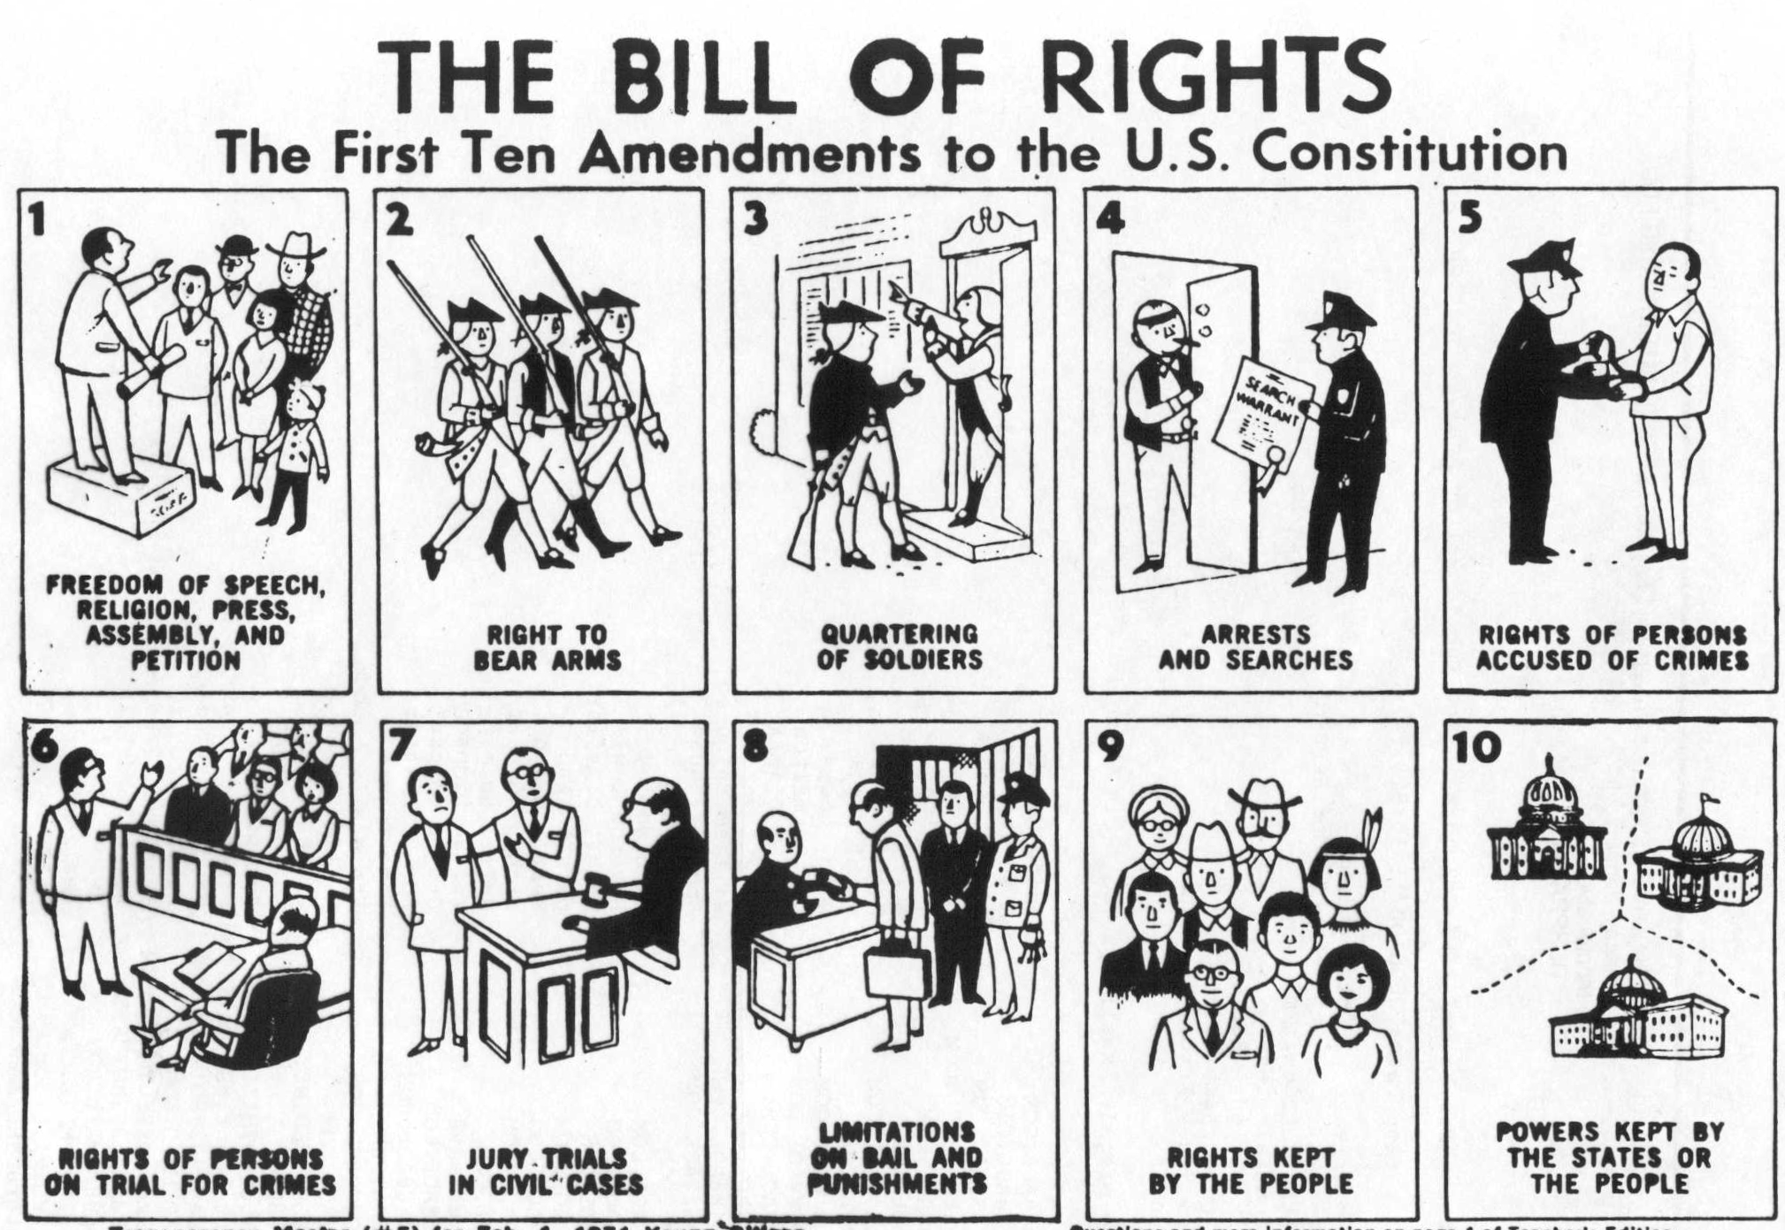

Slide 11
Two Unratified Amendments Passed by Congress in September 1789
1. "After the first enumeration required by the first article of the Constitution, there
shall be one Representative for every thirty thousand, until the number shall amount
to one hundred, after which the proportion shall be so regulated by Congress, that
there shall be not less than one hundred Representatives, nor less than one Representative for every forty thousand persons, until the number of Representatives shall amount to two hundred; after which the proportion shall be so regulated by Congress, that there shall not be less than two hundred Representatives, nor more
than one Representative for every fifty thousand persons.“
2. “No law, varying the compensation for the services of the Senators and Representatives, shall take effect, until an election of Representatives shall have intervened.”
[Ratified as the 27th Amendment on May 7, 1992]

Slide 12
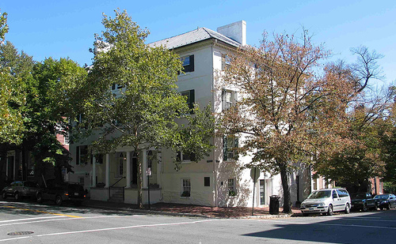
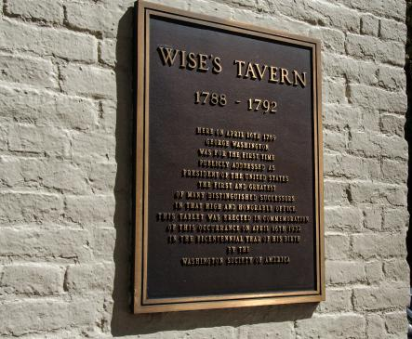
Wise’s Tavern,
Alexandria

Slide 13
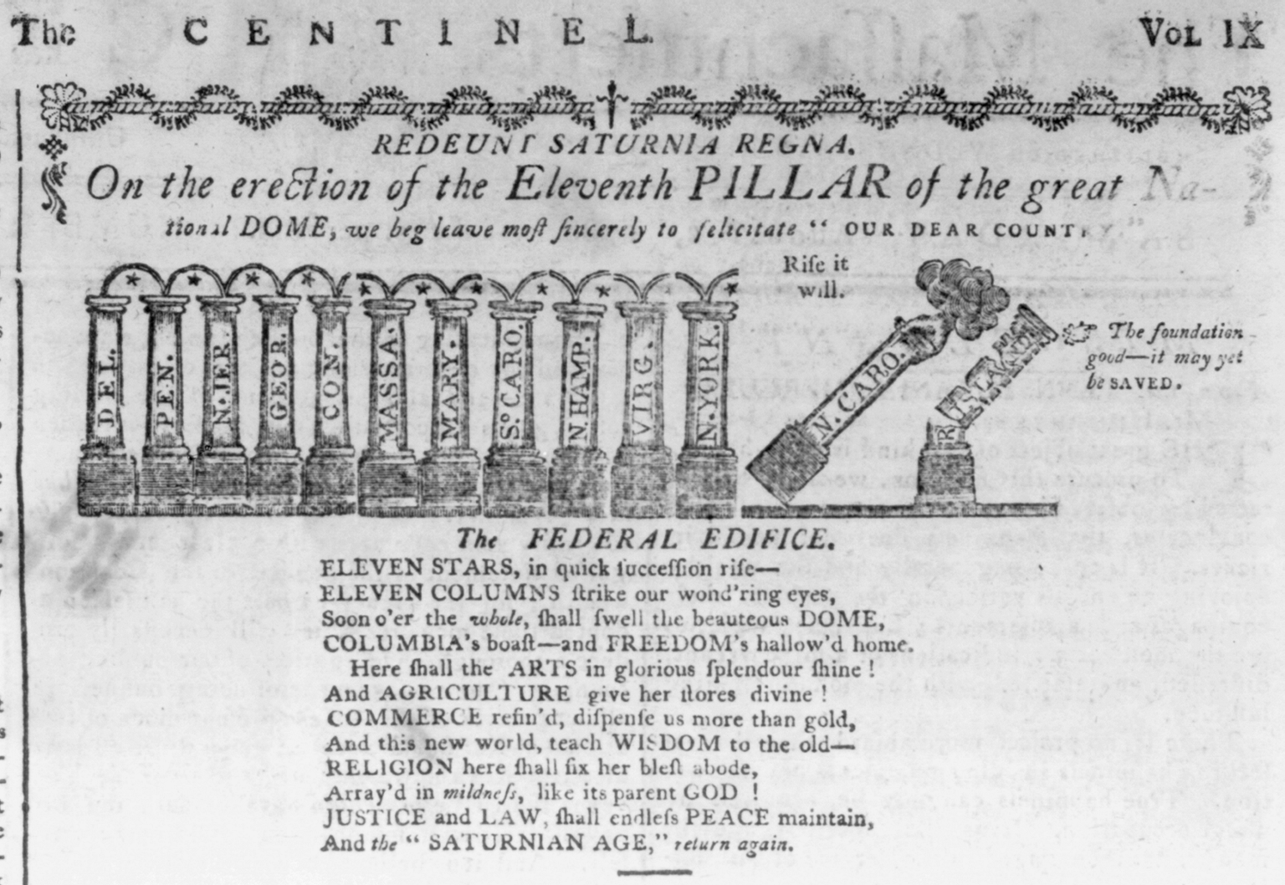
The Massachusetts Centinel [Boston], August 2, 1788

Slide 14
Top 10 Reasons Rhode Island Did Not Ratify the Constitution

Slide 15
Top 10 Reasons Rhode Island Did Not Ratify the Constitution
10. RI nation! (maintain independence)

Slide 16
Top 10 Reasons Rhode Island Did Not Ratify the Constitution
10. RI nation! (maintain independence)
9. The Constitution limits democracy.

Slide 17
Top 10 Reasons Rhode Island Did Not Ratify the Constitution
10. RI nation! (maintain independence)
9. The Constitution limits democracy.
8. And give up the benefits of this coastline?

Slide 18
Top 10 Reasons Rhode Island Did Not Ratify the Constitution
10. RI nation! (maintain independence)
9. The Constitution limits democracy.
8. And give up the benefits of this coastline?
7. Paper money for life!

Slide 19
Top 10 Reasons Rhode Island Did Not Ratify the Constitution
10. RI nation! (maintain independence)
9. The Constitution limits democracy.
8. And give up the benefits of this coastline?
7. Paper money for life!
6. It pays to be small!

Slide 20
Top 10 Reasons Rhode Island Did Not Ratify the Constitution
10. RI nation! (maintain independence)
9. The Constitution limits democracy.
8. And give up the benefits of this coastline?
7. Paper money for life!
6. It pays to be small!
5. Where is the Bill of Rights?

Slide 21
Top 10 Reasons Rhode Island Did Not Ratify the Constitution
10. RI nation! (maintain independence)
9. The Constitution limits democracy.
8. And give up the benefits of this coastline?
7. Paper money for life!
6. It pays to be small!
5. Where is the Bill of Rights?
4. The Constitution protects slavery.

Slide 22
Top 10 Reasons Rhode Island Did Not Ratify the Constitution
10. RI nation! (maintain independence)
9. The Constitution limits democracy.
8. And give up the benefits of this coastline?
7. Paper money for life!
6. It pays to be small!
5. Where is the Bill of Rights?
4. The Constitution protects slavery.
3. “Rogue Island” this! (emotion)

Slide 23
Top 10 Reasons Rhode Island Did Not Ratify the Constitution
10. RI nation! (maintain independence)
9. The Constitution limits democracy.
8. And give up the benefits of this coastline?
7. Paper money for life!
6. It pays to be small!
5. Where is the Bill of Rights?
4. The Constitution protects slavery.
3. “Rogue Island” this! (emotion)
2. Your Federalists can beat up our Federalists.

Slide 24
Top 10 Reasons Rhode Island Did Not Ratify the Constitution
10. RI nation! (maintain independence)
9. The Constitution limits democracy.
8. And give up the benefits of this coastline?
7. Paper money for life!
6. It pays to be small!
5. Where is the Bill of Rights?
4. The Constitution protects slavery.
3. “Rogue Island” this! (emotion)
2. Your Federalists can beat up our Federalists.
1. We’re just not that into you (popular opinion).

Slide 25
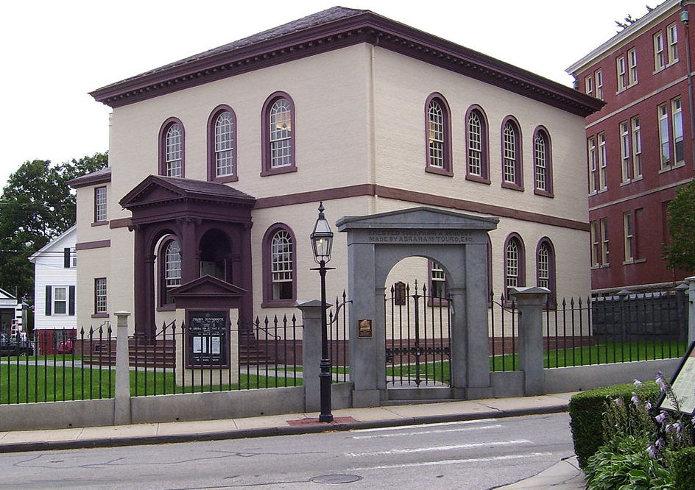
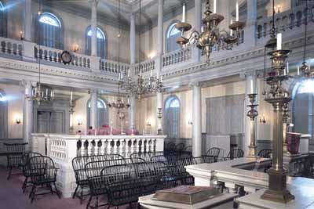
Touro Synagogue,
Newport, R.I.

Slide 26
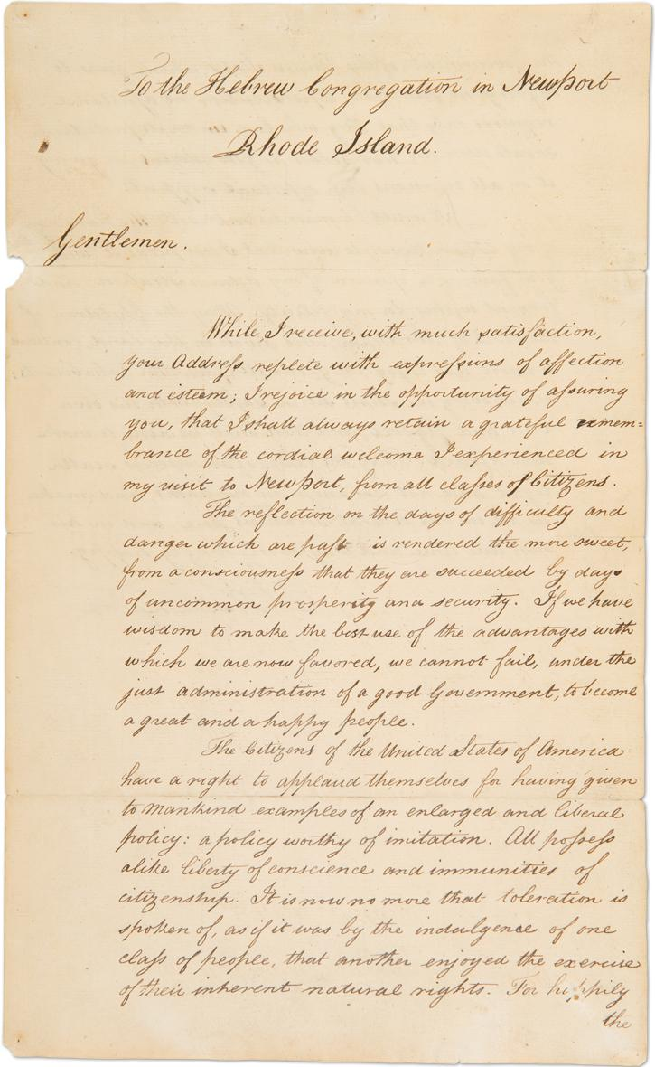
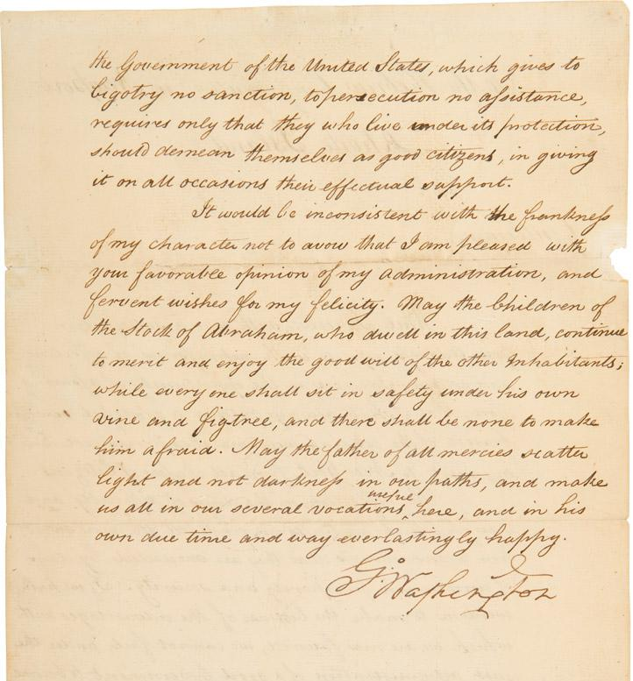
Washington to the Hebrew
Congregation of Newport,
August 18, 1790

Slide 27
American Political Party Systems
Pre-Parties
Federalists vs. Antifederalists (1787-1789)
First Party System
Federalists vs. Democratic Republicans (1794-1820)
Second Party System
Democrats vs. Whigs (1829-1856)
Third Party System
Democrats vs. Republicans (1856-1896)
Fourth Party System
Democrats vs. Republicans (1896-1932)
Fifth Party System
Democrats vs. Republicans (1932-1968)
Sixth Party System
Democrats vs. Republicans (1968-present)

Slide 28
thank you
brunsman@gwu.edu

