Slide 1
The Declaration of Independence
Denver Brunsman George Washington University

Slide 2
Texas Essential Knowledge and Skills (TEKS), Social Studies, Grade 8
Introduction
(2) To support the teaching of the essential knowledge and skills, the use of a variety of rich primary and secondary source material such as the complete text of the U.S. Constitution and the Declaration of Independence . . .
(7) State and federal laws mandate a variety of celebrations and observances, including Celebrate Freedom Week.
(A) Each social studies class shall include, during Celebrate Freedom Week as provided under the TEC, §29.907, or during another full school week as determined by the board of trustees of a school district, appropriate instruction concerning the intent, meaning, and importance of the Declaration of Independence and the U.S. Constitution, including the Bill of Rights, in their historical contexts. The study of the Declaration of Independence must include the study of the relationship of the ideas expressed in that document to subsequent American history, including the relationship of its ideas to the rich diversity of our people as a nation of immigrants, the American Revolution, the formulation of the U.S. Constitution, and the abolitionist movement, which led to the Emancipation Proclamation and the women's suffrage movement.
(B) Each school district shall require that, during Celebrate Freedom Week or other week of instruction prescribed under subparagraph (A) of this paragraph, students in Grades 3-12 study and recite the following text from the Declaration of Independence: "We hold these Truths to be self-evident, that all Men are created equal, that they are endowed by their Creator with certain unalienable Rights, that among these are Life, Liberty and the Pursuit of Happiness--That to secure these Rights, Governments are instituted among Men, deriving their just Powers from the Consent of the Governed."
Knowledge and Skills
1 (B) explain the significance of the following dates: 1607, founding of Jamestown; 1620, arrival of the Pilgrims and signing of the Mayflower Compact; 1776, adoption of the Declaration of Independence . . .
4 (C) explain the issues surrounding important events of the American Revolution, including declaring independence . . .
15 Government. The student understands the American beliefs and principles reflected in the Declaration of Independence, the U.S. Constitution, and other important historic documents. The student is expected to:
(C) identify colonial grievances listed in the Declaration of Independence and explain how those grievances were addressed in the U.S. Constitution and the Bill of Rights;

Slide 3
Texas Essential Knowledge and Skills (TEKS), Social Studies, Grade 8
Political Documents and Systems of Government in the Anglo-American Tradition
Knowledge and Skills
1 (B) explain the significance of the following dates: 1607, founding of Jamestown; 1620, arrival of the Pilgrims and signing of the Mayflower Compact; 1776, adoption of the Declaration of Independence . . .
3 (B) analyze the importance of the Mayflower Compact, the Fundamental Orders of Connecticut, and the Virginia House of Burgesses to the growth of representative government . . .
15 Government. The student understands the American beliefs and principles reflected in the Declaration of Independence, the U.S. Constitution, and other important historic documents. The student is expected to:
(A) identify the influence of ideas from historic documents, including the Magna Carta, the English Bill of Rights, the Mayflower Compact, and the Federalist Papers, on the U.S. system of government;
(C) identify colonial grievances listed in the Declaration of Independence and explain how those grievances were addressed in the U.S. Constitution and the Bill of Rights;

Slide 4
Three Imperial Crises
1. Stamp Act Crisis (1764-66)
2. Townshend Acts Crisis (1767-1770)
3. Tea Act/Independence Crisis (1773-76)

Slide 5
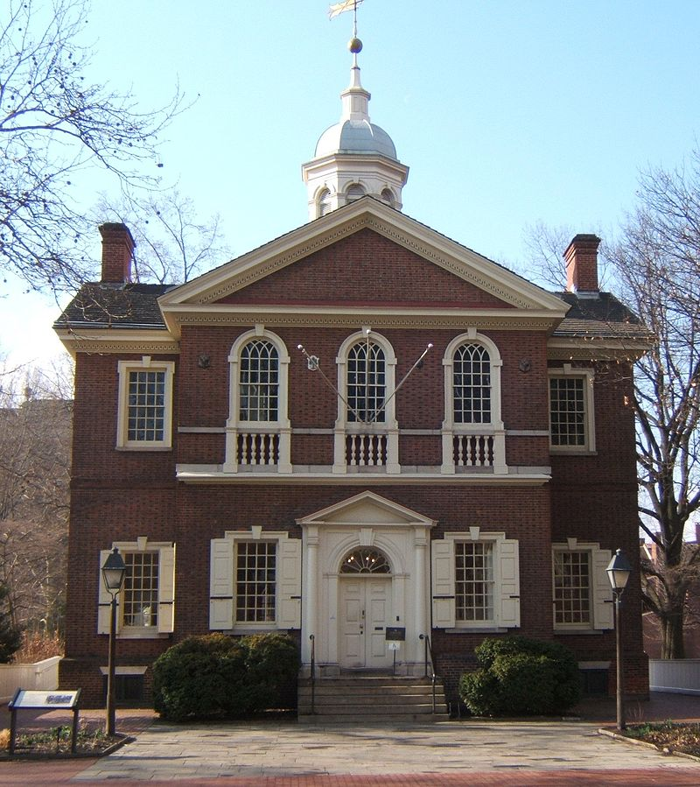
Carpenters’ Hall,
Philadelphia
(First Continental Congress,
Sept.-Oct. 1774)

Slide 6
American Position, c. 1774
(First Continental Congress)
1. Continental Association (united boycott of British goods)
2. No parliamentary legislation without consent
3. Congress accepted British regulation of trade
(Navigation Acts)
4. Parliament no longer legitimate; petitioned the king

Slide 7
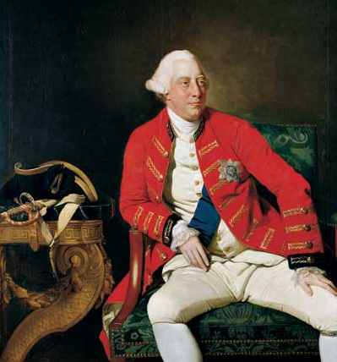
George III
Johann Zoffany (1771)

Slide 8
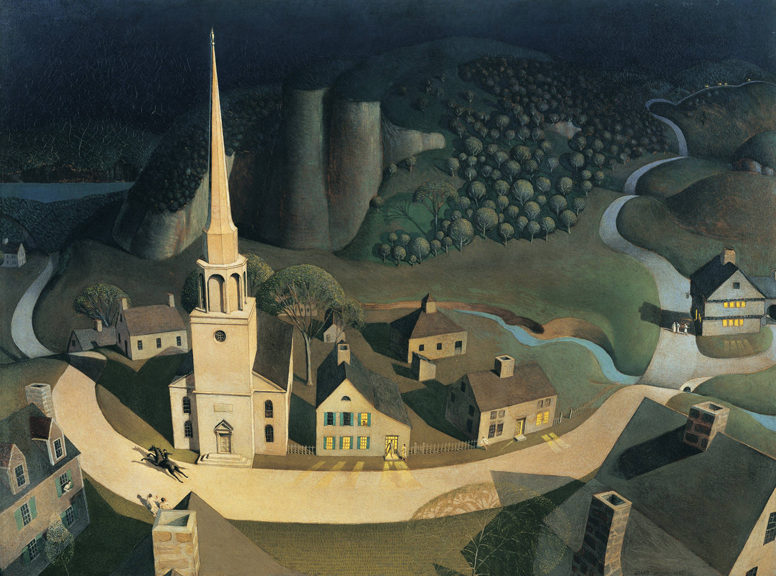
The Midnight Ride of Paul Revere, Grant Wood (1931)

Slide 9
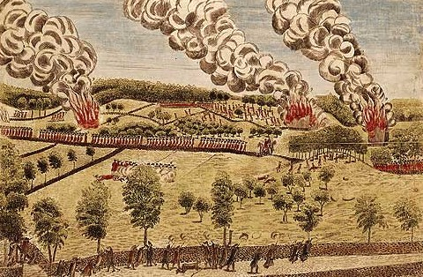
The Battle of Lexington
Amos Doolittle (1775)

Slide 10
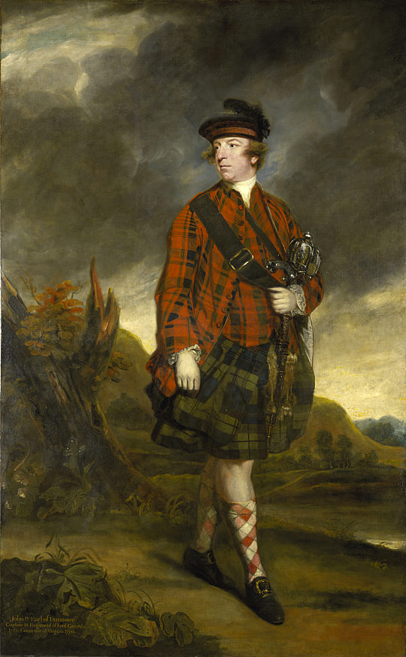
John Murray,
4th Earl of Dunmore
Joshua Reynolds (1765)

Slide 11
War and Individual Declarations of Independence
Benjamin Franklin to William Strahan, July 5, 1775
(never sent)
“You are a Member of Parliament, and one of that Majority which has doomed my Country to Destruction. – You have begun to burn our Towns, and murder our People. – Look upon your Hands! They are stained with the Blood of your Relations! – You and I were long Friends: You are now my Enemy, and I am
Yours,
B. Franklin”

Slide 12
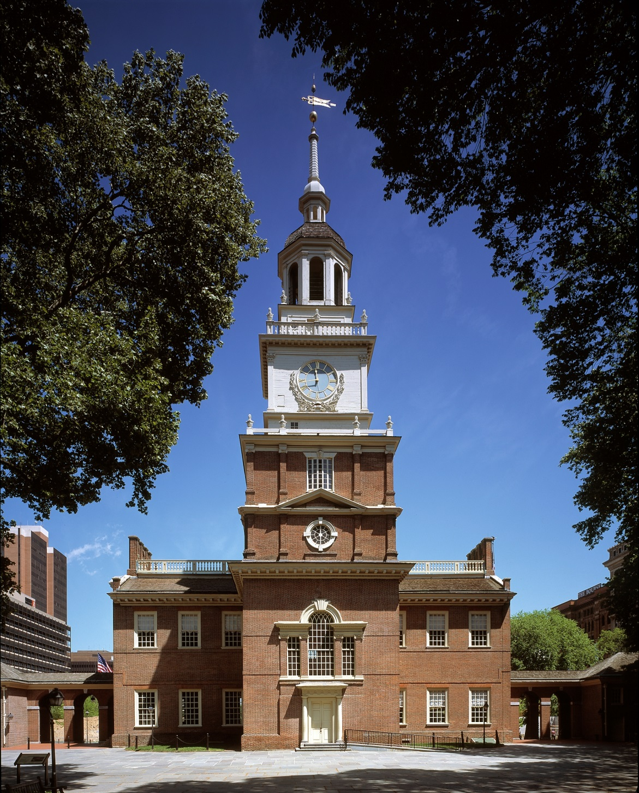
Independence Hall
(Pennsylvania State House –
Second Continental Congress, May 1775-March 1781)

Slide 13
American Position, c. 1775
(based on the Second Continental Congress)
1. Jointly pursued war and reconciliation
2. Rejected North’s Conciliatory Proposition (which affirmed parliamentary sovereignty)
3. Olive Branch Petition to king (rejected by George III)
4. Still maintained loyalty to the king (weakening)

Slide 14
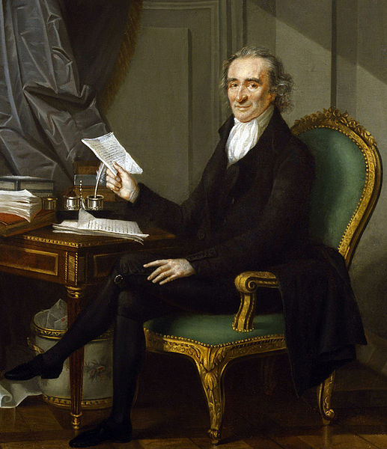
Thomas Paine
Laurent Dabos,
c. 1791

Slide 15
American Position, c. 1776
1. April-June – about 90 local declarations of independence
(Congress more cautious than individual communities)
2. May 15 – Congress advised all the colonies to form governments for themselves (state constitutions and sovereignty)
3. June 7 – Richard Henry Lee introduced resolution for American independence (tabled, but committee formed to draft declaration)
4. July 2 – Lee’s resolution approved, followed by Declaration of Independence on July 4

Slide 16
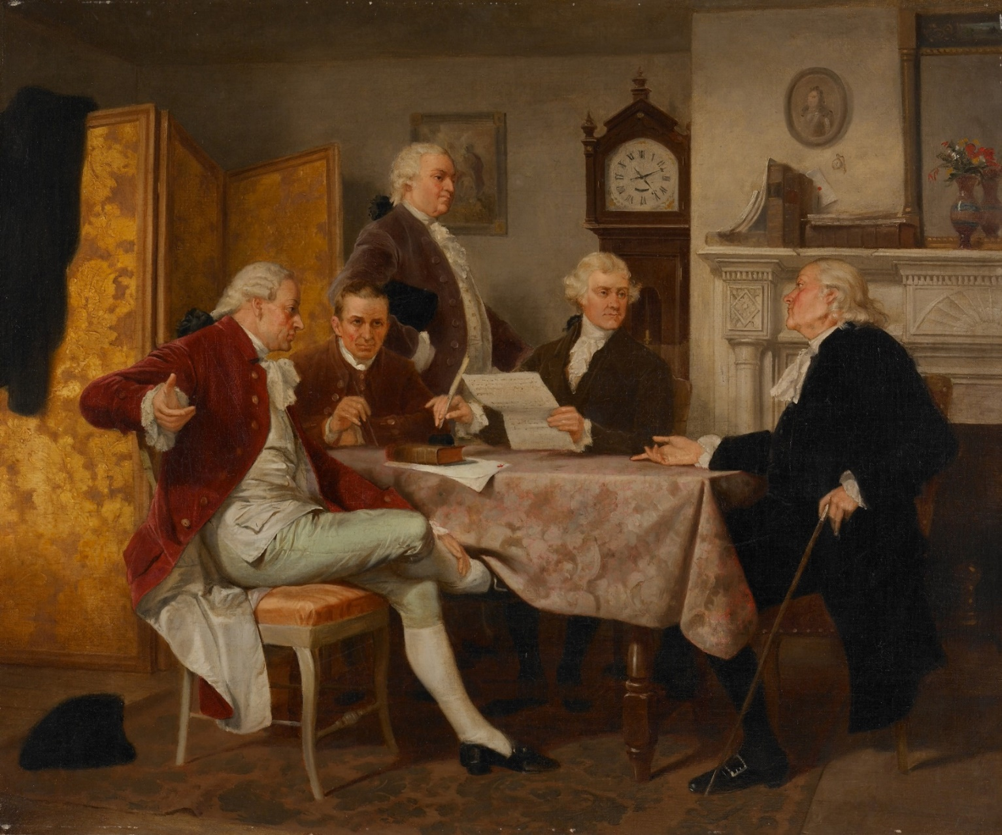
Drafting the Declaration of Independence,
Alonzo Chappel (1857)

Slide 17
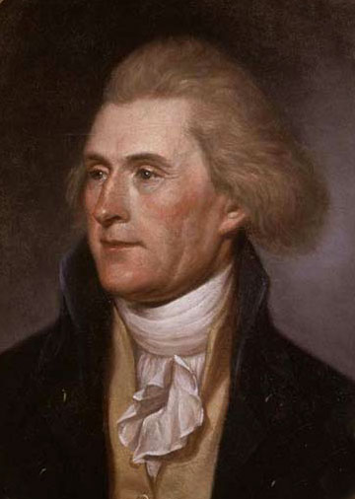
Thomas Jefferson
Charles Willson Peale (1791)

Slide 18
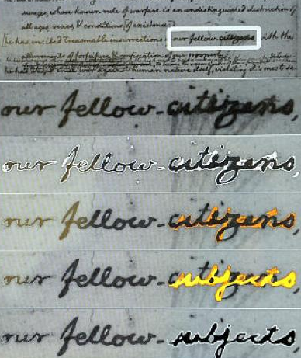
Library of Congress
computer imaging
Jefferson draft of
Declaration of
Independence

Slide 19
Declaration of Independence
27th (final) grievance against George III
He has excited domestic insurrections amongst us, and has endeavored to bring on the inhabitants of our frontiers, the merciless Indian savages, whose known rule of warfare, is undistinguished destruction of all ages, sexes and conditions.

Slide 20
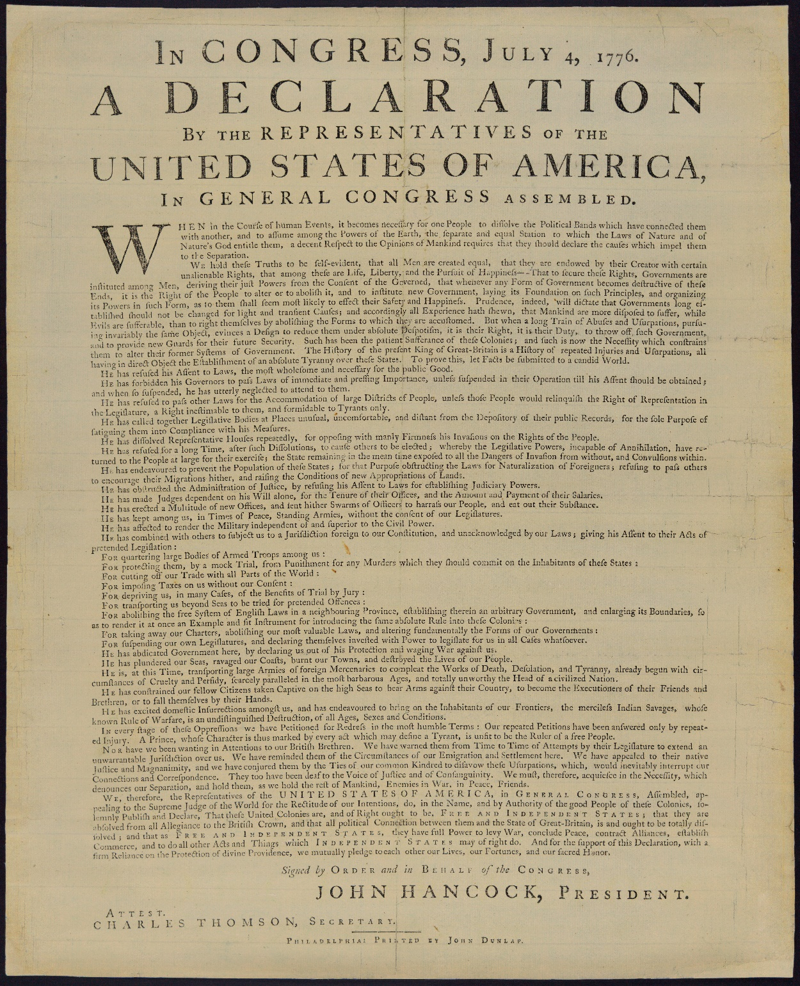
Dunlap printing of the
Declaration of Independence,
July 4/5, 1776

Slide 21
THANK YOU!

