Slide 1
The Articles of Confederation
Denver Brunsman George Washington University

Slide 2
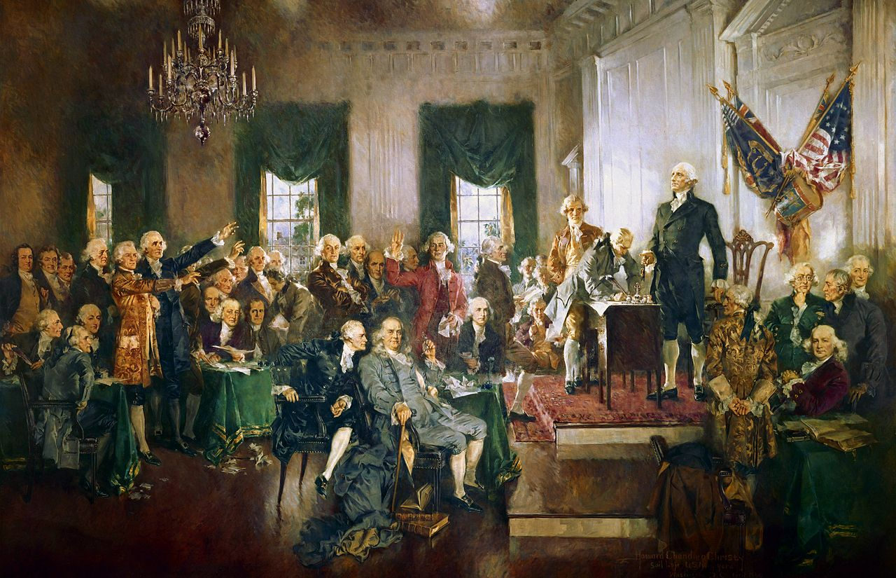
Scene at the Signing of the Constitution of the United States
Howard Chandler Christy (1940)

Slide 3
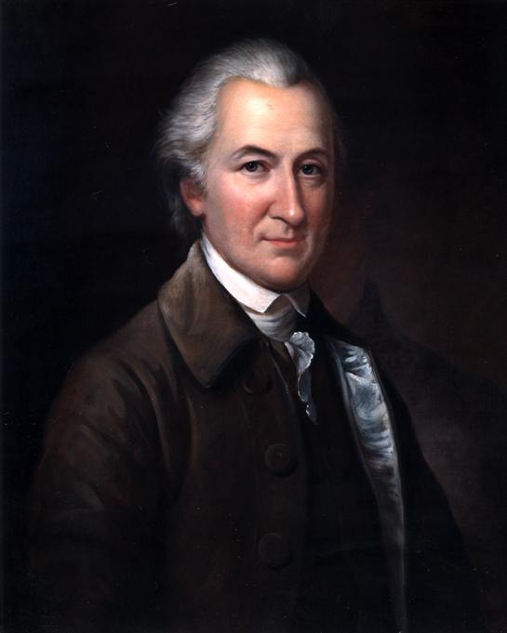
John Dickinson
(1732-1808)

Slide 4
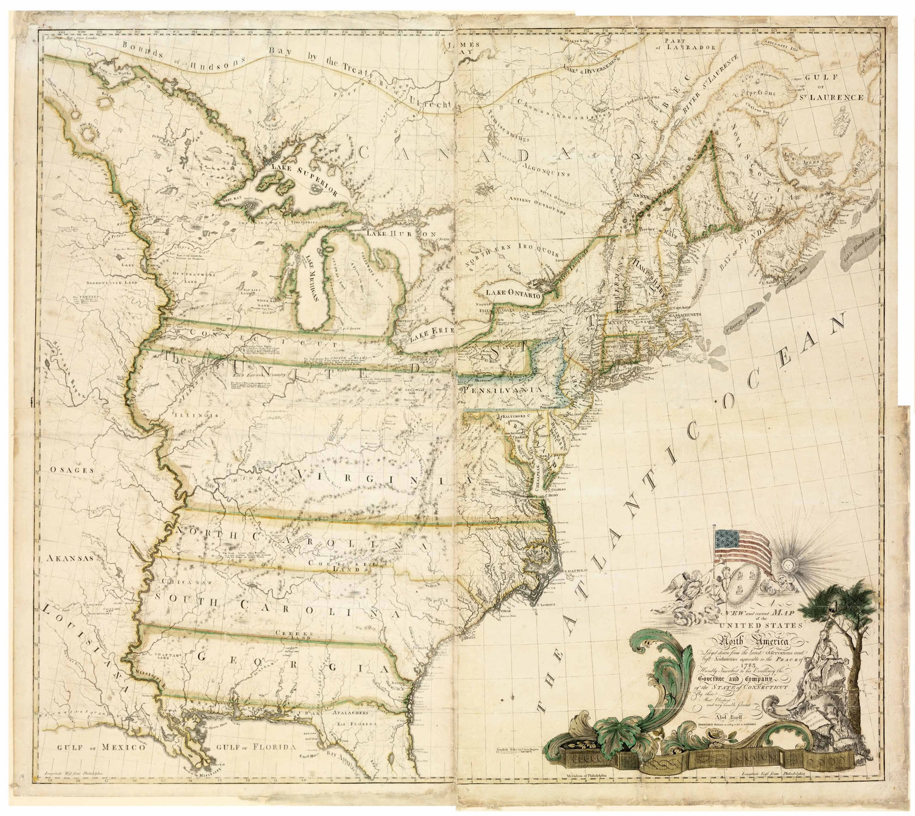
Abel Buell, A New and
Correct Map of
the United States of
North America (1784)

Slide 5
Limits of the Articles of Confederation
Congress lacked power to collect taxes
Congress could not regulate interstate trade
No executive (weak central government)
No national judiciary
No single national currency (each state had its own currency)
Super majority needed for consequential votes (9 of 13 states)
Articles could not be amended without unanimous vote (all 13 states)

Slide 6
The Price of Independence:
American Debt after the Revolutionary War
National: £28,000,000 (1787)
Foreign: £10,275,000 (1788)
State: £4,250,000 (VA in 1784)
Private: problem of bankruptcies & foreclosures

Slide 7
Powers of Congress under
the Articles of Confederation
Raise a national army and navy and conduct war
Conduct the nation’s diplomacy and enter into treaties, including with Native Americans
Regulate the value of coins and standard weights and measurements
Manage the postal service
Incorporate new states and solve boundary disputes

Slide 8
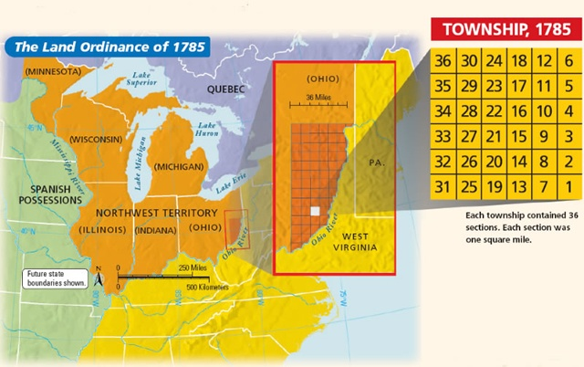

Slide 9
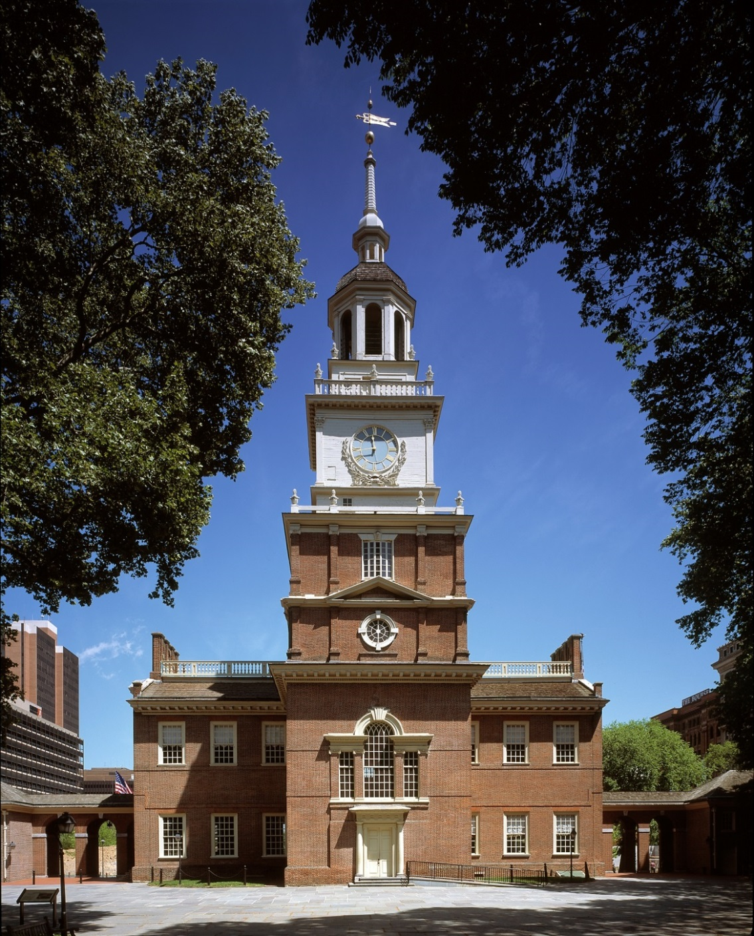
Pennsylvania State House
(Independence Hall)

Slide 10
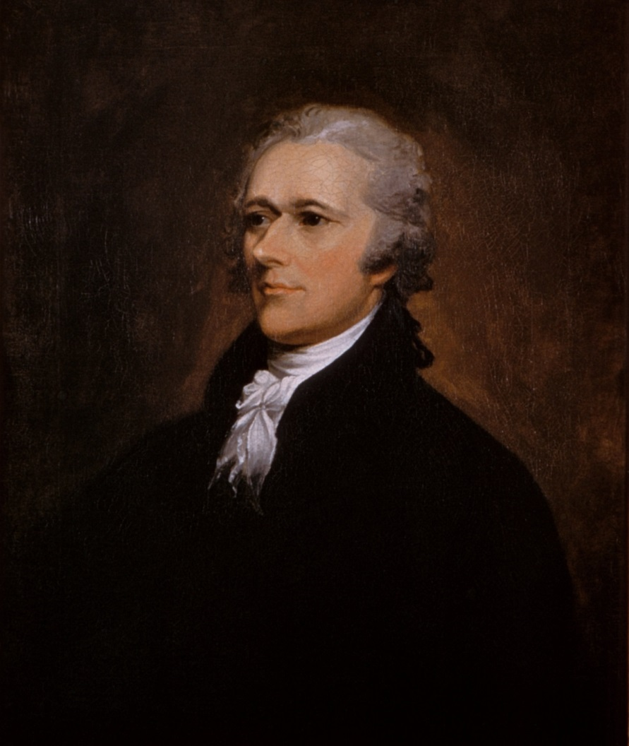
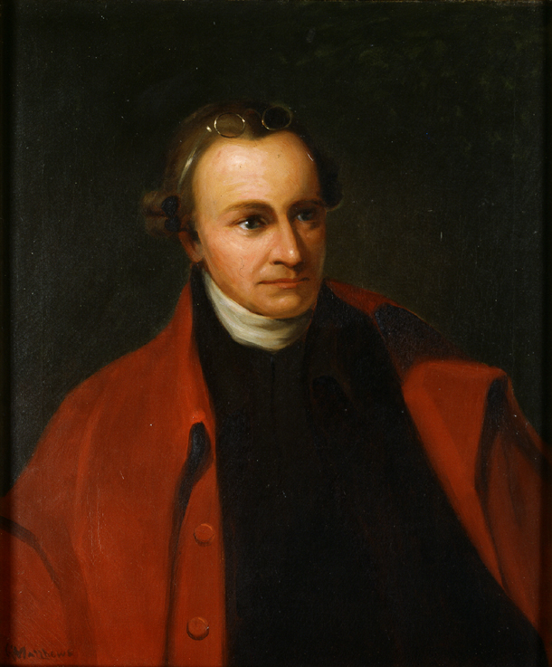
Cosmopolitans Localists
Alexander Hamilton Patrick Henry

Slide 11
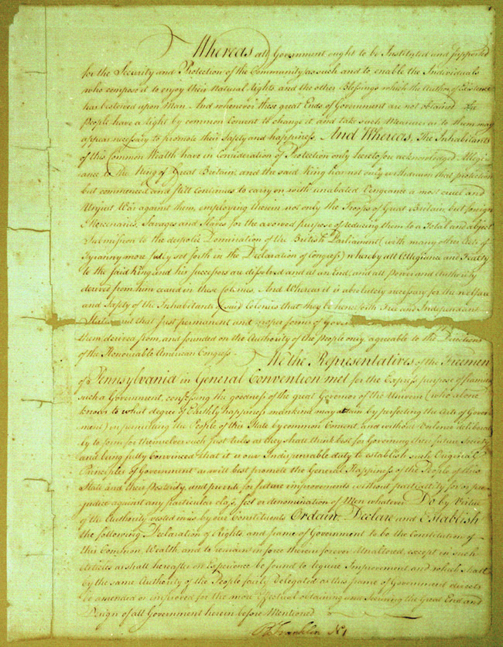
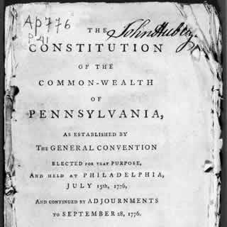
Pennsylvania State
Constitution of 1776

Slide 12
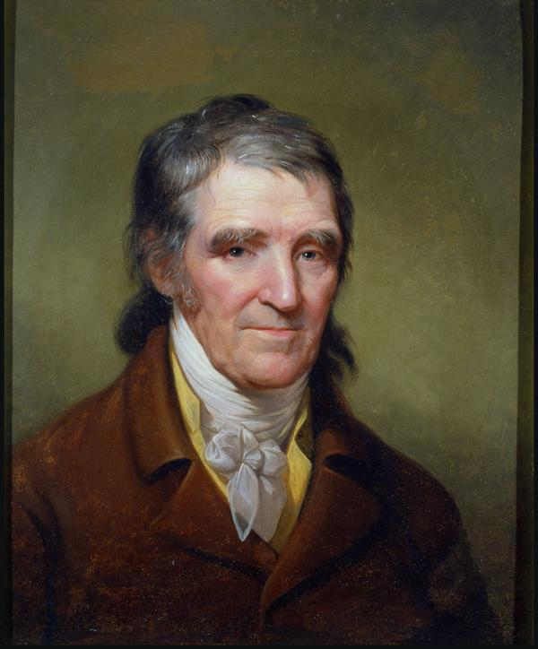
William Findley
Rembrandt Peale (1805)

Slide 13
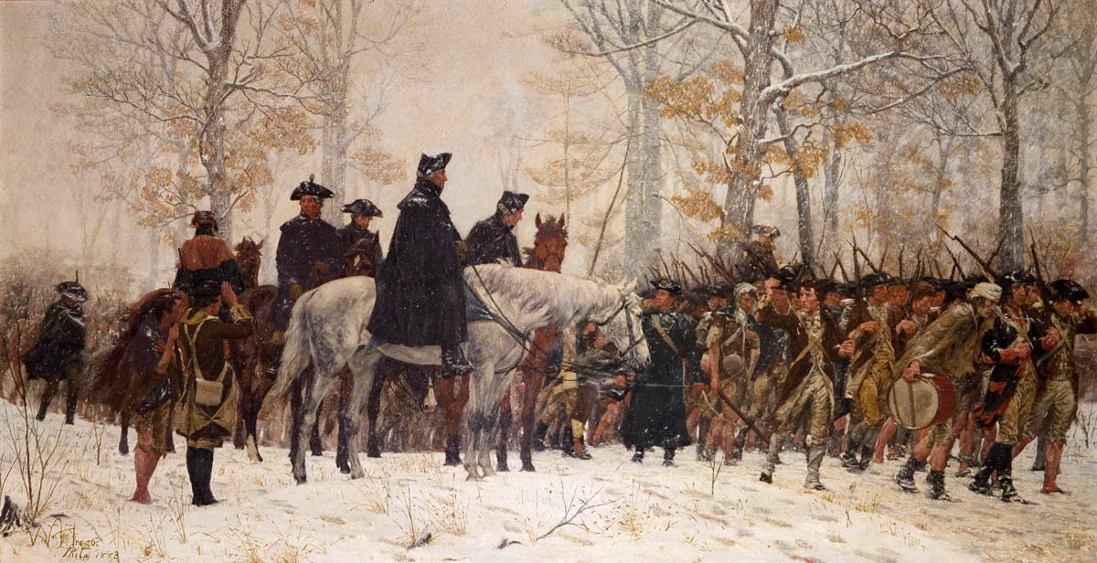
The March to Valley Forge
William B. T. Trego (1883)

Slide 14
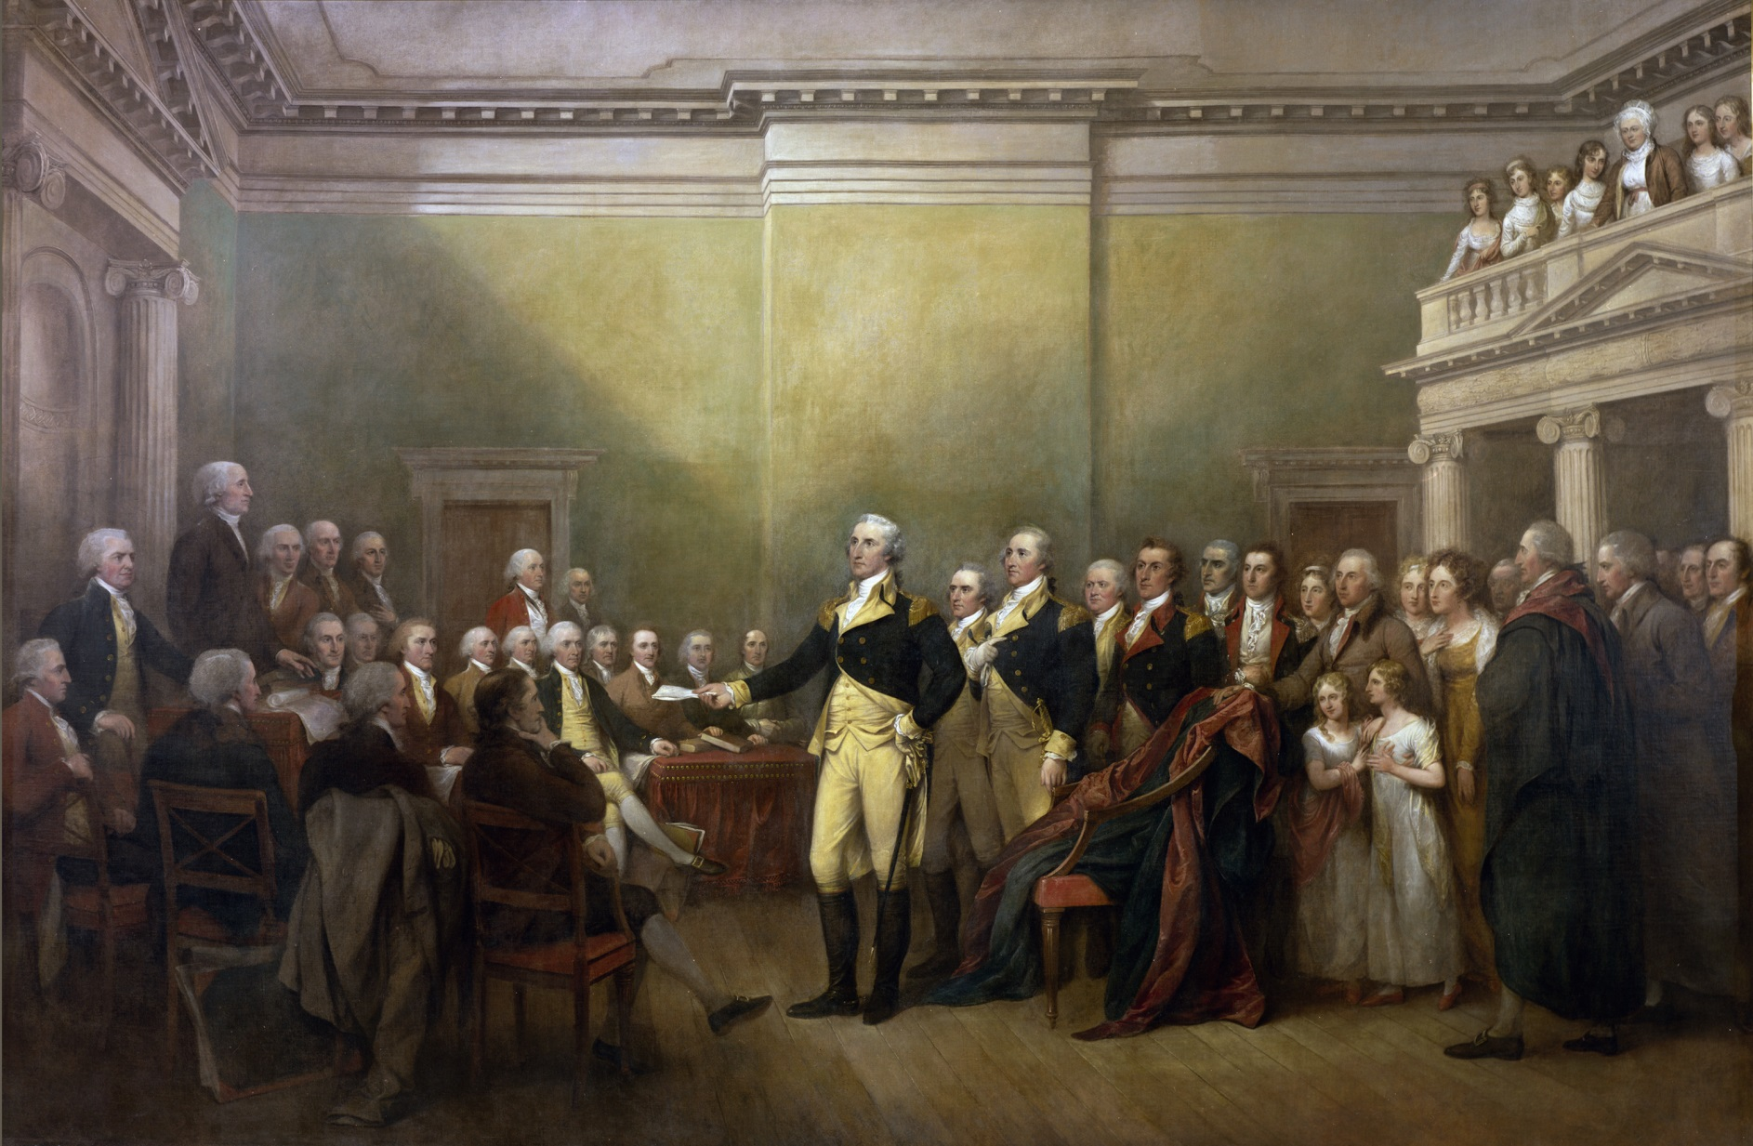
General George Washington Resigning His Commission
John Trumbull (c. 1824)

Slide 15
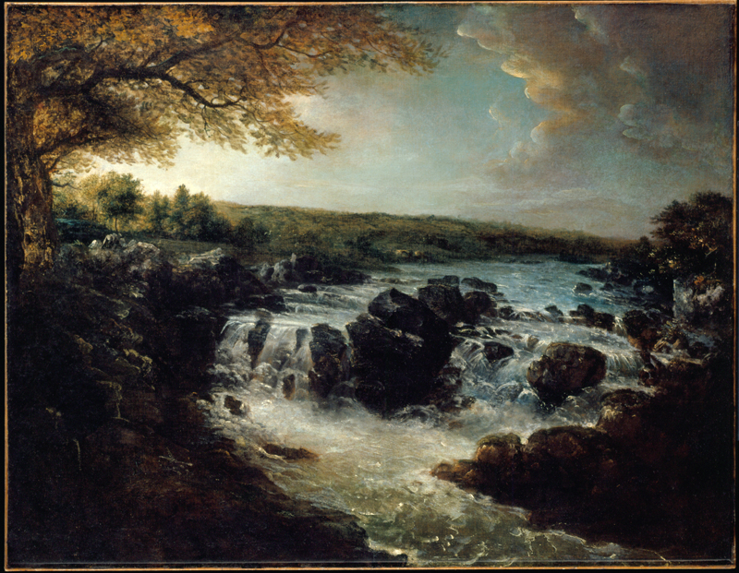
The Great Falls of the Potomac
George Beck (1797)

Slide 16
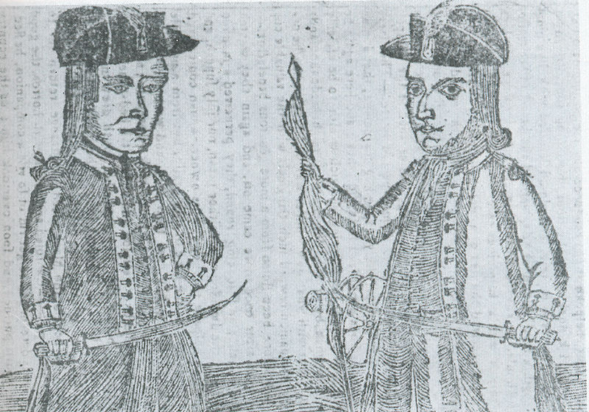
Depiction of Daniel Shays and Job Shattuck,
leaders of the Mass. “Regulators” (1787)

Slide 17
The Road to Philadelphia
Mount Vernon Conference (March 1785)
Annapolis Convention (September 1786)
Shays’ Rebellion (August 1786-Februrary 1787)

Slide 18
thank you

