Slide 1
Anglo-americans in Texas

Slide 2
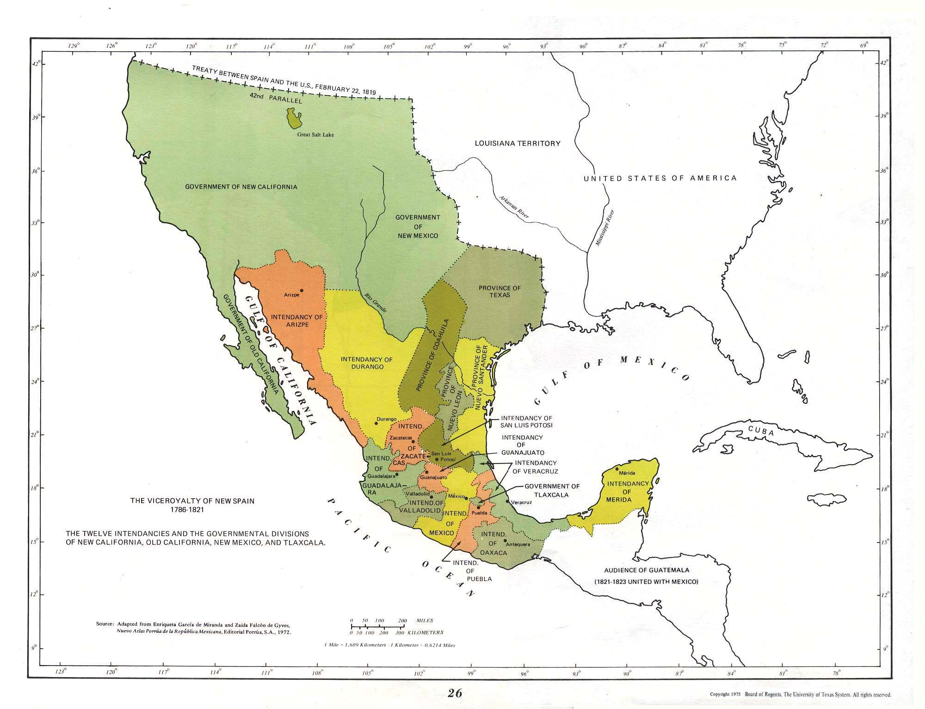
Notes:
New Spain

Slide 3
Mexican Wars for Independence, 1810-1821

Slide 4
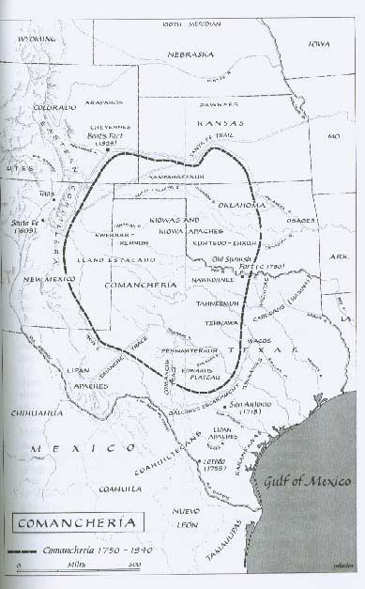
The Comanche Empire

Slide 5
Texas, ca. 1821

Slide 6
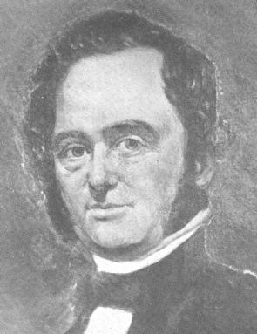
Moses
Austin

Slide 7
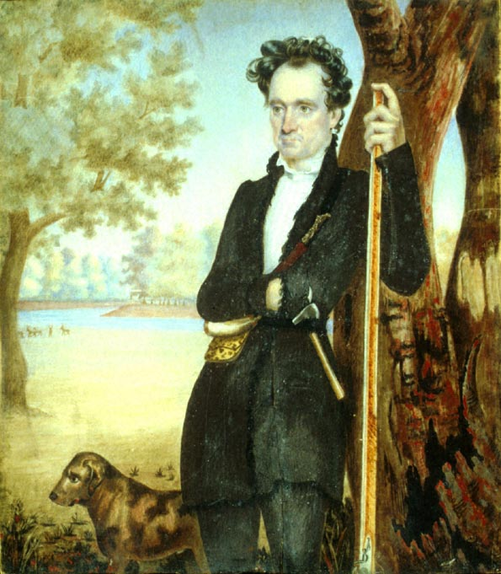
Stephen F.
Austin

Slide 9
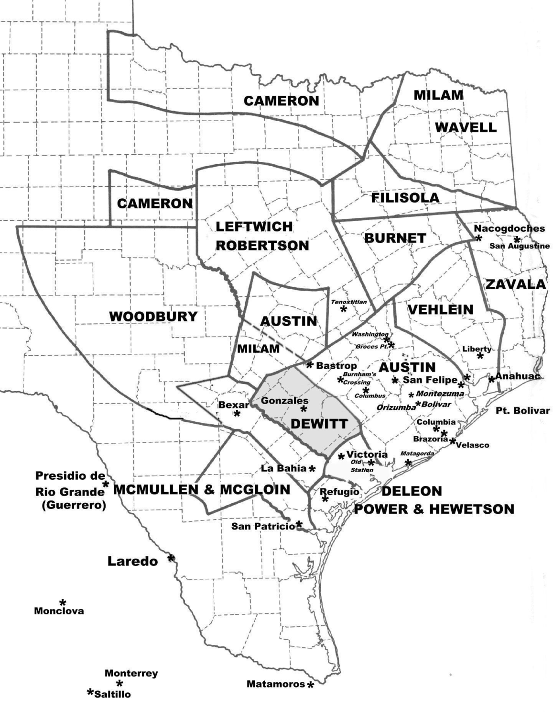
Empresario Grants

Slide 10
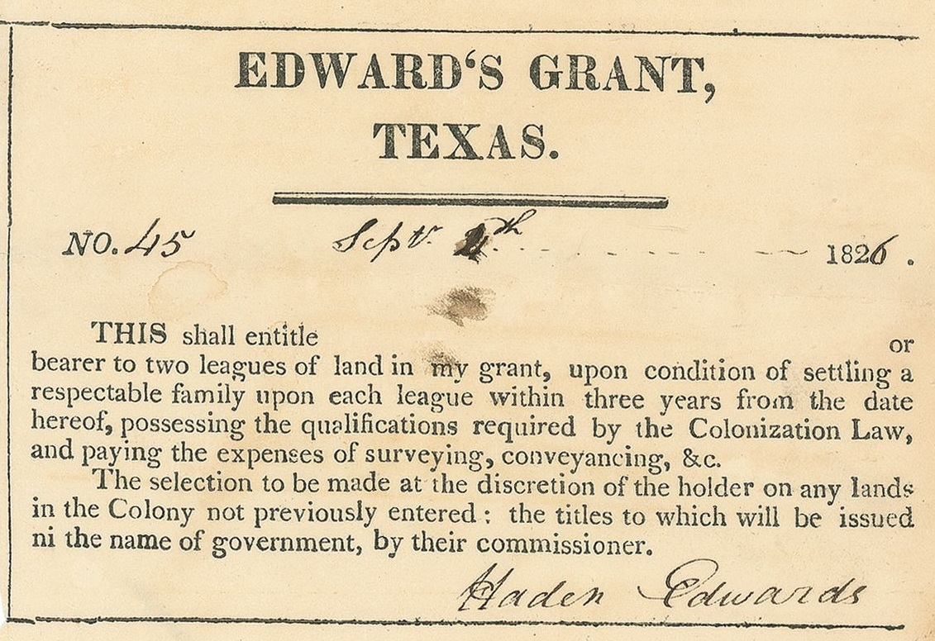

Slide 11
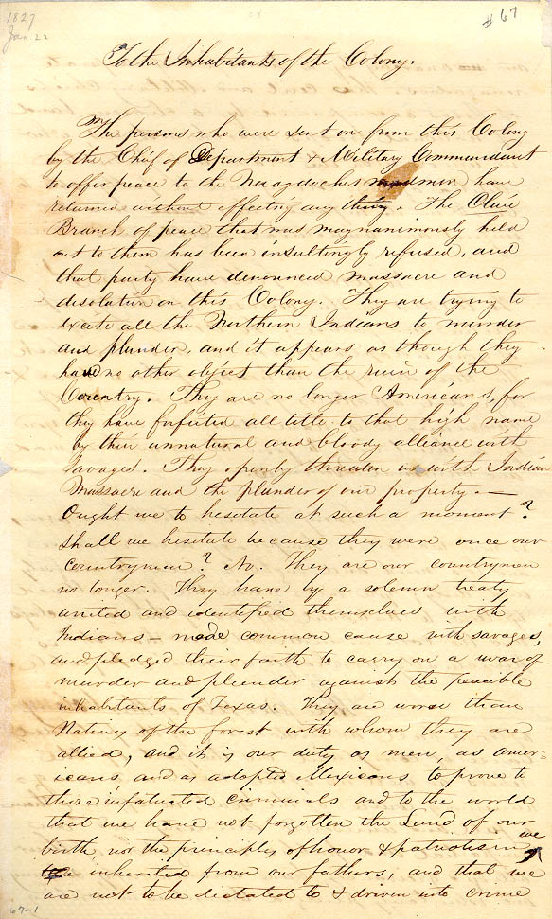

Slide 12
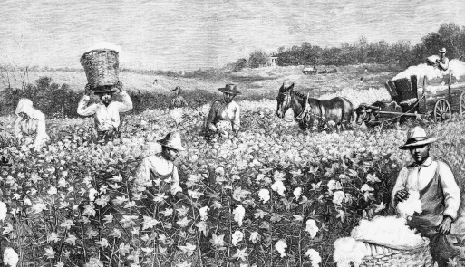

Slide 13
Manuel de Mier y Terán

Slide 14
TAKEAWAYS
Think of Texas, 1821-1835 as a borderland
Put Texas in global context
Avoid old chauvinistic tropes

Slide 15
Anglo-americans in Texas

