Slide 1
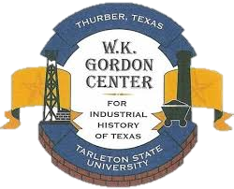
Deborah Liles, PhD Tarleton State University
Cattle and Railroads in Texas

Slide 2
Question for you:
How does Texas history connect to the larger history of America and why is that important to consider when we teach?

Slide 3
Texas Longhorn
Iberian stock
Hardy
Could kill a coyote
Can go for 4 days without water
Eats scrub brush
High immunity
Easy births
Low maintenance

Slide 4
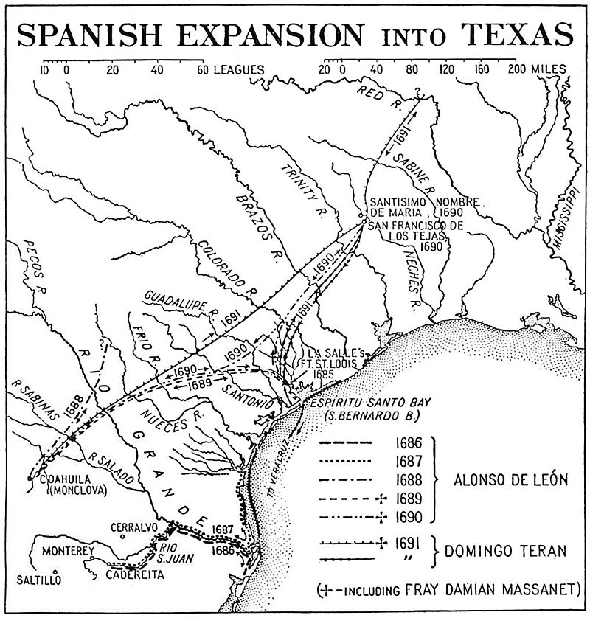
Bringing cattle to Texas.
Sp ranching (men and women) est. nearly 100 yrs before Anglos arrive
Alonso de León, 1686, males and females from Río Grande to Neches to repopulate.
Gov. Domingo Terán - to first ranching centers at east Texas missions. Abandoned in 1693, cattle left behind.
March 1721, Marqués de Aguayo expedition drove 2,800 horses, 4,800 cattle, and 6,400 sheep and goats to Béxar.
By 1750s, 1,000s of livestock –horses, cattle, sheep, and goats – along rivers around San Antonio and south.

Slide 5
Est. of large Sp. ranches - became elite class, houses, peóns.
Tomás Sánchez, Laredo’s founder, and Vázquez Borrego partnered and set up ranch on north of Rio Grande.
1st drive out of Texas during the American Revolution, 1779
LA gov, Bernardo de Galvez, Opelousas Trail
2,000 cattle to Sp. troops from SA region. Over the next 3 yrs, 10-15k more
Letters authorizing first cattle drive from Texas. Bullock Museum.

Slide 6
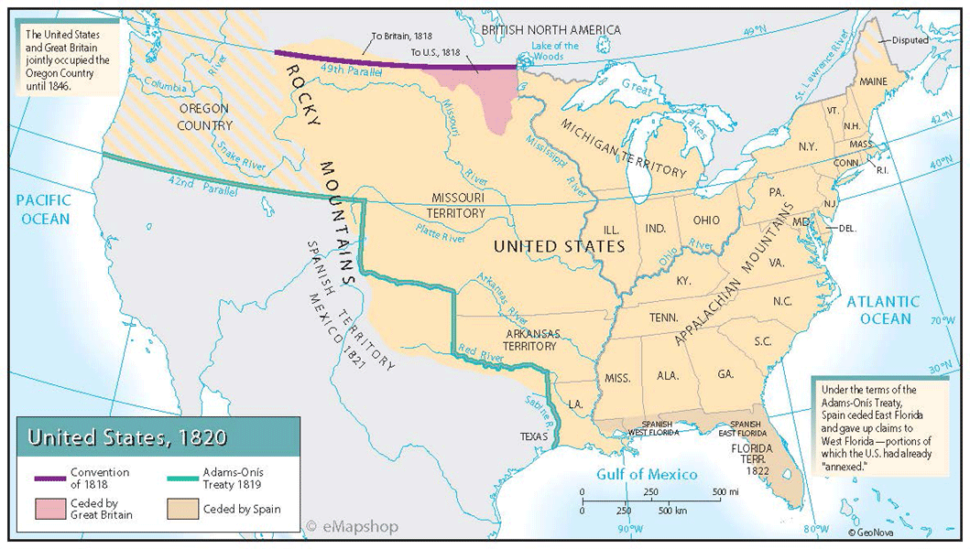
Livestock, Grains, Upper South
Cotton, Rice, and Sugar Lower South

Slide 7
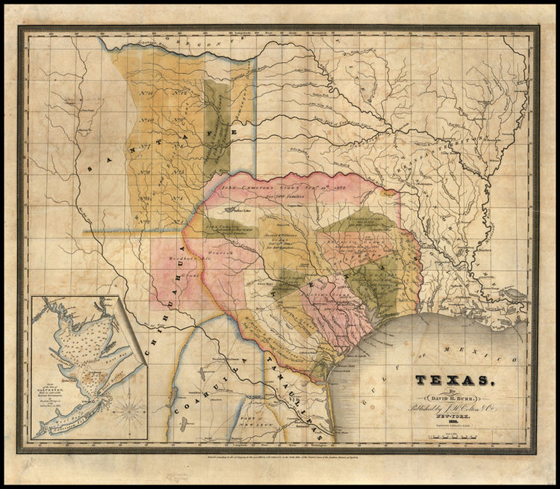
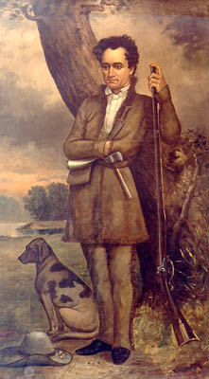
Tejas Stephen Fuller Austin - 1821
22:1
4:1

Slide 8
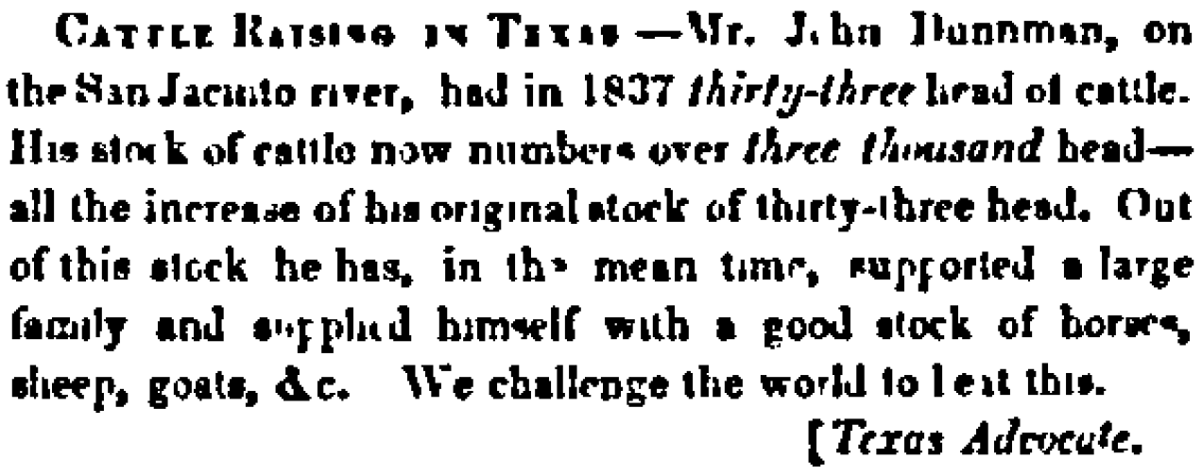
Daily National Intelligencer, Washington D.C.,
December 8, 1849, from the Texas Advocate.
John Dunman, on San Jacinto River
33 head of cattle in 1837
12 yrs later = 3,000 head
After supporting himself and family
“We challenge the world to beat this.”
Trading with the South = $$$$
Texas is a prime location for raising cattle.
What else happens in 1849?

Slide 9
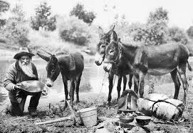
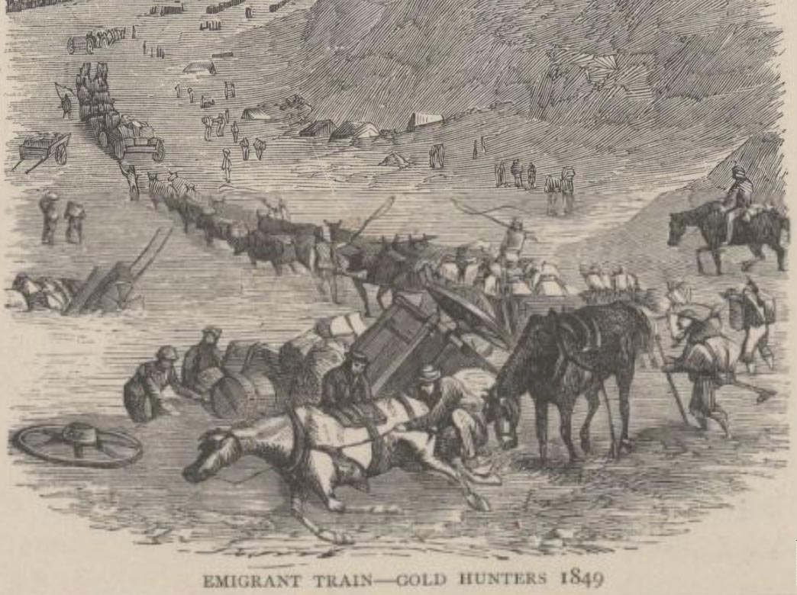
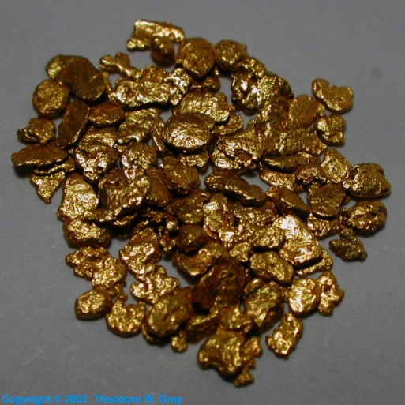
Bonanza hits in 1848 with the discovery of gold at Sutter’s Post.
Gold rush in CA. Use of livestock by Argonauts.

Slide 10
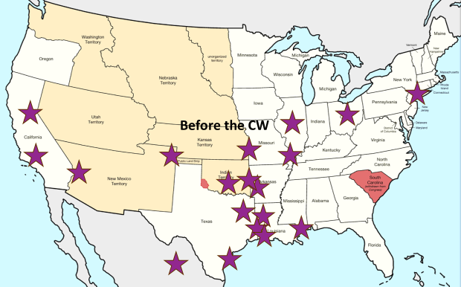
Markets
Ohio in 1846 and through 1861
Illinois in 1850s
Up the western frontier to get to CA (Ill, Ark, Missouri)
IT to feed Indians and gov’t
Colorado after 1859
N.O., Memphis, Biloxi, Alexandria
William Bellinger
Gonzales County
(May 30, 1858)
to Chicago Illinois
(Oct 20, 1858).
Rare account.

Slide 11
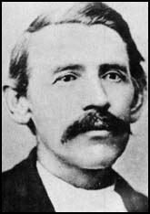
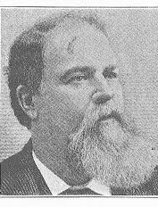
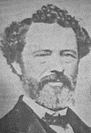
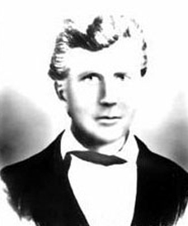
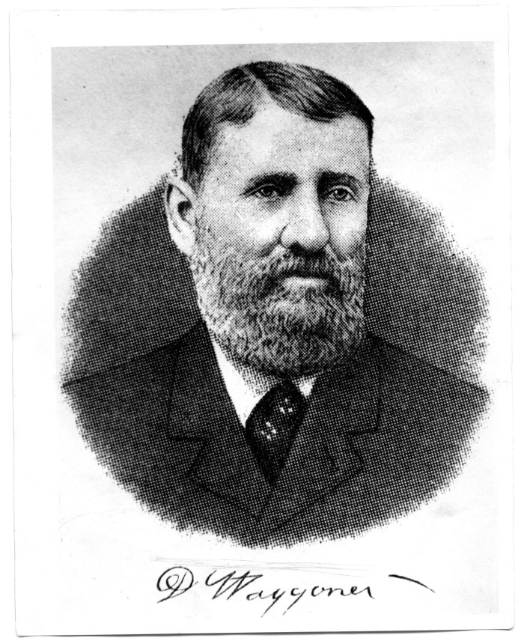
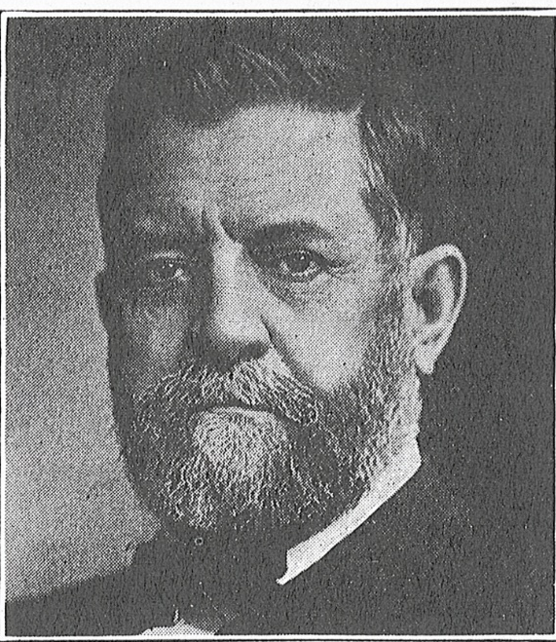
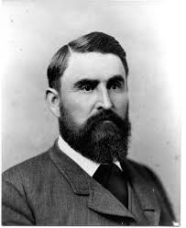
Oliver Loving
John Simpson Chisum
C. C. Slaughter
John Hunter Herndon,
richest man in 1860
George West

Slide 12
Post war
Men returned from war and capitalized on pre-war/war time trade.
Formed new national identity
Both N and S need beef, west too!
S devastated. Pork depleted or gone.
Beef becomes the new main course
260k Tx cattle moved north in 1866
By 1885, 5 mil + moved north

Slide 13
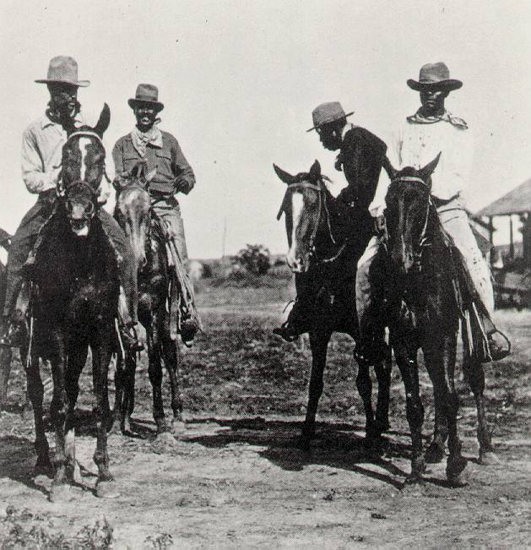
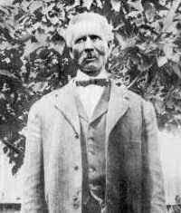
Black cowboys (not sharecroppers)
Pay often = to white cowboys – paid for their experience, not their color.
Est. 1/3 men = person of color up the trail
Doesn’t include those working on ranches
Bose Ikard
Frank Chisum
John Chisum
$66k in livestock 1864 $1 mil in 2017 money

Slide 14
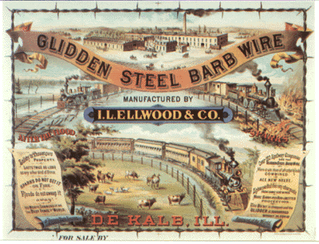
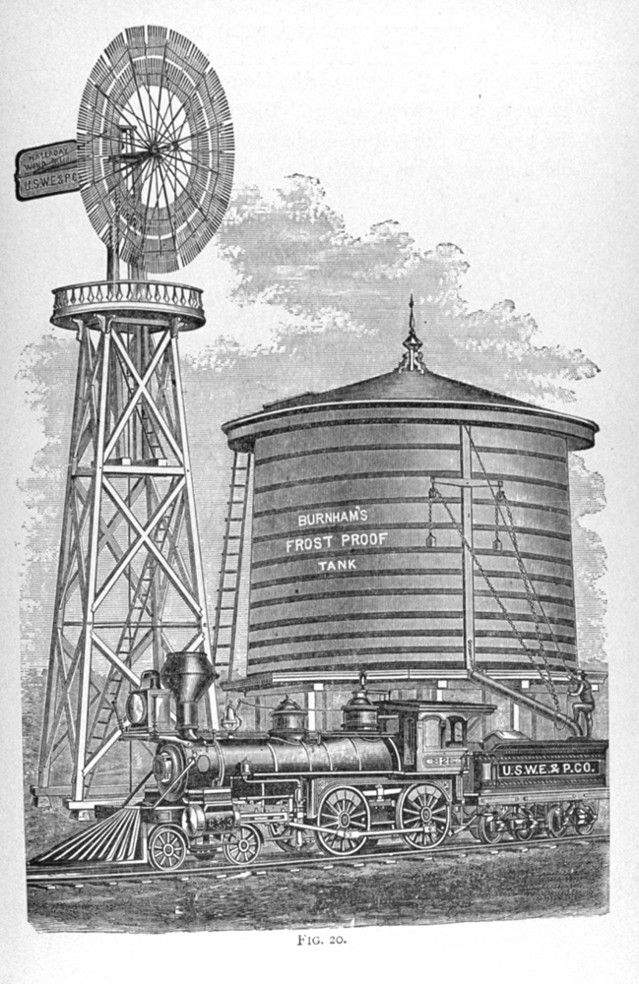
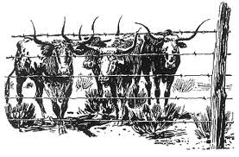
Glidden, 1874
People were skeptical
John “Bet-a-million” Gates
San Antonio to sell wire.
Barbed wire enclosure.
By 1876, nearly 3 mil #s barbed wire produced.
Daniel Halladay patented windmill in 1854.
-water access restricted bc barbed wire
-Provided water across the west to travelers, trains, and livestock.
XIT installed over 335 windmills.
Images from http://99percentinvisible.org/episode/devils-rope/

Slide 15
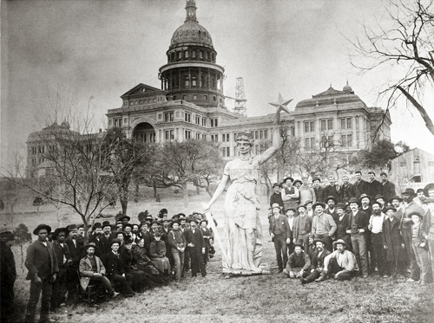
Barbed wire ended open range and smaller ranchers, created larger ranches Big business, not smaller ranchers
XIT Ranch 3.1 mil acres
JA 1.3 mil acres
King Ranch 1.1 mil acres
Matador Ranch 861k acres
https://slideplayer.com/slide/4505353/

Slide 16
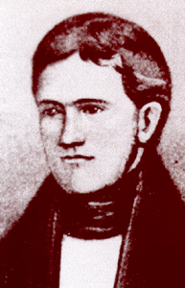
Andrew Briscoe Texas Railroads
In 1839, cattle trading, began planning a RR – including a line that went to California.
Charter granted by the Republic of Texas, January 9, 1841.
Couldn’t sell land in Harrisburg to pay for RR ties, as it was uncertain if Mexico would invade.
Courtesy of Find a Grave.

Slide 17
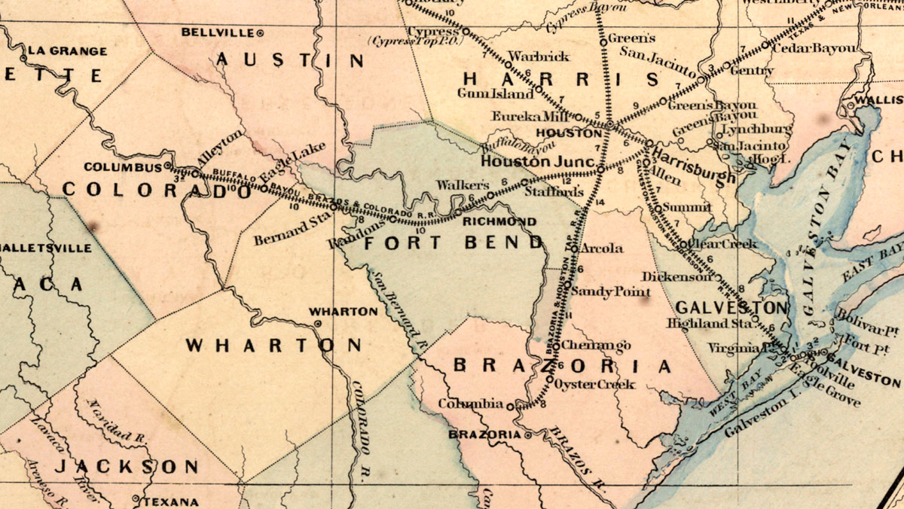
Asher & Adams 1871 Railroad map.
August 1, 1853, 20 miles of track from Harrisburg to Stafford. BBQ to celebrate.
By 1855, Texas legislature passed acts to help build RRs.
Loan of $6k per mile
Alleyton opened by fall 1860 – 80 miles from Harrisburg.
Rail extended to Columbus during the war – 2.5 miles.
Alleyton, Sally Scull, and cotton during the war.
Image from Texas Transportation Archive

Slide 18
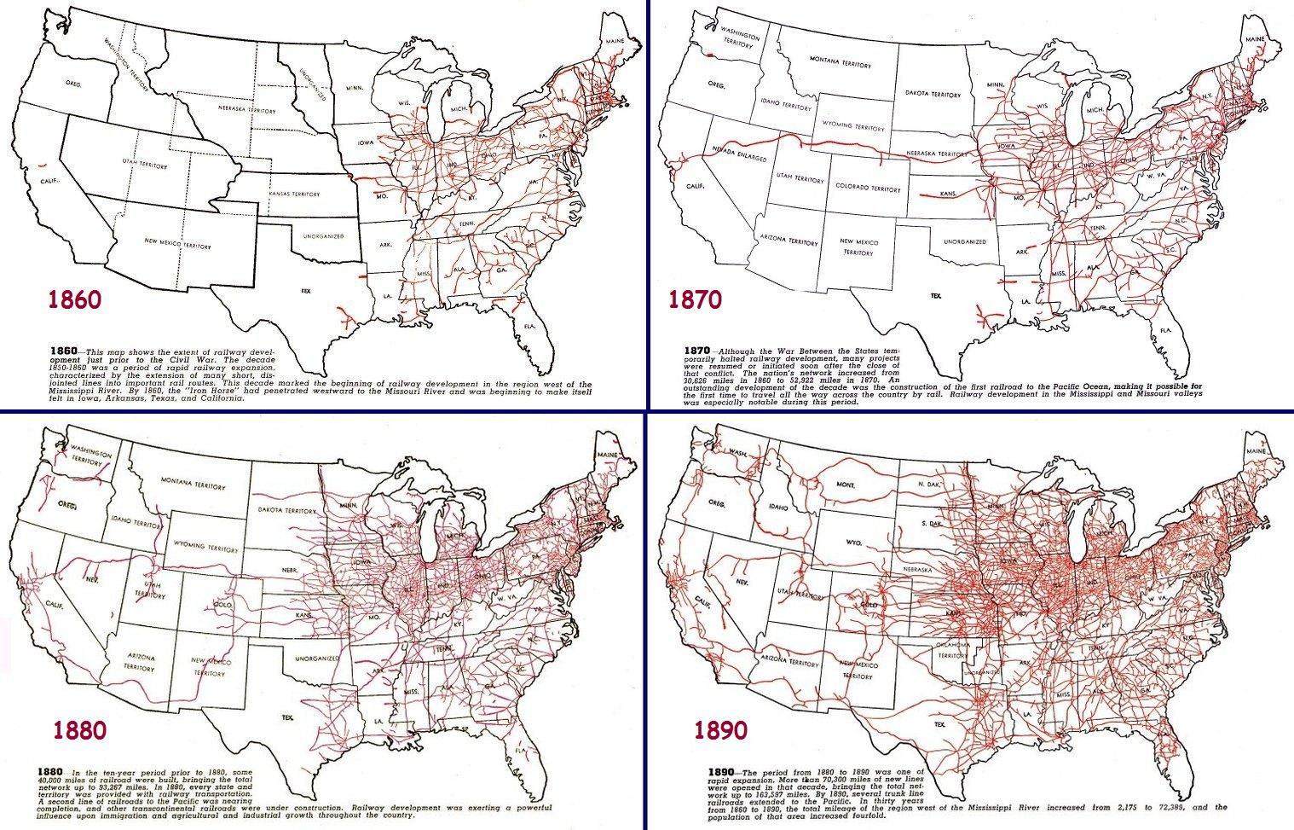
Railroad development in Texas was woefully slow, but not unlike the rest of railroad development in the South.
Gov. Jim Hogg
Promised RR regulation
created TX RR Com in 1891
John Reagan will be chair
Conservative focus on rates and stock, not working conditions.
Grew the state economy by helping manufacturers.

Slide 19
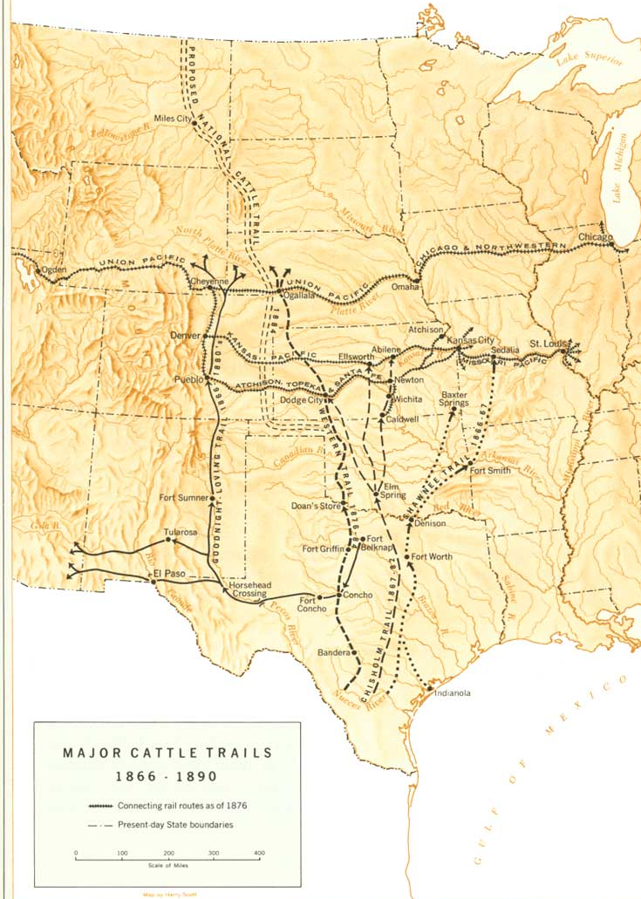
Cattle trails from 1866-1890 went to railheads outside of the state.
Moved west with development of RRs
Took livestock where needed:
- north/east after the war.
- west as migration increased
- to Indian Reservations
- and to mining settlements, like during California Gold Rush.
Image from the National Park Service

Slide 20
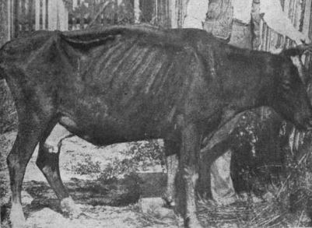
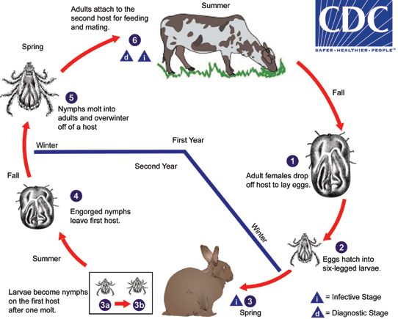
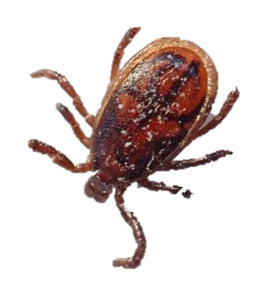
Texas Fever
Mysterious
cattle that contacted Texas cattle died.
MO outlawed Texas cattle in mid 1850s
Cattlemen skirted by boundaries (Bellinger).
Texas fever stopped when cattle stopped coming.
started again when drives started post war.
90% fatal to other cattle.
New quarantines instigated. Winchester Quarantine
The one that hurt the worst was in Kansas in 1885 – completely outlawed Texas cattle.
Instrumental in ending the cattle drives.

Slide 21
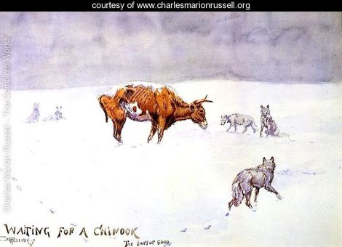
The big die-up – winter of 1885-87
Blizzards hit the southern plains
Cattle couldn’t escape barbed wire.
Huddled together
Crushed/froze to death
1,000s died
Panhandle lost up to 75% of their stock
Die-up followed by years of drought
Cattlemen lost all, others sold out and moved on.

Slide 22
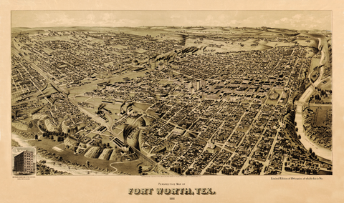
Began with Spanish ranching end with Fort Worth, aka “Cowtown.”
Fort Worth in 1876
Struggling to survive
Image from http://www.birdseyeviews.org/browse.php?city_select=all_cities&page=5
Fort Worth in 1891
What changed things?
Image from https://copanobaypress-gallery.com/products/birds-eye-view-of-fort-worth-1891

Slide 23
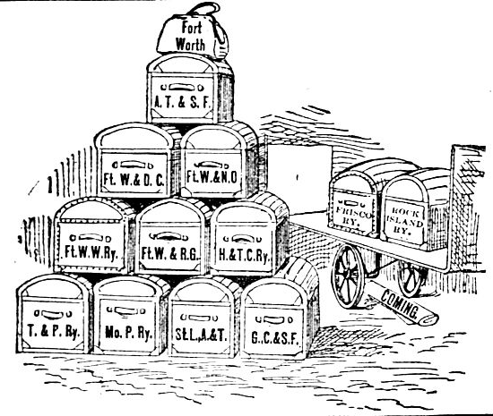
1886 – B.B. Paddock’s Tarantula map.
Thurber
Cartoon from 1888
Images from http://hometownbyhandlebar.com/?p=6609

Slide 24
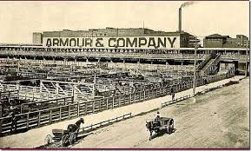
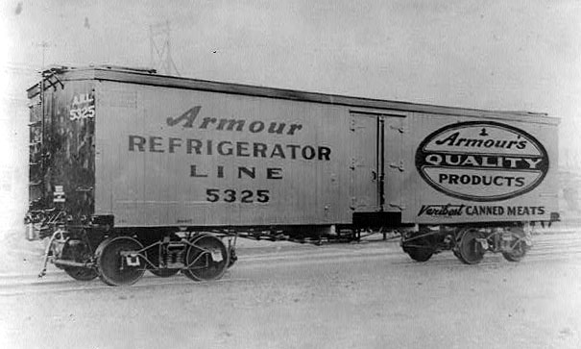
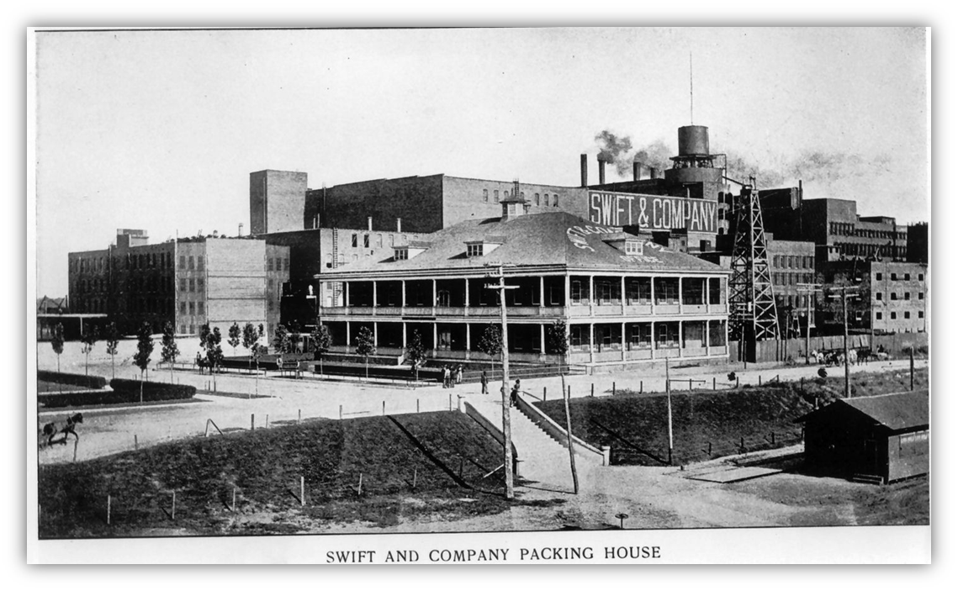
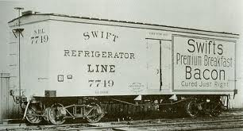
- Refrigerated rail cars patented in 1867
- Railroad arrived in Fort Worth in 1876
- Union Stockyards built in 1887
1900, Armour & Co and Swift & Co
FW becomes the Wall Street of the West
Today Texas still the #1 state for cattle - $10.5 billion – = to all other agriculture in the state.

Slide 25
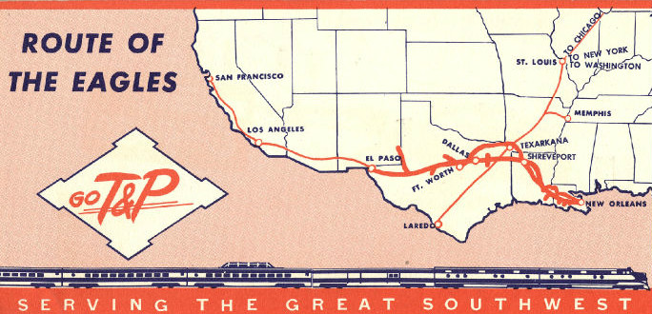
- 45% new track built after 1900
- TX first in US by 1911 and is still first (It’s a big state, y’all)
- Peak mileage in 1932 – 17k
- Trucks
- Remove tracks and building roads and hways instead.
Ira D. Dodge, 1926.

Slide 26
Back to our question: How does Texas history connect to the larger history of America and why is that important to consider when we teach?

Slide 27
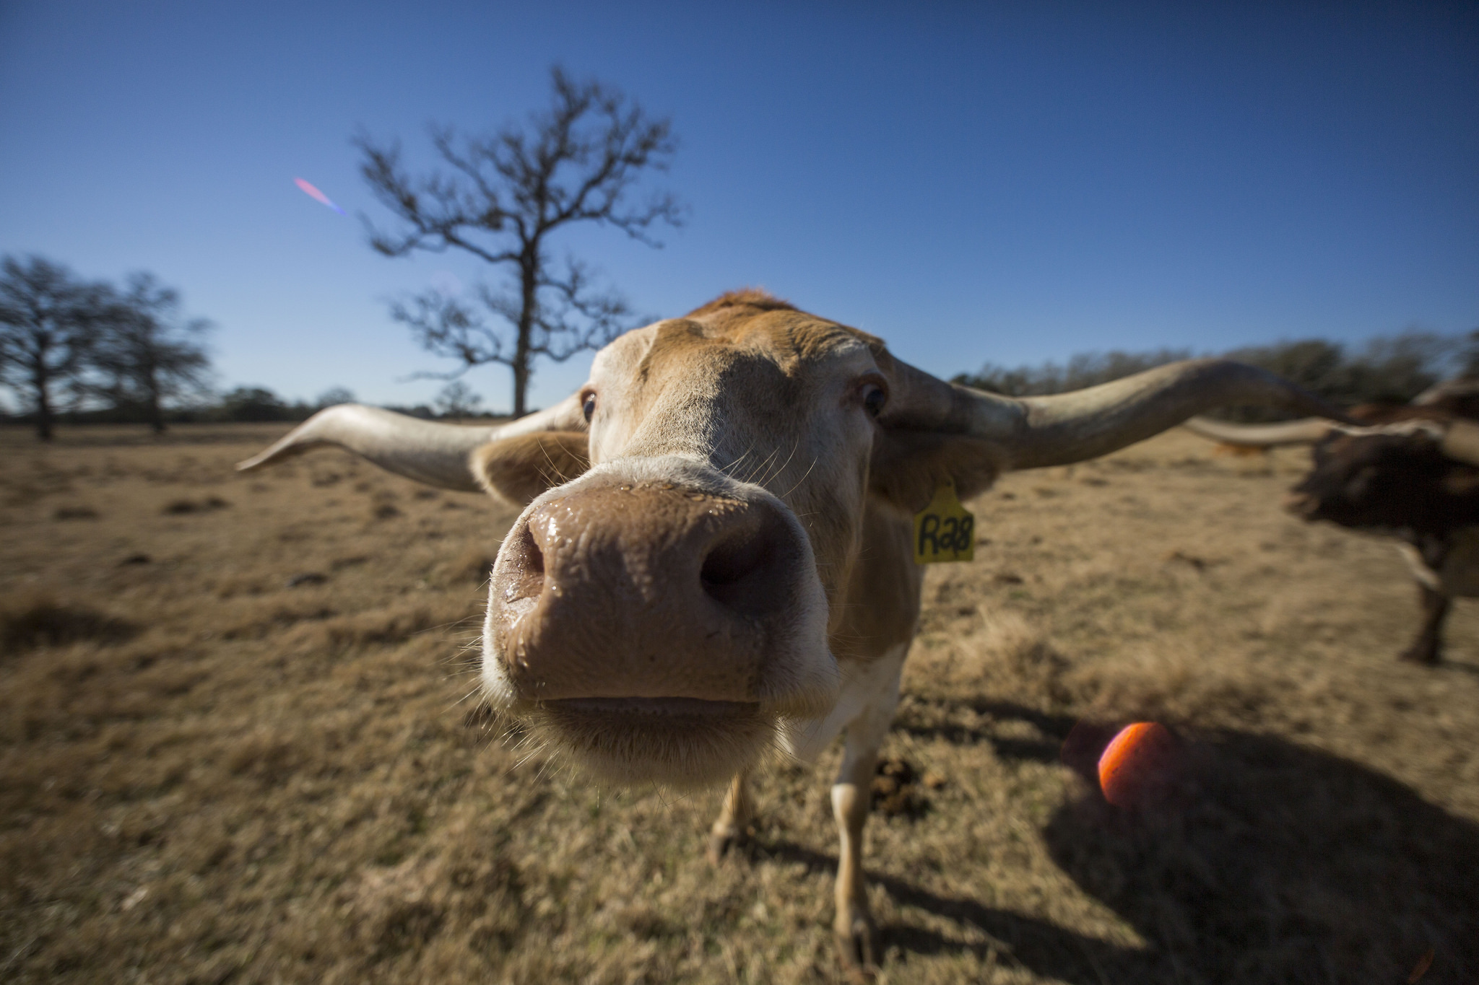
Questions?
☺
Questions?
☺

