Slide 1
Caught Between the Republic and the United States, 1836-1860
Humanities Texas Webinar Series
September 2021

Slide 2
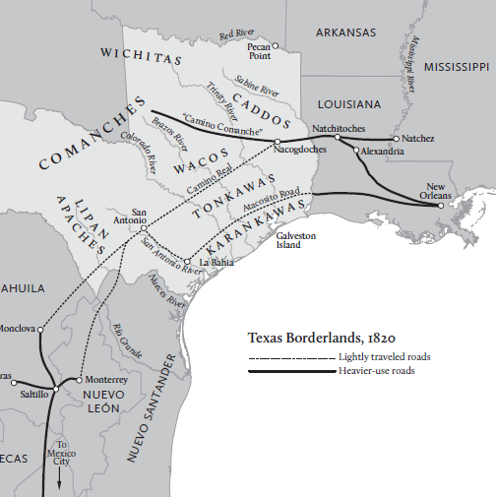

Slide 3
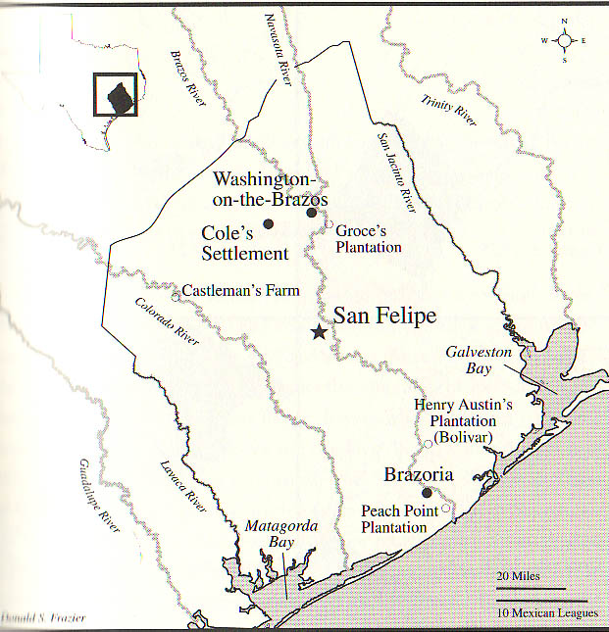
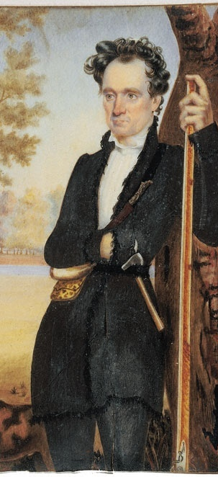

Slide 4
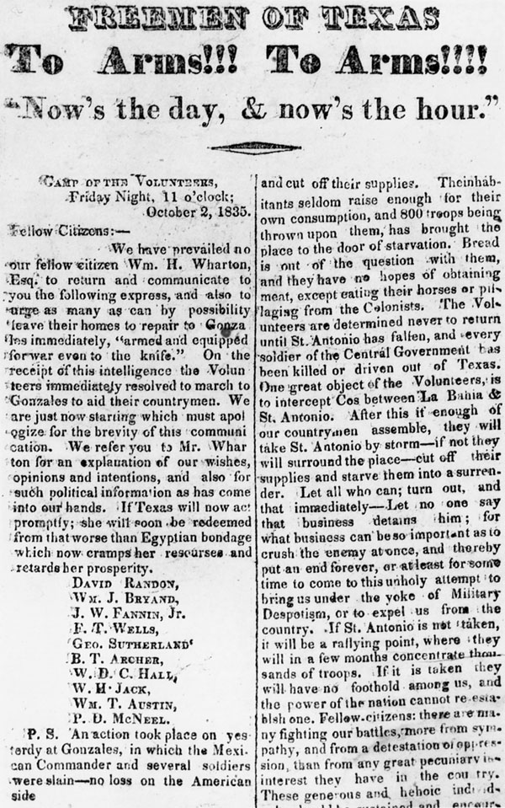

Slide 5
Essential Question #1:
How did the Texas Revolution and the emergence of the Republic change the power dynamic for American Indians in Texas?

Slide 6
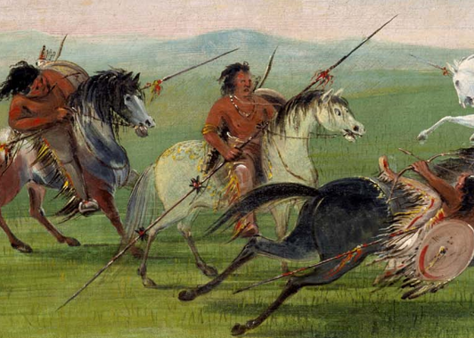
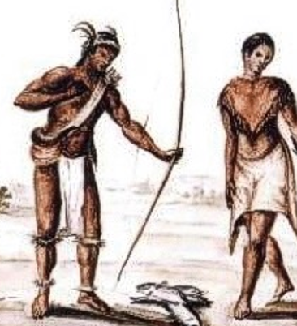
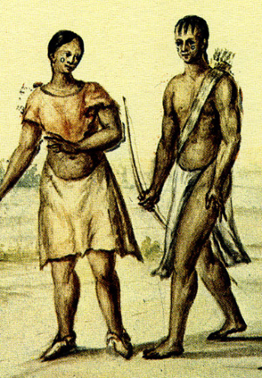
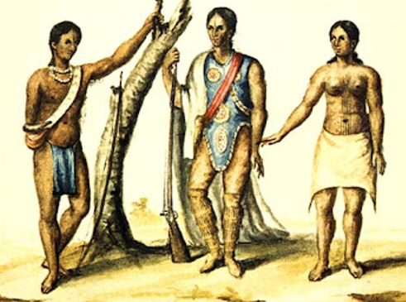

Slide 7
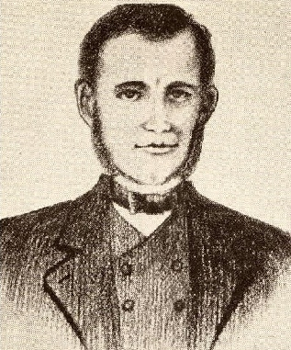
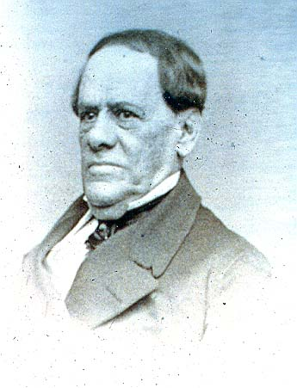
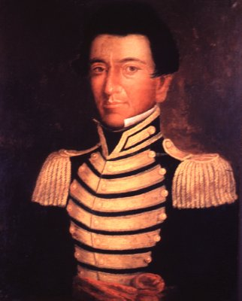

Slide 8
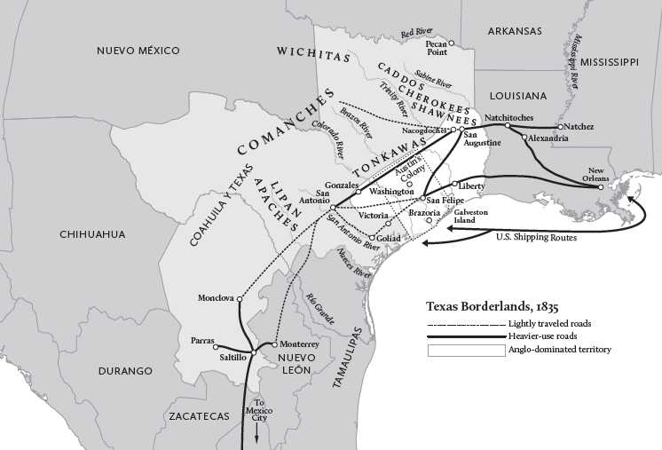

Slide 9
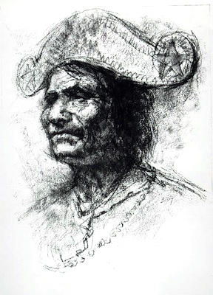
Chief Bowl or Duwali

Slide 10
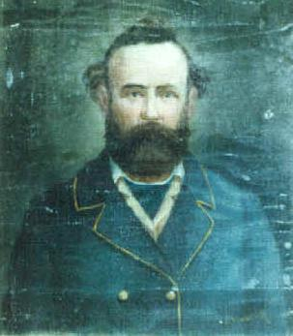
Domingo de Ugartechea
Chief Bowl or Duwali

Slide 11
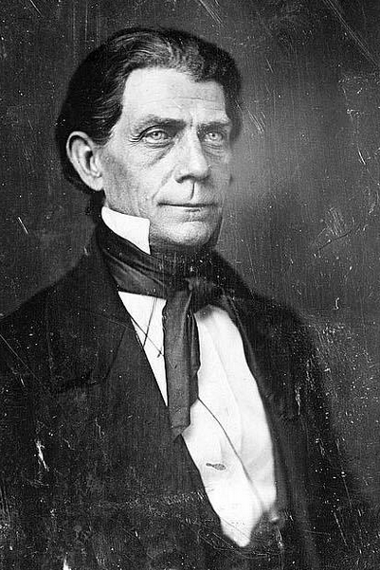

Slide 12
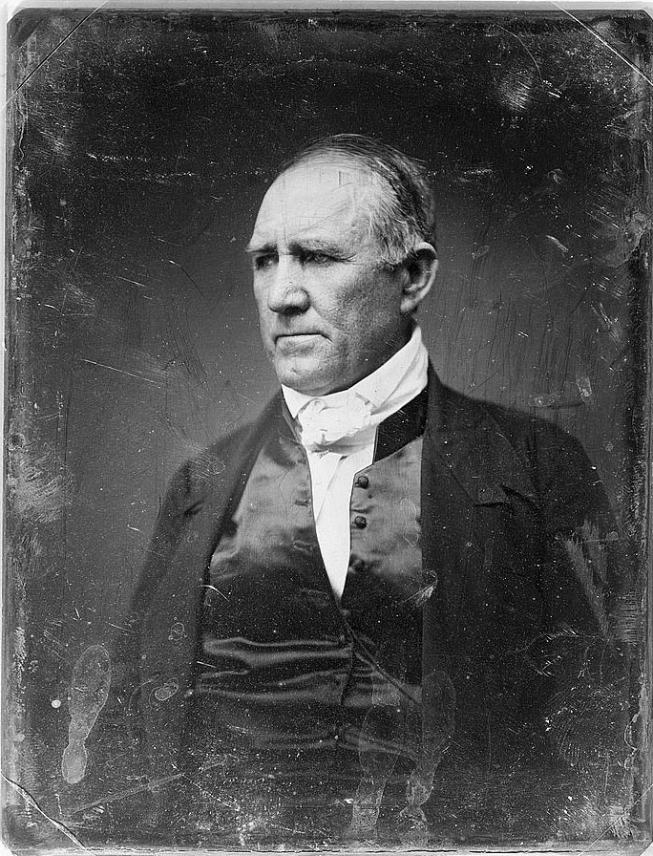

Slide 13
“a firm and lasting peace forever”

Slide 16
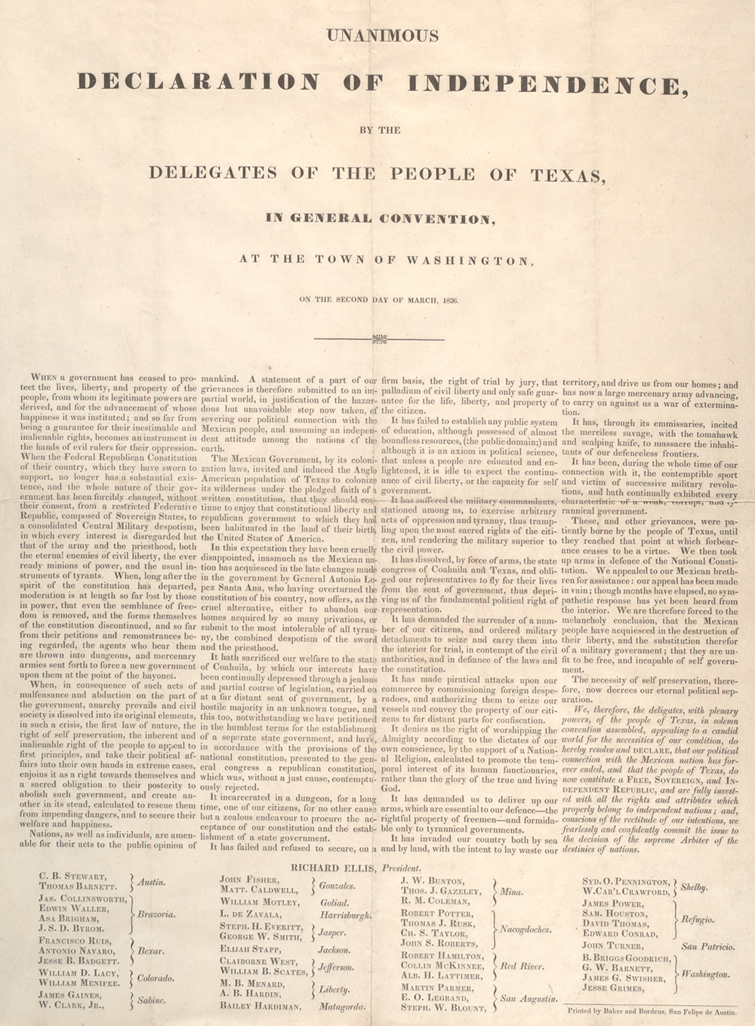

Slide 17
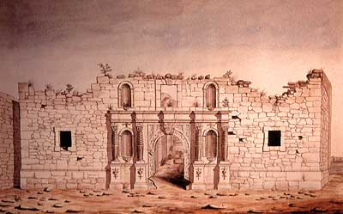

Slide 18
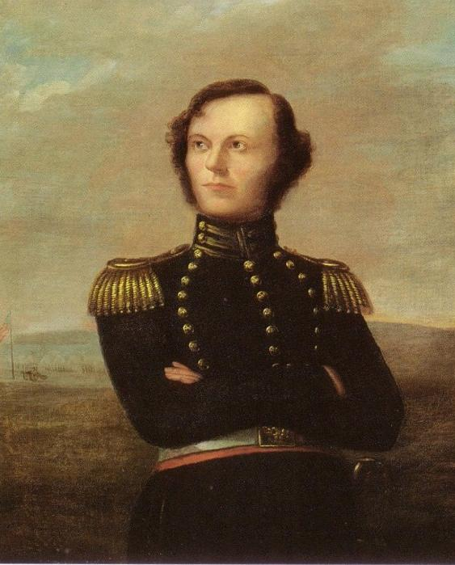

Slide 19
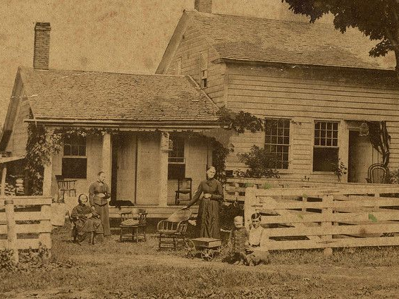

Slide 20
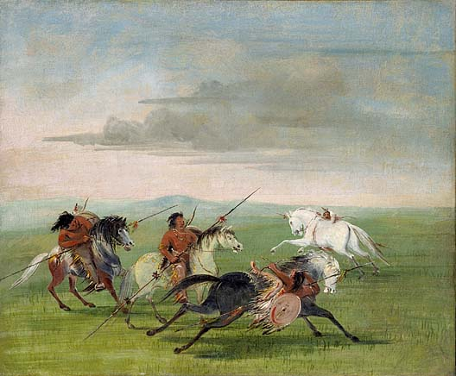

Slide 21
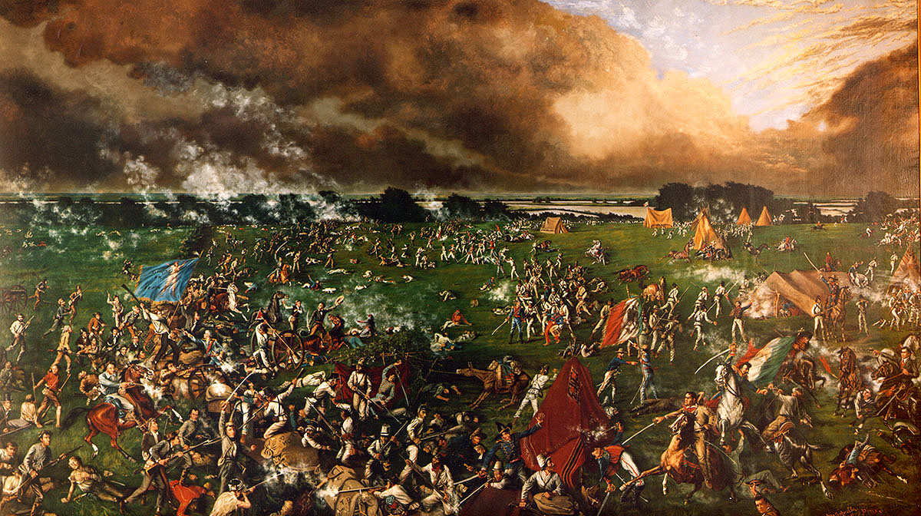

Slide 22
At its moment of independence from Mexico, Texas had approximately:

Slide 23
At its moment of independence from Mexico, Texas had approximately:
30,000 Anglos

Slide 24
At its moment of independence from Mexico, Texas had approximately:
30,000 Anglos
5,000 enslaved African Americans

Slide 25
At its moment of independence from Mexico, Texas had approximately:
30,000 Anglos
5,000 enslaved African Americans
3,400 Tejanos

Slide 26
At its moment of independence from Mexico, Texas had approximately:
30,000 Anglos
5,000 enslaved African Americans
3,400 Tejanos
15,000 to 20,000 American Indians

Slide 28
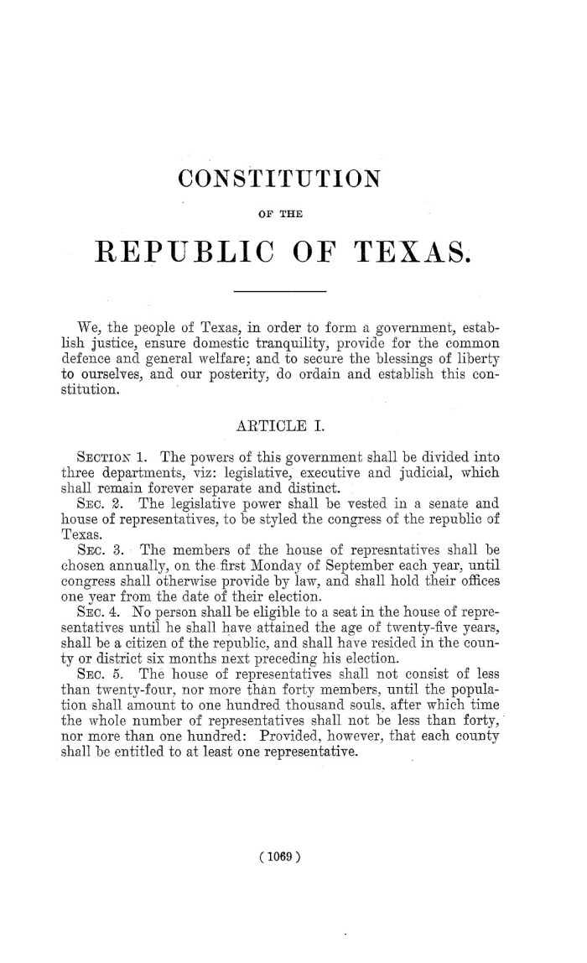

Slide 29
General Provisions, Section 10:
“All persons, (Africans, the descendants of Africans, and Indians excepted,) who were residing in Texas on the day of the Declaration of Independence, shall be considered citizens of the Republic, and entitled to all the privileges of such”

Slide 30
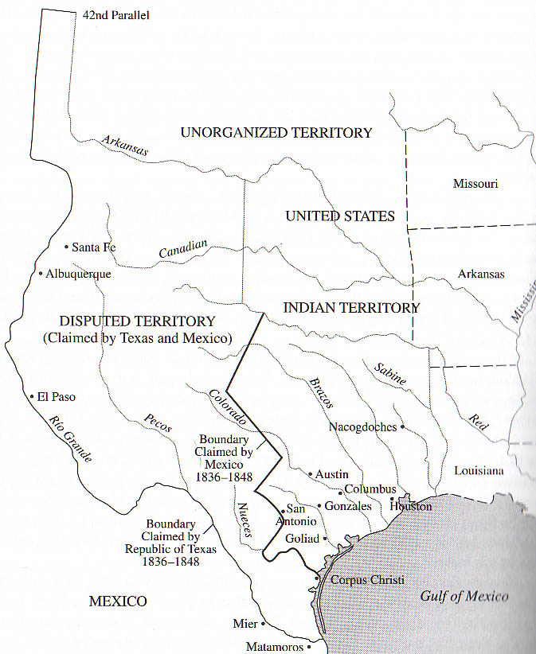
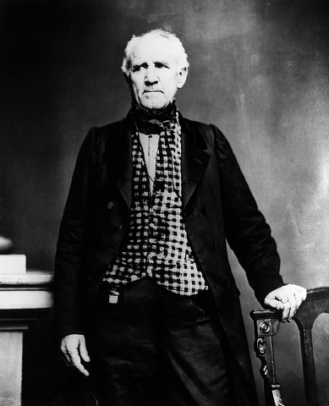

Slide 31
Houston’s overriding approach as president:
Stabilize the situation in Texas!

Slide 33
“Treaties of peace and amity and the maintenance of good faith with the Indians, present themselves to my mind as the most rational ground on which to obtain their friendship. Let us abstain on our part from aggression, establish commerce with the different tribes, supply their useful and necessary wants, maintain even handed justice with them, and natural reason will teach them the utility of our friendship.”
[Houston’s inaugural address, October 22, 1836, Writings of Sam Houston, Vol. 1, p. 449.]

Slide 37
In December 1837, the Texas Senate declared that the treaty that Houston negotiated in February 1836 with the Cherokees to be “null and void.”

Slide 38
How did the Texas Revolution and the emergence of the Republic change the power dynamic for American Indians in Texas?

Slide 39
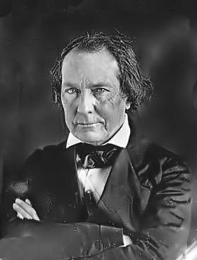

Slide 40
Essential Question #2:
How did the Presidency of Mirabeau Lamar and annexation to the United States weaken the position of American Indians in Texas?

Slide 42
“The white man and the red man cannot dwell in harmony together. Nature forbids it. They are separated by the strongest antipathies, by colour, by habits, by modes of thinking, and indeed by all the causes which gender hatred…”
[Citation: Mirabeau Lamar, Second Annual Message to Congress, November 12, 1839, reprinted in Gulick, The Papers of Mirabeau Buonapart Lamar, Vol 3, p. 167]

Slide 44
In his first message to the Texas Congress, Lamar called for “the prosecution of an exterminating war on their warriors, which will admit no compromise and have no termination except in their total extinction or total expulsion.”
[Source: Lamar to the Republic of Texas Congress, December 21, 1838, reprinted in Gulick, The Papers of Mirabeau Buonapart Lamar, 2:352-53.]

Slide 46
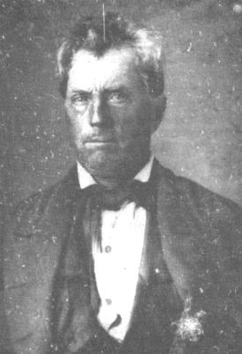
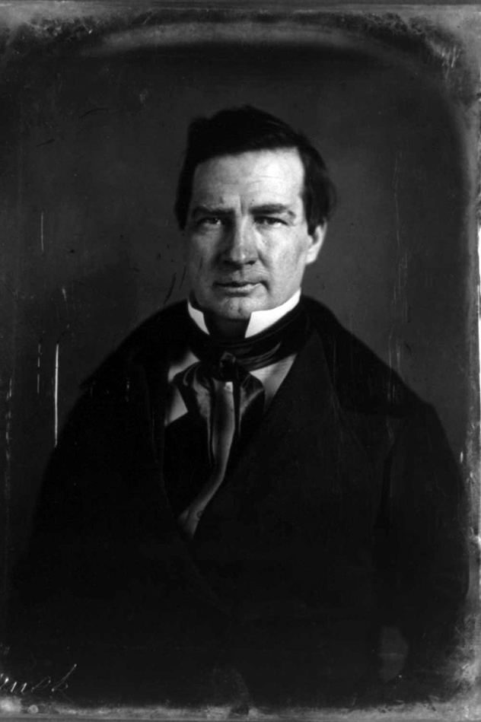
Edward Burleson
Thomas J. Rusk

Slide 49
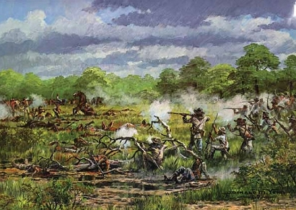
Battle of the Neches, July 1839

Slide 50
Battle of the Neches, July 1839

Slide 53
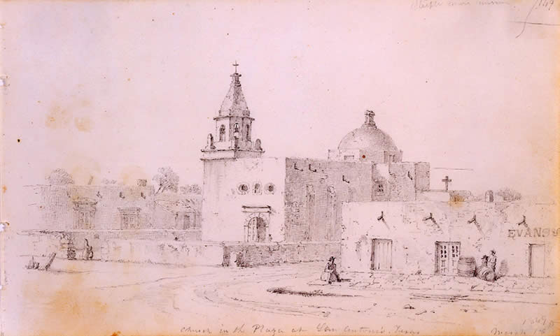

Slide 54
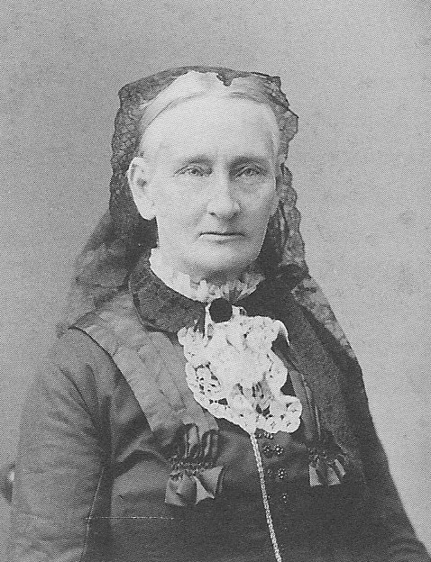
“She was in a frightful condition, poor girl, when at last she returned to civilization. Her head, arms, and face were full of bruises and sores, and her nose actually [was] burnt off to the bone, all the fleshy end gone and a great scab formed on the end of the bone. Both nostrils were wide-open and denuded of flesh.”
[Source: Memoirs of Mary A. Maverick: A Journal of Early Texas, edited by Rena Maverick Green and Maverick Fairchild Fisher (1921; reprinted by Maverick Publishing Company, 2005), pp. 32-33.]
Mary Maverick, in later years

Slide 56
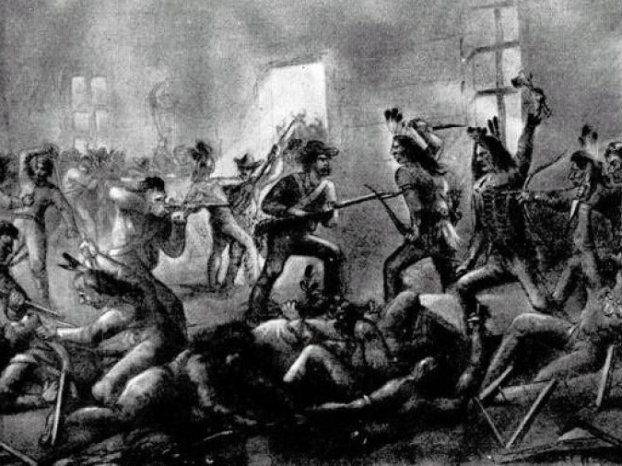
Council House Fight/Massacre
San Antonio, March 1840

Slide 58
Results of Lamar’s “Indian Wars”?

Slide 60
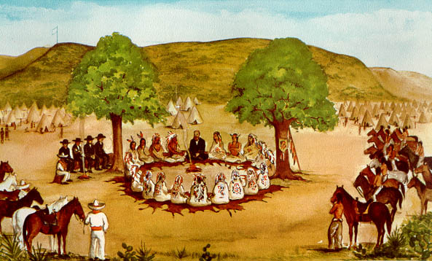

Slide 61
Treaty of Tehuacana Creek, 1843

Slide 62
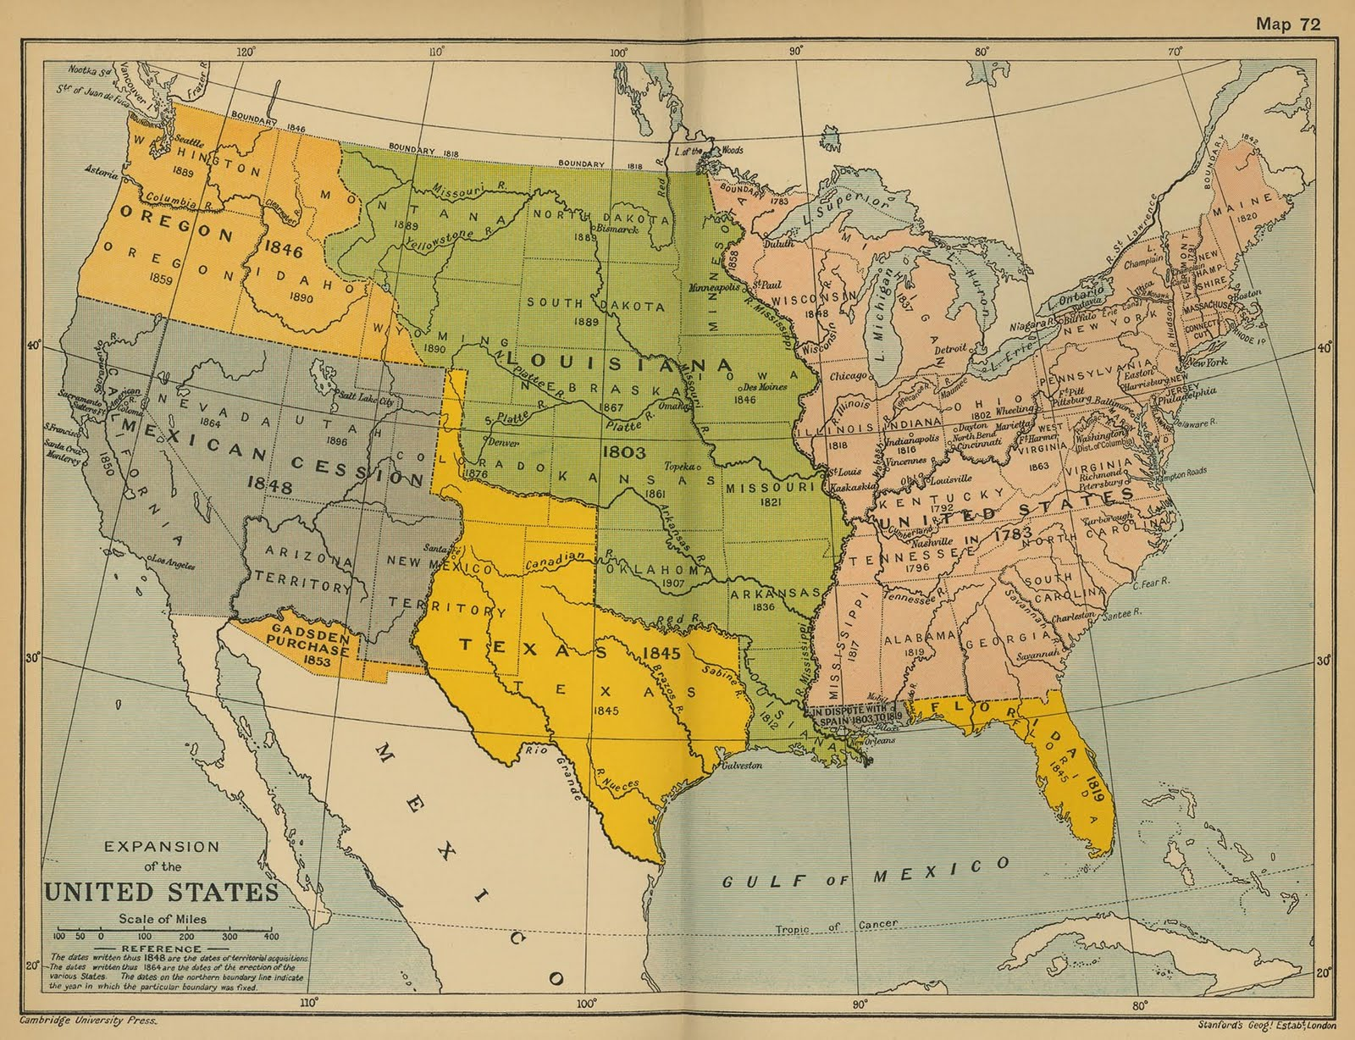

Slide 63
Population Shifts in Texas:

Slide 64
Population Shifts in Texas:
In 1836, there were approximately 35,000 to 40,000 non-Indians in Texas.

Slide 65
Population Shifts in Texas:
In 1836, there were approximately 35,000 to 40,000 non-Indians in Texas.
By 1845-47, there were 140,000 non-Indians in Texas.

Slide 66
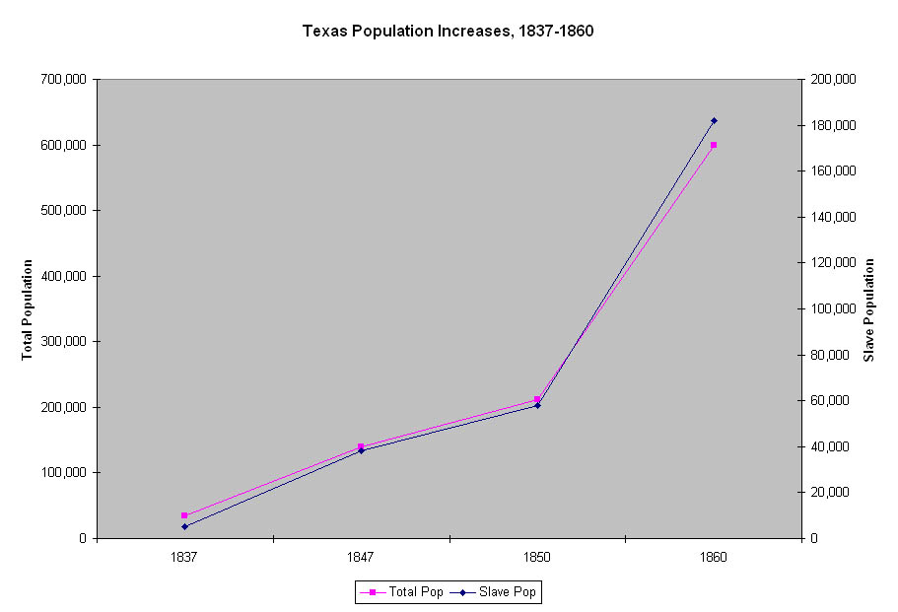

Slide 67
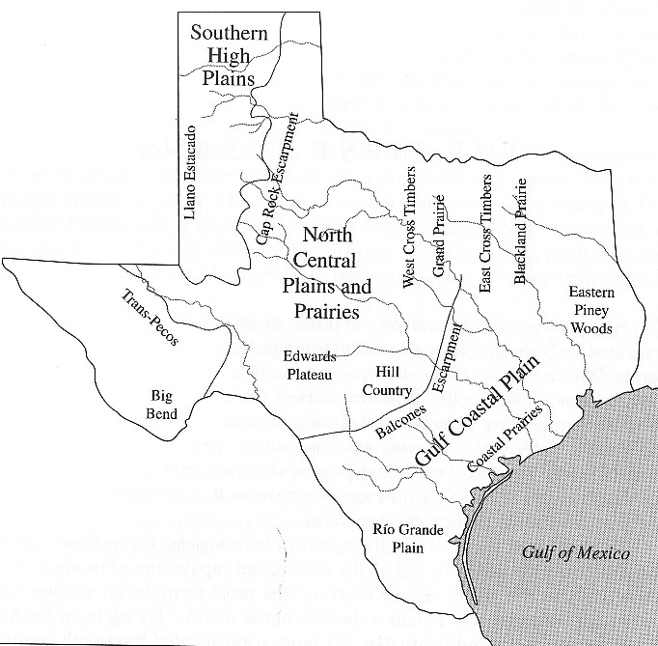

Slide 69
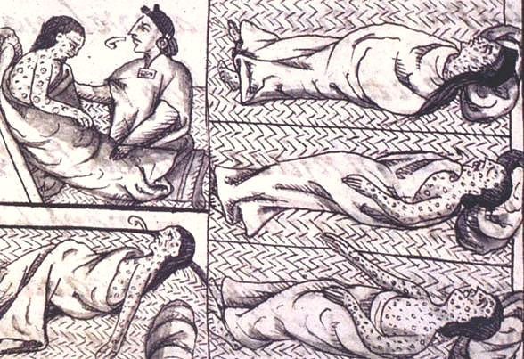

Slide 70
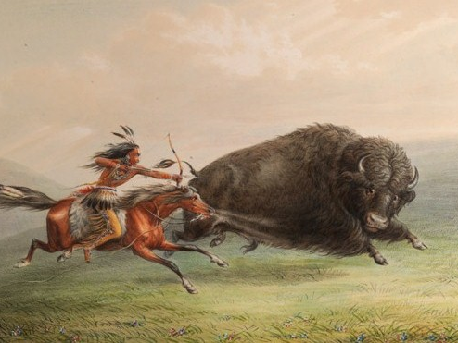

Slide 71
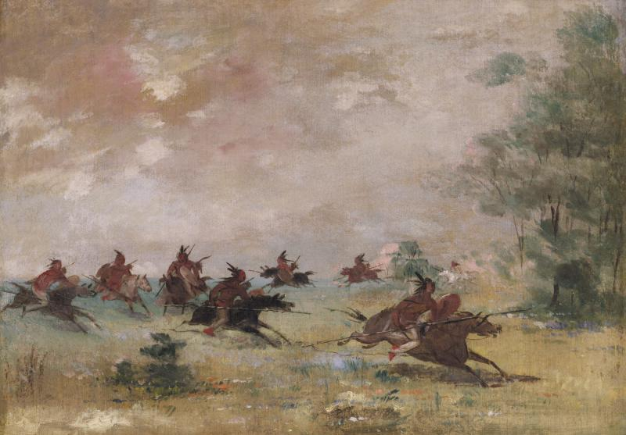

Slide 72
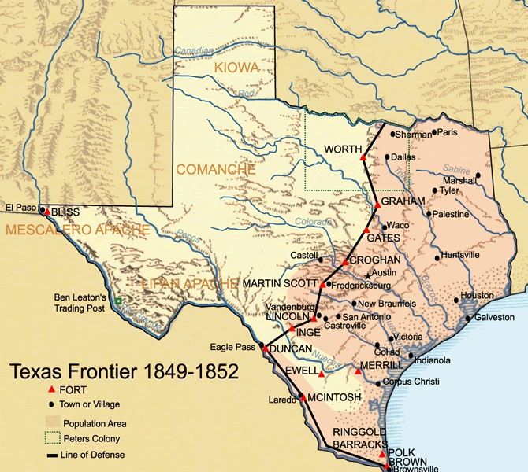

Slide 74
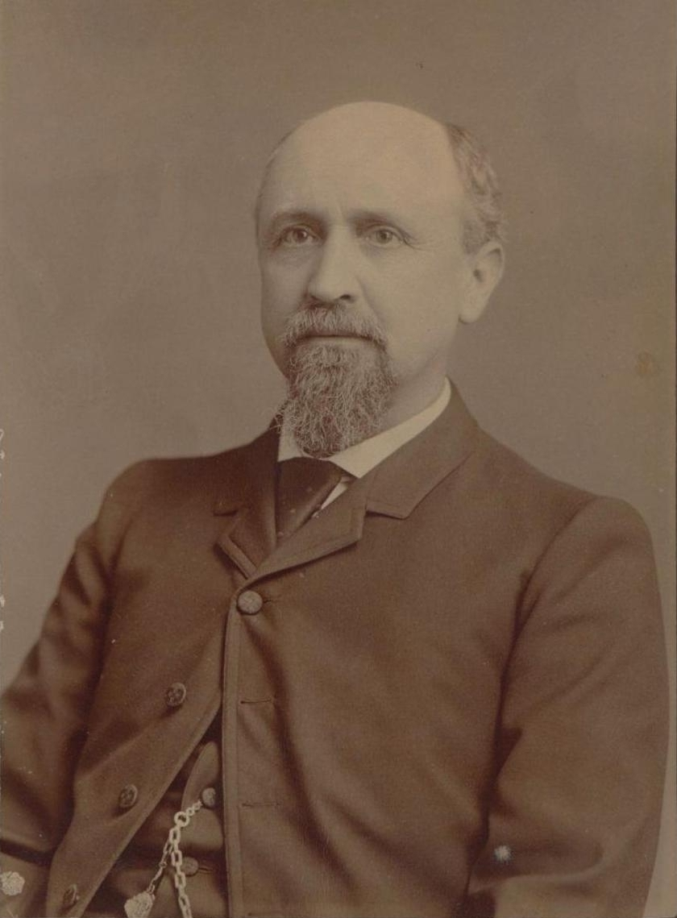
Lawrence Sullivan Ross

Slide 76
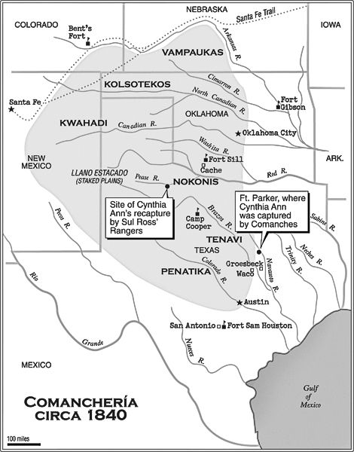

Slide 77
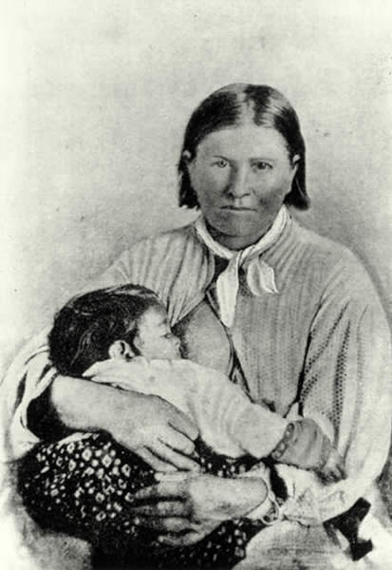

Slide 78
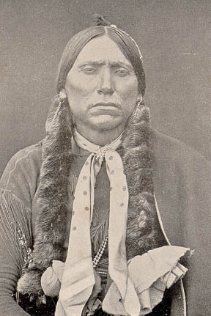

Slide 79
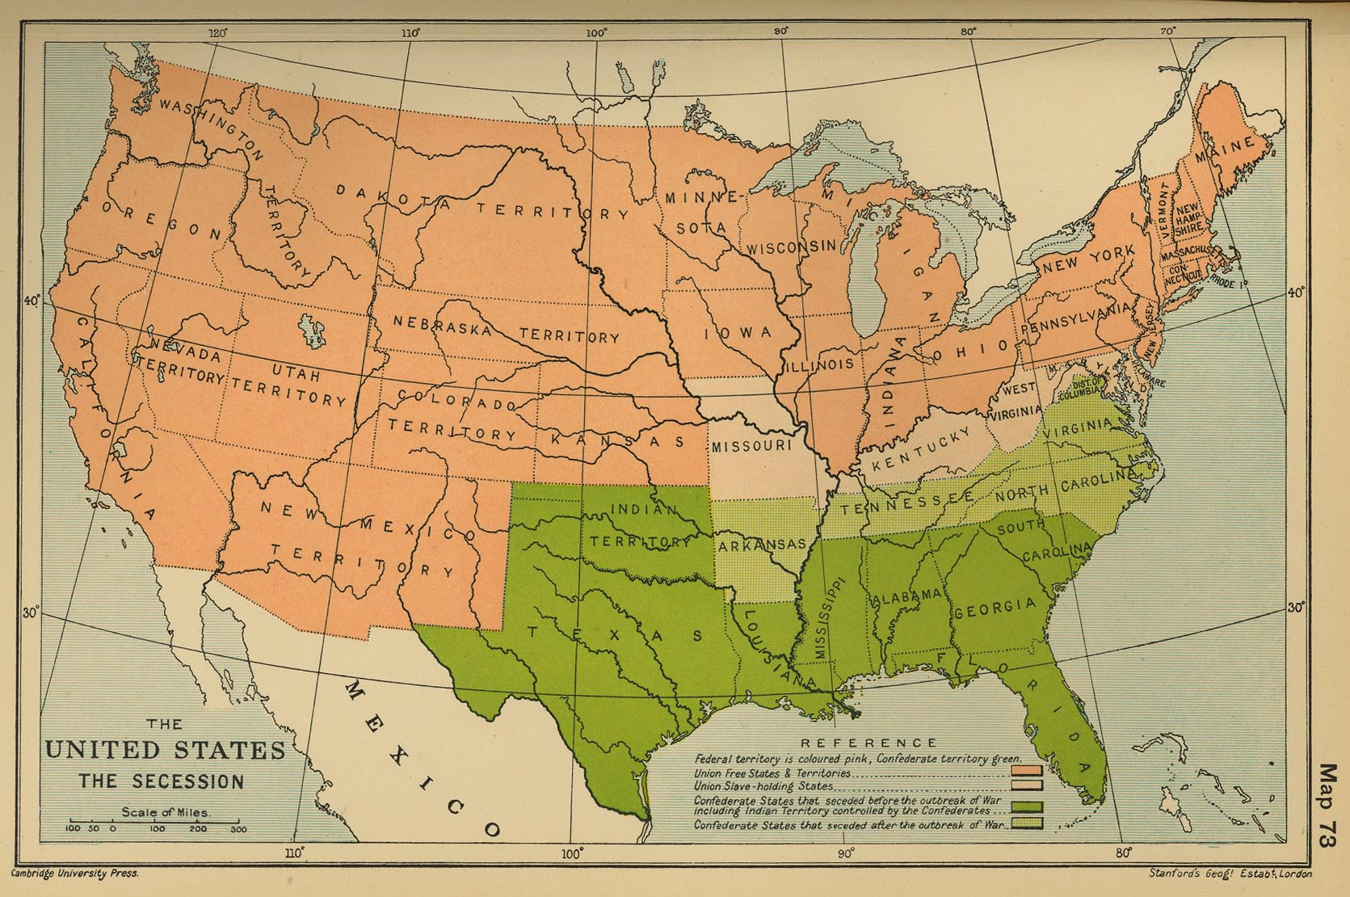

Slide 80
How did the Presidency of Mirabeau Lamar and annexation to the United States weaken the position of American Indians in Texas?

