Slide 1
Civil Liberties and the
U.S. Supreme Court
Humanities Texas Teacher Workshop
The Court and the Constitution
October 25, 2021
Kevin T. McGuire
Department of Political Science
University of North Carolina

Slide 2
What are civil liberties?
Limits on what government may do
Constitution’s Articles 1-3 cover what government may do
Tax, regulate interstate commerce, coin money, declare war
Bill of Rights covers what government may not do
Abridge speech, press, religion

Slide 3
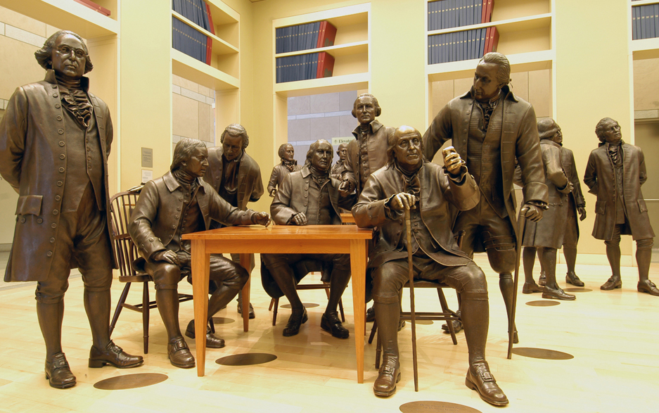
Why no Bill of Rights in original Constitution?
Not the purpose of Constitutional Convention

Slide 4
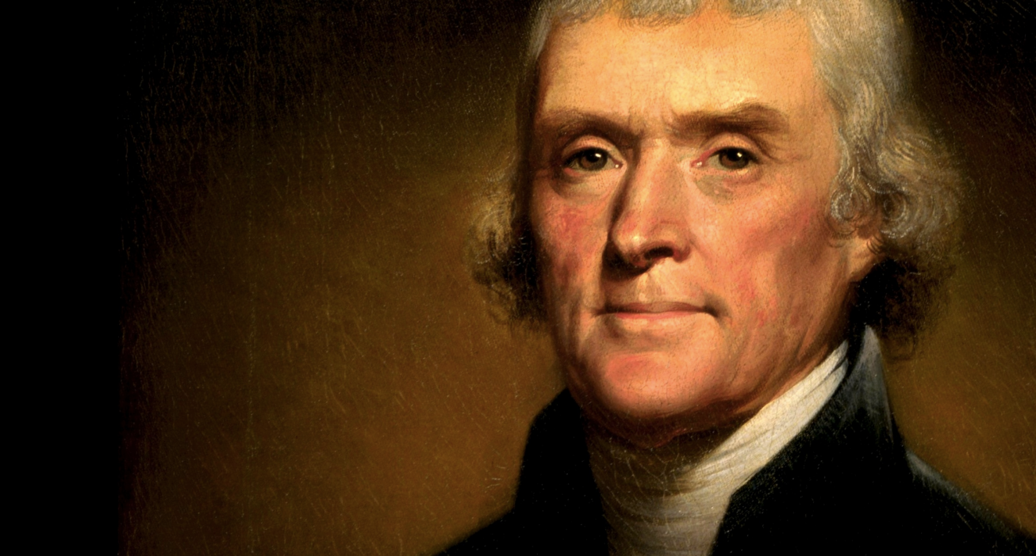

Slide 5
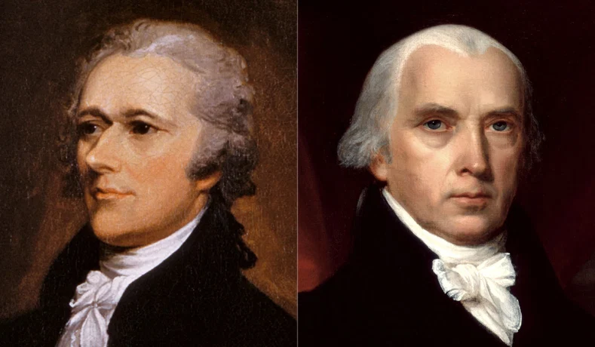

Slide 6
Why no Bill of Rights in original Constitution?
Not the purpose of Constitutional Convention
Enumerating power limited it
Separation of powers protected against abuse

Slide 7
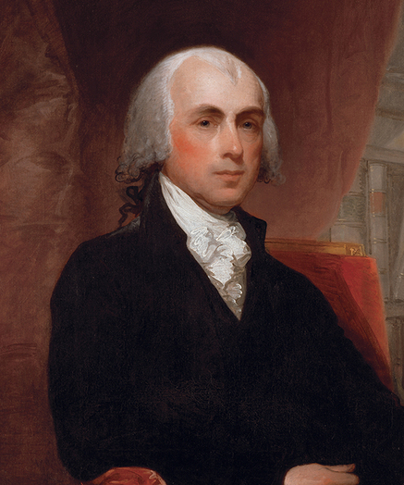
What determined the contents of the Bill of Rights?
Leading legal traditions
British influence
Magna Carta, English Bill of Rights
American influence
State constitutions
Goal is to limit national power

Slide 8
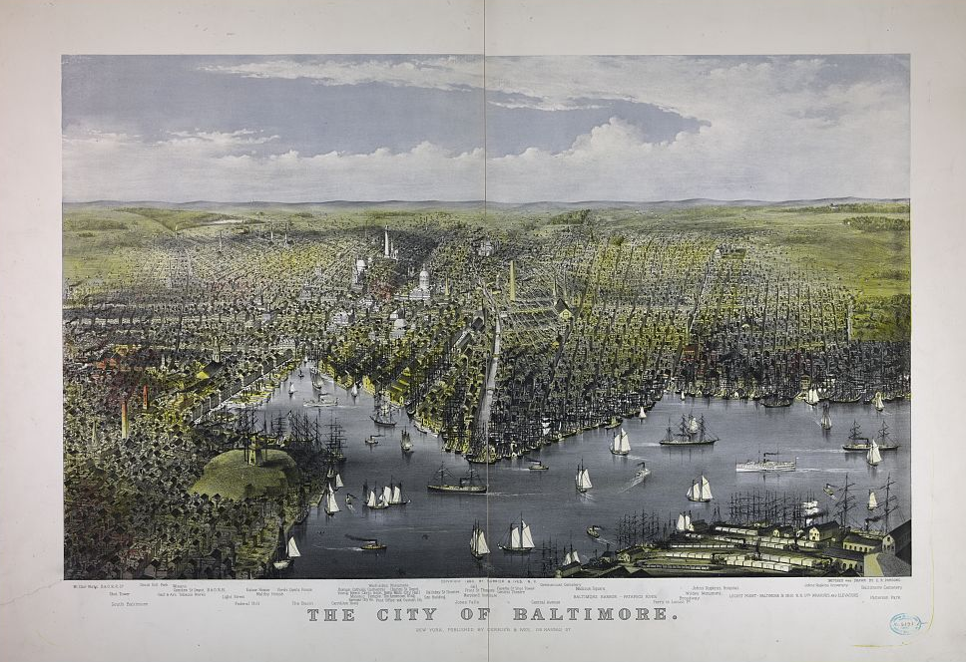
To whom would Bill of Rights apply?
Pre-Civil War
Limits only Congress
Barron v. Baltimore (1833)

Slide 9
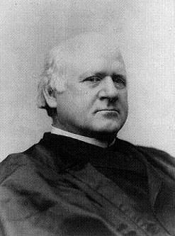
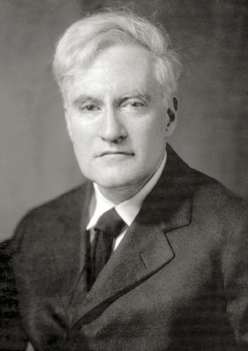
To whom would Bill of Rights apply?
Post-Civil War
Limits states, too
14th Amendment’s Due Process Clause
Palko v. CT (1937)
Harlan I
Cardozo

Slide 10
How does the Supreme Court evaluate civil liberties?
Difficult to generalize
Variation across time and issues
Justices tend to strike down:
State actions that discriminate
Singling out a particular idea, burdening a specific religious preference
State actions where there is no tangible harm
No disruption from speech, no interference with national security from news

Slide 11
Singling out a religious belief?
Church of the Lukumi Babalu Aye v. Hialeah (1993)
Employment Division v. Smith (1990)

Slide 12
Singling out a particular idea?
Texas v. Johnson (1989)
U.S. v. O’Brien (1968)

Slide 13
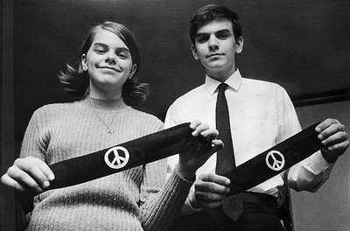
Is there harm from speech?
Bethel School District v. Fraser (1969)
Tinker v. Des Moines School District (2011)

Slide 14
Is there harm from press?
New York v. Ferber (1982)
Brown v. Entertainment Merchants Assoc. (2011)

Slide 15
What might future decisions hold?
Many important precedents are embedded
Difficult to imagine change
Likely always skeptical of discriminating against an idea, belief
More likely to see shifts that move policy
In some areas, Court seems interested in moving away from principles
Religion may enjoy greater protection
Press may enjoy less

