Slide 1
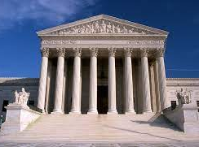
Civil Rights & the Constitution
Carol Nackenoff
Richter Professor of Political Science Emeritus,
Swarthmore College
Prepared for the Humanities Texas Teacher Workshop, The Court and the Constitution
November 8, 2021

Slide 2
What ARE Civil Rights, and where in the Constitution do we look for them?
The Legal Information Institute at Cornell defines a civil right this way, which is a useful beginning point:
“A civil right is an enforceable right or privilege, which if interfered with by another gives rise to an action for injury.”
We use the term discrimination for situations when an individual’s civil rights are denied because of membership in a particular group or class.
Some civil rights protections have come to be seen as required by the Constitution; some are statutory (such as the Civil Rights Act of 1965).

Slide 3
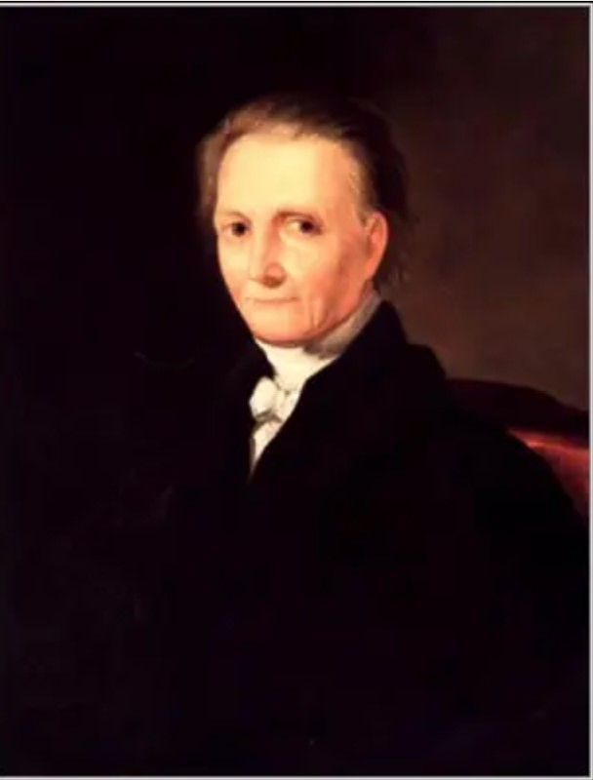
But that still does not tell us what a civil right IS
Justice Bushrod Washington offered a definition of fundamental privileges and immunities of citizens (Art. IV Sec. 2)in 1823 that was not meant to be exclusive. It included:
Protection by the government; the enjoyment of life and liberty, with the right to acquire and possess property of every kind . . .
The right of a citizen of one state to pass through, or to reside in any other state, for purposes of trade, agriculture, professional pursuits, or otherwise [this would encompass the right to travel]
. . . to which may be added, the elective franchise, as regulated and established by the laws or constitution of the state in which it is to be exercise

Slide 4
14th Amendment, Section 1
All persons born or naturalized in the United States, and subject to the jurisdiction thereof, are citizens of the United States and of the State wherein they reside. No State shall make or enforce any law which shall abridge the privileges or immunities of citizens of the United States; nor shall any State deprive any person of life, liberty, or property, without due process of law; nor deny to any person within its jurisdiction the equal protection of the laws.

Slide 5
A view of rights in 2nd half of 19th c.
THREE KINDS OF RIGHTS:
CIVIL RIGHTS (CIVIC EQUALITY)– THE MOST IMPORTANT. THESE ARE RIGHTS STATES HAVE A DUTY TO PROTECT.
RIGHT TO MAKE CONTRACTS
TO OWN, LEASE, CONVEY PROPERTY
TO SUE AND BE SUED
POLITICAL RIGHTS (EQUAL POLITICAL RIGHTS)- NOT ALL CITIZENS HAVE TO HAVE THESE
RIGHT TO VOTE
RIGHT TO SERVE ON JURIES
RIGHT TO HOLD OFFICE
SOCIAL RIGHTS (SOCIAL EQUALITY) – DEPENDS ON PREFERENCES AND BEHAVIOR OF INDIVIDUALS. STATE IS GENERALLY NOT INVOLVED. SITTING TOGETHER IN RAILROAD CARS OR PLACES OF ENTERTAINMENT? THE STATE SHOULD NOT COMPEL CO-MINGLING

Slide 6
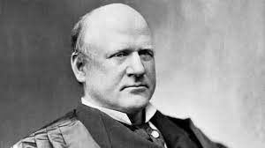
From Justice Harlan’s Dissent in Plessy:
“In the view of the Constitution, in the eye of the law, there is in this country no superior, dominant, ruling class of citizens. There is no caste here. Our Constitution is color-blind, and neither knows nor tolerates classes among citizens.”
But what does this mean?

Slide 7
OPTION 1: ANTI-CLASSIFICATION
OPTION 2: ANTI-SUBORDINATION
The Constitution is color-blind and bars racial classifications.
The Constitution opposes the maintenance of racial castes, group subordination, and second-class citizenship.

Slide 8
Legal mobilization to dismantle jim crow
NAACP’s incremental work. How to get justices to see that separate is not equal in small settings? Settings they were familiar with?
Other groups (including Center for Individual Rights) work to dismantle affirmative action in educational settings
Example: Sweatt v. Painter (1950) – SCOTUS requires that Blacks be admitted to the U.Tx. Law school despite fact Tx. had just opened a law school for blacks.
Court found the educational opportunities were not substantially equal
“the U. of Texas Law School possesses to a far greater degree those qualities which are incapable of objective measurement but which make for greatness in a law school
CIR recruited and selected plaintiffs for several key lawsuits, including Grutter and Gratz v. Bollinger (2003)
Getting to the Supreme Court takes allies, resources, strategy, and some luck. Organizations concerned about policy issues look for cases with potential to advance causes.

Slide 9
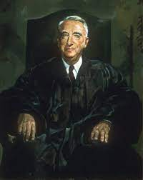
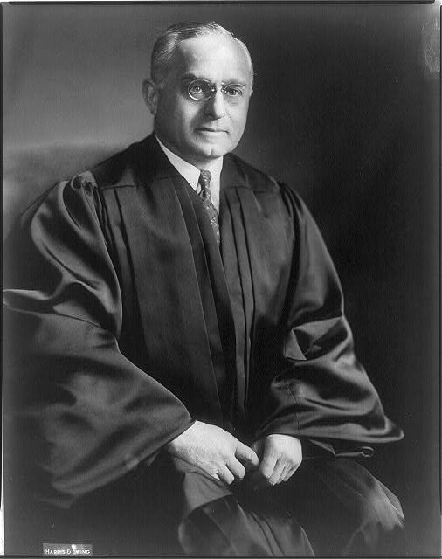
Chief Justice Fred M. Vinson was opposed to striking down school segregation. He died suddenly of a heart attack in September 1953 and President Eisenhower nominated Earl Warren to take his seat in October 1953 (he was sworn in then as a recess appointment and confirmation was spring 1954)
Vinson’s sudden death led Felix Frankfurter to say privately that Vinson's death was "the first solid piece of evidence I've ever had that there really is a God."

Slide 10
A bit of back story about Earl warren:
As CA attorney general, Warren, who was running for governor (1942), was supportive of efforts by the Native Sons of the Golden West & American Legion to overturn Wong Kim Ark (in a case involving Japanese-Americans). Federal courts rebuffed this effort to erase birthright citizenship for Asian heritage people born in the U.S.
At this same time, Warren kept urging President Roosevelt to intern Japanese-Americans
Earl Warren was Dewey’s vice-presidential candidate in 1948. He had presidential aspirations, but the two front-running candidates for the Republican nomination in 1952 were Ike and Robt. Taft. Sen. Nixon made it known that, while pledged to Warren on the first ballot, he preferred Ike. Ike’s campaign staff offered Nixon the vice-presidential nomination if he could deliver California for Ike . . . Not clear whether there was any agreement at that time to put Warren on the Court if Warren threw his support to him. Warren denied it.
Ike didn’t use ideological litmus tests when nominating justices to the Supreme Court. Later, he referred to Earl Warren nomination as “the biggest damn fool mistake I ever made.”

Slide 11
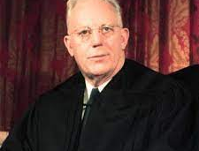
Overturning Plessy, Brown held that separate educational institutions were inherently unequal
“To separate [black children] from others of similar age and qualifications solely because of their race generates a feeling of iinferiority as to their status in the community that may affect their hearts and minds in a way unlikely ever to be undone.”
NEW: court looked at evidence from psych. Experiment w/black, white dolls

Slide 12
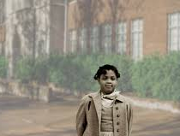
A common misunderstanding about Brown v. Board
Brown commanded the dismantling of dual school districts. Segregation that resulted from state action had to be remedied. It didn’t simply command integration.

Slide 13
A potentially fun exercise:
How (and How Much) Did Brown Matter?
Gerald Rosenberg (The Hollow Hope) challenges those who think that even landmark Supreme Court decisions make a big difference in American politics to produce the evidence.
In the South, very little desegregation happened from 1954-1964; a bit more in the marginal South.
“All deliberate speed” (Brown II) pretty much meant no speed. The Supreme Court alone could not effect social change (without Congress, Executive support).
Hamilton, Fed. 78: “The Judiciary . . . has no influence over either the sword or the purse; no direction either of the strength or of the wealth of the society, and can take no active resolution whatever. It may truly be said to have neither FORCE nor WILL, but merely judgment...”

Slide 14
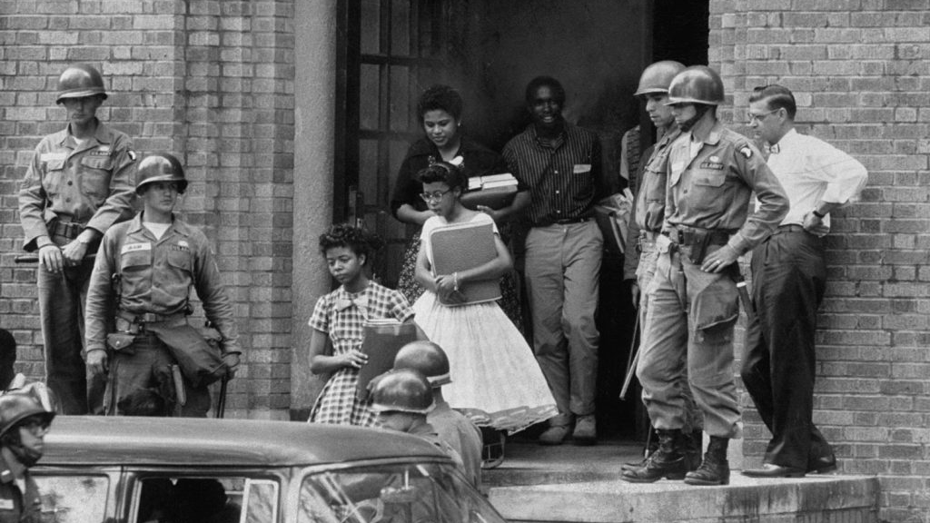
YES, Eisenhower was persuaded to send troops to Little Rock to desegregate Central High School (1957)
But resistance by courts, elected officials, the public continued

Slide 15
How much difference did Brown make (cont’d)
More desegregation of public facilities occurred after the 1964 Civil Rights Act
Did school districts have to deal with de facto segregation? What if whites lived increasingly in suburbs and blacks in nearby cities?
Court has released many districts from oversight (by roughly 1990)
The racial composition of schools, classrooms now looks about as segregated as it did in 1954
“Over the last three decades, black students have been increasingly segregated in intensely segregated schools, and by 2016, 40% of all black students were in schools with 90% or more students of color. “ (somewhat less true for white students). Source: “Harming Our Common Future: America’s Segregated Schools 65 Years After Brown”, Frankenberg, Ee, Ayscue, G. Orfield (May 2019)

Slide 16
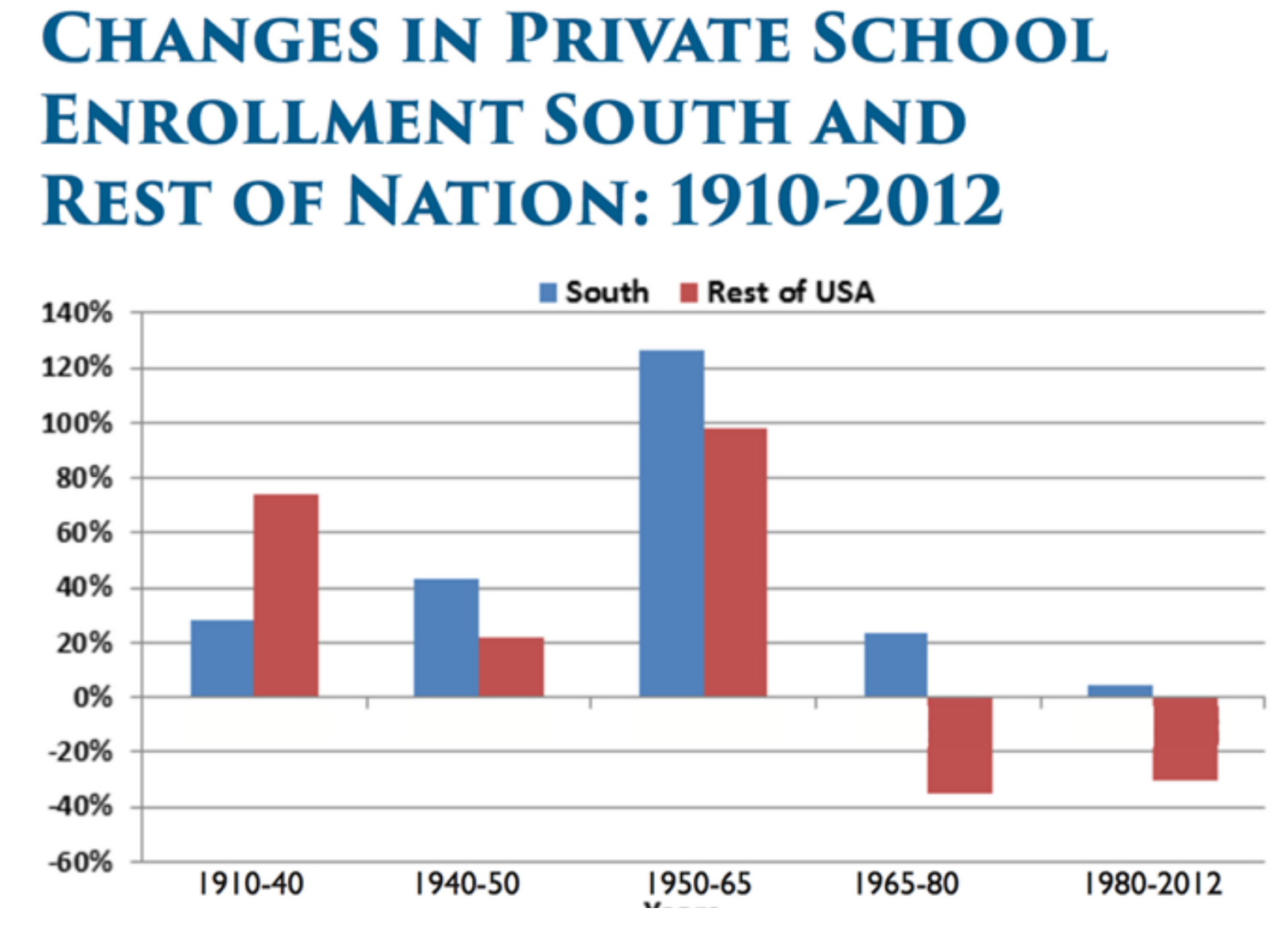
Fewer white children attended public schools after Brown (enrollment in catholic school peaks c. 1965; rise of Christian day schools)

Slide 17
On the other hand:
There is power in rhetoric. Brown is considered an accessible decision. It is revered (even if people disagree about what it means). It put moral authority on the side of those challenging legally enforced segregation and added momentum to the movement for civil rights

Slide 18
Cooper v. Aaron (1958) – an interesting note
Did the Court claim more that Marshall had in Marbury about their role in establishing the meaning of the Constitution (the Court’s reading in Brown IS the Constitution)?
[Some scholars talk about “Judicial supremacy” as opposed to “judicial review” as an increasing phenomenon from this time forward] – and in decisions that aren’t just about race
“[Marbury v. Madison] declared the basic principle that the federal judiciary is supreme in the exposition of the law of the Constitution, and that principle has ever since been respected by this Court and the Country as a permanent and indispensable feature of our constitutional system. It follows that the interpretation of the Fourteenth Amendment enunciated by this Court in the Brown case is the supreme law of the land, and Art. VI of the Constitution makes it of binding effect on the States "any Thing in the Constitution or Laws of any State to the Contrary notwithstanding." Every state legislator and executive and judicial officer is solemnly committed by oath taken pursuant to Art. VI, cl. 3, "to support this Constitution." . . . No state legislator or executive or judicial officer can war against the Constitution without violating his under-taking to support it.”

Slide 19
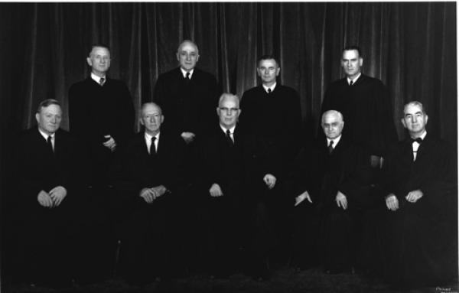
The 1958 court unanimously reaffirmed Brown in cooper v. aaron, and all members signed. Those who were not present in 1954 wrote that they would have joined the brown opinion

Slide 20
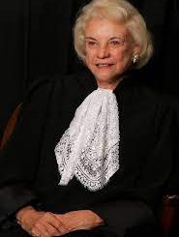
The many lives of Harlan’s 1896 Dissent in Plessy
In overturning Plessy, Brown was seen as vindicating Justice Harlan’s dissent
In Richmond v. Croson (1989), Justice O’Connor (joined by C.J. Rehnquist and J. White and Kennedy) wrote that even race preferences required strict scrutiny. “Absent searching judicial inquiry into the justification for such race-based measures [minority business set-asides], there is simply no way of determining what classifications are ‘benign’ or ‘remedial’ and what classifications are in fact motivated by illegitimate notions of racial inferiority or simple racial politics. . . “
Shaw v. Reno (1993): Justice O’Connor writes that “[racial] classifications of any sort pose the risk of lasting harm to our society.”
Questions: (A) If there has been a history of legal disadvantage, so that a minority group is unrepresented and has little or no chance of righting wrongs through the legislative process (e.g.), if then the majority decides to disadvantage itself when those legal impediments are removed, should this new legislation be looked at differently? (B) If women were excluded from voting, and even after that, if few or no women were included in the legislatures where measures chiefly affecting women were voted upon, are those measures potentially suspect?

Slide 21
Another civil rights vehicle? 14th A. Sec. 5
The Congress shall have power to enforce, by appropriate legislation, the provisions of this article.
Does Congress have some latitude to define equal protection when passing laws? (Violence Against Women Act, Affirmative Action)
Could Congress work toward a goal of antisubordination?
What kind of a grant of power is this? Recently, Court has held Congress can only act in response to a concrete violation (it can’t be proactive)

Slide 22
Race, Gender, and levels of scrutiny
Suspect classifications, fundamental rights
Quasi-suspect classifications and judicial scrutiny
Strict scrutiny is USUALLY fatal in fact for the classification (it wasn’t in Grutter)
Is there a compelling state interest in the legislative classification?
Is the classification really necessary to accomplish a compelling state objective?
Is the means the least intrusive of rights that could have been devised?
RACE is now a suspect classification
There may be reasons for some classifications (e.g., gender), so these classifications are usually viewed under “intermediate” scrutiny
Does the classification serve an important governmental interest?
Is the means substantially related to the achievement of these objectives?

Slide 23
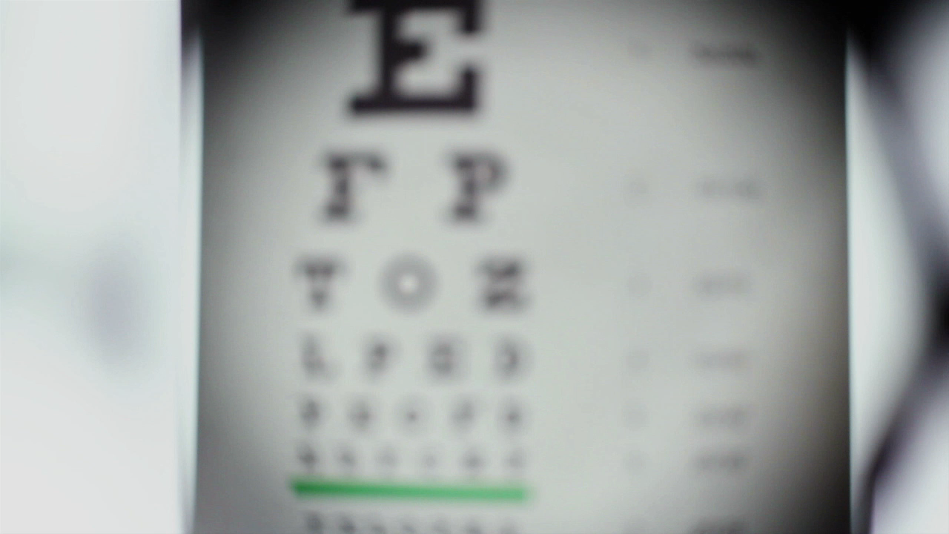
Interesting fact: levels of scrutiny & sexual Orientation
Justice Kennedy penned all the major gay rights decisions of the Court (from Romer through Obergefell)
Rational basis review (the lowest level of scrutiny) was employed for almost all of them (in some, they don’t indicate)
Was there ANY rational basis for singling out LGBTQ+ people at law?
If not, it must be animus. This is an illegitimate state purpose. The law cannot stand.

Slide 24
Art. 1 sec. 8(3) The Commerce Clause & Civil Rights
The Congress shall have power . . . To regulate commerce with foreign nations, and among the several states, and with the Indian tribes.
Use of the commerce clause to get at discrimination that is not strictly caused by “state action” – discrimination by businesses, employers, for example
Made possible by the New Deal Court’s expanded reading of the commerce clause 1937 (to at least 1995):
  Does X activity have a substantial effect on interstate commerce? (read w/low level scrutiny
  Does X activity have an aggregate effect on interstate commerce?

Slide 25
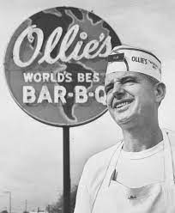
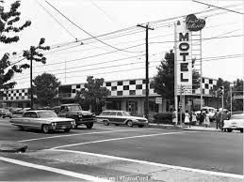
EXAMPLES:
Heart of Atlanta Motel v. U.S. (1964)
Katzenbach v. McClung (1964)

Slide 26
SOME QUESTIONS:
How does thinking about the Court’s decision-making in these cases help students understand issues surrounding judicial activism and restraint?
Consider activism with regard to: overturning the Court’s own decisions, overturning acts of Congress, or overturning state laws. Is activism ever a virtue? Is restraint (deciding not to act, not to wade into a fight) ever a vice?
How does a focus on some of these cases help students think about the relationship between the national government and state governments? And between privileges and immunities of U.S. citizens and privileges and immunities that are up to the states to determine?

Slide 27
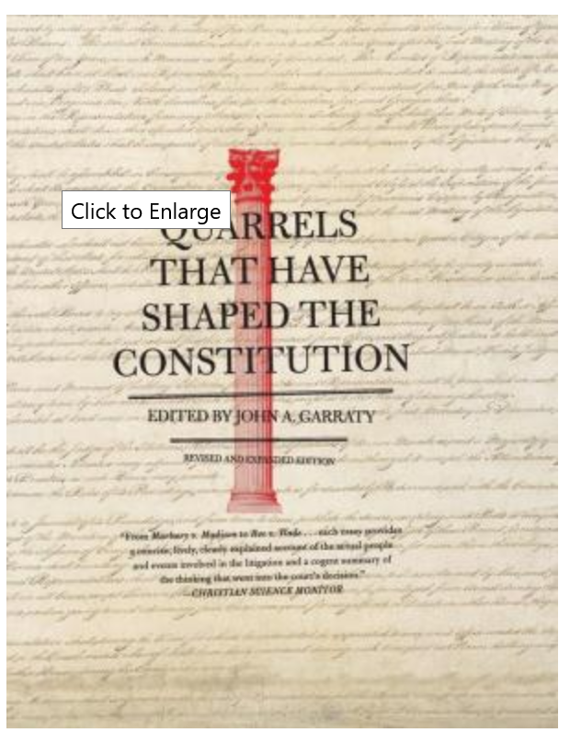
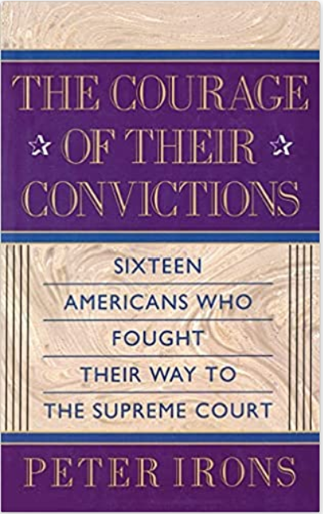
Some good sources to make cases come alive for students (and one for teachers especially interested)
And one for teachers: Race Law Stories, ed. R. Moran & D. Carbado, Foundation Press 2008.

