Slide 1
Collapse of Indian Power in Texas, 1861-1875
Humanities Texas Webinar Series
October 2021

Slide 2
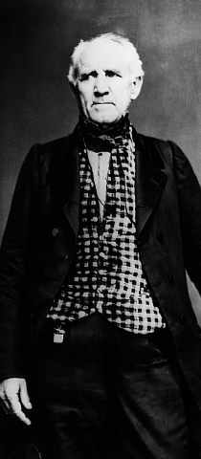
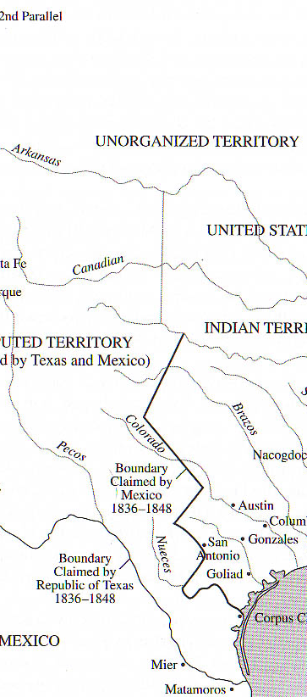
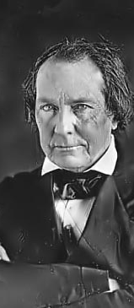

Slide 3
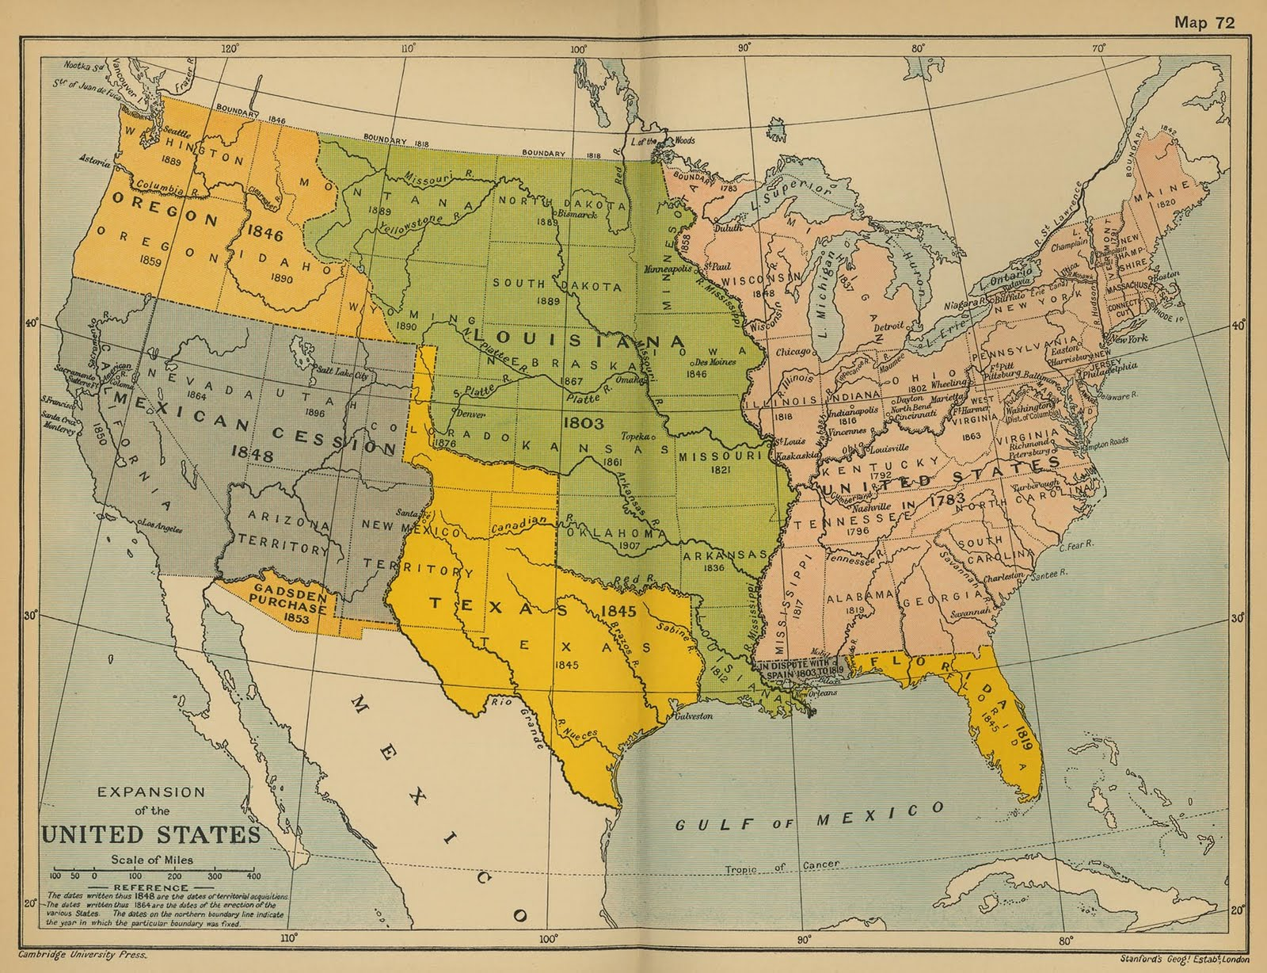

Slide 4
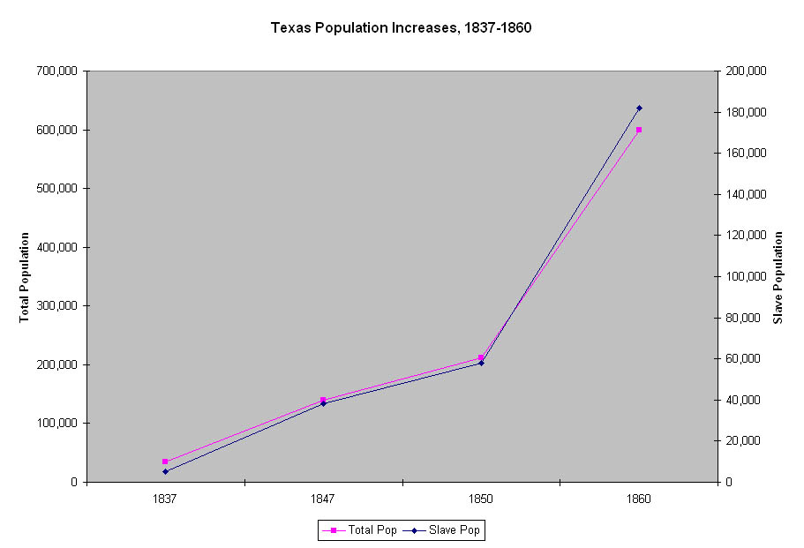

Slide 5
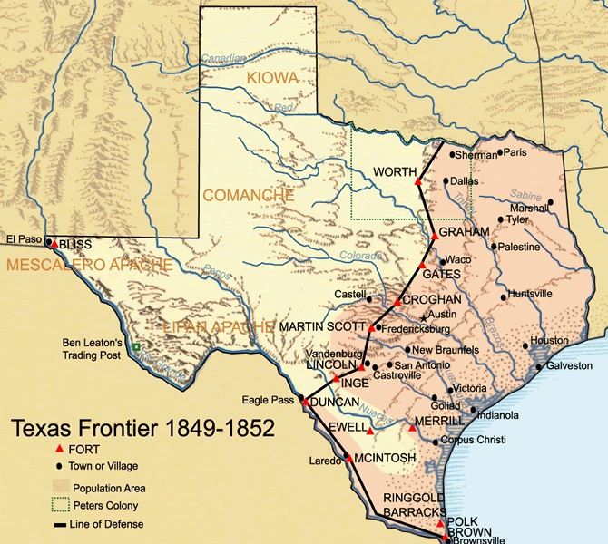

Slide 6
Essential Question #1:
How did the Civil War affect the relationship between American Indians and Anglo-American settlers in Texas?

Slide 7
TEXAS VOTES ON SECESSION
Texas Legislature, February 1, 1861:
166 in favor, 8 against
State-wide Referendum, February 23, 1861:
46,000 in favor, 14,700 against

Slide 8
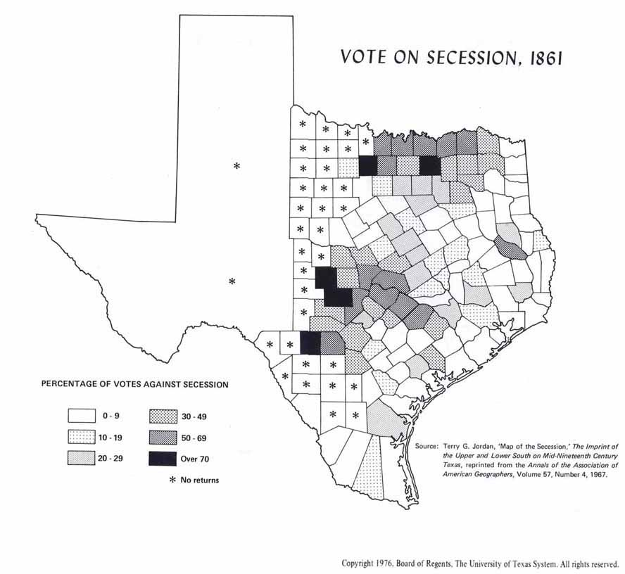

Slide 9
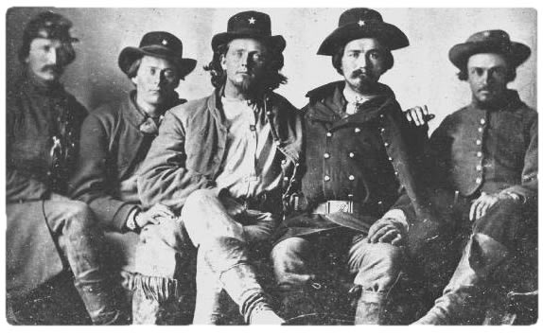

Slide 12
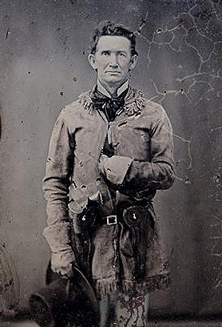
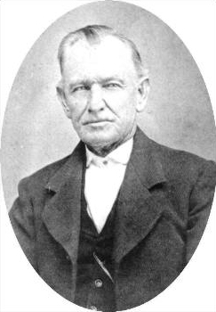
John S. “Rip” Ford
Henry McCullough

Slide 13
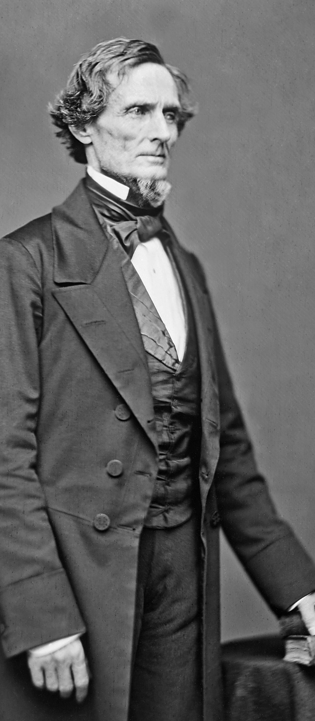

Slide 14
“Border Regiment,” December 1861

Slide 15
“Frontier Organization,” 1863

Slide 16
October 1864: Comanche and Kiowa raid Elm Creek Valley

Slide 17
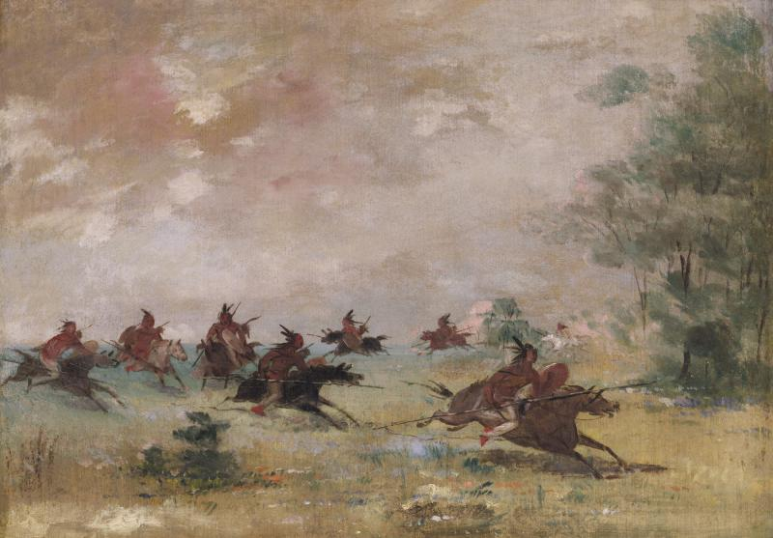

Slide 18
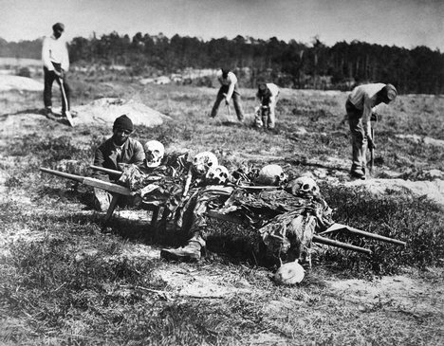

Slide 19
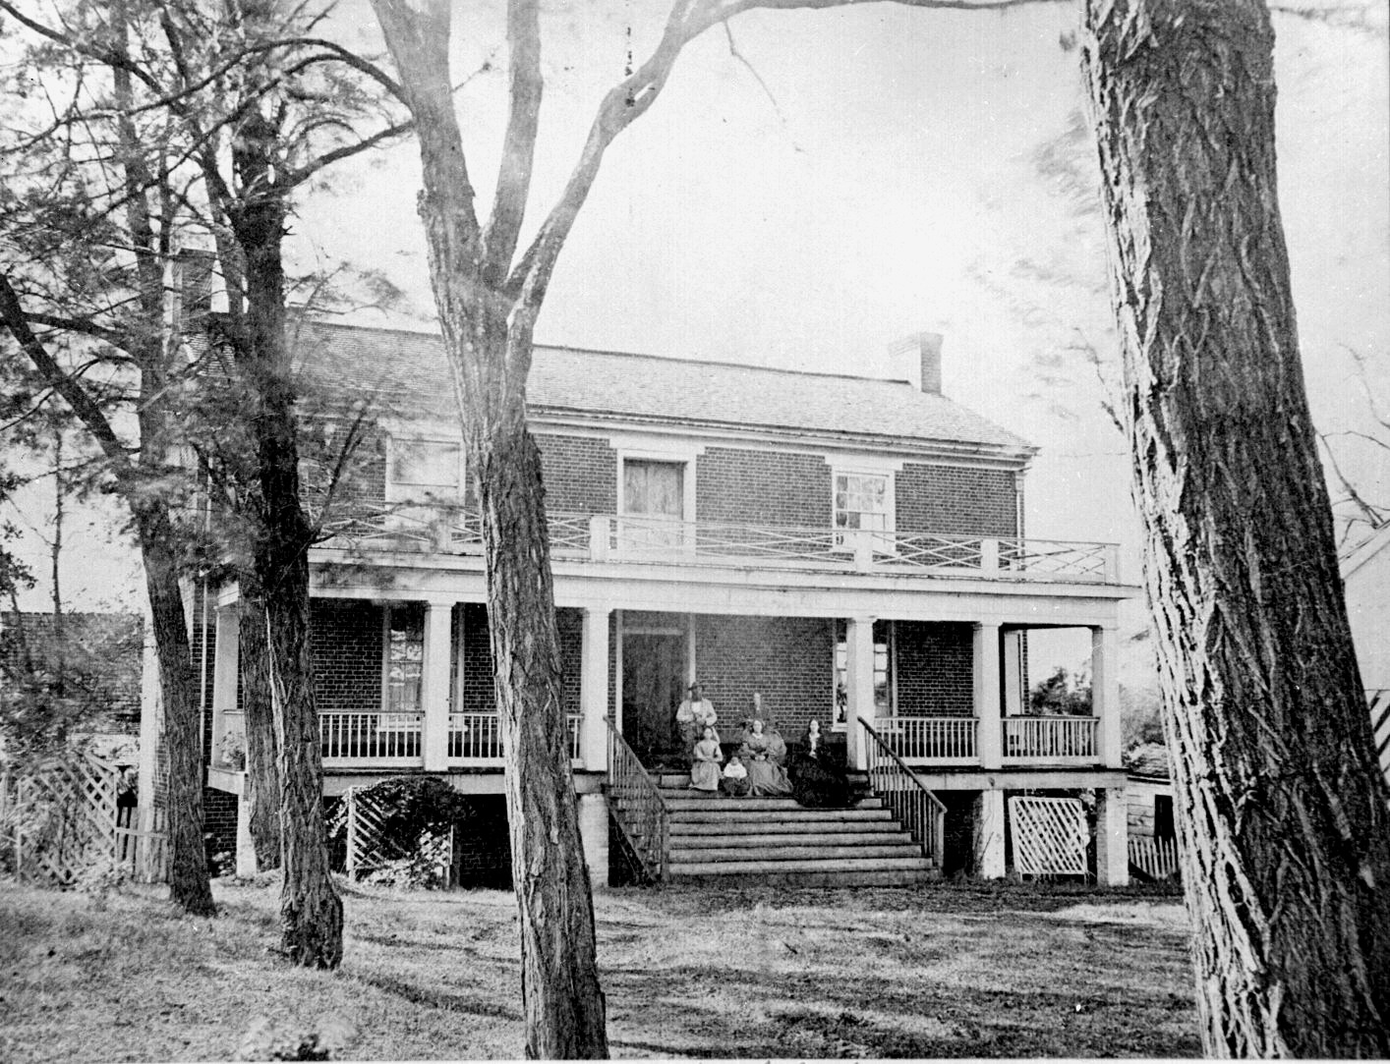

Slide 20
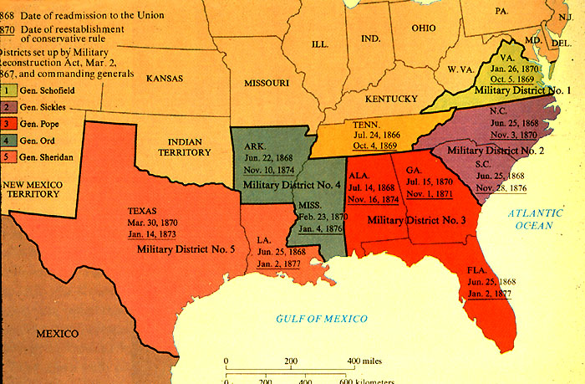
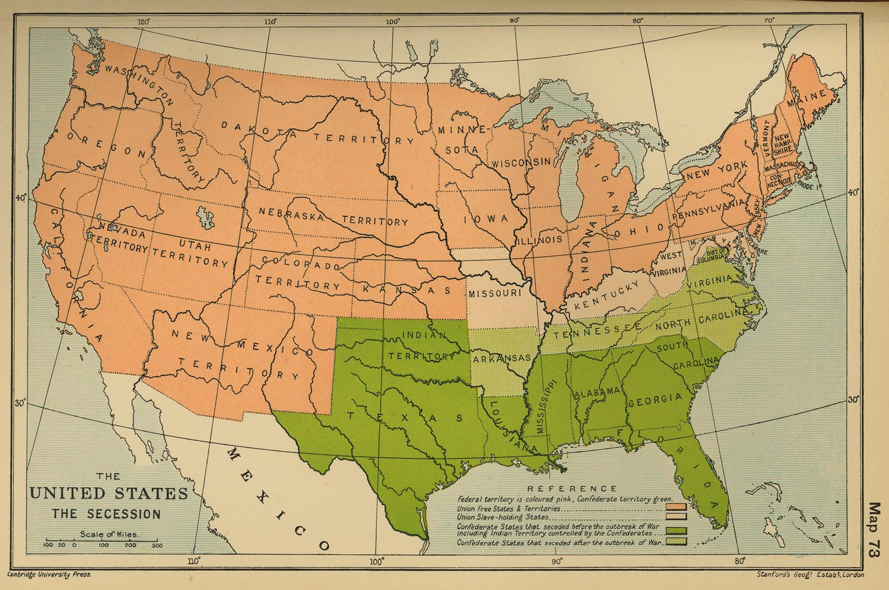

Slide 22
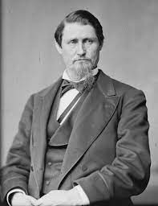
Governor James Throckmorton reported that Indian raiders killed 162 Texans, captured 43, and wounded another 24 during the two years between May 1865 and July 1867.

Slide 23
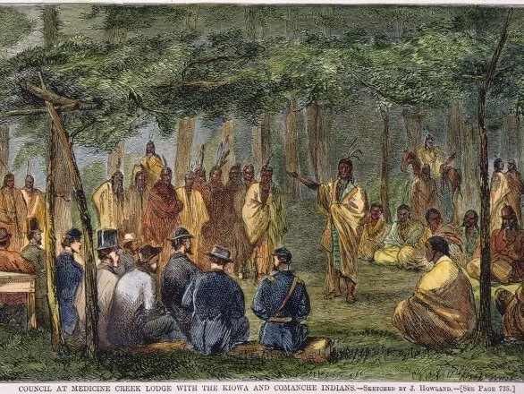

Slide 24
Treaty of Medicine Lodge Creek, 1867

Slide 25
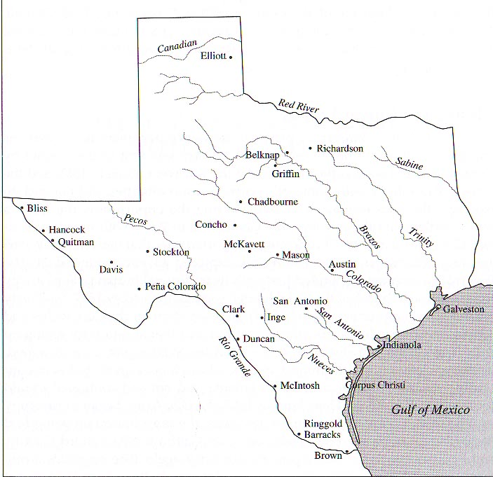

Slide 26
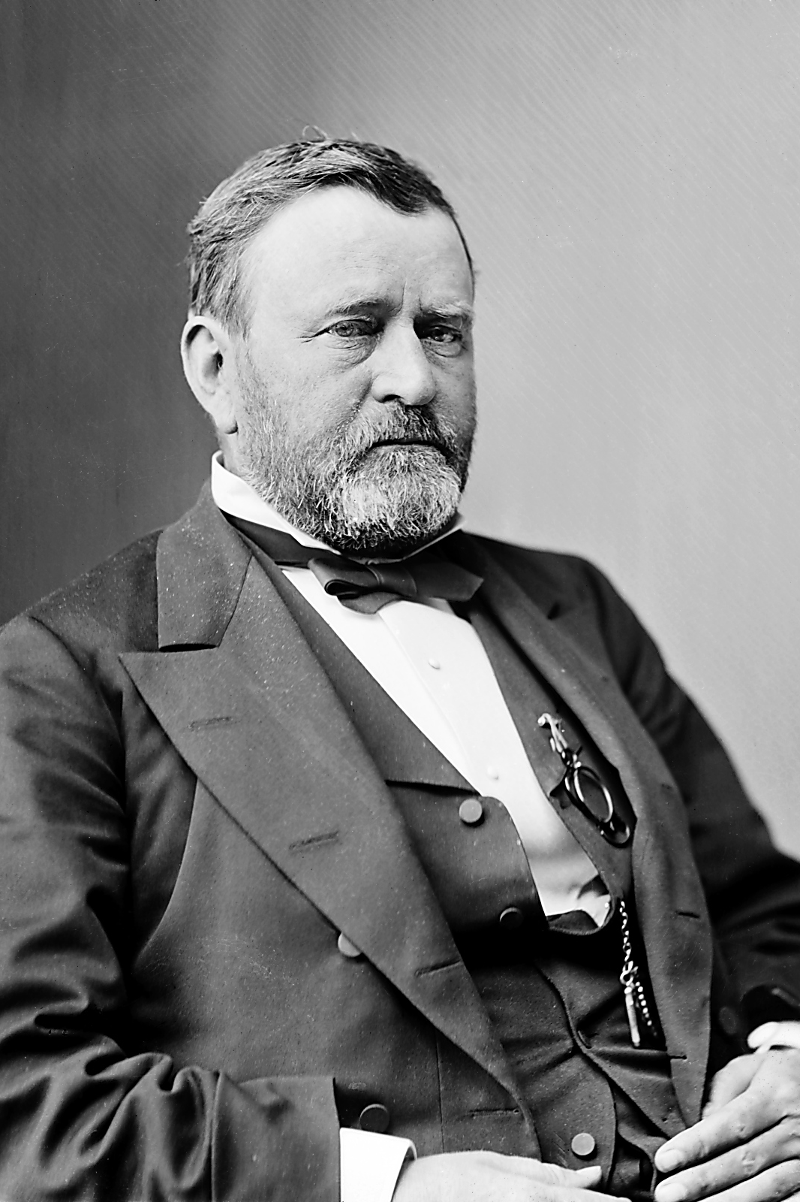
U.S. Grant

Slide 27
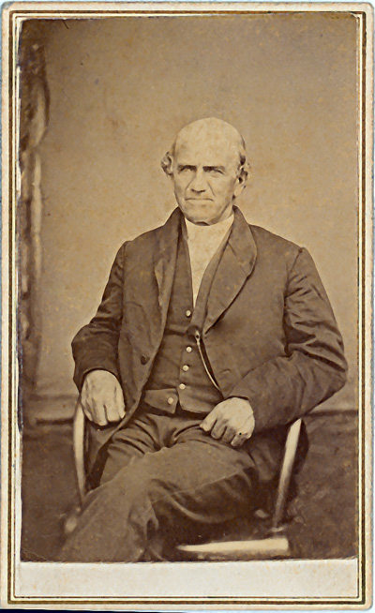
U.S. Grant
Lawrie Tatum

Slide 29
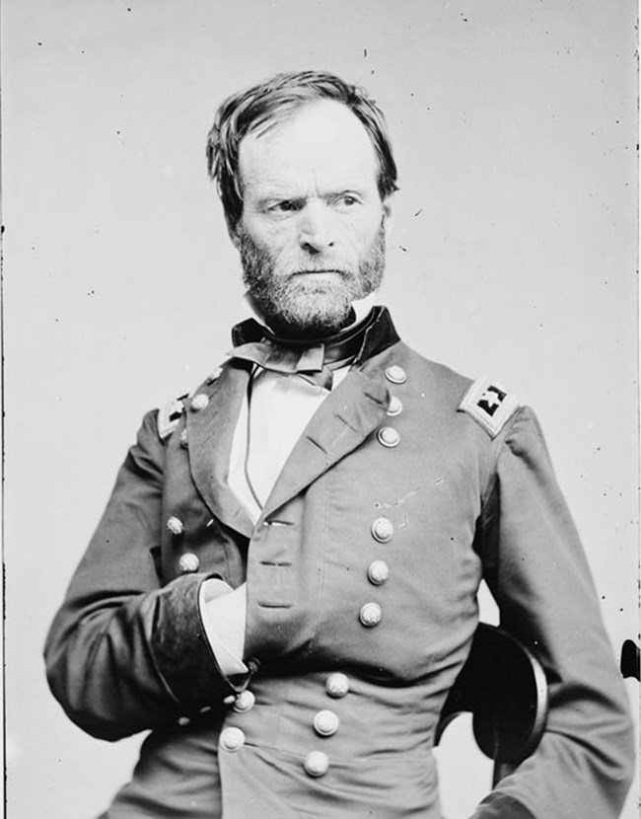
William Tecumseh Sherman

Slide 31
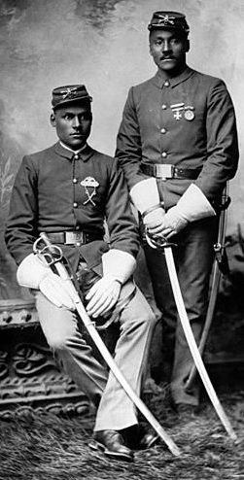

Slide 33
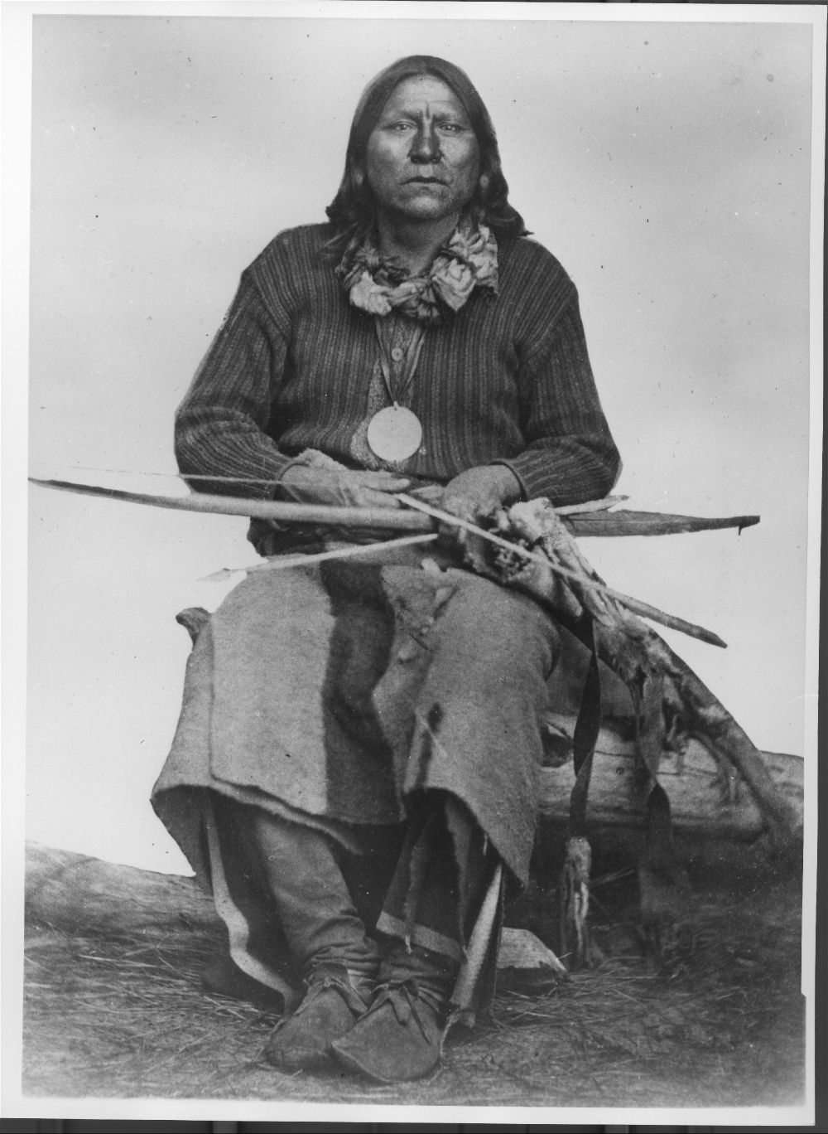
“White Eagle” or “Santana”

Slide 34
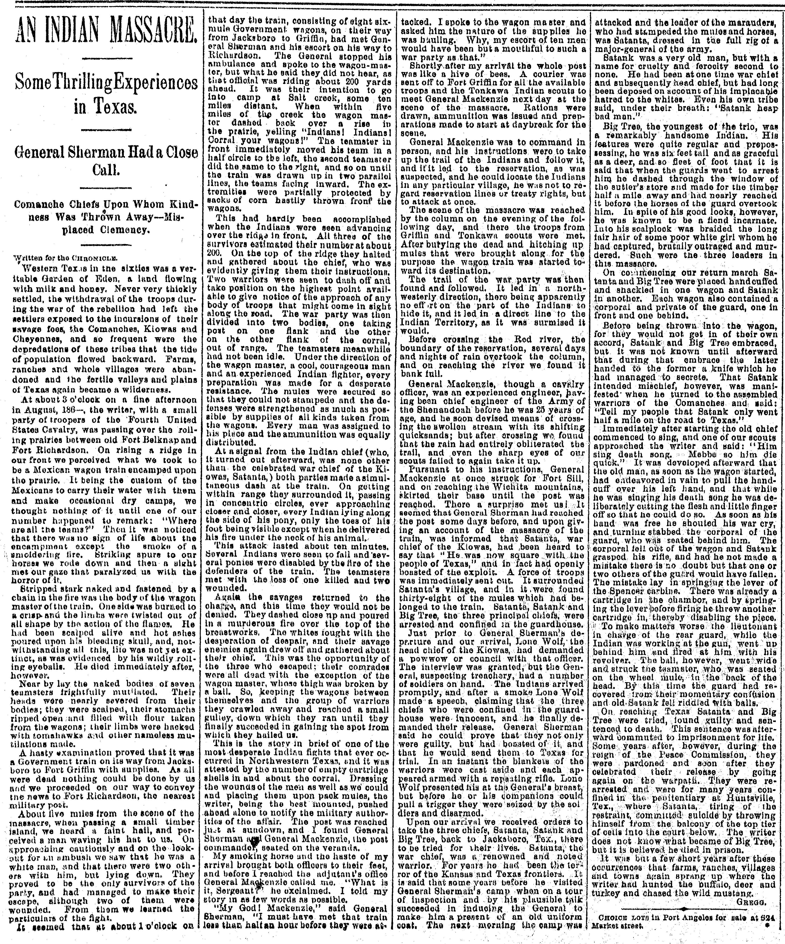

Slide 35
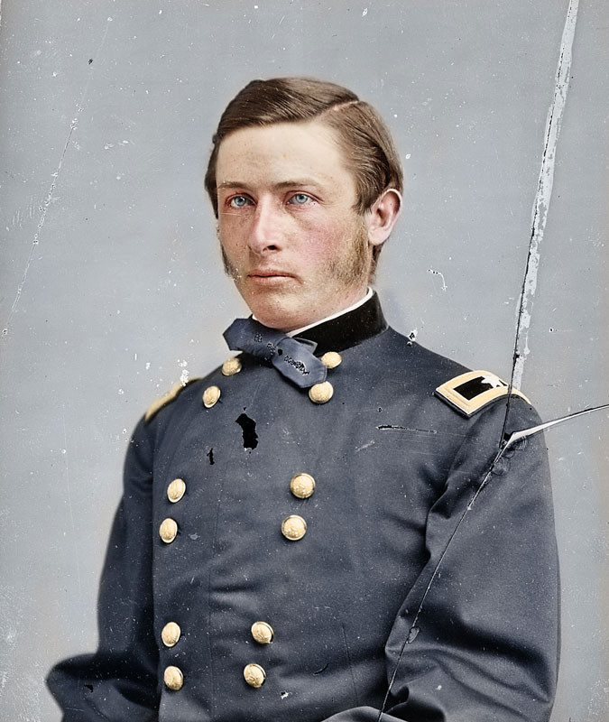
Randall Slidell Mackenzie

Slide 36
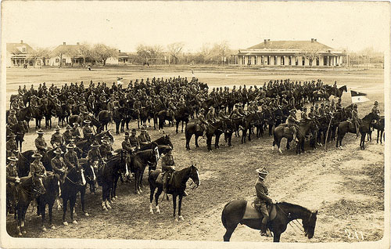

Slide 37
Essential Question #2:
What led to the “Indian Wars” of the 1870s and why, exactly, did American Indians lose this final fight?

Slide 38
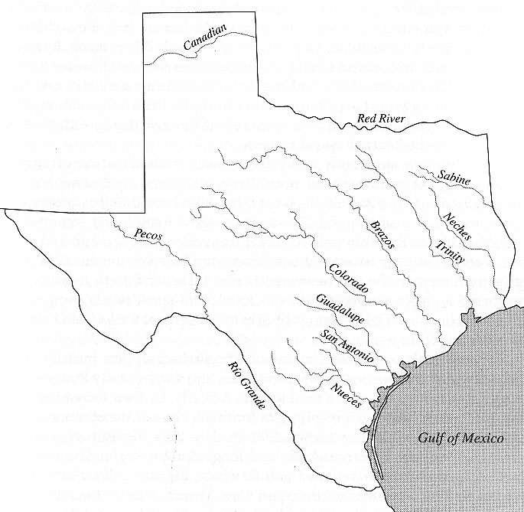

Slide 39
Texas Population Increases:

Slide 40
Texas Population Increases:
1870: 800,000 people

Slide 41
Texas Population Increases:
1870: 800,000 people
1880: 1.6 million people

Slide 42
Texas Population Increases:
1870: 800,000 people
1880: 1.6 million people
1890: 2.2 million people

Slide 43
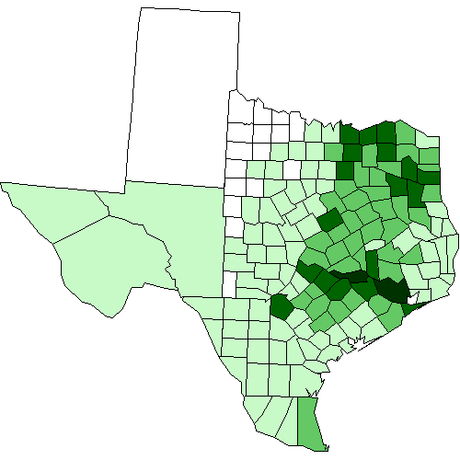
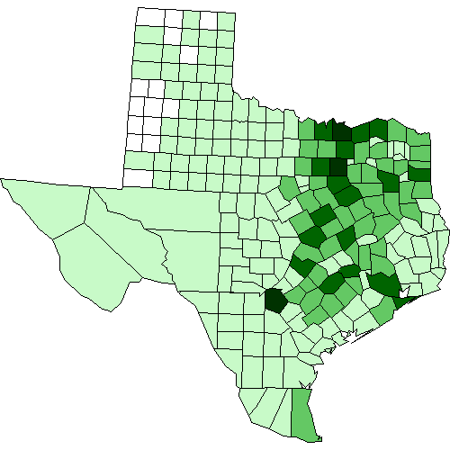
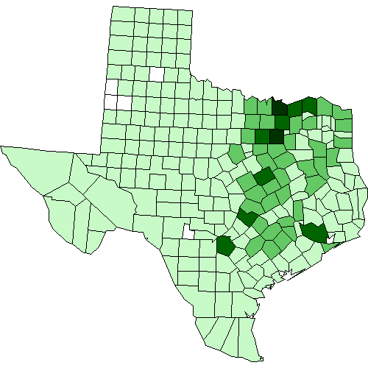
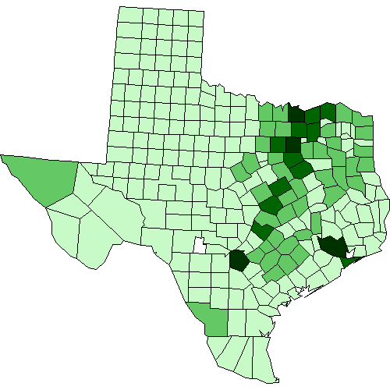
Population Change, 1870-1900
Population, 1870:
815,579
Population, 1880:
1,591,749
Population, 1890:
2,235,597
Population, 1900:
3,048,710

Slide 44
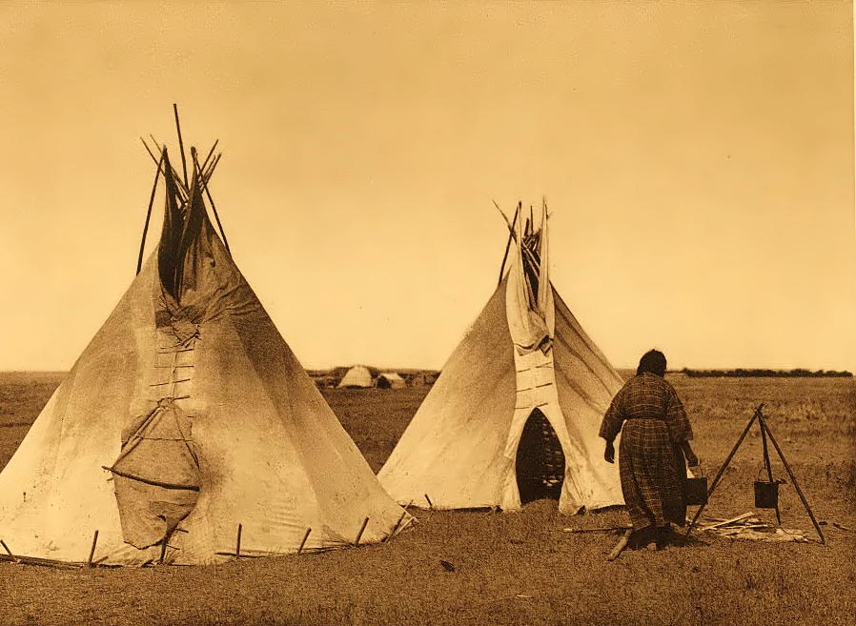

Slide 45
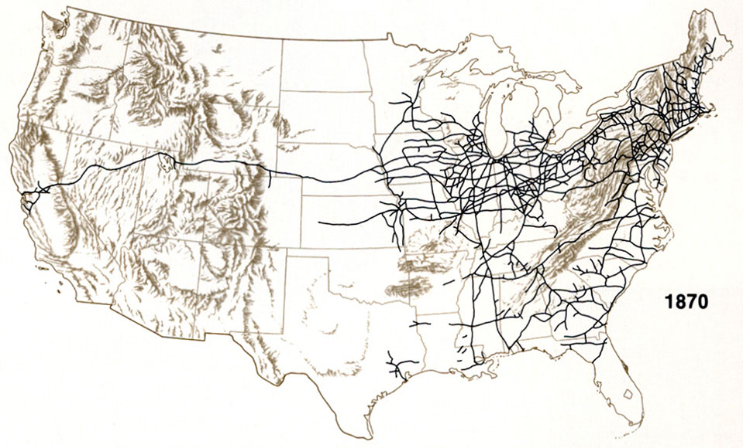

Slide 46
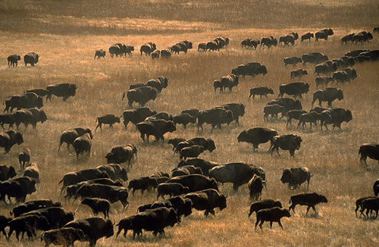

Slide 47
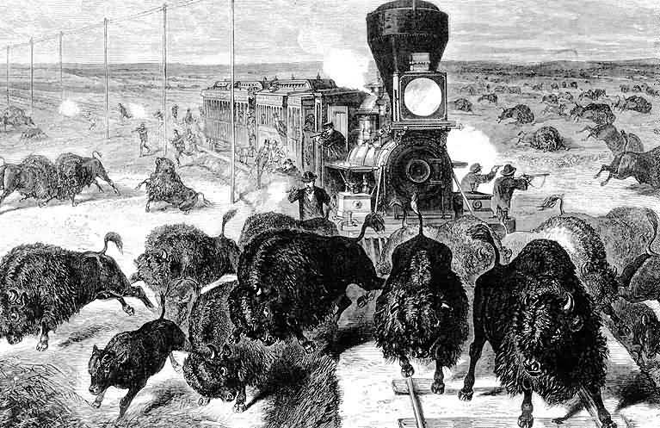

Slide 48
In 1872, a Philadelphia tanner bought 57 buffalo hides for $200.

Slide 49
In 1872, a Philadelphia tanner bought 57 buffalo hides for $200.
Realizing they made great leather, he put in an order for 2,000 more.

Slide 50
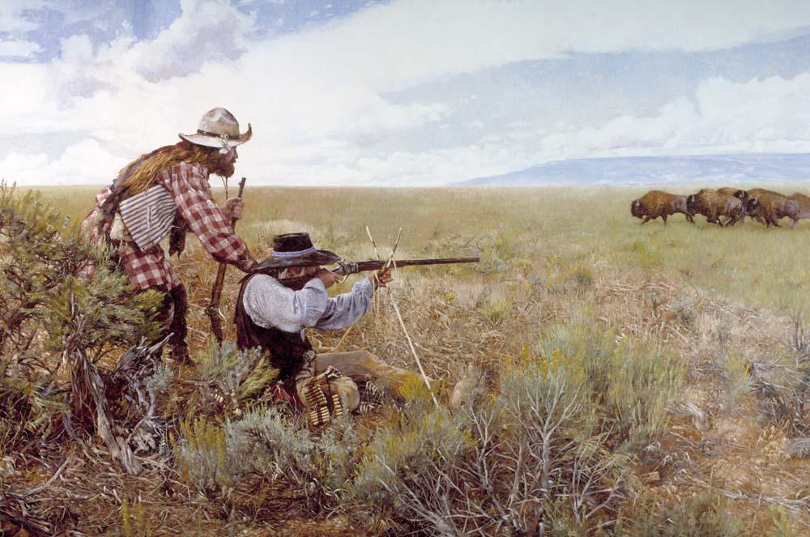

Slide 51
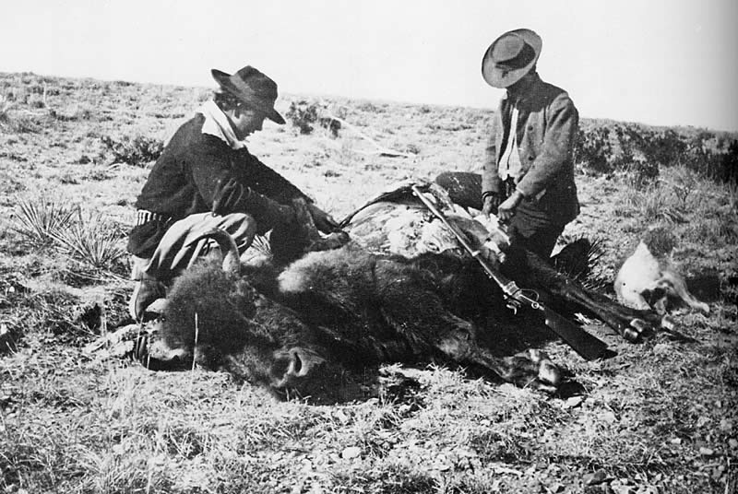

Slide 52
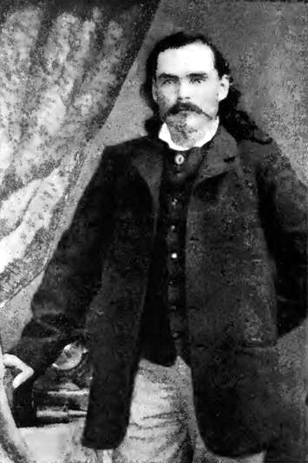
“No mercy was shown the buffalo. I killed as many as my three men [skinners] could handle, working them as hard as they were willing to work. This was deadly business, without sentiment; it was dollars against tender-heartedness, and dollars won.”
-Billy Dixon

Slide 53
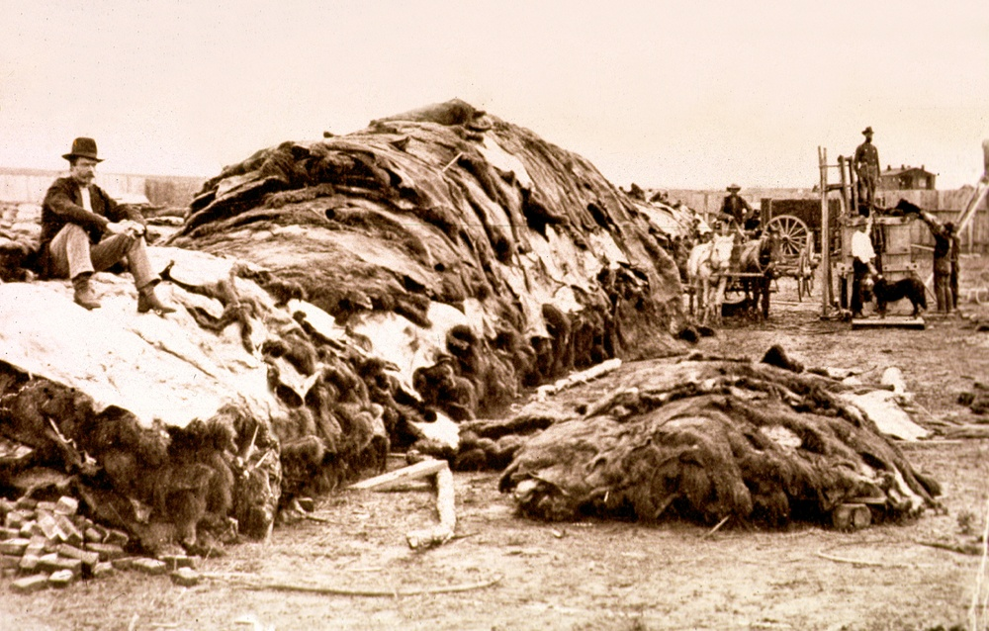

Slide 54
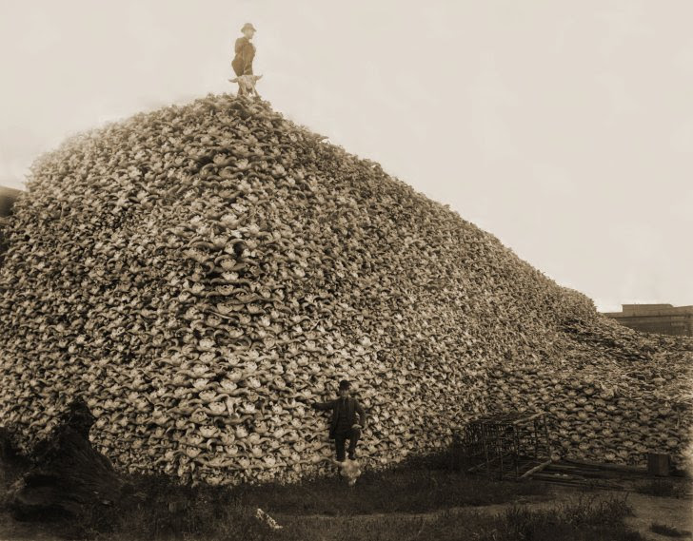

Slide 55
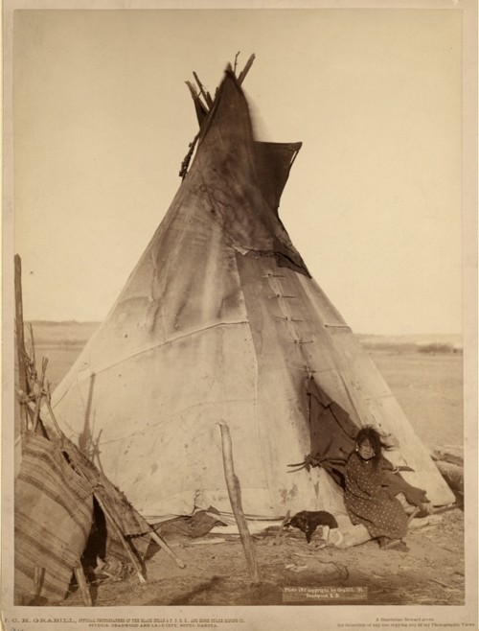

Slide 56
Buffalo hunters have “done more in the last two years . . . To solve the vexed Indian question than the entire regular army has done in the last 30 years.”
-General Philip Sheridan

Slide 58
White Eagle

Slide 59
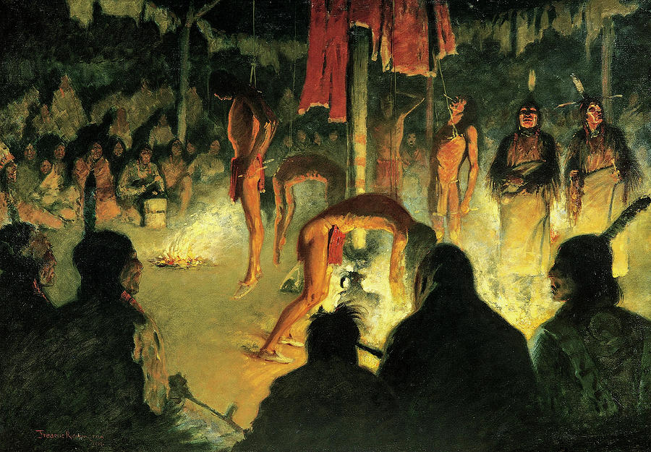

Slide 60
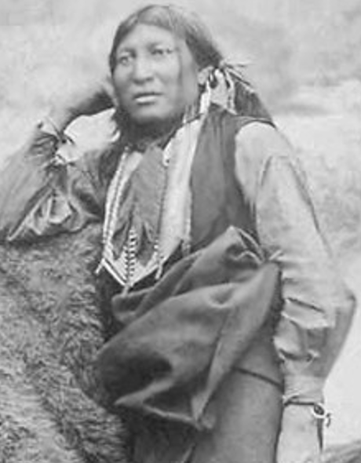

Slide 61
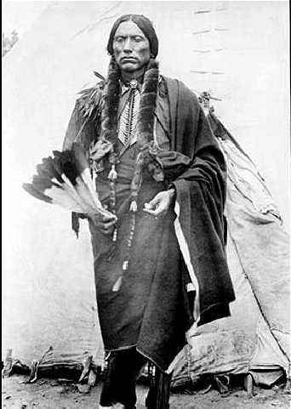
Quanah Parker
White Eagle

Slide 62
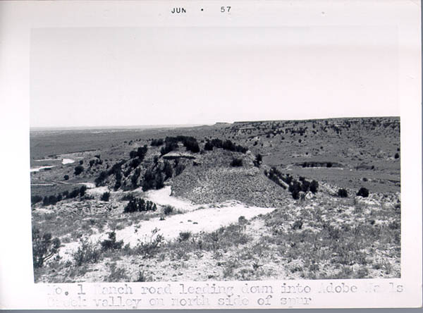
Adobe Walls, June 1874

Slide 63
Billy Dixon

Slide 64
Renamed “Isa-Tai”

Slide 65
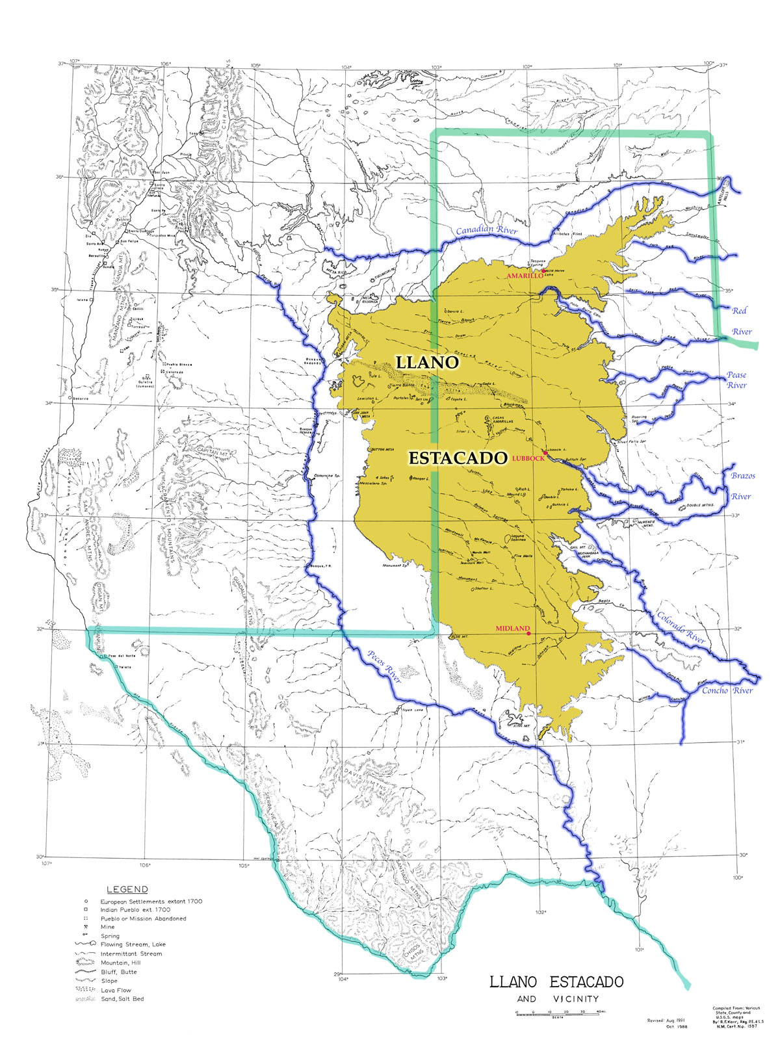

Slide 66
Red River War

Slide 67
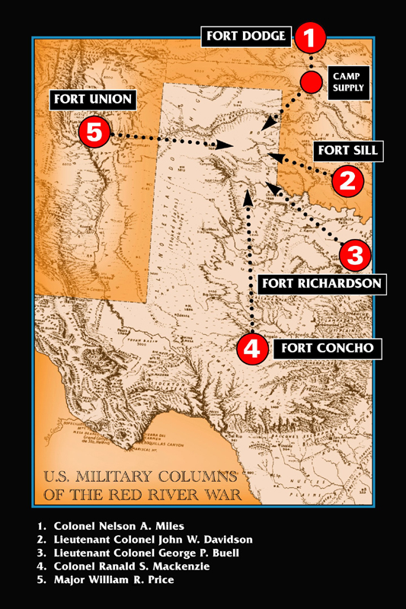

Slide 68
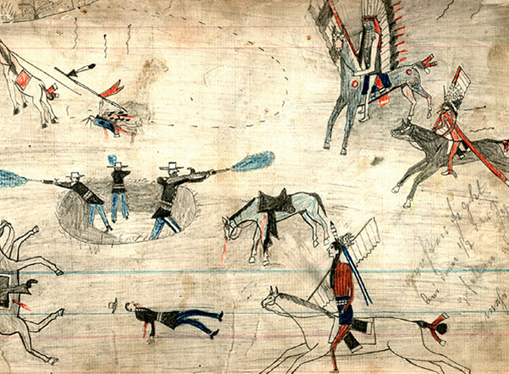

Slide 69
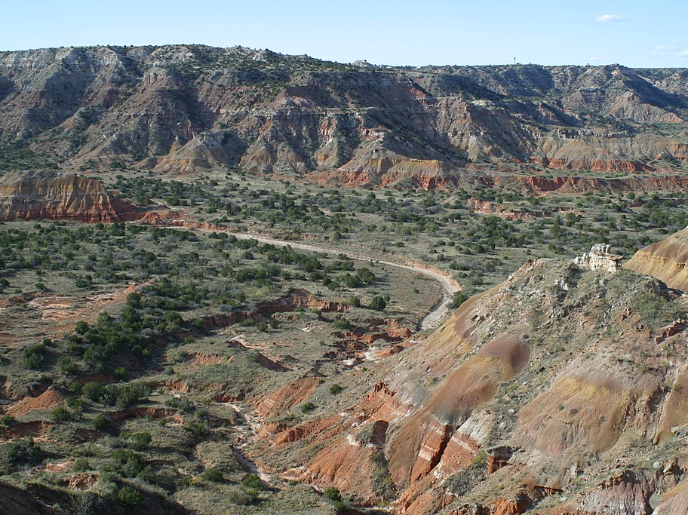

Slide 72
With the surrender of the Comanche under Quanah Parker in June 1875, it was the end of an age in Texas.

