Slide 1
1865-1900 Gregg Cantrell Humanities Texas Webinar March 2021

Slide 2
From Grade 7 Social Studies TEKS
Introduction #4:
Students identify the role of the U.S. free enterprise system within the parameters of this course and understand that this system may also be referenced as capitalism or the free market system.

Slide 3
From Grade 7 Social Studies TEKS
History TEK #6:
(C) identify significant individuals, events, and issues, including the effects of the growth of railroads and the contributions of James Hogg;
(D) explain the political, economic, and social impact of the agricultural industry and the development of West Texas resulting from the close of the frontier.
History TEK #7:
(C) describe and compare the impact of reform movements in Texas in the 19th and 20th centuries . . .
Economics TEK #7:
(B) explain the impact of economic concepts within the free enterprise system such as supply and demand, profit, and world competition on the economy of Texas;

Slide 4
Essential Question for Today:
How did capitalism—also known as the U.S. free enterprise system—lead Texas farmers in the late nineteenth century into the political reform movement known as Populism?

Slide 5
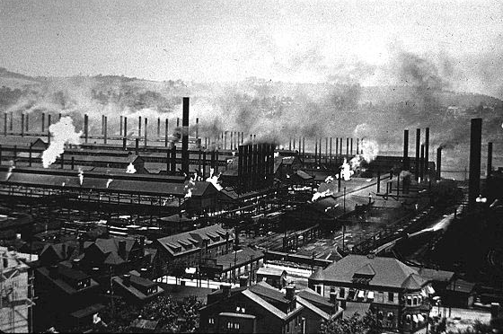

Slide 7
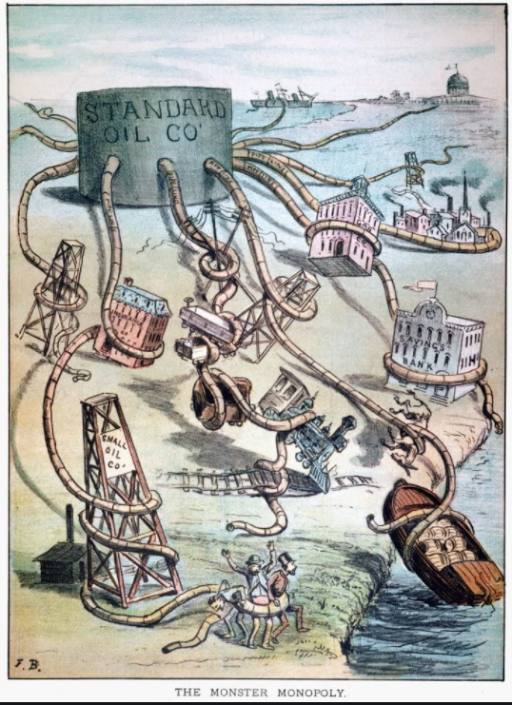

Slide 8
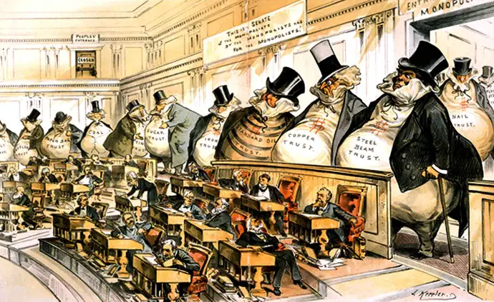
Monopoly Power Over Congress
“Bosses of the Senate”

Slide 9
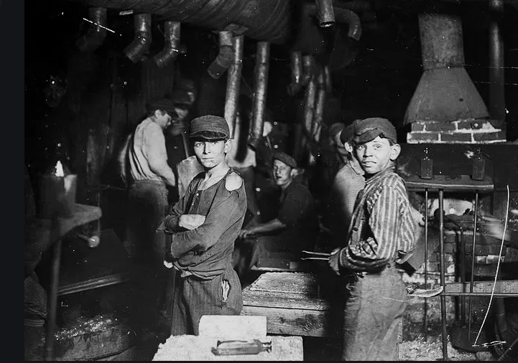

Slide 11
Cotton Merchants in India, 1878

Slide 12
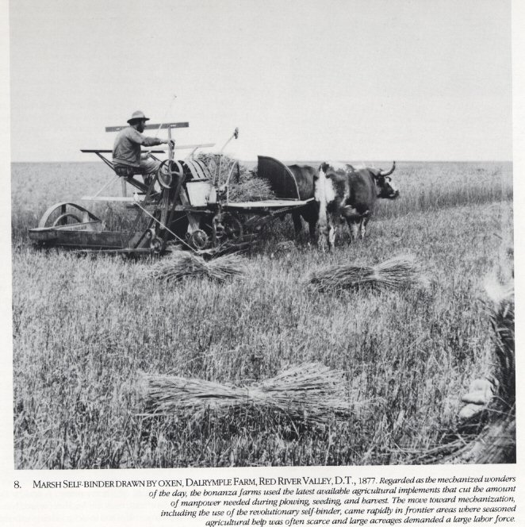

Slide 13
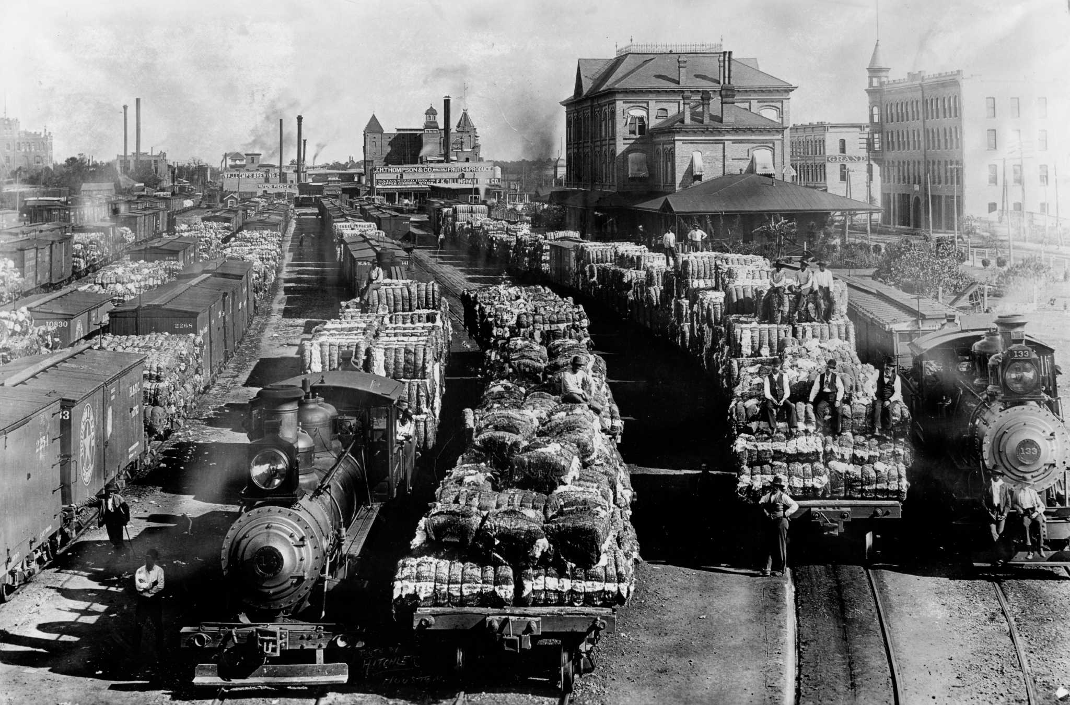

Slide 14
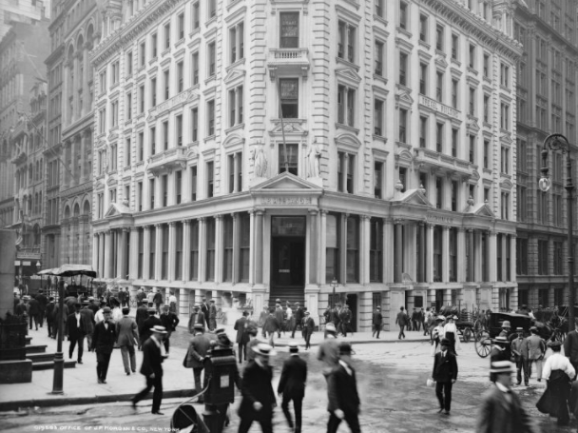
Drexel, Morgan, & Co., 23 Wall Street

Slide 15
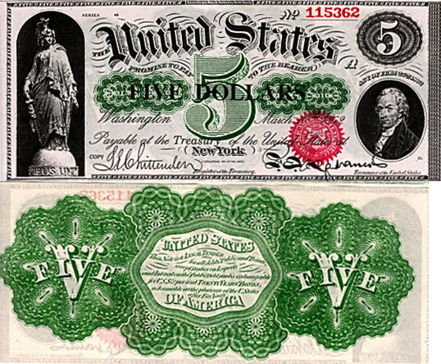
Federal Monetary Policy:
Greenbacks vs. Gold

Slide 16
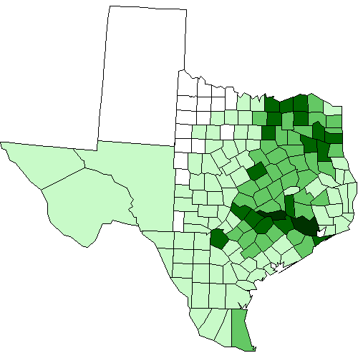
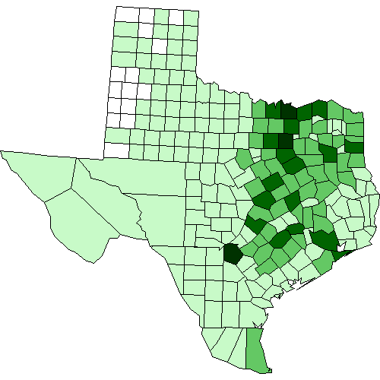
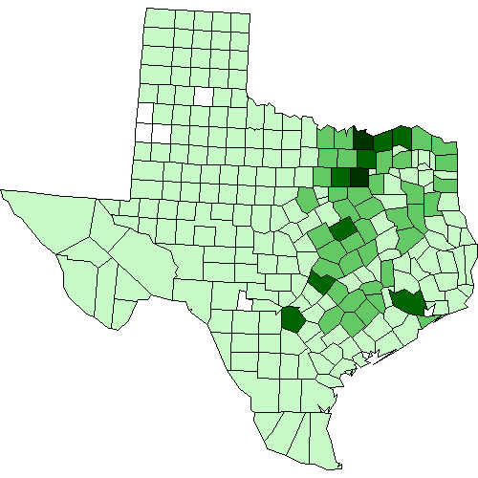
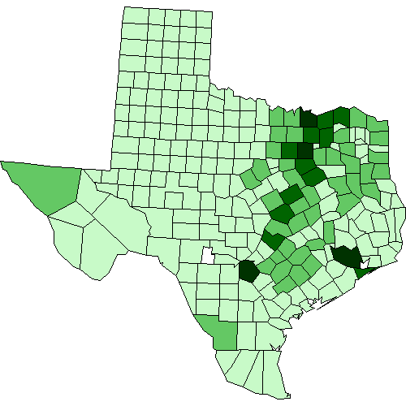
Population Change, 1870-1900
Population, 1870:
815,579
Population, 1880:
1,591,749
Population, 1890:
2,235,597
Population, 1900:
3,048,710

Slide 17
Texas Population, 1870-1900
Decade % Change
1870-1880 95
1880-1890 40
1890-1900 36
Total percentage change, 1870-1900: 372%

Slide 18
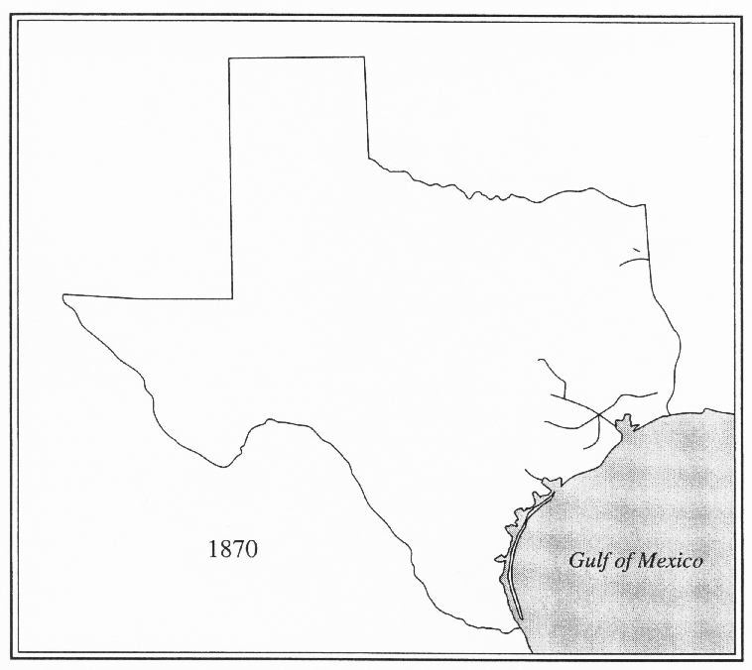
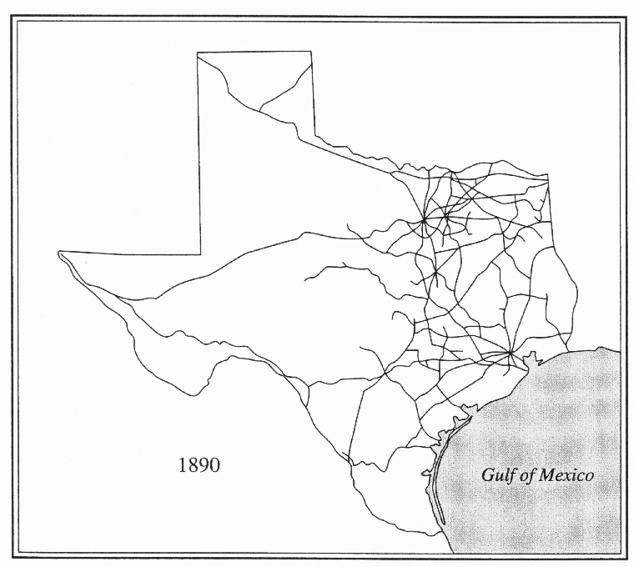
Railroads, 1870 - 1890

Slide 19
Texas Cotton Acreage
1870: 922,000
1880: 2,178,000
1890: 3,934,000
1900: 6,960,000

Slide 20
Cotton Prices
1869: 16 cents
1870: 12
1875: 11
1880: 10
1885: 9
1890: 9
1893: 7
1894: 5
(with little recovery until after 1900)

Slide 21
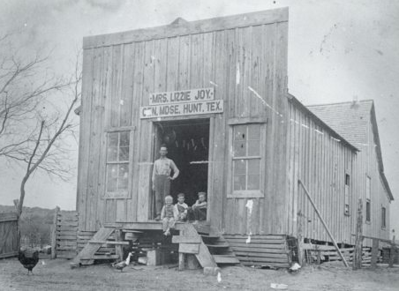
Furnishing Merchant

Slide 22
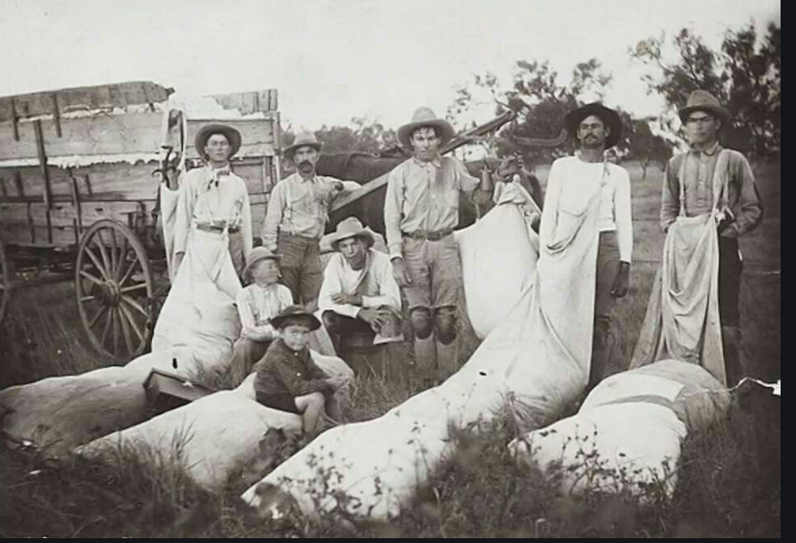

Slide 23
Selected Statistics from Texas
Farms Mortgaged
1890: 8,000
1900: 38,000
1910: 64,000
Farms Operated by Tenants
1880: 38%
1890: 42%
1900: 50%

Slide 24
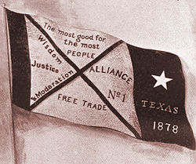
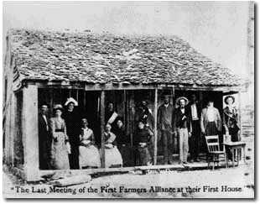
Lampasas, Texas, 1877 Birth of the Farmers’ Alliance

Slide 25
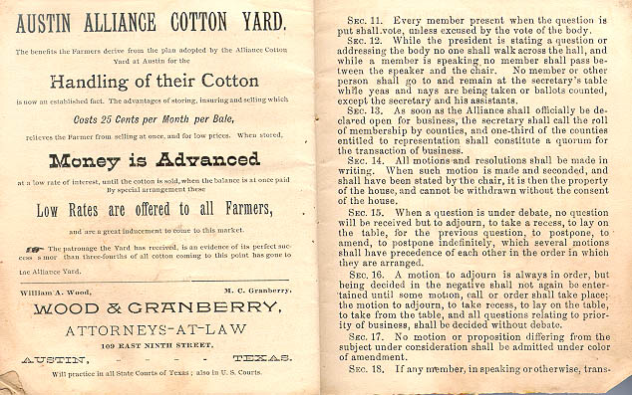
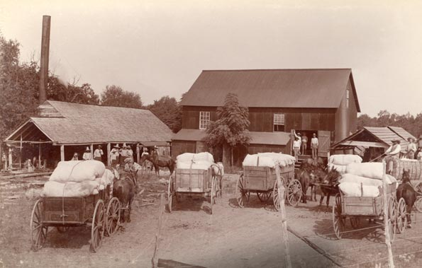

Slide 26
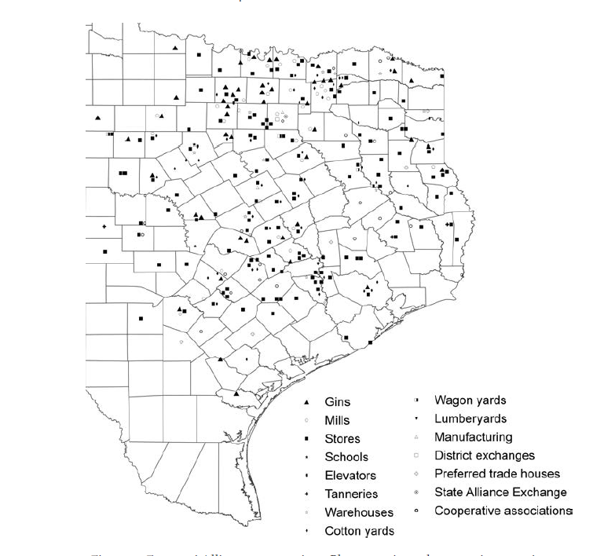
Alliance Cooperatives

Slide 27
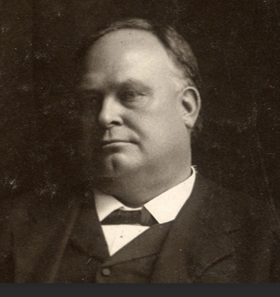
James Stephen Hogg

Slide 28
Major Alliance Demands
national paper currency (“Greenbacks”)
Subtreasury Plan—low-cost govt. loans
graduated income tax
government ownership of railroads
direct election of U.S. senators
collective bargaining rights

Slide 30
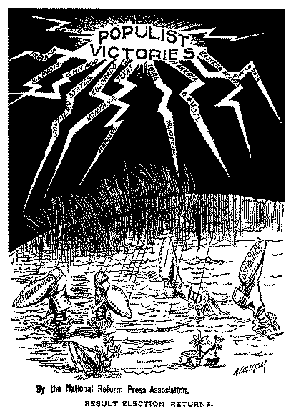

Slide 31
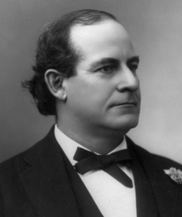
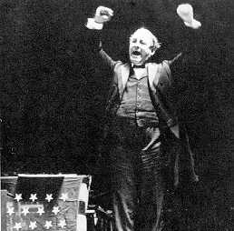

Slide 32
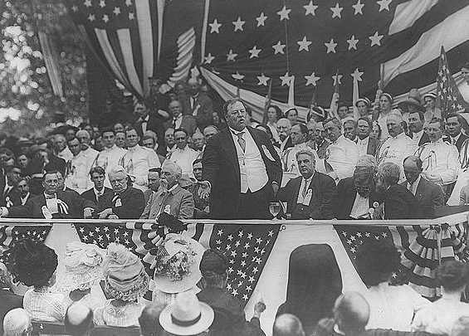

Slide 33
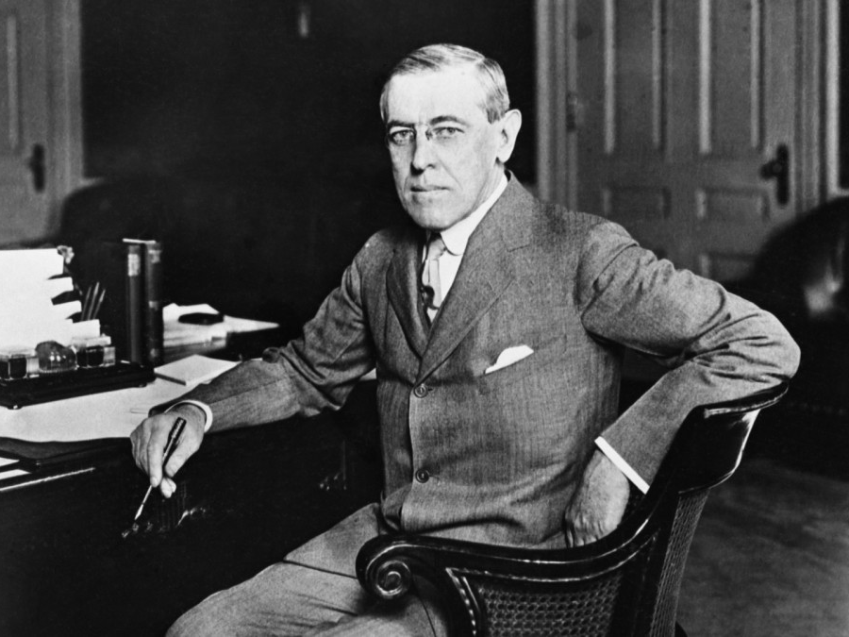

Slide 34
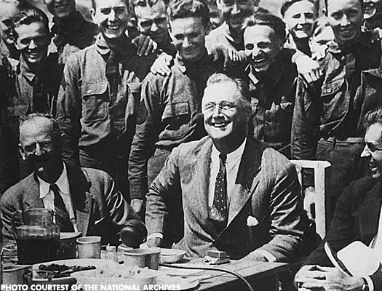

Slide 35
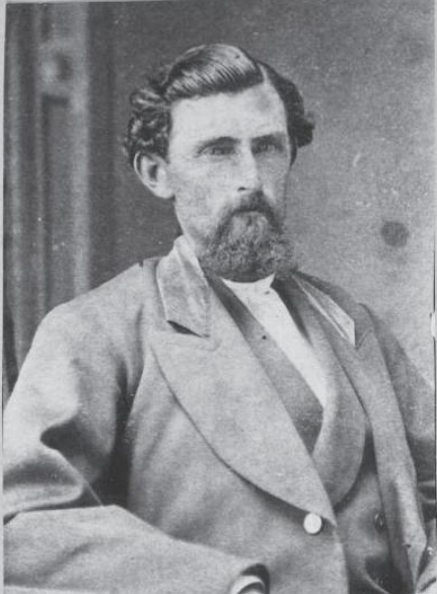
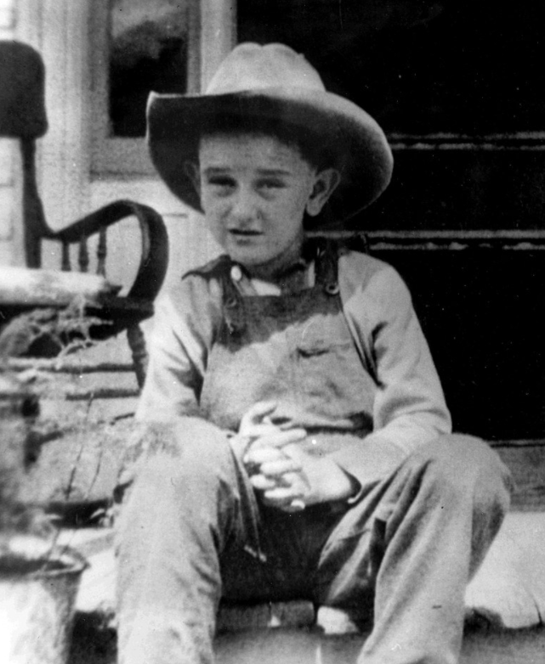

Slide 37
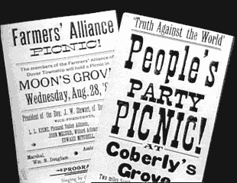

Slide 38
1865-1900 Gregg Cantrell Humanities Texas Webinar March 2021

