Slide 1
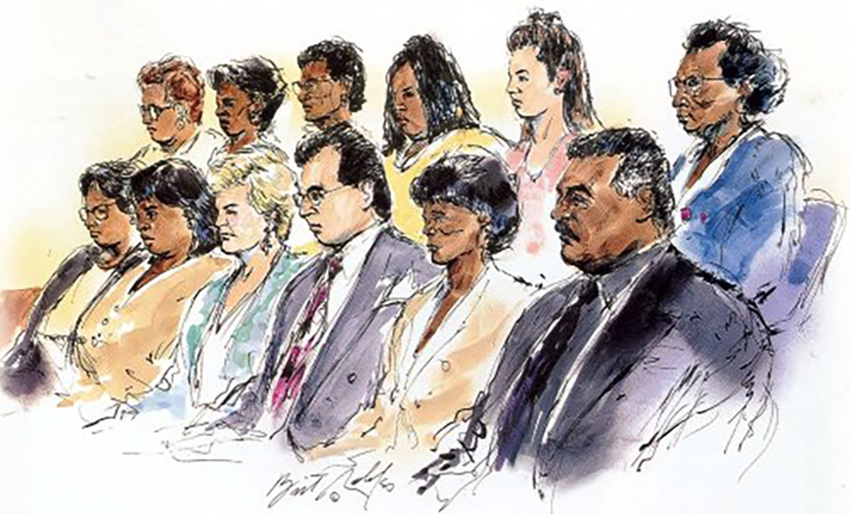
Criminal Procedure Humanities TX Teacher Workshop The Court and the Constitution November 1, 2021
Alyx Mark
Dept. of Government
Wesleyan University
The Simpson Jury by Bill Robles

Slide 2
Tonight’s focus
Constitutional deprivation of liberty
½ c. 4th Amendment
Admissibility of evidence
1 tbsp. 5th Amendment
Jury selection practices
dash of 6th Amendment
Provision of counsel
zest of one 14th Amendment
8th Amendment (punishment)
James Madison (…and John Bingham)

Slide 3
Where do rights of the criminally accused come from?
“No free man shall be seized or imprisoned, or stripped of his rights or possessions, or outlawed or exiled, or deprived of his standing in any other way, nor will we proceed with force against him, or send others to do so, except by the lawful judgment of his equals or by the law of the land.”
Magna Carta

Slide 4
Where do rights of the criminally accused come from?
Hurtado v. California (1884)
“…if the people of the State find it wise and expedient to abolish the grand jury and prosecute all crimes by information, there is nothing in our State Constitution and nothing in the Fourteenth Amendment to the Constitution of the United States which prevents them from doing so.”
Justice Matthews, majority

Slide 5
Where do rights of the criminally accused come from?
Hurtado v. California (1884)
“I omit further citations of authorities, which are numerous, to prove that, according to the settled usages and modes of proceeding existing under the common and statute law of England at the settlement of this country, information in capital cases was not consistent with the "law of the land," or with "due process of law." Such was the understanding of the patriotic men who established free institutions upon this continent.”
Justice Harlan, dissent

Slide 6
Where do rights of the criminally accused come from?
Hurtado v. California (1884)
“… [the] law of the land in each State… [is] exerted within the limits of those fundamental principles of liberty and justice which lie at the base of all our civil and political institutions.”
Justice Matthews

Slide 9
Where do rights of the criminally accused come from?
"It is possible that some of the personal rights safeguarded by the first eight Amendments against National action may also be safeguarded against state action, because a denial of them would be a denial of due process of law. If this is so, it is not because those rights are enumerated in the first eight Amendments, but because they are of such a nature that they are included in the conception of due process of law.”
Justice Moody in Twining (1908)

Slide 10
Constitutional deprivation of liberty
½ c. 4th Amendment
Admissibility of evidence
1 tbsp. 5th Amendment
Jury selection practices
dash of 6th Amendment
Provision of counsel
zest of one 14th Amendment
James Madison (…and John Bingham)

Slide 11
“…the conception of due process of law” and enforcing the 4th Amendment
The right of the people to be secure in their persons, houses, papers, and effects, against unreasonable searches and seizures, shall not be violated, and no Warrants shall issue, but upon probable cause, supported by Oath or affirmation, and particularly describing the place to be searched, and the persons or things to be seized.
What do we do if a law enforcement official violates provisions of the 4th Amendment?
Exclusionary rule?
Federal: Weeks v. US (1914) 👍
State: Wolf v. Colorado (1949) 👎

Slide 12
Mapp v. Ohio (1961)
“There is no war between the Constitution and common sense. Presently, a federal prosecutor may make no use of evidence illegally seized, but a state's attorney across the street may, although he supposedly is operating under the enforceable prohibitions of the same Amendment.”
Justice Clark, majority

Slide 13
Are you in favor of or opposed to an unrestricted Exclusionary Rule?
Example of an argument for:
Deters police misconduct (Linkletter v Walker 1965)
Against:
Should we allow “the criminal to go free because the constable blundered?” (Cardozo in People v. Defore 1926 – NY Court of Appeals)

Slide 14
Restricting the Exclusionary Rule
US v. Leon (1984), Michigan v. Hudson (2006)
Breonna Taylor case

Slide 15
Constitutional deprivation of liberty
½ c. 4th Amendment
Admissibility of evidence
1 tbsp. 5th Amendment
Jury selection practices
dash of 6th Amendment
Provision of counsel
zest of one 14th Amendment
James Madison (…and John Bingham)

Slide 17
Sixth Amendment and the Right to Counsel
5th and 14th Amendment: the government cannot deprive me of my “life, liberty, or property” without the due process of law.
6th Amendment: “In all criminal prosecutions, the accused shall…have the assistance of counsel for his defense.”

Slide 18
Life, liberty, and ??
Life, state (and extraordinary circumstances): Powell v. Alabama (1932)
Liberty, federal: Johnson v. Zerbst (1938)
Liberty, state:

Slide 19
Life, liberty, and ??
Life, state (and extraordinary circumstances): Powell v. Alabama (1932)
Liberty, federal: Johnson v. Zerbst (1938) 👍
Liberty, state:

Slide 20
Life, liberty, and ??
Life, state (and extraordinary circumstances): Powell v. Alabama (1932)
Liberty, federal: Johnson v. Zerbst (1938) 👍
Liberty, state: Betts v. Brady (1941)

Slide 21
Life, liberty, and ??
Life, state (and extraordinary circumstances): Powell v. Alabama (1932)
Liberty, federal: Johnson v. Zerbst (1938) 👍
Liberty, state: Betts v. Brady (1941) 👎
Why fundamental at the federal level but not the state level?

Slide 22
Gideon v. Wainwright (1963)
”…this noble ideal [impartial criminal trials] cannot be realized if the poor man charged with crime has to face his accusers without a lawyer to assist him.”

Slide 23
Status of the right to counsel
NCCRC website

Slide 24
Constitutional deprivation of liberty
½ c. 4th Amendment
Admissibility of evidence
1 tbsp. 5th Amendment
Jury selection practices
dash of 6th Amendment
Provision of counsel
zest of one 14th Amendment
James Madison (…and John Bingham)

Slide 25
Juries and the Founding
Declaration of Independence
“the accustomed and inestimable privilege of trial by jury, in cases of both life and property.”
Constitution
“The Trial of all Crimes, except in Cases of Impeachment, shall be by Jury”
5th, 6th, 7th Amendments

Slide 26
Selecting jurors
“In all criminal prosecutions, the accused shall enjoy the right to a speedy and public trial, by an impartial jury of the State and district wherein the crime shall have been committed…”

Slide 27
Selecting jurors
Hernandez v. Texas (1954)
Batson v. Kentucky (1985)
Pete Hernandez with attorneys, c/o Garcia Papers at Texas A&M Corpus Christi

Slide 28
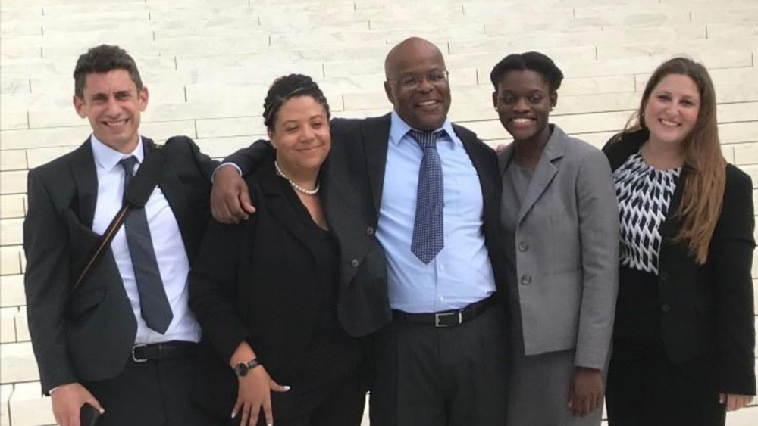
Summing up
Tyson Timbs, Timbs v. Indiana (2019)
Ramos v. Louisiana (2020) legal team

Slide 29
Thank you!
amark@wesleyan.edu

