Slide 1
The Collapse of Spain in Texas
Humanities Texas Webinar Series
September 2022

Slide 2
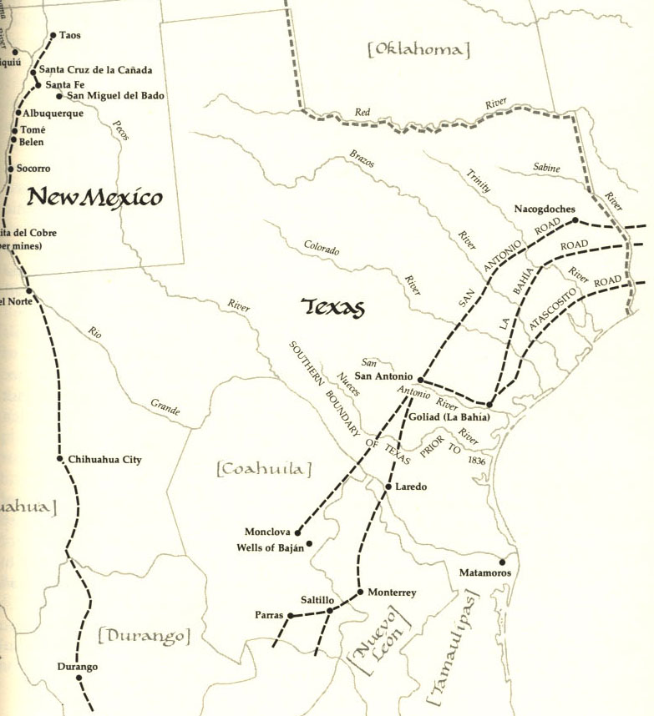

Slide 3
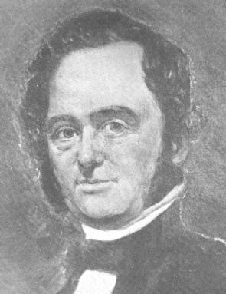

Slide 4
Essential Question #1:
Why were the Spanish so (incredibly) weak in Texas by 1820?

Slide 5
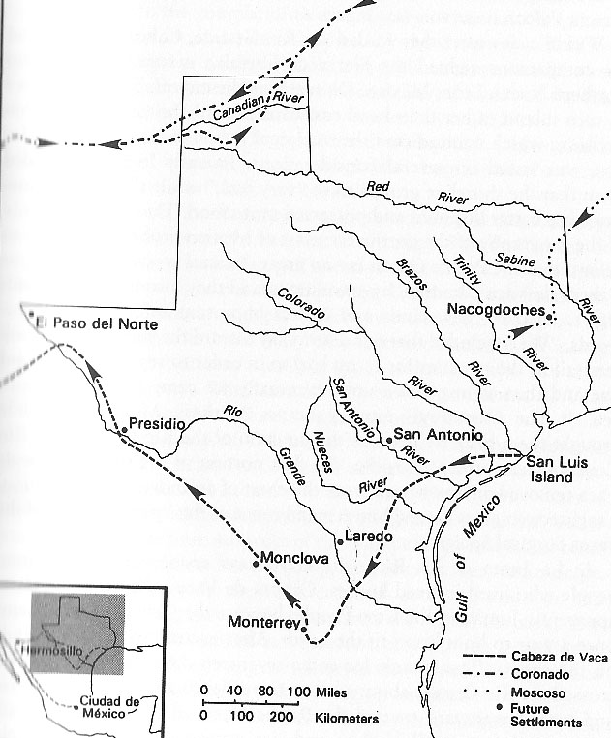

Slide 6
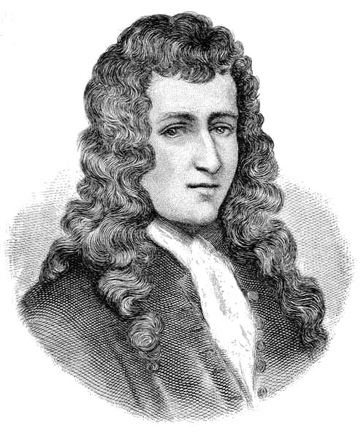

Slide 7
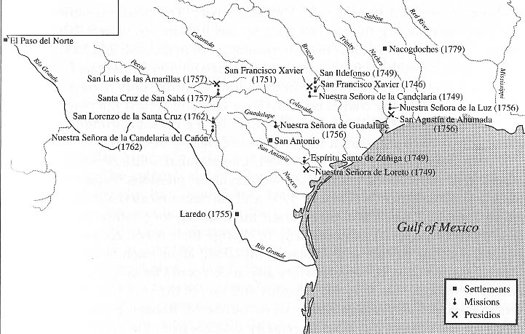

Slide 8
So what was the situation in Texas for the Spanish by 1800?

Slide 10
Major Problem #1:
The United States is your new neighbor!

Slide 11
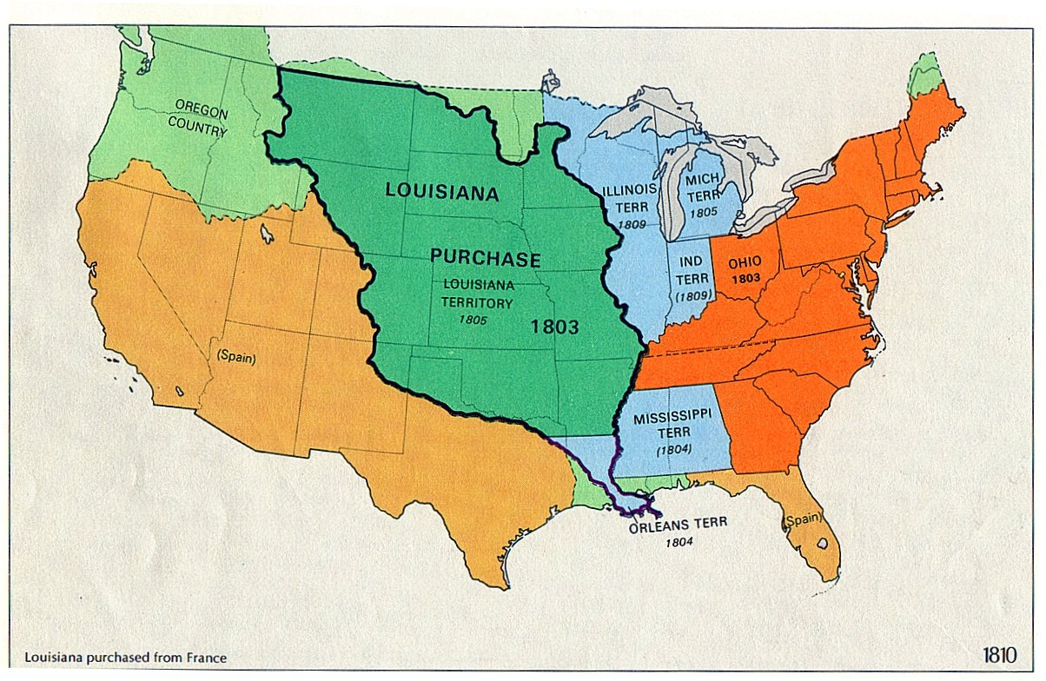

Slide 12
Major Problem #2:
Mexican War for Independence!

Slide 13
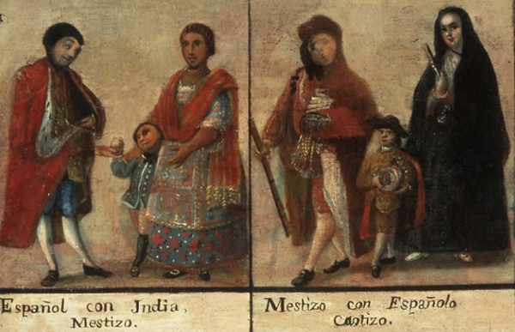

Slide 15
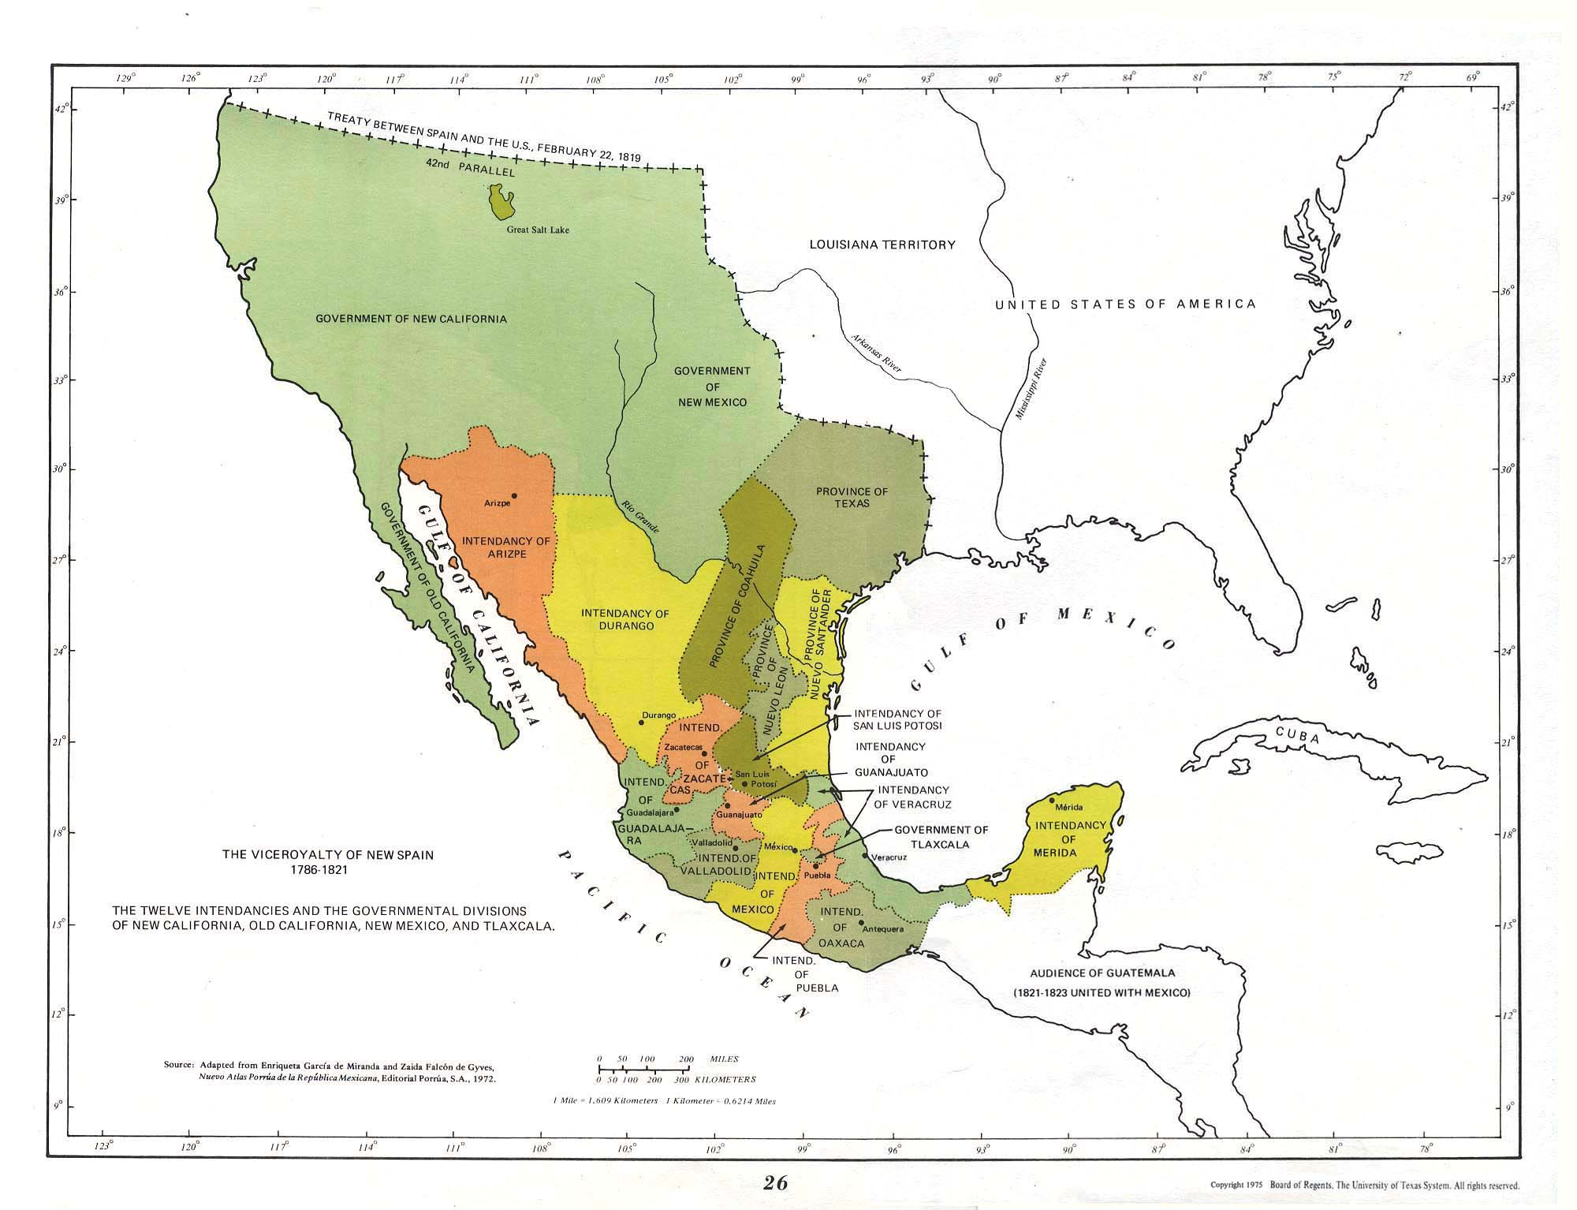
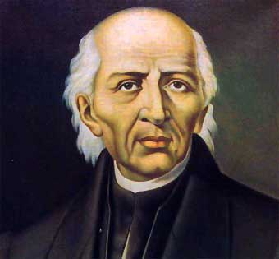

Slide 16
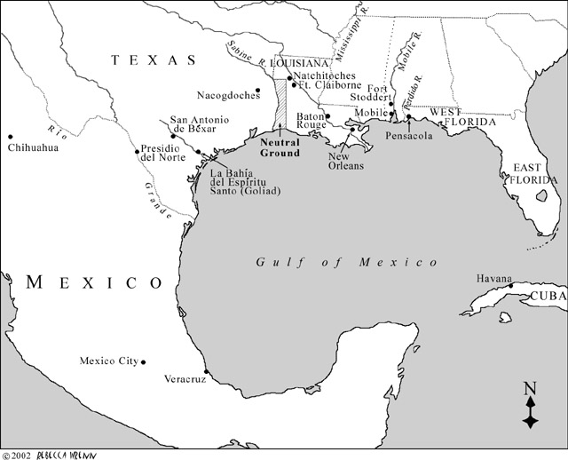

Slide 17
Gutierrez-Magee Expedition

Slide 19
Jose Joaquin de Arredondo

Slide 21
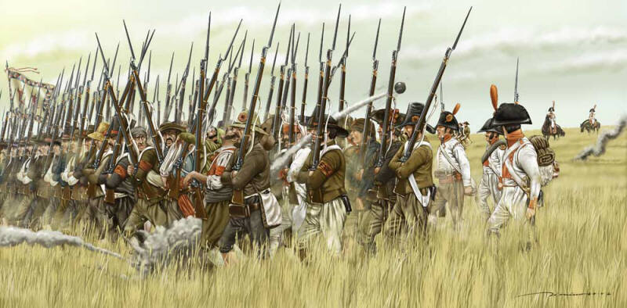

Slide 22
Of the 1,400 rebels, only around 100 survived.

Slide 23
Of the 1,400 rebels, only around 100 survived.
Of Arredondo’s 1,800 soldiers, only 50 died.

Slide 24
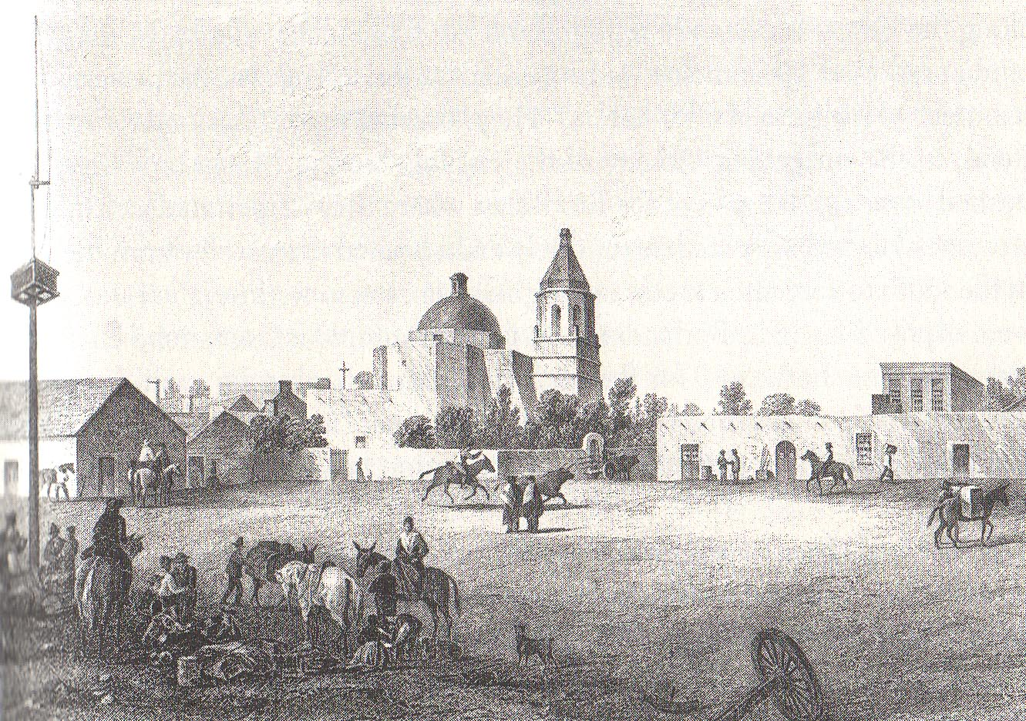

Slide 26
Major Problem #3:
Indian Raiding Increases Dramatically!

Slide 27
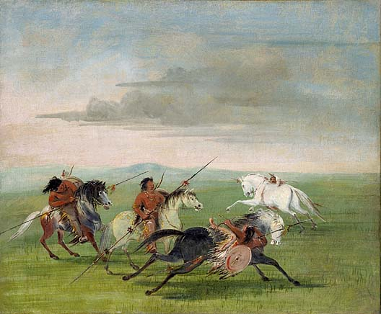

Slide 29
Major Problem #4:
Americans Invade Texas, and Spain Can Do Nothing!

Slide 30
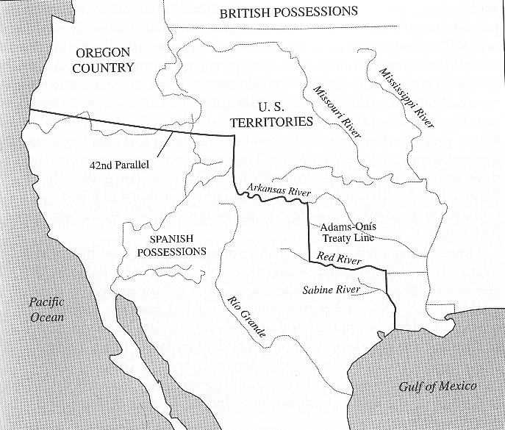

Slide 32
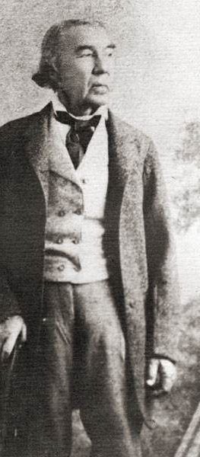

Slide 33
MAJOR PROBLEMS FACING TEJANOS BY THE LATE 1810s:

Slide 34
MAJOR PROBLEMS FACING TEJANOS BY THE LATE 1810s:
They had been decimated by the Mexican War for Independence.

Slide 35
MAJOR PROBLEMS FACING TEJANOS BY THE LATE 1810s:
They had been decimated by the Mexican War for Independence.
They could do nothing to stop any Anglo-Americans from coming into Texas.

Slide 36
MAJOR PROBLEMS FACING TEJANOS BY THE LATE 1810s:
They had been decimated by the Mexican War for Independence.
They could do nothing to stop any Anglo-Americans from coming into Texas.
They were overrun by Indians.

Slide 37
MAJOR PROBLEMS FACING TEJANOS BY THE LATE 1810s:
They had been decimated by the Mexican War for Independence.
They could do nothing to stop any Anglo-Americans from coming into Texas.
They were overrun by Indians.
They were getting pretty much NO support from Mexico City.

Slide 39
Essential Question #2:
Why would Spanish authorities approve Moses Austin’s plan to bring Americans into Texas?

Slide 40
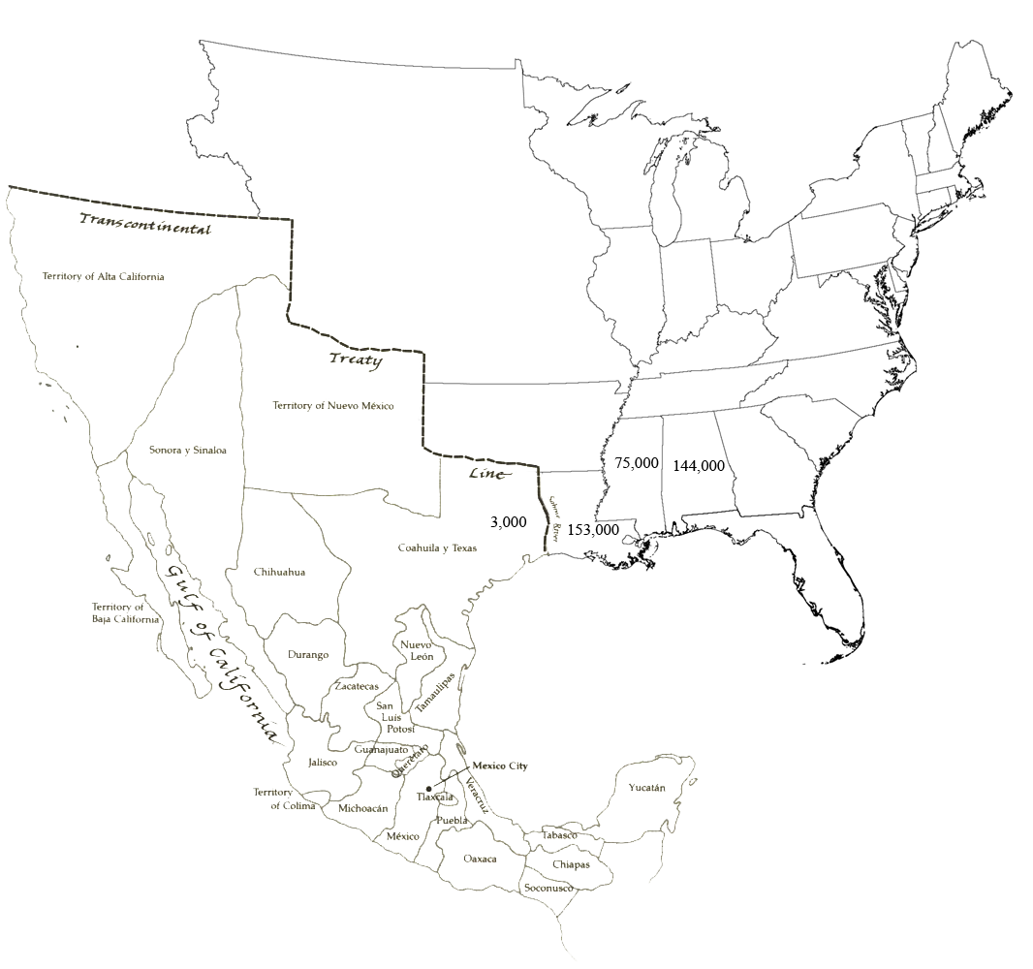

Slide 41
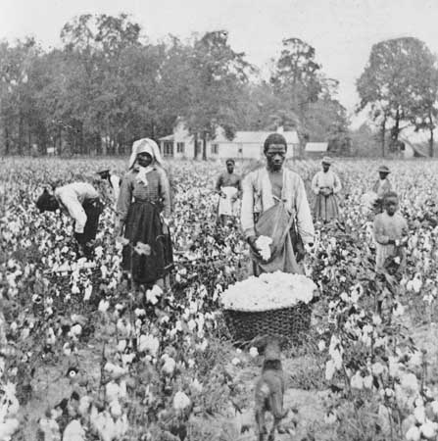

Slide 42
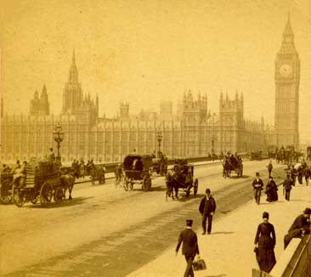

Slide 43
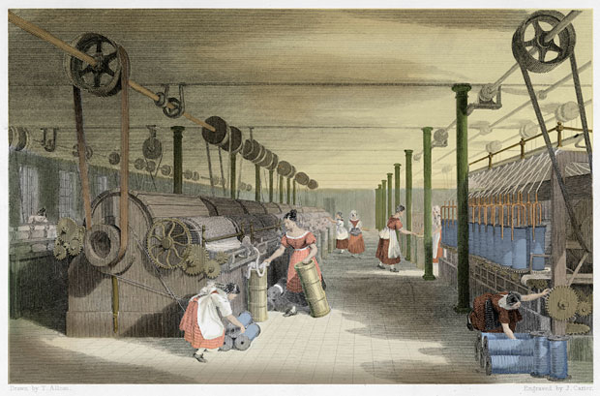

Slide 44
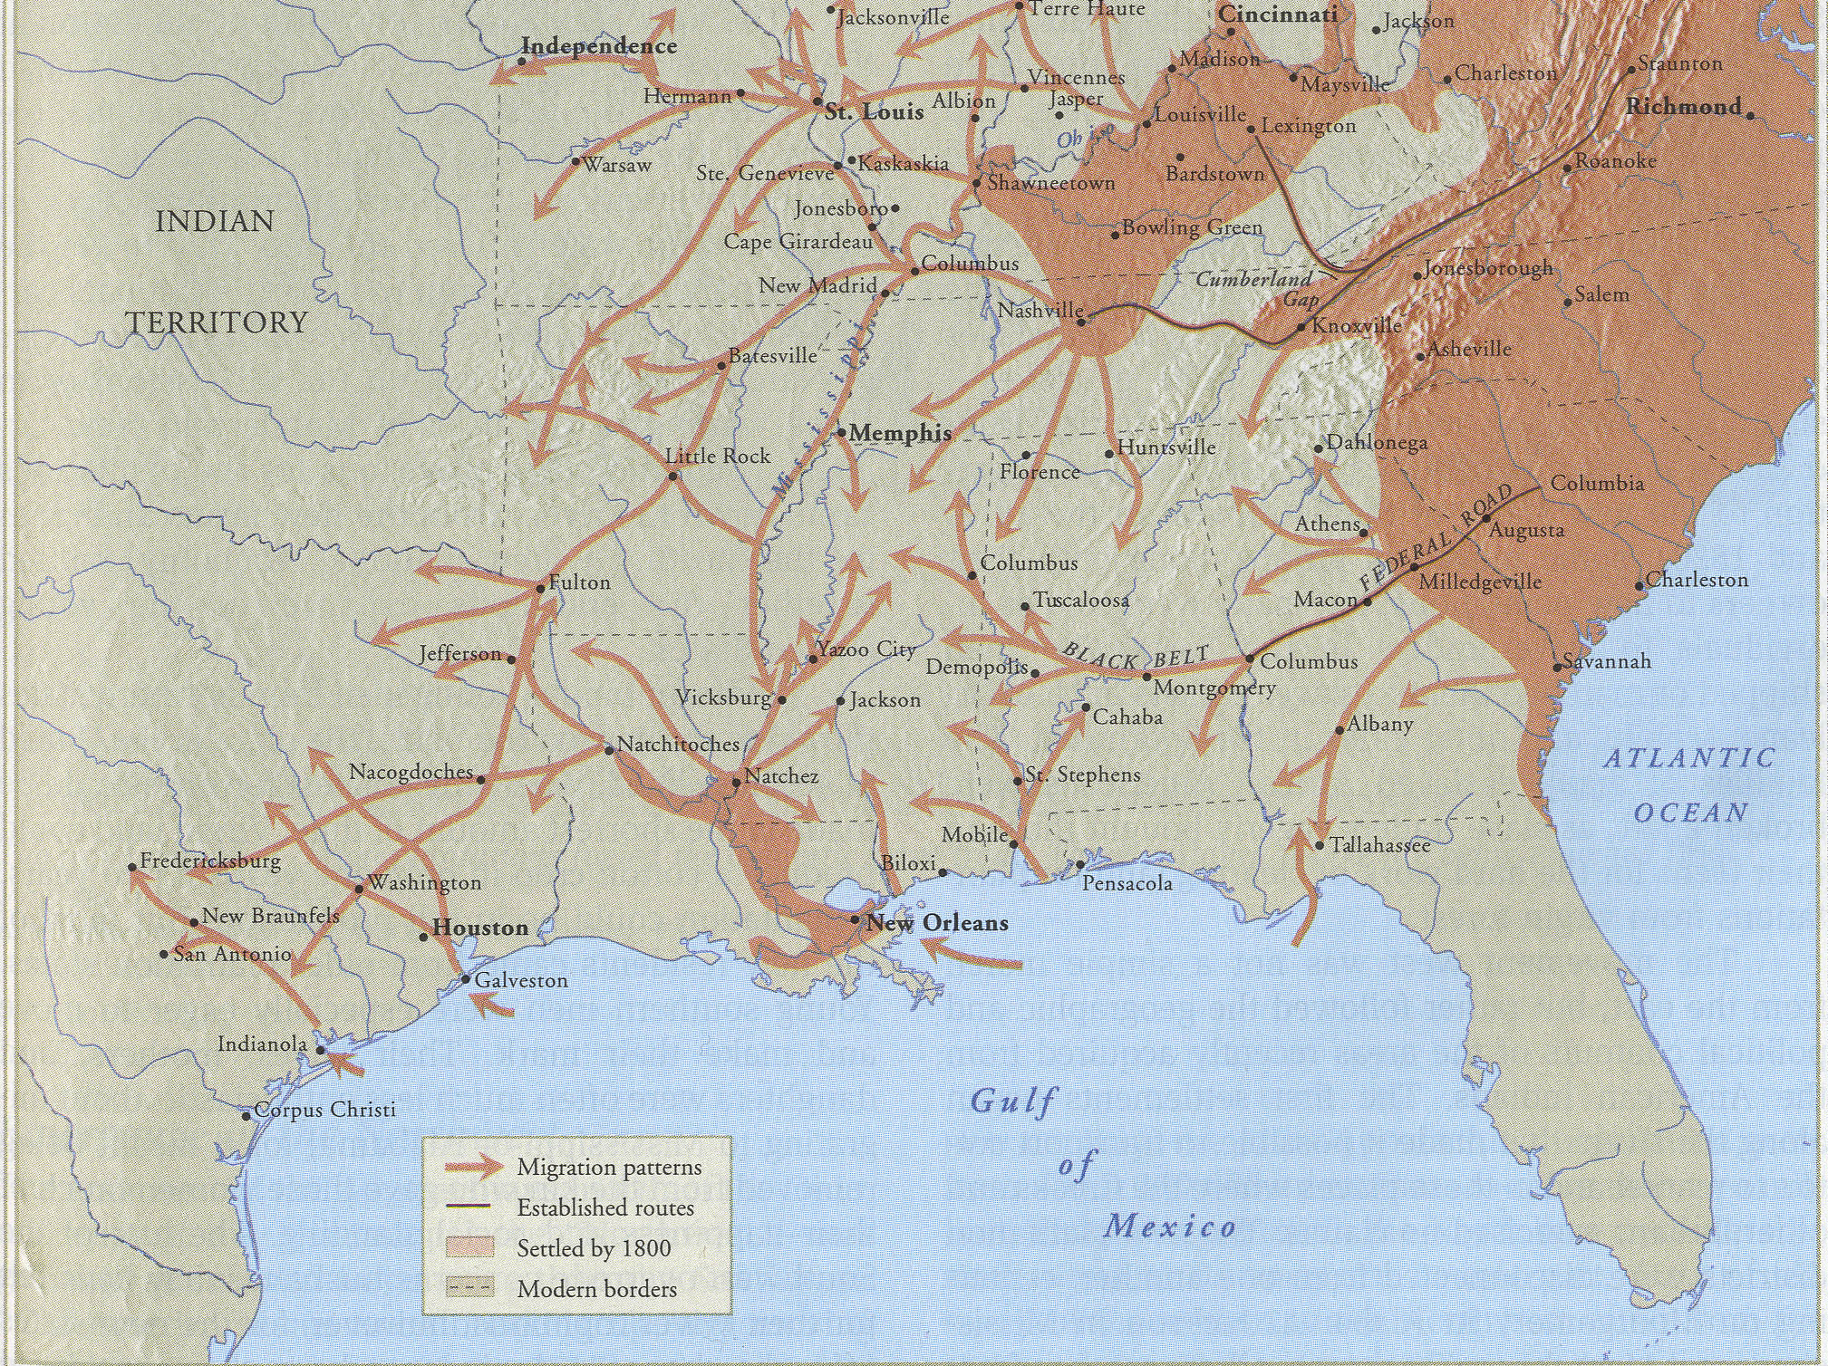

Slide 45
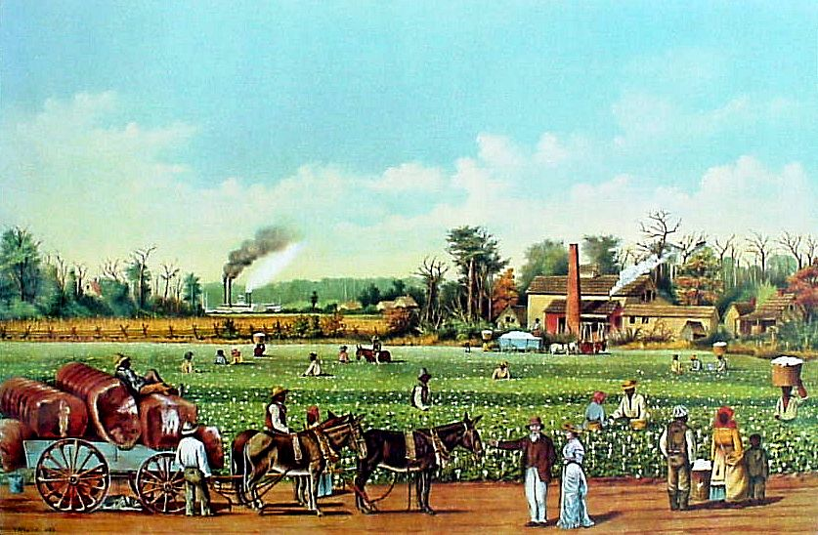

Slide 46
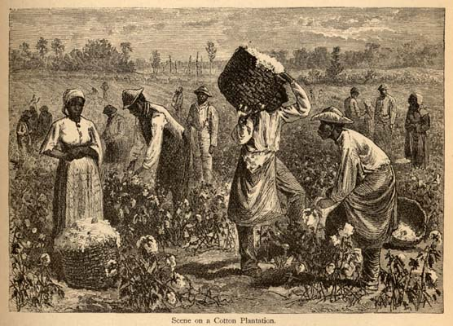

Slide 48
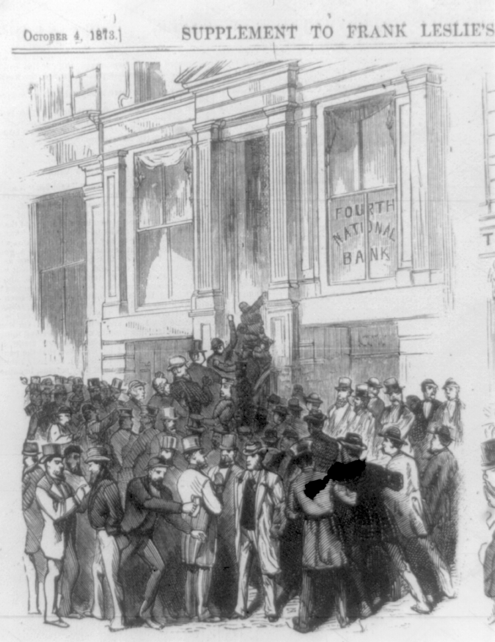
Panic of 1819

Slide 49
In an attempt to prevent another crisis, the U.S. Congress changes the rules for buying federal land. Now you need to put down enough cash to buy 80 acres outright – which, at $1.25/acre, is $100.

Slide 50
In an attempt to prevent another crisis, the U.S. Congress changes the rules for buying federal land. Now you need to put down enough cash to buy 80 acres outright – which, at $1.25/acre, is $100.
U.S. federal land sales immediately plummet by 80 percent.

Slide 51
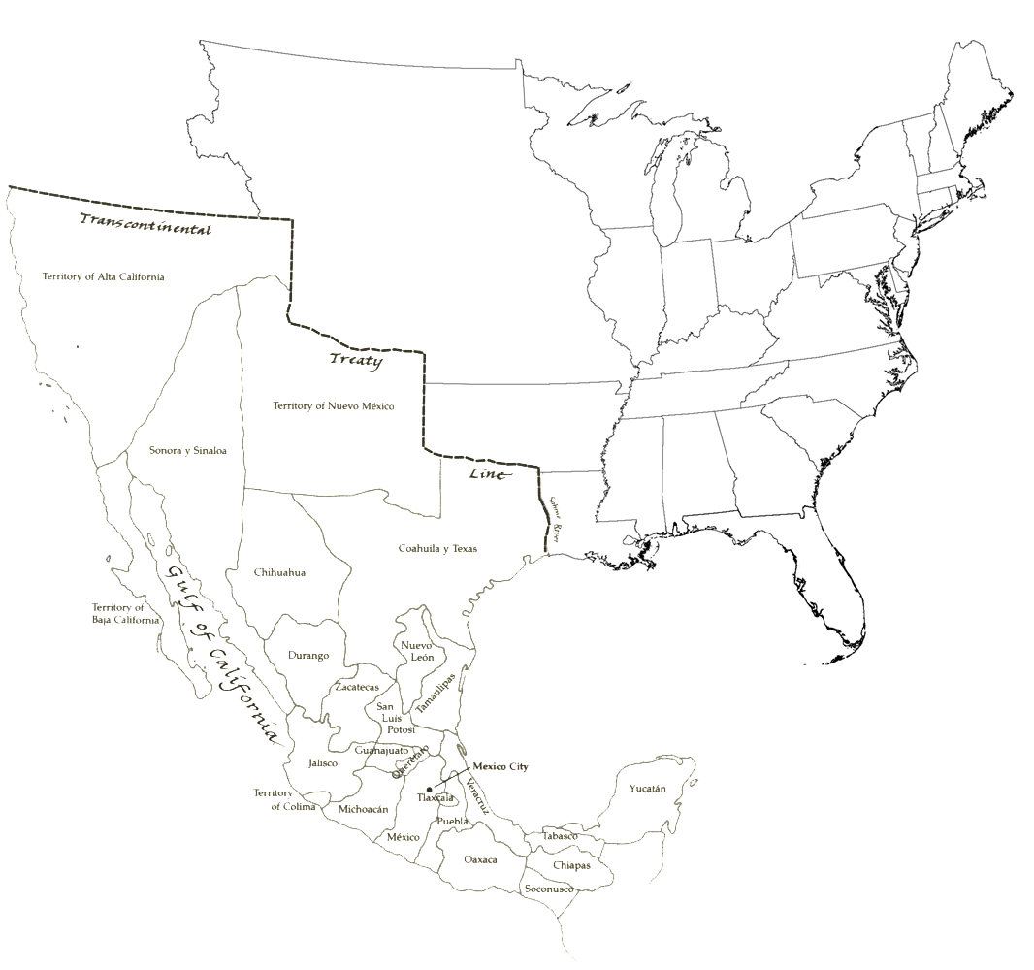

Slide 53
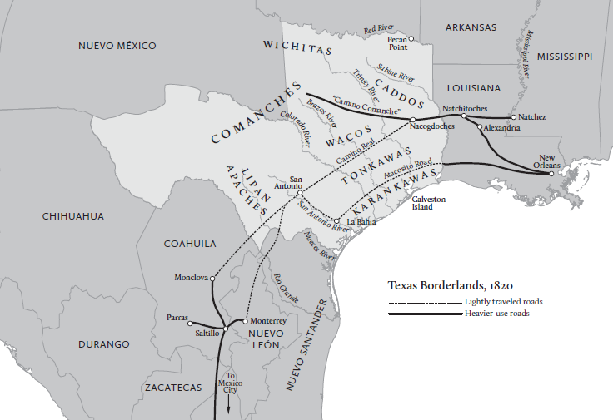

Slide 54
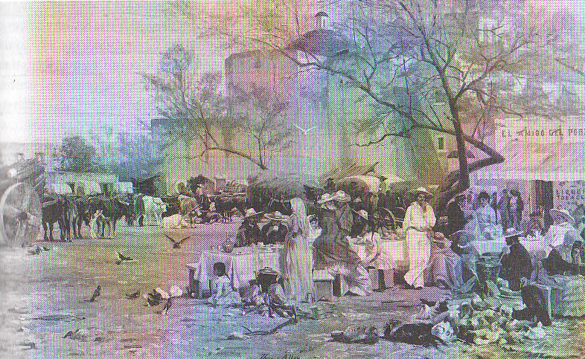

Slide 55
If you were the Spanish governor of Texas, what would you have said in response to Austin’s proposal?

Slide 57
TEJANOS SUPPORTED AUSTIN’S PROPOSAL FOR THREE MAIN REASONS:

Slide 58
TEJANOS SUPPORTED AUSTIN’S PROPOSAL FOR THREE MAIN REASONS:
They simply needed people.

Slide 59
TEJANOS SUPPORTED AUSTIN’S PROPOSAL FOR THREE MAIN REASONS:
They simply needed people.
They really, really wanted to develop Texas economically – and the Tejanos had seen what the cotton revolution did for New Orleans.

Slide 61
TEJANOS SUPPORTED AUSTIN’S PROPOSAL FOR THREE MAIN REASONS:
They simply needed people.
They really, really wanted to develop Texas economically – and the Tejanos had seen what the cotton revolution did for New Orleans.

Slide 62
TEJANOS SUPPORTED AUSTIN’S PROPOSAL FOR THREE MAIN REASONS:
They simply needed people.
They really, really wanted to develop Texas economically – and the Tejanos had seen what the cotton revolution did for New Orleans.
They felt they would likely never get significant support from Mexico City.

Slide 64
“The proposal which he is making is, in my opinion, the only one which is bound to provide for the increase and prosperity . . . in this settlement . . . Otherwise I look upon the appearance of such a favorable development as quite remote.”
--Governor Antonio Martinez

Slide 66
