Slide 1
The Making of Mexican Texas
Humanities Texas Webinar Series
September 2022

Slide 2
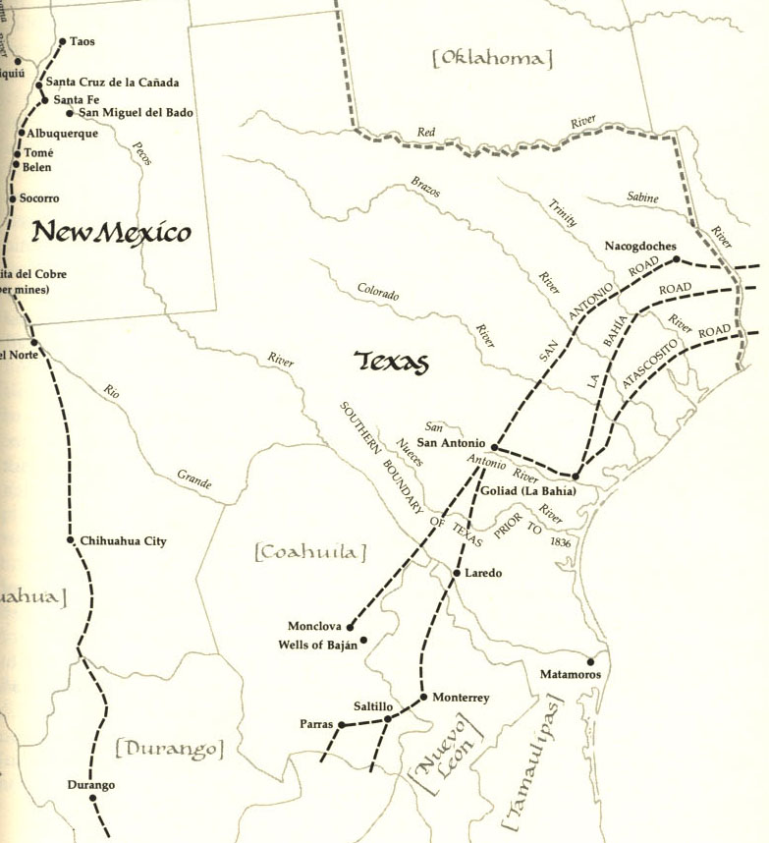
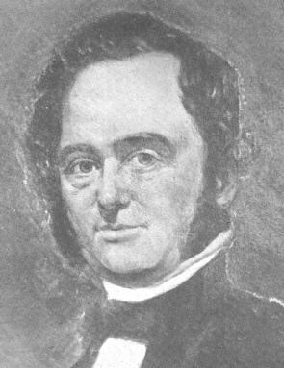

Slide 3
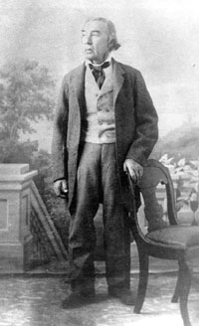
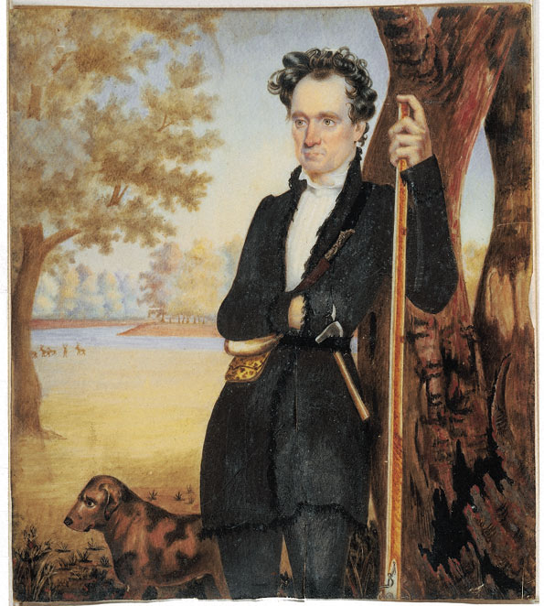

Slide 4
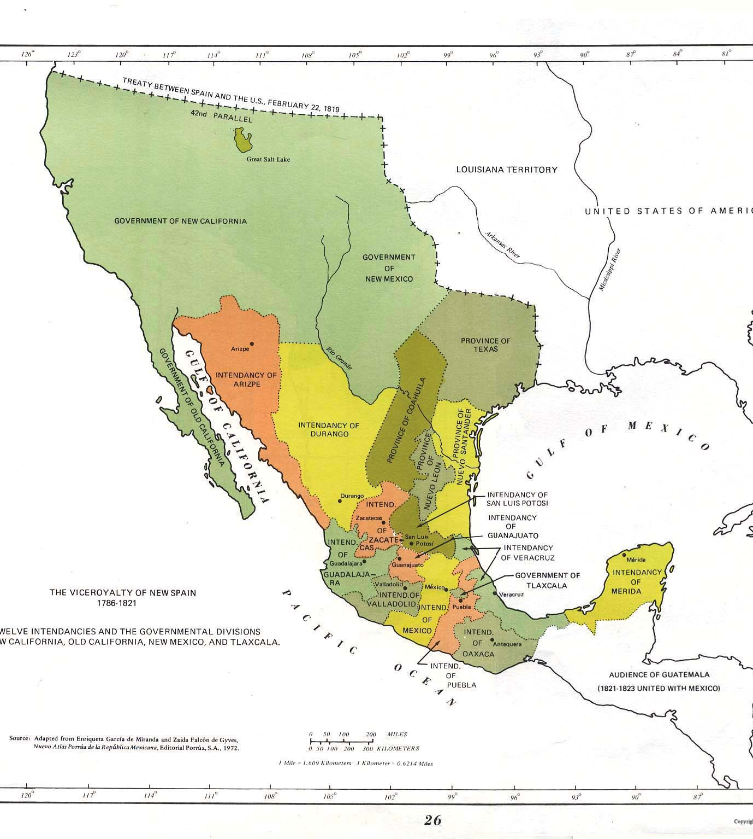
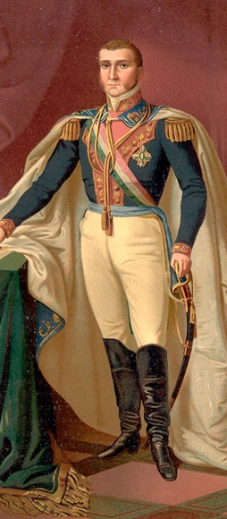

Slide 5
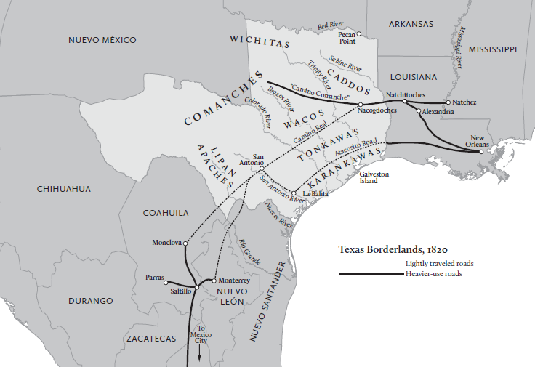

Slide 6
Essential Questions #1:
What were Austin’s central goals in establishing his colony?
What did he do to achieve those goals?

Slide 7
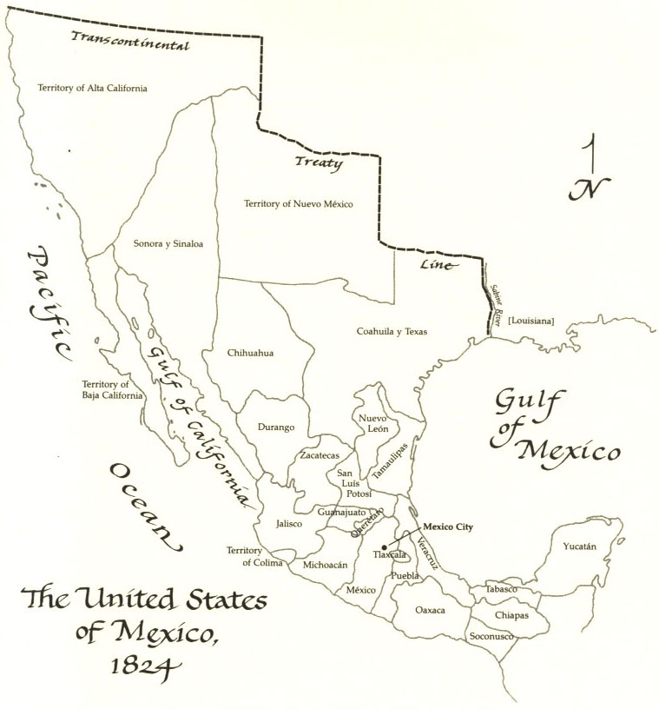

Slide 8
“The most important problem is the security of the Province of Texas. It would be an irreparable loss to the Empire if this beautiful Province is lost. In order to save it there remains only one recourse—to populate it.”
--Mexico City commission, December 1821

Slide 11
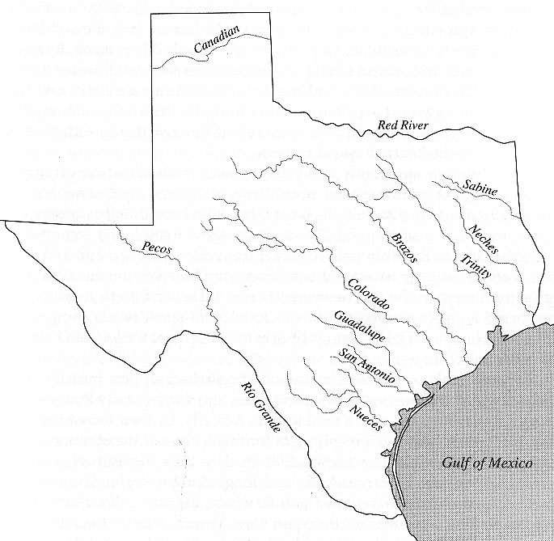
Where would YOU put the colony, if you were Stephen F. Austin?

Slide 12
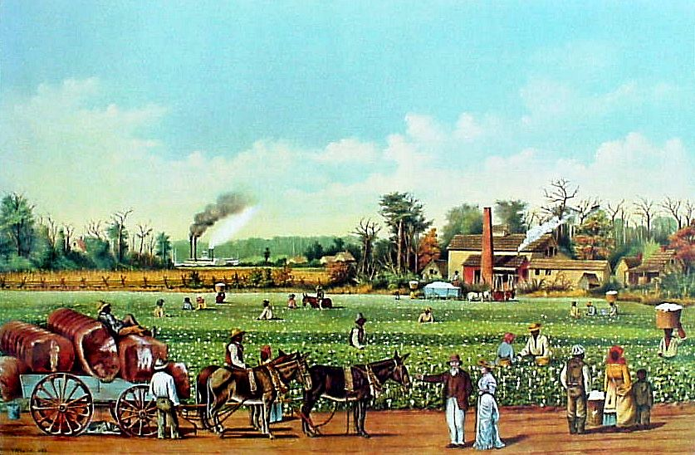

Slide 13
Where would YOU put the colony, if you were Stephen F. Austin?

Slide 14
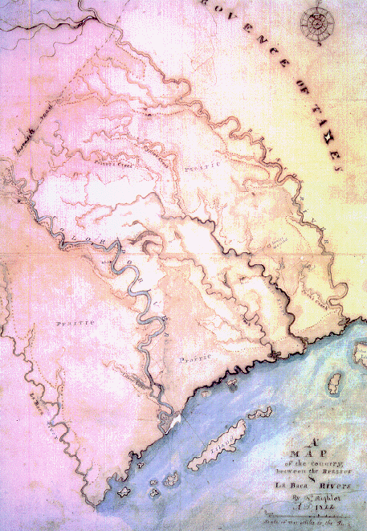

Slide 15
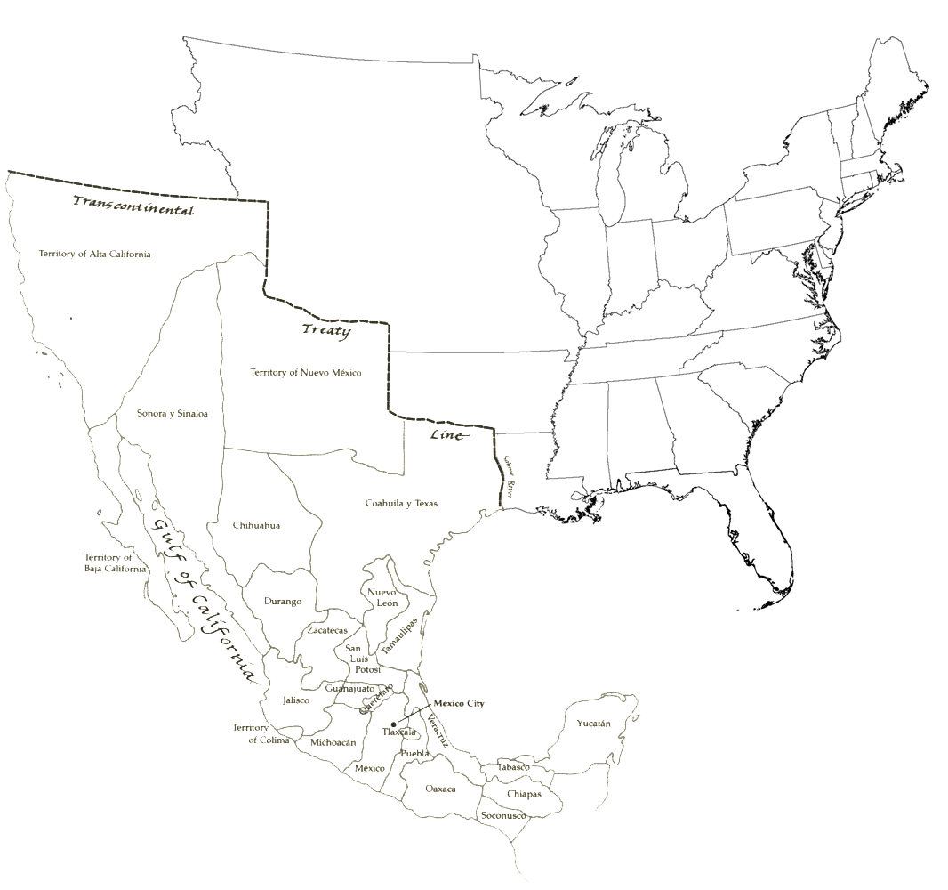

Slide 16
“The richness of the soil, healthfulness of the climate, contiguity to the sea, and other natural advantages promise [Americans who come to Mexico] a reward to our labors which few spots on the globe could furnish to an equal extent.”
--Stephen F. Austin

Slide 17
ANY MAN COMING TO AUSTIN’S COLONY WOULD BE ELIGIBLE TO RECEIVE:

Slide 18
ANY MAN COMING TO AUSTIN’S COLONY WOULD BE ELIGIBLE TO RECEIVE:
4,428 acres of land for showing up. That’s seven square miles!

Slide 19
ANY MAN COMING TO AUSTIN’S COLONY WOULD BE ELIGIBLE TO RECEIVE:
4,428 acres of land for showing up. That’s seven square miles!
An extra 200 acres for bringing his wife.

Slide 20
ANY MAN COMING TO AUSTIN’S COLONY WOULD BE ELIGIBLE TO RECEIVE:
4,428 acres of land for showing up. That’s seven square miles!
An extra 200 acres for bringing his wife.
Another 100 acres for each child.

Slide 21
ANY MAN COMING TO AUSTIN’S COLONY WOULD BE ELIGIBLE TO RECEIVE:
4,428 acres of land for showing up. That’s seven square miles!
An extra 200 acres for bringing his wife.
Another 100 acres for each child.
An additional 50 acres for every enslaved person.

Slide 22
THERE WERE, HOWEVER, SOME REQUIREMENTS:

Slide 23
THERE WERE, HOWEVER, SOME REQUIREMENTS:
You had to be Catholic. (Wink, wink.)

Slide 24
THERE WERE, HOWEVER, SOME REQUIREMENTS:
You had to be Catholic. (Wink, wink.)
You needed to present “letters of good character.”

Slide 25
THERE WERE, HOWEVER, SOME REQUIREMENTS:
You had to be Catholic. (Wink, wink.)
You needed to present “letters of good character.”
You needed some money.

Slide 26
THERE WERE, HOWEVER, SOME REQUIREMENTS:
You had to be Catholic. (Wink, wink.)
You needed to present “letters of good character.”
You needed some money.
The land was free, but you had to pay Austin 12.5 cents per acre for surveying it and procuring the legal documents. That’s about $550.

Slide 27
THERE WERE, HOWEVER, SOME REQUIREMENTS:
You had to be Catholic. (Wink, wink.)
You needed to present “letters of good character.”
You needed some money.
The land was free, but you had to pay Austin 12.5 cents per acre for surveying it and procuring the legal documents. That’s about $550.
You needed at least a year’s worth of supplies.

Slide 29
“I am convinced that I could take on fifteen hundred families as easily as three hundred if permitted to do so.”
--Stephen F. Austin

Slide 31
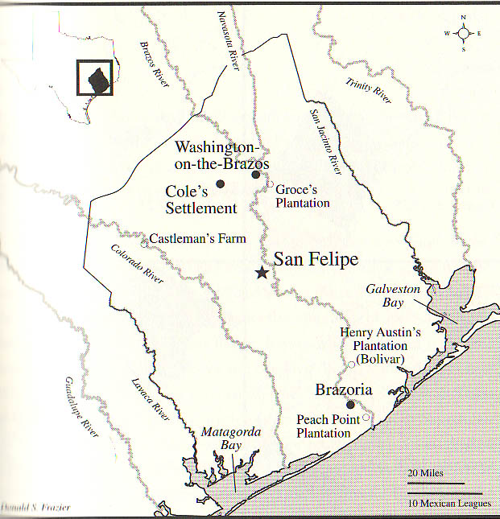

Slide 32
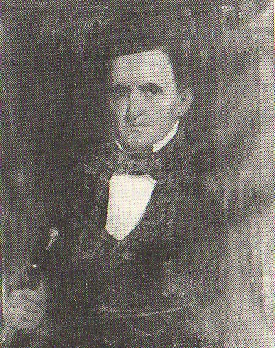

Slide 33
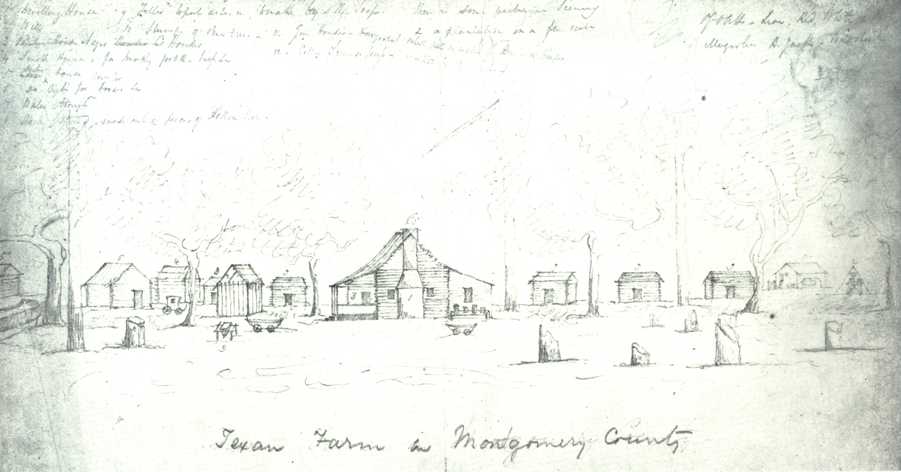

Slide 35
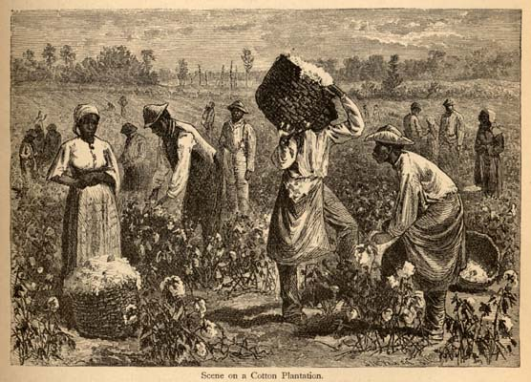

Slide 37
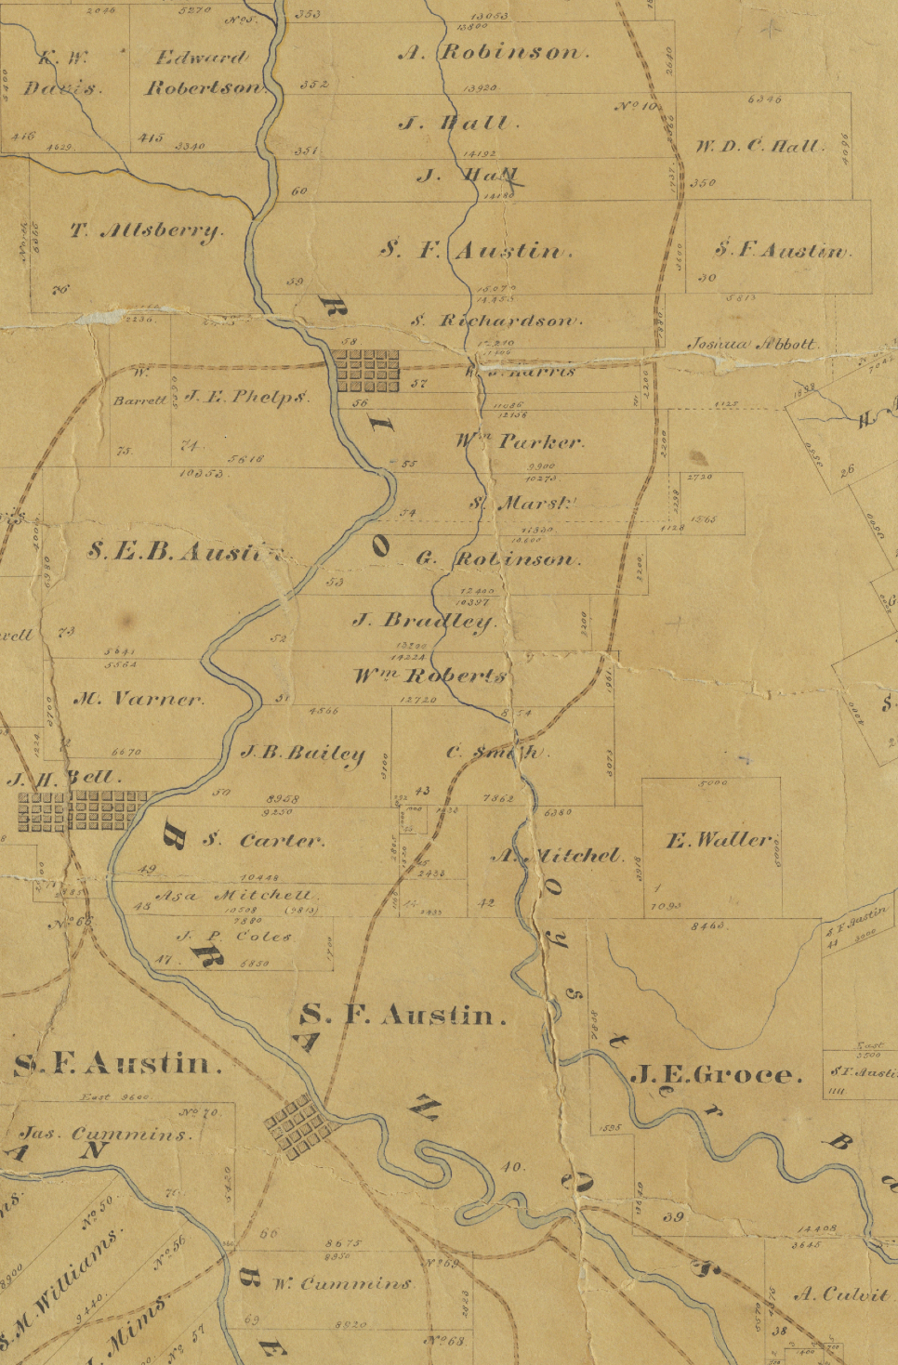

Slide 38
There is a problem:

Slide 39
There is a problem:
Mexico has approved none of this!

Slide 40
Essential Questions #2:
What was so important about the Constitution of 1824 and how did it affect Texas?
Why was embracing federalism really important for Mexico?

Slide 44
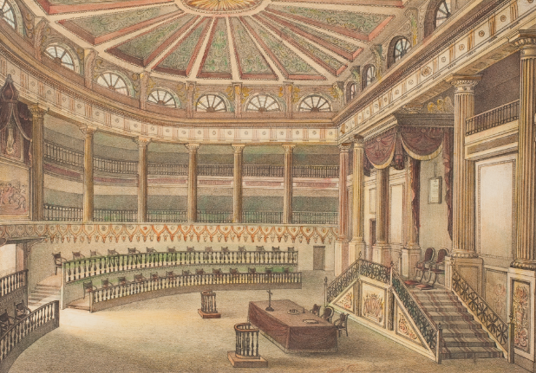

Slide 45
American colonization proves to NOT be controversial.

Slide 47
What was controversial about American immigration to Mexico?

Slide 50
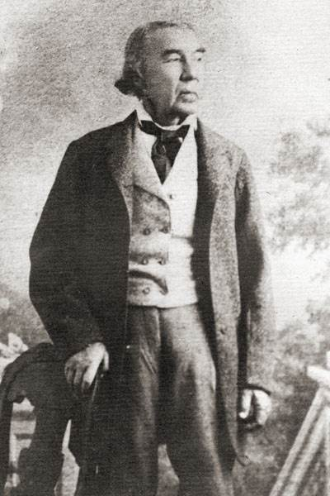

Slide 51
“The primary product that will elevate us from poverty is Cotton and we cannot do this without the help of slaves.”
--Stephen F. Austin, 1824
“Tell Austin that I am well aware that abolition of the Slaves will hinder emigration.”
--Erasmo Seguín, 1824

Slide 52
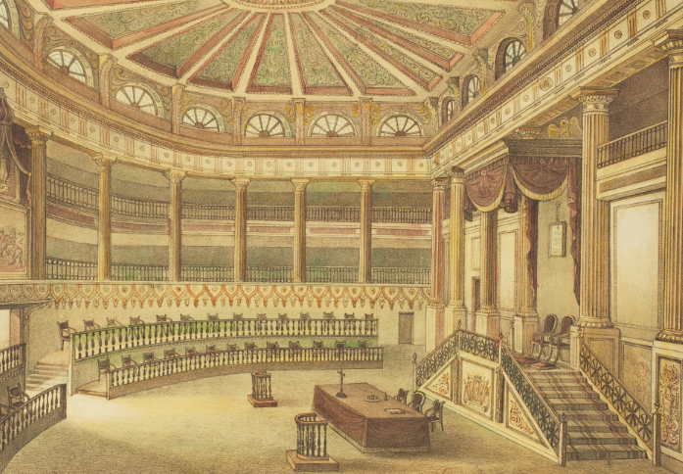

Slide 53
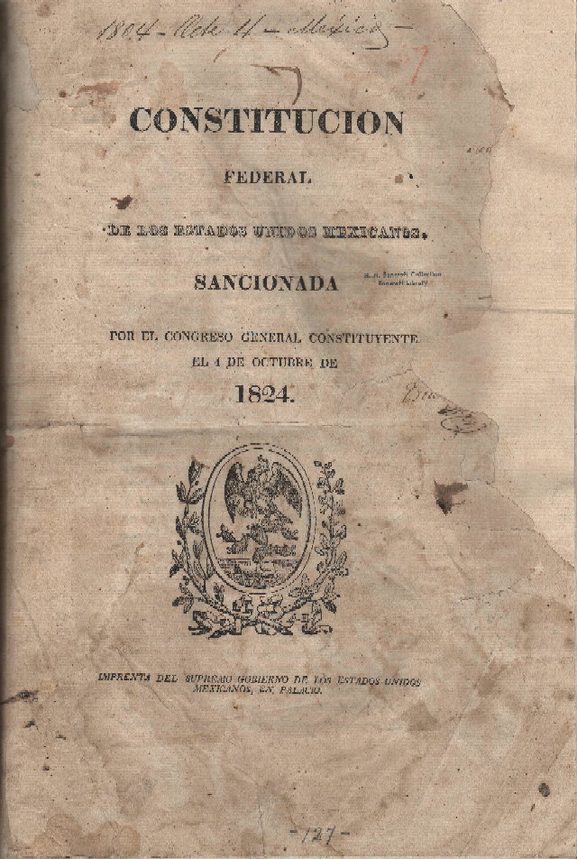

Slide 56
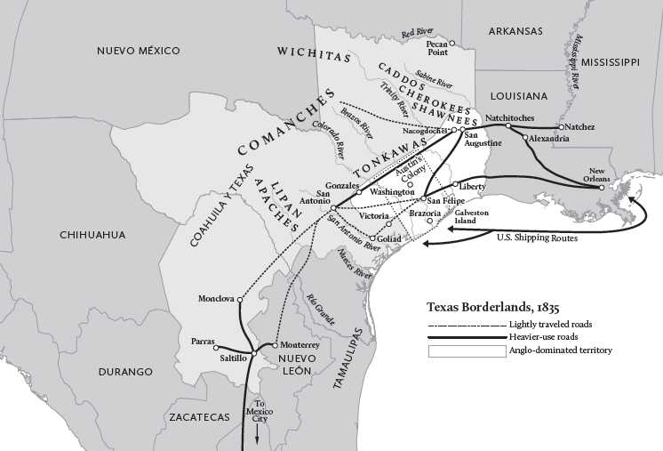

Slide 58
WHAT IS THE SITUATION IN TEXAS BY 1825?

Slide 59
WHAT IS THE SITUATION IN TEXAS BY 1825?
Anglo Americans are arriving in significant numbers – Austin had fulfilled his Old 300 contract already.

Slide 60
WHAT IS THE SITUATION IN TEXAS BY 1825?
Anglo Americans are arriving in significant numbers – Austin had fulfilled his Old 300 contract already.
Most Tejanos are highly supportive of colonization because it promises to develop Texas.

Slide 61
WHAT IS THE SITUATION IN TEXAS BY 1825?
Anglo Americans are arriving in significant numbers – Austin had fulfilled his Old 300 contract already.
Most Tejanos are highly supportive of colonization because it promises to develop Texas.
Texas has been joined to Coahuila, and the state congress in Coahuila has begun writing a state constitution which will deal with the contentious slavery issue.

