Slide 1
Conflicts between
Texas and Mexico
Humanities Texas Webinar Series
October 2022

Slide 2
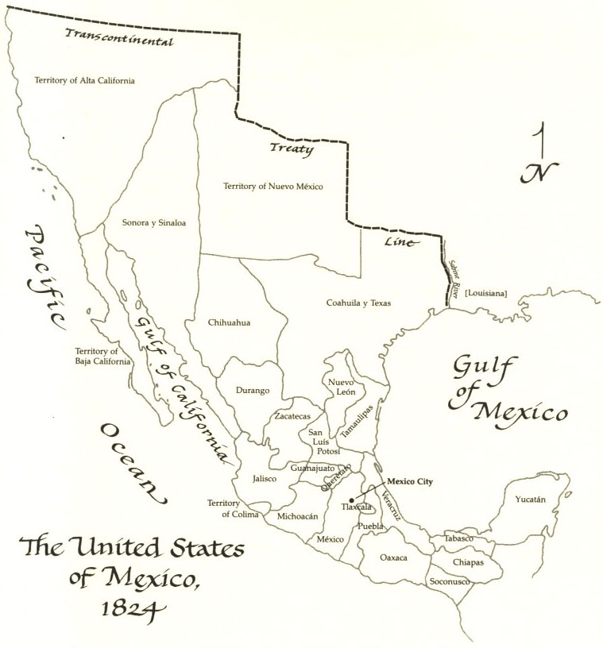
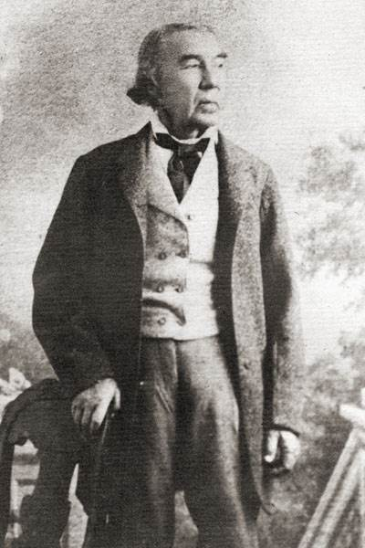
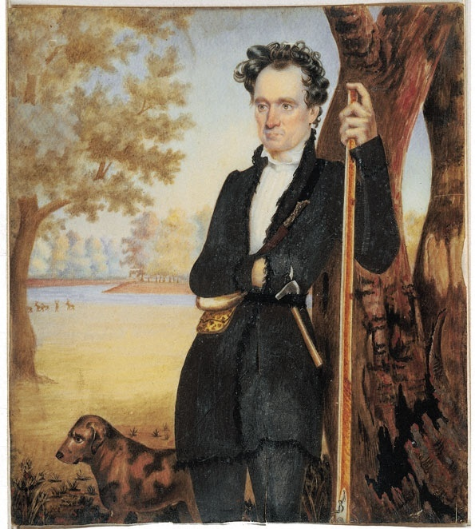

Slide 3
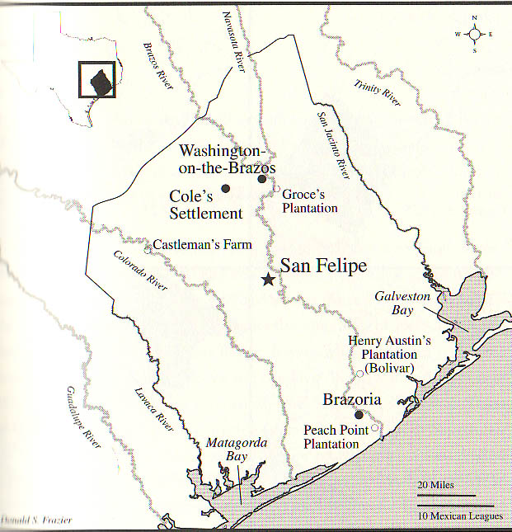

Slide 4
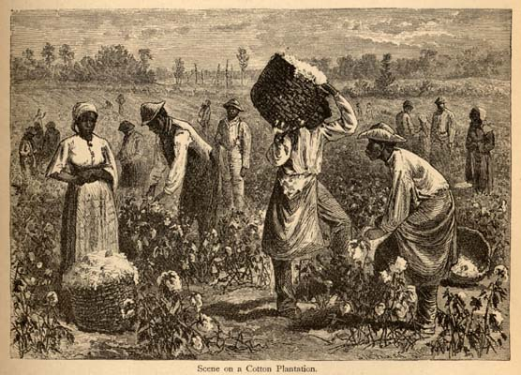

Slide 5
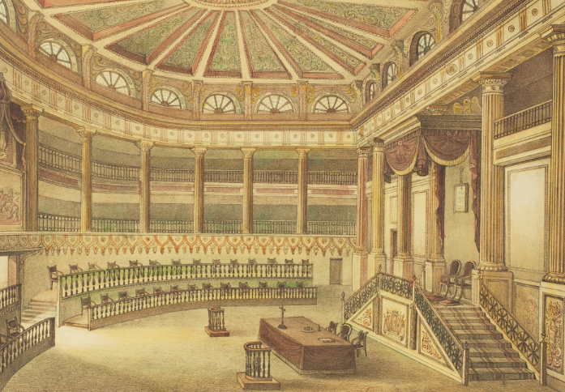

Slide 6
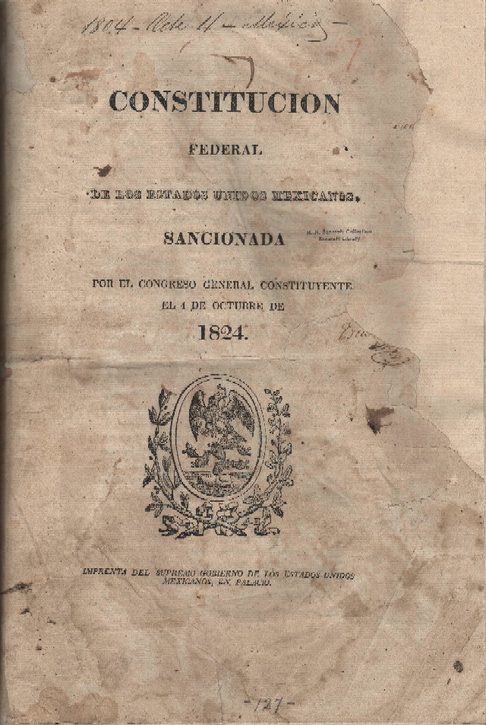

Slide 7
Essential Question #1:
Why did tensions between Texans and the governments of Mexico (both state and national) rise so quickly during the late 1820s?

Slide 8
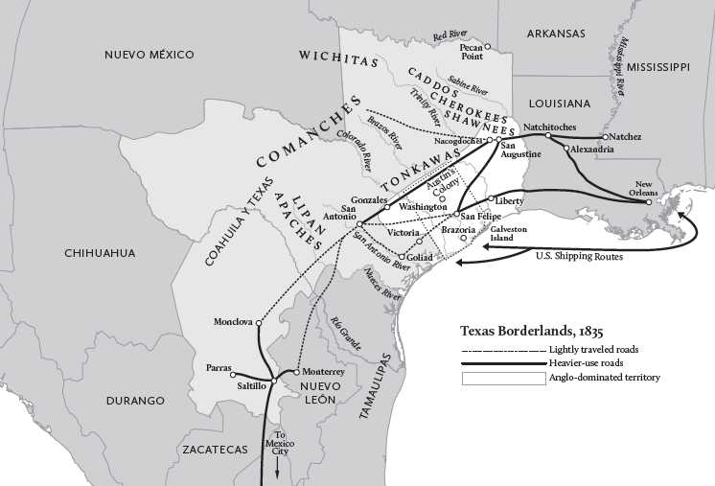

Slide 9
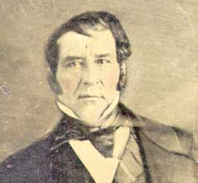
Haden Edwards

Slide 11
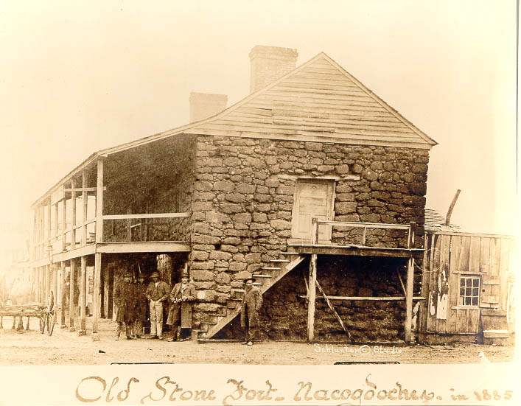

Slide 14
“The people in your quarter have run mad or worse! . . . The slave question is now pending in the Legislature, the constitution now forming . . . What influence are acts of this outrageous character calculated to have on the minds of the members and on the decision of the slave or any other question involving the interests and prosperity of the new Settlements?”
--Stephen F. Austin

Slide 16
SIGNIFICANCE OF THE FREDONIAN REBELLION

Slide 17
SIGNIFICANCE OF THE FREDONIAN REBELLION
It confirmed the fears of some Mexican leaders, particularly in Mexico City, that they could not trust these American immigrants.

Slide 18
SIGNIFICANCE OF THE FREDONIAN REBELLION
It confirmed the fears of some Mexican leaders, particularly in Mexico City, that they could not trust these American immigrants.
At the same time, it reaffirmed for Tejanos that they could trust Austin and the colonists, because Austin’s men had helped to put down the rebellion.

Slide 20
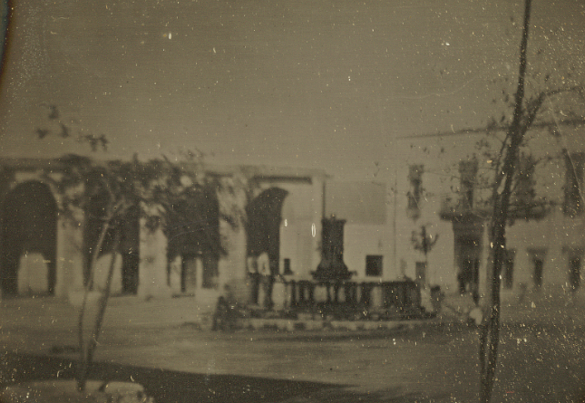

Slide 21
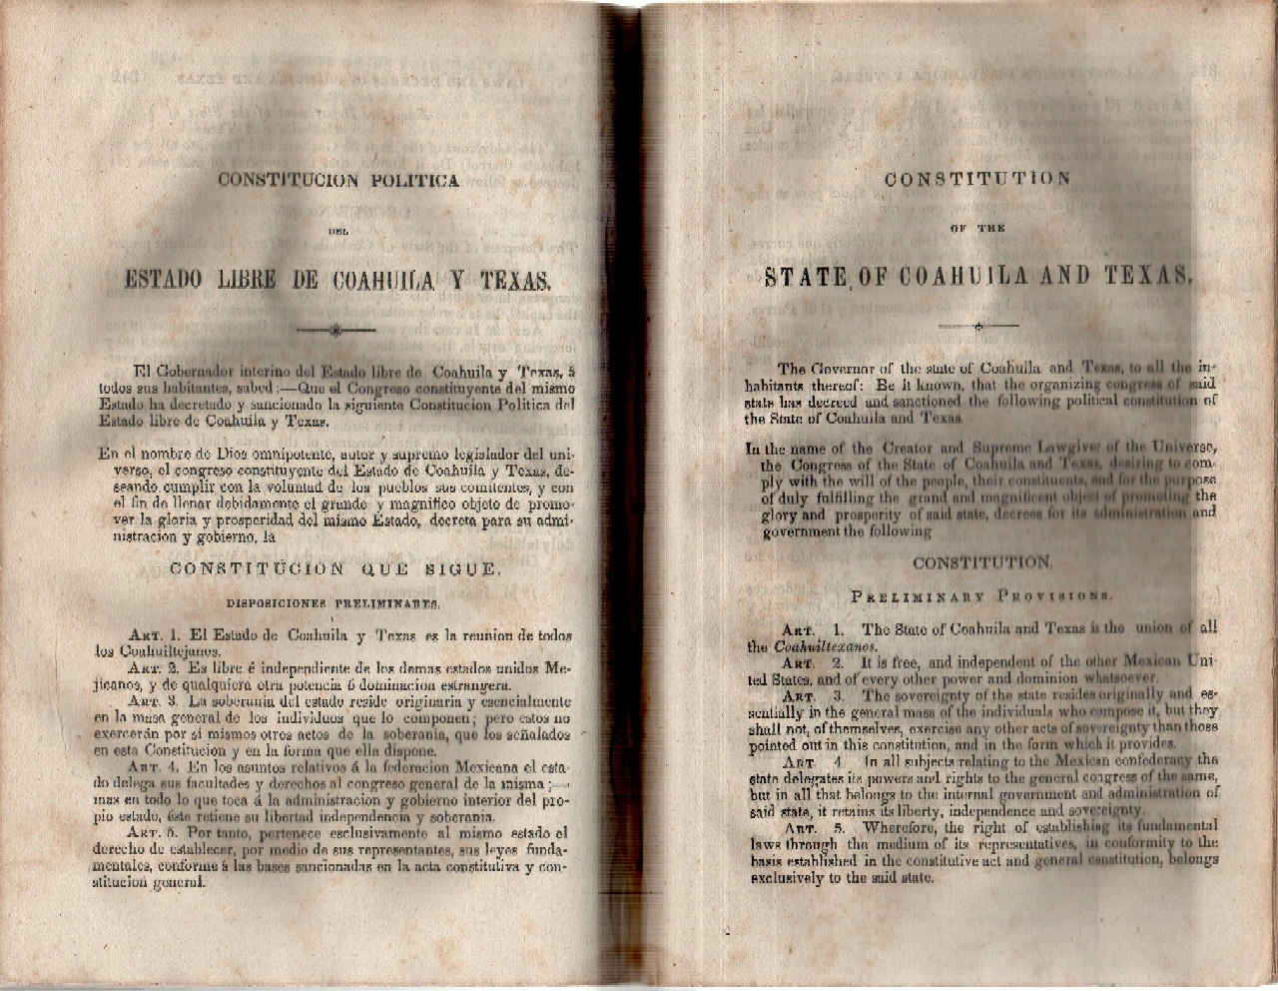

Slide 22
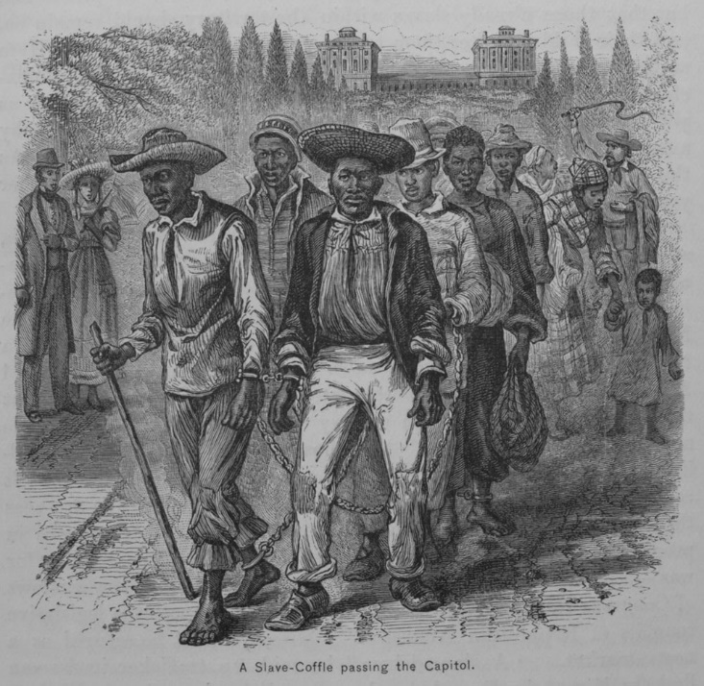

Slide 26
“The law of Mexico, prohibiting slavery, is evaded by having negros bound to serve an apprenticeship of 99 years.”
--New Orleans newspapers

Slide 27
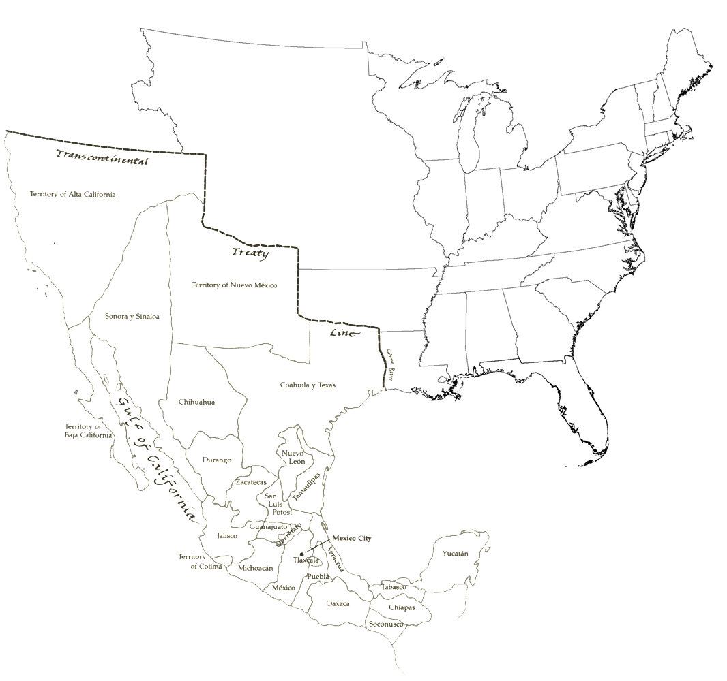

Slide 28
Essential Question #2:
Why did Mexico abandon federalism and how did that affect Texas?

Slide 29
Centralism vs Federalism
in Mexico

Slide 31
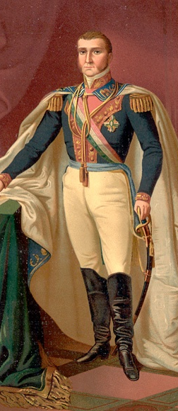

Slide 34
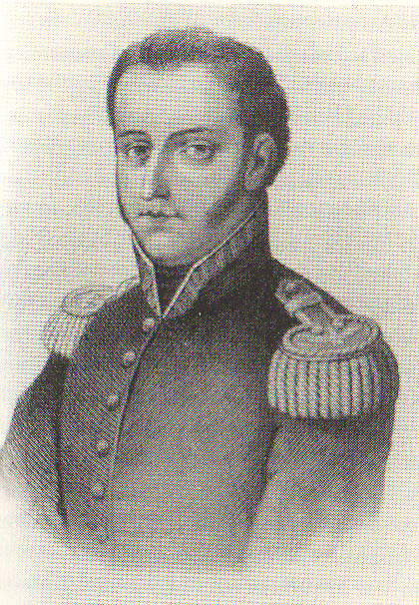
Manuel de Mier y Teran

Slide 35
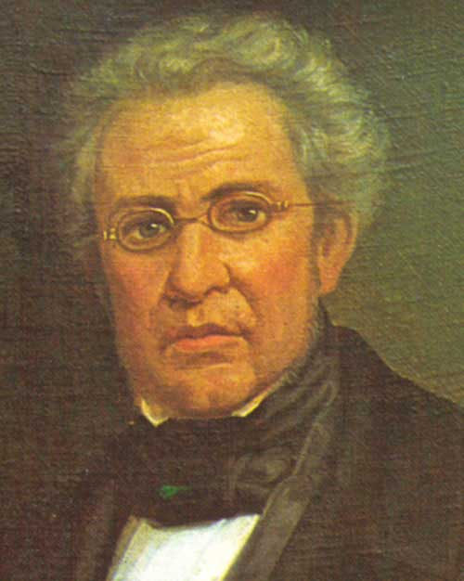
Lucas Alaman

Slide 36
LAW OF APRIL 6, 1830:

Slide 37
LAW OF APRIL 6, 1830:
No more American immigration into Mexico!

Slide 38
LAW OF APRIL 6, 1830:
No more American immigration into Mexico!
Mexico’s president has the right to establish new forts in Texas to begin collecting taxes.

Slide 39
LAW OF APRIL 6, 1830:
No more American immigration into Mexico!
Mexico’s president has the right to establish new forts in Texas to begin collecting taxes.
Mandated that the importation of enslaved people stop.

Slide 40
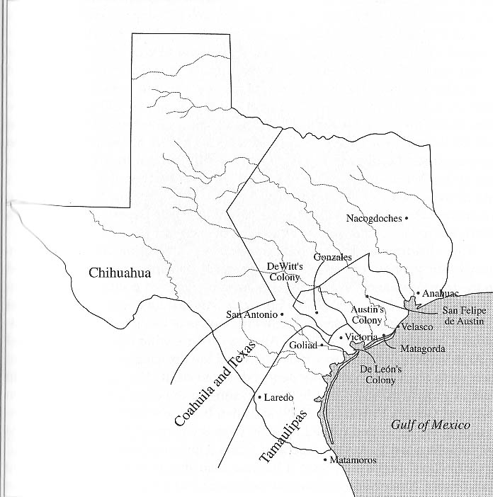

Slide 41
At Velasco, ten Texans and five Mexican soldiers died.

Slide 43
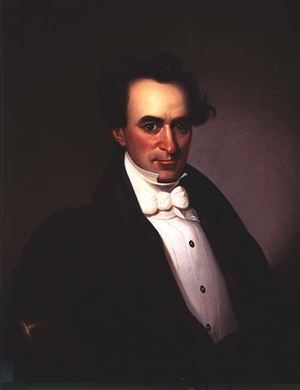

Slide 45
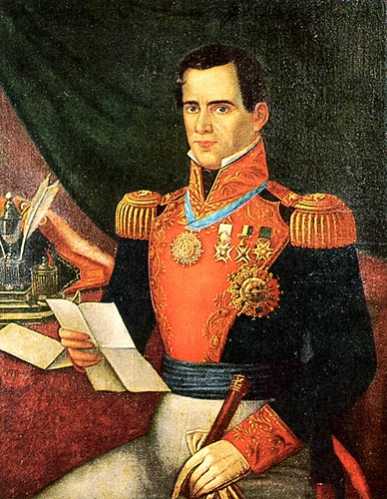

Slide 48
Now Stephen F. Austin is imprisoned in Mexico City!
How do the Texans react?

Slide 50
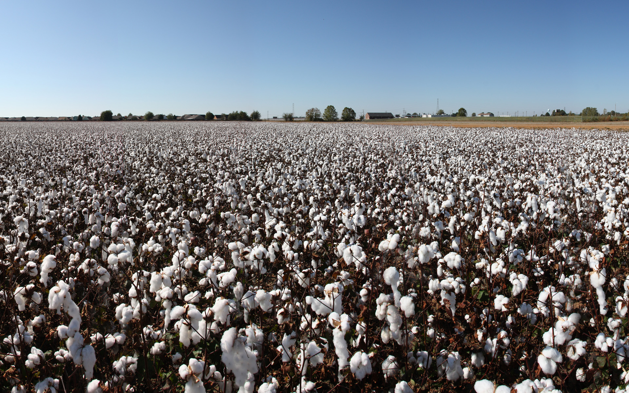

Slide 51
Population results of the cotton boom:
10,000 to 21,000

Slide 53
And then, Mexico erupts in a civil war!

