Slide 1
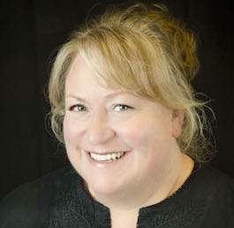
Creating Civic Mindsets:
Critical Media Literacy Lessons
Gwynne Ellen Ash, Ph.D.
Texas State University
gwynne@txstate.edu
In The Muddle® Consulting
gwynneash@inthemuddle.com

Slide 2
“If men were wise, the most arbitrary princes could not hurt them.
If they are not wise, the freest government is compelled to be a tyranny.”
—William Blake

Slide 3
TEKS
PDF on Google Classroom with TEKS Alignment for the presentation for courses in Social Studies, English Language Arts and Reading, and other areas (Journalism, Media, etc.)

Slide 4
What is Critical Media Literacy?
The New London Group (1996) envisioned a critical literacy pedagogy that ensured
“all students benefit from learning in ways that allow them to participate fully in public, community, and economic life” (p. 60).

Slide 5
Four Reader Roles/
Four resources Model
Adapted from Freebody & Luke, 1990 and Ash, 2002, 2005
CODE BREAKER
TEXT USER
MEANING MAKER
TEXT ANALYST

Slide 6
Code Breaker
Good readers
decode the words in the text and their meanings
Understand how print works
Use many strategies to read unknown words and to find the meanings of unknown words
Clarify the meaning of difficult words and phrases
Use varied strategies to make sense of difficult ideas and concepts

Slide 7
Meaning Maker
Good Readers
interact with the text to make meaning
Use personal and background knowledge to make text connections (to themselves, other texts, and the world)
Make predictions and revise them as they read
Read “between the lines” and make inferences
Ask questions while they read
Summarize the text and synthesize ideas/info within it with other ideas/information
Monitor comprehension and repair it when it goes awry

Slide 8
Text User
Good Readers
decide how they can use the text and the meaning they made with the text
Set a clear purpose for reading (find information, evaluate argument, be entertained, etc.)
Create or identify a method of expressing what they have learned, interpreted, or constructed while reading
Understand that different kinds of reading/expression are called for in different situations

Slide 9
Text Analyst
Good Readers
analyze the text with a
“critical eye”
Identify the author’s purpose— Why did he/she write the work?
Identify the author’s point of view toward the story/topic
Identify other possible points of view toward the story/topic
Infer if the author expects the reader to hold certain beliefs/viewpoints about the story/topic or the world at large
Accept or resist the author’s implied message or the author’s expectations for the reader’s beliefs/viewpoints

Slide 10
Five Key Questions (CML)
Who created this message?
What creative techniques are used to attract my attention?
How might different people understand this message differently from me?
What lifestyles, values and points of view are represented in, or omitted from, this message?
Why was this message sent?

Slide 11
Challenges to developing
Critical Media literacy
“It is not a pedagogy in the traditional sense, with firmly established principles, a canon of texts, and tried-and-true teaching procedures.
It requires a democratic pedagogy which involves teachers sharing power with students as they join together in the process of unveiling myths and challenging hegemony.”
(Kellner & Share, 2005, p. 373)

Slide 12
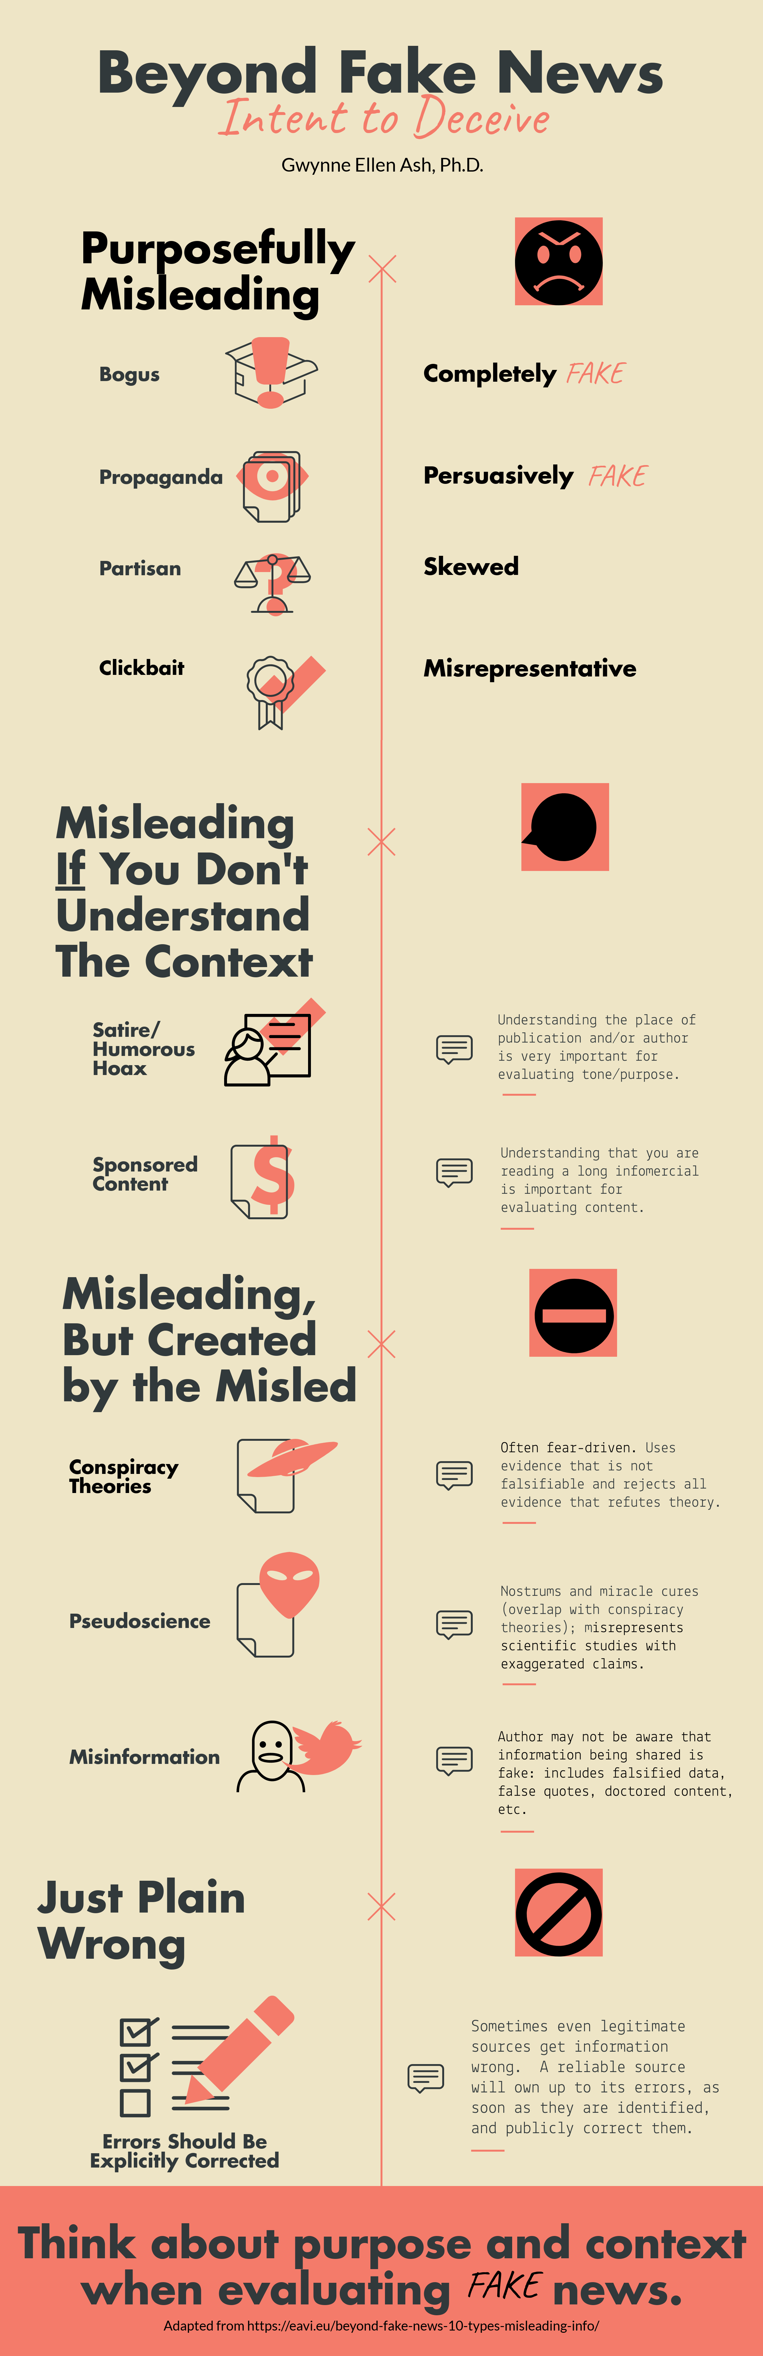

Slide 13
https://www.nytimes.com/interactive/2017/06/07/world/europe/anatomy-of-fake-news-russian-propaganda.html

Slide 14
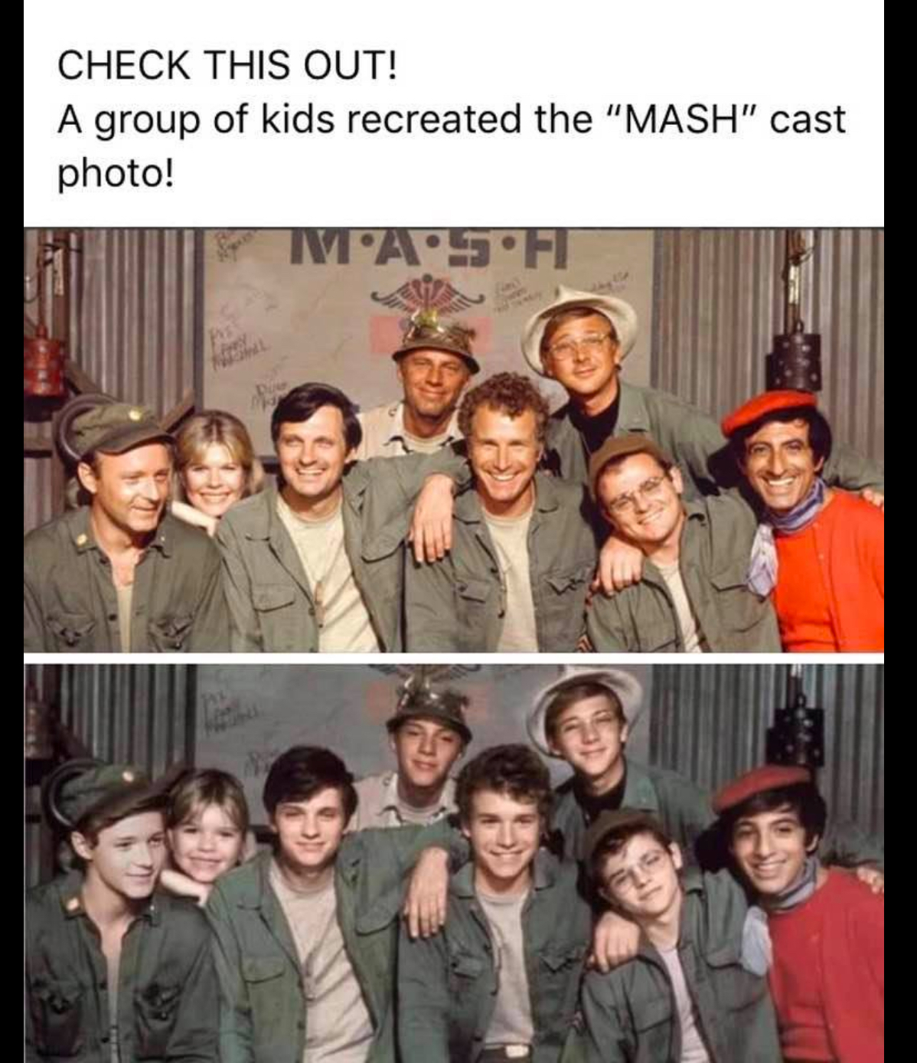
What I want you to do…
Take a look at an online social media headline shared by a friend (circa 10/14/2021).
The source was ifunny.
“Read” the picture.
What do you notice?

Slide 15
Questions for Visual Analysis
What do you notice?
Why is the image structured in this way?
What does it make you think about?
How does it make you feel?
Does anything bother you about the picture? Why?
Do you think the caption/description goes with the picture? If not, what might an accurate one be?
Why do you think the image’s creator chose to make it? What was the purpose? Do you think it is being used for its intended purpose?

Slide 16
In a Breakout, Visit about…
    Would you check to see if it was real?
      Why or why not?
    How would you check to see if it, or something else, was real?
      What questions would you ask?
  How could you find answers to your questions about a social media post?
    What resources would you use?

Slide 17
Google reverse image search
How reverse image search works
When you search using an image, your search results may include:
  Similar images
  Sites that include the image
  Other sizes of the image you searched for
Reverse search using an image works best when the image is likely to show up in other places on the web.

Slide 18
So what’s the story?
Reverse Google image search
Find the original post: Facebook MASH Group
Follow a link on the page for more information about the source of the share: https://ifunny.co/picture/a-group-of-kids-recreated-the-mash-cast-photo-8GJEoRL09
Use Fact Checking sites: https://leadstories.com/hoax-alert/2021/10/fact-check-child-actors-did-not-recreate-this-mash-cast-photo-its-a-digital-manipulation.html

Slide 19
News or Opinion?
FACT – A statement that is verifiable.
OPINION – A statement that reflects point of view, which is NOT verifiable.
Important to emphasize that a single document, story, news report, video, might include elements of both.
    An opinion story might use factual news to bolster the argument for the opinion.
Focus on STATEMENTS v. documents.

Slide 20
How are we doing?

Slide 21
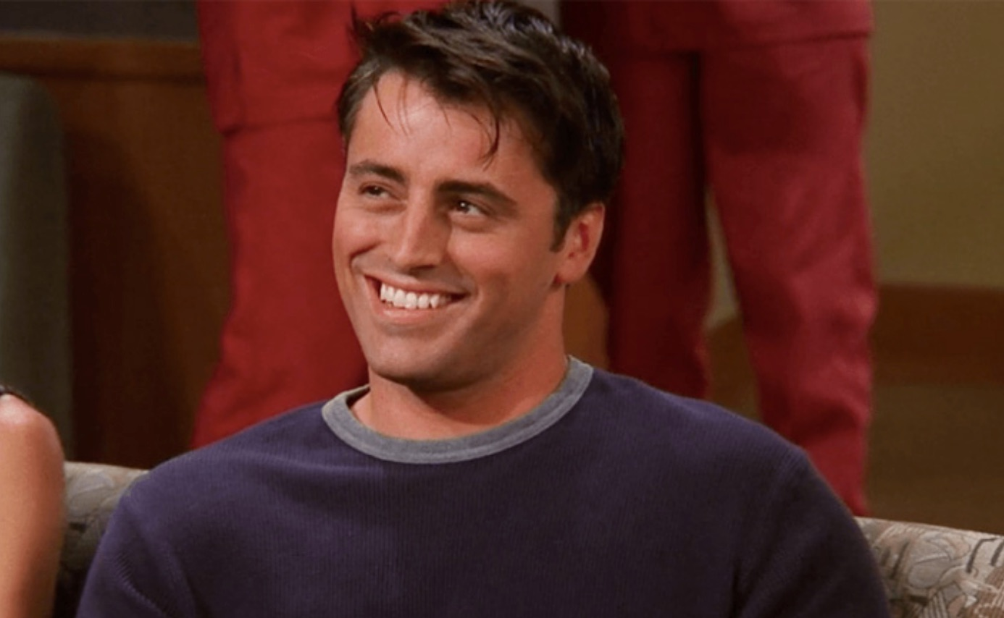
How’re YOU DOING?

Slide 22
Anticipation Guide
Rate each comment:
  A for agree,
  D for disagree, or
  U for Uncertain.
  ___Zoot Suits were worn solely by young Mexican American Gang Members.
  ___People referred to the unrest as the Zoot Suit Riots because they were caused by the Zoot Suiters.
  ___How the news is reported shapes the way people perceive later events.

Slide 23
History Case: Zoot Suits
Read Zoot Suits Impounded from the resources.
Read Zoot Suit Delinquents.
Watch clip of History.com video.
Read ZS 2 June 1943.
Read ZS 1999 1943.

Slide 24
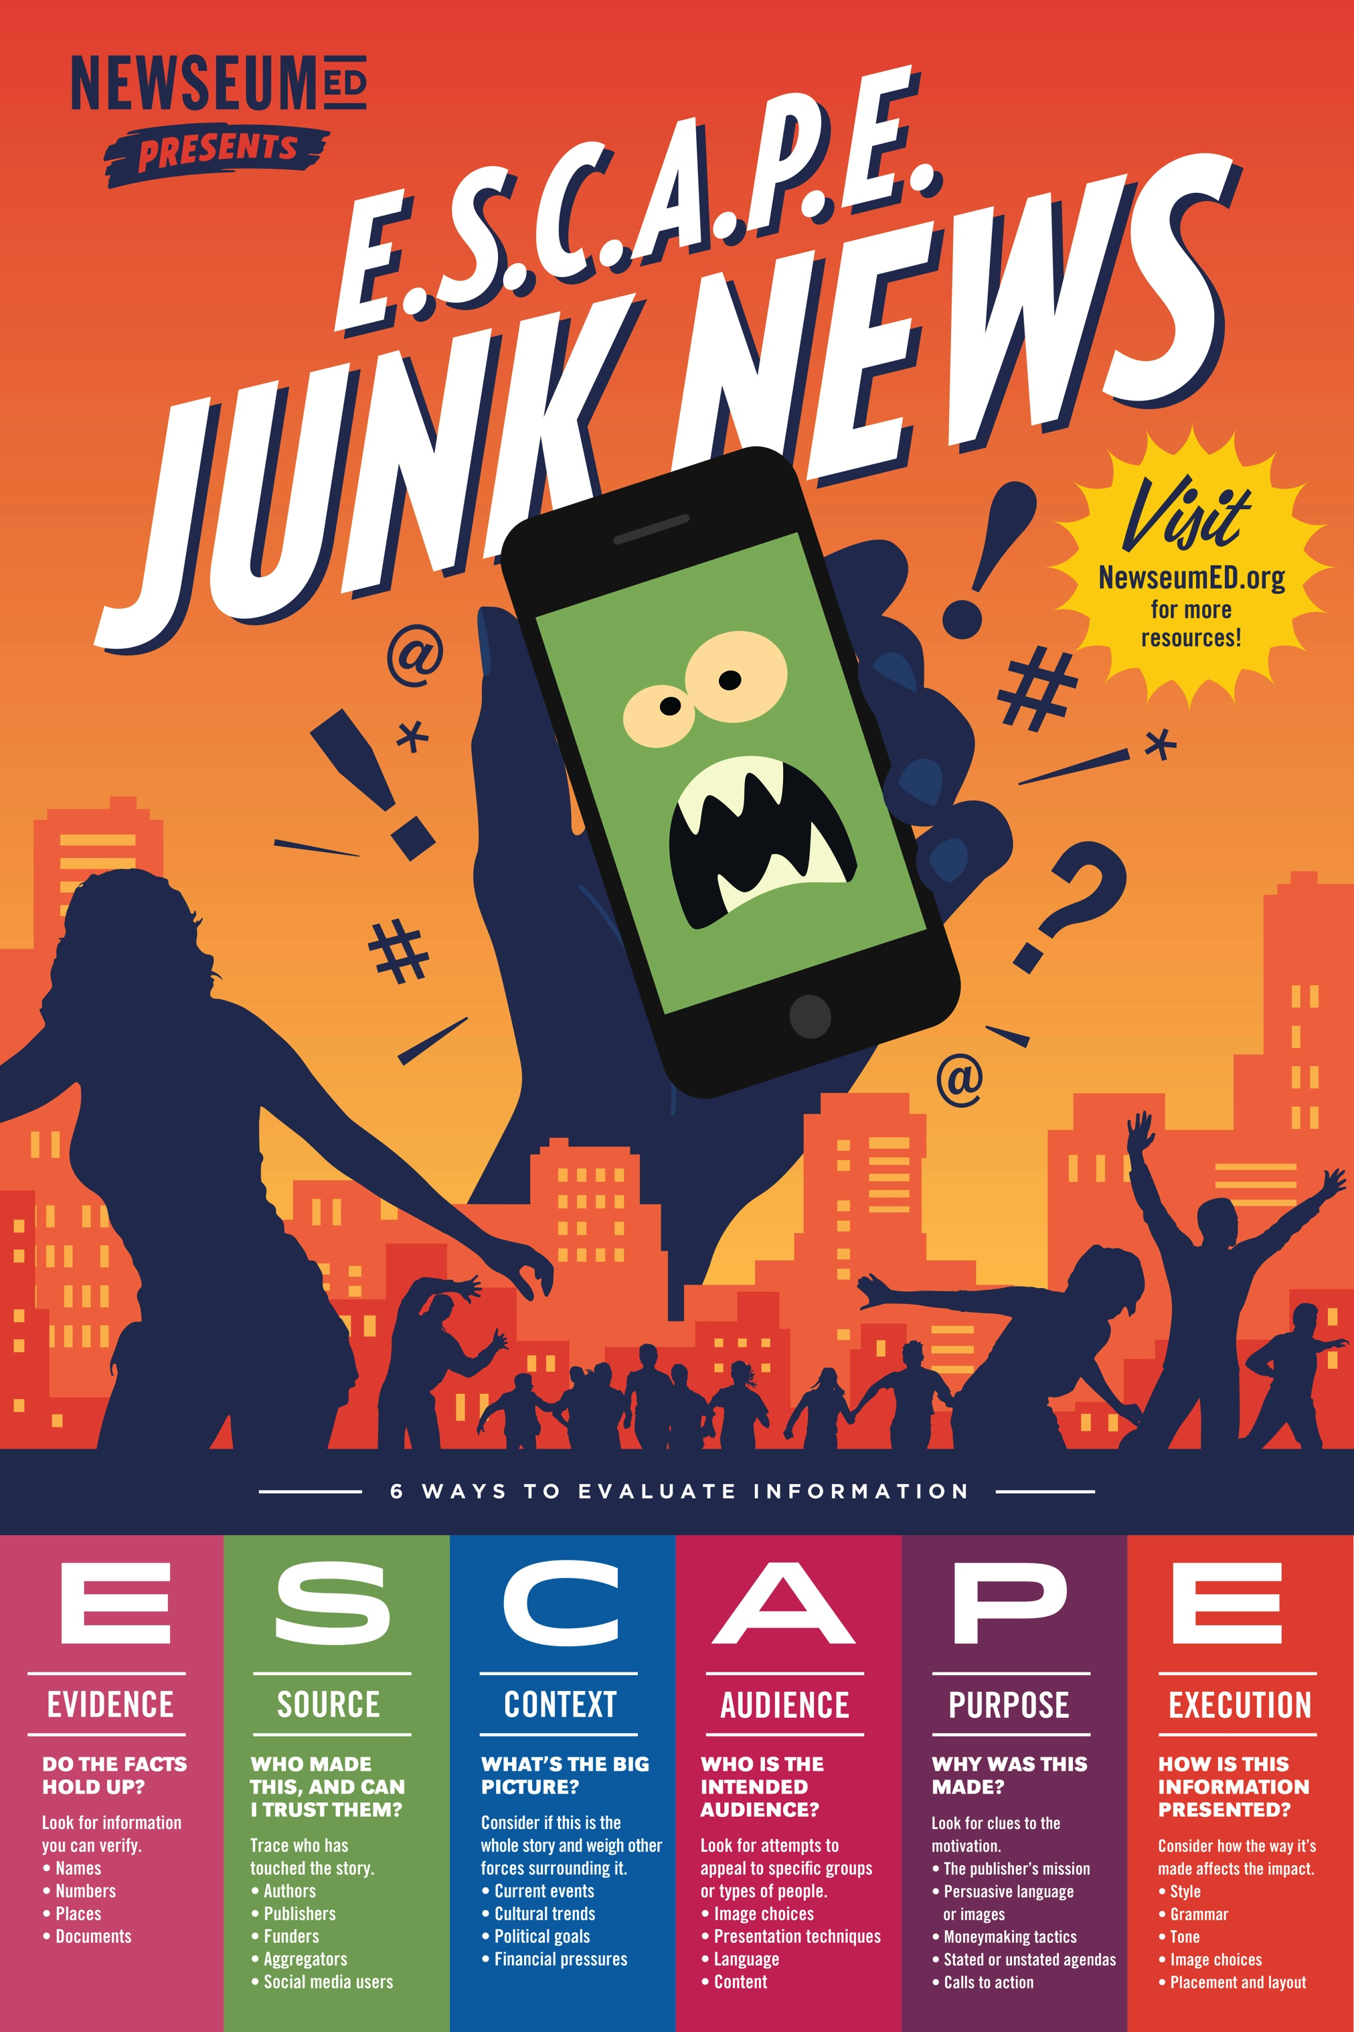
https://newseumed.org/activity/e-s-c-a-p-e-junk-news/

Slide 25
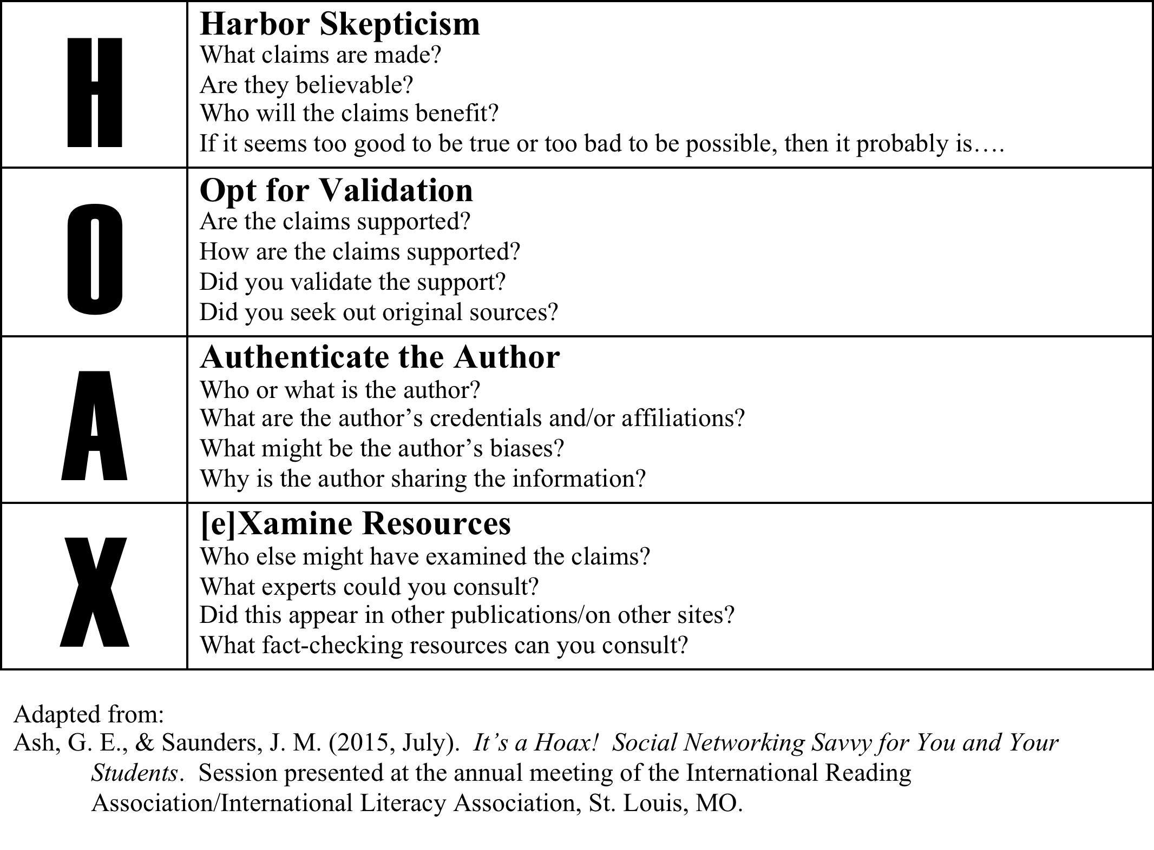

Slide 26
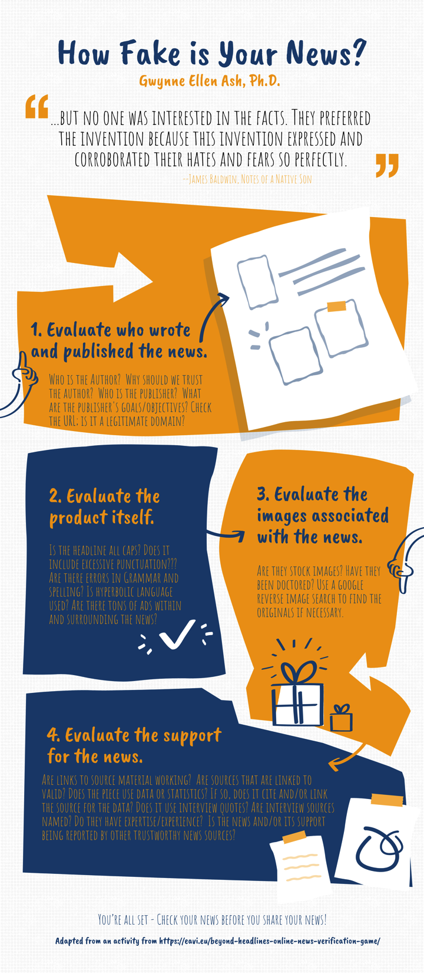

Slide 27
Factitious
Can you separate real from fake news?

Slide 28
One thing that may help students identify fake news is writing it!
www.getbadnews.com

Slide 29
What do you Do When you read through material?
How do you evaluate sources, compare viewpoints, consider tone, etc. across different social media platforms?
How do you use social media to “use your voice” about stories/topics that you care about?
What do you think your students do when they encounter information in social media?
How do you think they use social media?
  Have you asked them?

Slide 30

Supporting kids’ metaphorical megaphones
How could bringing news/media materials into your classroom help you and students learn together how to evaluate the news that’s shared on online platforms?
To create their own media?

Slide 31
Questions?
Gwynne Ellen Ash, Ph.D.
gwynne@txstate.edu
gwynneash@inthemuddle.com
www.inthemuddle.com
www.facebook.com/inthemuddle/

