Slide 1
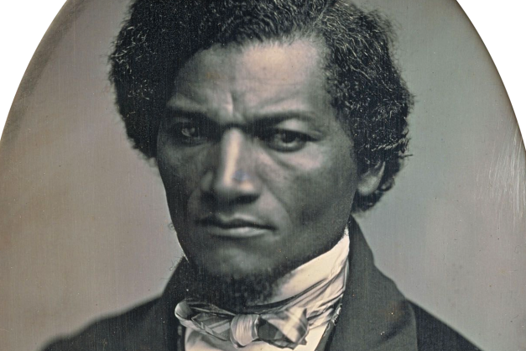
An Introduction to Frederick Douglass, 1818-1895
ROBERT S. LEVINE
UNIVERSITY OF MARYLAND
rlevine@umd.edu
go.umd.edu/robertslevine

Slide 2
Donald Trump on Frederick Douglass, February 2017
“Frederick Douglass is an example of somebody
who’s done an amazing job and is being recognized
more and more, I notice.”

Slide 3
A Douglass Chronology of His Pre-Civil War Career: Part 1
1818 Frederick Bailey born into slavery in Talbot County on the Eastern Shore of Maryland.
1838 Escapes from slavery, disguised as a sailor. Changes name to Douglass. Marries the free Black Anna Murray in New York, and they subsequently make their way to New Bedford, Massachusetts.
1841 Speaks at an antislavery convention in Nantucket; William Lloyd Garrison, the white abolitionist leader of the Massachusetts Antislavery Society, hires him as a lecturer for his organization.
1845 Publishes Narrative of the Life of Frederick Douglass. Because of its popularity, Douglass flees to the British Isles to escape from fugitive slave catchers.

Slide 4
DOUGLASS’S CORE BELIEFS AS A GARRISONIAN ABOLITIONIST, 1841-1845
MORAL SUASION (i.e. nonviolence)
THE CONSTITUTION IS A PROSLAVERY DOCUMENT (therefore one should not vote in elections or otherwise participate in the political process)
IMMEDIATISM (slavery is immoral and must end immediately)

Slide 5
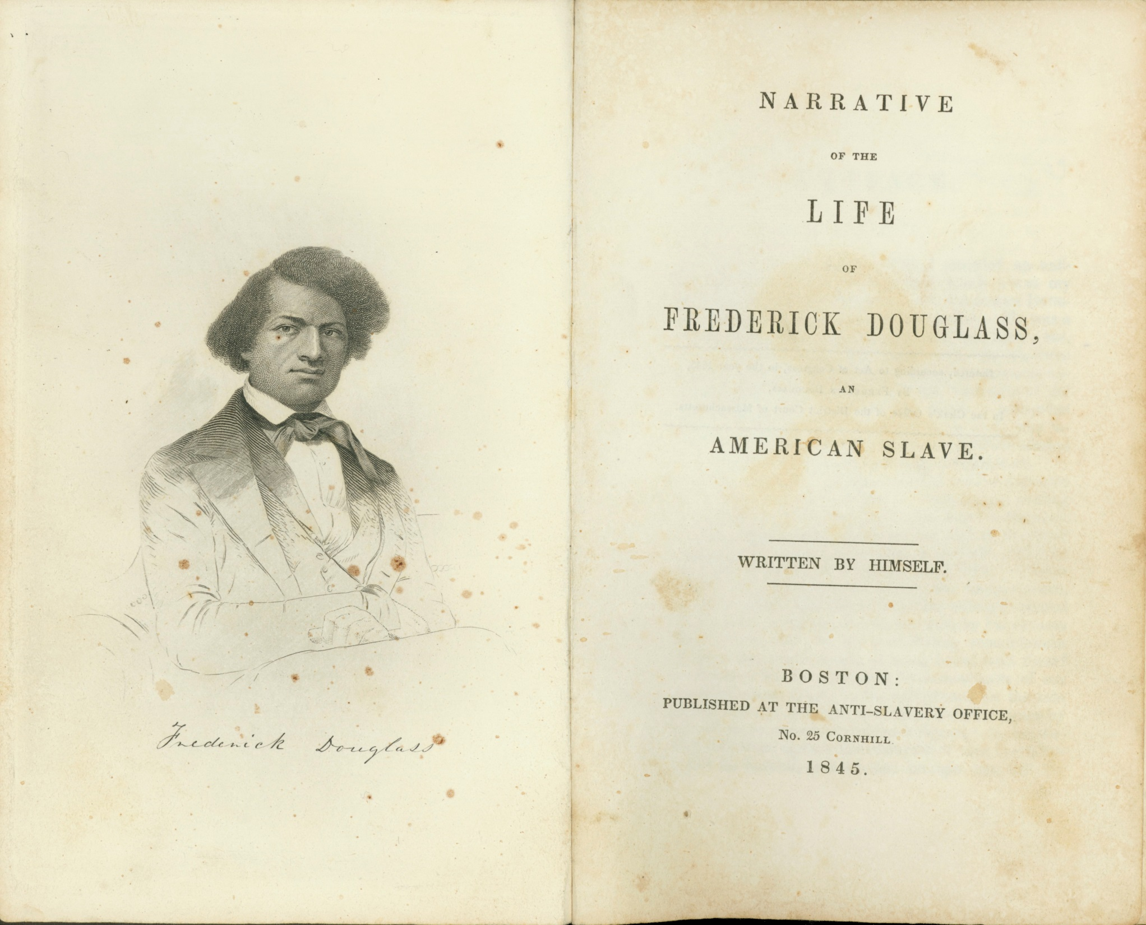

Slide 6
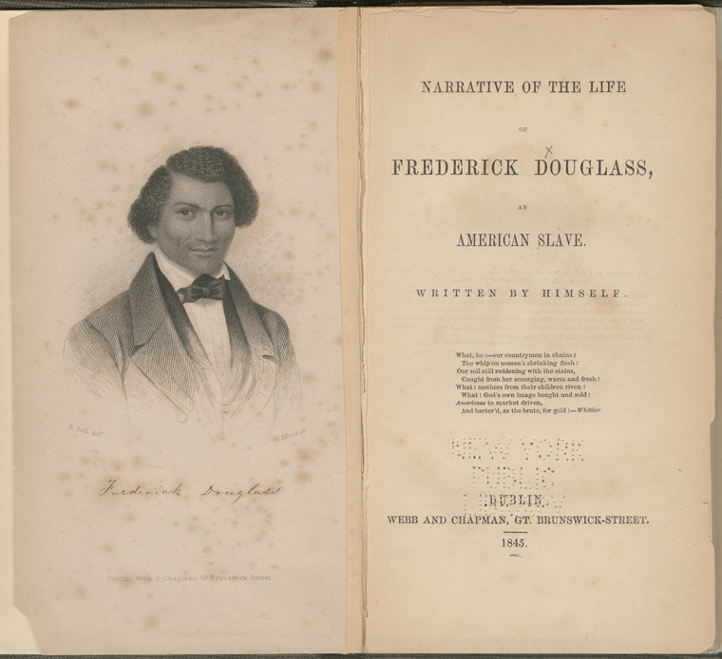

Slide 7
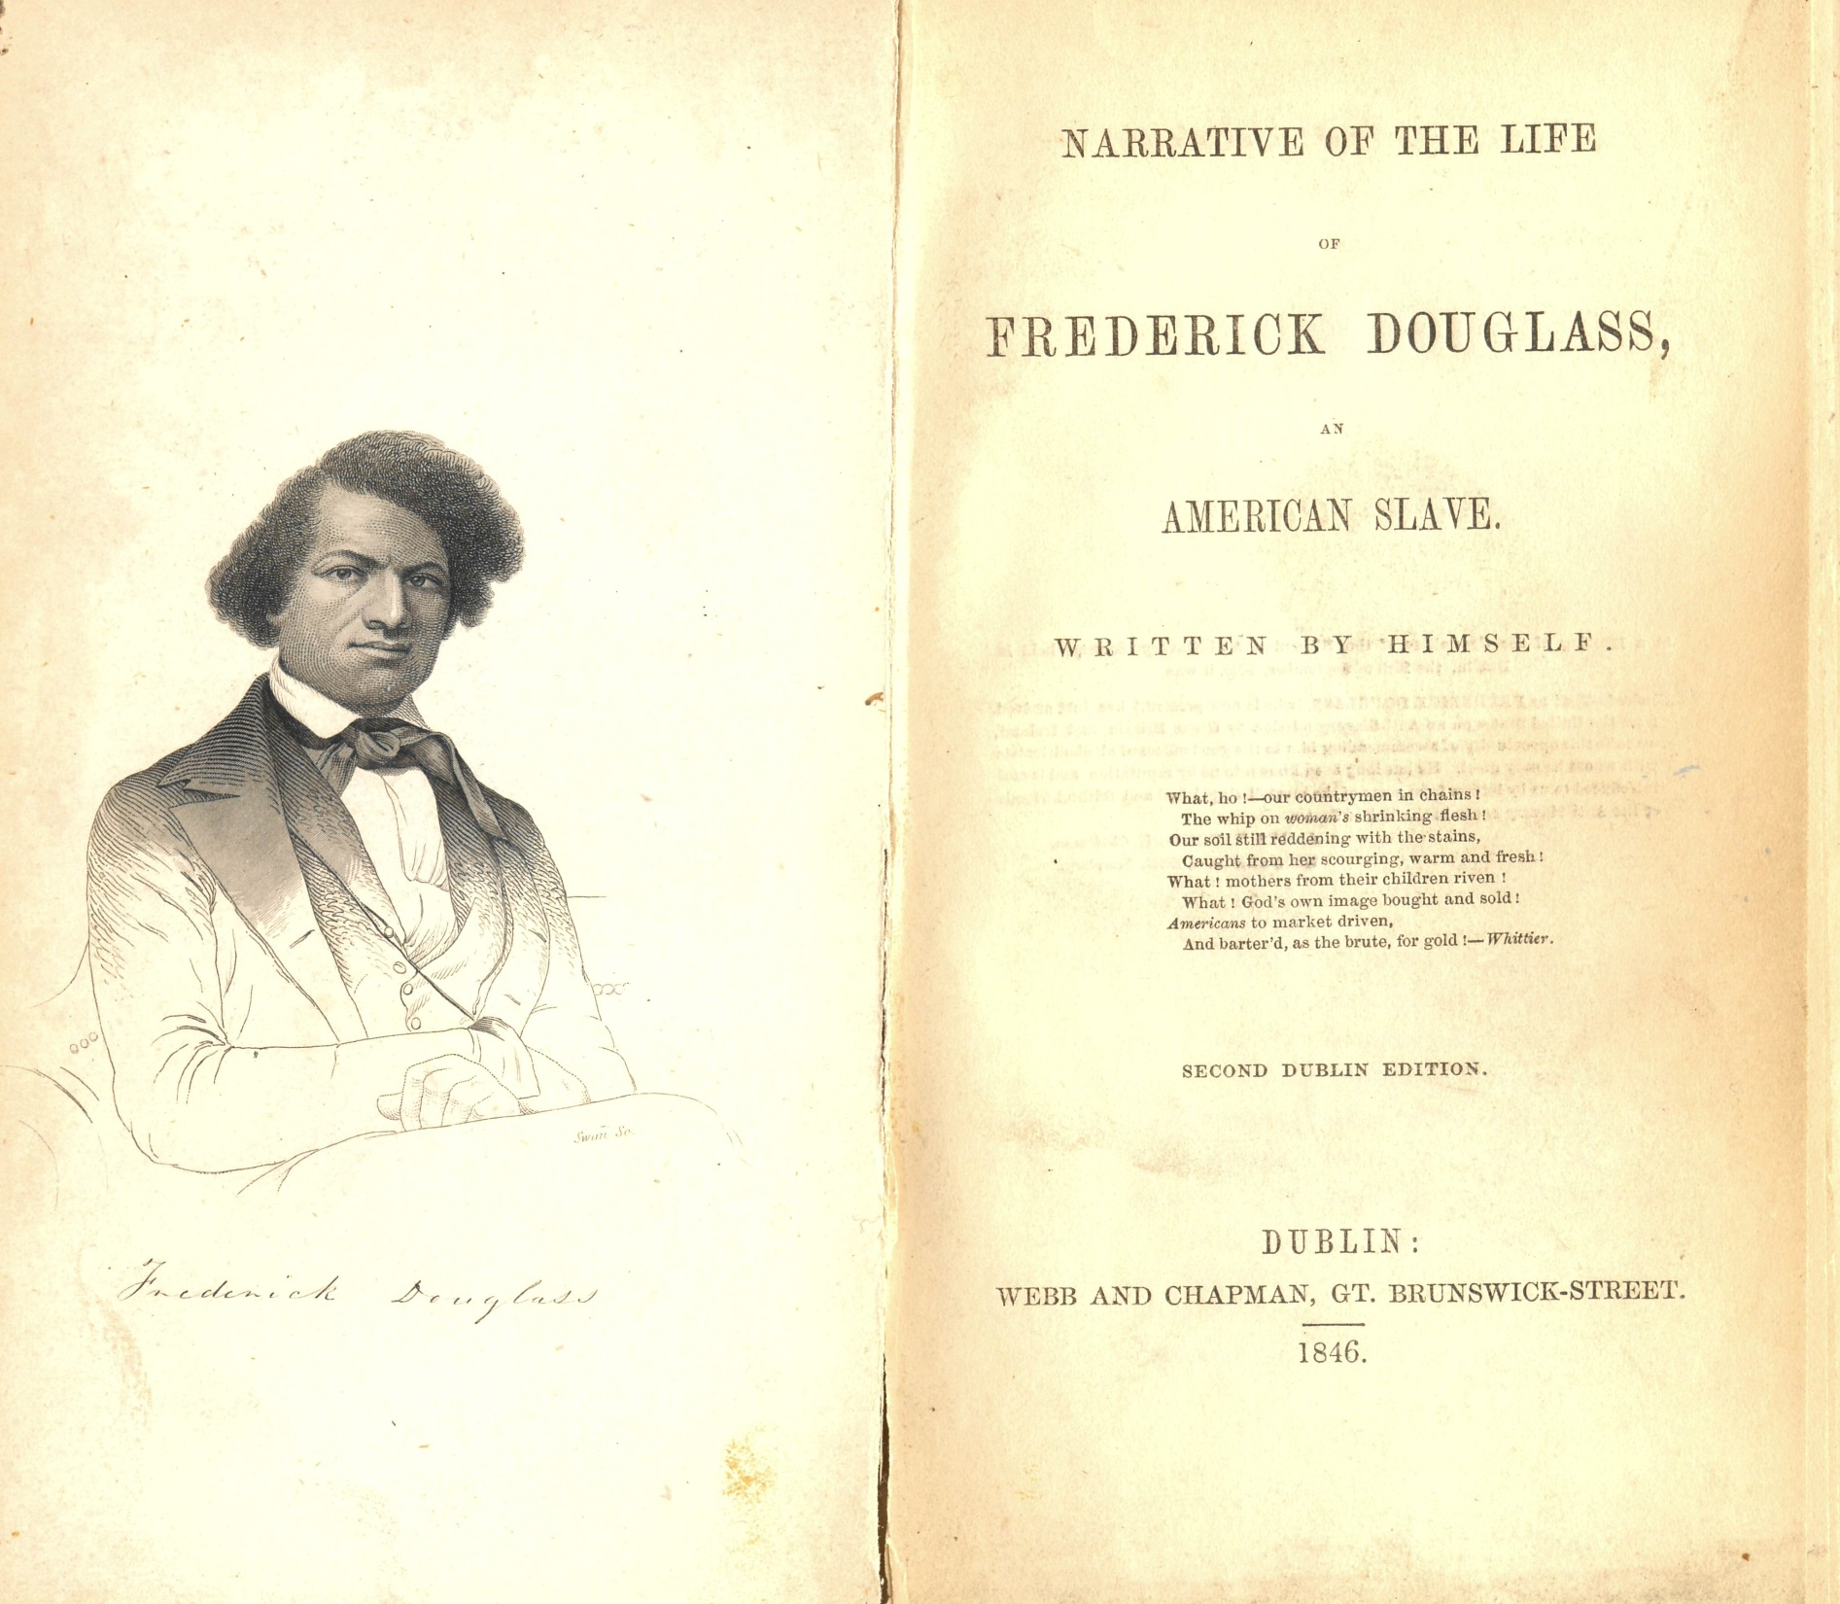

Slide 8
A Douglass Chronology of His Pre-Civil War Career, Part 2
1847 Douglass’s British supporters buy him out of slavery; Douglass returns to Rochester, New York, where he establishes his own antislavery newspaper, The North Star.
1850 Douglass formally breaks with Garrison. The Compromise of 1850 includes a strengthened fugitive slave law, leading Douglass to adopt a more militant politics.
1852 Delivers “What to the Slave Is the Fourth of July?” in Rochester.
1855 Publishes his second autobiography, My Bondage and My Freedom.
1857 Supreme Court rules in Dred Scott case that Blacks have “no rights that whites are bound to respect” and that Blacks could never become U.S. citizens. Douglass in an 1857 speech on the case declares, ironically, that he’s delighted with the decision because he thinks it’s so ludicrous it will be rejected by the American people.
1858-60 Meets with John Brown. After Brown attacks Harpers Ferry in October 1859, Douglass flees to England; he returns in 1860 and supports Lincoln for the presidency.

Slide 9
DOUGLASS’S CORE BELIEFS
AFTER BREAKING WITH GARRISON IN 1850
THE CONSTITUTION IS AN ANTISLAVERY DOCUMENT (therefore one should participate in elections and the larger political process)
ANTISLAVERY VIOLENCE, IN SOME INSTANCES, IS A PROPER RESPONSE TO THE VIOLENCE OF SLAVERY

Slide 10
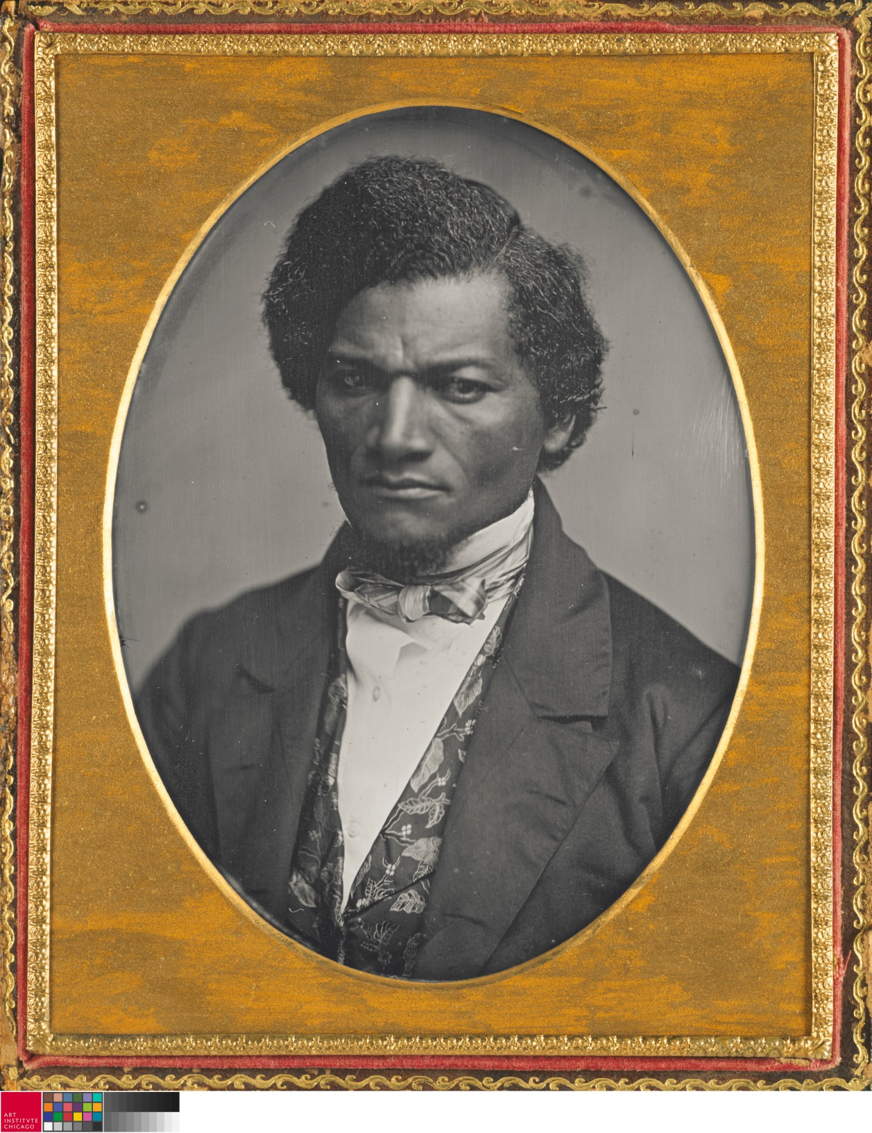
Douglass in 1852

Slide 11
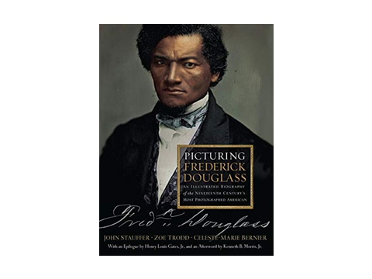
Published by W. W. Norton, 2015

Slide 12
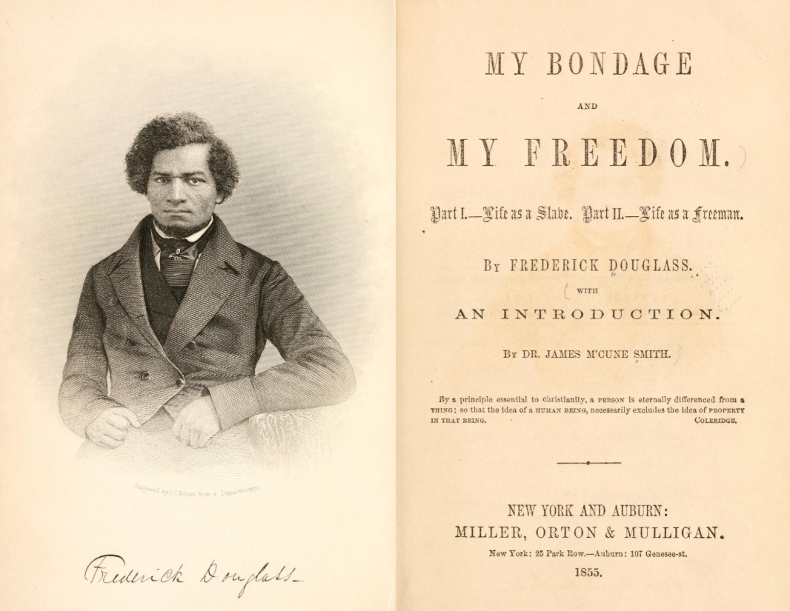

Slide 13
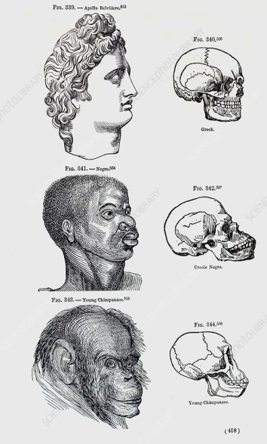
From Josiah C. Nott and George Gliddon, Types of Mankind
(Philadelphia: Lippincott, Grambo & Co, 1854). Douglass responded
to this book in a famous speech, “The Claims of the Negro,
Ethnologically Considered” (1854).

Slide 14
A Douglass Chronology, Civil War and Beyond
1863-1865 Visits Lincoln three times at the White House; they become friends of sorts. During this period, Douglass helps to recruit Black troops for the Union Army.
1865-1868 Challenges Andrew Johnson; supports his impeachment. Actively works for Reconstruction and Black rights from this time to his death in 1895.
1870-1874 Edits The New Era, Washington D.C. newspaper championing Reconstruction.
1877-1895 Dismayed by the failure of Reconstruction, but keeps on fighting.
1881, 1892 Publishes his third autobiography, Life and Times of Frederick Douglass.
1884 After the death of his wife Anna, marries Helen Pitts, a white woman twenty years his junior who had been working as his secretary.
1894 Delivers one of his most famous speeches, “Lessons of the Hour,” an attack on the lynching of black men.
1895 Dies on February 20th, several hours after speaking at a women’s rights convention.

Slide 15
Lincoln delivering second inaugural address, March 4,1865

Slide 16
Published by W. W. Norton, 2021

Slide 17
The Douglass Argument, 1861-1895
“Slavery is not abolished until the black man has the ballot.”
(from a speech at the May 1865 American Anti-Slavery Society)

Slide 18
Frederick Douglass circa 1880
(from negatives at the Library of Congress)

Slide 19
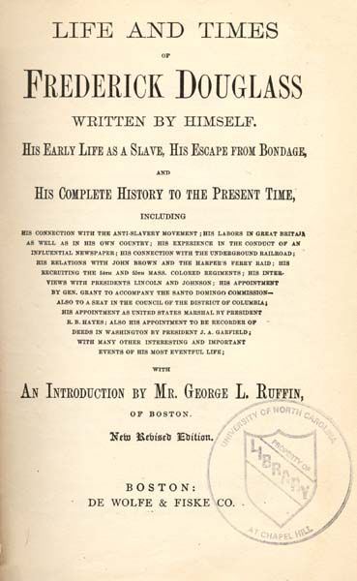
1881; 1892

Slide 20
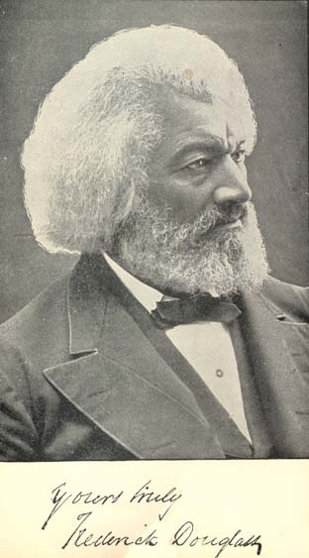
Frontispiece photograph in Life and Times of Frederick Douglass

Slide 21
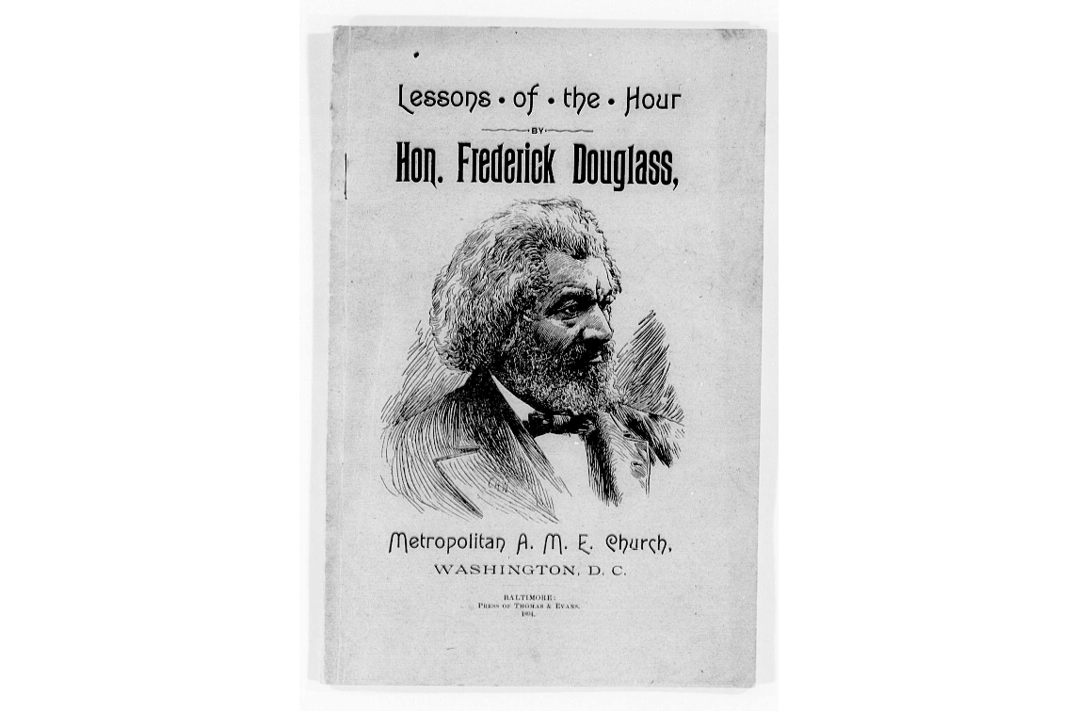

Slide 22
The closing words of Douglass’s 1894 “The Lessons of the Hour”
Put away your race prejudice. Banish the idea that one class must rule over another. Recognize the fact that the rights of the humblest citizen are as worthy of protection as those of the highest, and your problems will be solved; and, whatever may be in store for it in the future, whether prosperity, or adversity; whether it shall have foes without, or foes within, whether there shall be peace, or war; based upon the eternal principles of truth, justice, and humanity, and with no class having any cause of complaint or grievance, your Republic will stand and flourish forever.

Slide 23
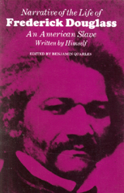
Douglass’s Narrative published by Harvard University Press, 1961;
the first reprinting since around 1850.

Slide 24
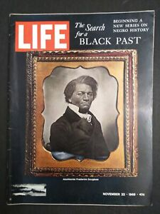
Douglass on the cover of the November 22, 1968 Life Magazine, several months after the assassination of Martin Luther King and on the anniversary of Kennedy’s assassination on the same day in 1963.

Slide 25
Douglass at the Present Moment:
See my recent op-eds on Douglass and voting rights, Douglass
and Critical Race Theory, and Douglass and the abuses of
executive power (links at go.umd.edu/robertslevine):
“Why We Must Hear the Warning in Frederick Douglass’s
‘Sources of Danger to the Republic’ Today,” Time Magazine,
August 24, 2021.
“Frederick Douglass and the Trouble with Critical Race Theory,”
Los Angeles Review of Books, August 2, 2021.
“Georgia’s Voter Suppression Laws Betray the Promise of
Reconstruction,” Washington Post, April 27, 2021.

Slide 26
The opening paragraph of Douglass’s 1845 Narrative
I was born in Tuckahoe, near Hillsborough, and about twelve miles from Easton, in Talbot county, Maryland. I have no accurate knowledge of my age, never having seen any authentic record containing it. By far the larger part of the slaves know as little of their ages as horses know of theirs, and it is the wish of most masters within my knowledge to keep their slaves thus ignorant. I do not remember to have ever met a slave who could tell of his birthday. They seldom come nearer to it than planting-time, harvest-time, cherry-time, spring-time, or fall-time. A want of information concerning my own was a source of unhappiness to me even during childhood. The white children could tell their ages. I could not tell why I ought to be deprived of the same privilege. I was not allowed to make any inquiries of my master concerning it. He deemed all such inquiries on the part of a slave improper and impertinent, and evidence of a restless spirit. The nearest estimate I can give makes me now between twenty-seven and twenty-eight years of age. I come to this, from hearing my master say, some time during 1835, I was about seventeen years old.

Slide 27
Selections from the Appendix to Douglass’s 1845 Narrative
“I hate the corrupt, slaveholding, women-whipping, cradle plundering, partial and hypocritical Christianity of this land. Indeed, I can see no reason, but the most deceitful one, for calling the religion of this land Christianity.”
“The man who wields the blood-clotted cowskin during the week fills the pulpit on Sunday, and claims to be the minister of the meek and lowly Jesus.”

Slide 28
Questions for you and your students
Douglass was celebrated as a great rhetorician--a speaker and writer who knew how to use language to persuade. He wrote the Narrative (1845) at time when abolitionism was just starting to gain traction. What does Douglass do in the opening chapter to draw the reader in and get the reader on his side? You might discuss tone and what Aristotle called Ethos (the sense of character or voice conveyed through language).
How would you compare the tone of the Appendix to the opening of the Narrative? How is Douglass imagining his audience at the end of the Narrative as opposed to at the beginning?
Can the full opening chapter of the Narrative be taught in your classroom? Why or why not? And could the full Appendix be taught in your classroom? Again, why or why not?

