Slide 1
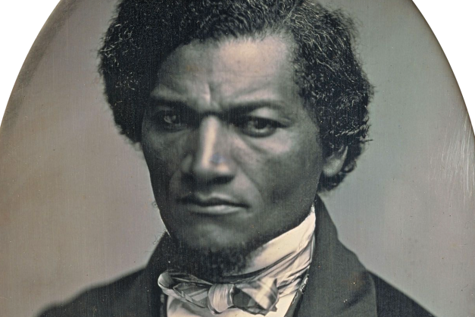
Teaching Frederick Douglass’s Narrative and “What to the Slave Is the Fourth of July?”
ROBERT S. LEVINE
UNIVERSITY OF MARYLAND
rlevine@umd.edu
go.umd.edu/robertslevine

Slide 2
A Douglass Chronology of His Pre-Civil War Career: Part 1
1818 Frederick Bailey born into slavery in Talbot County on the Eastern Shore of Maryland.
1838 Escapes from slavery, disguised as a sailor. Changes name to Douglass. Marries the free Black Anna Murray in New York, and they subsequently make their way to New Bedford, Massachusetts.
1841 Speaks at an antislavery convention in Nantucket; William Lloyd Garrison, the white abolitionist leader of the Massachusetts Antislavery Society, hires him as a lecturer for his organization.
1845 Publishes Narrative of the Life of Frederick Douglass. Because of its popularity, Douglass flees to the British Isles to escape from fugitive slave catchers.

Slide 3
DOUGLASS’S CORE BELIEFS AS A GARRISONIAN ABOLITIONIST, 1841-1845
MORAL SUASION (i.e. nonviolence)
THE CONSTITUTION IS A PROSLAVERY DOCUMENT (therefore one should not vote in elections or otherwise participate in the political process)
IMMEDIATISM (slavery is immoral and must end immediately)

Slide 4
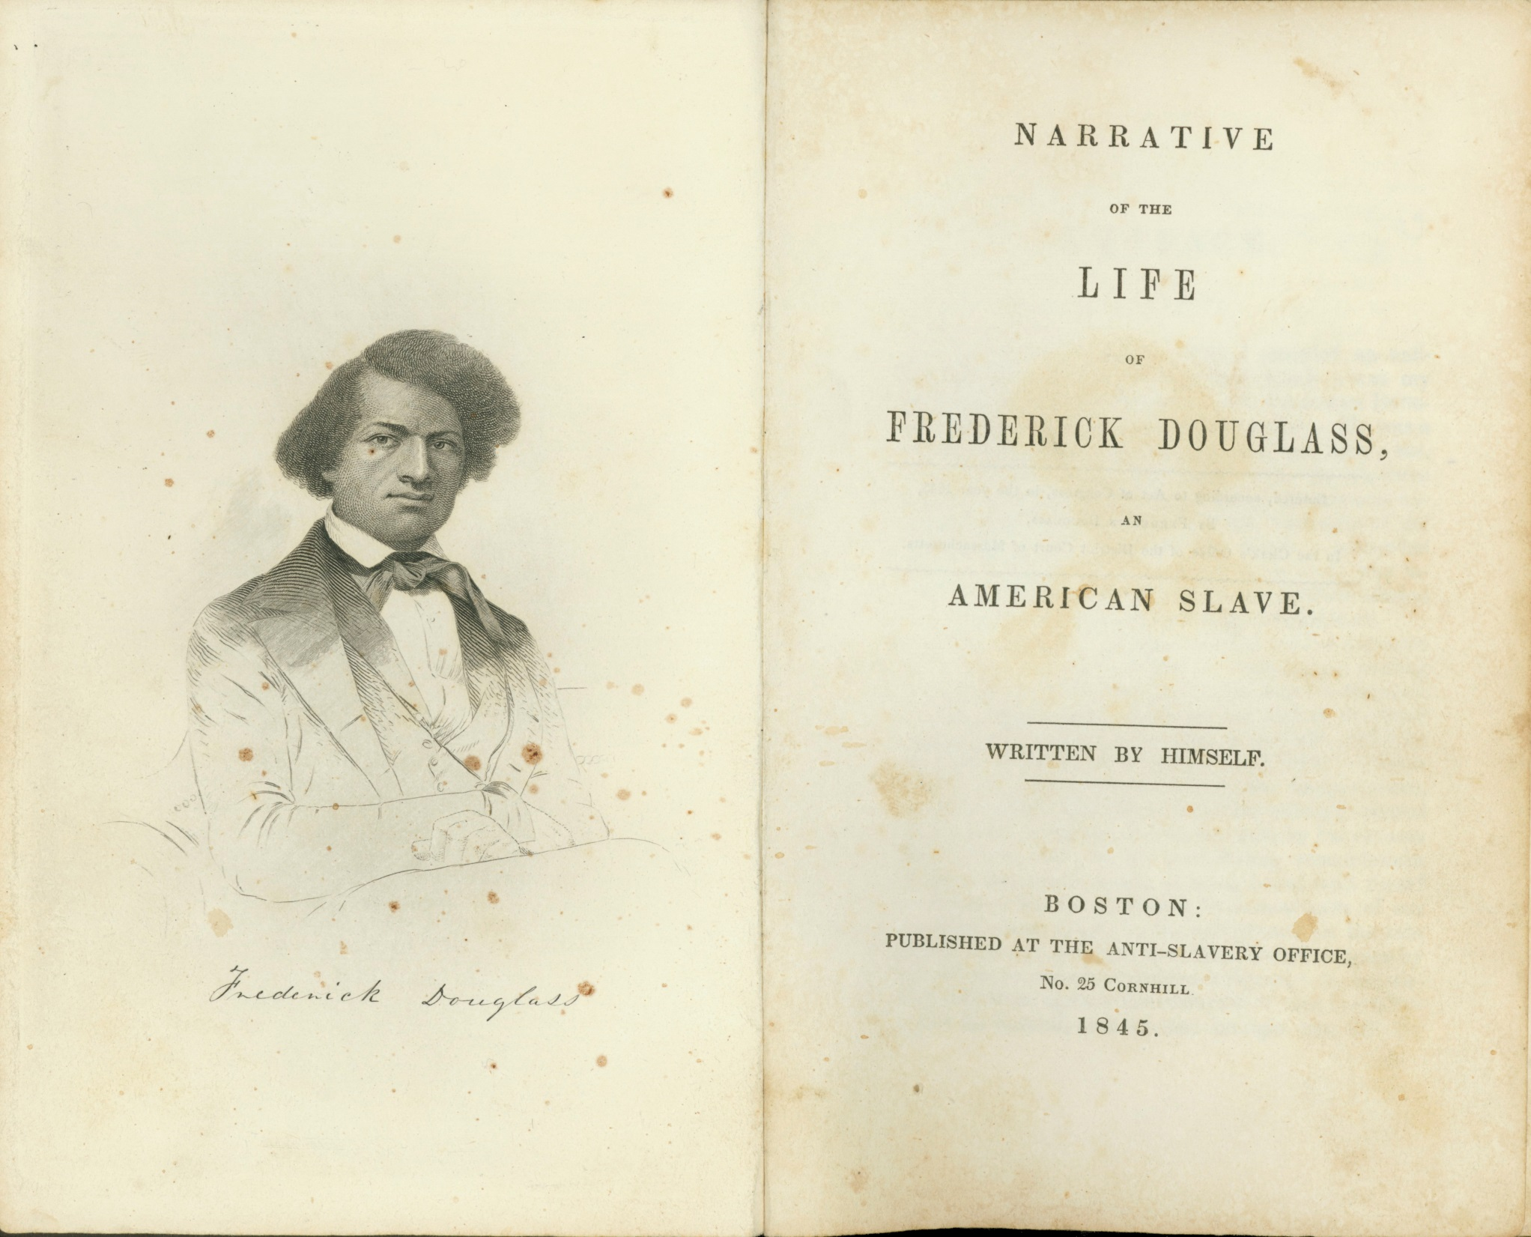

Slide 5
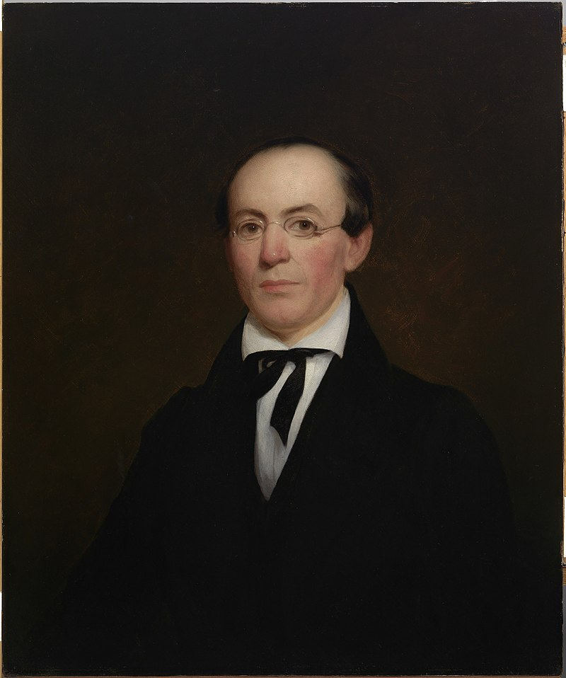
From William Lloyd Garrison’s “Preface” to the Narrative:
I shall never forget his first speech at the convention--I think I never hated slavery so intensely as at that moment; . . . There stood one, in physical proportion and stature commanding and exact--in intellect richly endowed--in natural eloquence a prodigy . . .yet a slave, ay, a fugitive slave,--trembling for his safety. . . Capable of high attainments as an intellectual and moral being--needing nothing but a comparatively small amount of cultivation to make him an ornament to society and a blessing to his race--by the law of the land, by the voice of the people, by the terms of the slave code, he was only a piece of property, a beast of burden, a chattel personal, nevertheless!

Slide 6
The opening paragraph of Douglass’s 1845 Narrative
I was born in Tuckahoe, near Hillsborough, and about twelve miles from Easton, in Talbot county, Maryland. I have no accurate knowledge of my age, never having seen any authentic record containing it. By far the larger part of the slaves know as little of their ages as horses know of theirs, and it is the wish of most masters within my knowledge to keep their slaves thus ignorant. I do not remember to have ever met a slave who could tell of his birthday. They seldom come nearer to it than planting-time, harvest-time, cherry-time, spring-time, or fall-time. A want of information concerning my own was a source of unhappiness to me even during childhood. The white children could tell their ages. I could not tell why I ought to be deprived of the same privilege. I was not allowed to make any inquiries of my master concerning it. He deemed all such inquiries on the part of a slave improper and impertinent, and evidence of a restless spirit. The nearest estimate I can give makes me now between twenty-seven and twenty-eight years of age. I come to this, from hearing my master say, some time during 1835, I was about seventeen years old.

Slide 7
PASSAGES FROM TWO NOTABLE BLACK-AUTHORED TEXTS PUBLISHED BEFORE DOUGLASS’S 1845 NARRATIVE
From David Walker’s Appeal to the Colored Citizens . . . of the United States of America (1829):
“Kill or be killed.”
From Henry Highland Garnet’s “An Address to the Slaves of the United States” (1843):
“Let your motto be resistance! resistance! RESISTANCE! No oppressed people have ever secured their liberty without resistance.”

Slide 8
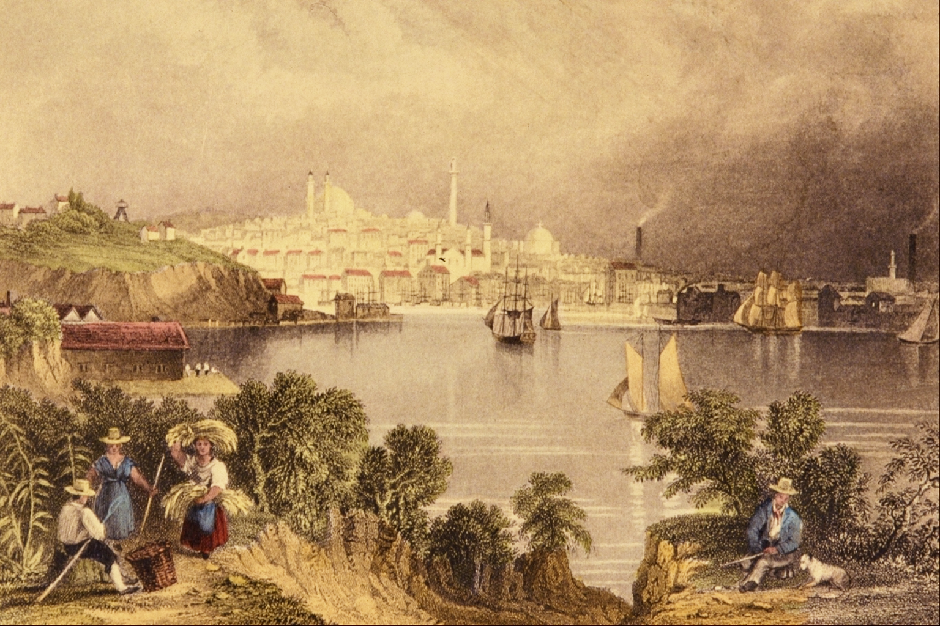
At age 8, Douglass was sent from the Eastern Shore of Maryland
to Baltimore.
Baltimore c. 1830; the harbor and city viewed from Federal Hill

Slide 9
Key passage in the Narrative on being sent to Baltimore:
Going to live at Baltimore laid the foundation, and opened the gateway, to all my subsequent prosperity. I have ever regarded it as the first plain manifestation of that kind providence which has ever since attended me, and marked my life with so many favors. . . .
I may be deemed superstitious, and even egotistical, in regarding this event as a special interposition of divine Providence in my favor. But I should be false to the earliest sentiments of my soul, if I suppressed the opinion.
(from the concluding paragraphs of chapter 5)

Slide 10
Chapter 7: Douglass teaches himself to read and write (with the help of local white boys)
Highlights and teaching moments:
Sophia and Hugh Auld: She’s willing to teach Douglass; Hugh (in a famous moment in chapter 6) stops the teaching, which Douglass says reveals to him that power resides in language.
Douglass uses various “stratagems” to trick the white boys of Baltimore into becoming his teachers.
As Douglass learns about the evils of slavery through reading, he writes: “I envied my fellow-slaves for their stupidity.” But how “stupid” are they? At the end of chapter 2, Douglass says he first learned about slavery’s evils from slave songs: “To these songs I trace my first glimmering conception of the dehumanizing character of slavery.”
Reads The Columbian Orator.

Slide 11
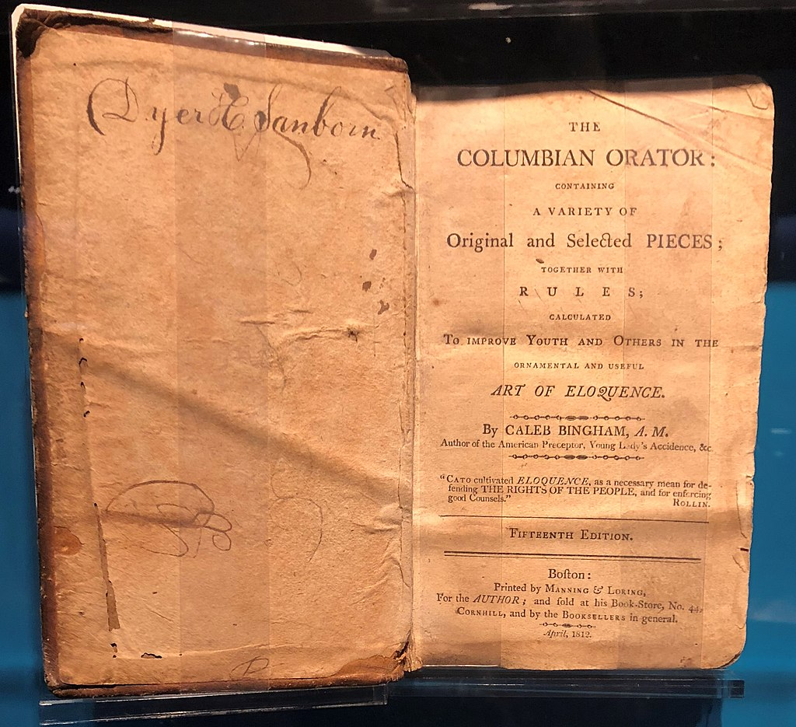
First
published
in Boston
in 1797

Slide 12
Consider teaching “Dialogue between a Master and Slave,” which Douglass read in the Columbian Orator
https://quod.lib.umich.edu/e/evans/N24063.0001.001/1:4.2.64?rgn=div3;view=fulltext
It presents “both sides” on slavery.
It shows how, at a time of polarization, people on different sides can actually listen to one another.
It shows an enslaved Black person changing the mind of a white enslaver through the use of rhetoric.

Slide 13
Chapter 10: Douglass rebels against the slave-breaker Covey
Highlights and teaching moments:
Analogy between Douglass and the ox he’s supposed to tame (the ox is to Douglass as Douglass is to Covey): “Behold a man transformed into a brute!”
The famous apostrophe to the sailboats on the Chesapeake: “You are loosed from your moorings and are free; I am fast in my chains, and am a slave!” [read the whole paragraph in class; it’s brilliant]
“You have seen how a man was made a slave; you shall see how a slave was made a man.” [chiasmus]
After being beaten by Covey, Douglass walks several miles to Thomas Auld’s cabin and presents himself to his master: “From the crown of my head to my feet, I was covered with dust and blood; my shirt was stiff with blood. My legs and feet were torn in sundry places with briers and thorns.”
Sandy’s root
Douglass’s temperate resistance to Covey: “It was a glorious resurrection, from the tomb of slavery, to the heaven of freedom.”

Slide 14
Selections from the Appendix to Douglass’s 1845 Narrative
“I hate the corrupt, slaveholding, women-whipping, cradle plundering, partial and hypocritical Christianity of this land. Indeed, I can see no reason, but the most deceitful one, for calling the religion of this land Christianity.”
“The man who wields the blood-clotted cowskin during the week fills the pulpit on Sunday, and claims to be the minister of the meek and lowly Jesus.”

Slide 15
A Douglass Chronology of His Pre-Civil War Career, Part 2
1847 Douglass’s British supporters buy him out of slavery; Douglass returns to Rochester, New York, where he establishes his own antislavery newspaper, The North Star.
1850 Douglass formally breaks with Garrison. The Compromise of 1850 includes a strengthened fugitive slave law, leading Douglass to adopt a more militant politics.
1852 Delivers “What to the Slave Is the Fourth of July?” in Rochester.
1855 Publishes his second autobiography, My Bondage and My Freedom.
1857 Supreme Court rules in Dred Scott case that Blacks have “no rights that whites are bound to respect” and that Blacks could never become U.S. citizens. Douglass in an 1857 speech on the case declares, ironically, that he’s delighted with the decision because he thinks it’s so ludicrous it will be rejected by the American people.
1858-60 Meets with John Brown. After Brown attacks Harpers Ferry in October 1859, Douglass flees to England; he returns in 1860 and supports Lincoln for the presidency.

Slide 16
DOUGLASS’S CORE BELIEFS
AFTER BREAKING WITH GARRISON IN 1850
THE CONSTITUTION IS AN ANTISLAVERY DOCUMENT (therefore one should participate in elections and the larger political process)
ANTISLAVERY VIOLENCE, IN SOME INSTANCES, IS A PROPER RESPONSE TO THE VIOLENCE OF SLAVERY

Slide 17
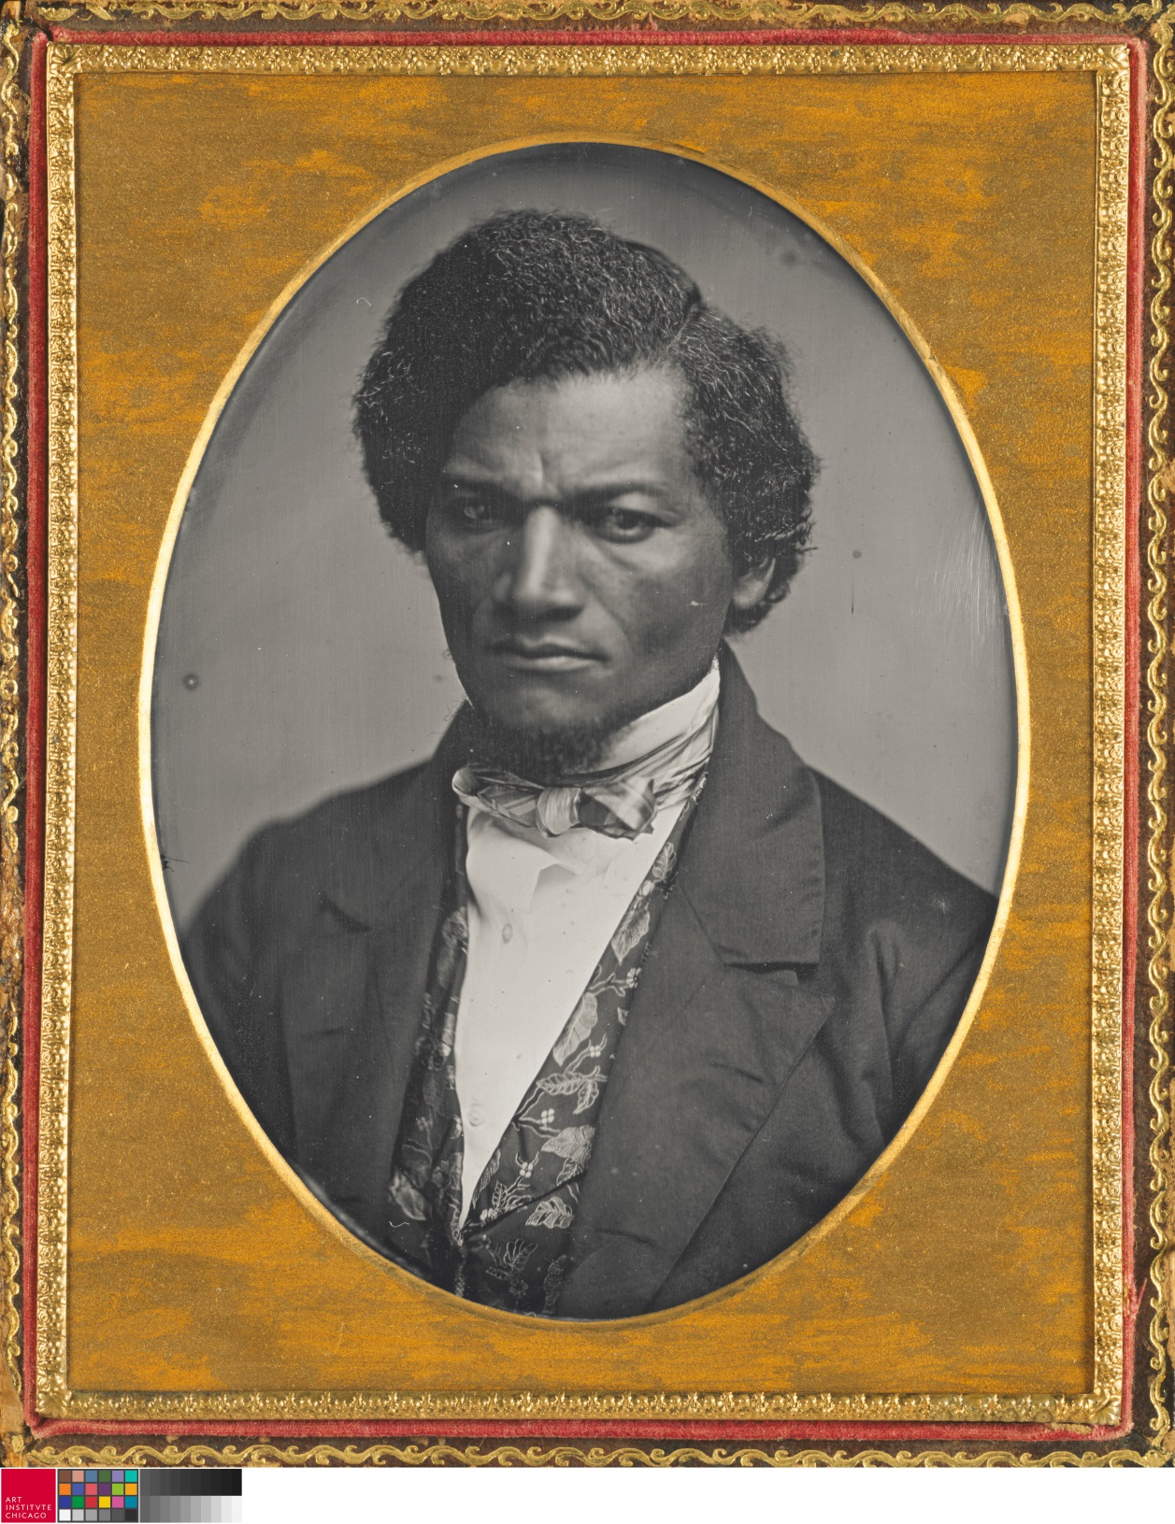
Douglass in 1852

Slide 18
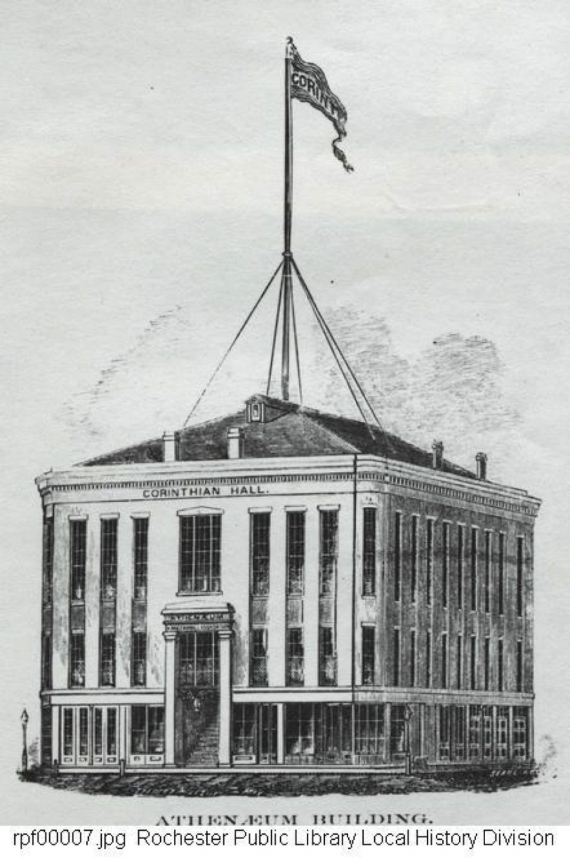
Rochester’s Corinthian Hall, first opened in 1849; Ralph Waldo
Emerson, Charles Dickens, and other luminaries spoke there.

Slide 19
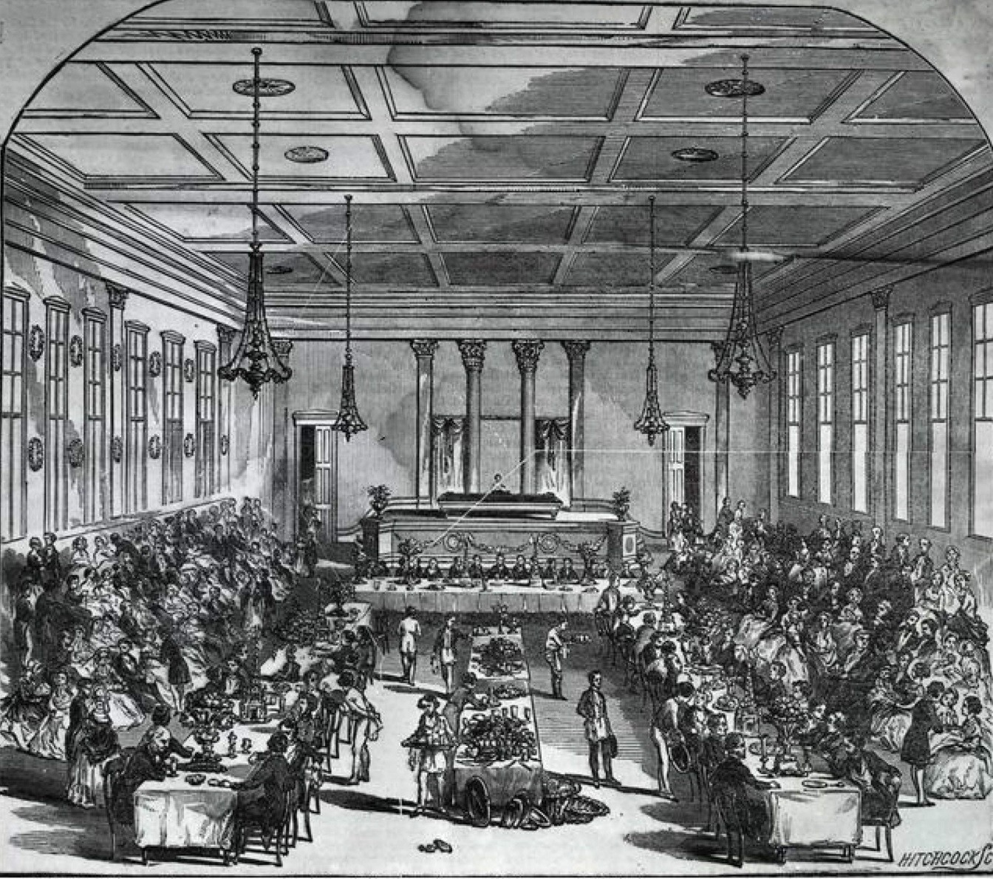
Interior of Corinthian Hall. On July 5, 1852, Douglass, at the invitation of the Rochester Ladies’ Antislavery Society, spoke to approximately 600 abolitionists, who paid an admission charge of 12 cents.

Slide 20
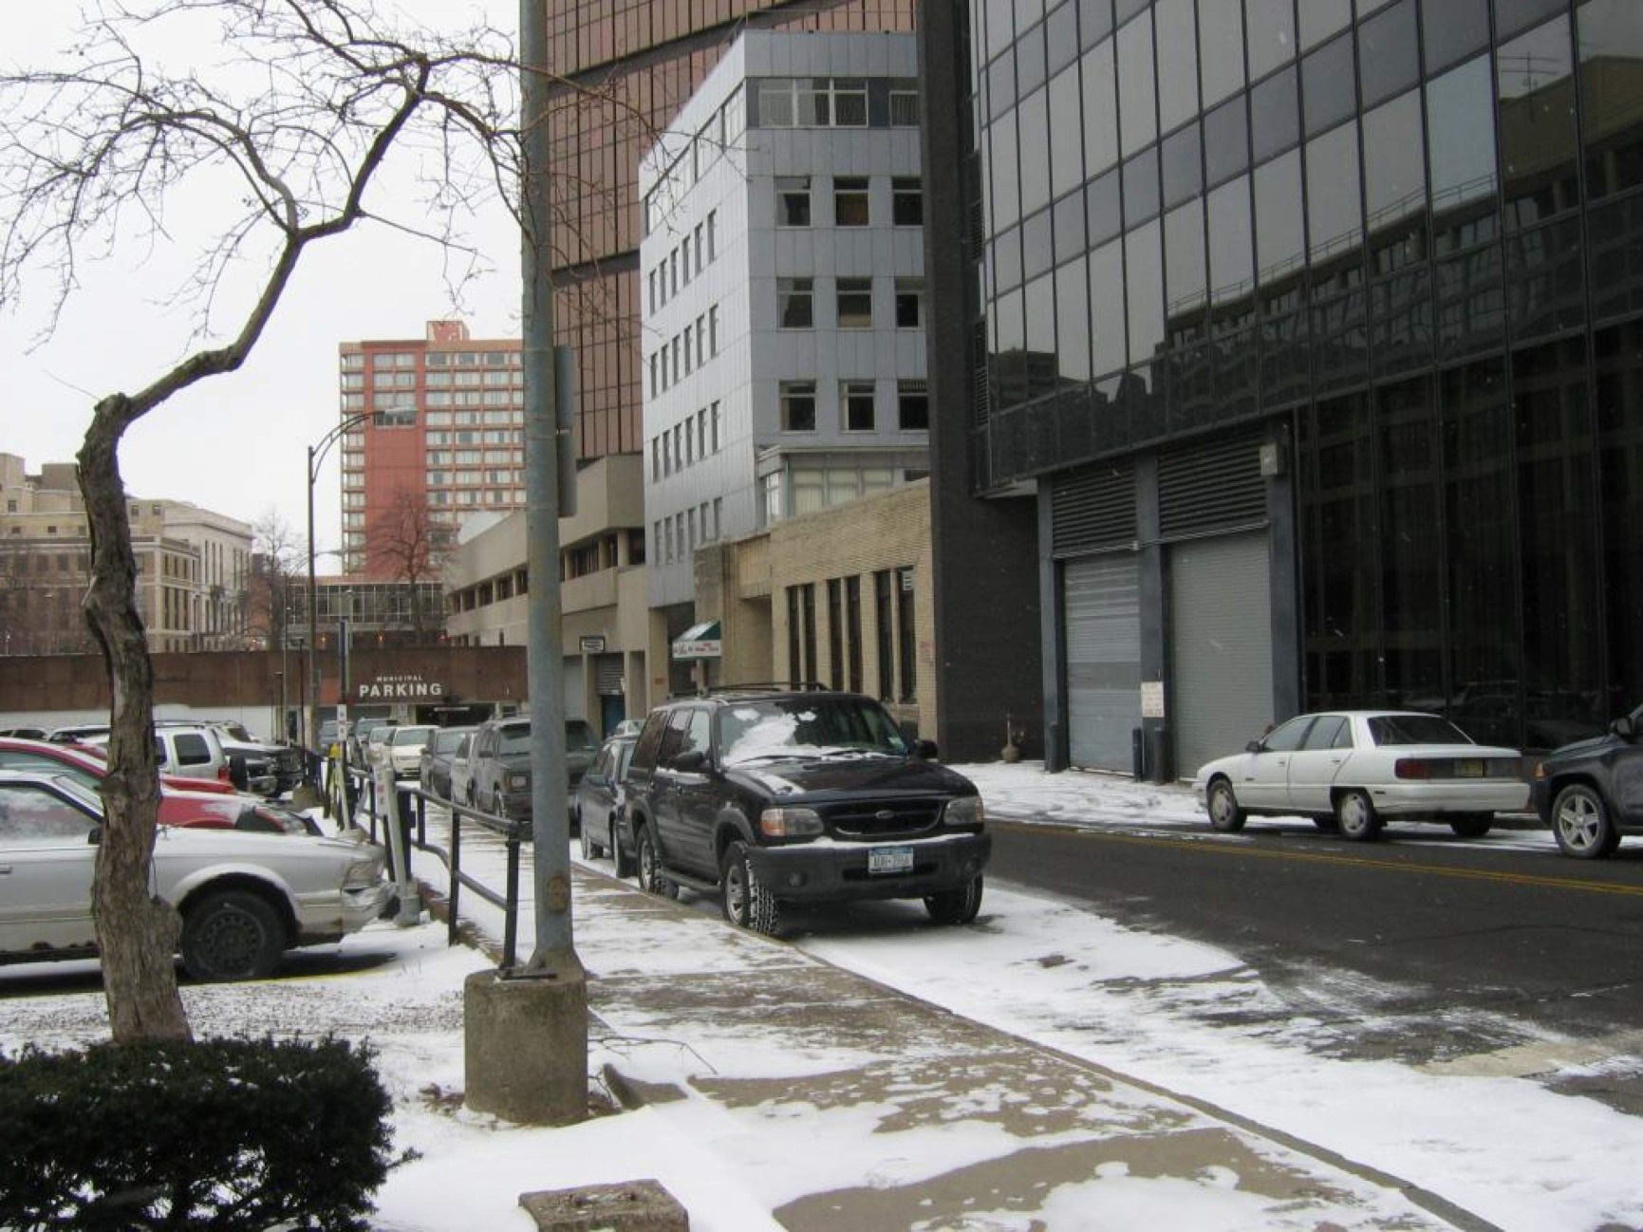
Corinthian Hall razed in 1920 and now the site of a parking lot near a Holiday Inn

Slide 21
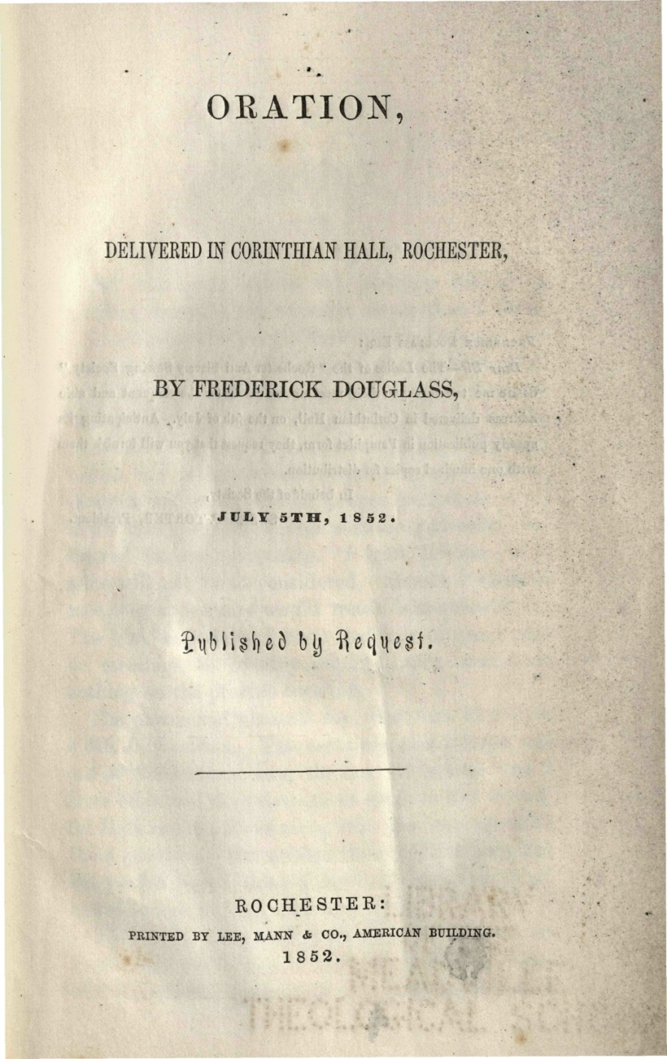
Widely distributed right after the speech at 50 cents per copy

Slide 22
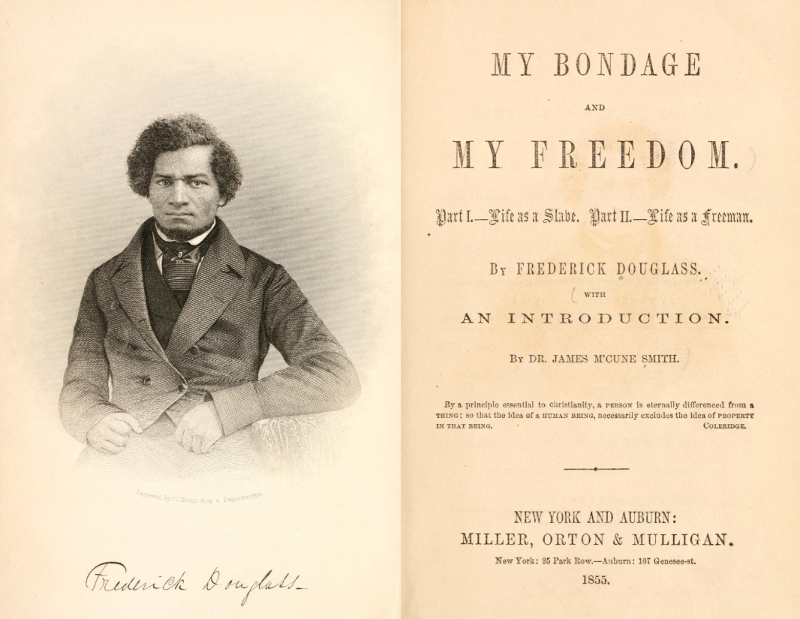

Slide 23
Key passages from “What to the Slave Is the Fourth of July”
“Fellow Citizens”
“The Fourth of July is yours, not mine. You may rejoice, I must mourn.”
He refers to “the great sin and shame of America” and quotes from Psalm 137.
“Must I undertake to prove that the slave is a man?”
“At a time like this, scorching irony, not convincing argument, is needed.”
Works with the form and tone of the Jeremiad.

Slide 24
THE CONCLUDING PARAGRAPHS OF THE 1855 VERSION OF “WHAT TO THE SLAVE IS THE FOURTH OF JULY”
What, to the American slave, is your 4th of July? I answer, a day that reveals to him, more than all other days in the year, the gross injustice and cruelty to which he is the constant victim. To him, your celebration is a sham; your boasted liberty, an unholy license; your national greatness, swelling vanity; your sounds of rejoicing are empty and heartless; your denunciations of tyrants, brass-fronted impudence; your shouts of liberty and equality, hollow mockery; your prayers and hymns, your sermons and thanksgivings, with all your religious parade, and solemnity, are to him mere bombast, fraud, deception, impiety, and hypocrisy — a thin veil to cover up crimes which would disgrace a nation of savages. There is not a nation on the earth guilty of practices more shocking and bloody, than are the people of these United States, at this very hour.
Go where you may, search where you will, roam through all the monarchies and despotisms of the old world, travel through South America, search out every abuse, and when you have found the last, lay your facts by the side of the every-day practices of this nation, and you will say with me, that, for revolting barbarity and shameless hypocrisy, America reigns without a rival.

Slide 25
Douglass on the American Revolutionaries of 1776
From near the opening of the 1852 “What to the Slave Is the Fourth of July”:
They were peace men; but they preferred revolution to peaceful submission to bondage. They were quiet men; but they did not shrink from agitating against oppression. . . . With them, justice, liberty, and humanity were “final”; not slavery and oppression.

Slide 26
Questions for you and your students [1]
Discuss how Douglass taught himself to read and write. Why did he so desperately want to learn how to read and write? What were his most effective ways of doing so? What do we learn about Douglass from chapter 7? What does Douglass regard as the advantages of literacy? The disadvantages?
Why doesn’t Covey kill Douglass when he resists him? Earlier in the Narrative, in chapter 4, an enslaved man named Demby resists an overseer and he’s shot dead in his tracks. Why doesn’t this happen to Douglass? (I can think of at least four reasons, but two stand out.)
What do you make of Sandy and his root? What does Douglass find appealing about him? Unappealing?
One of the most famous passages in the Narrative is when Douglass addresses the sailboats in the Chesapeake in an “apostrophe” (a direct address to someone who’s not there or to a personified object, like a sailboat). As a creative exercise, reread that passage and then write an apostrophe that speaks to something important in your life.

Slide 27
Questions for you and your students [2]
Douglass’s “What to the Slave Is the Fourth of July” is so critical of the United States that it almost seems anti-American. What are good strategies for teaching this essay, especially its concluding paragraphs, so that you wouldn’t have parents complaining about the anti-Americanism being brought into your classroom?
Why did Douglass give the initial lecture on July 5th? How would emphasizing that date help you to teach Douglass’s purpose and craft in this short essay version?
Discuss how Douglass attempts to appeal to his different audiences.

