Slide 1
The End of the Cold War Professor Jeremi Suri University of Texas at Austin http://jeremisuri.net

Slide 2
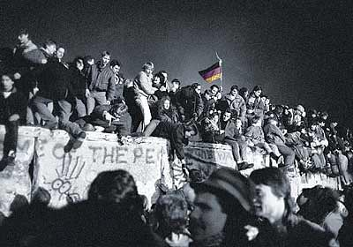

Slide 3
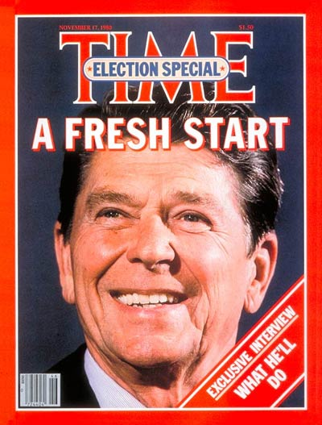
Notes:
http://img.timeinc.net/time/magazine/archive/covers/1980/1101801117_400.jpg
Time 17 November 1980

Slide 4
Key points:
1. Reagan and the New Right
2. The Gorbachev Generation
3. The End of the Cold War

Slide 5
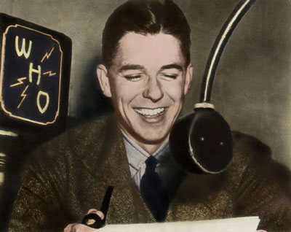
Notes:
http://businessimagegroup.com/presidentialimages.com/images/Reagan/reagan-Who-announcer-a12_400.jpg
Ronald Reagan began his broadcasting career as a radio announcer for the Chicago Cubs, WHO Radio, Des Moines, Iowa • Circa 1930 Courtesy of Ronald Reagan Library Hand-tinted by Bennett Hall © 1999

Slide 6
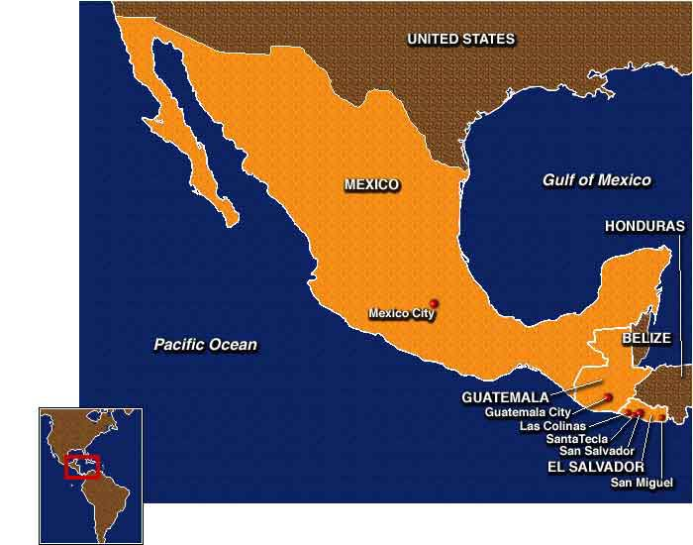
Notes:
http://cnnstudentnews.cnn.com/2001/fyi/news/01/15/salvador.quake/map.mex.el.salv.guatemala.jpg

Slide 7
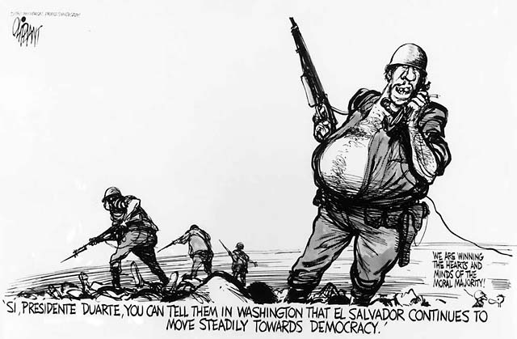
Notes:
http://www.loc.gov/exhibits/oliphant/vc007234.jpg
Pat Oliphant

Slide 8
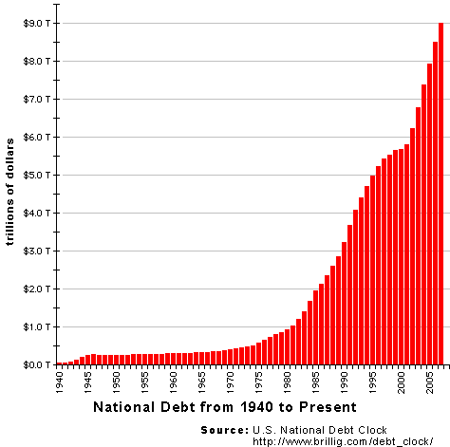

Slide 9
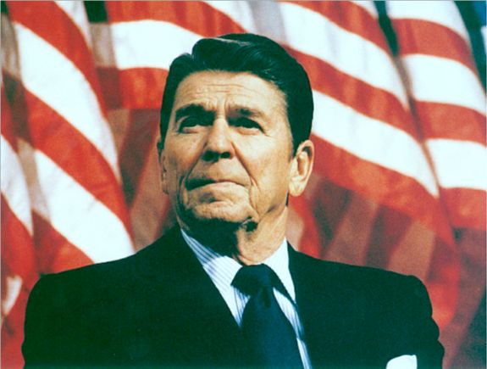
Notes:
http://www.rlrouse.com/pic-of-the-day/ronald-reagan.jpg

Slide 10
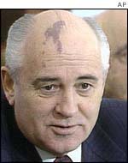
Mikhail Gorbachev
Notes:
Mikhail Gorbachev
http://news.bbc.co.uk/media/images/38145000/jpg/_38145563_gorbachevnewap150.jpg

Slide 11
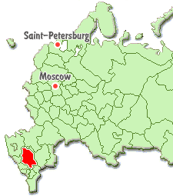
Stavropol Province, Russia
Notes:
http://www.russiatrek.com/regions/stavropol_l.gif

Slide 12
3 Phases of Gorbachev’s Reforms
1. Acceleration (“uskorennie”), 1985-86
2. Openness (“glasnost”), 1986-87
3. Restructuring (“perestroika”), 1988-89

Slide 13
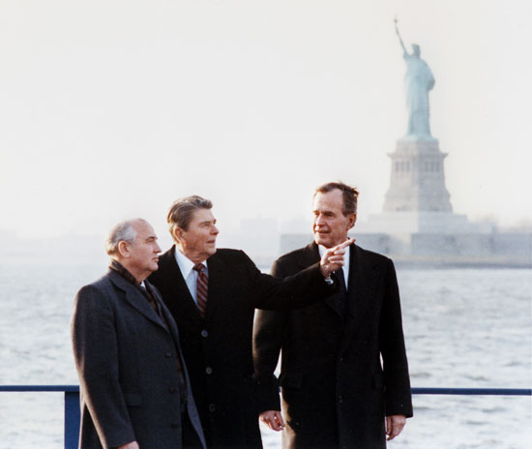
Notes:
http://www.theage.com.au/ffximage/2004/06/06/Gorbachev1_thumbnail,0.jpg

