Slide 1
FDR AND THE NEW DEAL
Professor Meg Jacobs
A New Deal
Relief
Reform

Slide 4
Notes:
http://maps.unomaha.edu/peterson/funda/MapLinks/Africa-2/Africa2.htm

Slide 6
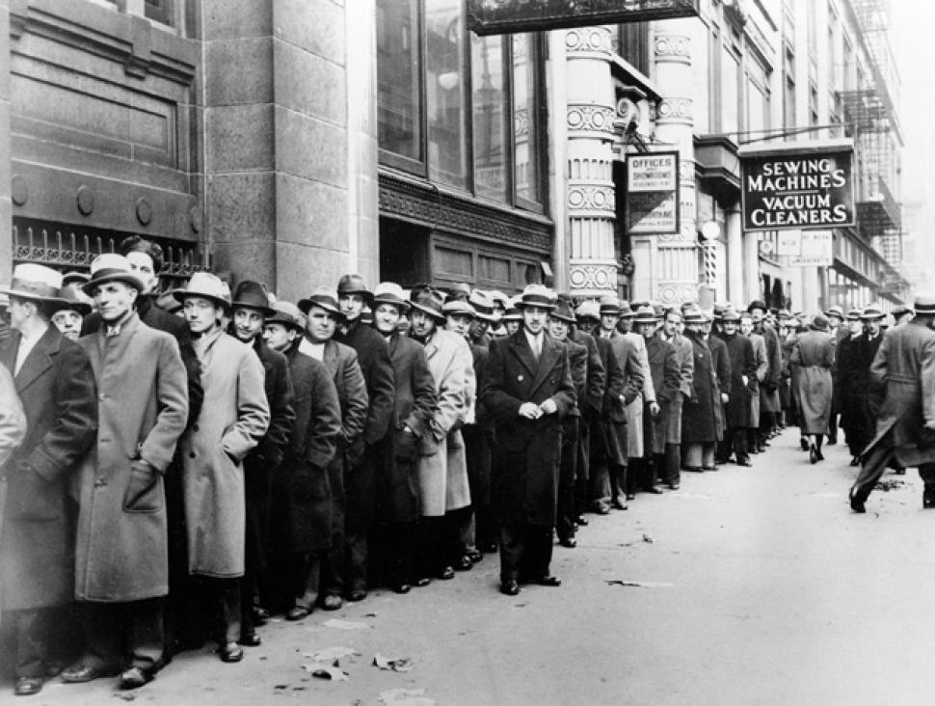

Slide 8
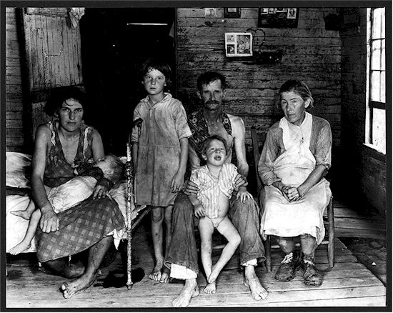

Slide 9
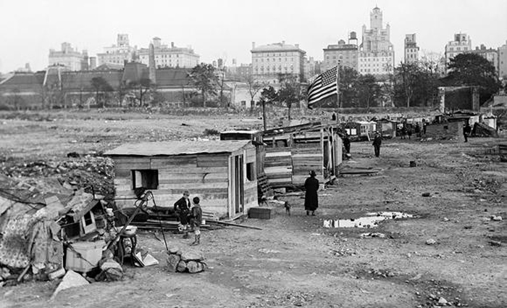

Slide 10
