Slide 1
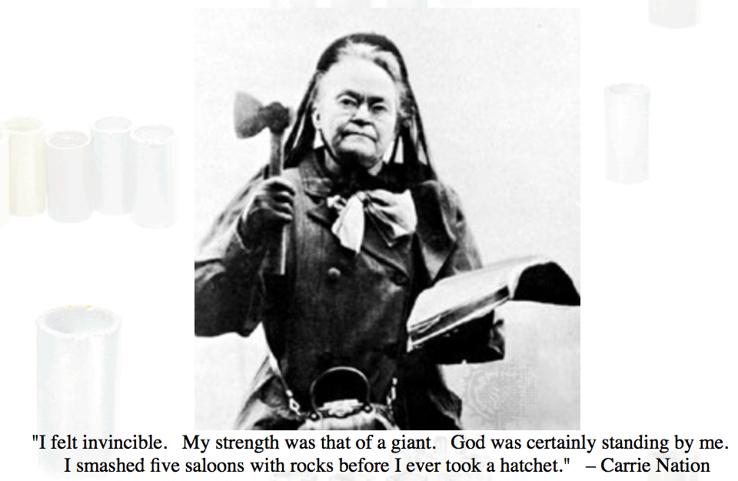

Slide 2
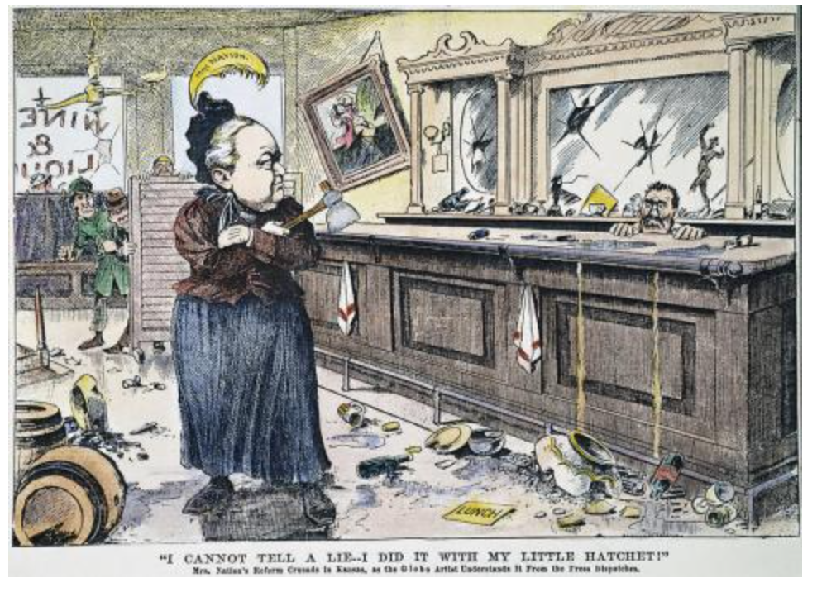

Slide 3
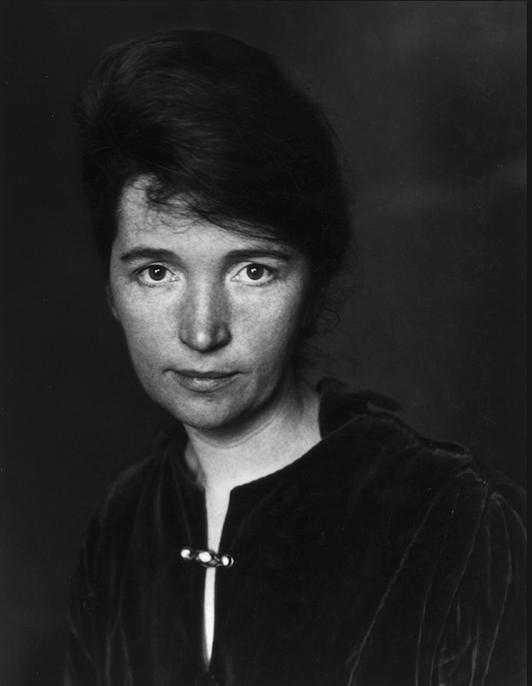

Slide 4
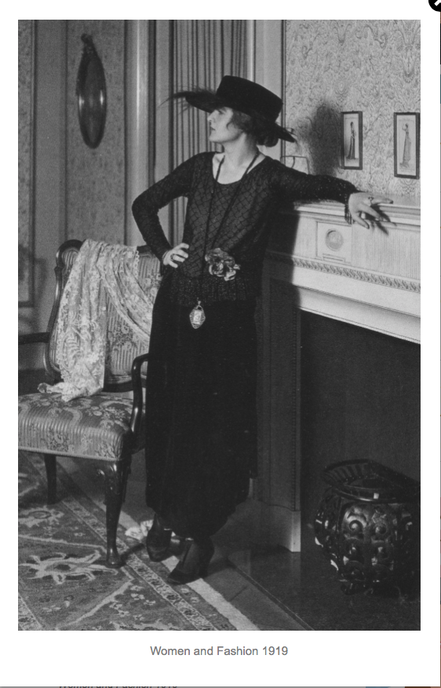

Slide 5
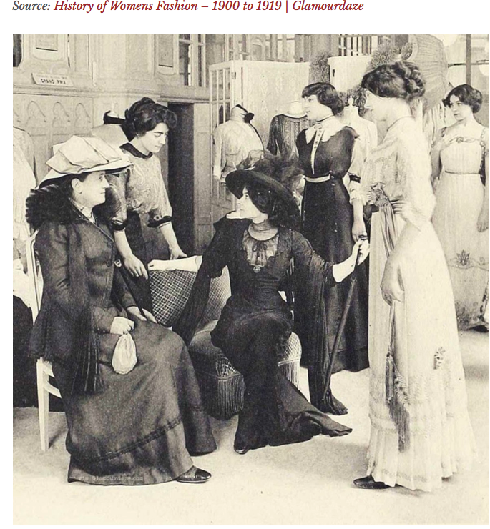

Slide 6
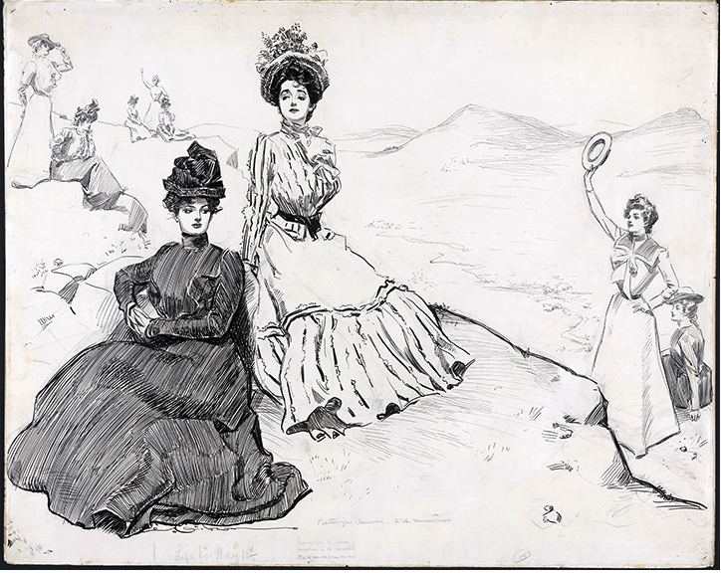

Slide 7
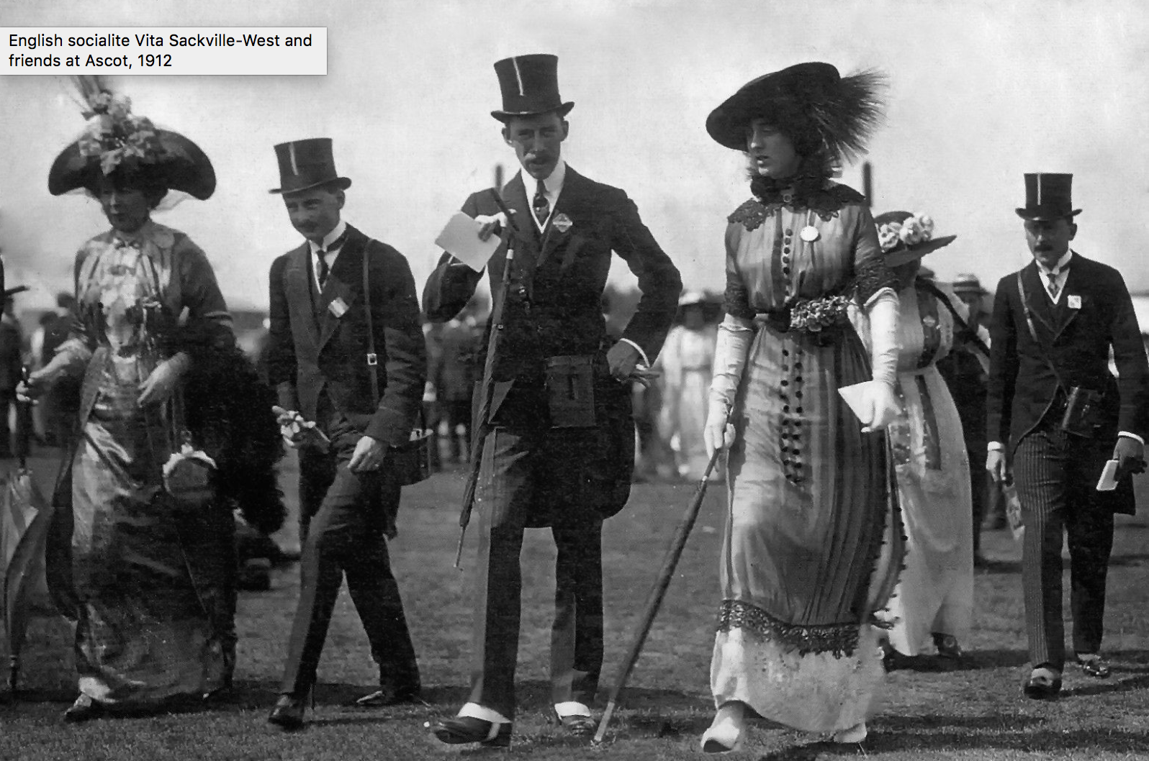

Slide 9
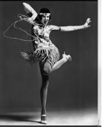
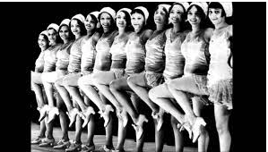

Slide 13
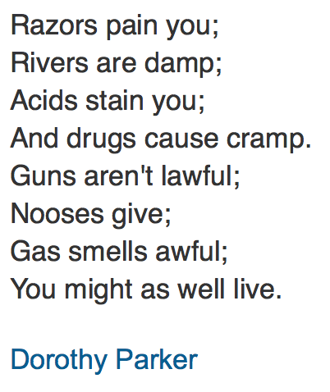
1926

Slide 14
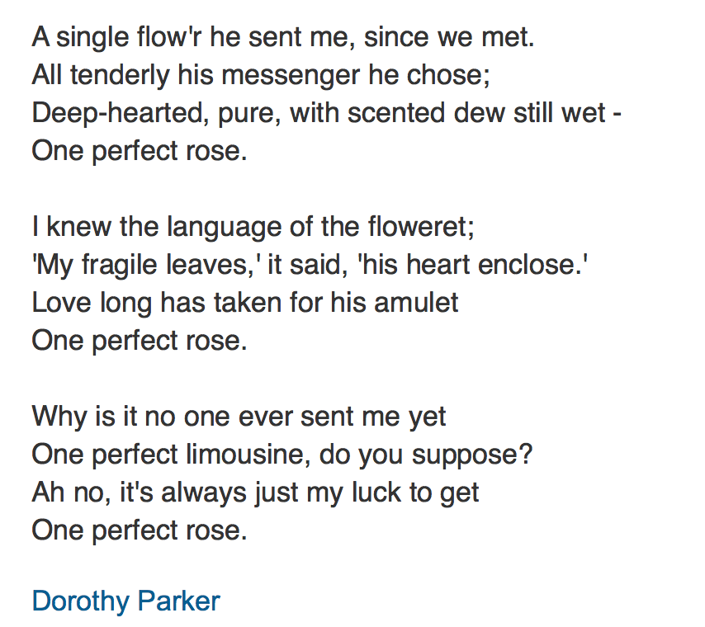
1926

Slide 15
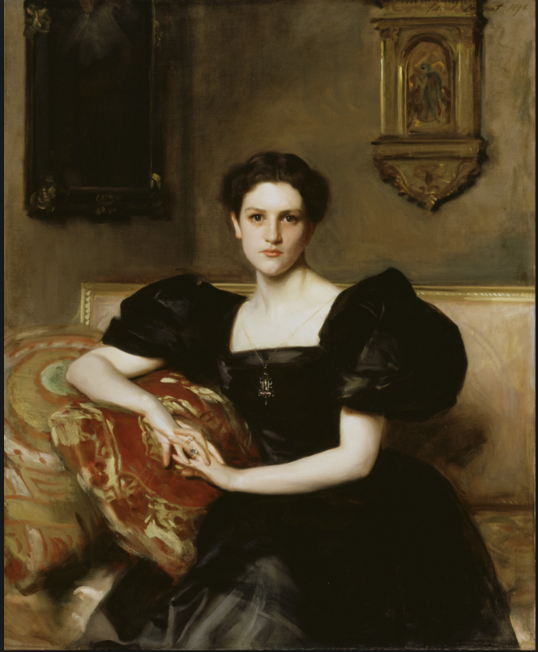
John Singer Sargent, “Elisabeth Winthrop Chanler,” 1893

Slide 16
Picasso
Girl Before a Mirror
1932

Slide 17
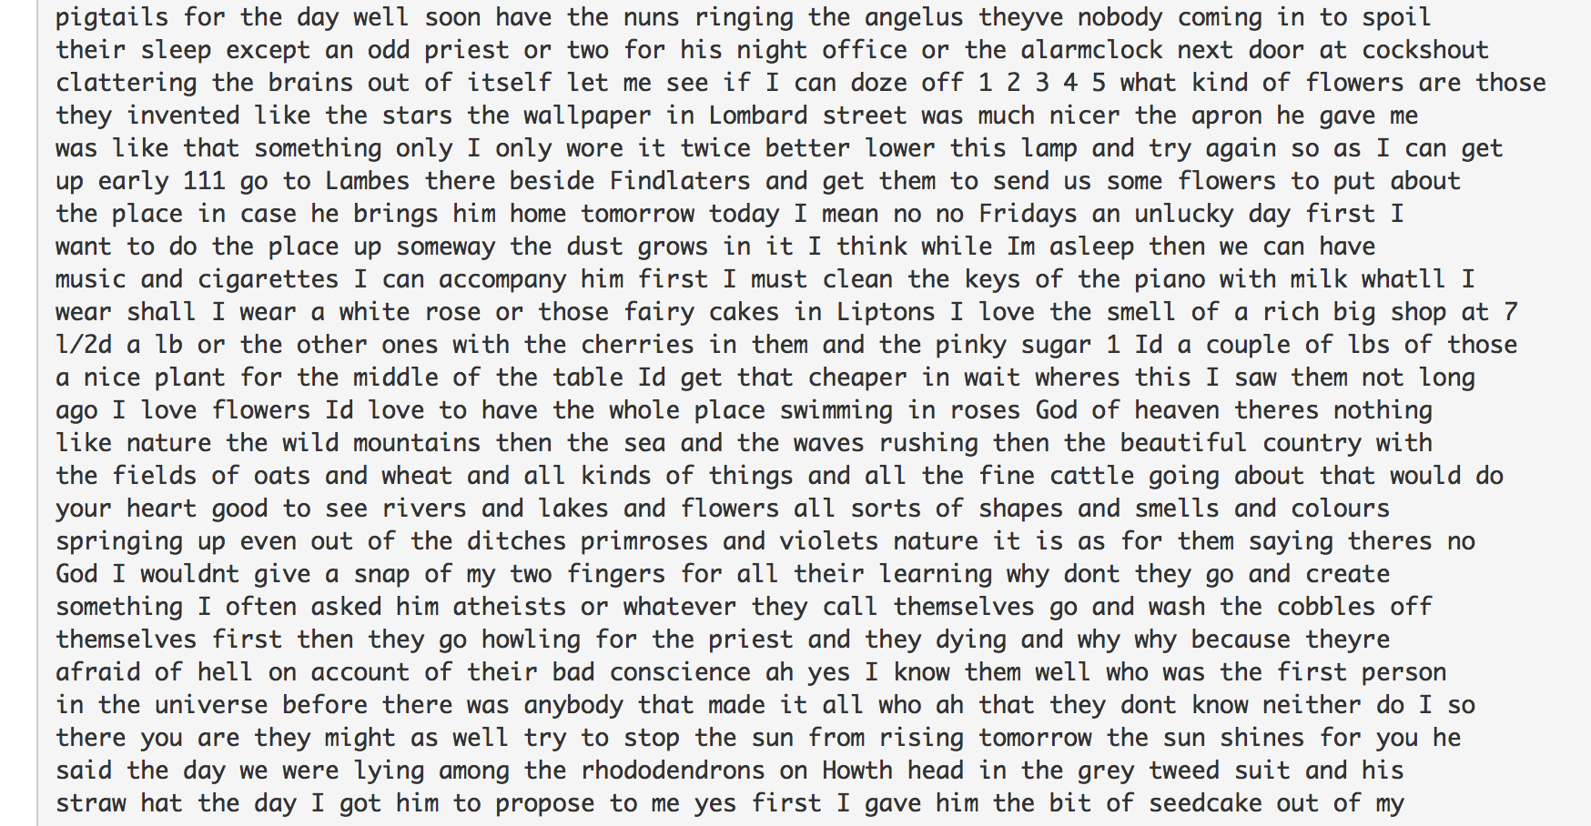

Slide 18
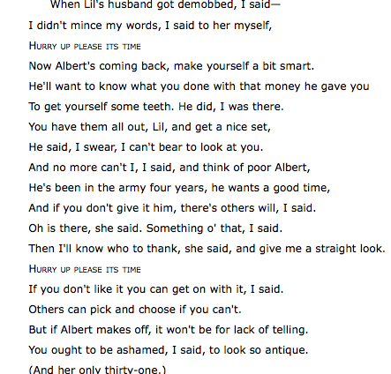
from Eliot, The Waste Land, 1922

Slide 19
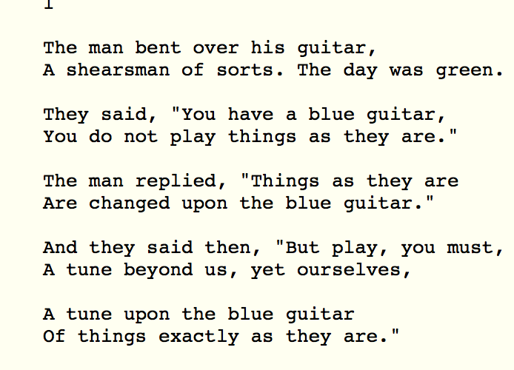
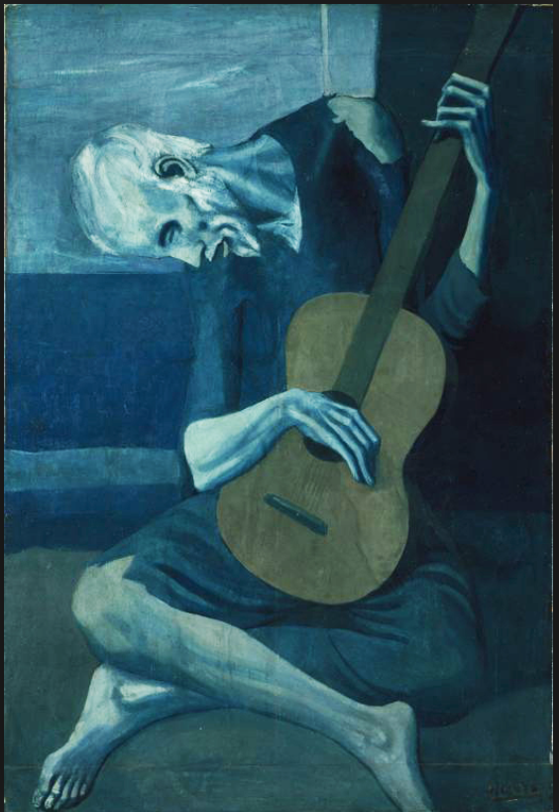

Slide 22
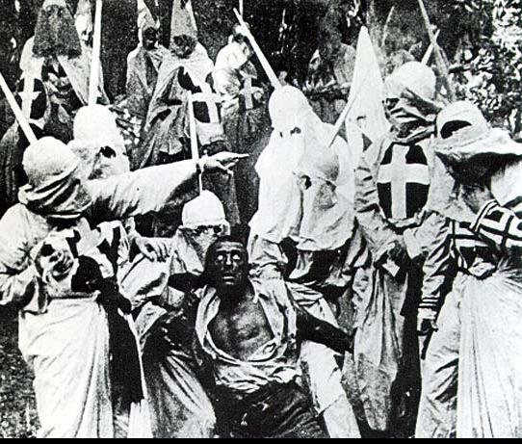

Slide 23
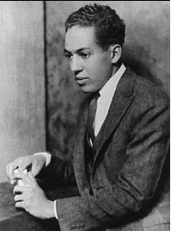
Langston Hughes

Slide 24
Harlem
What happens to a dream deferred?
Does it dry up
Like a raisin in the sun?
Or fester like a sore—
And then run?
Does it stink like rotten meat?
Or crust and sugar over—
Like a syrupy sweet?
Maybe it just sags
Like a heavy load.
Or does it explode?
1951

Slide 25
Question – Langston Hughes
When the old junk man Death
Comes to gather up our bodies
And toss them into the sack of oblivion,
I wonder if he will find
The corpse of a white multi-millionaire
Worth more pennies of eternity,
Than the black torso of
A Negro cotton-picker?
1925

Slide 26
For a Lady I Know – Countee Cullen
She even thinks that up in heaven
Her class lies late and snores,
While poor black cherubs rise at seven
To do celestial chores.
1925

Slide 27
Countee Cullen

Slide 28
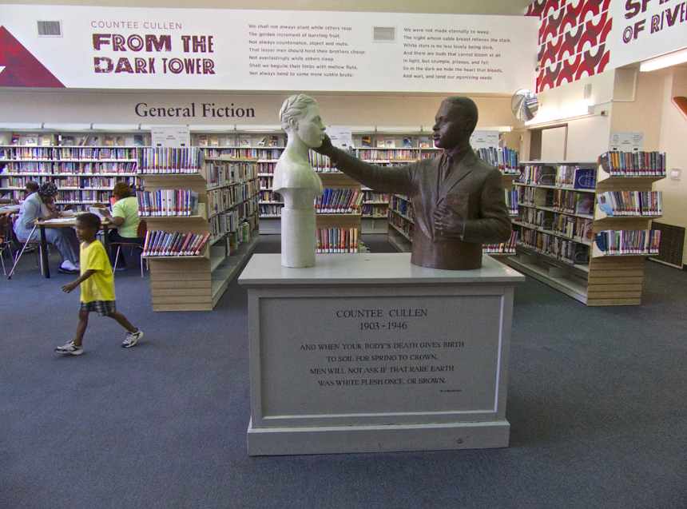

Slide 29
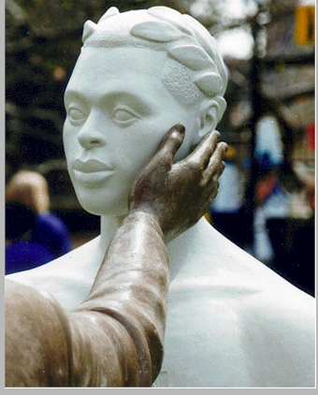

Slide 32
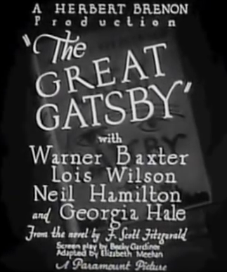

Slide 33
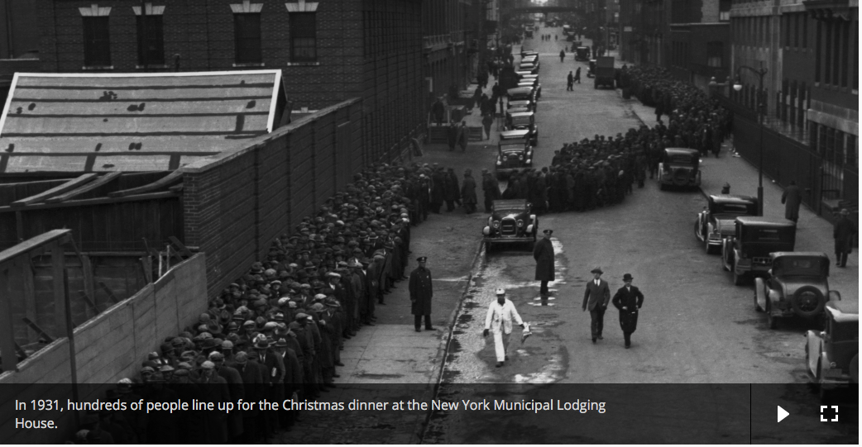

Slide 34
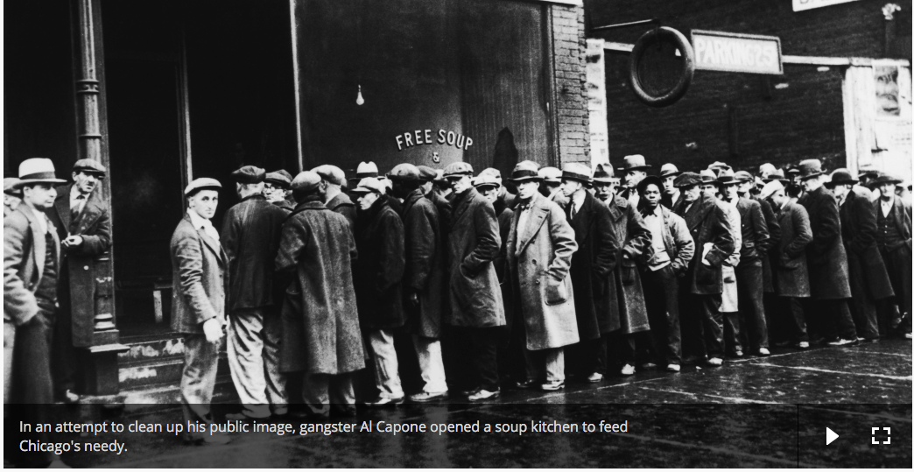

Slide 35
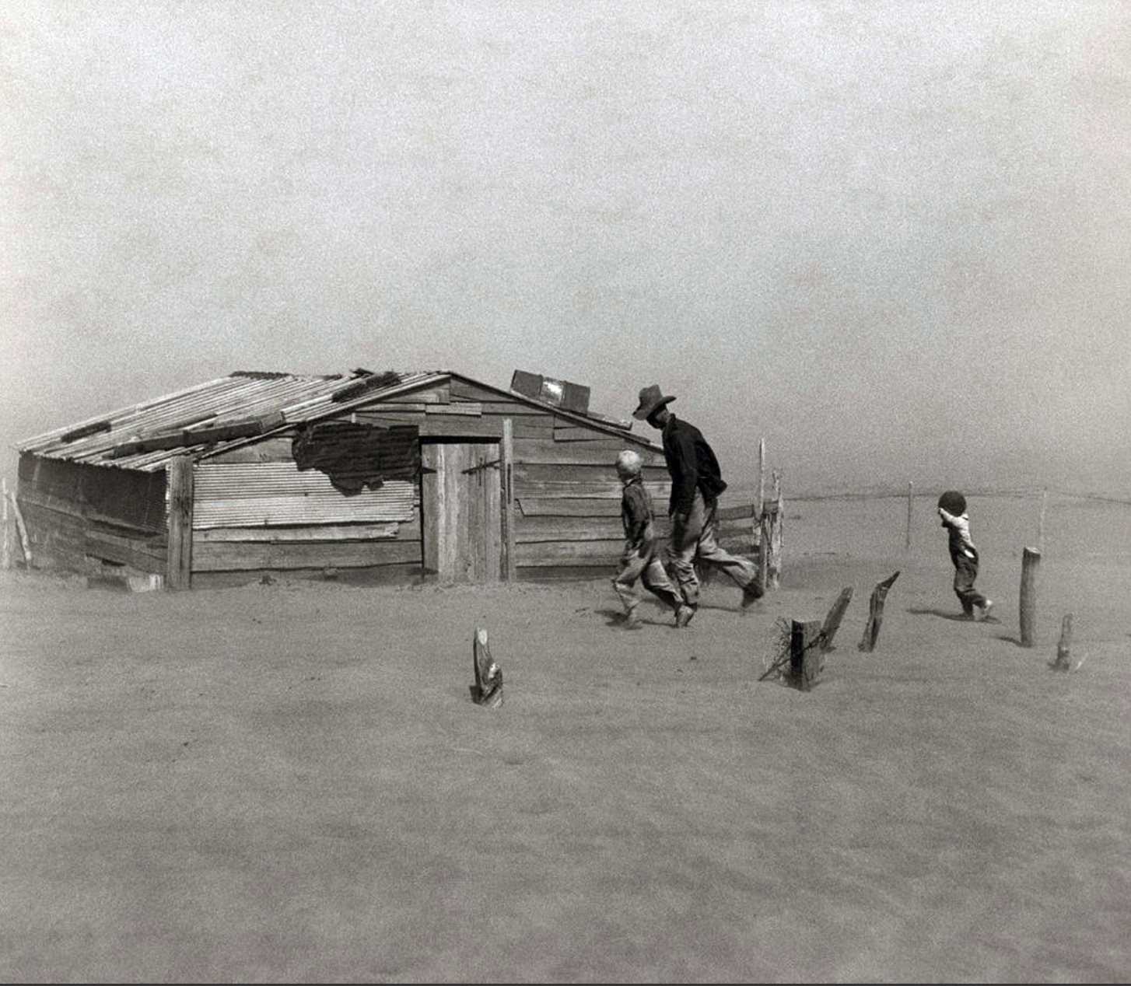
Arthur
Rothstein
Notes:
Oklahoma dust storm

Slide 36
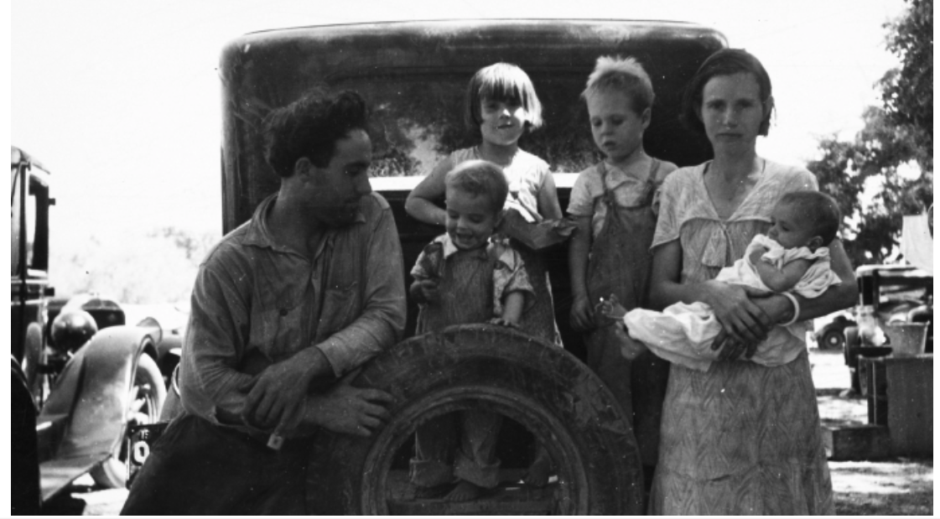

Slide 37
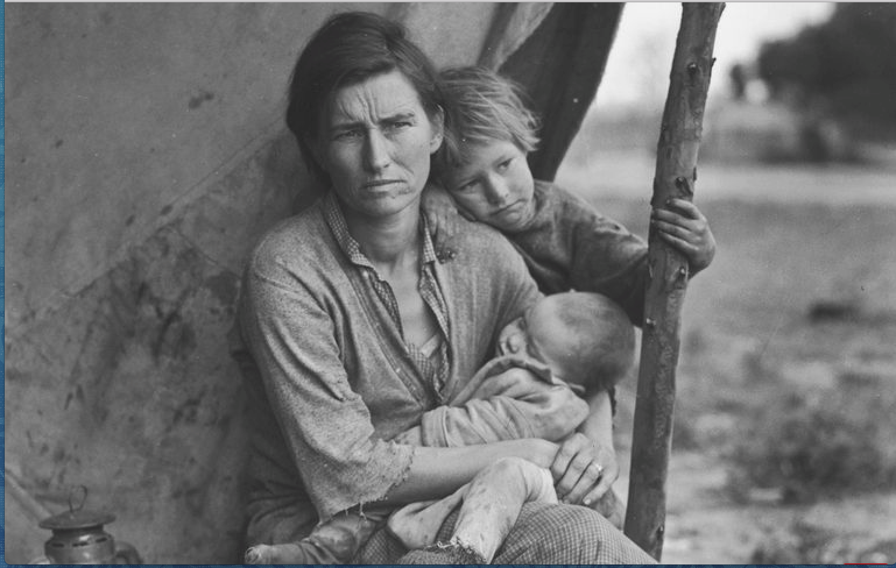
Dorothea Lange

Slide 38
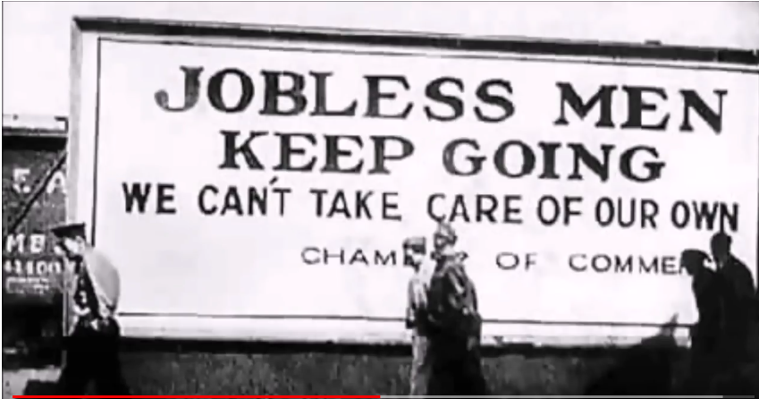

Slide 39
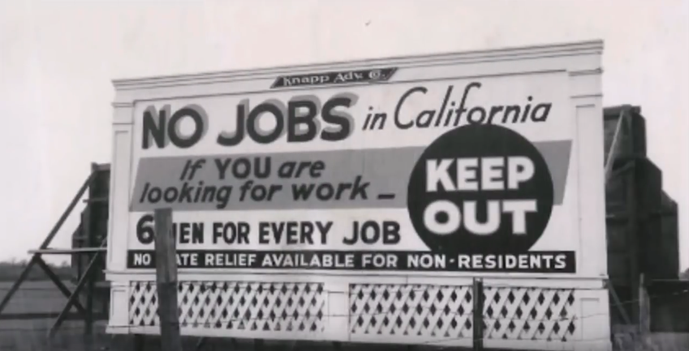

Slide 41
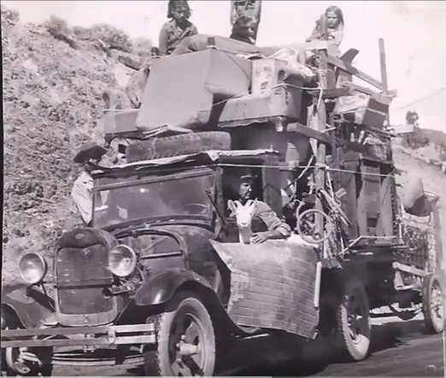

Slide 42
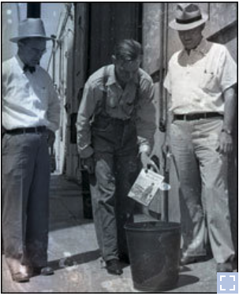

Slide 43
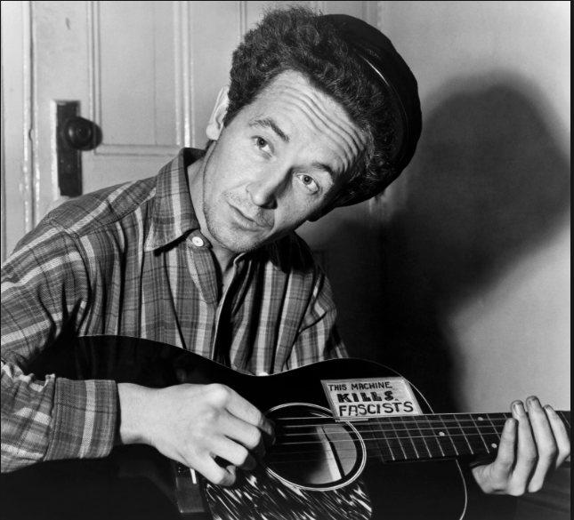

Slide 44
https://www.youtube.com/watch?v=ptWE8DAVl5E

