Slide 1
The Articles of Confederation Teaching with Documents Humanities Texas, September 2023

Slide 2
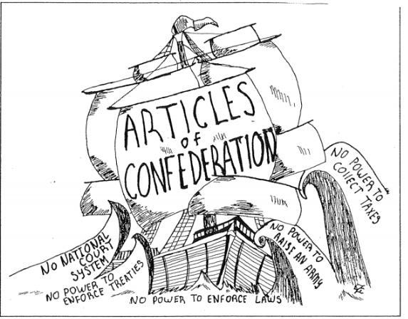

Slide 3
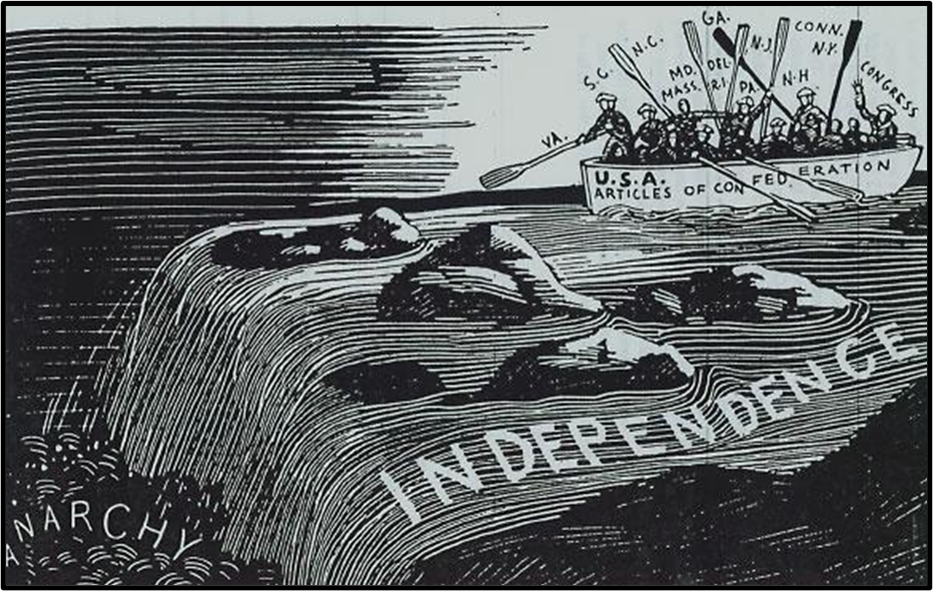

Slide 4
Articles of Confederation, Article V (bold added) For the more convenient management of the general interests of the united states, delegates shall be annually appointed in such manner as the legislature of each state shall direct, to meet in Congress on the first Monday in November, in every year, with a power reserved to each state to recall its delegates, or any of them, at any time within the year, and to send others in their stead, for the remainder of the Year. No State shall be represented in Congress by less than two, nor by more than seven Members; and no person shall be capable of being delegate for more than three years, in any term of six years; nor shall any person, being a delegate, be capable of holding any office under the united states, for which he, or another for his benefit receives any salary, fees or emolument of any kind. Each State shall maintain its own delegates in a meeting of the states, and while they act as members of the committee of the states. In determining questions in the united states, in Congress assembled, each state shall have one vote. Freedom of speech and debate in Congress shall not be impeached or questioned in any Court, or place out of Congress, and the members of congress shall be protected in their persons from arrests and imprisonments, during the time of their going to and from, and attendance on congress, except for treason, felony, or breach of the peace. Complete text available here: https://avalon.law.yale.edu/18th_century/artconf.asp

Slide 5
Founders Online: founders.archives.gov Yale Avalon Project, State Constitutions, Articles of Confederation, Madison’s Notes: avalon.law.yale.edu iCivics, Constitutional Compromise, Race to Ratify: icivics.org

Slide 6
Excerpts from George Washington to the States, 8 June 1783 (Circular Letter, Bold Added) It appears to me there is an option still left to the United States of America; that it is in their choice and depends upon their conduct, whether they will be respectable and prosperous or contemptible and Miserable as a Nation. This is the time of their political probation: this is the moment when the eyes of the whole World are turned upon them—This is the moment to establish or ruin their National Character for ever. With this conviction of the importance of the present Crisis, silence in me would be a crime. There are four things, which I humbly conceive are essential to the well being, I may even venture to say to the existence, of the United States as an independent Power. 1st An indissoluble Union of the States under one federal Head. 2ndly A sacred regard to public Justice. 3dly The adoption of a proper Peace Establishment—and 4thly The prevalence of that pacific and friendly disposition among the people of the United States, which will induce them to forget their local prejudices and policies, to make those mutual concessions which are requisite to the general prosperity, and, in some instances, to sacrifice their individual advantages to the interest of the community. These are the pillars on which the glorious fabrick of our Independancy and National Character must be supported —Liberty is the basis. Altho it may not be necessary or proper for me in this place to enter into a particular disquisition of the principles of the Union and to take up the great question which has been frequently agitated, whether it be expedient and requisite for the States to delegate a larger proportion of Power to Congress or not, yet it will be a part of my duty, and that of every true Patriot; to assert without reserve and to insist upon the following positions—That unless the States will suffer Congress to exercise those prerogatives they are undoubtedly invested with by the Constitution, every thing must very rapidly tend to Anarchy and confusion—that it is indispensible to the happiness of the individual States that there should be lodged somewhere, a supreme power to regulate and govern the general concerns of the confederated Republic, without which the Union cannot be of long duration. Complete letter available here: https://founders.archives.gov/documents/Washington/99-01-02-11404

Slide 7
Representation:
Who/What? How? Why?
British Government
Articles of Confederation
Constitution

