Slide 1
“The Great Depression” Humanities Texas Workshop October 27, 2020
By
Lizabeth Cohen
Department of History, Harvard University

Slide 2
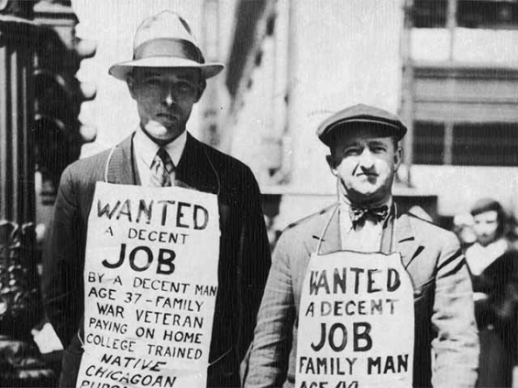

Slide 3
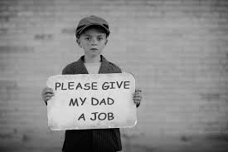

Slide 4
Unemployed men being fed at Emmanuel Baptist Church, Chicago, 1930

Slide 5
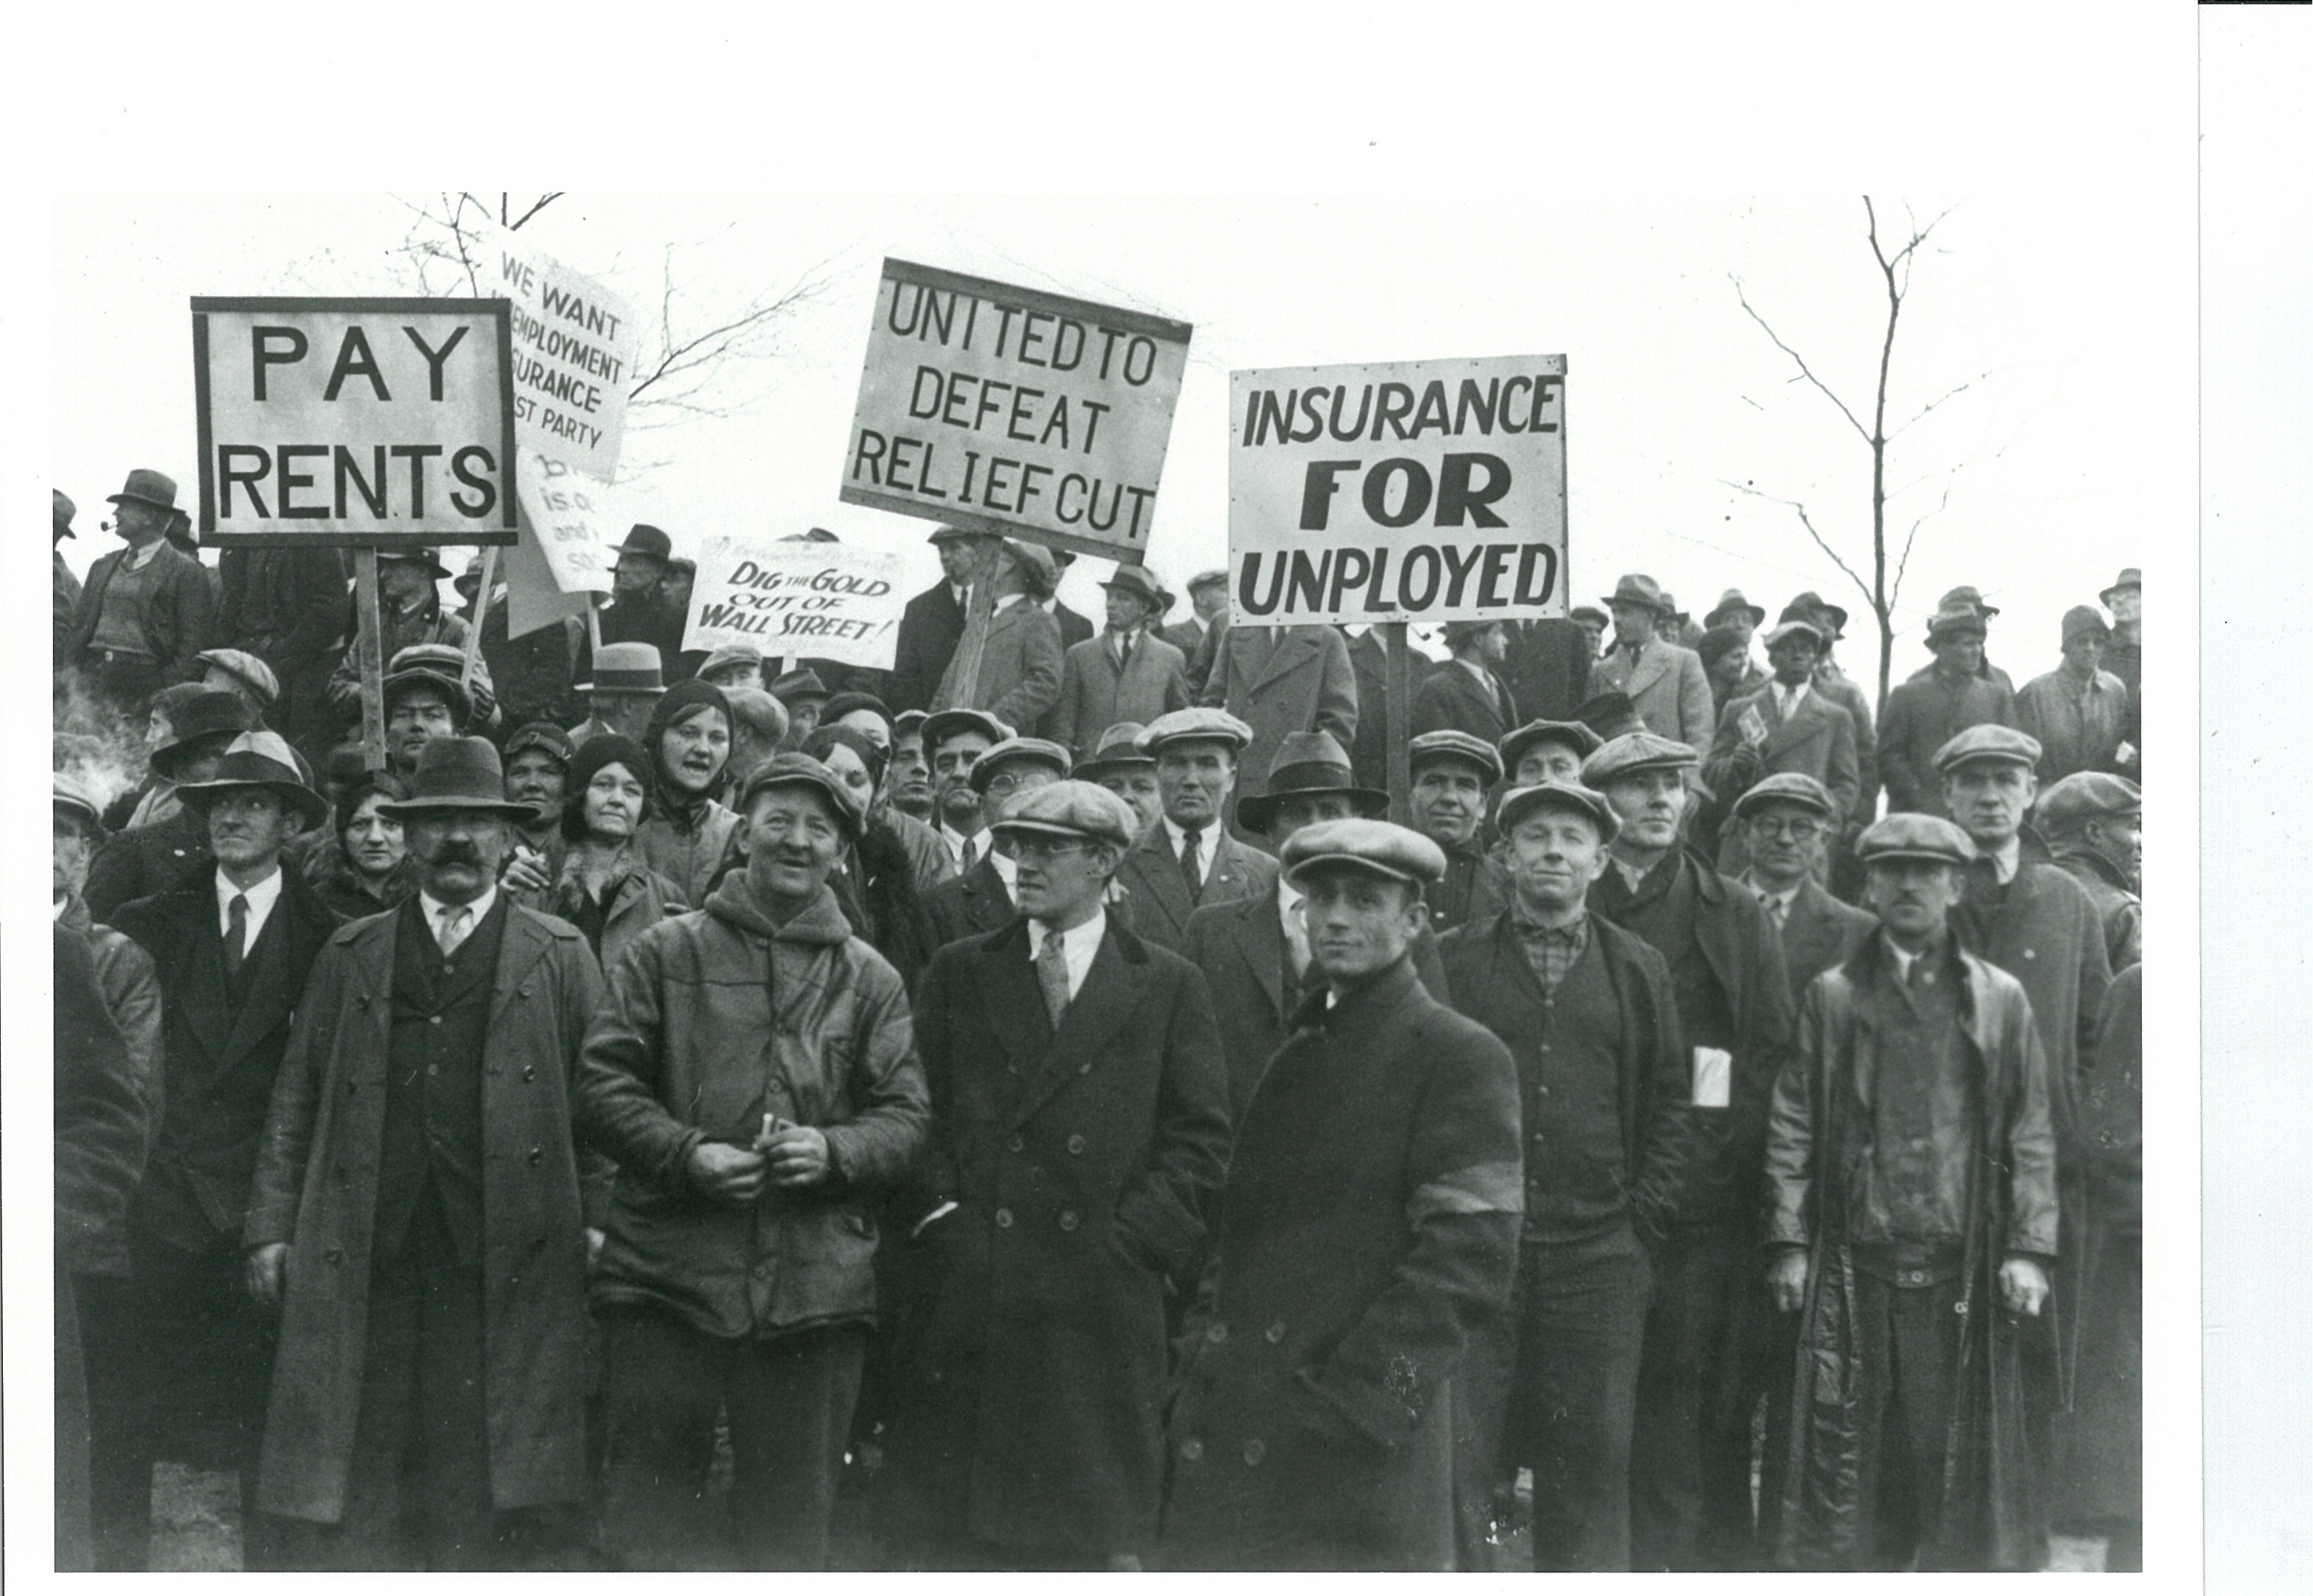

Slide 6
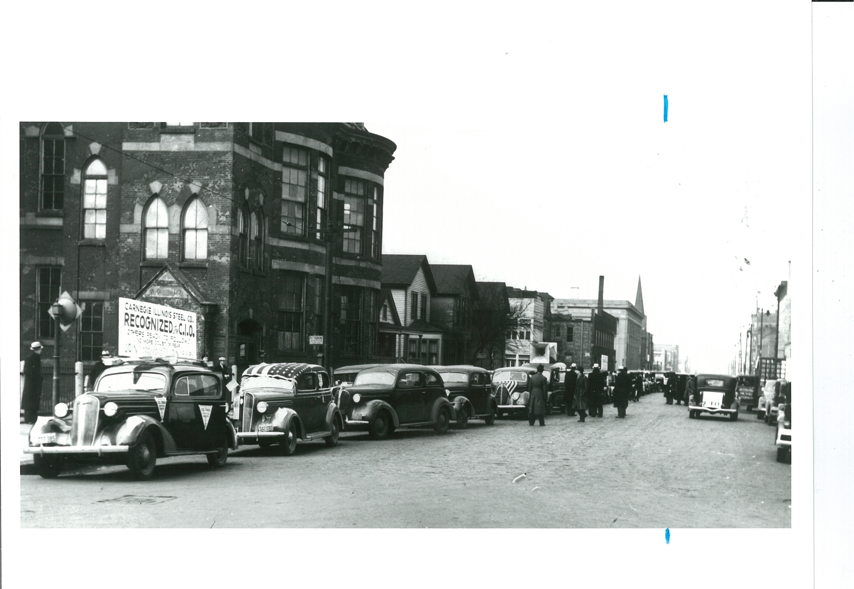
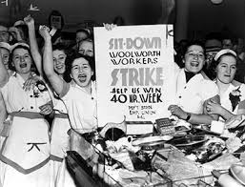
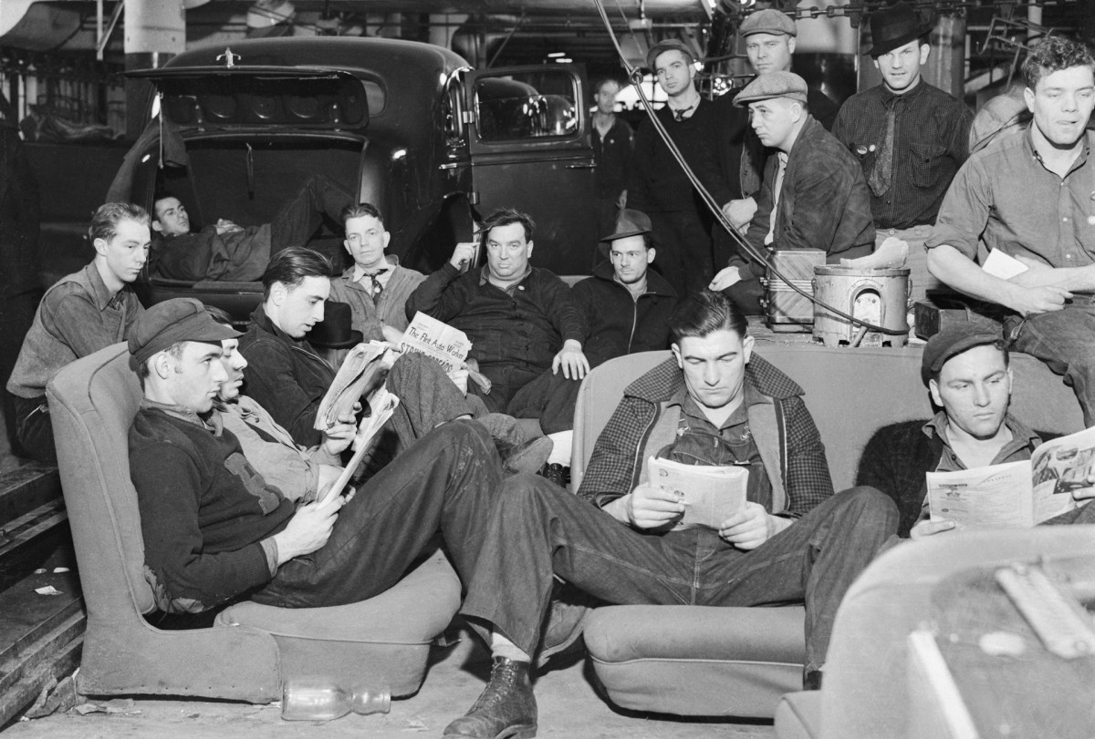

Slide 7
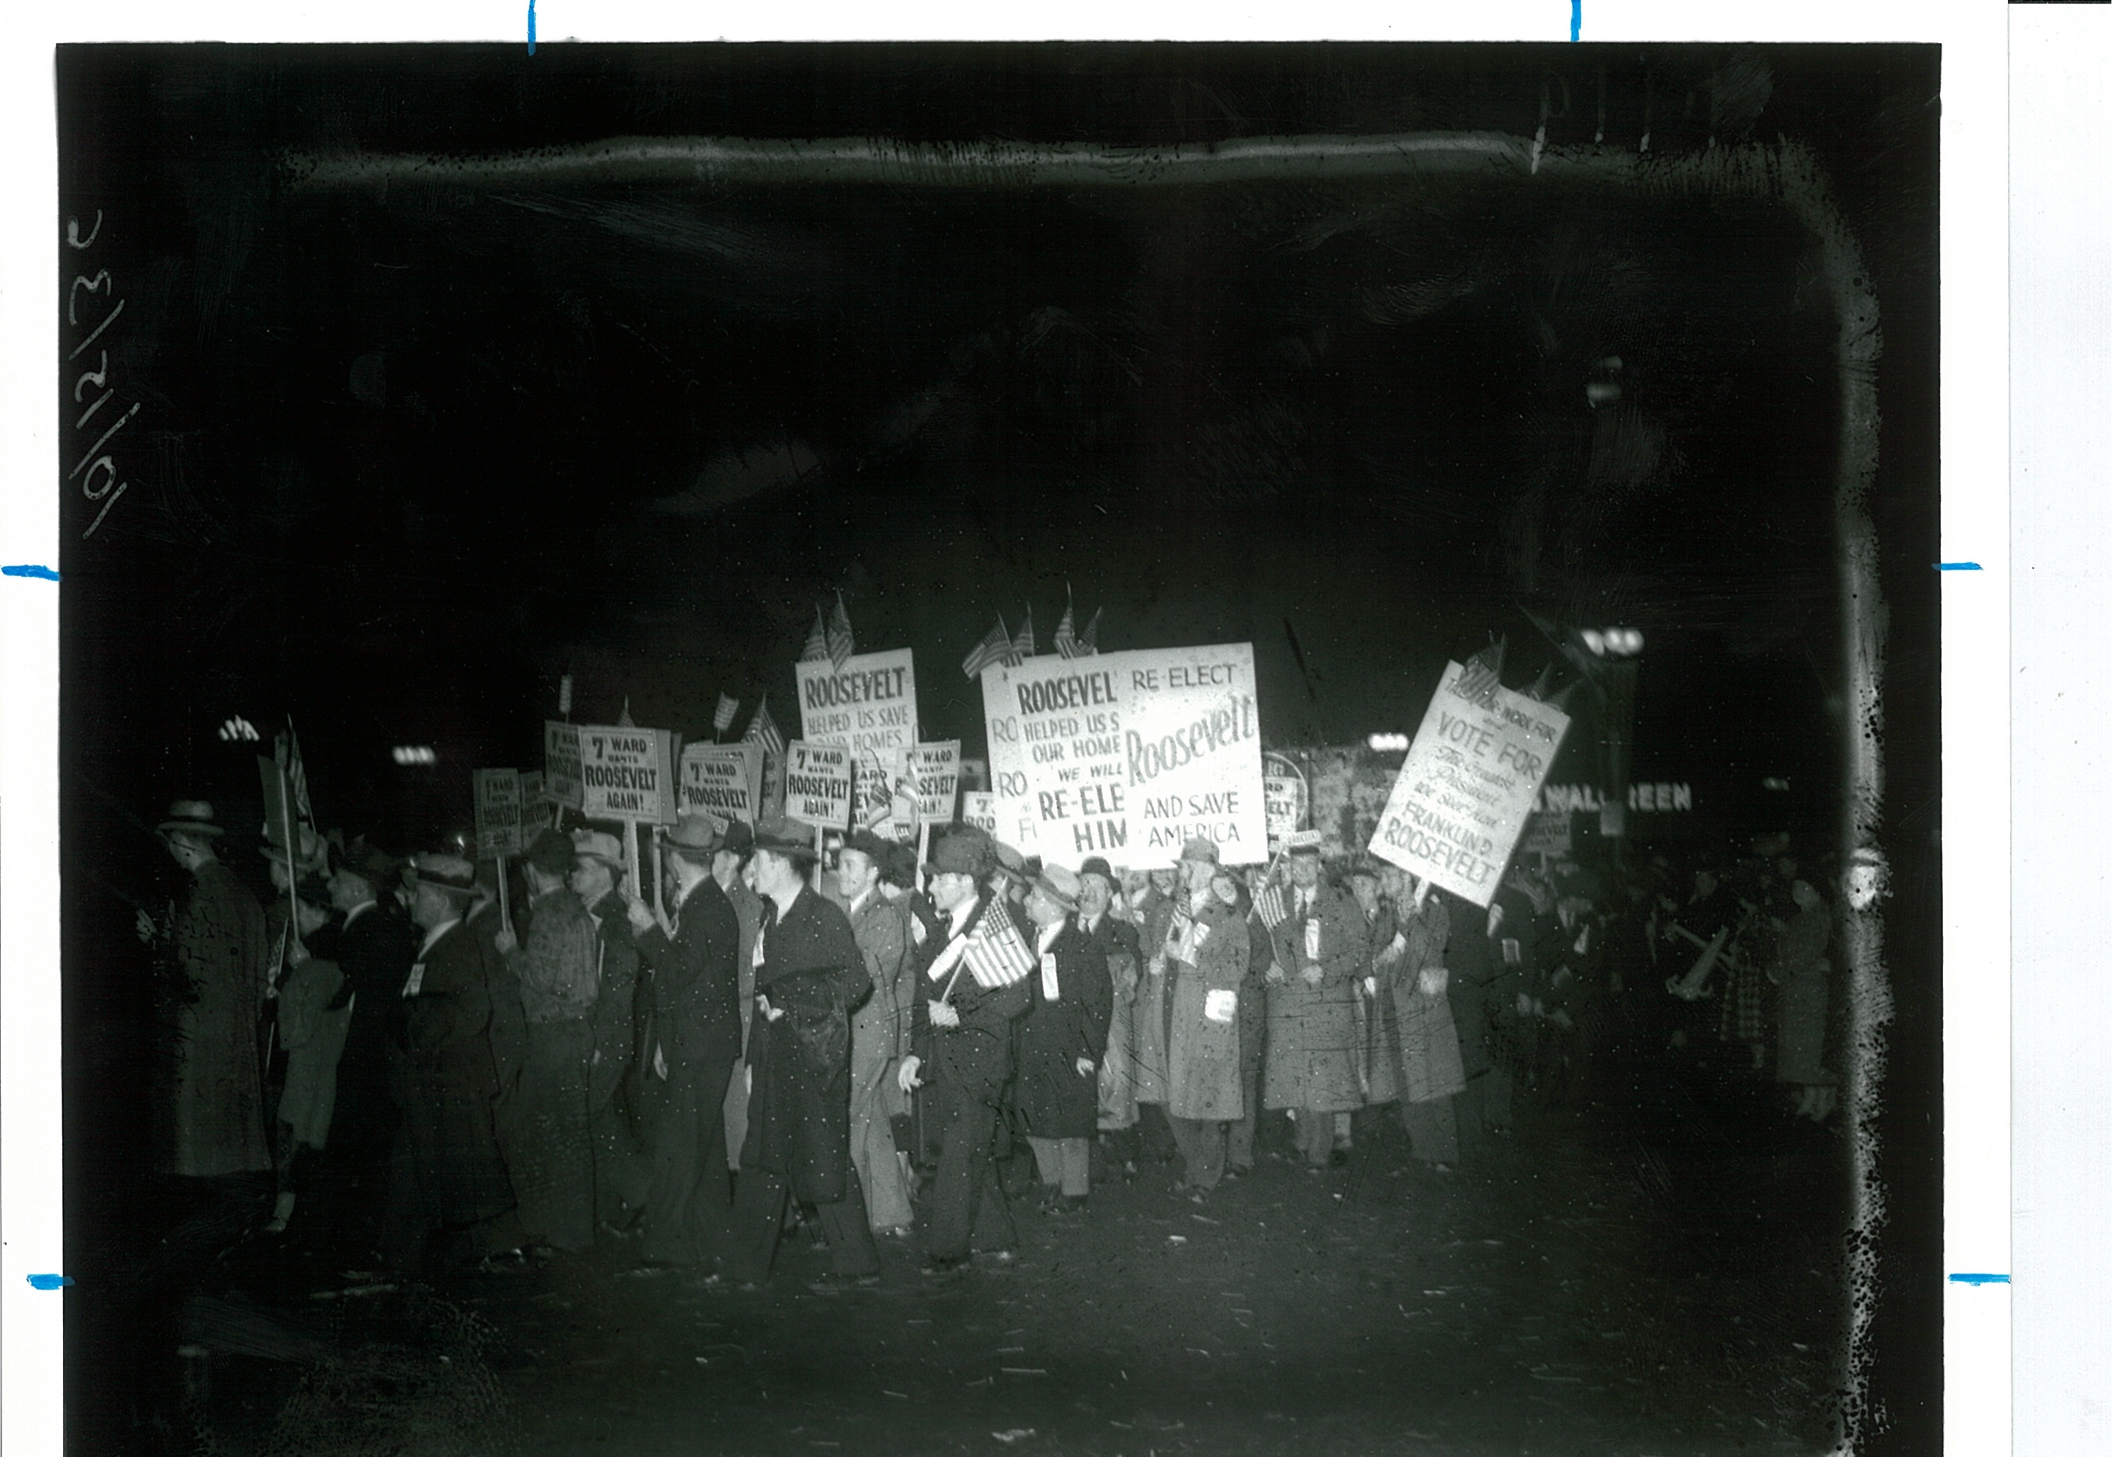

Slide 8
