Slide 1
Resources for Teaching Texas History:
PRIMARY SOURCES
Portal to Texas History (the newspaper collection is particularly rich) https://texashistory.unt.edu Texas Archive of the Moving Image https://texasarchive.org/education Library of Congress, Digital Collections (Immense collection; has wonderful images, for example, of people like Sam Houston) https://loc.gov/collections/ | SMU Libraries Digital Collections (contains materials not in the Portal) https://www.smu.edu/Libraries/digitalcollections Texas State Archives – Digital Archive https://tsl.access.preservica.com/ https://www.tsl.texas.gov/arc/onlinecollections Houston Area Digital Archives https://digital.houstonlibrary.org/

Slide 2
Resources for Teaching Texas History:
LESSON PLANS
Resources for Educators – Portal https://education.texashistory.unt.edu Teaching Texas (aggregates resources from lots of different places) https://teachingtexas.org/ Texas General Land Office --- Teaching Resources https://txgloeducation.com/ | Texas Archive of the Moving Image https://texasarchive.org/education Bob Bullock Museum – Educator Resources https://www.thestoryoftexas.com/education/educators The Alamo – Lesson Plans https://thealamo.org/remember/education/lesson-plans/index.html

Slide 3
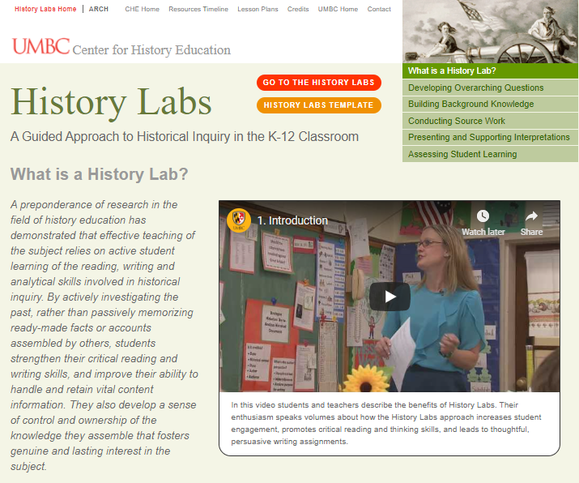
History Labs (UMBC Center for History Education)
History Labs are research and investigative learning experiences that provide teachers with the necessary information, resources, and procedures to teach a full range of historical thinking skills by taking students through a process that is methodologically similar to that employed by historians.
https://www.umbc.edu/che/historylabs/index.php

Slide 4
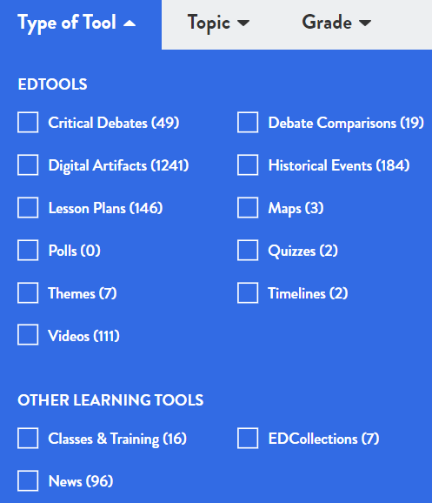
NewseumED.org
NewseumED.org offers free resources to cultivate the First Amendment and media literacy skills essential to civic life. Learn how to authenticate, analyze and evaluate information from a variety of sources and put current events in historical context through standards-aligned lesson plans, videos, primary sources, virtual classes and programs.

Slide 5
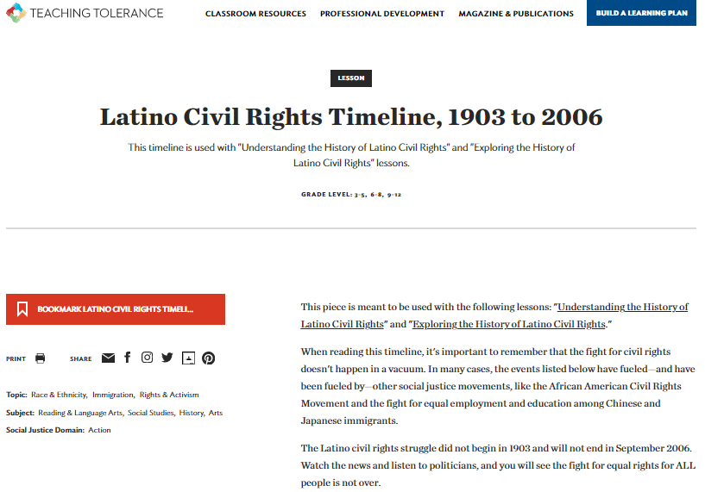
Tolerance.org
Teaching Tolerance (tolerance.org) provides free lessons and resources to K-12 Educators. Educators use our materials to supplement the curriculum, to inform their practices, and to create civil and inclusive school communities where children are respected, valued and welcome participants.
The anti-bias approach encourages children and young people to challenge prejudice and learn how to be agents of change in their own lives.

Slide 6
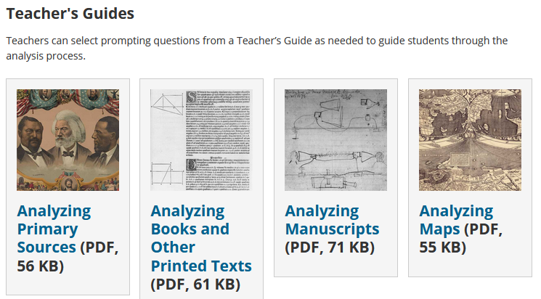
Library of Congress Primary Source Analysis Guides for Teachers
https://www.loc.gov/programs/teachers/getting-started-with-primary-sources/guides/

