Slide 1
Slavery in the Early Republic
Dr. Daina Ramey Berry
The University of Texas at Austin
Twitter: @DainaRameyBerry
Dr. Anthony Brown
The University of Texas at Austin
Dr. Keffrelyn Brown
The University of Texas at Austin
Twitter: @DrKeffrelynB

Slide 2
Introduction & Overview
What we are Doing
Historical Knowledge: Slavery in Early America
Historical Knowledge: Key Constructs in Race and Racism
Breakout Session: Looking at Documents
Q/A

Slide 3
What We are Doing Today (5 min.)
Dr. Anthony Brown & Dr. Keffrelyn Brown

Slide 4
Slavery in the Early Republic
Timeline of Key Events:
1783 Blacks fled to Nova Scotia (Lord Dunmore)
1784 Gradual Emancipation legislation begins
1780s Development of Anti-Slavery Societies
NW Land Ordinance
1791-1804 Haitian Revolution*
Fugitive Slave Act
1793 Invention of the Cotton Gin
Gabriel Prosser’s Conspiracy
Louisiana Purchase
-06 Lewis & Clark Expedition*
1812-14 War of 1812*
April 1812 Lord Cochrane‘s Proclamation*
1793 Invention of the Cotton Gin
Notes:
Image found on Encyclopedia Britannica; DATE PUBLISHED; April 04, 2019, URL:
https://www.britannica.com/technology/cotton-gin
ACCESS DATE November 29, 2020.

Slide 5
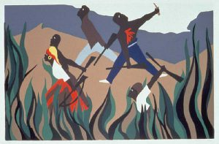
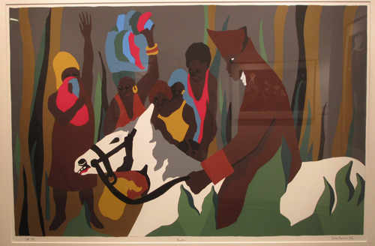
Haitian Revolution
The art of Jacob Lawrence provides a unique narrative of the Haitian Revolution (1791-1804).
Columbus colonized Haiti in 1492 and changed the name to Hispaniola for the Spanish Govt.
1697 French took over a large portion of the western side of the island and named it Saint-Domingue.
The French captured and enslaved Africans and brought them to the island.
Toussaint L’ Ouverture led enslaved and free blacks in battle to become the first independent black nation by conquering the Spanish side of the island.
Other leaders such as Jean-Jacques Dessalines and Henri Christophe defeated the French and ran Napoleon off of the island.
Dessalines declared Haiti independence in 1804
Notes:
Images from the Jacob Lawrence Collection available online at El Paso Museum of Art: https://epma.art/art/exhibitions/jacob-lawrence-s-toussaint-l-ouverture-series-the-haitian-revolution

Slide 6
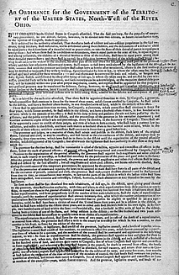
1787 Northwest Land Ordinance
Notes:
Original Document at the Library of Congress: https://www.loc.gov/rr/program//bib/ourdocs/northwest.html. Map of Territory courtesy of American History USA https://www.americanhistoryusa.com/northwest-ordinance-1787-effects/

Slide 7
1803 LA Purchase and 1804-06 York (Lewis & Clark Expedition)
LA Purchase doubled the the United States as the US received 827,000 Sq Miles of Land West of the Mississippi for $15M.
Thomas Jefferson purchased this land from the French Government and some say it was his version of Manifest Destiny.
York
Statue of William Clark's slave York, a member of the Lewis and Clark Expedition of 1804-1806. The statue is installed in Louisville, Kentucky.

Slide 8
19th Century Enslaved Population Census
Notes:
National Portrait Gallery, Smithsonian: https://npg.si.edu/object/posts_68f148247a89bca28fdf1c9669c24ce4?destination=edan-search/default_search%3Fpage%3D563%26edan_q%3DABRAHAM%2520LINCOLN%26search_si%3D1

Slide 9
The Cotton Gin and the Expansion of Slavery
Video: The African Americans Many Rivers to Cross click here.
OR
https://www.youtube.com/watch?v=TRlfMhP_CMI

Slide 10
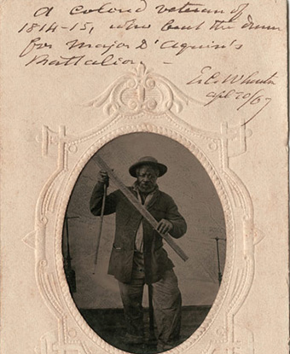
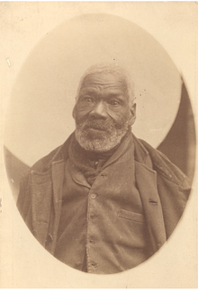
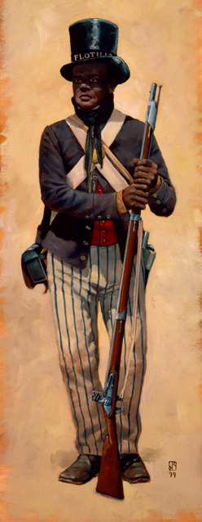
Black Soldiers in the War of 1812
Some fled to Nova Scotia CAN, similar to the efforts that began during the American Revolution.
Gabriel Hall (far right), went to Canada during the war. When he fled, to the British he was around 13 years old.
Some Black men served as drummers. Pictured (middle) is the drum of Jordan Noble (b. enslaved in Georgia) -- marched with the US Army at the age of 13. He received his freedom during the war.
Charles Ball (left )wrote about his wartime experience in his slave narrative.
Notes:
Image of Charles Ball available at the National Park Service: https://www.nps.gov/articles/american-liberty-and-slavery-in-the-chesapeake.htm;; Image of Gabriel Hall at the Nova Scotia Archives: https://archives.novascotia.ca/africanns/archives/?ID=151; Image of Jordan Noble

Slide 11
Key Constructs in the Study of Race & Racism (10 min.)
Dr. Anthony Brown & Dr. Keffrelyn Brown

Slide 12
Presence of Racism in U.S. History: Seeing Race
Jim Crow racism (legal, de jure)
Color-blind racism (post-Civil Rights)

Slide 13
Social Construction of Race
Science
Policy
Popular culture
Everyday practices
Laws
ideologies (stories)

Slide 14
Types of Racism
Racism
interpersonal racism (micro)
Structural/
institutional racism
(macro)
Internalized racism

Slide 15
Social construction of race
Material consequences of race

Slide 16
Enslavement
Black agency/resistance

Slide 17
Looking at Documents (15 min.)

Slide 18
Questions to Consider (10 min.)
How do the images in the slideshow and the documents provided illustrate
Black agency/resistance
Black personhood/citizenship
What struck you when looking at the documents? Did you discover a new or deepened insight?
What questions or wonderings do you have after completing this activity?

Slide 21
Digital Resources
Slate: The History of American Slavery
Teaching Texas Slavery
Teaching Tolerance: American Slavery
People Not Property: Stories of Slavery in the Colonial North
Slavery Voyages: The Dispersal of Enslaved Africans Across the Atlantic World
Washington Post article on York
Lewis and Clark Expedition Journals

Slide 22
Thanks!
Dr. Daina Ramey Berry
Email: drb@austin.utexas.edu
Twitter: @DainaRameyBerry
Dr. Anthony Brown
Email: alb@austin.utexas.edu
Dr. Keffrelyn Brown
Email: keffrelyn@austin.utexas.edu
Twitter: @DrKeffrelynB

