Slide 1
Childhood as a Lens in Teaching Fiction
Theme, Context, Technique
Katherine Henninger
Louisiana State University

Slide 2
Childhood as a universal experience
All high school kids feel they know something about childhood
how it is (personal experience)
how it should be (cultural ideals)
how class, race, religion, gender, etc., affect what it is (the real world)

Slide 3
Childhood in literary context
the ways childhood is represented
the ways authors USE childhood to represent other things
States of being: innocence, freedom, ignorance, naïvite, helplessness; dependence
Ways of thinking or knowing: wide-eyed, sensory, analogical thinking, magical thinking
The state of the world (the world of the story; the human condition)

Slide 4
Theme: loss of innocence; coming of age; perception (versus reality?); cultural traditions; individual/community; family; nature/nurture; dependence/independence
Social and historical context: the ways that childhood has changed in time and place; the effects of race, class, region, family status, etc. on what childhood is; how where/when/with whom you grow up affects and effects who you are; what childhood tells us about “the world”
Literary technique: structure; setting; duration; point of view; voice; tone; focalization; characterization; symbolism

Slide 5
Theme
Social and historical context
Literary technique

Slide 6
“Childhood Studies”
Not talking about children’s literature, but rather, literature about children
“the child” as a figure, an idea, a symbol
Childhood has a history

Slide 7
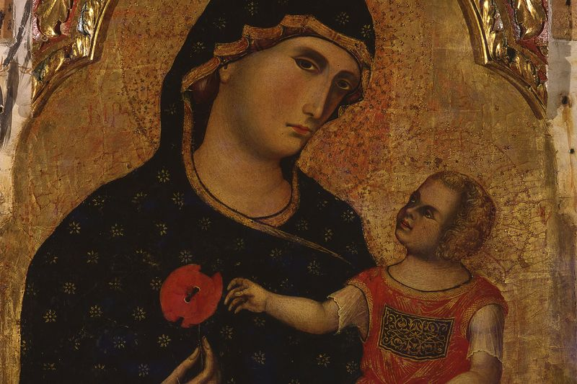
“Mini-me” Medieval Little Adults
Paolo Veneziano/Mondadori Portfolio/Getty Images "Madonna With Child“ 1333 Italy

Slide 8
Renaissance/Enlightenment
Raphael, 1506. Fine Art Images/Heritage Images/Getty Images

Slide 9
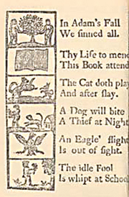
Reformation/Puritan
The New-England Primer, Improved; or, an Easy and Pleasant Guide to the Art of Reading. Adorned with cuts. To which is added, the Catechism. c. 1690

Slide 10
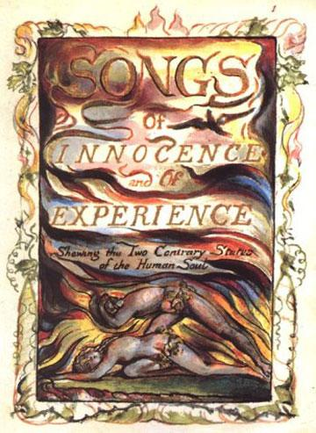
Romanticism
William Wordsworth, 1802
My heart leaps up when I behold A rainbow in the sky: So was it when my life began; So is it now I am a man; So be it when I shall grow old, Or let me die! The Child is the father of the Man; And I could wish my days to be Bound each to each by natural piety.

Slide 11
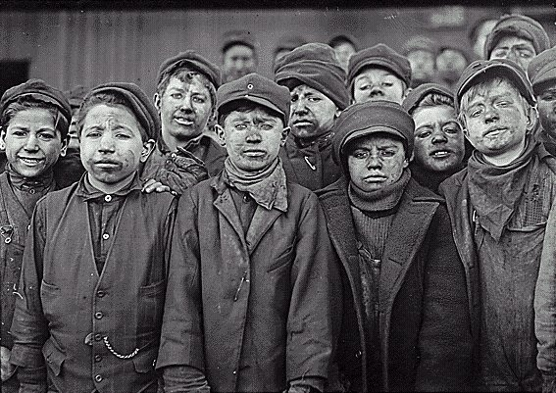
Realism

Slide 12
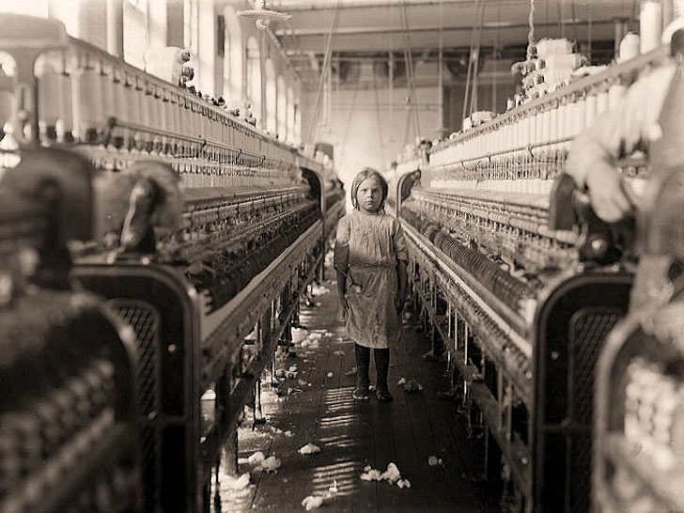
Realism
Lewis Hine, Mollahan Mills in Newberry, S.C., 1908.

Slide 13
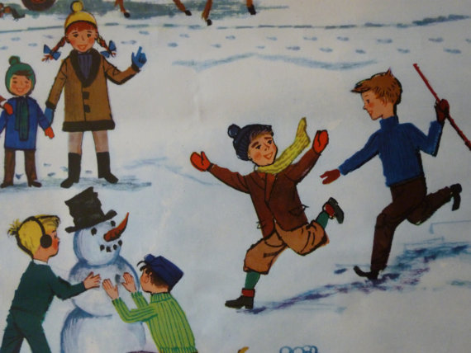
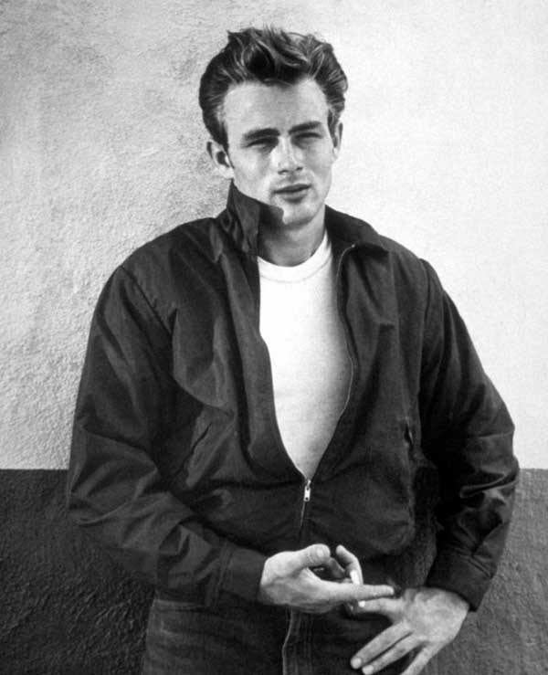
The Modern Child

Slide 14
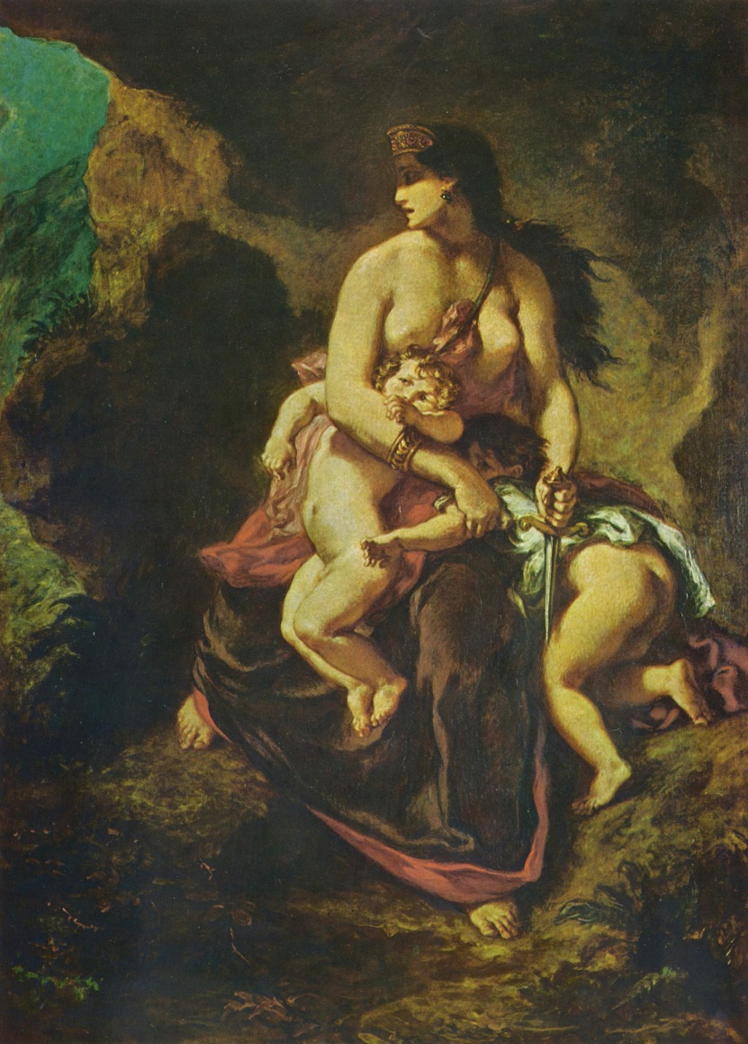
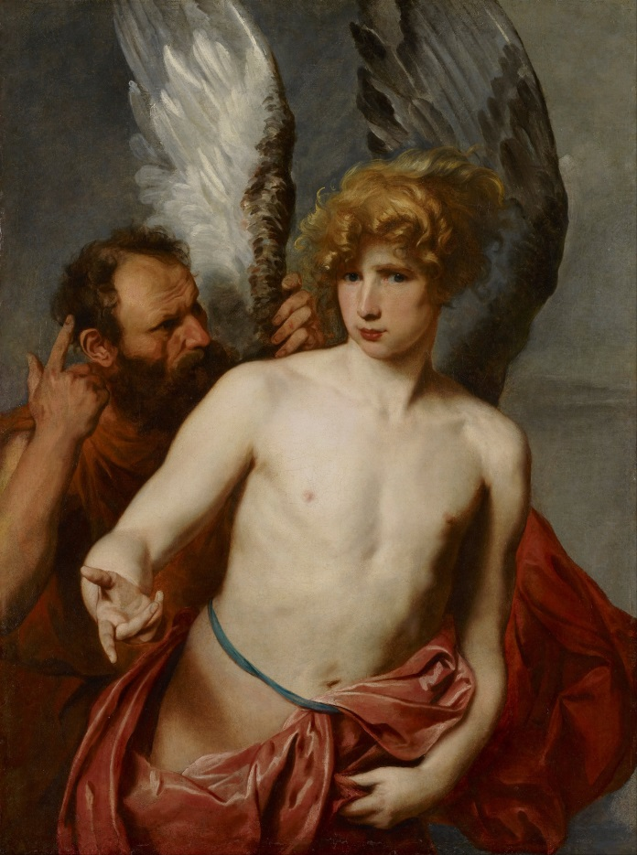
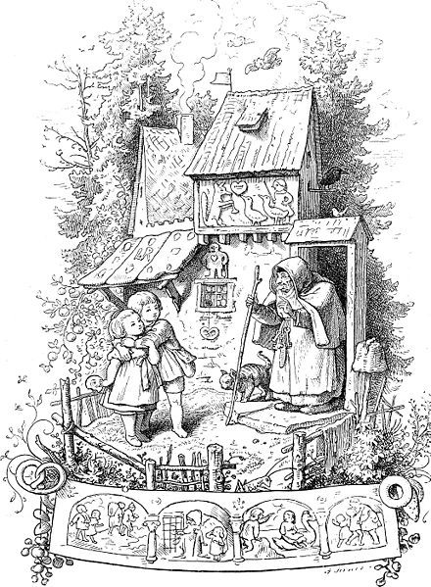
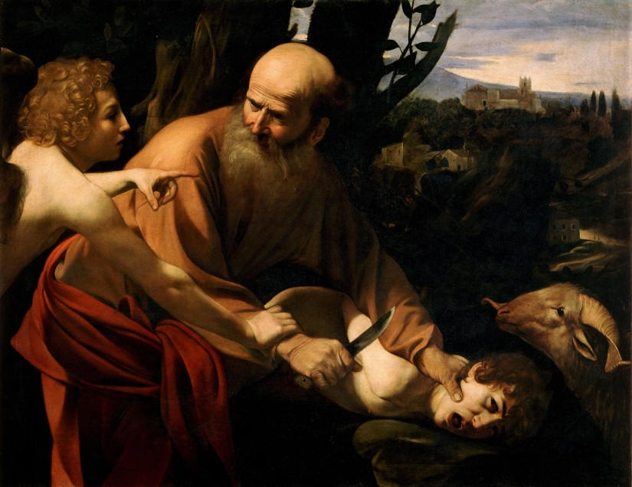
But of course, you could go way further back…
Daedalus and Icarus,
(Anthony van Dyke, 1629)
Euripides, Medea 431 BCE
(Eugene Delacroix, 1862)
Abraham and Isaac, (Caravaggio, c. 1600)

Slide 15
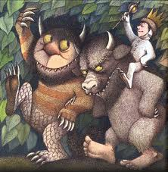
Childhood studies is interdisciplinary and transnational, which makes it a great lens for…

Slide 16
ELA/TEKS!
(2) Reading/Comprehension of Literary Text/Theme and Genre. Students analyze, make inferences and draw conclusions about theme and genre in different cultural, historical, and contemporary contexts and provide evidence from the text to support their understanding. Students are expected to:
analyze the way in which the theme or meaning of a selection represents a view or comment on the human condition;
relate the characters and text structures of mythic, traditional, and classical literature to 20th and 21st century American novels, plays, or films; and
relate the main ideas found in a literary work to primary source documents from its historical and cultural setting.

Slide 17
(5) Reading/Comprehension of Literary Text/Fiction. Students understand, make inferences and draw conclusions about the structure and elements of fiction and provide evidence from text to support their understanding. Students are expected to:
evaluate how different literary elements (e.g., figurative language, point of view) shape the author's portrayal of the plot and setting in works of fiction;
analyze the internal and external development of characters through a range of literary devices;
analyze the impact of narration when the narrator's point of view shifts from one character to another; and
demonstrate familiarity with works by authors in American fiction from each major literary period.

Slide 18
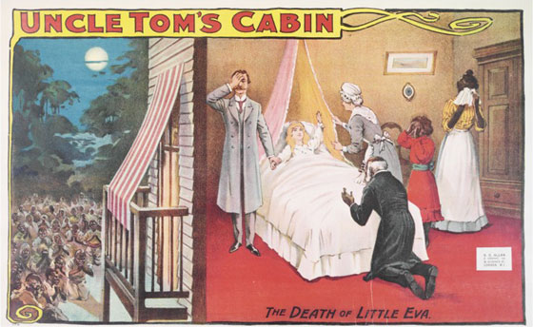
Harriet Beecher Stowe, Uncle Tom’s Cabin (1852)

Slide 19
Mark Twain, Adventures of Huckleberry Finn (1885)

Slide 20
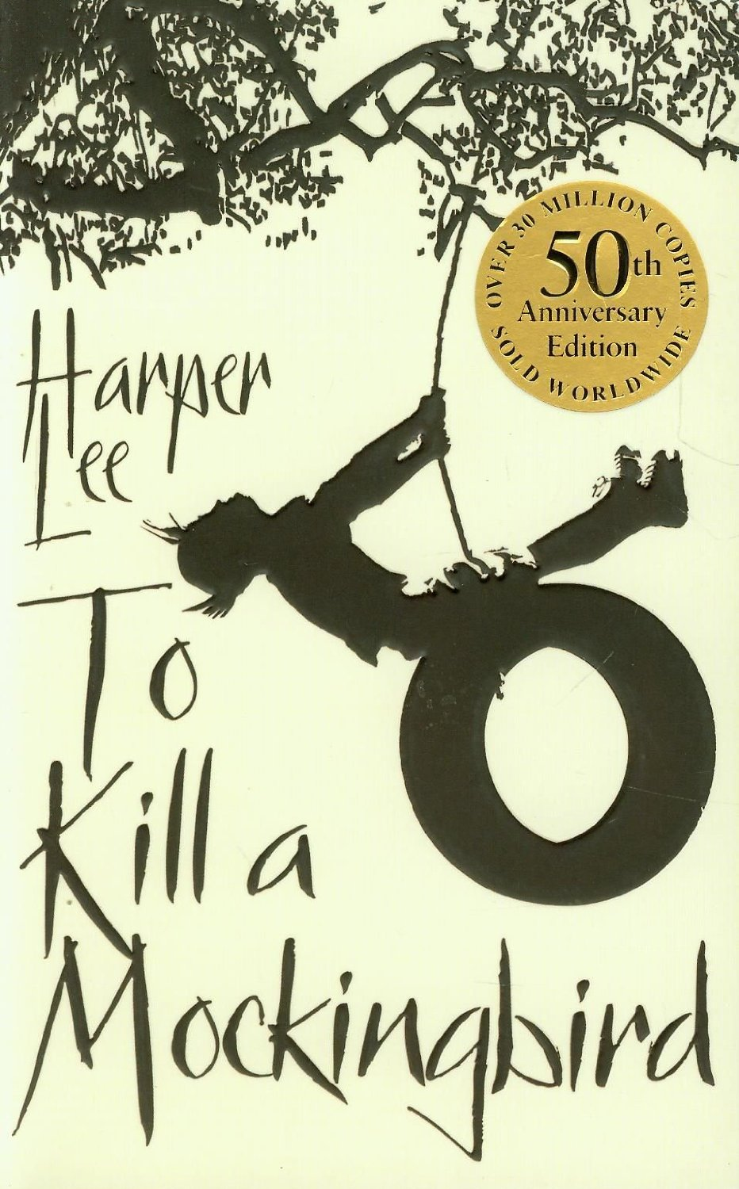
Harper Lee, To Kill a Mockingbird (1960)

Slide 21
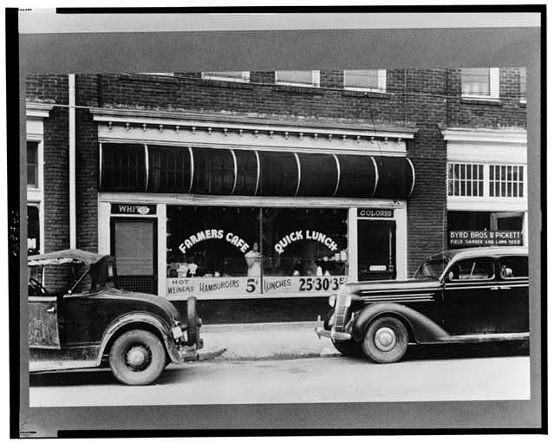
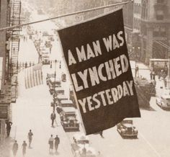
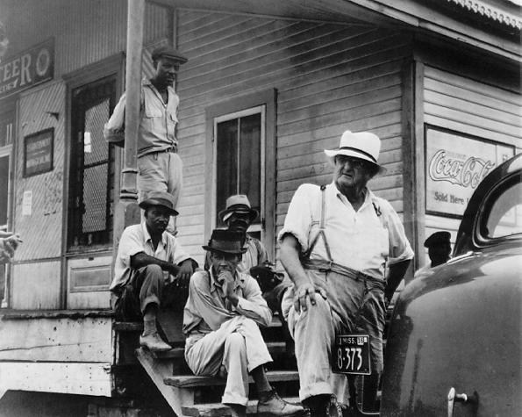

Slide 22
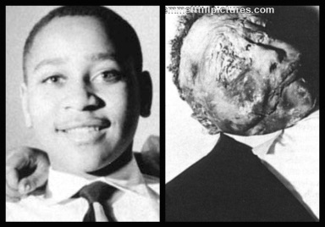
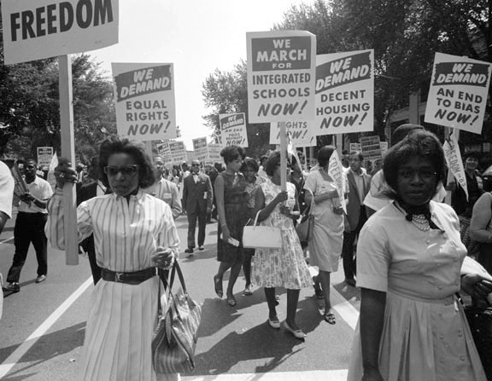
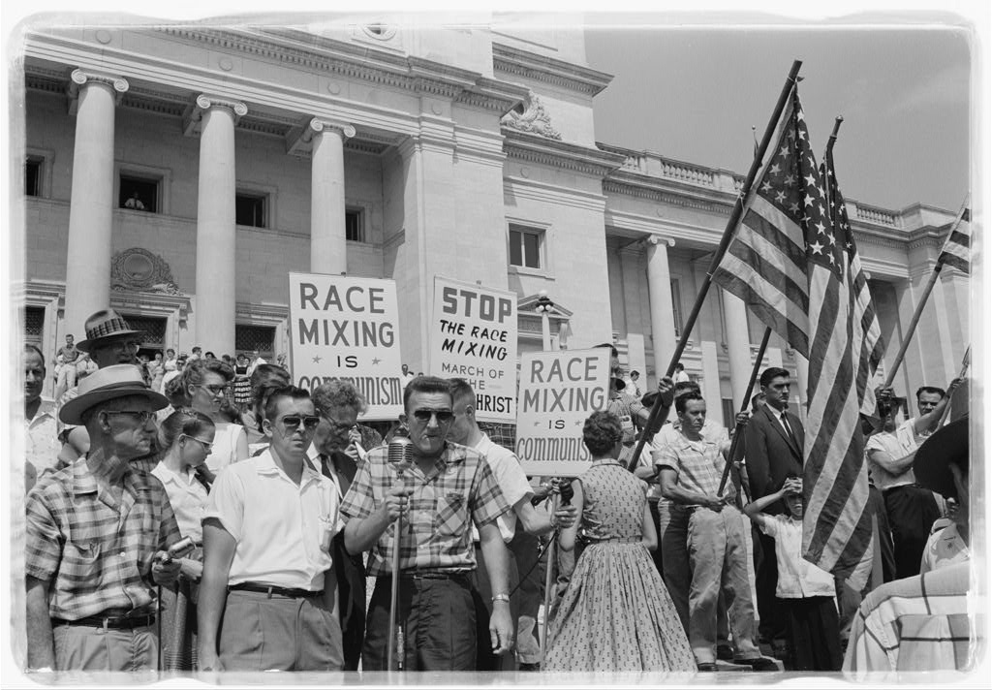

Slide 23
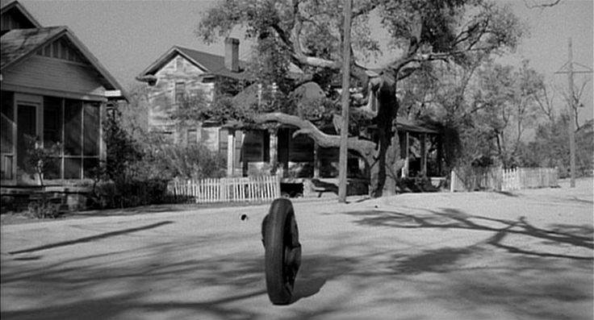

Slide 24
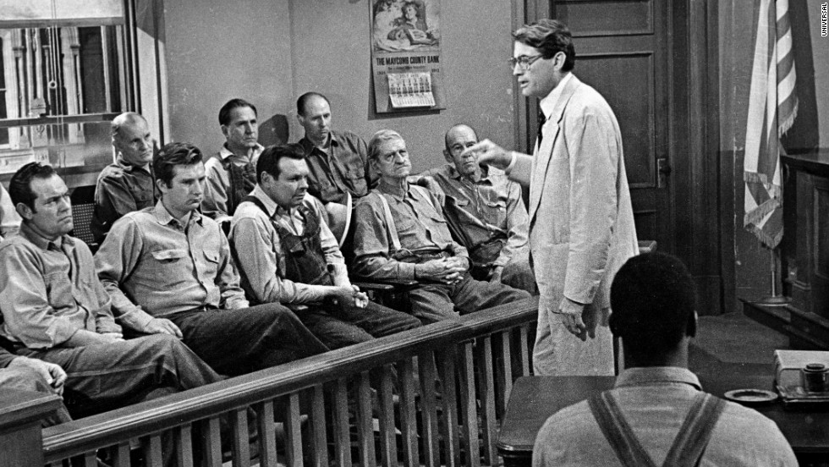

Slide 25
Scout speaks for the class
As the Cunninghams had no money to pay a lawyer, they simply paid us with what they had. “Did you know” said Atticus, “that Dr. Reynolds works the same way? He charges some folks a bushel of potatoes for delivery of a baby.”…
If I could have explained these things to Miss Caroline, I would have saved myself some inconvenience and Miss Caroline subsequent mortification, but it was beyond my ability to explain things as well as Atticus, so I said, “You’re shamin’ him, Miss Caroline. Walter hasn’t got a quarter at home to bring you, and you can’t use any stovewood.”

Slide 26
Scout puzzles it out
“Lemme tell you somethin’ now, Billy,” a third said, “you know the court appointed him to defend this nigger.”
“Yeah, but Atticus aims to defend him. That’s what I don’t like about it.”
This was news, news that put a different light on things. Atticus had to, whether he wanted to or not. I thought it odd that he hadn’t said anything to us about it—we could have used it many times in defending him and ourselves. He had to, that’s why he was doing it, equaled fewer fights and less fussing. But did that explain the town’s attitude? The court appointed Atticus to defend him. Atticus aimed to defend him. That’s what they didn’t like about it. It was confusing.

Slide 27
The Verdict against Tom Robinson
What happened after that had a dreamlike quality: in a dream I saw the jury return, moving like underwater swimmers, and Judge Taylor’s voice came from far away and was tiny. I saw something only a lawyer’s child could be expected to see, could be expected to watch for, and it was like watching Atticus walk into the street, raise a rifle to his shoulder and pull the trigger, but watching all the time knowing that the gun was empty. (282)

Slide 28
Dill’s not coming for summer
The fact that I had a permanent fiance was little compensation for his absence: I had never thought about it, but summer was Dill by the fishpool smoking string, Dill’s eyes alive with complicated plans to make Boo Radley emerge; summer was the swiftness with which Dill would reach up and kiss me when Jem was not looking, the longings we sometimes felt each other feel. With him, life was routine; without him, life was unbearable. I stayed miserable for two days. (154)

Slide 29
The death of Tom Robinson
Maycomb was interested by the news of Tom’s death for perhaps two days; two days was enough for the information to spread through the county. “Did you hear about? …. No? Well, they say he was runnin’ fit to best lightnin’ …” To Maycomb, Tom’s death was typical. Typical of a nigger to cut and run. Typical of a nigger’s mentality to have no plan, no thought for the future, just run blind first chance he saw. Funny thing, Atticus Finch might’ve got him off scot free, but wait--? Hell no. You know how they are. Easy come, easy go. Just shows you, that Robinson boy was legally married, they say he kept himself clean, went to church and all that, but when it comes down to the line the veneer’s pretty thin. Nigger always comes out in ‘em. (322)

Slide 31
William Faulkner, “That Evening Sun” 1931

