Slide 1
Writing & Reading Poetry: Windows Into Ourselves, Our Communities & World
Humanities Texas teacher seminar Nov. 17, 2020
Emmy Pérez, Texas Poet Laureate 2020
Professor, Creative Writing, University of Texas Rio Grande Valley

Slide 2
Note: this presentation was made for the teachers in attendance. I encourage each teacher to decide if individual poems included are age-appropriate for their students or not.

Slide 3
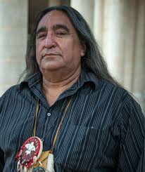
Juan B. Mancias, Tribal Chairman, Esto’k Gna Nation, and Poet
“In our Hokan language, Esto’k Gna means the Human People. Our oral tradition informs us that we have lived with these lands [Texas] we call Somi Sek since time immemorial. The closest English translation of Somi Sek is this big land that we believe is alive and stands all by itself. The Spanish invaders mistakenly named us the Carrizo/Comecrudo. Carrizo (meaning Reed) for the reeds that we used to build our houses and many of our tools and weapons, Comecrudo (meaning Eats Raw) for the ways we prepared and ate our foods.”
-Juan B. Mancias, Tribal Chairman, Carrizo/Comecrudo
Tribe of Texas
from “The biggest tribe you never learned about in your Texas history books”
https://thepostnewspaper.net/2018/11/19/com-celebrating-native-american-heritage-month/

Slide 4
Juan B. Mancias
“my real name is Yen Nawi’s Nepol’k, meaning ‘I stand alone.’”
My Children
Remember your Lifeways
Remember your People.
Remember your Ancestors
For your Lifeways to remember you
For your people to remember you
For your Ancestors to remember you...
https://xicanation.com/tlahtolli-carrizo-comecrudo-nation-of-texas/

Slide 5
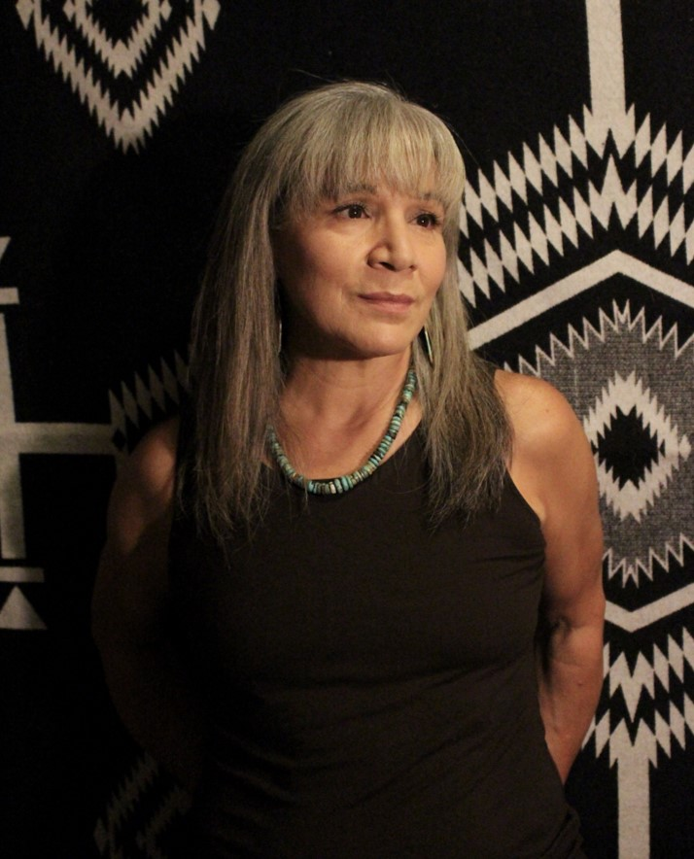
Margo Tamez, Nde’ Poet
“Poetry is a vital form to address histories and voices relegated as disposable and abject.”
“I (re)visit intimate familial places in Lipan Apache (Ndé) homelands, in South Texas, eastern New Mexico, and northeastern Mexico.”
from https://siwarmayu.com/nde-alliterations-by-margo-tamez/

Slide 6
Where are you from? Where is your family from? Where do you live now if not the same place?
Please type your answers in the chat…

Slide 7
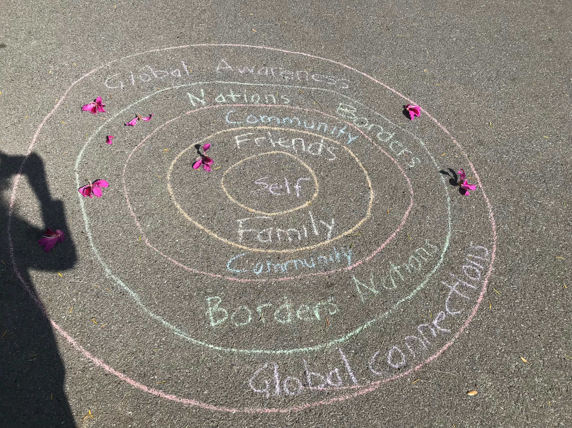
The concentric circles of my creative writing teaching philosophy
The following in concentric circles
1. Self/autobiography
2. Family/friends
3. Communities/Participating, witnessing
4. Nations/Borders/Witnessing
5. Global Awareness & Connections

Slide 8
English Language Arts & Reading TEKS
B4 “ELLs can and should be encouraged to use knowledge of their first language to enhance vocabulary development; vocabulary needs to be in the context of connected discourse so that it is meaningful. Strategic use of the student's first language is important to ensure linguistic, affective, cognitive, and academic development in English.”
4E Comprehension skills “make connections to personal experiences, ideas in other texts, and society;”

Slide 9
English Language Arts & Reading TEKS
7B Multiple Genres: analyze relationships among characteristics of poetry, including stanzas, line breaks, speaker, and sound devices in poems across a variety of poetic forms;
8. Author’s Purpose & Craft: The student analyzes and applies author's craft purposefully in order to develop his or her own products and performances F. evaluate how the author's diction and syntax contribute to the mood, voice, and tone of a text;
9E Composition: “publish written work for appropriate audiences.” (i.e. make a zine/chapbook, a class anthology, or poetry broadside)
10A Composition: “compose literary texts such as fiction and poetry using genre characteristics and craft;”

Slide 10
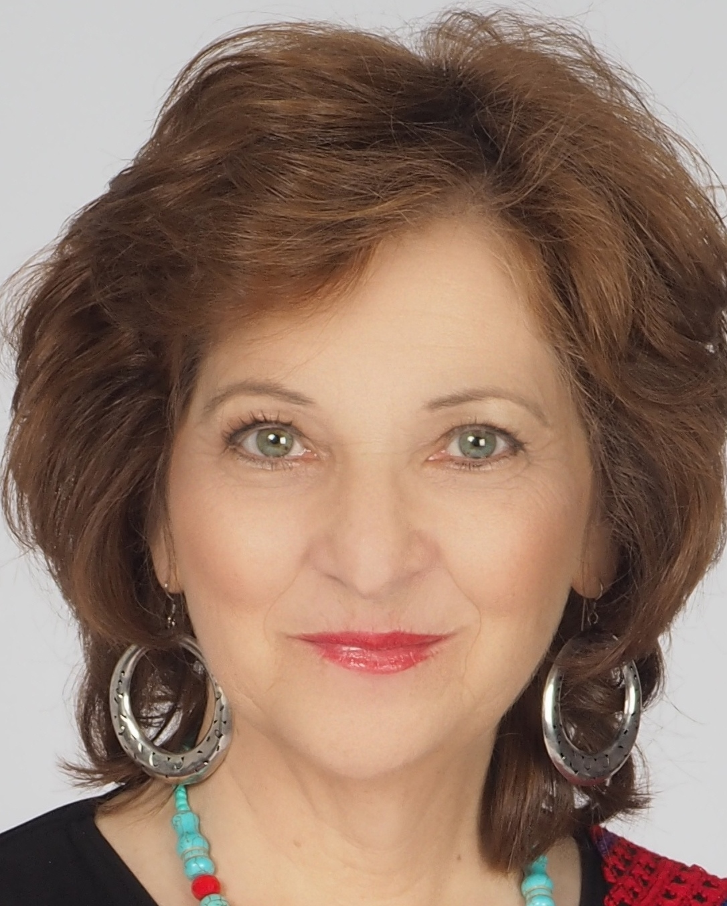
Carmen Tafolla (b. 1951) TX Poet Laureate 2015-2016
“Writing is not about structures or rules or even parts of speech. Structures and rules are just tools that writers use to facilitate the transmission of their message. But writing is really about people—it starts with people and it ends with people.”
-from “Empowering Students through Creative Writing”
(originally published1989-1990)

Slide 11
Gloria E. Anzaldúa (1942-2004) Borderlands/La Frontera (1987)
“If it's an actual, physical borderlands, I use the small ‘b.’ If it's a metaphorical Borderlands I use the big ‘B.’”
-Gloria Anzaldúa, Interview

Slide 12
from “How to Tame a Wild Tongue” in Borderlands/La Frontera
“I remember being caught speaking Spanish at recess—that was good for three licks on the knuckles with a sharp ruler. I remember being sent to the corner of the classroom for ‘talking back’… when all I was trying to do was tell her how to pronounce my name. ‘If you want to be American, speak ‘American.’ If you don’t like it, go back to Mexico where you belong.”
“At Pan American University, I, and all Chicano students were required to take two speech classes. Their purpose: to get rid of our accents.”
(Anzaldúa, Borderlands, 75-76)

Slide 13
from Carmen Tafolla’s (b. 1951) poem “When I Dream Dreams”
“(‘You’ll never get to high school
speakin’ Spanish,’ I was told)
[nice of them, they thought, to not report me,
breakin’ state law, school law, speakin’ dirty
(speakin’ Spanish)”
San Antonio poet… poem “When I Dream Dreams”
p. 94 Sonnets to Human Beings and Other Selected Works (2nd edition 1992)
Mini documentary: https://archive.org/details/WhenIDreamDreams

Slide 14
“Overcoming the Tradition of Silence”
“En boca cerrada no entran moscas. ‘Flies don’t enter a closed mouth’ is a saying I kept hearing when I was a child. Ser habladora was to be a gossip and a liar, to talk too much. Muchachitas bien criadas, well-bred girls don’t answer back. Es una falta de respeto to talk back to one’s mother or father. I remember one of the sins I’d recite to the priest in the confession box the few times I went to confession: talking back to my mother, hablar pa’ trás, repelar. Hocicona, repelona, chismosa, having a big mouth, questioning, carrying tales are all signs of being mal criada. In my culture they are all words that are derogatory if applied to women—I’ve never heard them applied to men”
“Even our own people, other Spanish speakers nos quieren poner candados en la boca. They would hold us back with their bag of reglas de academia” (Anzaldúa 76).
from “How to Tame a Wild Tongue” in Borderlands”

Slide 15
from “How to Tame a Wild Tongue” in Borderlands/La Frontera
“So, if you want to really hurt me, talk badly about my language. Ethnic identity is twin skin to linguistic identity—I am my language. Until I can take pride in my language, I cannot take pride in myself. Until I can accept as legitimate Chicano Texas Spanish, Tex-Mex and all the other languages I speak, I cannot accept the legitimacy of myself. Until I am free to write bilingually and to switch codes without having always to translate, while I still have to speak English or Spanish when I would rather speak Spanglish, and as long as I have to accommodate the English speakers rather than having them accommodate me, my tongue will be illegitimate.”
(Gloria Anzaldúa, Borderlands 81)

Slide 16
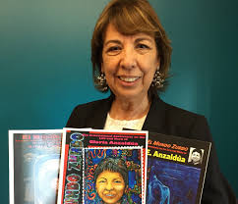
Norma E. Cantú (b. 1947) from Laredo
“… [Gloria Anzaldúa’s work] gave me permission to write in my own Spanglish and to acknowledge that part of who we are on the border. Her book was one of those life-transforming things for me. Not just because of the language… also because of her fierce, candid portrayal of who we are on the border, including critiques…”
-from interview
6:15 “El Retorno: El Valle Celebra Nuestra Gloria” video clip https://www.youtube.com/watch?v=rI6AGsbHMFc

Slide 17
Norma Elia Cantú’s new poetry collection
In the packet of poems I prepared, you will find some poems from this collection in both languages

Slide 18
On the writing process by Gloria Anzaldúa:
“It is like a Cactus needle embedded in the flesh - it worries itself deeper and deeper, and I keep aggravating it by poking at it. When it begins to fester I have to do something to put an end to the aggravation and to figure out why I have it. I get deep down into the place where it's rooted in my skin and pluck away at it, playing it like a musical instrument - the fingers pressing, making the pain worse before it can get better. Then out it comes. No more discomfort, no more ambivalence. Until another needle pierces the skin. That's what writing is for me, an endless cycle of making it worse, making it better, but always making meaning out of the experience, whatever it may be” (94-95).
When I write it feels like I'm carving bone. It feels like I'm creating my own face, my own heart…” (95).
-from Borderlands/La Frontera (1987)

Slide 19
Write down three “cactus needles”
-Think about today or this past week. Write down three things that are or were like “cactus needle[s] embedded in flesh” for you…
-Feelings of “anguish" or even smaller things that bothered you
-Jot down a few words or phrases to help represent what you’re feeling or how you felt at the time:
1) X
2) Y
3) Z
I encourage you to freewrite about any of these when you have time

Slide 20
Write down three positive things you’ve felt recently
-Think about today or this past week. Write down three things that brought you positive feelings, such as comfort, happiness, love, etc…
-Jot down a few words or phrases to help represent what you’re feeling or felt then:
1) X
2) Y
3) Z
I encourage you to freewrite about any of these when you have time

Slide 21
Write how you speak (creative writing)
Students will have different audiences for different assignments of classwork
With creative writing, I encourage writing in the languages they feel the most comfortable writing in

Slide 22
Which languages do you speak?
Anzaldúa writes, “Some of the languages we speak are:
Standard English
Working class and slang English
Standard Spanish
Standard Mexican Spanish
North Mexican Spanish dialect
Chicano Spanish (Texas, New Mexico, Arizona and California have regional variations)
Tex-Mex
Pachucho (called caló)”
(77 Borderlands/La Frontera)

Slide 23
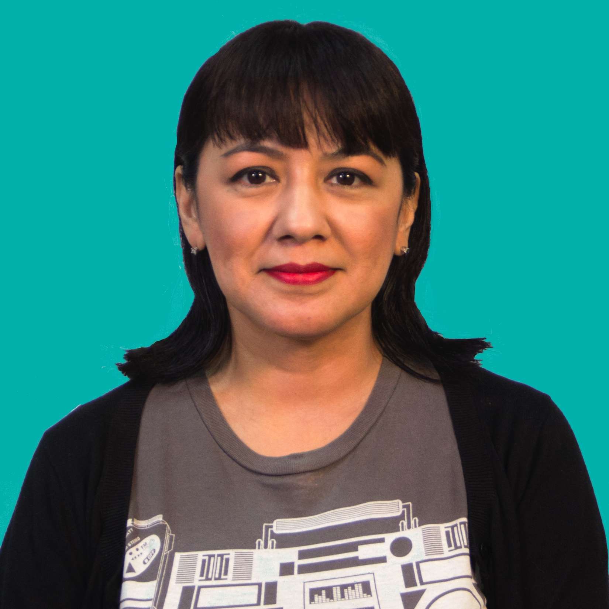
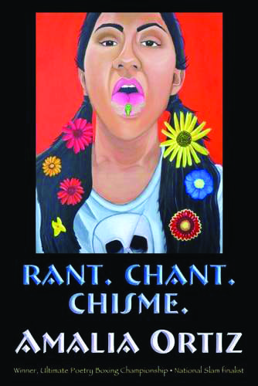
Amalia Ortiz
-from La Feria, TX
-HBO Def Poetry Jam Poet
-Theatre Arts Teaching Artist in the SAY Sí Program in San Antonio
-Author of Rant. Chant. Chisme (2015) and The Canción Cannibal Cabaret (2019)
-
Won an American Book Award 2020 in Oral Literature for her 2019 book
Notes:
Rio Grande Valley and now San Antonio. Author of Rant.Chant.Chisme

Slide 24
Amalia Ortiz
“Raised by my grandmother from a young age in the Rio Grande Valley, I was expected to learn the limited role of a woman in a Mexican family. I was eager to please, and did what I was told: cooking, cleaning, ironing, and sewing. I learned to crochet, knit, and embroider. It was clear that my place was in the home. Had I not had the influences of my brother and television, I would have believed this was the only life for women, and succumbed to this cultural tyranny. Though I mastered the tasks my grandmother set before me, I had a rebellious nature.”
(from unpublished paper, used with permission of author)

Slide 25
Amalia Ortiz:
“I falsely thought the Valley was the root of all my pain. I thought if I escaped I could leave the old, dry ideas of the borderlands behind me, crushed beneath my feet as I ran from it. My brother paved the way, making his escape to Loyola University of Chicago when I was a junior [in high school]. He was the first person in my family to compel me to go to college and the first person to introduce me to Gloria Anzaldúa in 1989. On his first Christmas home from Chicago, he gifted me with books, music, and stories from far away. Among the loot was Borderlands La Frontera. ‘She is from here!’ he proclaimed excitedly, ‘She is one of us, and she is smart!’ he added as though the words ‘here,’ ‘us,’ and ‘smart’ used together were such an anomaly.”
(from unpublished paper, used with permission of author)

Slide 26
“me acuerdo,” poem excerpt by Amalia Ortiz (the TEDx talk has “radio versions” of the poems)
“however far I roam, soy Tejana
can never forget my illicit language
fierce like Pancho Villa
my lengua so feared it was outlawed
from Texas school yards and halls, y’all
so, ten cuidado!
speak your Spanglish there
and they’ll smack your manos” (p. 3 Rant. Chant. Chisme.)

Slide 27
“me acuerdo” poem excerpt (Amalia Ortiz)
“like my tia Tina
once upon a time they tried to keep her in line
in el Valle del Rio Grande
she was paddled for her covert
Castilian conversations
with every lick, her curses grew”
(p. 3 Rant. Chant. Chisme)

Slide 28
“me acuerdo,” poem excerpt (Amalia Ortiz)
“my language is Tex-Mex to the max
a photo-negative del otro lado
there they speak Norteño here Tejano
my rascuache linguistics mix
Selena with Los Sex Pistols
like a dyslexic DJ
ready to bidi bidi bomb the suburbs
punk ruka style
como los old-school roqueros
Ritchie Valens and Freddy Fender didn’t care about the rules
‘cause It’s your happiness that matters most of all.”
(p. 4 Rant. Chant. Chisme)

Slide 29
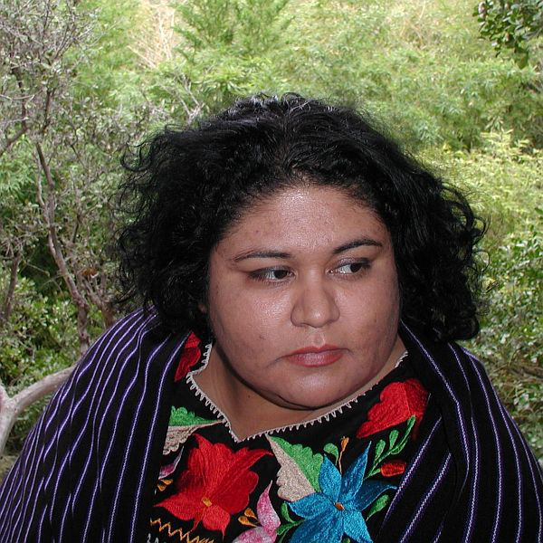
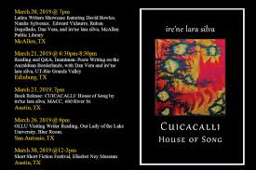
ire’ne lara silva
Author of several poetry collections including Cuicacalli / House of Song. From the Rio Grande Valley and currently lives in Austin.
Notes:
Two books of poetry: furia, blood sugar canto, and a book of stories Flesh to Bone. From the Rio Grande Valley and lives in Austin.

Slide 30
ire’ne lara silva on writing
“I don’t know writing that requires no effort, no strain, no heartbreak, no investment of blood and flesh and heartbreak. I don’t know freedom that is obtained without endurance or kept without intention.”
– from her essay in IMANIMAN: Poets Writing in the Anzaldúan Borderlands

Slide 31
Tips on reading a poem
How long to pause when reading a poem in terms of increasing time increments?
Enjambment = half a comma (Denise Levertov)
A comma
A period, a question mark, an exclamation mark
A stanza break
White space on the page also means something.
Reference “The Music of the Line” chapter in The Poet’s Companion by poets Kim Addonizio and Dorianne Laux can be helpful further reading. I often use the book in my beginning poetry classes at the university.

Slide 32
i come from women illiterate and rough-skinned by ire’ne lara silva (from furia)
i come from women illiterate and rough-skinned all their creativity
bent to the tasks of survival
enslaved women conquered women
who watched the world they knew die mute and screaming silent
and weeping women whose lives were worn short abandoned
women violated women
fractured women who nightly mended
themselves with threads of faith and resistance and endurance
women who toiled in the fields picked cotton shelled corn milked
cows and goats collected eggs hunted and skinned and
disemboweled the meat served at the table

Slide 33
Continued….
women who nurtured
babies in their wombs embraced them buried them women who
made walls with their own hands who sewed and washed and cared
for the sick women who took in laundry cleaned houses cared
for the children of others
women who prayed on their knees prayed on
their feet prayed working living dying
i come from women who never sat indoors
my mother was a silent mother she died with a thousand songs
unsung a thousand canvases still blank a thousand stories unwritten
Notes:
From furia (mouthfeel press). Used by permission of the poet.

Slide 34
my mother died the chemotherapy and radiation fueled a fire
that burned from the inside ravaging her skin
and as she lost her
vision she told me when she closed her eyes it felt like she was flying
over greening valleys the blue peaks of mountains in the distance
incandescent forests alive with color
no one knew my mother
was an artist she would draw me pictures when i was little i remember
a woman’s profile with short curls and a heart-shaped necklace a flock
of seagulls ocean waves on a cloudy day birthday cakes on birthday
cards she could only sign her name until she learned to write
Happy Birthday carving one letter at a time
my mother was an artist she made
blankets to keep us warm she made tortillas and meals that nurtured
a family of ten she was a gardener who made
the hard earth blossom (continues…)

Slide 35
“you love a river” by ire’ne lara silva
for twenty years you love a river and every time you cross it or sit to stare at it you imagine your suddenly immense hands brushing over its calm ripples as if it was fur as if it was skin as if it could touch you back as if it also loved you as if it had waited for you always this peaceful uncontested river always serene so different from that other river the river that has defined your entire life
the river you love is far but not that far from that other river that other river sometimes muddy sometimes dry sometimes green sometimes lovely but you can never think of it without seeing almost two centuries of blood shed over it can never see it without thinking of the lives the pain the hurt the losses crossing that river has cost you have always loved rivers but is it still a river if it has walls
from http://www.americanmicroreviews.com/irene-lara-silva-interview

Slide 36
from an interview of ire’ne lara silva:
“How do you identify?”
“I’m ok with being called Latina, with being called Chicana or Xicana, Tejana, but probably what I most identify with would be indigena because I do feel very strongly attached to my indigenous roots. Especially, when in my family history there’s been so much shame, you know, to do with our indigenous ancestry, our indigenous features, you know, our indigenous ways. And, so, that’s what to me feels the closest.” –ire’ne lara silva

Slide 37
ire’ne lara silva
“I want to uncategorically refuse to forget any part of our history while simultaneously refusing to be defined only by our suffering. I want to speak to not only how we have survived and endured, but how we have carved beauty of our lives, nurtured our joy, and suffused our lives with song.”
From Interview: http://www.americanmicroreviews.com/irene-lara-silva-interview

Slide 38
“it seems to me the stars are enduring” by ire’ne lara silva (p. 1)

Slide 39
p. 2

Slide 40
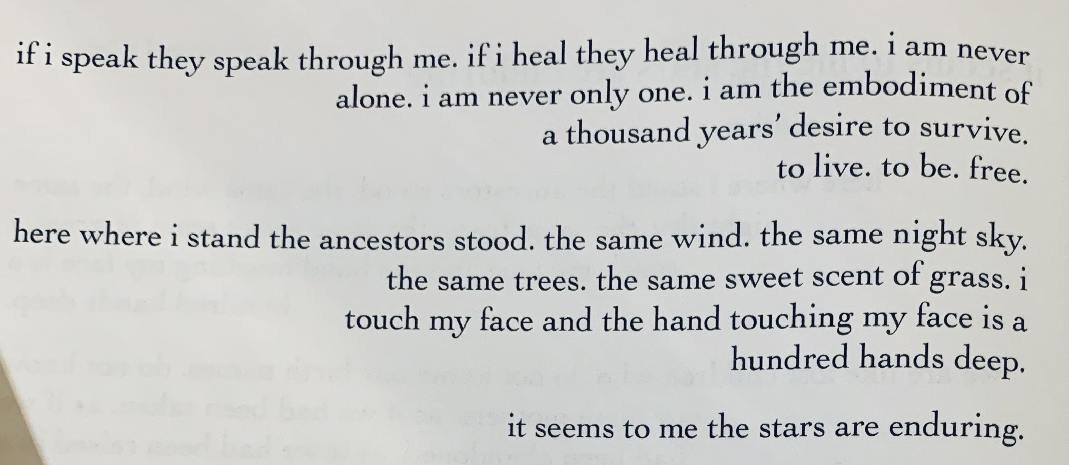
p. 3
Cuicacalli / House of Song

Slide 41
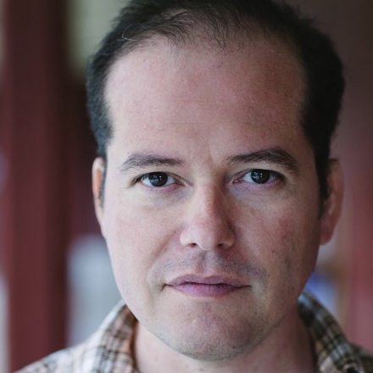
José Antonio Rodríguez
Born in Mexico
Raised in McAllen, TX
Author of a memoir House Built on Ashes and several poetry books, including the latest, This American Autopsy.
Notes:
Books: The Shallow End of Sleep, The Backlit Hour, and a memoir, House Built on Ashes. Lives in McAllen, TX.

Slide 42
Rodríguez on canonical poets:
“I certainly enjoyed the imagery, rhythms, and cadences of Robert Frost, Walt Whitman, and Emily Dickinson, but the worlds they created on the page never felt immediate and when they wrote ‘we,’ I never really felt included.”
José Antonio Rodríguez (from IMANIMAN: Poets Writing in the Anzaldúan Borderlands)

Slide 43
“La Migra” by José Antonio Rodríguez
The grownups sat on their long chair called couch And talked of the weather, the dew of the blossoms’ morning, And what might happen to us, the children. Mom said don’t leave the house, not without Papers. Do I dare speak of the papers hoarded In corners? How many more poems can you write About a face spackled with fear before It holds you? The reader aiming, too. Let us find a darkened corner, you and I, Where we will lay these words. Leave children To sleep in windowless rooms. The mother Biting a prayer. The country weaving a tomb.
from This American Autopsy

Slide 44
“American Abundance, or First Trip to H-E-B Grocery Store” by José Antonio Rodríguez
Carnation milk can sat
On the shelf in the store:
The reddest flower copying itself
Over and over—so many perfect bouquets
At the same edge and no counter
Between them and me.
I feared they might go bad, spoil,
Because surely nobody could,
No matter how hungry, empty this landscape
Where magic repeated itself over the tile.
Having been allowed to hold
Every bag and box, every sum, in my hands
And place them in a wheeled cart,

Slide 45
Without anyone to say no,
To demand payment, I asked Mom
If we could just walk out,
Take it all home. But no,
There was the young woman in uniform.
And her steady hands passed every item
Over a clear window by the register
With a red eye that beeped.
And on the other side,
Every item dropped tilted and rolled,
Revealing the mark—a block of lines like prison bars
And numbers with hard corners—
The code by which to pass the scanner
Like a bridge.
-from this american autopsy by José Antonio Rodríguez

Slide 46
José Antonio Rodríguez’s “Poem in honor of the one-year anniversary of my sister Aleida’s death, which is five days away”
And which is not really a poem. But if I call it one, may I be allowed A small measure of madness? May I Speak of the urn then with its delicate Etchings of leaves, silvered vessel that holds A fragment of what’s left. So small, It fits in my palm. Wanted each to have a part of her. May I speak of this detail: The one pound bag of shelled pecans – So many halved hearts – she brought My parents every time she visited,
Notes:
http://rhinopoetry.org/wp-content/uploads/2014/07/14_RhinoBook_Rodriguez_PoeminhonoroftheoneyearanniversaryofmysisterAleidasdeathwhichisfivedaysaway.pdf

Slide 47
(continued)
Because they savored them so, Because she knew they’d never spend On such an extravagance? May I speak Of the light in that room? Her hands five days before? The thinnest fingers. Their stillness. May I speak of the syringe? Or would that be too much. Morbid. I know, I know, people die. Except, Sometimes we don’t, like the day before She died, when my car was totaled On some nameless street, the other driver Off to the hospital, the wreckage Strapped to the bed of a tow truck, And me walking away.
-from this american autopsy by José Antonio Rodríguez

Slide 48
Gabriel Ramirez’s poem “Before going to the Barbershop”
I gotta call my barber Eric to let him know I’m pullin’ up. Yo hello? Yea yea who this? Ahhhh yo what up homie? How you been kid? Would say he asks a lot of questions for a barber but he been linin’ me up ‘fore I knew who I was. I asked for stars and two lines on both sides of my head in middle school. I asked to keep the stars unfinished. I asked to see the mirror and as botched as I had been— ‘cause I ain’t let him finish—he and I knew this was the first time I got to choose how I looked and since I was told not to call a boy beautiful, I was my first.
Afro-Latinx poet and teaching artist who grew-up in NY. CantoMundo fellow.
This poem appears
on the Split this Rock Poetry database.

Slide 49
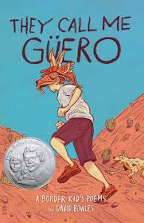
David Bowles’s They Call Me Guëro: A Border Kid’s Poems
Written for middle grade and up
The book has won numerous prizes.
A Spanish version has just been released this month.
A personal favorite is “La Mano Pachona”

Slide 50
Checkpoint by David Bowles
On our road trip to San Antonio for shopping and Six Flags, Dad slows the car as we approach the checkpoint, all those border patrol in their green uniforms, guns on their belts. Mom clutches los papeles—our passports, her green card. She’s from Mexico. A resident, not a citizen, by her own choice. At the checkpoint
a giant German Shepherd sniffs the tires
as the agents ask questions, inspect our trunk.
My little brother squeezes my hand, afraid.
My rebel sister nods and says her yessirs, but I can tell she’s mad, the way her eyes get.
We’re innocent, sure, but our hearts beat fast.
We’ve heard stories.
Bad stories.

Slide 51
p. 2
A cold nod and we’re waved along, allowed to leave the borderlands— made a limbo by the uncaring laws of people a long way away who don’t know us,
a quarantine zone between white and brown.
I feel angry, just like my sister,
but I hold it tight inside.
We just don’t understand
why we have to prove every time
that we belong in our own country
where our mother gave birth to us.
Dad, like he can feel the bad vibes
coming from the back seat, tells us to chill.

Slide 52
p. 3
“It won’t always be like this,” he says,
“but it’s up to us to make the change,
especially los jóvenes, you and your friends.
Eyes peeled. Stay frosty. Learn and teach the truth.
Right now? What matters is San Antonio.
We’ll take your mom shopping,
go swimming in the Texas-shaped pool,
and eat a big dinner at Tito’s.
Order anything you want.”
And he slides his favorite CD
into the battered radio. Los Tigres del Norte
start belting out “La Puerta Negra”—
“Pero ni la puerta ni cien candados
van a poder detenerme.”
Not the door. Not one hundred locks.
Ah, my dad. He always knows the right song.

Slide 53
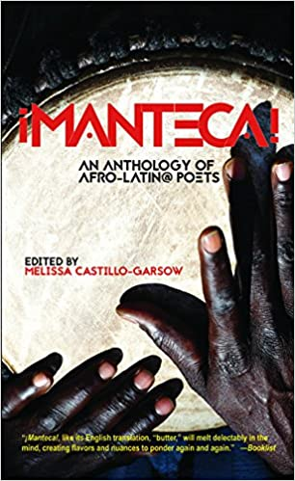
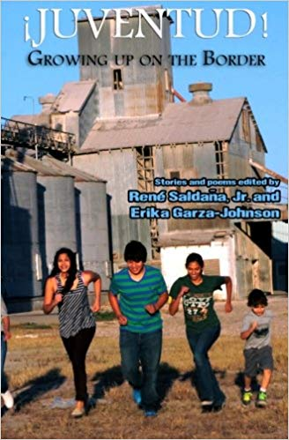
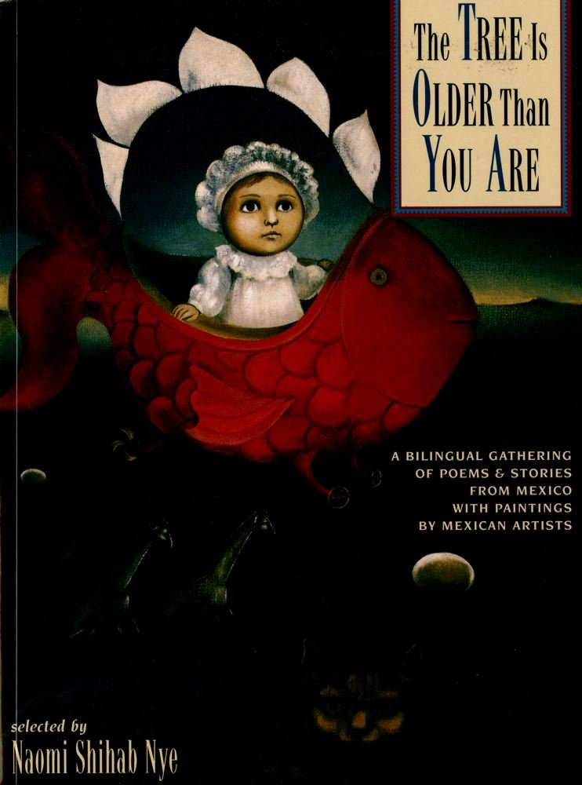
A few anthology recommendations:

Slide 54
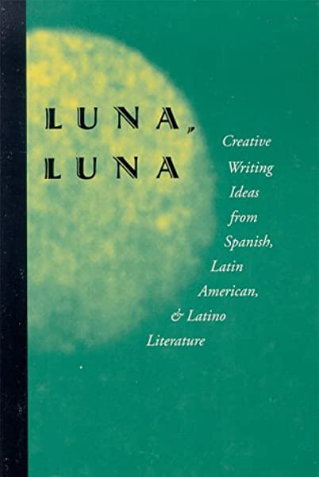
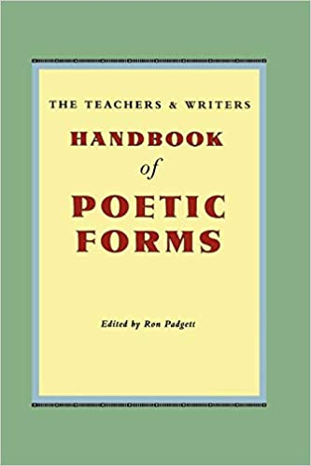
Teachers and Writers Collaborative creative writing books I recommend
“Founded in 1967, Teachers & Writers Collaborative is one of the first writers-in-the-schools programs, with a 50+ year history of delivering innovative creative writing programs that increase access to the arts, build community and amplify youth voices”

Slide 55
Excerpt from the poem “Passage” by Ariana Brown (see next page for lesson plan link)
“2015 was the first year in which Mexico included Afromexicans in the national census, despite having been a country for 500 years.
“& because most of my grandparents’ country thinks this happened so long ago that I cannot possibly exist, the man at the carnicería speaks to me in English, even though I started the conversation in Spanish. & the number of times I’ve been asked if I’m Puerto Rican when I grew up in a Mexican neighborhood three hours from the border.”

Slide 56
Ariana Brown’s website has lesson plans aligned with the TEKS for some of her poems
“Lesson plans. LPs also include TEKS objectives (Texas Essential Knowledge & Skills) for Texas-based educators. High school LPs are designed to take place over 1-2 days. Elementary LPs are designed to take place over one week. ” http://www.arianabrown.com/resources.html
Some of the listed poem topics include: bilingualism, African slavery in Mexico, Latinx identity, race/ethnicity, Black girlhood, self-esteem, beauty, anti-Blackness, mental health, spirituality, mental health, self-care, and more

Slide 57
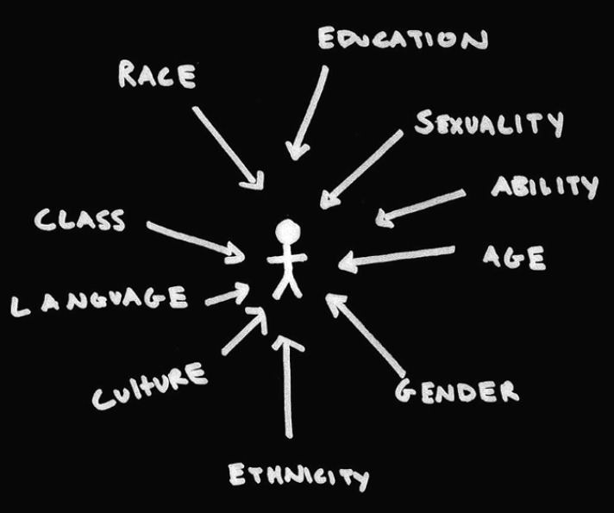
Post-presentation activities
Break-out rooms
Discuss one of the following poems in your group:
-one of iren’e lara silva’s poems
-one of José Antonio Rodríguez’s poem
Gabriel Ramirez’s poem
Underline words, phrases that resonate
if time, discuss how you would teach it?
If time, think about a creative writing exercise that could
go along with the poem for the youth
Image from IDWA website

Slide 58
Writing workshop activities during the pandemic
by Emmy Pérez
Texas Poet Laureate 2020
Professor of Creative Writing, University of Texas Rio Grande Valley

Slide 59
Writing prompts I’ve used lately with youth during the pandemic
1. Encouragement for breaking silence in writing. Freewriting to express how they are feeling right now
2. Levi Romero’s Where I’m From writing activity, but adapted as a scavenger hunt in the house or wherever they are at—they can also draw the details from memory
3. Write an epistolary or letter poem as a love poem to your community/communities or someone you miss and can’t see very much anymore during the pandemic

Slide 60
How do we liberate our pens, hearts, & minds as writers?
Audre Lorde, writes, “What are the words you do not yet have? What do you need to say? What are the tyrannies you swallow day by day and attempt to make your own…”
from ”The Transformation of Silence into Language and Action”

Slide 61
Gloria Anzaldúa on why she writes:
“By writing I put order in the world, give it a handle so I can grasp it. I write because life does not appease my appetites and hunger. I write to record what others erase when I speak, to rewrite the stories others have miswritten about me, about you. To become more intimate with myself and you. To discover myself, preserve myself, to make myself, to achieve self-autonomy… Finally, I write because I’m scared of writing but I’m more scared of not writing.”
– “Speaking in Tongues: A Letter to Third World Women Writers”
from This Bridge Called My Back (1981) and The Gloria Anzaldúa Reader

Slide 62
Gloria Anzaldúa’s writing advice:
“Throw away abstraction and the academic learning, the rules, the map and compass. Feel your way without blinders. To touch more people, the personal realities and the social must be evoked…
Write with your eyes like painters, with your ears like musicians, with your feet like dancers. You are the truthsayer with quill and torch. Write with your tongues of fire. [...]
Find the muse within you. The voice that lies buried under you, dig it up.”
– “Speaking in Tongues: A Letter to Third World Women Writers”

Slide 63
Write for 5-10 minutes straight without stopping….
How to deepen your freewriting: I learned this from taking a workshop with author Joy Castro… While you are writing, I will say “Go for the jugular…” which is what Natalie Goldberg recommends
"Go for the jugular. If something scary comes up, go for it. That's where the energy is. Otherwise, you'll spend all your time writing around whatever makes you nervous. It will probably be abstract, bland writing because you're avoiding the truth. Hemingway said, ‘Write hard and clear about what hurts.’ Don't avoid it. It has all the energy. Don't worry, no one ever died of it. You might cry or laugh, but not die.”
-Natalie Goldberg, Rules for Writing Practice, from Wild Mind: Living the Writer’s Life, https://whisperdownthewritealley.wordpress.com/2011/10/25/natalie-goldbergs-rules-for-writing-practice/

Slide 64
Where I’m from / De Donde Yo Soy (Writing exercise for all ages)
The following scavenger hunt questions I adapted from Levi Romero’s writing exercise after poems by George Ella Lyon & his own
Writing exercise by Levi Romero
( I also his writing exercise in Spanish—email me if you would like it)

Slide 65
Quick Scavenger Hunt
Look around your home for the following:
An object that represents you or your family
An object that you would be very sad to lose
Find a food item that you love
Find a plant inside or outside the window
Now imagine someone in your family saying something to you they often say… what are they saying?

Slide 66
Scavenger Hunt in Your Home
What kinds of plants do you see out the window or inside your home? (i.e. aloe vera, cactus, roses, etc)
Do you see any trees outside of your window? Do you know what kind they are? (i.e. oak, mesquite) If not, describe it/them.
What can you smell or taste in the kitchen in your home right now?
Find two products in your home (i.e. kinds of cereal, name of shampoo)

Slide 67
Look around your home
6. Do you see any pictures, mementos, or treasures that are important to you or your family? Write down at least one of them.
7. Write down the first two names that come to mind of family members __________ and __________
8. Briefly describe your home (i.e. the yellow apartment on the third floor)

Slide 68
Look inside your memories!
The name or part of a song you learned as a younger child? Can you sing it still or part of it?
What do you like to eat at home? Everyday foods and on special times?
Look around your home to remember – what kinds of things do you and your family like to do together?
Do you remember any sayings that your family says often? (i.e. I love you, eat your broccoli, wash your hands, etc.).
5. Family tradition: what do you do every year or once a week? Before or during the pandemic (i.e. celebrate your birthday? Eat pan dulce on Sundays?)
6. Family habits: what do you all like to do together often?

Slide 69
Where I’m From writing exercise by Levi Romero
I am from __________________________ (an everyday item in your home)
from ______________ and ____________ (products in your home for example, Chlorox, Cheerios)
I am from the _______________________ (description of your home)
___________________________________ (a detail about your home--
a taste, a smell, a feel)

Slide 70
I am from the _________________(plant, flower, natural item)
The _________________________ (plant or tree near your home)
whose long gone limbs I remember
as if they were my own

Slide 71
I’m from _____________________ and ________________________
(a family tradition) (a family trait – i.e. curly hair)
from _______________ and ______________ (family members names)
I’m from ____________ and ______________ (family habits)
and from ______________________________ (family habit)

Slide 72
I'm from _____________________ and ________________________
(things you were told as a younger child or this week)
and _____________________ (a song or saying you learned as a younger child)
I’m from __________________ (a family tradition)
I’m from __________________ (place of birth or where you live now)
and ______________________ (family ancestry or places where ancestors are from)
and ___________________ and _________________ (family foods)

Slide 73
From ________________________ (a story about a family member)
_____________________________ (detail about the story or person)
_____________________________ (description of family mementos, pictures or treasures)
_____________________________ (location of mementos — under my bed, on the wall, in my heart)
_____________________________ (more description if needed)

Slide 74
“Where I’m from” poem by George Ella Lyon p. 1
I am from clothespins,
from Clorox and carbon-tetrachloride.
I am from the dirt under the back porch.
(Black, glistening
it tasted like beets.)
I am from the forsythia bush,
the Dutch elm
whose long gone limbs I remember
as if they were my own.
(

Slide 75
p. 2
I am from fudge and eyeglasses,
from Imogene and Alafair.
I'm from the know-it -alls
and the pass -it -ons,
from Perk up! and Pipe down!
continues… whole poem here

Slide 76
“De donde yo soy” by Levi Romero
I am from leche de jarro
from Morrell manteca and Gold Medal flour
I am from acequias, viviendas, dispensas, y
el Rosario recited on Radio ¿Qué Dice?
I am from the Irises drooping like teardrops
in grammita’s abandoned flower bed
y las Barras de San José
whose long gone limbs I remember
as if they were my own. (continues…whole poem in the packet)

Slide 77
During these pandemic times… write a love letter
to your community/communities
to someone or more than one that you can’t see much of anymore due to the pandemic
to your life before the pandemic
to yourself during the pandemic
etc.

Slide 78
Parting quotes. Our own writing can make/change us—writing as inquiry, writing for discovery, writing for meaning. I hope you find time for personal writing.
“My soul makes itself in the creative act.”
“I change myself, I change the world.”
–Gloria Anzaldúa

Slide 79
Note on poems in the packet
Poems in the packet I prepared as a supplement to this presentation by Elizabeth Acevedo, Francisco Aragón, Sara Borjas, Mahogany L. Browne, Norma Eli Cantú, Lucille Clifton, Ross Gay, Aracelis Girmay, Sheryl Luna, Pablo Miguel Martínez, E. Ethelbert Miller, Amalia Ortiz, Alan Pelaez Lopez, Gabriel Ramirez, Levi Romero, José Antonio Rodríguez, ire’ne lara silva, Natasha Trethewey, Dan Vera, Javier Zamora. I will also send a few poems by David Bowles.

