Slide 1
Inventing the Supreme Court: John Marshall’s Federalist Constitution… and Judicial decisions
Joseph F. Kobylka
Altshuler Distinguished Teaching Professor
Associate Professor of Political Science Southern Methodist University
Prepared for delivery at the Humanities Texas Teacher Workshop:
Shaping the American Republic
2 December 2020

Slide 2
Why Focus on John Marshall?
Great Chief Justice
Great Constitutional Force
Great Creator and steward of the role of the Court
Very Cool Guy and story
(Hamiltonize history)
PBS, The Supreme Court, “One Nation Under Law”
Lesson Plans
Discussion Guide

Slide 3
Encapsulating Themes & TEKS
Constitutional
Judicial Power
National Supremacy
Property Rights (but not directly address here)
Political/Governmental
On-Going Battle Between “Federalists & Jeffersonians”
Judicial Politics (Politics of Separation of Powers)
Judicial Nationalism (Politics of Federalism)
Judicial Reality (The Limits of Judicial Power)

Slide 4
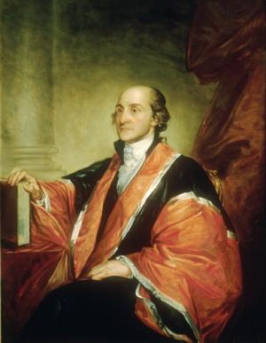
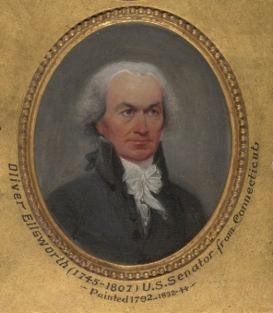
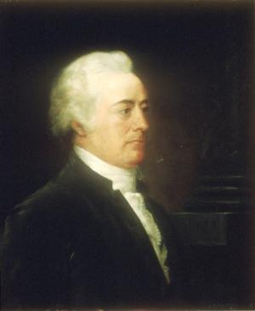
For the Court: An Inauspicious, Non-Supreme Beginning
No Formal “Office”
Three CJ’s in ten years
Justices Largely “Riding Circuit”
Chisholm v. Georgia (1793) &
Eleventh Amendment
John Jay to John Adams (1800): “The Court will never have the energy, weight, and dignity needed to be a co-equal institution of the national government.”
… until …

Slide 5
The “Revolution of 1800”
Jefferson Elected President
Chief Justice Ellsworth Resigns
On the Way Out the Door, Federalists
Pass Judiciary Act of 1801
Make “Midnight Appointments”
Nominate/Confirm Chief Justice Marshall
Jeffersonian Republicans Respond
Pass Judiciary Act of 1802
Refuse to Deliver Some Judicial Commissions

Slide 6
Federalists Fight from the Bench
Context: Tension with Jeffersonians
Political & Constitutional Goals
Nurturing Judicial Power (Supremacy)
Facilitating Broad National Power
Protecting Property Rights
Reinforcing Goals, but necessary to their achievement:
Judicial Power
Judicial Review

Slide 7
Theme #1: Judicial Power
The Concept of Judicial Review
Precursors to Judicial Review
Not Part of English Constitutional Law
State Constitutions and Courts
Federalist Seventy-Eight
Hylton v. U.S. (1796)
The Constitution (Article III)
Silent

Slide 8
Theme #1: Judicial Power
Marshall’s Jurisprudential Genius: Marbury v. Madison (1803)
Facts of the Case
Jefferson Election
Federalists Pack Courts
Marshall Fails to Deliver All Commissions
Marbury Sues

Slide 9
Theme #1: Judicial Power
Marshall’s Jurisprudential Genius: Marbury v. Madison (1803)
Disposition of Issues
Has Right to the Commission
Has Asked for the Right Tool to Get It (mandamus)
But… Has Asked a Court that Can’t Help Him
Section 13 of Judiciary Act of 1789 is Unconstititonal
The Judicial/Constitutional Hammer – The Implied Power of Judicial Review

Slide 10
Primary Source: Marbury v. Madison (1803)
“It is emphatically the province and duty of the judicial department to say what the law is. Those who apply the rule to particular cases, must of necessity expound and interpret that rule. If two laws conflict with each other, the courts must decide on the operation of each.”

Slide 11
Primary Source: Marbury v. Madison (1803)
“Between these alternatives there is no middle ground. The constitution is either a superior, paramount law, unchangeable by ordinary means, or it is on a level with ordinary legislative acts, and like other acts, is alterable when the legislature shall please to alter it…. If then the courts are to regard the constitution; and the constitution is superior to any ordinary act of the legislature; the constitution, and not such ordinary act, must govern the case to which they both apply.”

Slide 12
Theme #1: Judicial Power
Marshall’s Political Genius
Rendering a Decision that Couldn’t be Disobeyed
Create a Power
Create a Precedent from which to Build
Avoid “Emperor Has No Clothes” Problem
Jefferson Outraged: Departmental Theory of Constitutional Interpretation
Chase Impeachment Attempt
Marshall Response: Stuart v. Laird (1803)

Slide 13
Theme #1: Judicial Power
Marbury Creates the Basis of the Court’s Power
Limit Governmental Power
Legitimate Governmental Power – the “Double Negative”
With this power Marshall – and future justices and courts – can shape governmental policies at the national and state levels.

Slide 14
Theme #2: National Supremacy
Remember Context of Marshall’s Appointment: What to do with Judicial Power?
Federalists vs. Jeffersonians
Source of Sovereignty
States (Jeffersonians)
People (Federalists)
Scope of National Power
Narrow (Jeffersonians)
Broad (Federalists)
Interpretation of Constitution
Textual/Narrow (Jeffersonians)
Extra-Textual/Broad (Federalists)

Slide 15
Theme #2a: National Supremacy
Source of Sovereignty
States (Jeffersonian)
Ratification
Tenth Amendment
People (Federalist)
Ratification
Preamble
Supremacy Clause of Article VI
Marshall’s Answer: The People
McCulloch v. Maryland (1819)

Slide 16
Primary Source: McCulloch v. Maryland (1819)
Jeffersonian Position:
“The powers of the general government, it has been said, are delegated by the states, who alone are truly sovereign; and must be exercised in subordination to the states, who alone possess supreme dominion.
It would be difficult to sustain this proposition.”

Slide 17
Primary Source: McCulloch v. Maryland (1819)
Federalist Position:
“The convention which framed the constitution was indeed elected by the state legislatures…. It was reported to the then existing congress of the United States, with a request that it might 'be submitted to a convention of delegates, chosen in each state by the people thereof, under the recommendation of its legislature, for their assent and ratification.' This mode of proceeding was adopted; and by the convention, by congress, and by the state legislatures, the instrument was submitted to the people…. From these conventions, the constitution derives its whole authority….. It required not the affirmance, and could not be negatived, by the state governments. The constitution, when thus adopted, was of complete obligation, and bound the state sovereignties....”

Slide 18
Theme #2b: National Supremacy
Scope of National Power
Narrow (Jeffersonian)
Enumerated Powers in Article I, Section 8
Tenth Amendment
Broad (Federalist)
National Purpose
Implied Powers
Article I, Section 8, Necessary and Proper Clause
Marshall’s Answer: Broad
McCulloch v. Maryland (1819)
Gibbons v. Ogden (1824)

Slide 19
Primary Source: McCulloch v. Maryland (1819)
Constitution Contains Implied Powers
“Among the enumerated powers, we do not find that of establishing a bank or creating a corporation. But there is no phrase in the instrument which, like the articles of confederation, excludes incidental or implied powers; and which requires that everything granted shall be expressly and minutely described.”

Slide 20
Primary Source: McCulloch v. Maryland (1819)
But the Tenth Amendment!
“The powers not delegated to the United States by the Constitution, nor prohibited by it to the States, are reserved to the States respectively, or to the people.”
Marshall’s Response:
“Even the 10th amendment, which was framed for the purpose of quieting the excessive jealousies which had been excited, omits the word 'expressly,' and declares only, that the powers 'not delegated to the United States, nor prohibited to the states, are reserved to the states or to the people;' thus leaving the question, whether the particular power which may become the subject of contest, has been delegated to the one government, or prohibited to the other, to depend on a fair construction of the whole instrument.”

Slide 21
Primary Source: McCulloch v. Maryland (1819)
Article I, §8, §§18 – “necessary and proper” clause
Marshall’s Take:
“Is it true, that this is the sense in which the word 'necessary' is always used? Does it always import an absolute physical necessity, so strong, that one thing to which another may be termed necessary, cannot exist without t its use, in the common affairs of the world, or in approved authorshat other? We think it does not. If reference be had to, we find that it frequently imports no more than that one thing is convenient, or useful, or essential to another. To employ the means necessary to an end, is generally understood as employing any means calculated to produce the end.”

Slide 22
Theme #2c: Interpretation
How to Read/Apply the Constitution
Textually/Literally/Narrowly (Jeffersonian)
Popular Sovereignty – Limited National Authority
Tenth Amendment – States’ Rights
Textually/Broadly/Extra-Textually (Federalist)
Nature of a Constitution - Fundamental Law
Supremacy Clause of Article VI – National Purpose
Marshall’s Answer: Textually/Broadly/Extra-Textually
Marbury v. Madison (1803)
McCulloch v. Maryland (1819)
Gibbons v. Ogden (1824)

Slide 23
Primary Source: Gibbons v. Ogden (1824)
Article I, § 8, §§ 3 - The Congress shall have power to regulate… commerce among the several states…
Jeffersonian Position: Commerce is buying and selling and exchange of goods moving between states
Federalist Position: Commerce is all commercial activity, including but not limited to buying/selling, and activity that moves between states
Marshall’s Take: Commerce comprehends any economic activity that crosses state lines

Slide 24
Primary Source: Gibbons v. Ogden (1824)
Article I, § 8, §§ 3 - The Congress shall have power To regulate commerce among the several states
“It is the power to regulate; that is, to prescribe the rule by which commerce is to be governed. This power, like all others vested in Congress, is complete in itself [plenary], may be exercised to its utmost extent, and acknowledges no limitations, other than are prescribed in the constitution....”
“The subject to which the power is next applied, is to commerce 'among the several States.' The word 'among' means intermingled with. A thing which is among others, is intermingled with them. Commerce among the States, cannot stop at the external boundary line of each State, but may be introduced into the interior.”

Slide 25
Primary Source: Gibbons v. Ogden (1824)
Article I, § 8, §§ 3 - The Congress shall have power To regulate commerce among the several states
“Commerce, undoubtedly, is traffic, but it is something more: it is intercourse. It describes the commercial intercourse between nations, and parts of nations, in all its branches, and is regulated by prescribing rules for carrying on that intercourse.”

Slide 26
Goal #3: Protect Private Property
Private Property Rights
Jeffersonian Position: Lesser Protection
Tenth Amendment
Popular Sovereignty
Core Principles of Liberalism: Democracy
Federalist Position: More Protection
Constitutional Text
Fundamental Law/Limited Government
Core Principles of Liberalism: Individual Rights
Marshall’s Answer: “More”
Fletcher v. Peck (1810)
Martin v. Hunter’s Lessee (1816)
Dartmouth College v. Woodward (1819)

Slide 27
Goal #3: Protect Private Property
John Locke, The Second Treatise of Government
Man being born, as has been proved, with a title to perfect freedom, and an uncontrouled enjoyment of all the rights and privileges of the law of nature… not only to preserve his property, that is, his life, liberty and estate, against the injuries and attempts of other men (Chapter VII)
Constitutional Text
Article I, Section 10: “No State shall… pass any … Law impairing the Obligation of Contracts”
Fifth Amendment: “nor shall private property be taken for public use, without just compensation.”

Slide 28
Goal #3: Protect Private Property
James Madison, Federalist Ten
The diversity in the faculties of men, from which the rights of property originate, is not less an insuperable obstacle to a uniformity of interests. The protection of these faculties is the first object of government.
Alexander Hamilton, Federalist Seventy-Eight
This independence of the judges is equally requisite to guard the Constitution and the rights of individuals from the effects of those ill humors, which the arts of designing men, or the influence of particular conjunctures, sometimes disseminate among the people themselves, and which, though they speedily give place to better information, and more deliberate reflection, have a tendency, in the meantime, to occasion dangerous innovations in the government, and serious oppressions of the minor party in the community.

Slide 29
Wrap/Rap: Situating the Court in American Constitutional Politics
Marshall’s Phenomenal Success – Building Federalist Principles into Constitutional Law
But… Hamiltonize
Cool Story
The Politics of Marshall’s Appointment
The Politics of Marshall’s Early Career
The Success of Marshall’s Strategy and Leadership
But… Federalist Seventy-Eight: Purse & Sword
Lesson: The Court Must Be Judicious in Its Exercise of Judicial Review/Power
If not: Worchester v. Georgia … and Dred Scott
In John Marshall we see the fusion of constitutional law and constitutional politics … his genius: understanding principle and its relationship to the “art of the possible.”
In essence, he invented the Supreme Court.

Slide 30
Fini
113.20. Social Studies, Grade 8, Adopted 2018 - TEKS
(b) Knowledge and skills.
(1) History. The student understands traditional historical points of reference in U.S. history through 1877. The student is expected to:
(A) identify the major eras in U.S. history through 1877, including … creation and ratification of the Constitution
(B) explain the significance of the following dates … 1787, writing of the U.S. Constitution;
(5) History. The student understands the challenges confronted by the government and its leaders in the early years of the republic …
(A) describe major domestic problems faced by the leaders of the new republic, including … setting up the court system;
(15) Government. The student understands the American beliefs and principles reflected in the Declaration of Independence, the U.S. Constitution, and other important historic documents.
(D) analyze how the U.S. Constitution reflects the principles of limited government, republicanism, checks and balances, federalism, separation of powers, popular sovereignty, and individual rights;
(17) Government. The student understands the dynamic nature of the powers of the national government and state governments in a federal system. The student is expected to:
(A) analyze the arguments of the Federalists and Anti-Federalists…
(18) Government. The student understands the impact of landmark Supreme Court cases. The student is expected to:
(A) identify the origin of judicial review;
(B) summarize the issues, decisions, and significance of landmark Supreme Court cases, including Marbury v. Madison, McCulloch v. Maryland, and Gibbons v. Ogden;
(22) Citizenship. The student understands the importance of effective leadership in a constitutional republic. The student is expected to:
(A) analyze the leadership qualities of elected and appointed leaders of the United States such as … John Marshall
(29) Social studies skills. The student applies critical-thinking skills to organize and use information acquired through established research methodologies from a variety of valid sources, including technology. The student is expected to:
(A) differentiate between, locate, and use valid primary and secondary sources such as media and news services, biographies, interviews, and artifacts to acquire information about the United States;
Contact Information:
Joe Kobylka
Department of Political Science
Southern Methodist University
jkobylka@smu.edu

Slide 31
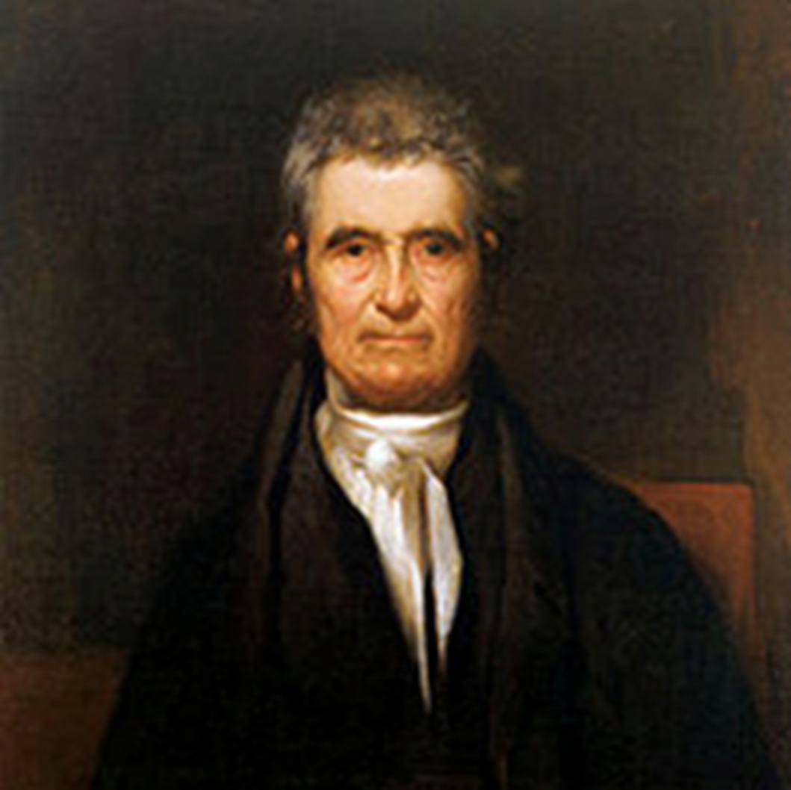
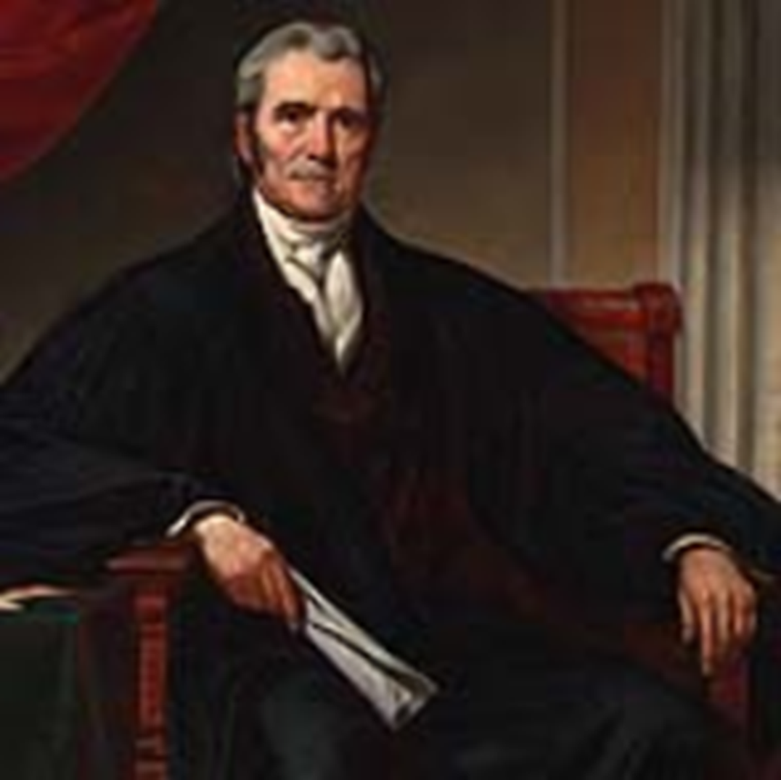
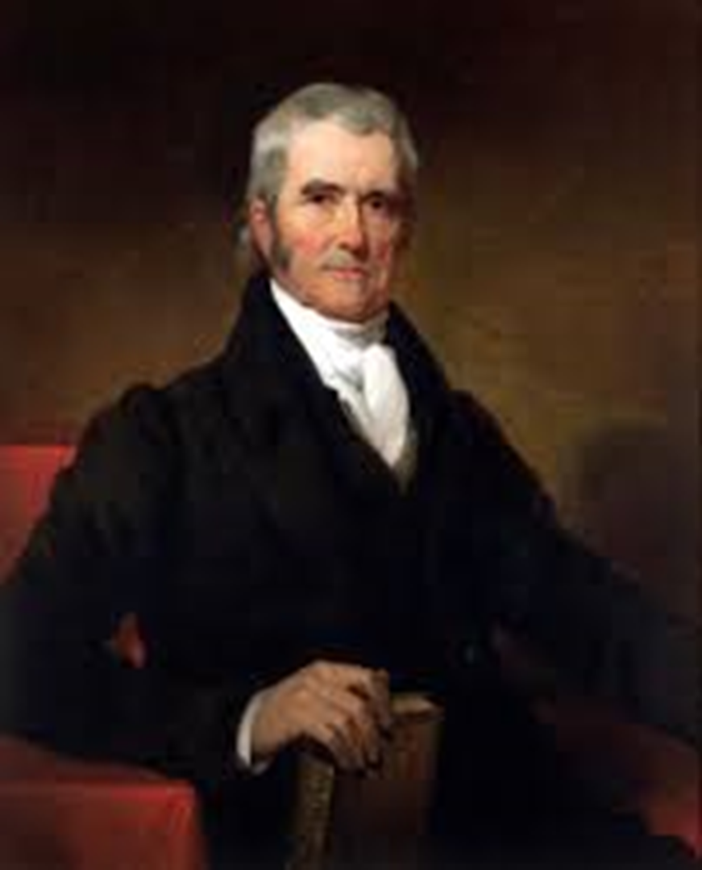
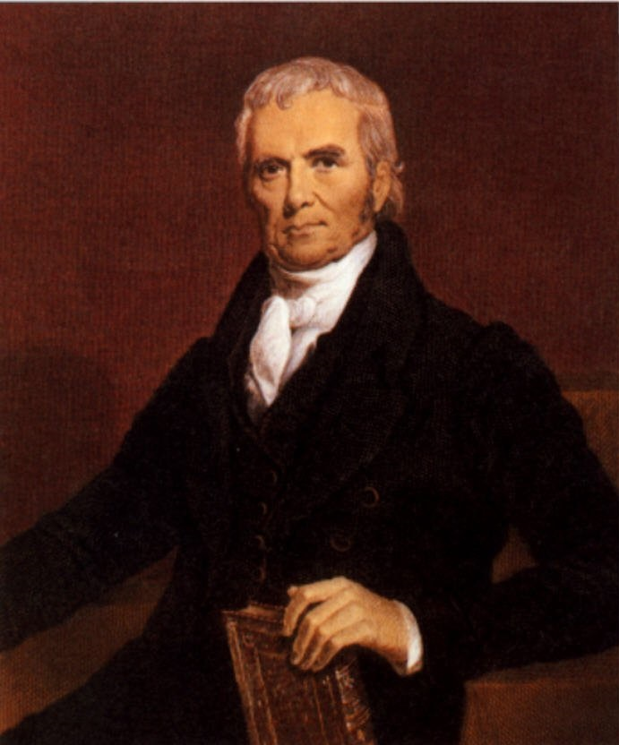
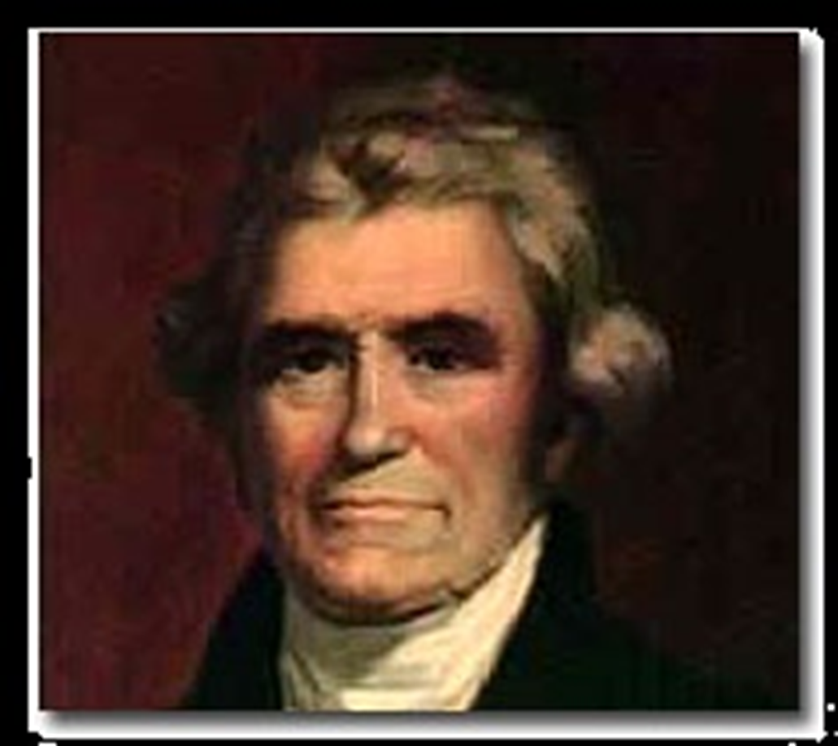
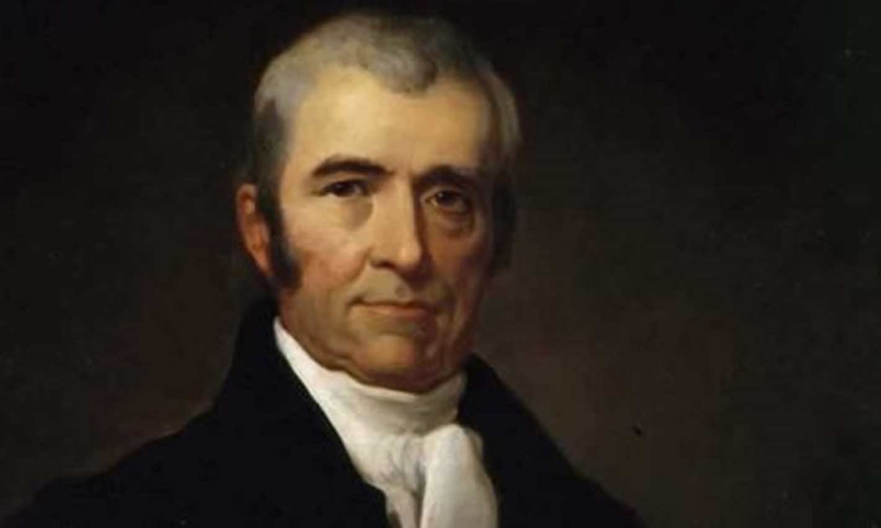
Q&A

