Slide 1
Defining Citizenship in the Early United States
Christopher Bonner
October 28, 2020

Slide 2
Big Question: What did citizenship mean in the early United States?
Objectives:
explore the uncertainty surrounding citizenship
examine lawmakers’ efforts to define citizenship in exclusionary ways
consider the work of African American activists to secure belonging and rights in the United States

Slide 3
In relation to Texas Grade 8 Social Studies Guidelines:
analyze the contributions of people of various racial, ethnic, and religious groups to our national identity
analyze how the U.S. Constitution reflects the principles of limited government, republicanism, checks and balances, federalism, separation of powers, popular sovereignty, and individual rights
describe the contributions of significant political, social, and military leaders of the United States such as Frederick Douglass, John Paul Jones, Susan B. Anthony, and Elizabeth Cady Stanton

Slide 4
Citizenship in the U. S. Constitution
“No Person except a natural born Citizen, or a Citizen of the United States, at the time of the Adoption of this Constitution, shall be eligible to the Office of President. . .”
“The judicial Power shall extend . . . to Controversies between two or more States;— between a State and Citizens of another State,—between Citizens of different States,—between Citizens of the same State claiming Lands under Grants of different States. . .” “The Citizens of each State shall be entitled to all Privileges and Immunities of Citizens in the several States.”

Slide 5
“any Alien being a free white person, who shall have resided within the limits and under the jurisdiction of the United States for the term of two years, may be admitted to become a citizen thereof on application to any common law Court of record in any one of the States wherein he shall have resided for the term of one year at least, and making proof to the satisfaction of such Court that he is a person of good character, and taking the oath or affirmation prescribed by law to support the Constitution of the United States. . .”
- From the 1790 Naturalization Act

Slide 6
“Each and every free able-bodied white male citizen of the respective states, resident therein, who is or shall be of the age of eighteen years, and under the age of forty-five years (except as is herein after excepted) shall severally and respectively be enrolled in the militia by the captain or commanding officer of the company, within whose bounds such citizen shall reside. . .”
- From the 1792 Militia Act

Slide 7
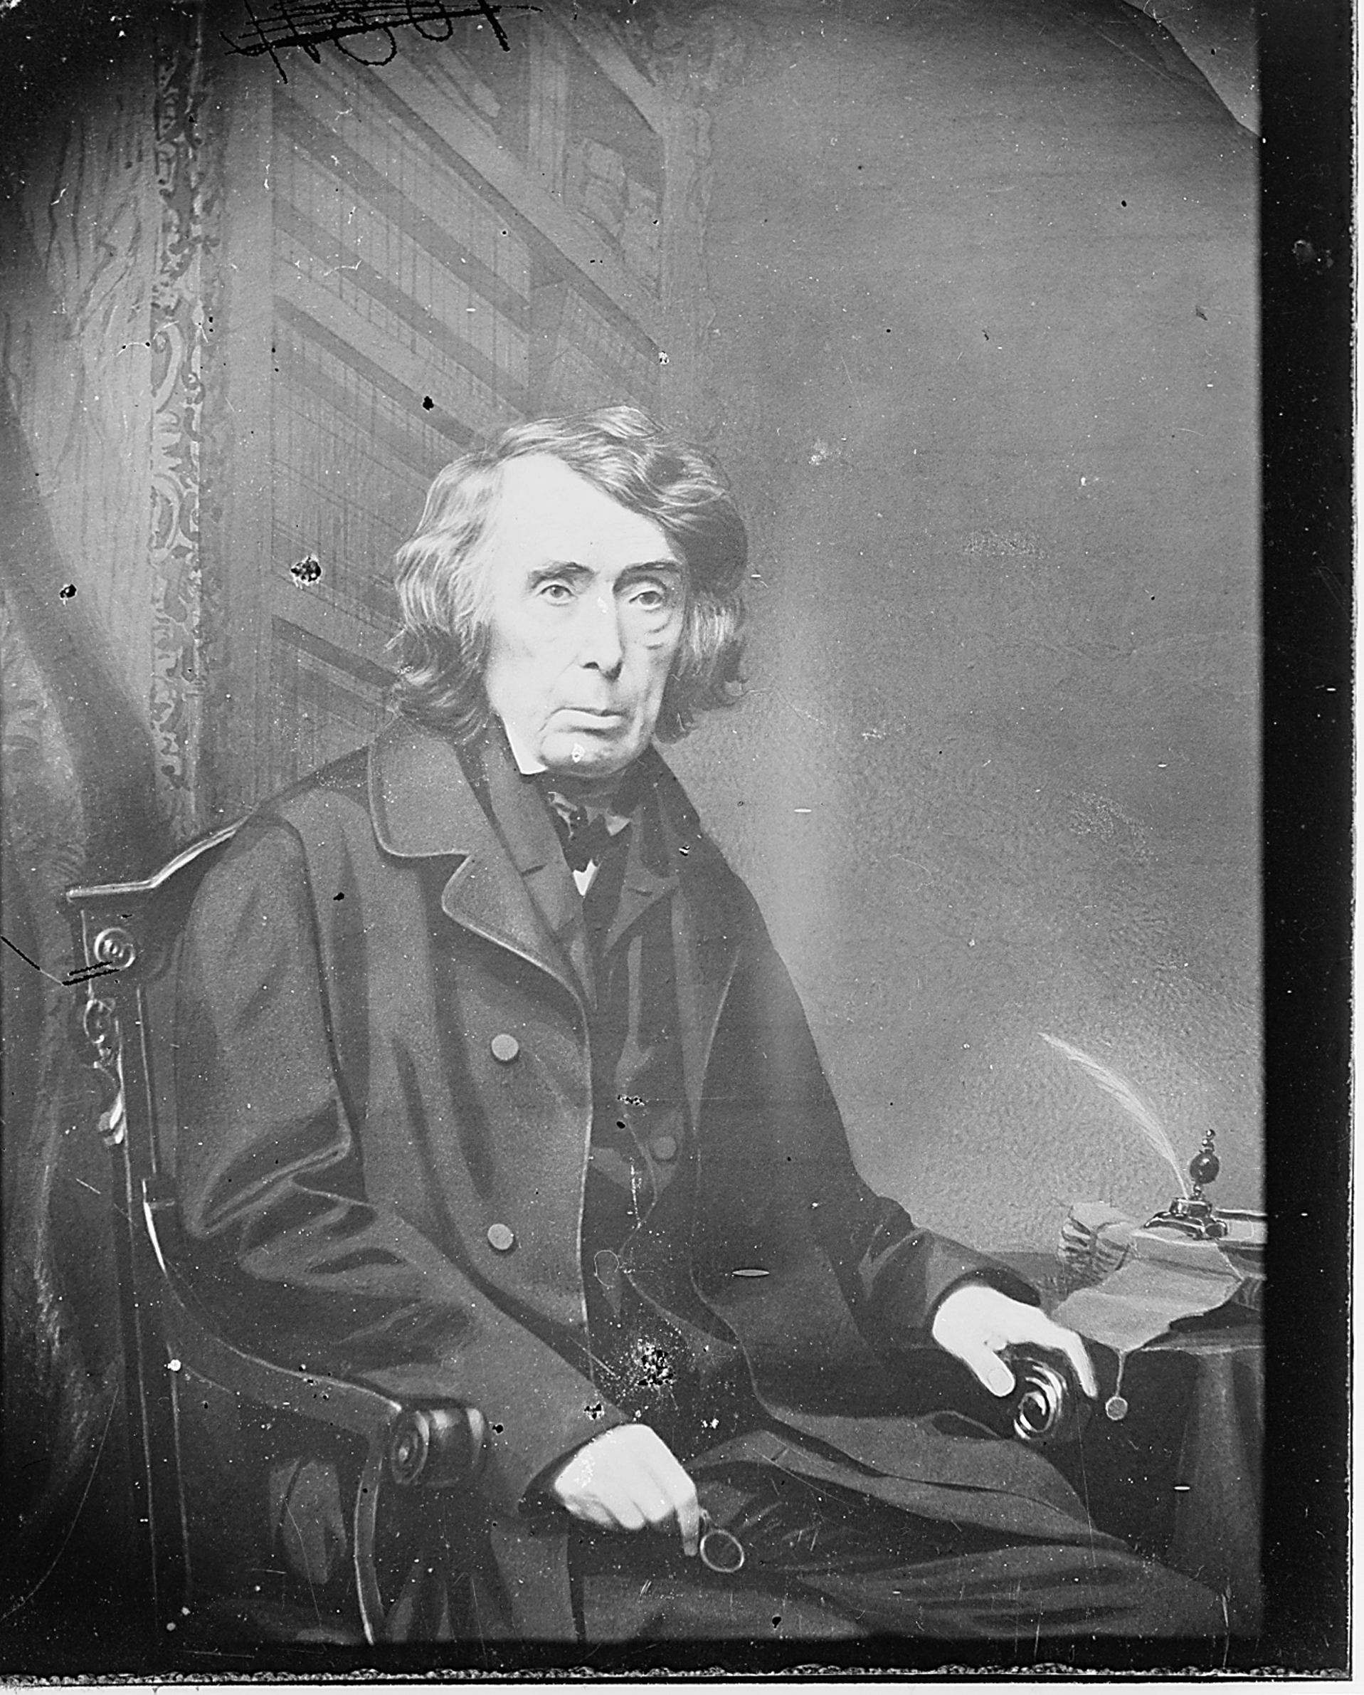
“at the time of the Declaration of Independence, and when the Constitution of the United States was framed and adopted. ... [African Americans] had for more than a century before been regarded as beings of an inferior order ... and so far inferior, that they had no rights which the white man was bound to respect. . .
From Dred Scott v Sanford (1857)
Chief Justice Roger B. Taney (c. 1860)

Slide 8
From William Russel Birch’s Views of Philadelphia (1800)

Slide 9
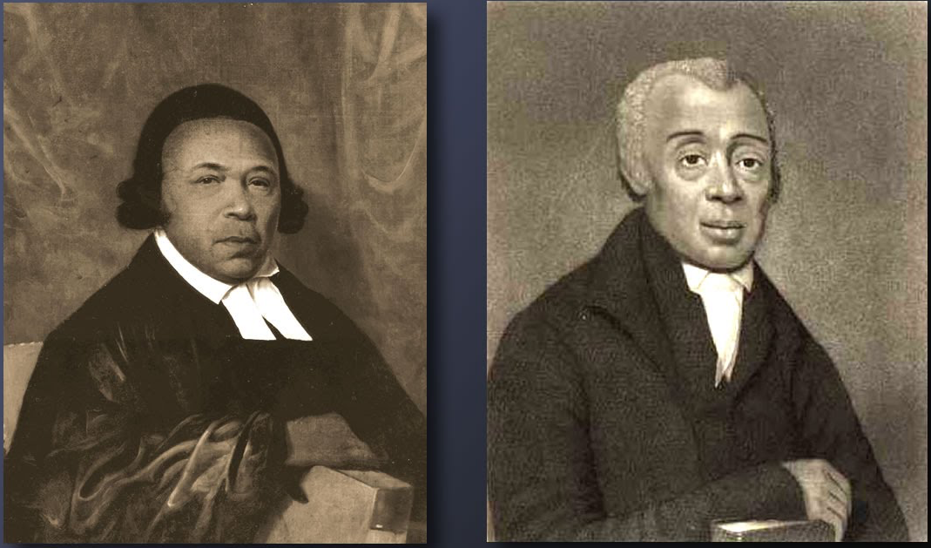
Absalom Jones and Richard Allen

Slide 10
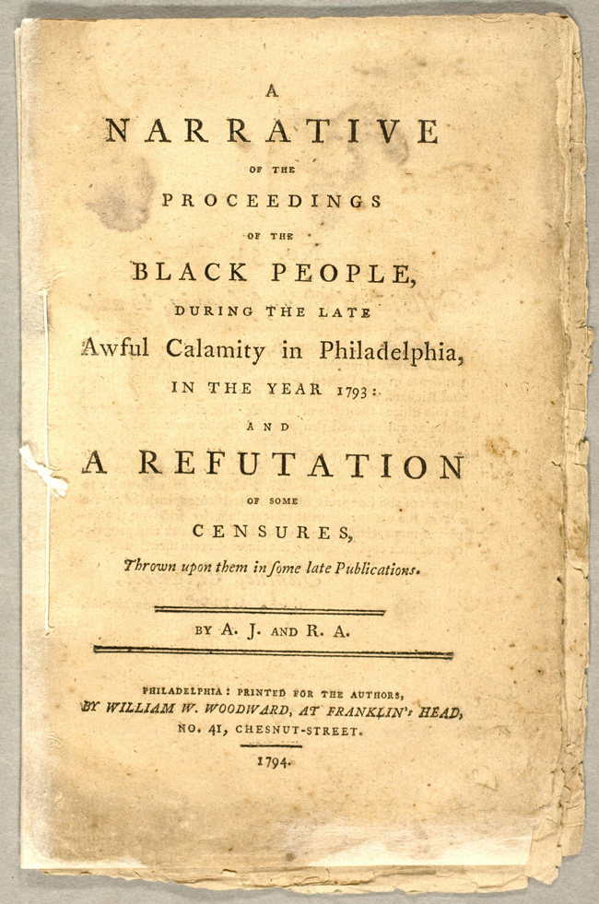
“The Lord was pleased to strengthen us, and remove all fear from us, and disposed our hearts to be as useful as possible. . . . A poor black man, named Samson, went constantly from house to house where distress was, without fee or reward; he was smote with the disorder, and died, after his death his family were neglected by those he had served.”
Allen and Jones’s pamphlet

Slide 11
God and a soldier, all men do adore,
in time of war, and not before
when the war is over, and all things righted,
God is forgotten, and the soldier slighted.
-from Allen and Jones’s Narrative of the Yellow Fever Epidemic

Slide 12
“any child born of a slave within this state after the fourth day of July next, shall be deemed and adjudged to be born free. Provided nevertheless that such child shall be the servant of the legal protector of his or her mother, until such servant if a male shall arrive at the age of twenty eight years, and if a female at the age of twenty five years.”
“An Act for the gradual abolition of Slavery,” New York, 1799

Slide 13
Citizenship in the U. S. Constitution
“No Person except a natural born Citizen, or a Citizen of the United States, at the time of the Adoption of this Constitution, shall be eligible to the Office of President. . .”
“The judicial Power shall extend . . . to Controversies between two or more States;— between a State and Citizens of another State,—between Citizens of different States,—between Citizens of the same State claiming Lands under Grants of different States. . .” “The Citizens of each State shall be entitled to all Privileges and Immunities of Citizens in the several States.”

Slide 14
"Resolved, That we are freemen, that we are brethren, that we are countrymen and fellow-citizens, and as fully entitled to the free exercise of the elective franchise as any men who breathe; and that we demand an equal share of protection from our federal government with any class of citizens in the community.
African Americans meet in m Pittsburgh, PA 1831, printed in “A Voice from the West,” Liberator 9/17/1831

Slide 15
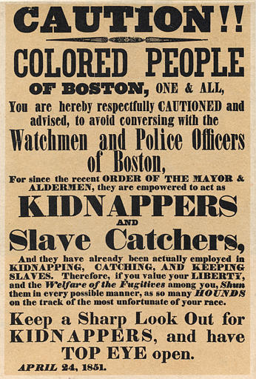

Slide 16
"The colored citizens of Philadelphia suffer very serious inconvenience and hardship, daily, by being excluded from riding in the city passenger cars . . . Colored people pay more taxes here than is paid by the same class in any other northern city.”
William Still, A Brief Narrative of the Struggle for the Rights of the Colored People of Philadelphia in the City Railway Cars (1862)

Slide 17
Big Question: What did citizenship mean in the early United States?
Objectives:
explore the uncertainty surrounding citizenship
examine lawmakers’ efforts to define citizenship in exclusionary ways
consider the work of African American activists to secure belonging and rights in the United States

Slide 18
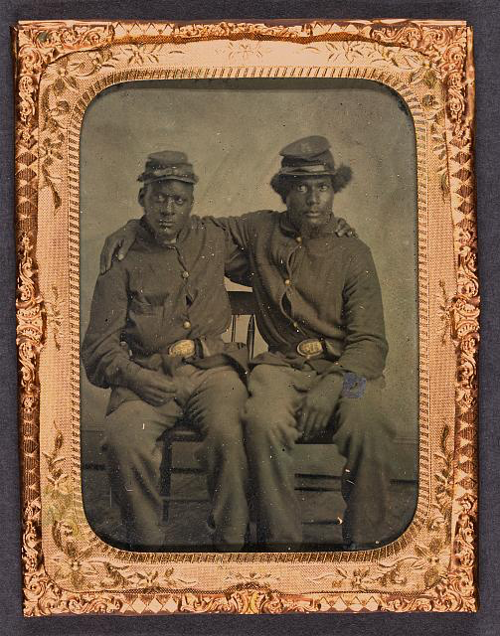

Slide 21
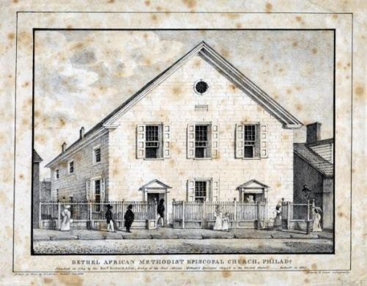
Bethel A.M.E., the nation’s second formally established African American church, founded in Philadelphia in 1794

Slide 22
The Colored American and its founding editor, Samuel Cornish

Slide 23
from the proceedings of the 1840 black state convention held in Troy, NY

Slide 24
Cornish urges black urbanites to embrace an agrarian lifestyle

Slide 25
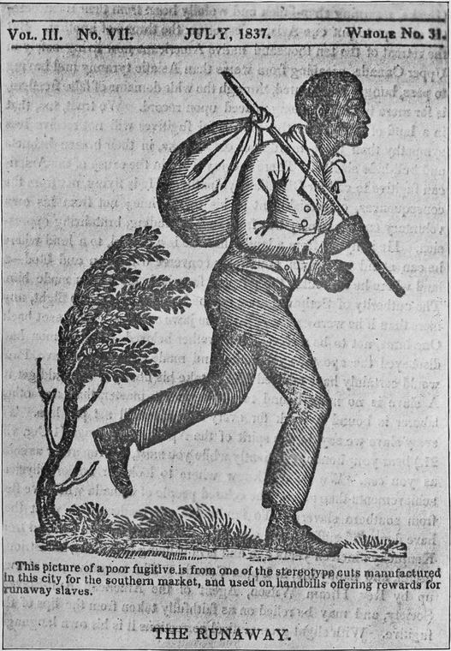

Slide 26
Selected Resources
- 1790 Naturalization Act: http://rs6.loc.gov/cgi-bin/ampage?collId=llsl&fileName=001/llsl001.db&recNum=226
-1792 Militia Act https://constitution.org/1-Activism/mil/mil_act_1792.htm
- Allen and Jones Narrative of the Yellow Fever Epidemic (1793) https://wellcomecollection.org/works/tx6drw63/items?langCode=eng&sierraId=b21133906&canvas=5

