Slide 1
Using Digital Humanities in the Classroom
Amy Earhart &
Roopika Risam

Slide 2
Hello!
Amy Earhart
Texas A&M University
aearhart@tamu.edu
Roopika Risam
Dartmouth College
roopika.risam@dartmouth.edu

Slide 3
1.What is Digital Humanities?
Broad field of scholarly inquiry
Creation, use and analysis of technologies
Develop open access scholarly materials
Develop open access tools for inquiry
https://en.wikipedia.org/wiki/Digital_humanities

Slide 4
2. Why Use Digital Humanities in the classroom?
FREE
Cutting edge materials for your students
Ready made lesson plans
Digital approaches engage students
Stairstep by cost and expertise
Add small pieces or large projects

Slide 5
Useful sources
Reviews in Digital Humanities, Curriculum and Pedagogy: https://reviewsindh.pubpub.org/curriculum-pedagogy
Digital Pedagogy in the Humanities: https://digitalpedagogy.mla.hcommons.org/keywords/
A Primer for Teaching Digital History: Ten Design Principles, Jennifer Guiliano: https://www.dukeupress.edu/a-primer-for-teaching-digital-history
.

Slide 6
Free resources!
There are many free resources to add digital content and tools to your classroom.
These can be added with only a teacher computer/projector so low cost and expertise.

Slide 7
TEKS
History:
To support the teaching of the essential knowledge and skills, the use of a variety of rich primary and secondary source material such as biographies, autobiographies, landmark cases of the U.S. Supreme Court, novels, speeches, letters, diaries, poetry, songs, and artworks is encouraged. Motivating resources are available from museums, historical sites, presidential libraries, and local and state preservation societies.

Slide 8
General Primary Sources
Humanities for All: https://humanitiesforall.org/
The Library of Congress: https://www.loc.gov/collections/
Stanford History Education Group: https://sheg.stanford.edu/
The Internet Archive: https://archive.org/
EdSite: https://edsitement.neh.gov/
American Yawp: http://www.americanyawp.com/reader.html

Slide 9
Texas focused digital materials
Texas History for Teachers: https://education.texashistory.unt.edu/
The Wittliff Collections: https://www.thewittliffcollections.txstate.edu/
Portal to Texas History: https://texashistory.unt.edu/
Arte Publico Press: https://artepublicopress.com/projects/
Sharing Stories 1977: https://sharingstories1977.uh.edu/
Llilas Benson Collection: http://curriculum.llilasbenson.utexas.edu/
Texas Slavery Project: http://www.texasslaveryproject.org/
Handbook of Texas: https://www.tshaonline.org/handbook
The Texas Freedom Colony project: https://www.thetexasfreedomcoloniesproject.com/
Texas Folklife: https://guides.loc.gov/texas-folklife

Slide 10
OER Textbooks
https://libguides.libraries.wsu.edu/affordablelearning/opentextbooks
https://www.oercommons.org/hubs/open-textbooks.
https://pressbooks.com/our-products/
https://oer.pressbooks.pub/informedarguments/
https://oer.pressbooks.pub/howdyorhello/

Slide 11
Teaching & Assignment Ideas
Teacher Computer & Projector Only

Slide 12
TEKS: English
Developing and sustaining foundational language skills: listening, speaking, reading, writing, and thinking--vocabulary. The student uses newly acquired vocabulary expressively. The student is expected to:
(A) use print or digital resources to clarify and validate understanding of multiple meanings of advanced vocabulary;
(B) analyze context to draw conclusions about nuanced meanings such as in imagery

Slide 13
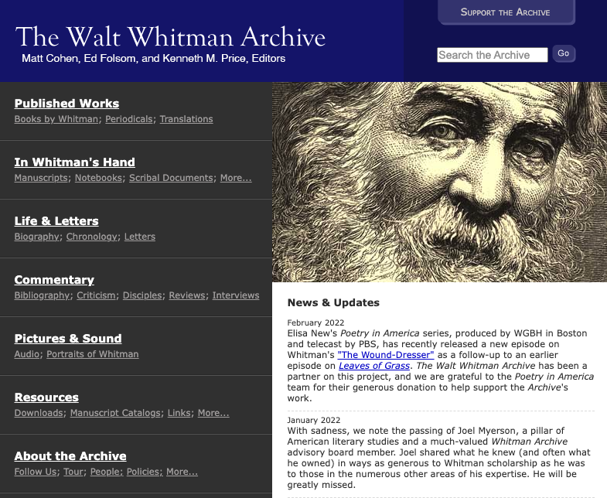
How do I USe free resources In My classroom?
Have students examine the physical copy of the first edition of The Leaves of Grass.
https://whitmanarchive.org/

Slide 14
TEKS: History
The student understands how historians use historiography to interpret the past and applies critical-thinking skills to organize and use information acquired from a variety of valid sources, including technology. The student is expected to:
(A) analyze primary and secondary sources such as maps, graphs, speeches, political cartoons, and artifacts to acquire information to answer historical questions;
(B) analyze information by applying absolute and relative chronology through sequencing, categorizing, identifying cause-and-effect relationships, comparing and contrasting, finding the main idea, summarizing, making generalizations, making predictions, drawing inferences, and drawing conclusions;
(C) apply the process of historical inquiry to research, interpret, and use multiple types of sources of evidence;
(D) evaluate the validity of a source based on corroboration with other sources and information about the author, including points of view, frames of reference, and historical context; and
(E) identify bias and support with historical evidence a point of view on a social studies issue or event.

Slide 15
How do I USe free resources In My classroom?
Cabeza De Vaca
Examine images of frontpiece and proem from the 1555 edition. See: https://exhibits.library.txstate.edu/cabeza/
Questions for students:
What does the image tell us about De Vaca’s text and his position as a writer?
What might we understand about how this book was to be used?

Slide 16
TEKS: History
Social studies skills. The student uses geographic tools to collect, analyze, and interpret data. The student is expected to:
(A) create a visual representation of historical information such as thematic maps, graphs, and charts; and
(B) pose and answer questions about geographic distributions and patterns shown on maps, graphs, charts, and available databases.
(31) Social studies skills. The student uses problem-solving and decision

Slide 17
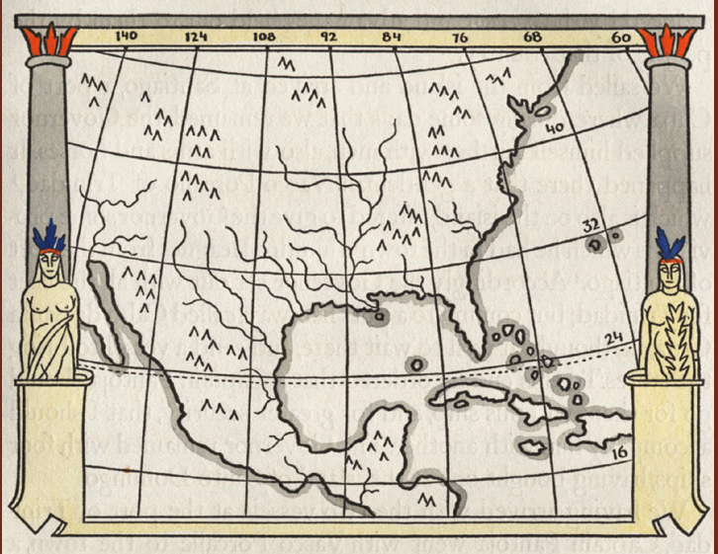
How do I USe free resources In My classroom?
Cabeza de Vaca, Routes
When you look at the maps of possible routes how do they help us to understand the impact of the geography on de Vaca?
https://exhibits.library.txstate.edu/cabeza/exhibits/show/cabeza-de-vaca/further-study/the-route
https://www.texasbeyondhistory.net/cabeza-cooking/encounters.html
https://www.humanitiestexas.org/programs/tx-originals/list/alvar-nunez-cabeza-de-vaca

Slide 18
TEKS: History
Culture.
The student understands the relationship between the arts and the times during which they were created. The student is expected to:
(A) describe how the characteristics of and issues in U.S. history have been reflected in various genres of art, music, film, and literature;
(B) describe the impacts of cultural movements in art, music, and literature such as Tin Pan Alley, the Harlem Renaissance, the Beat Generation, rock and roll, the Chicano Mural Movement, and country and western music on American society; and
(C) identify and analyze the global diffusion of American culture through various media.

Slide 19
TEKS: English
Multiple genres: listening, speaking, reading, writing, and thinking using multiple texts--genres. The student recognizes and analyzes genre-specific characteristics, structures, and purposes within and across increasingly complex traditional, contemporary, classical, and diverse texts. The student is expected to:
(A) read and analyze American literature across literary periods;
(B) analyze relationships among characteristics of poetry, including stanzas, line breaks, speaker, and sound devices in poems across a variety of poetic forms;
(C) analyze how the relationships among dramatic elements advance the plot;

Slide 20
How do I use free resources to my classroom?
Corridos could be useful in helping students understand poetry.
Possible Assignments:
What form does a corrido take? Stanzas? Rhyme scheme?
Create your own corrido
https://folkways.si.edu/lesson/corridos/music-as-storytelling-and-historical-record
https://blogs.loc.gov/teachers/2018/10/corridos-at-the-library-of-congress-spurring-creativity-while-studying-hispanic-heritage/

Slide 21
How do I use free resources to my classroom?
Some other ideas:
A history class might look at El Corrido de Gregorio Cortez to have students discuss how cross border conflict shaped the early 20th century Texas.
You might use several corridos to discuss representations of the Texas borderlands.
A literature class might look at various versions of a corrido to talk about how a living text shifts over time.
https://www.tshaonline.org/handbook/entries/el-corrido-de-gregorio-cortez
https://blogs.loc.gov/folklife/2015/09/corridos-of-the-border/

Slide 22
How do I use free resources to my classroom?
Additional materials for teaching corridos:
https://www.thestoryoftexas.com/visit/exhibits/life-and-death-on-the-border-1910-1920/musica-tejana
https://www.tshaonline.org/handbook/entries/corridos

Slide 23
Teaching & Assignment Ideas
Teacher Computer & Projector Only
Student Handheld Devices or Laptops

Slide 24
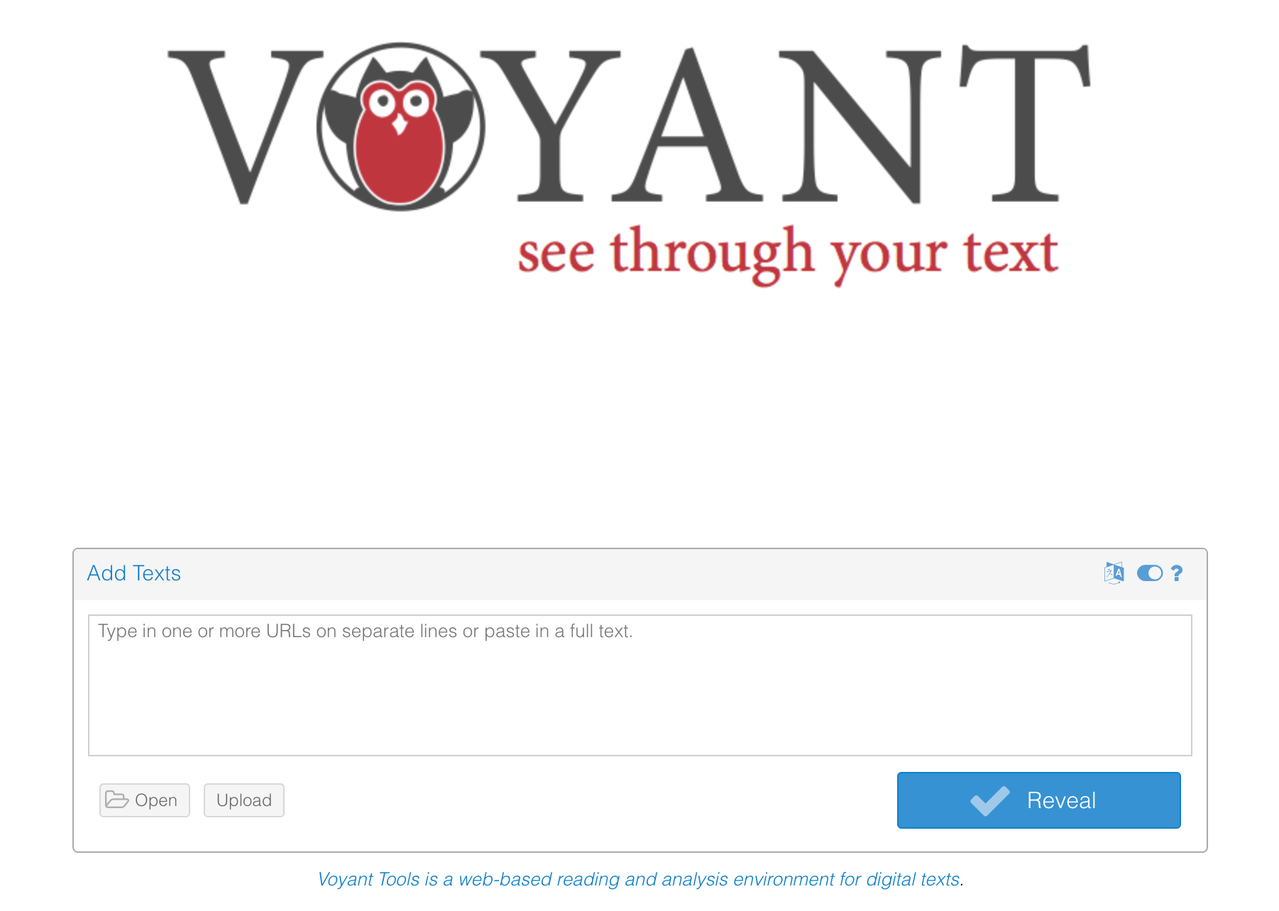
Voyant https://voyant-tools.org/

Slide 25
Voyant for analysis
The U.S. Constitution:
https://www.senate.gov/civics/constitution_item/constitution.htm
Frederick Douglass, “What to the Slave is the fourth of July” :
https://www.americanyawp.com/reader/democracy-in-america/frederick-douglass-what-to-the-slave-is-the-fourth-of-july-1852/

Slide 26
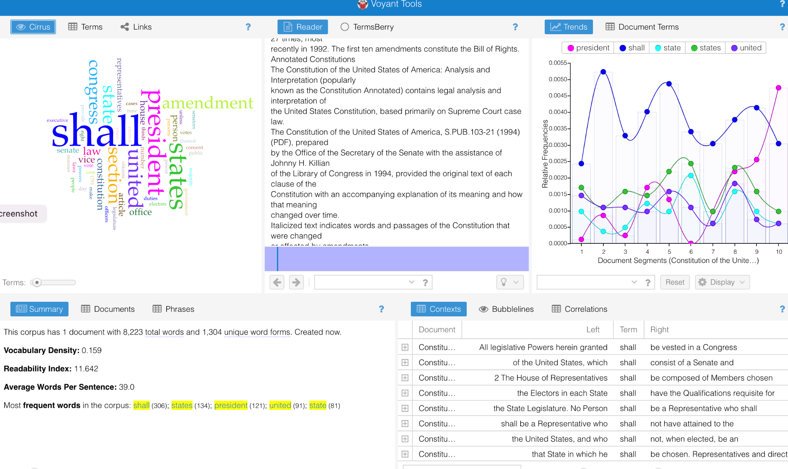
https://www.senate.gov/civics/constitution_item/constitution.htm

Slide 27
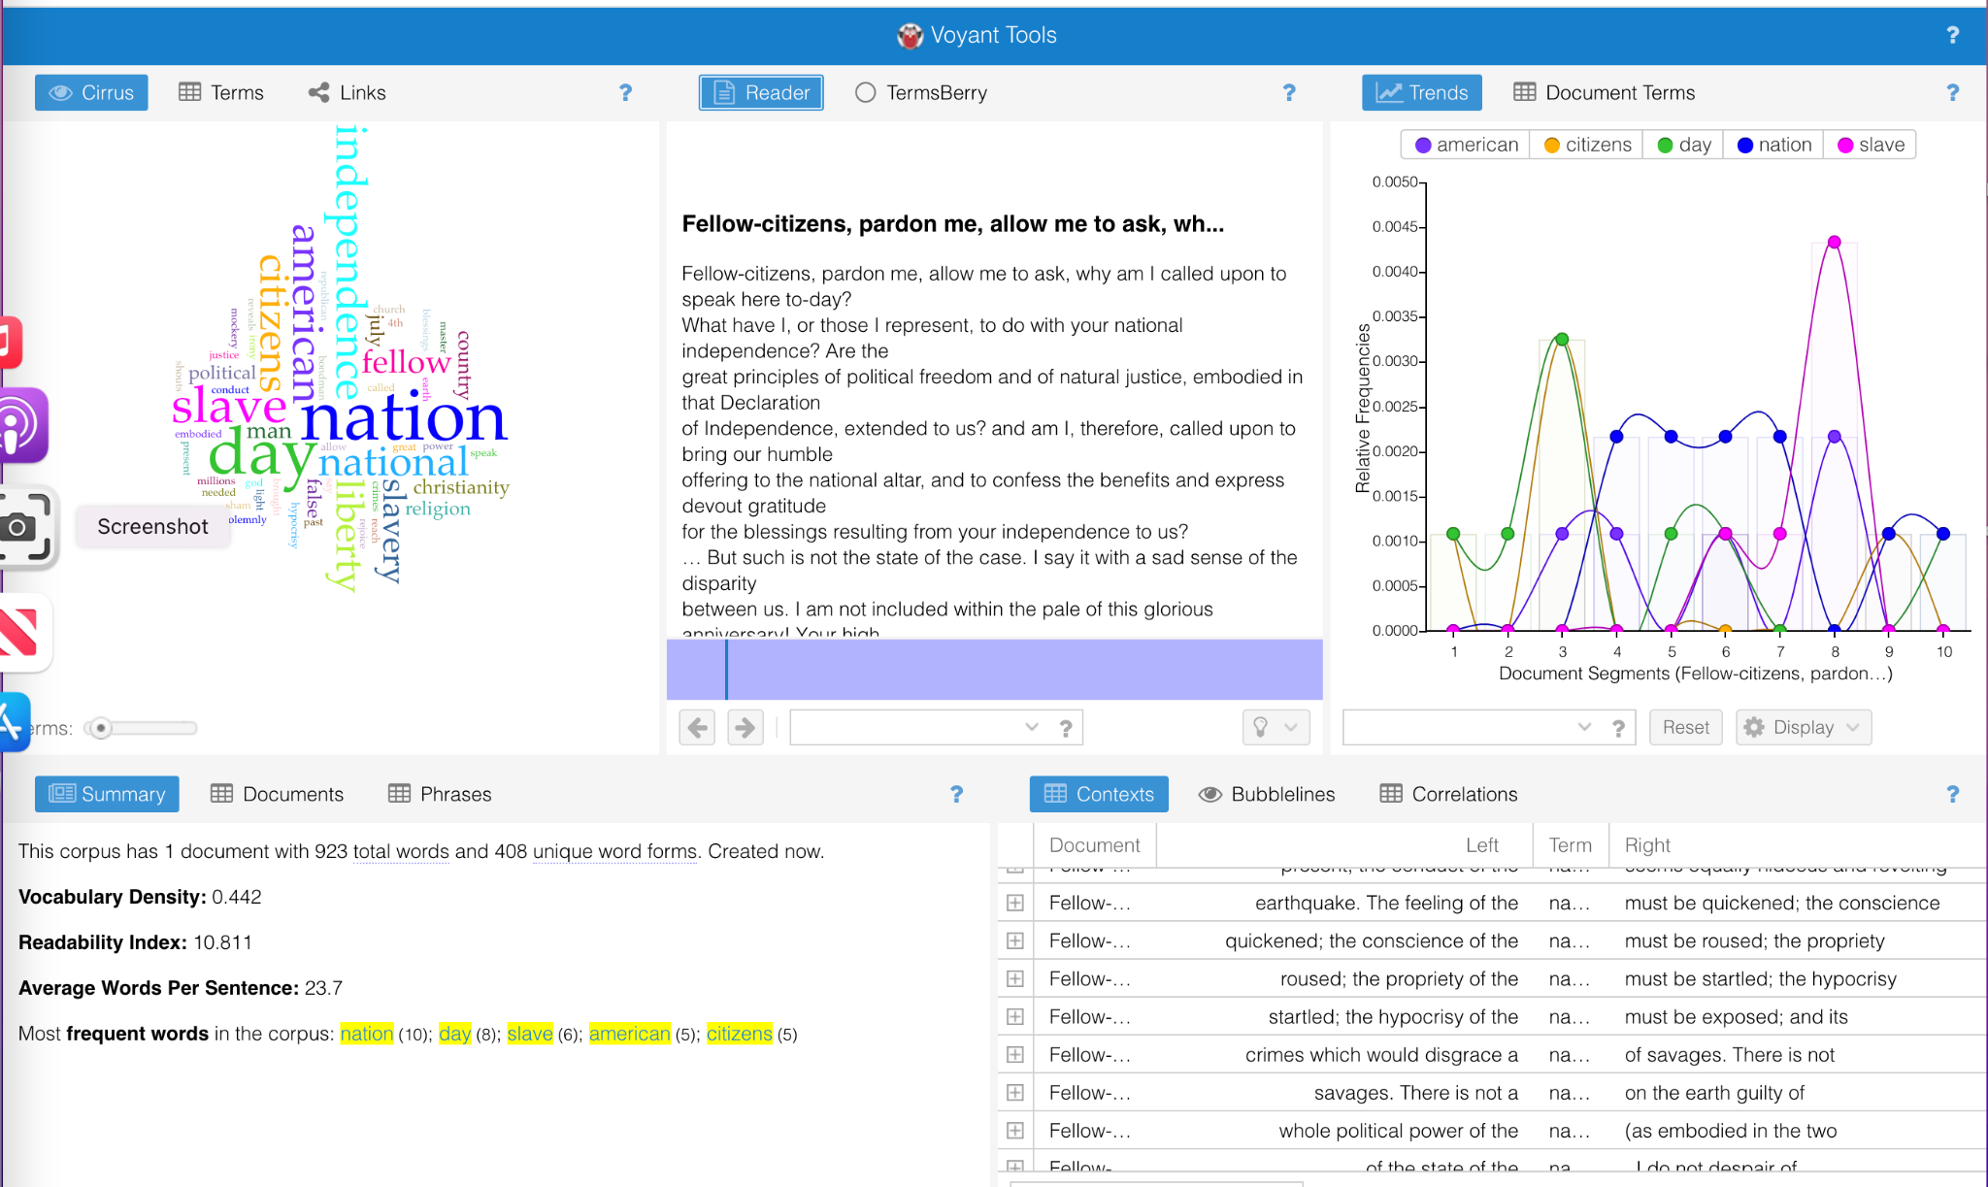
https://www.americanyawp.com/reader/democracy-in-america/frederick-douglass-what-to-the-slave-is-the-fourth-of-july-1852/

Slide 28
Voyant for revision
Notes:
Turn stop words on and off.

Slide 29
Activity (Groups of 4-6)
Choose one of the suggested activities. Work together to come up with a lesson plan that you could implement in your classroom. Discuss what technology would be needed to pull off the class.
Select someone to add notes to the shared Google drive page.
Select a spokesperson to report back to the group.

Slide 30
Maps and Timelines!
There are many free resources for incorporating spatio-temporal literacy into your teaching.
These can be added with only a teacher computer and a projector — low cost, technical expertise not required — or used for assignments if students have access to devices.

Slide 31
1. Why Maps and Timelines?
Everyone (students too!) loves maps and timelines.
Spatio-temporal literacy and geography are critical skills to help our students develop alongside their digital literacy skills.
Maps and timelines can help students understand the relationship between geography, time, and history, literature, art, music, and other forms of culture, while informing their analysis.
There are tons of freely-available maps and timelines to explore — and tools that allow students to make their own.

Slide 32
Teaching & Assignment Ideas
Teacher Computer & Projector Only

Slide 33
TEKS - English Language Arts (Interpretation/Analysis)
(8) Author's purpose and craft: listening, speaking, reading, writing, and thinking using multiple texts. The student uses critical inquiry to analyze the authors' choices and how they influence and communicate meaning within a variety of texts. The student analyzes and applies author's craft purposefully in order to develop his or her own products and performances. The student is expected to:
(A) analyze the author's purpose, audience, and message within a text;
(B) analyze use of text structure to achieve the author's purpose;
(C) evaluate the author's use of print and graphic features to achieve specific purposes;

Slide 34
TEKS - Social Studies
(3) To support the teaching of the essential knowledge and skills, the use of a variety of rich primary and secondary source material such as state papers, legal documents, charters, constitutions, biographies, autobiographies, speeches, letters, literature, music, art, and architecture is encouraged. Motivating resources are available from museums, art galleries, and historical sites.

Slide 35
TEKS - Social Studies
(2) Social studies skills. The student applies critical-thinking skills to organize and use information acquired from a variety of valid sources, including electronic technology. [...]
(E) collect visual images (photographs, paintings, political cartoons, and other media) to enhance understanding and appreciation of multiple perspectives in a social studies topic;
(F) identify bias in written, oral, and visual material; [...]
(H) use appropriate mathematical skills to interpret social studies information such as maps and graphs.

Slide 36
TEKS - Social Studies - Content Example
(c)(E) identify major causes and describe the major effects of the following important turning points in world history from 1750 to 1914: the Scientific Revolution, the Industrial Revolution and its impact on the development of modern economic systems, European imperialism, and the Enlightenment's impact on political revolutions;

Slide 37
How to Blow Students’ Minds with Maps
Explain that while they think of maps as neutral — or even scientific — depictions of space, they are actually representations.
Show them the “Gail-Peters” Project clip from The West Wing (0:00-2:18) https://www.youtube.com/watch?v=vVX-PrBRtTY
Prompt them to analyze how maps reflect socio-political forces:
Octopus maps: https://www.popsci.com/article/technology/brief-history-octopi-taking-over-world/
Colonial Maps: https://scholarblogs.emory.edu/postcolonialstudies/2014/06/21/maps-in-colonialism/

Slide 38
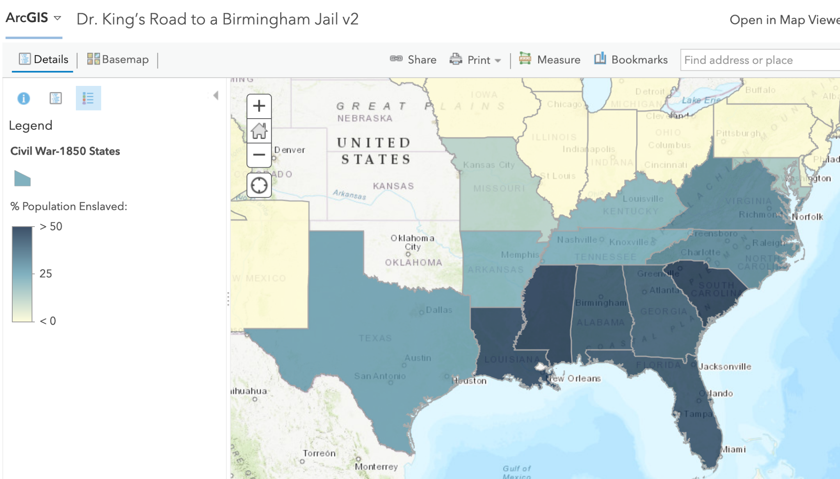
Dr. King’s Road to a Birmingham Jail
A standards-based lesson for Martin Luther King’s “A Letter from Birmingham Jail” by ESRI GeoInquiries
https://www.esri.com/content/dam/esrisites/en-us/media/fliers/geoinquiries/american-lit/12-mlk-jail.pdf

Slide 39
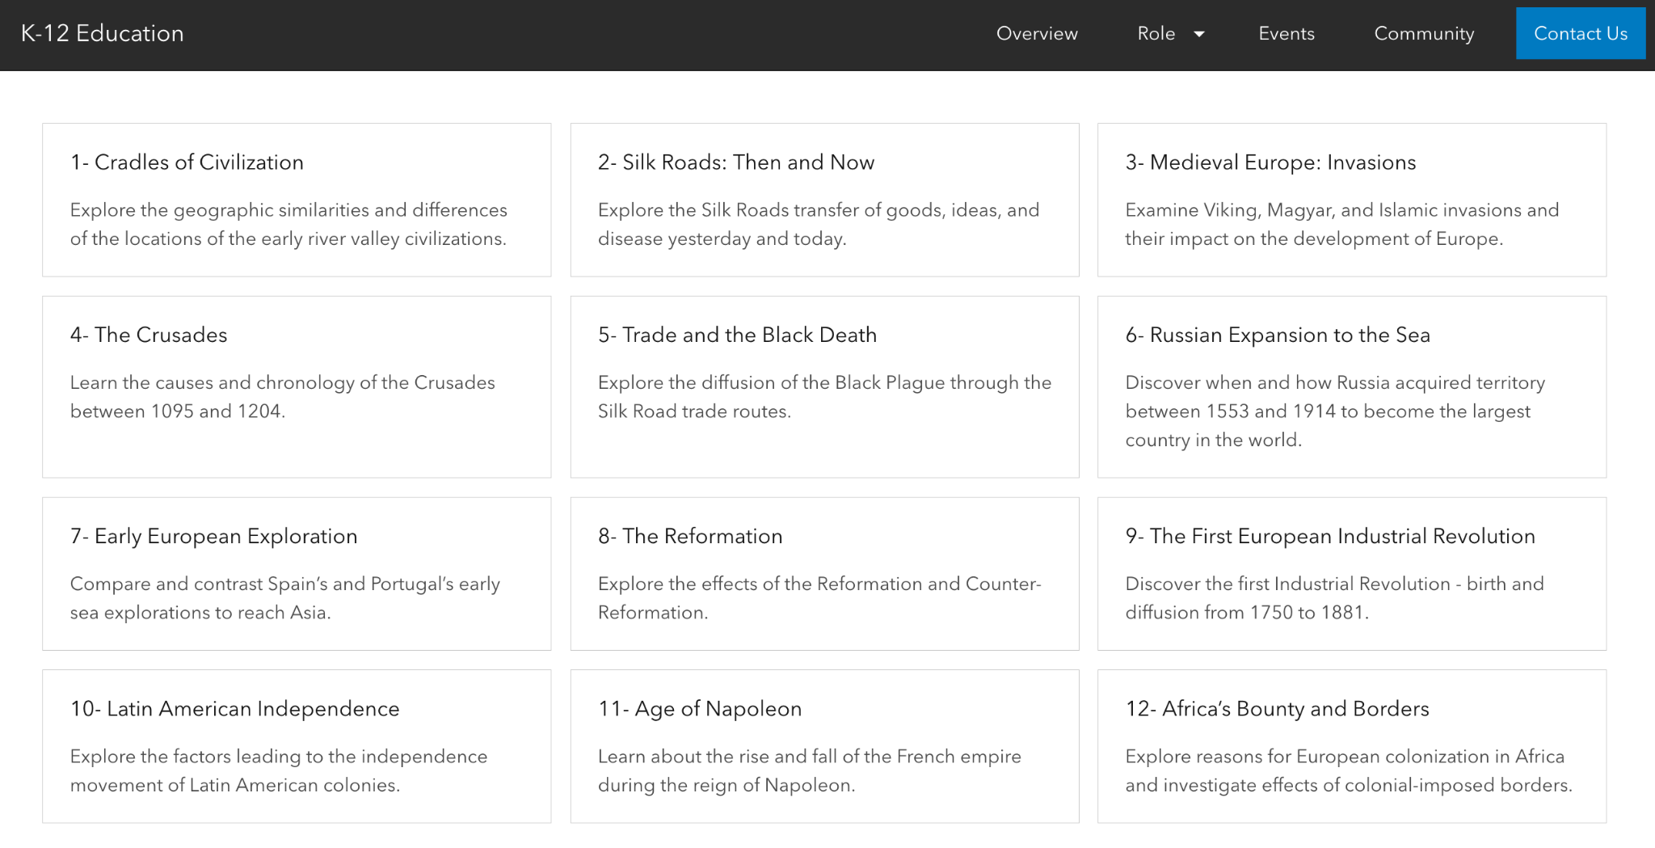
ESRI Geoinquiries
The ESRI GeoInquiries Collection covers lots of topics and disciplines!
https://www.esri.com/en-us/industries/k-12-education/geoinquiries?rsource=https%3A%2F%2Fwww.esri.com%2Fen-us%2Findustries%2Feducation%2Fschools%2Fgeoinquiries-collections

Slide 40
Exploring Texas Cattle Trails
A ready-made lesson in StoryMaps and an exemplar of how teachers can use StoryMaps as a teaching tool in class
https://tage.maps.arcgis.com/apps/MapJournal/index.html?appid=c4039e664981444da829a4ffbce5ed43

Slide 41
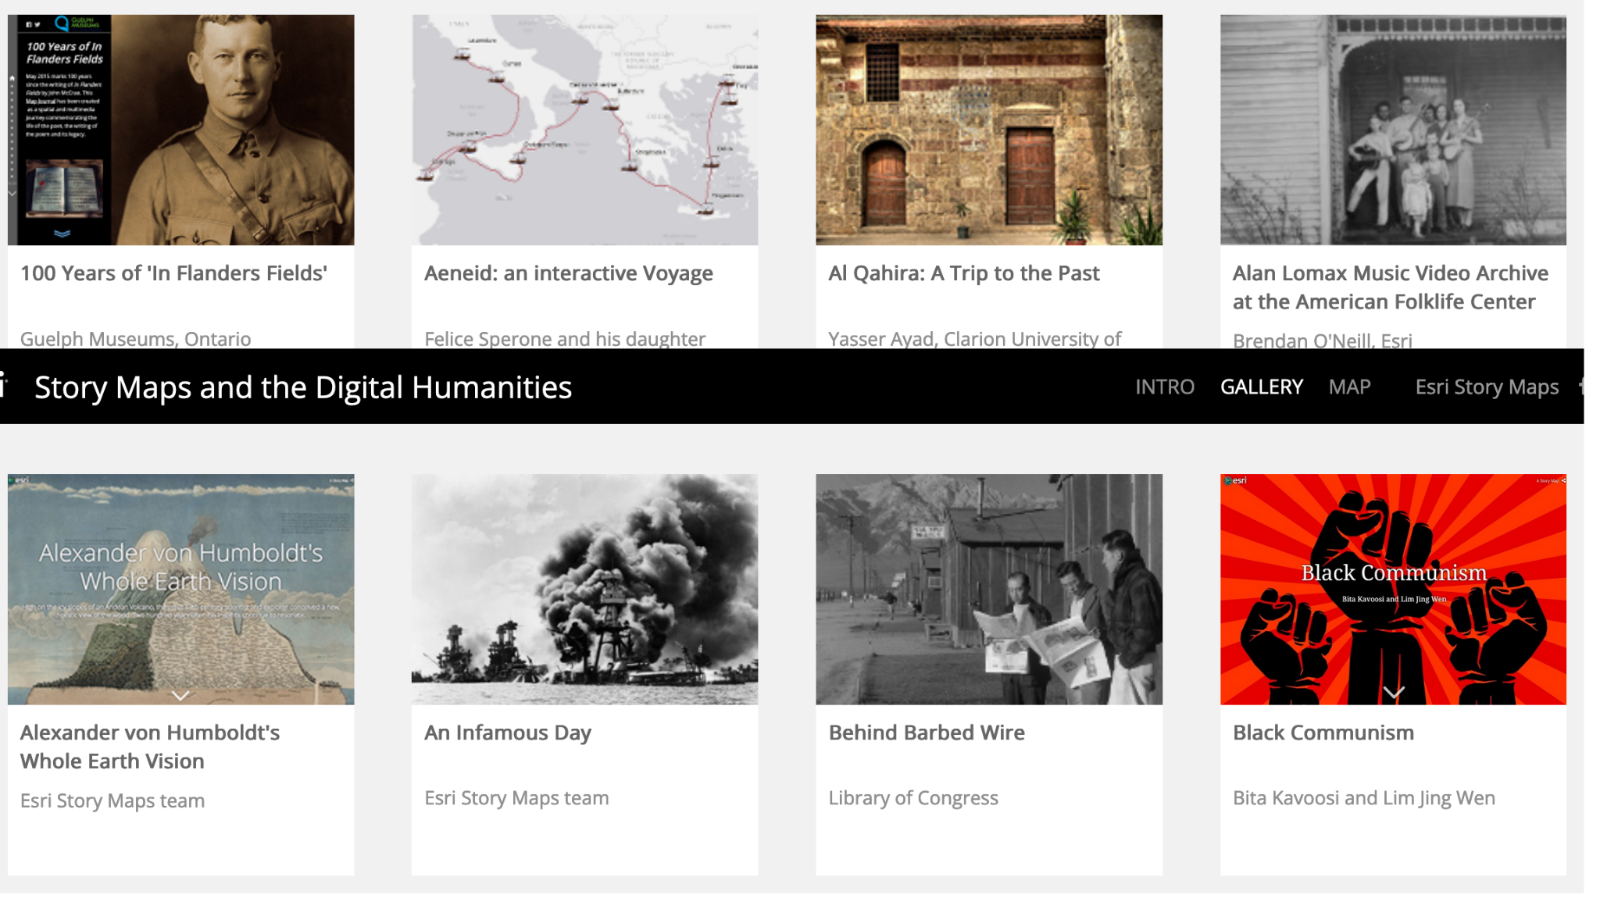
StoryMaps and Digital Humanites Gallery
The StoryMaps Digital Humanities Gallery has tons of additional maps that may be useful!
https://collections.storymaps.esri.com/humanities/

Slide 42
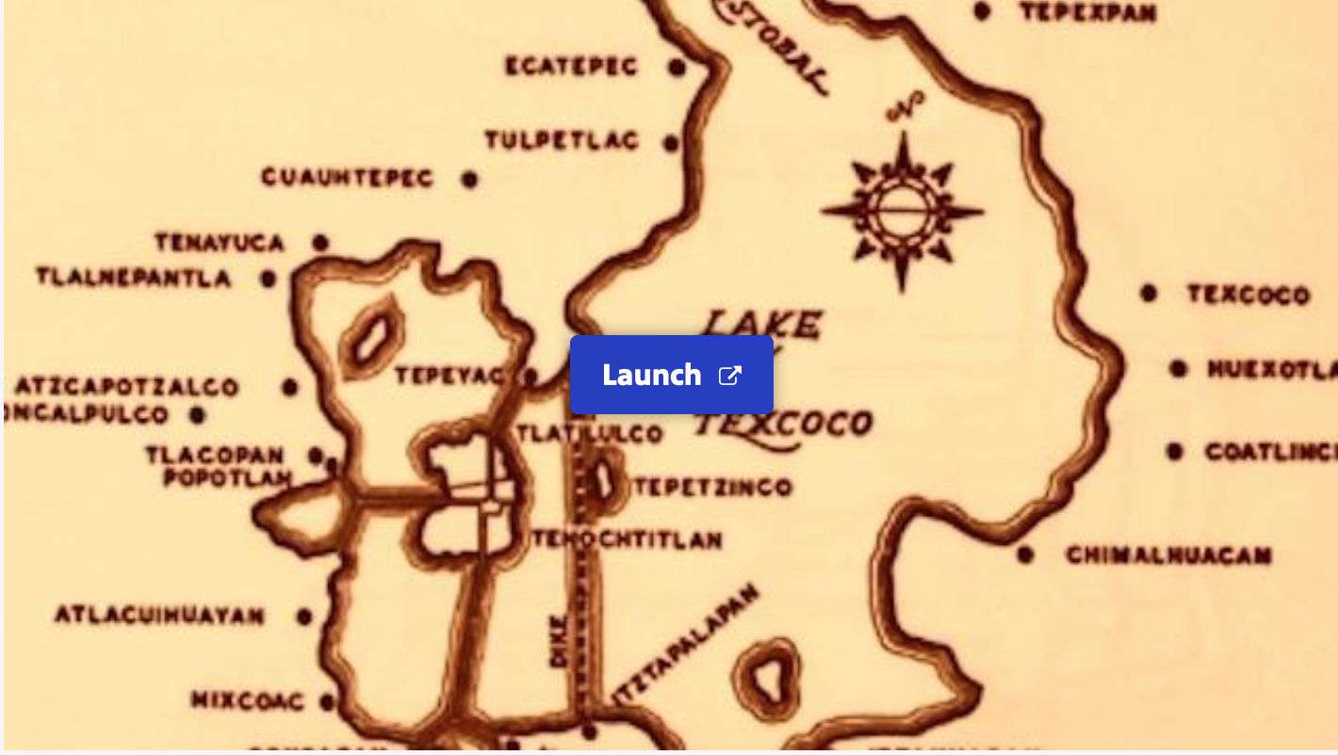
Exploring Borderlands
An standards-based interactive with timeline
https://mass.pbslearningmedia.org/resource/314ffbd6-e405-44da-ae01-c15da678557d/exploring-borderlands-american-passages-timeline/

Slide 43
PBS Learning Media
PBS Learning Media has lots of lessons, interactives, and galleries with teaching tips
https://mass.pbslearningmedia.org/subjects/social-studies/

Slide 44
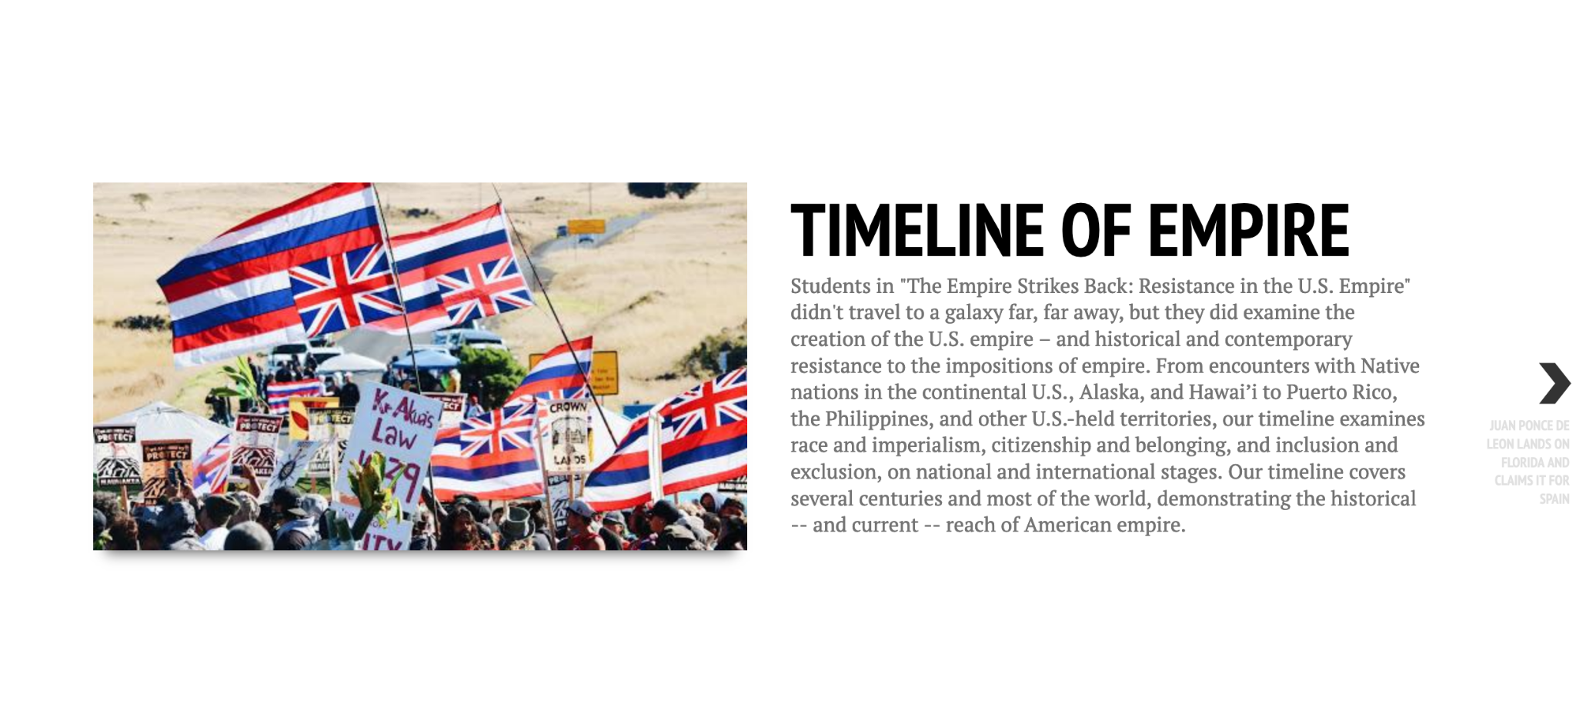
Timeline of Empire
Student-created timeline of U.S. imperialism using Timeline.Js
https://cdn.knightlab.com/libs/timeline3/latest/embed/index.html?source=1FoRrZY6Kn6SzKMtNqchmuRm7pFOqaRrrmZGY1hd8iF8&font=Default&lang=en&initial_zoom=2&height=1000

Slide 45
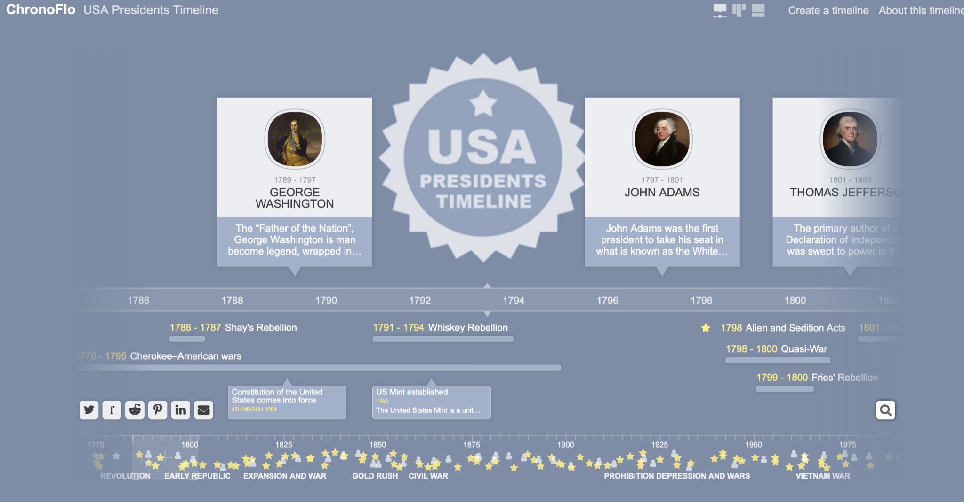
USA presidents
Timeline of US presidents created in Tiki-Toki
https://www.chronoflotimeline.com/timeline/shared/3114/USA-Presidents-Timeline/

Slide 46
Teaching & Assignment Ideas
Student Devices

Slide 47
TEKS - English Language Arts (Composition)
(10) Composition: listening, speaking, reading, writing, and thinking using multiple texts--genres. The student uses genre characteristics and craft to compose multiple texts that are meaningful. The student is expected to: [...]
(B) compose informational texts such as explanatory essays, reports, resumes, and personal essays using genre characteristics and craft;
(C) compose argumentative texts using genre characteristics and craft;
Great opportunity for ELA collaboration with a history class!

Slide 48
TEKS - English Language Arts (Composition)
(11) Inquiry and research: listening, speaking, reading, writing, and thinking using multiple texts. The student engages in both short-term and sustained recursive inquiry processes for a variety of purposes. The student is expected to:
(A) develop questions for formal and informal inquiry;
(B) critique the research process at each step to implement changes as needs occur and are identified;
(C) develop and revise a plan;
(D) modify the major research question as necessary to refocus the research plan;

Slide 49
TEKS - English Language Arts (Composition)
(E) locate relevant sources;
(F) synthesize information from a variety of sources;
(G) examine sources for:
(i) credibility, bias, and accuracy; and
(ii) faulty reasoning such as straw man, false dilemma, faulty analogies, and non-sequitur;
(H) display academic citations, including for paraphrased and quoted text, and use source materials ethically to avoid plagiarism; and
(I) use an appropriate mode of delivery, whether written, oral, or multimodal, to present results.

Slide 50
T
African Imperialism and Map Analysis
Map-based inquiry assignment that can be done in groups to explore the history of imperialism in Africa
http://www.wroskills.org/african-imperialism-and-map-analysis.htm

Slide 51
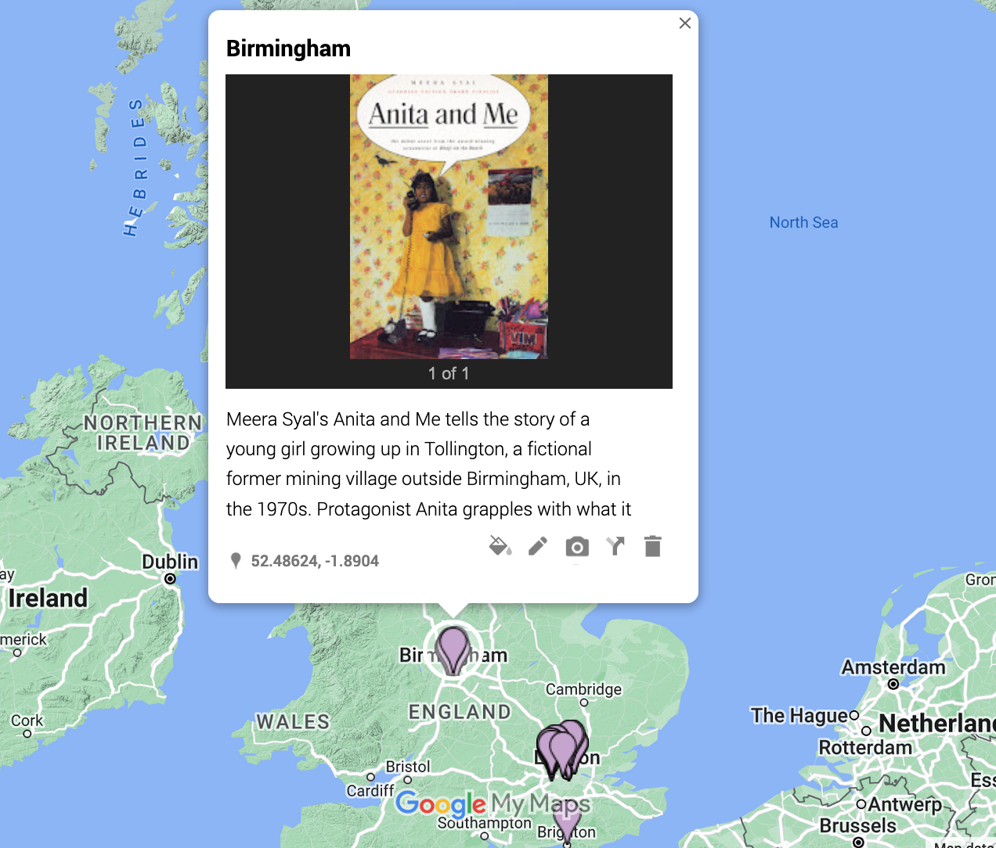
Google My Maps
Using Google My Maps, students can drop pins in locations and add text, image, and video for context
https://mymaps.google.com

Slide 52
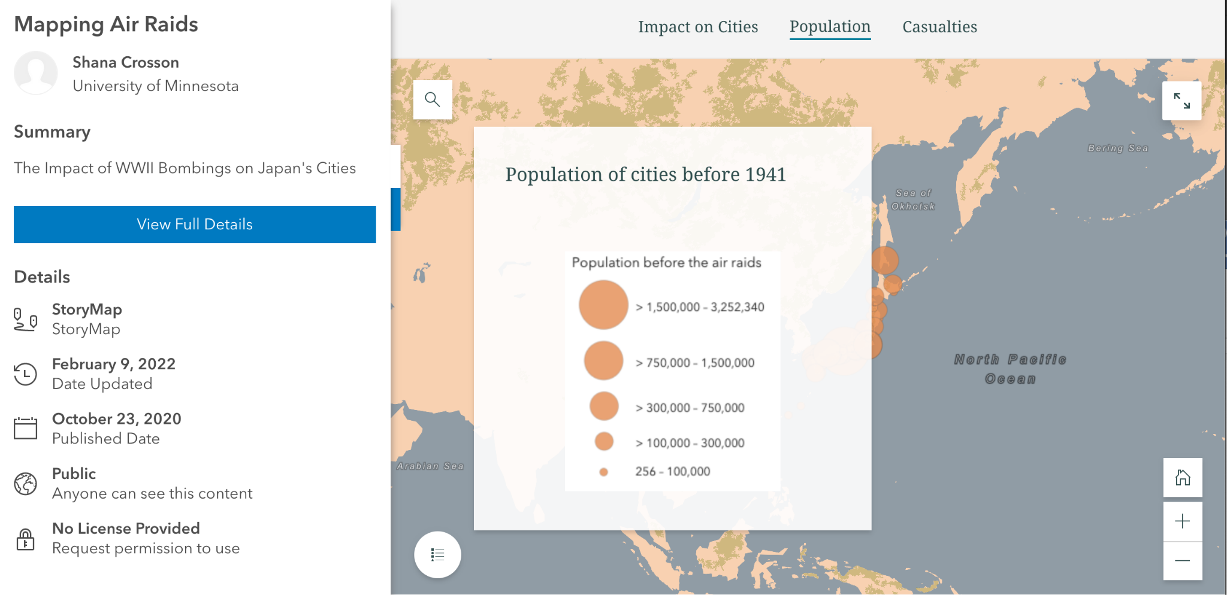
StoryMaps
Using StoryMaps, students can assemble image, text, video, and location into a linear narrative
https://storymaps.arcgis.com

Slide 53
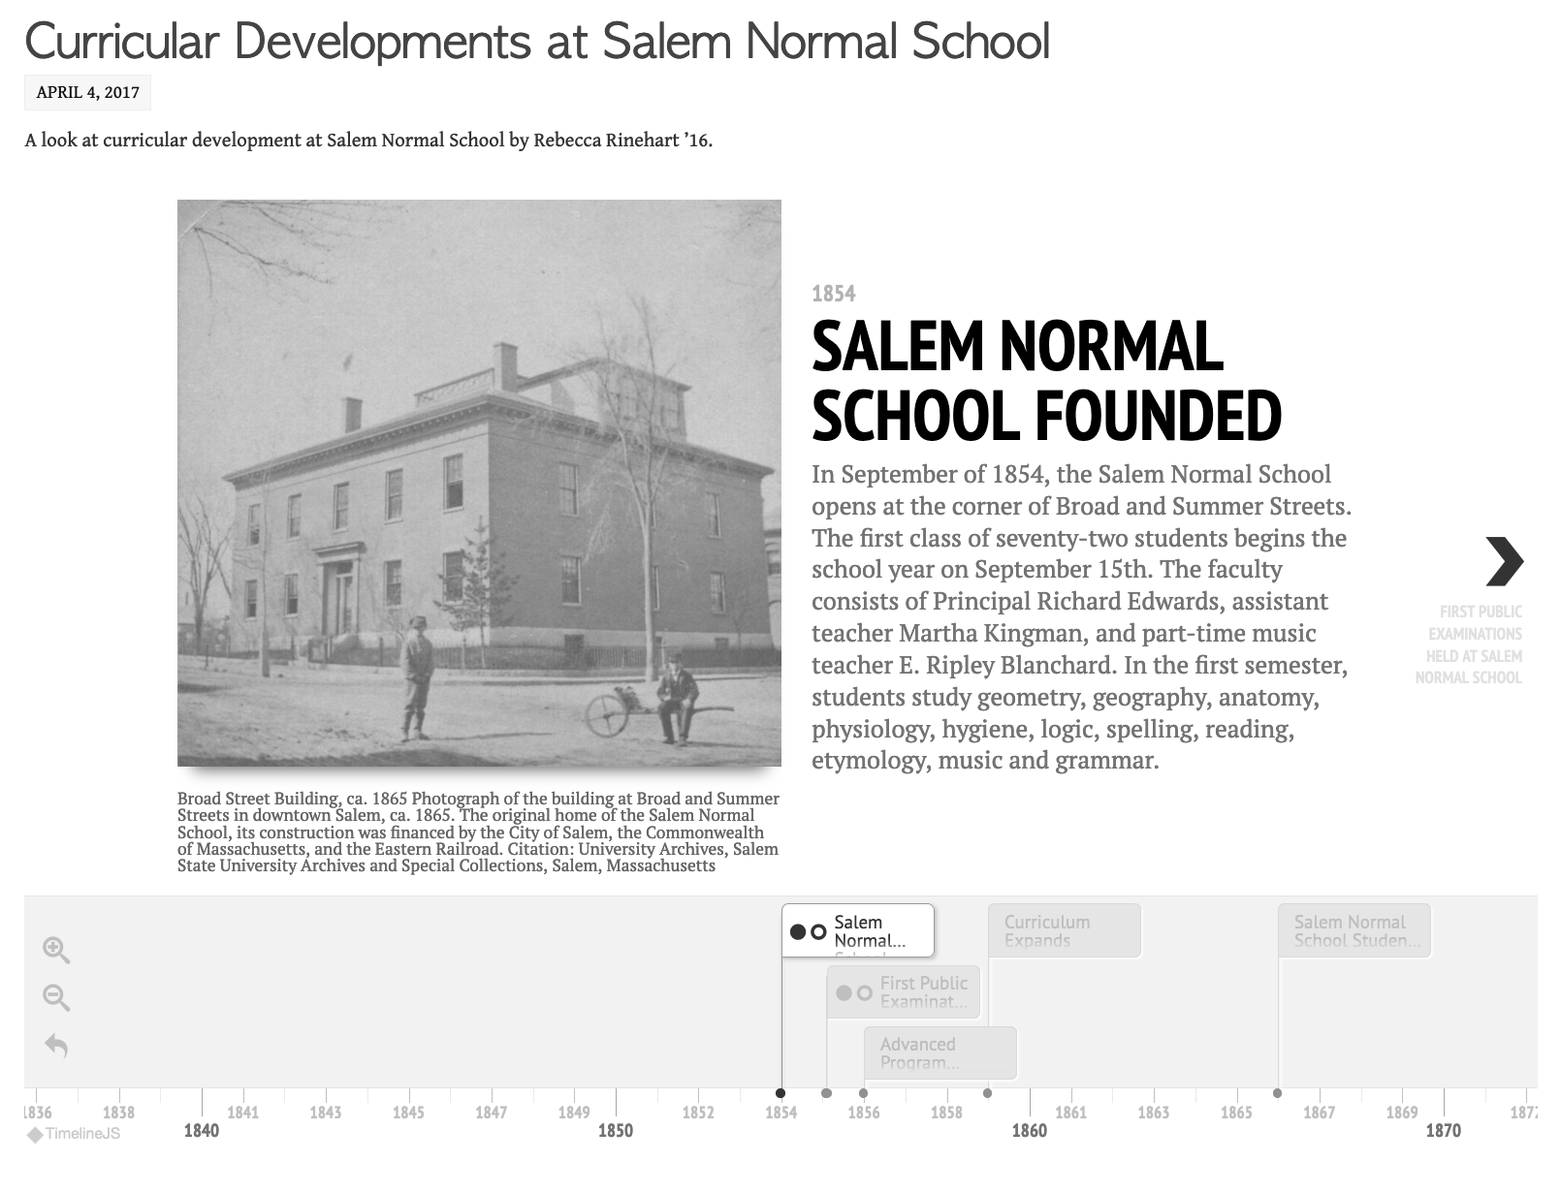
Timeline.JS
Using Timeline.Js, students enter timeline events and images into a Google Sheet, which then becomes a timeline
https://timeline.knightlab.com/

Slide 54
Freely available Resources - Teacher Computer & Projector
Teaching Social Studies with Digital Maps https://gato-docs.its.txstate.edu/jcr:c9d6f5c0-c089-41f2-952b-aecc94710543/Draft%20THECB_AGO%20Lessons%20201606.pdf
American Geographical Society Library Digital Map Collection https://uwm.edu/lib-collections/agsl-digital-map-collection/
Old Maps of Texas https://uwm.edu/lib-collections/agsl-digital-map-collection/
Teaching at Every Level with Data Rich Maps https://blog.tcea.org/data-rich-digital-maps/

Slide 55
Freely available MapPing Resources - Student Devices
National Geographic Classroom Resources - Mapping https://www.nationalgeographic.org/education/classroom-resources/mapping
Google for Education - Create a Community Map https://applieddigitalskills.withgoogle.com/c/middle-and-high-school/en/create-a-community-my-map/overview.html
5 Digital Mapping Activities https://www.freetech4teachers.com/2020/10/5-digital-mapping-activities.html
StoryMap Assignment https://www.tngeographicalliance.org/uploads/7/7/3/8/7738447/storymapassignment.docx.pdf
StoryMap Resources for the Classroom https://storymaps.arcgis.com/collections/a3aa4a87372b4de7a3b3a23c1778f

Slide 56
Freely available MapPing Resources - Student Devices
How to Make a Timeline with Timeline.JS https://edtech.domains.trincoll.edu/how-to-make-a-timeline-with-timeline-js/
Timeline and Mapping Experiment https://canvas.northwestern.edu/courses/94647/assignments/566929
Collaborative Digital Projects in the Undergraduate Humanities Classroom: Case Studies with TimelineJS https://jitp.commons.gc.cuny.edu/classroom-timeline-projects/
Skill Assignment #3: Timeline http://amanda-regan.com/390summer19/skill3/
20 Ways Google My Maps Can Enhance Lessons in Any Class https://ditchthattextbook.com/20-ways-google-mymaps-can-enhance-lessons-in-any-class/

Slide 57
Activity (Groups of 3-4)
Pick a StoryMap or Timeline.Js and discuss how you would use it in a class with just a teacher computer/projector.
Design an assignment in which students would create a StoryMap or Timleine.JS. This could be based on reverse engineering one you like or picking a topic of your own:
What kind of research or writing would students need to do?
How many locations or events will they select? How many images will they need? What kinds of sources should they use?
How would you chunk or scaffold the assignment?
Time permitting: start playing around with StoryMaps or Timeline.JS
Share out: what is 1 insight or 1 question that emerged in your group?

