Slide 1
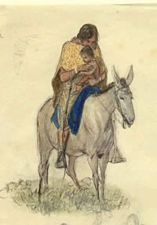
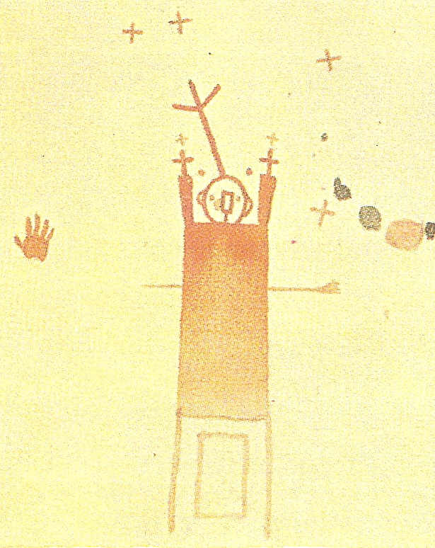
Texas Indians & the Power of Maps
Juliana Barr
University of Florida

Slide 2
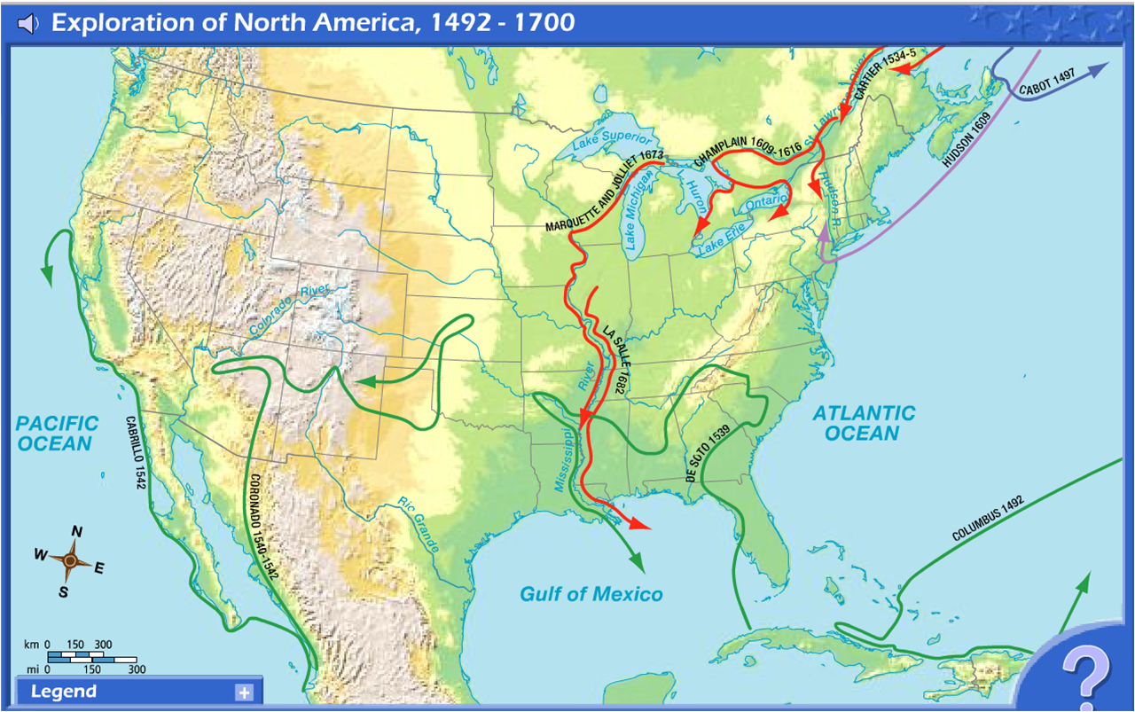

Slide 3
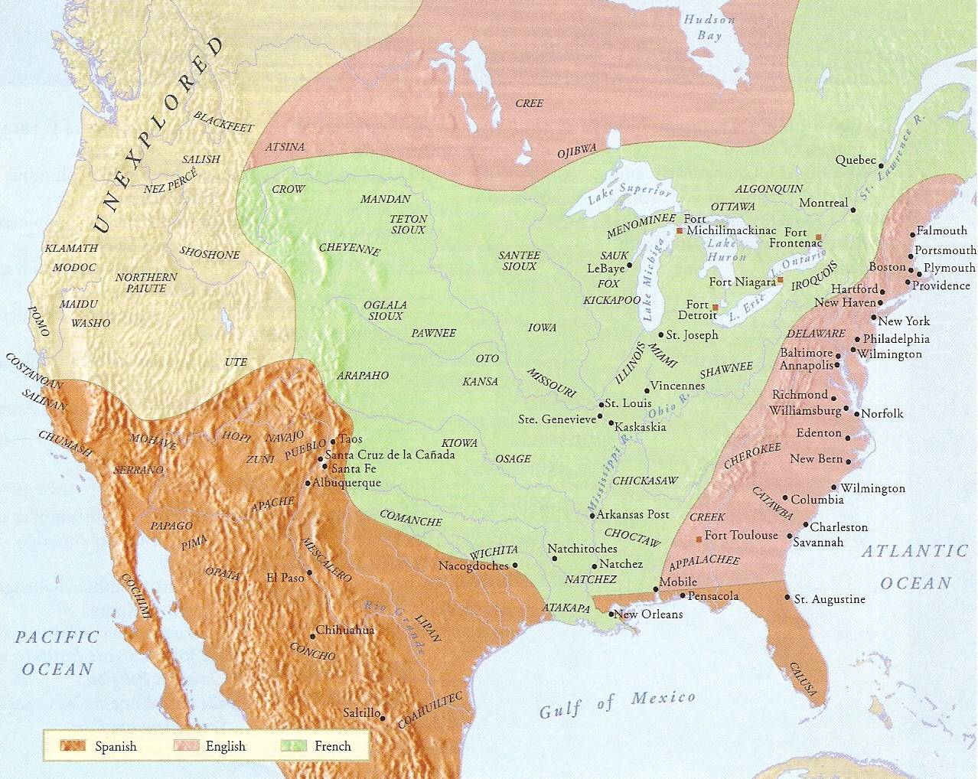
The limits and claims of European exploration

Slide 4
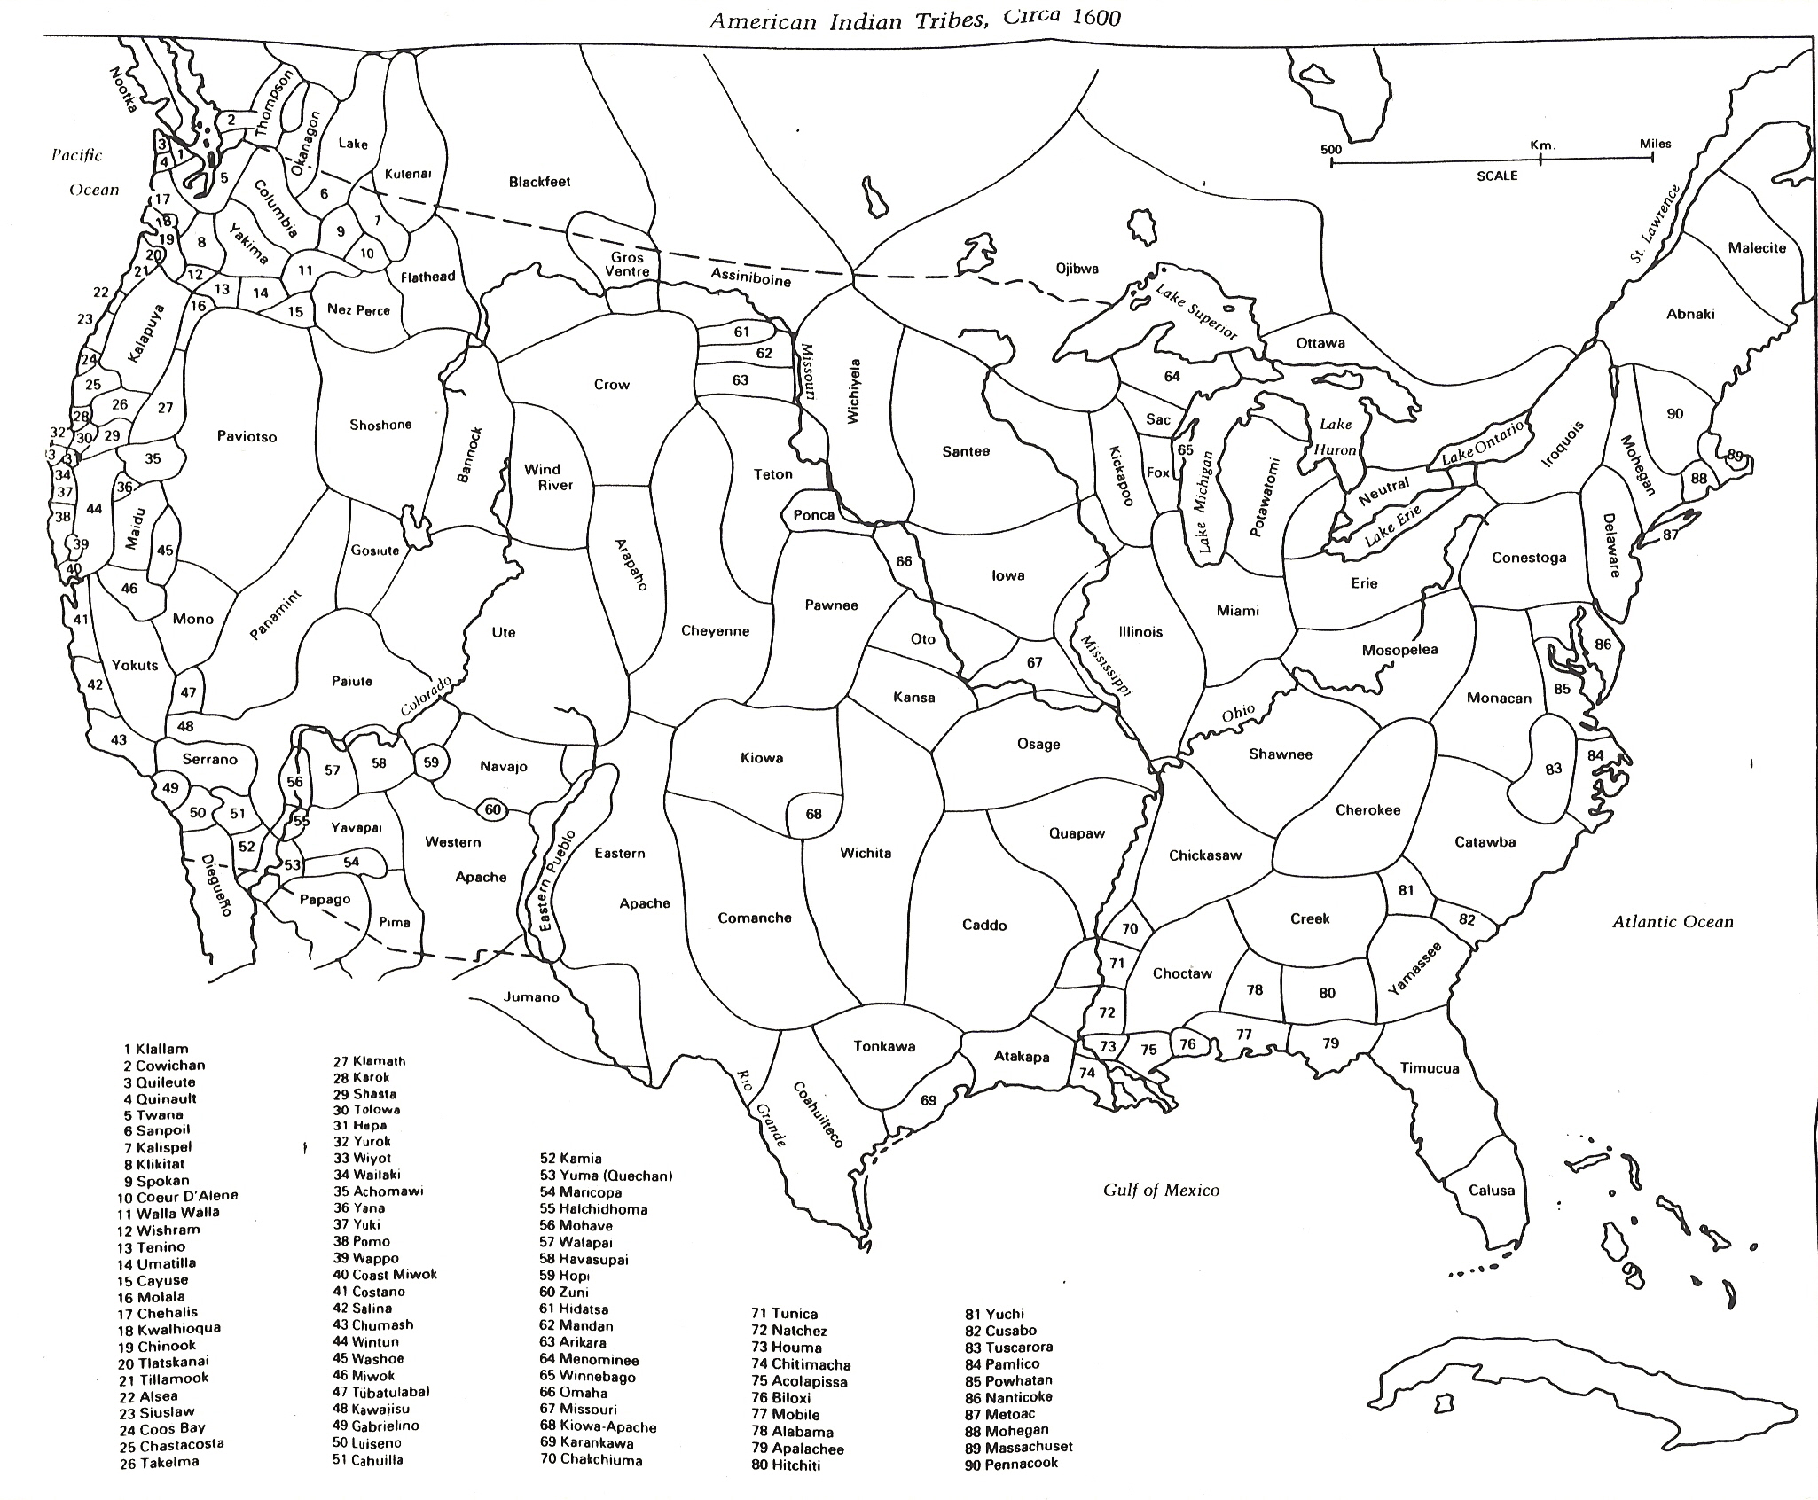

Slide 5
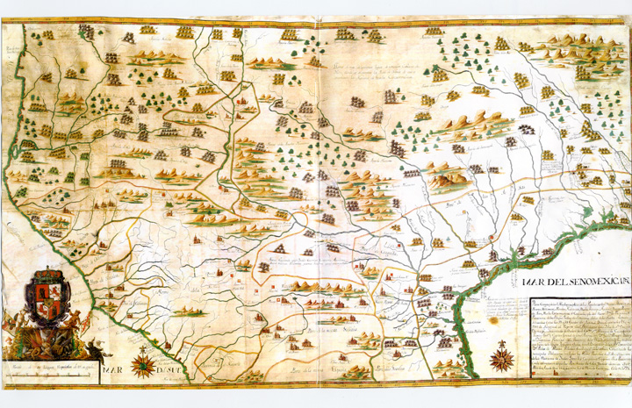
Spanish map of Indian settlements hemming in Spanish towns throughout northern provinces, 1728

Slide 6
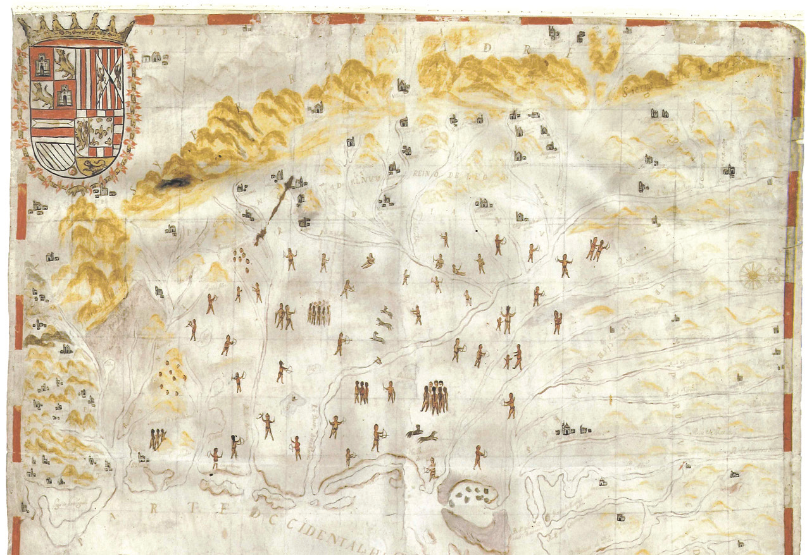
Miguel Durán, Descripción y mapa de la nueva provincia poblada de bárbaros . . ., 1744

Slide 7
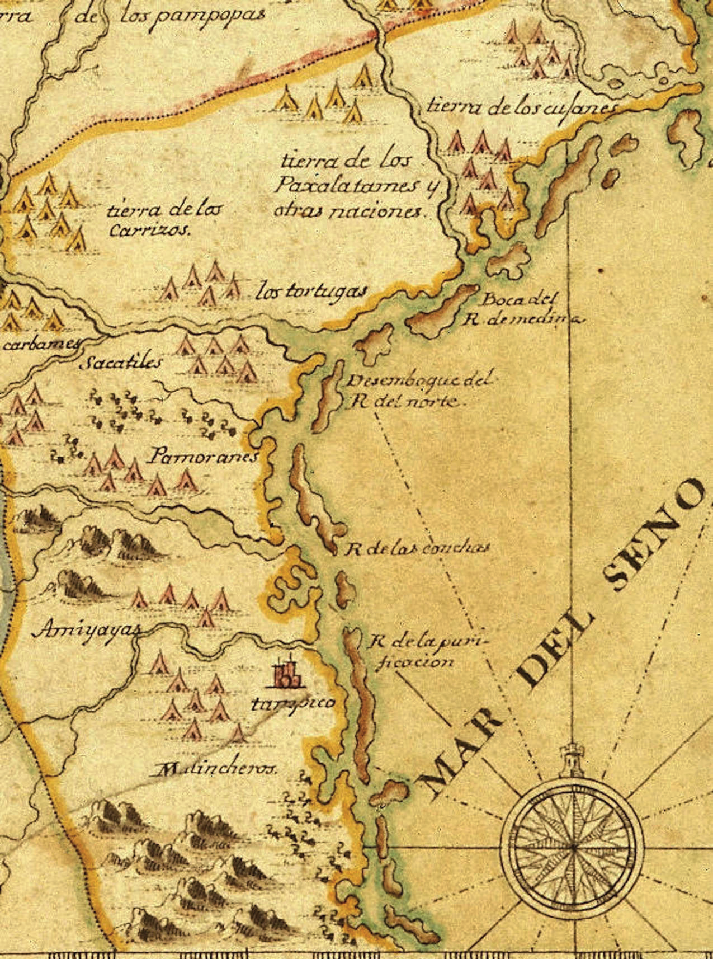
Detail of Francisco Álvarez Barreiro’s 1728 map illustrating Spanish mapping of Indian domains

Slide 8
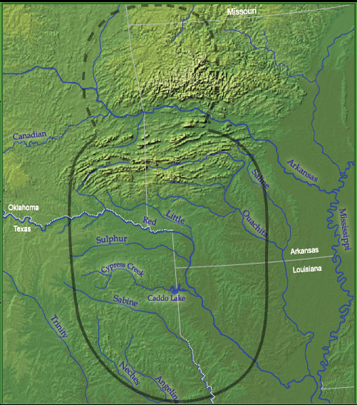
Map of Caddo territories

Slide 9
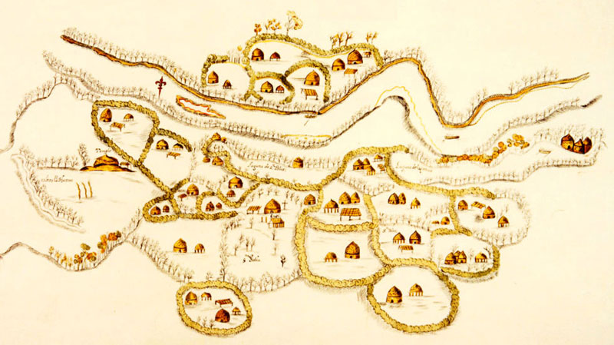
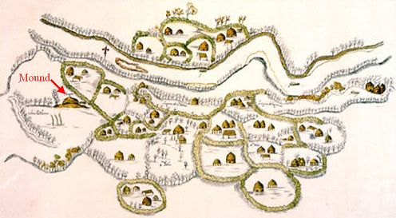
1691 map of Domingo Terán de los Rios of a Caddo community of farmsteads & extended family compounds stretching several miles along the Red River

Slide 10
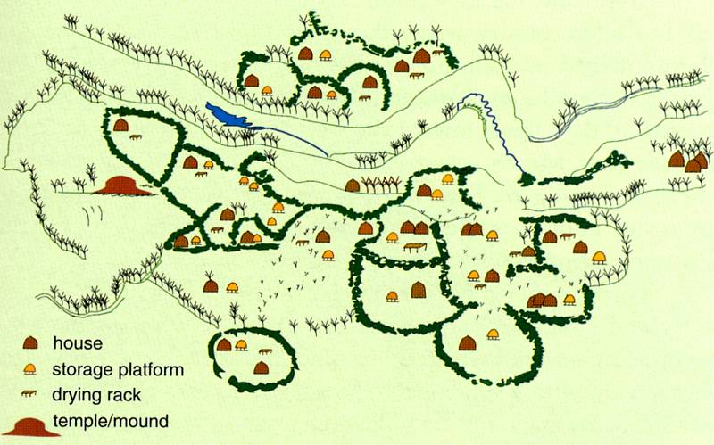
Translation of Terán map

Slide 11
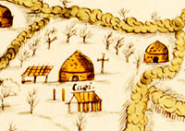
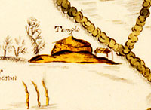
Compound of caddí
Temple mound

Slide 12
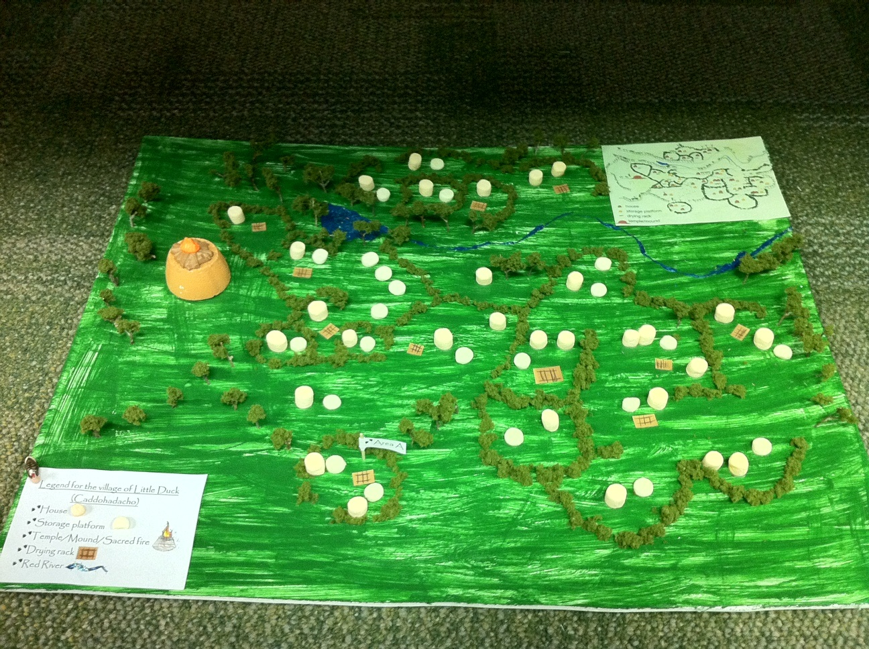

Slide 13
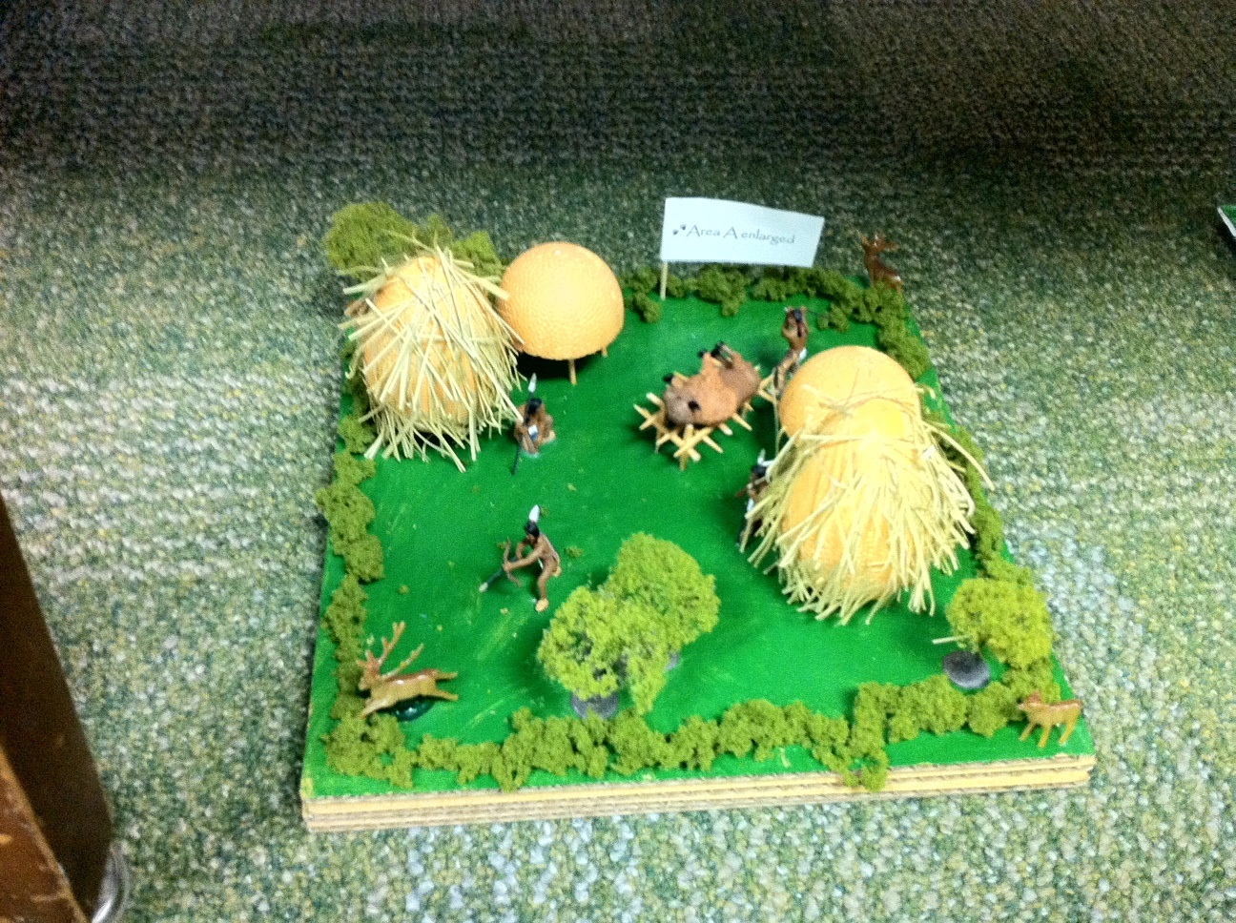

Slide 14
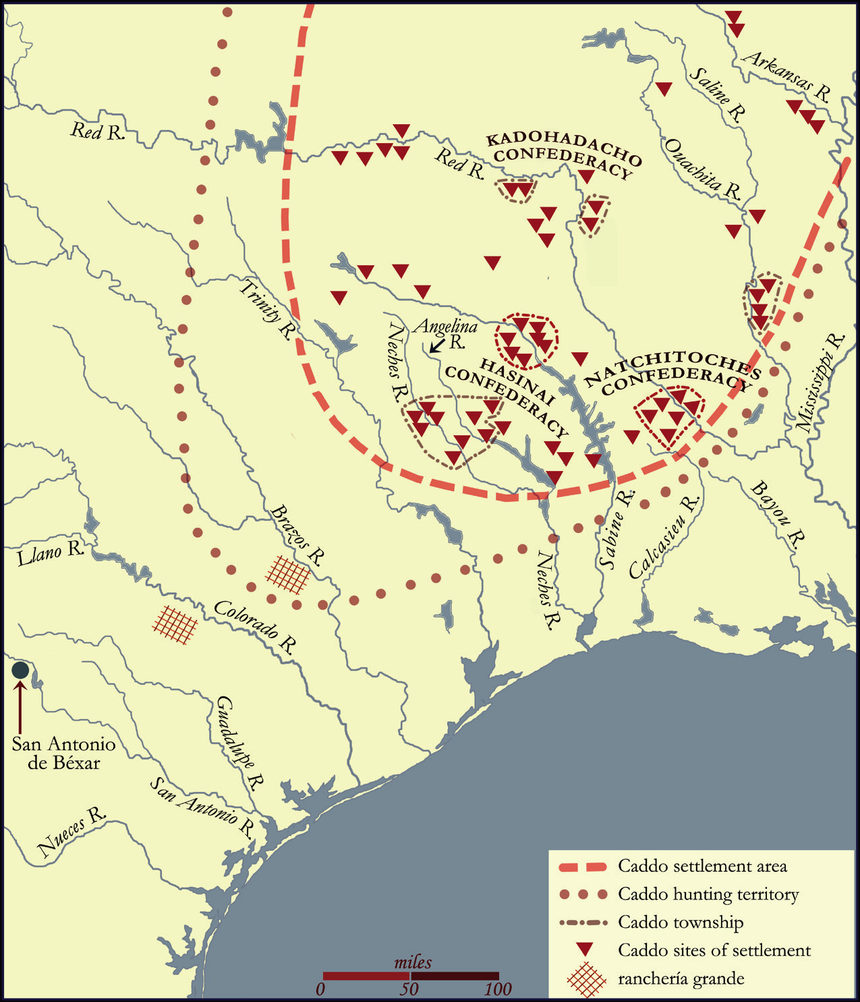
The expansive rings of the Caddo domain fanning out from its core,
ca.1700

Slide 15
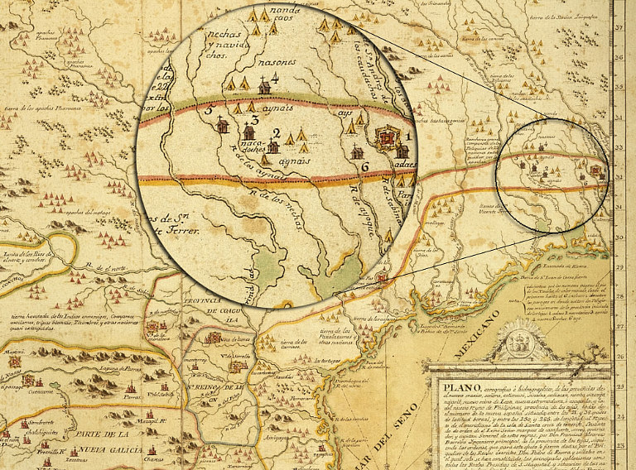
Detail from 1728 Francisco Álvarez Barreiro map of the kingdom of the Tejas

Slide 16
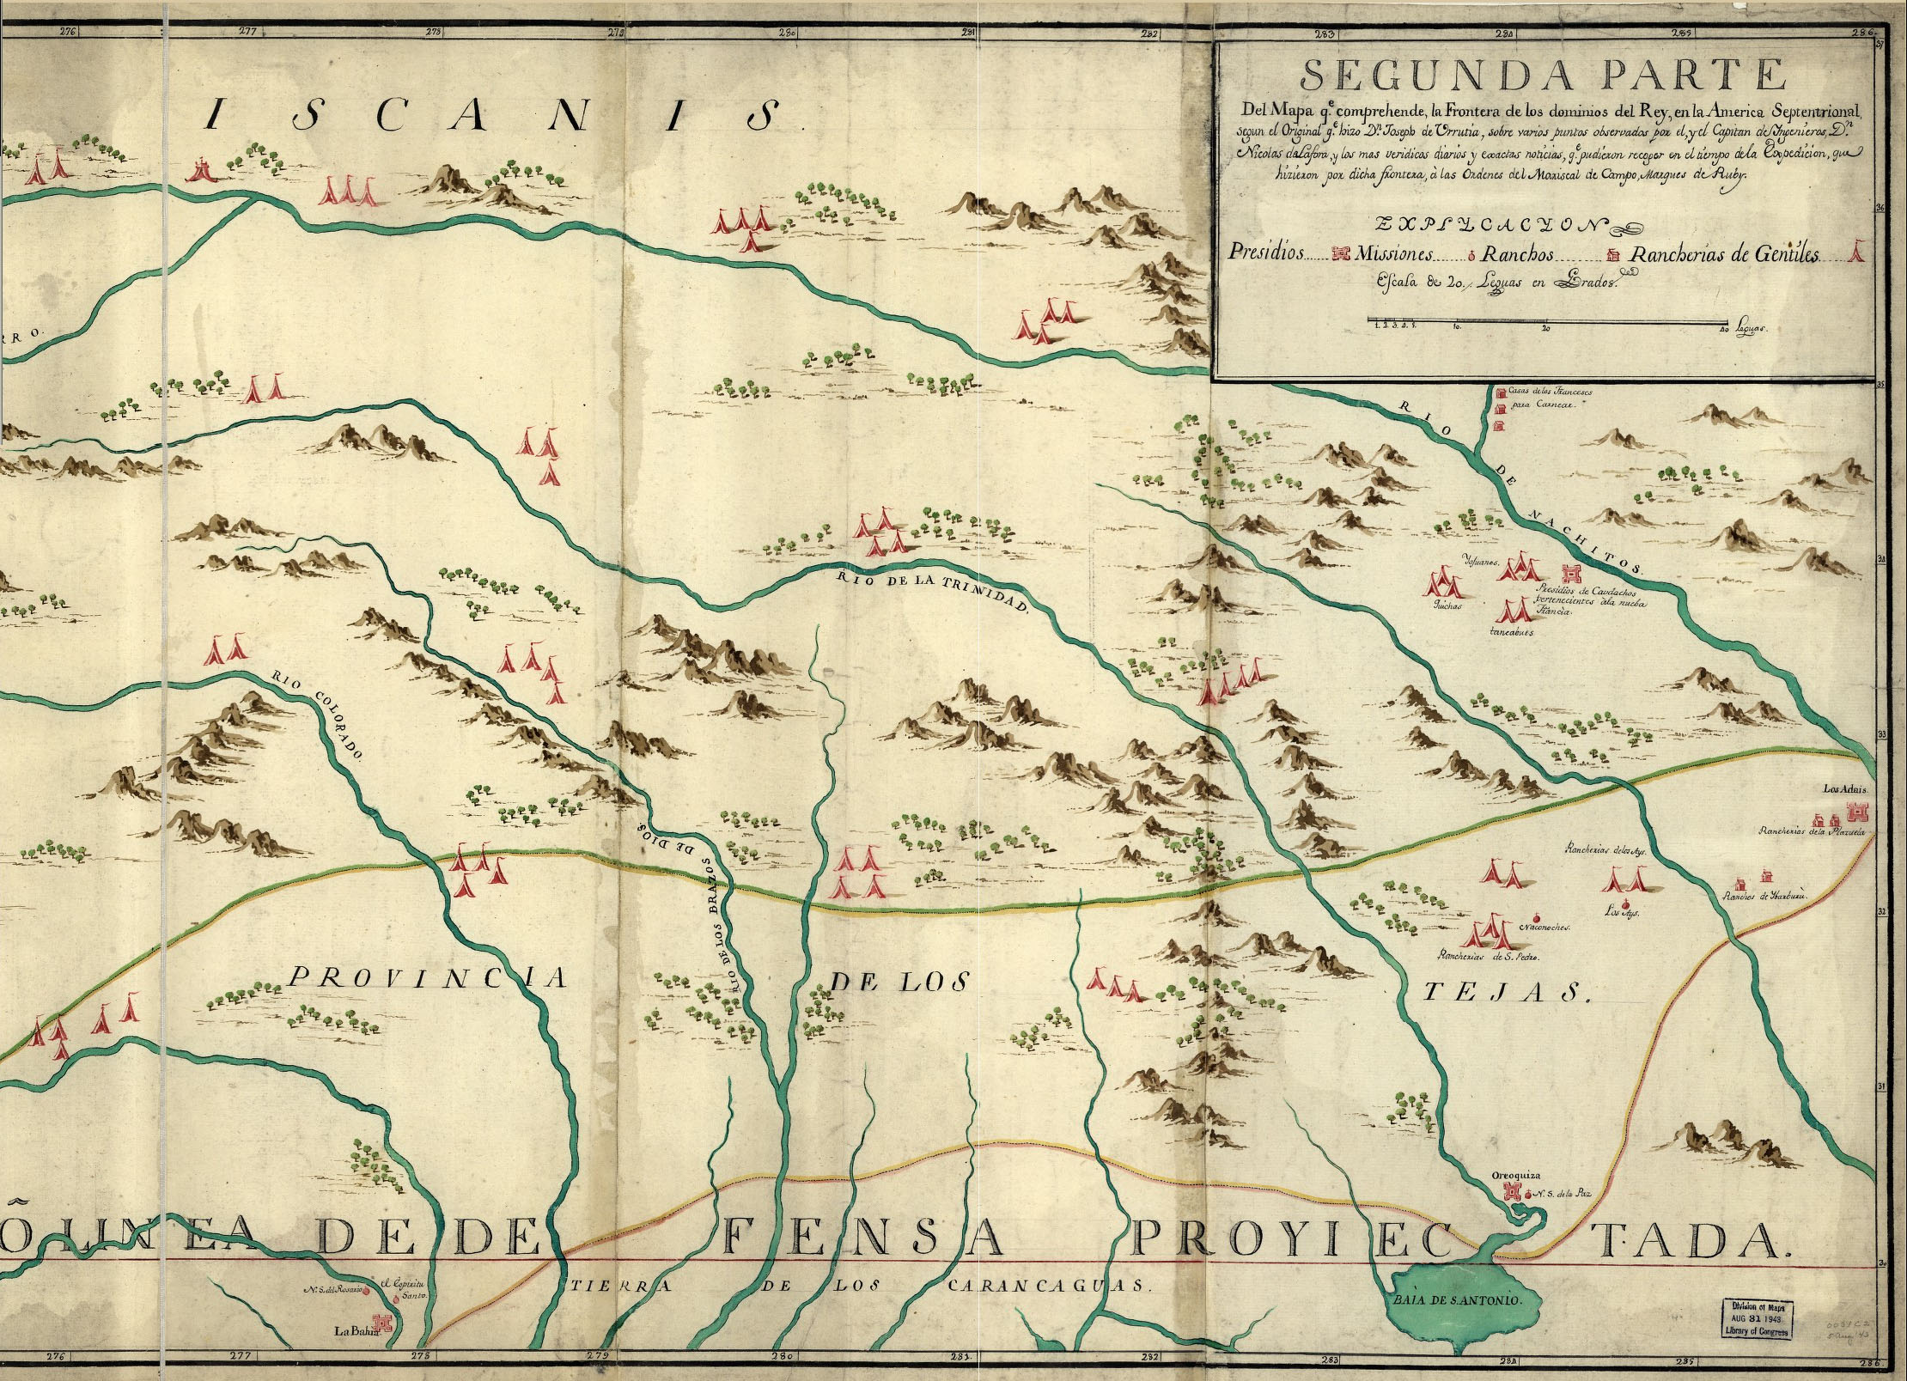
Los Adaes presidio and town in midst of the Caddo (Hasinai) province

Slide 17
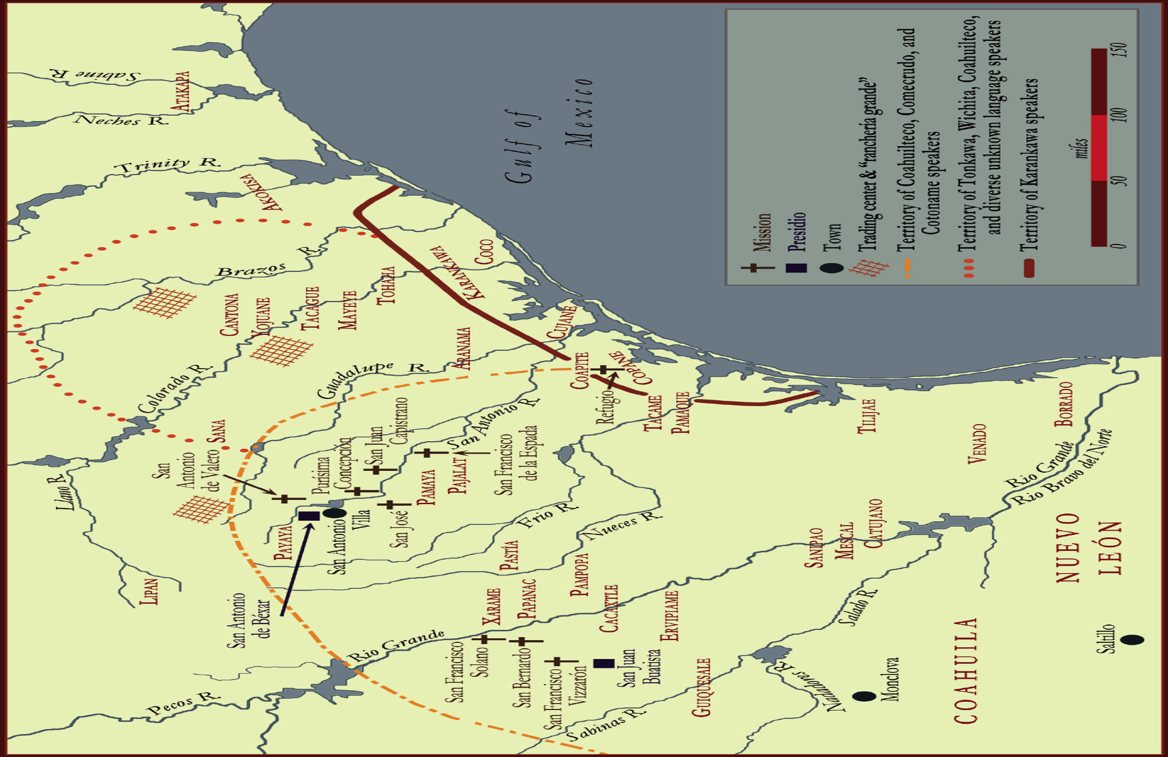
Bordered territories within which different Indian communities shared subsistence & settlement sites in southern & coastal Texas, ca. 1720

Slide 18
Five missions located at joint settlement sites along
San Antonio River

Slide 19
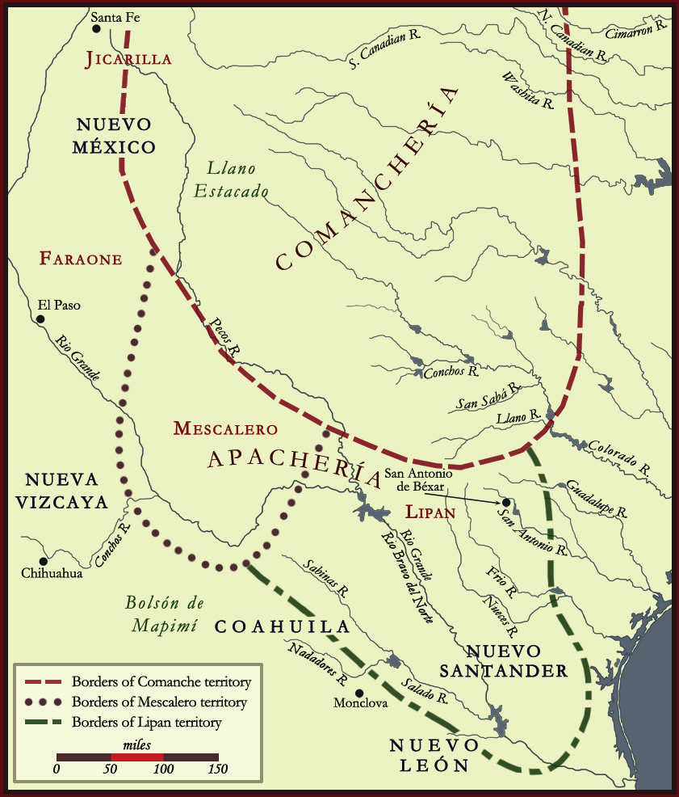
The borders of Apachería and Comanchería in the 1770’s and 1780’s, as they shifted menacingly southward into New Spain

Slide 20
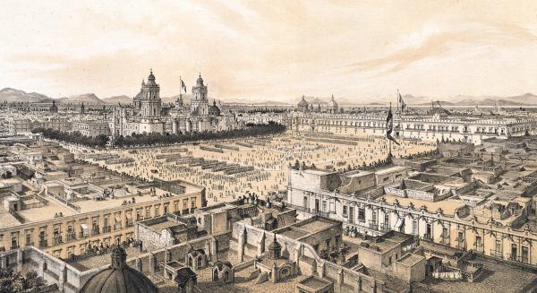
18th-century Mexico City, capitol of New Spain

Slide 21
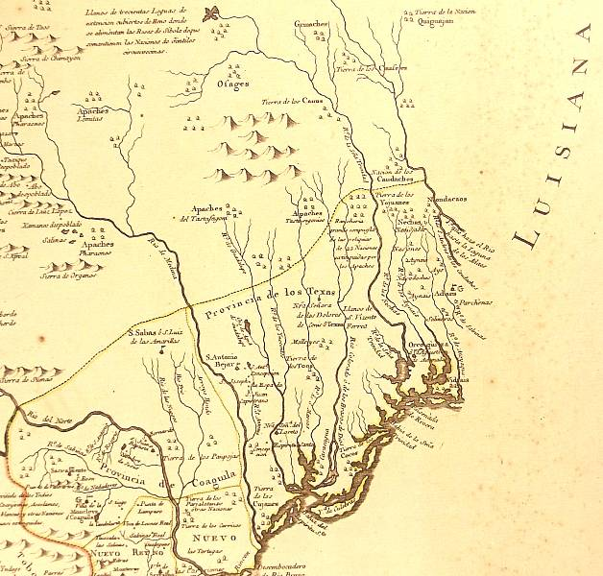
The limits of Spanish expansion in 1768

Slide 22
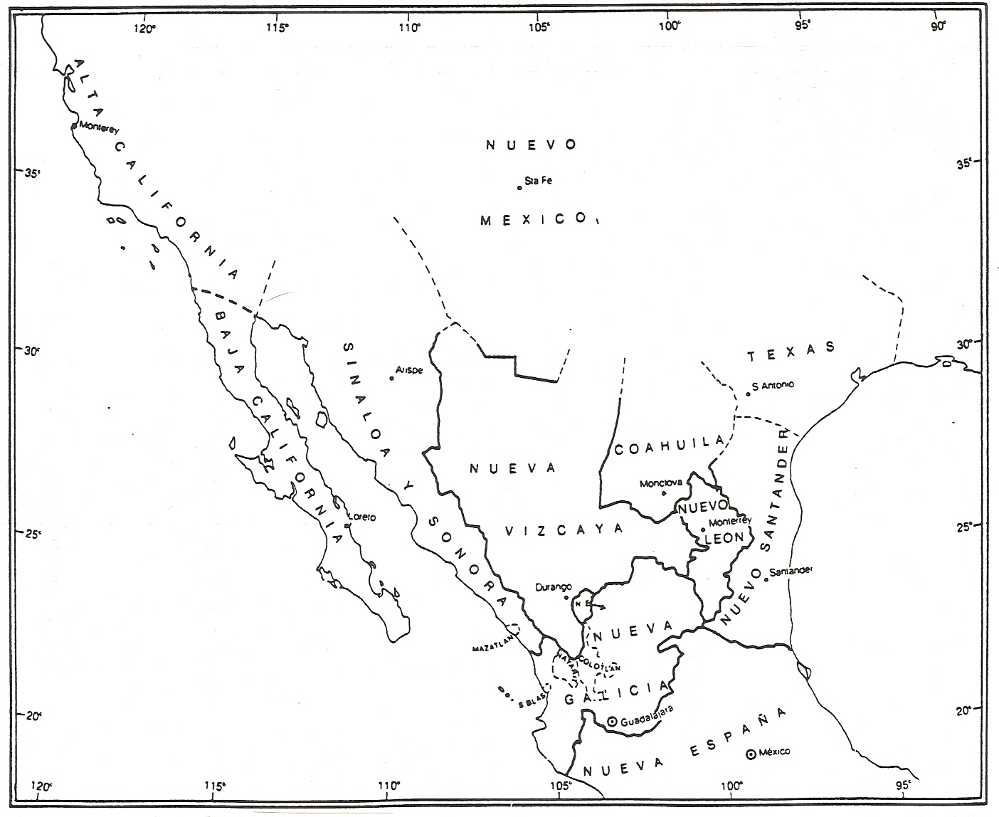
Limits of northern Spanish boundary claims in 1786

Slide 23
http://oieahc.wm.edu/wmq/Jan11/Barr/

