Slide 1
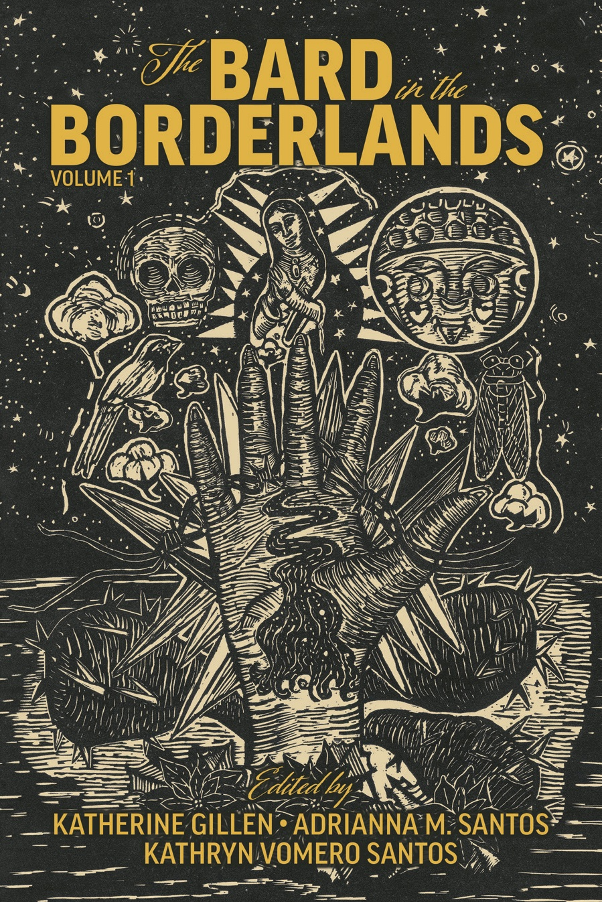
Hamlet
en La Frontera
Katherine Gillen
Kathryn Vomero Santos
Adrianna M. Santos
Humanities Texas Webinar
December 5, 2023
Notes:
https://www.youtube.com/watch?app=desktop&v=DyXsXsLespQ

Slide 2
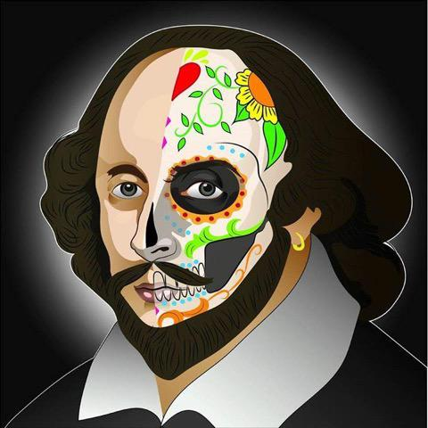
What is Borderlands Shakespeare?
A hybrid project blending English texts with Chicanx and Indigenous art forms, genres, and myths.
Acknowledges Shakespeare’s potential role as a symbol of whiteness, Anglo, and/or colonial power.
Appropriates Shakespeare to empower local communities and call attention to social issues.
José Rivera, Calaveraspeare (2015)
Notes:
Kate defines the term.

Slide 3
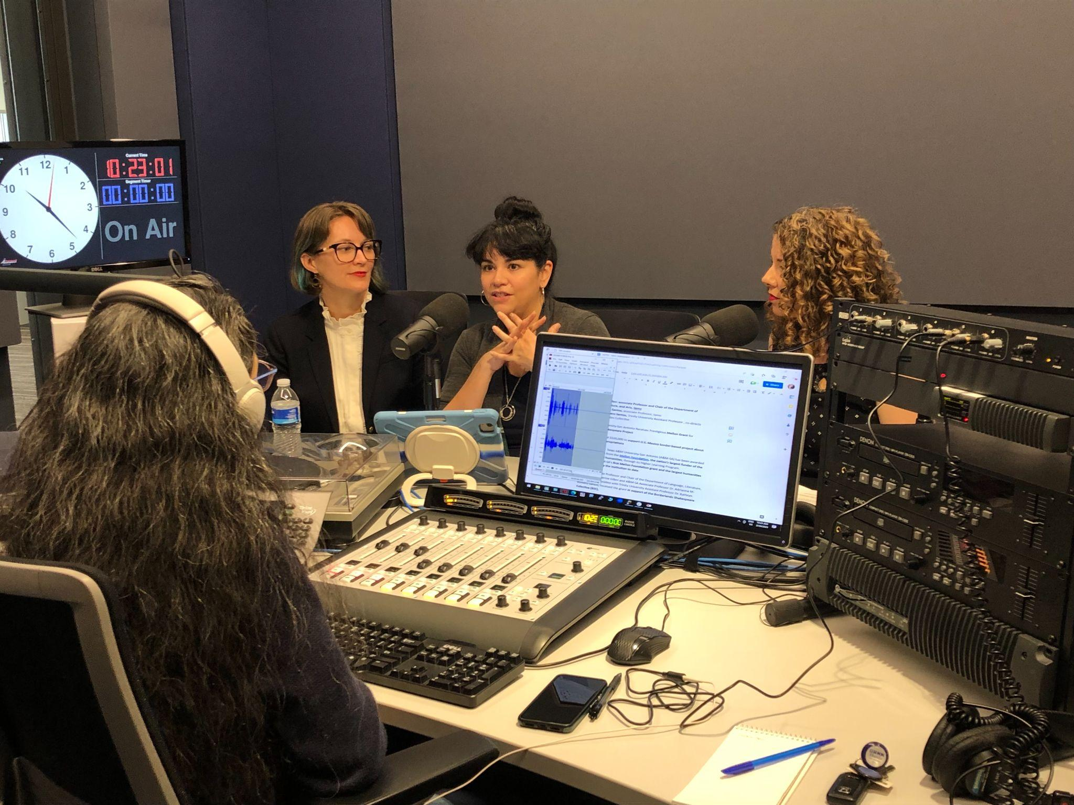
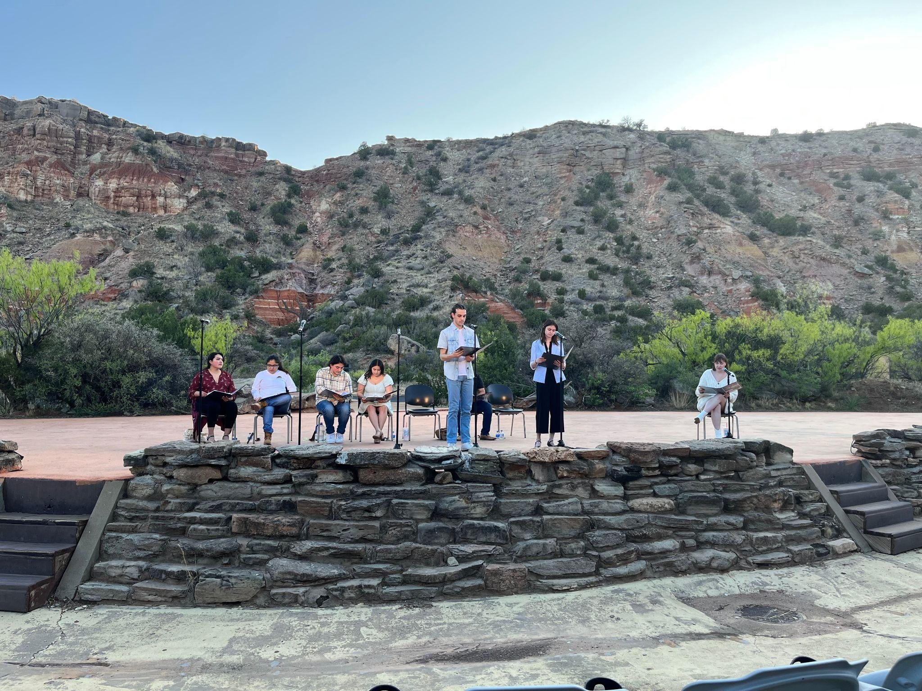
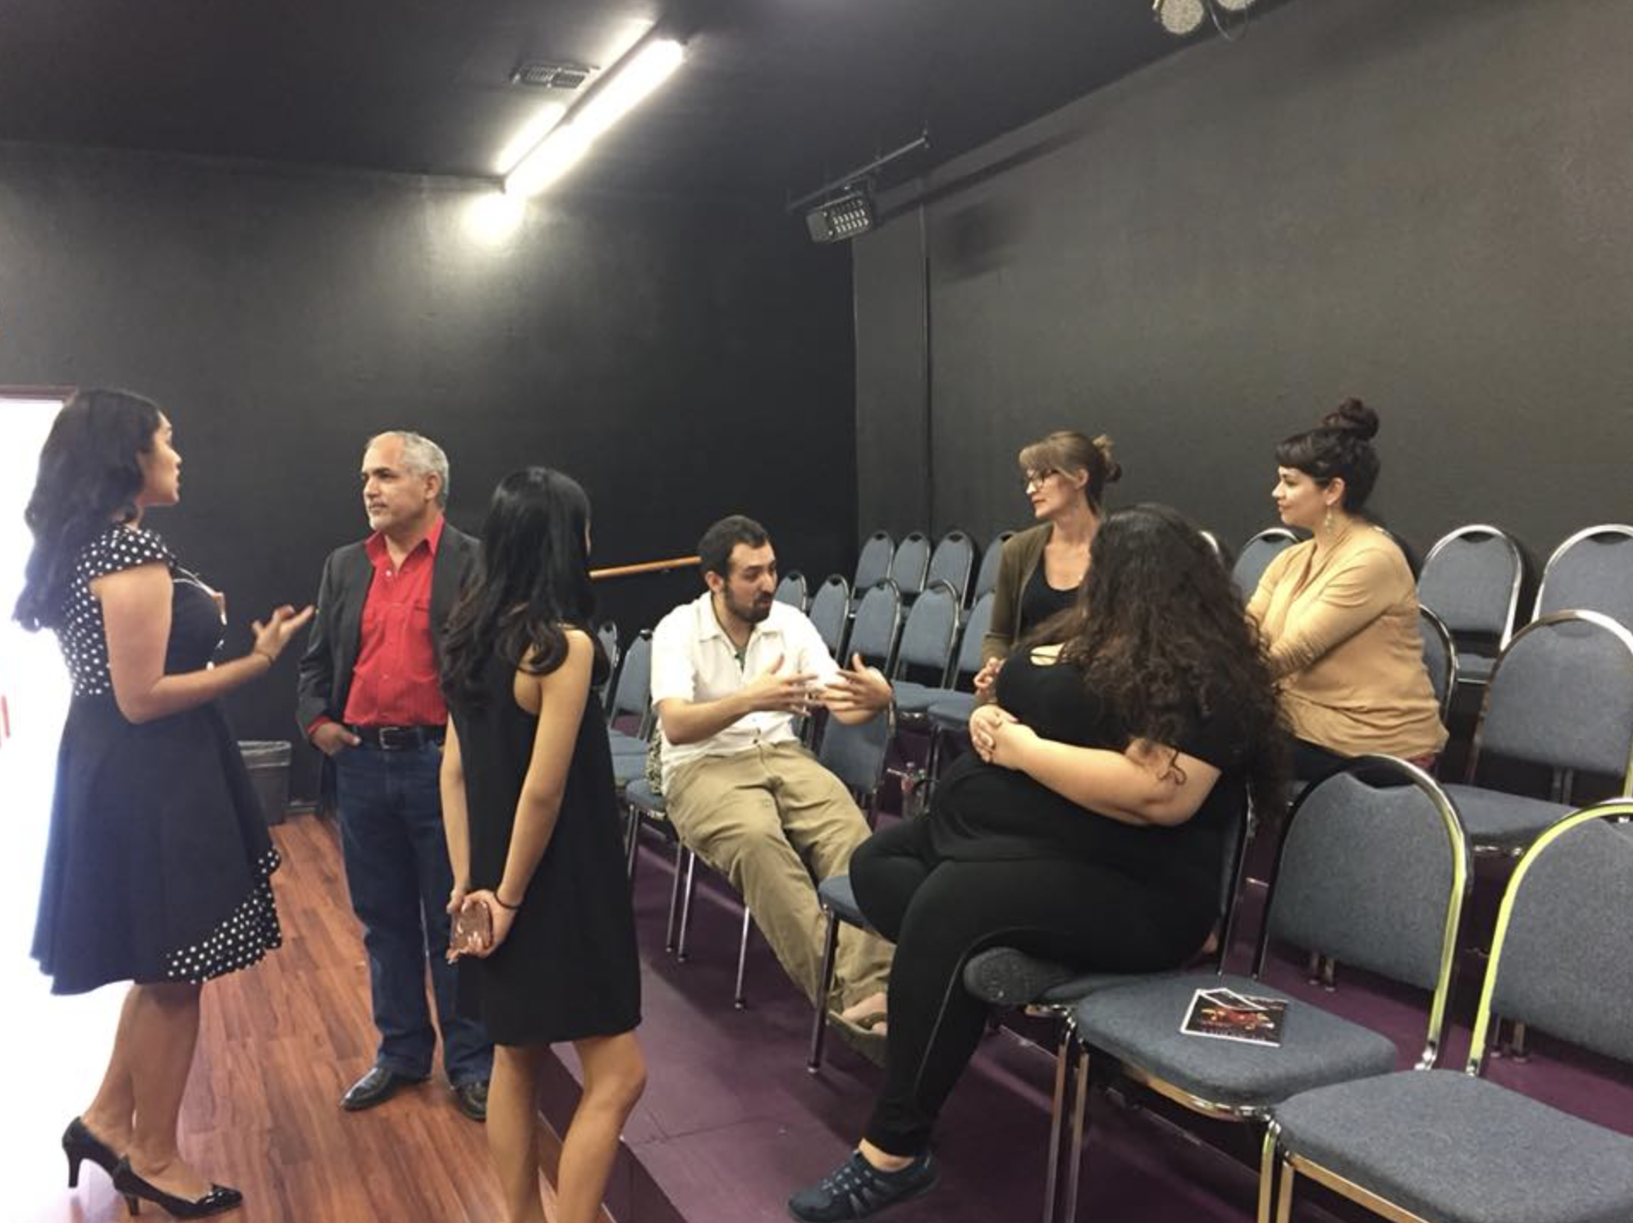
Notes:
KATIE

Slide 4
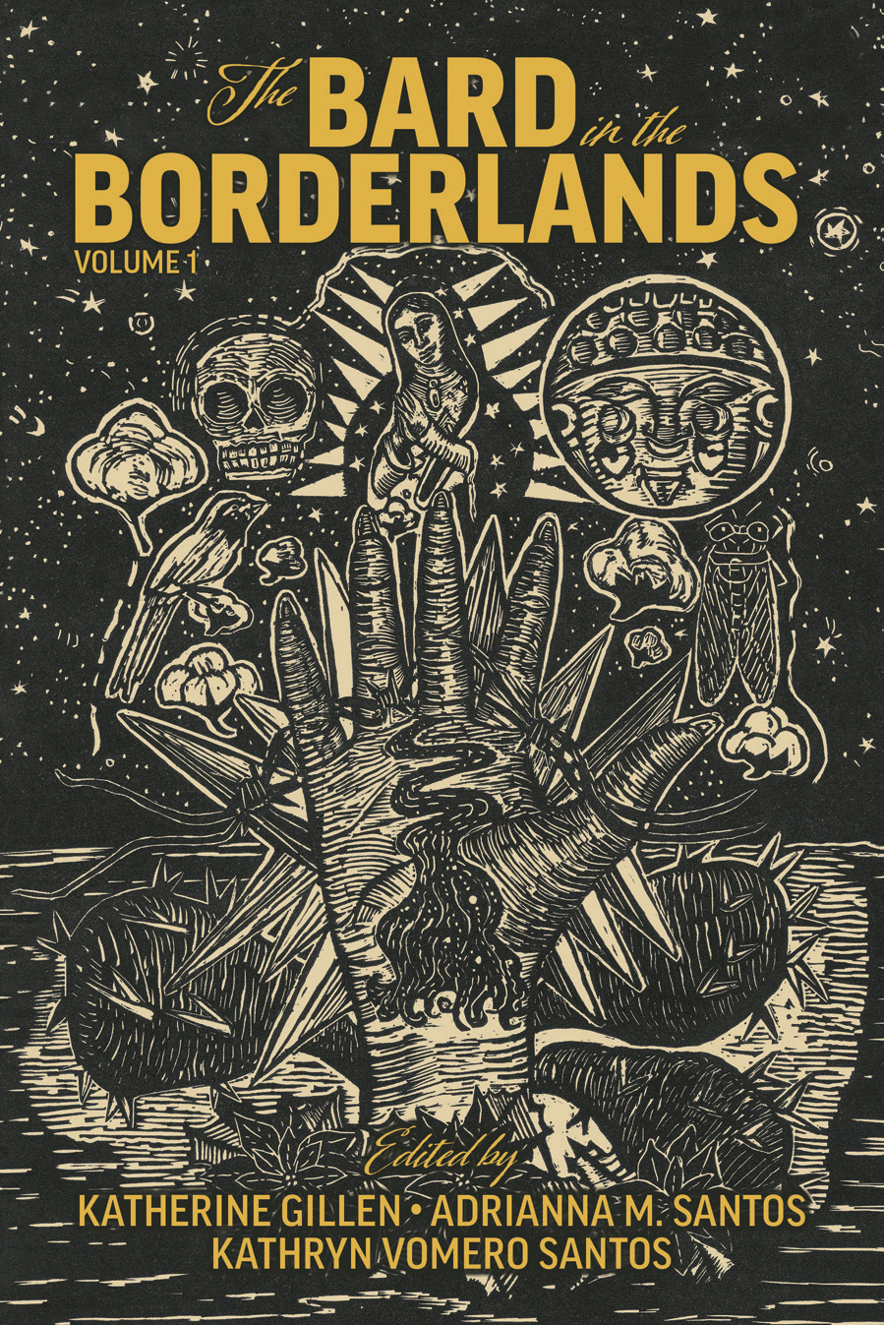
Borderlands Shakespeare appropriations “emphasize the value, beauty, and restorative power of Indigenous and Chicanx languages, genres, mythologies, and rituals, providing a counterpoint to the Western epistemologies conveyed in their source texts.”
Cover art: Healing Borderland Hand by Celeste De Luna (2022)
Notes:
Do we need this slide and the previous or can we combine them?

Slide 5
Why Teach (with) Borderlands Shakespeare?
Offers various points of access, allowing students to bring themselves and their knowledge to Shakespeare’s works.
Validates ways of knowing that arise from Borderlands communities depicted in the plays.
Drives conversations about complex mixture of language—Englishes, Spanishes, Spanglishes, and Indigenous languages.
Considers contemporary resonances of Shakespeare and differences among historical periods and geographical regions.
Invites creative responses to Shakespeare rather than seeing the works as static and fixed in time.
Notes:
Adri

Slide 6
Some Approaches to Teaching (with) Borderlands Shakespeare
Compare themes in Shakespeare with Borderlands adaptations, using scenes or full plays. What changes in Borderlands contexts? What becomes clearer or deeper as a result?
Analyze language. What does Shakespeare’s text mean? What is the effect of translating or adapting it? What do students think about hearing or reproducing Shakespeare in Spanish or Spanglish?
Explore Borderlands cultures, genres, geographies, and histories and how these relate to Shakespeare’s early modern English contexts.
Invite students to create their own adaptations, appropriations, translations, and remixes.
Notes:
Adri

Slide 7
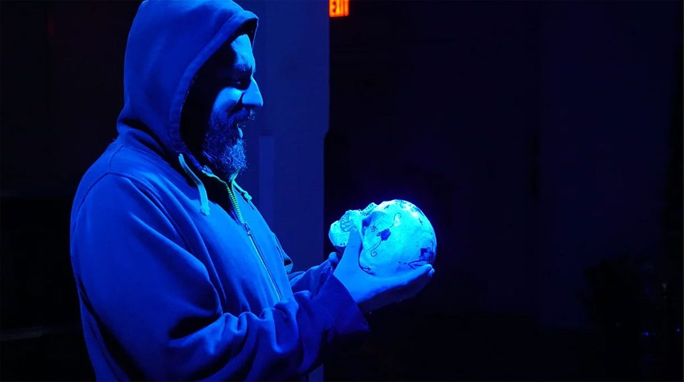
Hamlet en La Frontera
Artists en La Frontera often redirect the existential questions of Shakespeare’s best-known character toward what Gloria E. Anzaldúa theorizes as a “consciousness of the Borderlands”
Hamlet holding a calavera in telatúlsa’s 2018 production of Tara Moses’s Hamlet, El Príncipe de Denmark. Photo by Russell Mills, courtesy of telatúlsa.

Slide 8
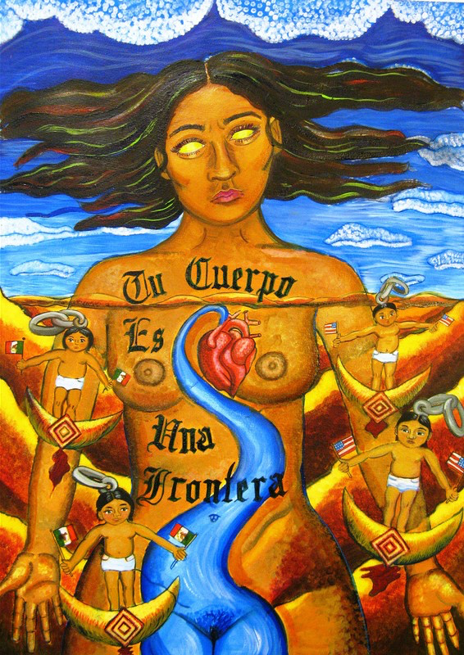
“Tu Cuerpo es una Frontera” Celeste de Luna
Notes:
“Border thinking” offers the opportunity to imagine the possibility of theorizing from the border (as a threshold and liminality, as two side connected by a bridge, as a geographical and epistemological location”
~Walter Mignolo
Around since 1848
Centralist, external perspective from US or Mexico
End of 20th c. saw a shift towards the border as its own identity
Major US theorists – Herbert Bolton, Américo Paredes, Gloria Anzaldúa
In cultural studies
Metaphorical questions of borders
How discourse communities affect national culture
Points to more heterogeneous transnational space
Transformation and identity formation
“Border theory” narrativizes a history in which culturally transgressive texts, actions, and bodies circumvent traditional structures of power, but this emplotment of resistance can mute another narrative in which power can and does reassert itself
~Russ Castronovo
Concepts governed by Northern side rarely translate easily to South
Literature from the Mexican border has been understudied
Need to see each side and how they come together
More than a questions of metaphor
Risks of “intellectual colonialism”
Lived experience
Border Arte Themes
Linguistic diversity
The frontier v. la frontera
Violence, danger, death
Shifting, changing, transformation
Hybridity v. boundary
Third space – liminality, in-between space
Questions of nation, identity, geography
Crossing – transnational and immigrant experiences

Slide 9
To live in the Borderlands means you…
are neither hispana india negra espanola
ni gabacha, eres mestiza, mulata, half-breed
caught in the crossfire between camps
while carrying all five races on your back
not knowing which side to turn to, run from;
To live in the Borderlands means knowing that the india in you,
betrayed for 500 years,
is no longer speaking to you,
the mexicanas call you rajetas, that denying the Anglo inside you
is as bad as having denied the Indian or Black;
Cuando vives en la frontera
people walk through you, the wind steals your voice,
you’re a burra, buey, scapegoat,
forerunner of a new race,
half and half-both woman and man, neither-a new gender;
To live in the Borderlands means to
put chile in the borscht,
eat whole wheat tortillas,
speak Tex-Mex with a Brooklyn accent;
be stopped by la migra at the border checkpoints;
Living in the Borderlands means you fight hard to
resist the gold elixir beckoning from the bottle,
the pull of the gun barrel,
the rope crushing the hollow of your throat;
In the Borderlands
you are the battleground
where enemies are kin to each other;
you are at home, a stranger,
the border disputes have been settled
the volley of shots have scattered the truce
you are wounded, lost in action
dead, fighting back;
To live in the Borderlands means
the mill with the razor white teeth wants to shred off
your olive-red skin, crush out the kernel, your heart
pound you pinch you roll you out
smelling like white bread but dead;
To survive the Borderlands
you must live sin fronteras
be a crossroads.
Gloria E. Anzaldúa (1987) from Borderlands/La Frontera

Slide 10
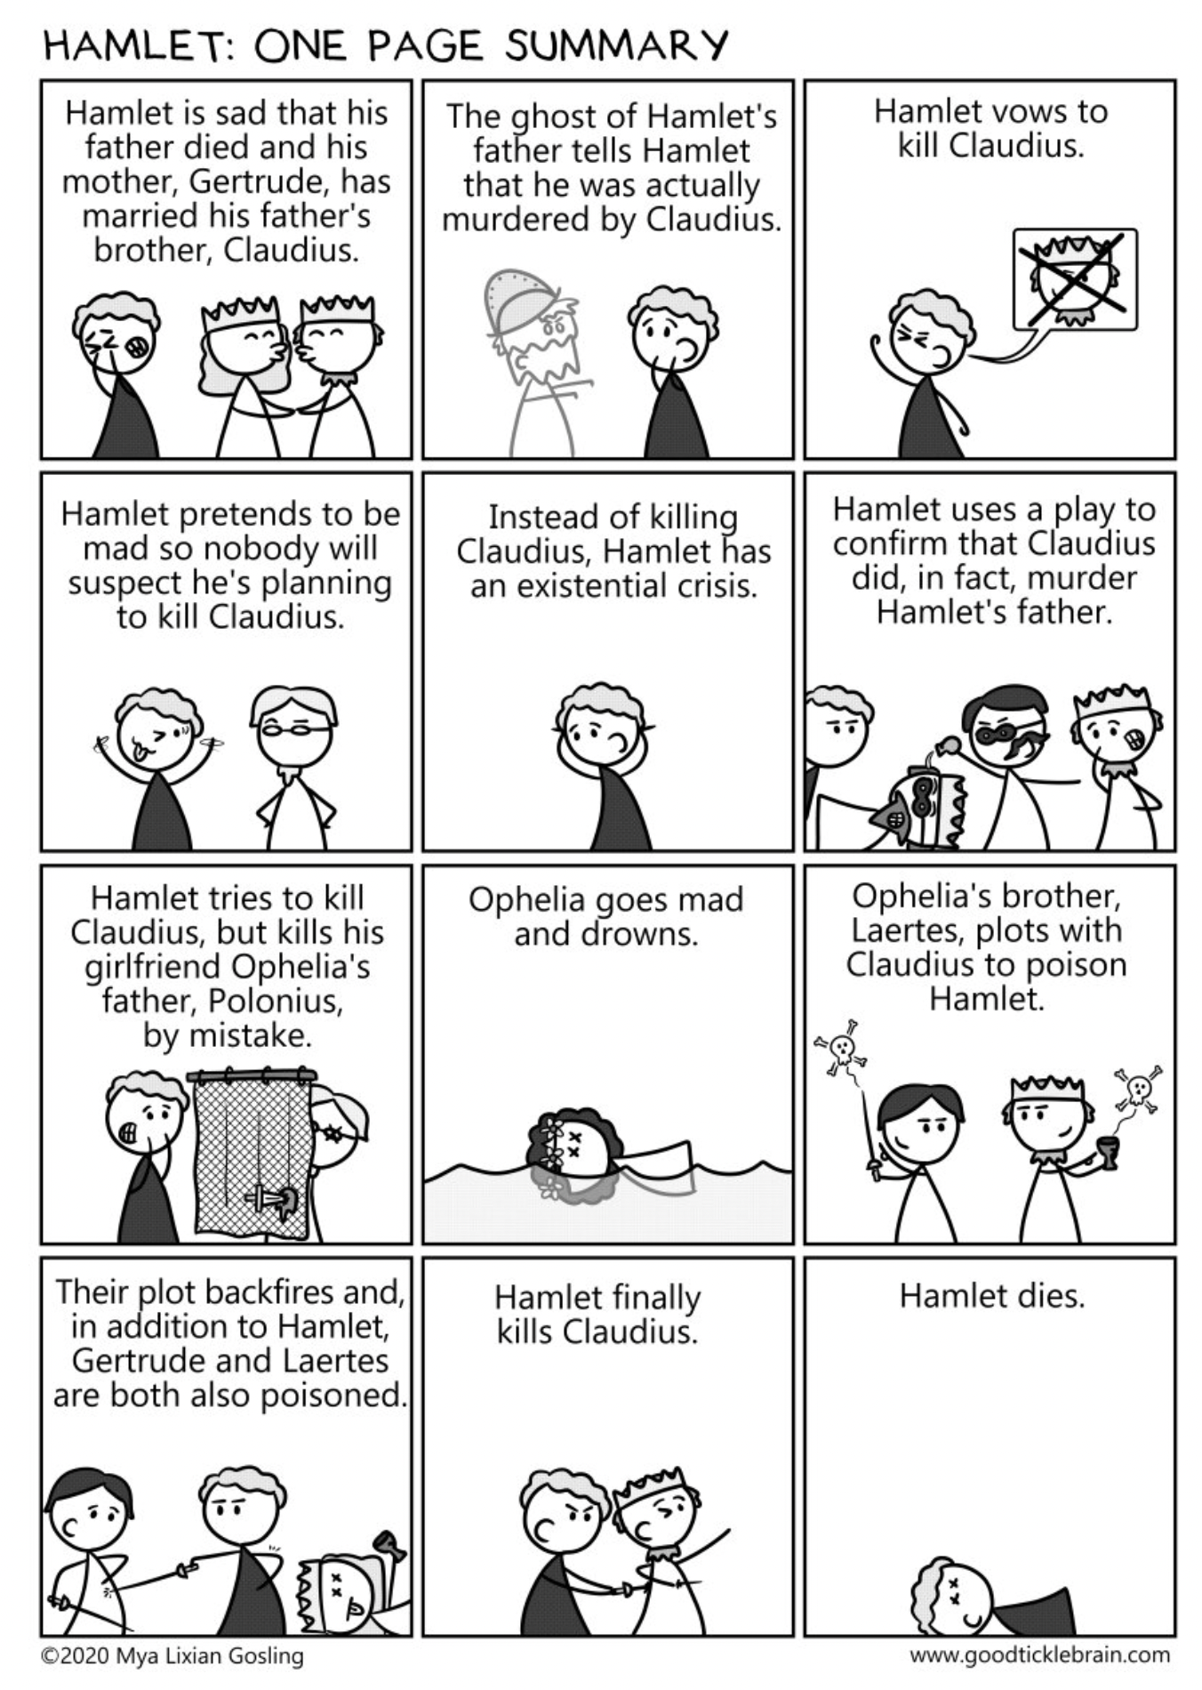
Hamlet
A Quick Recap

Slide 11
“To be, or not to be”
Soliloquy
For who would bear the whips and scorns of time,
Th'oppressor’s wrong, the proud man's contumely,
The pangs of dispriz’d love, the law’s delay,
The insolence of office, and the spurns
That patient merit of th’unworthy takes,
When he himself might his quietus make
With a bare bodkin? Who would fardels bear,
To grunt and sweat under a weary life,
But that the dread of something after death,
The undiscovere’d country, from whose bourn
No traveller returns, puzzles the will,
And makes us rather bear those ills we have
Than fly to others that we know not of?
Thus conscience doth make cowards of us all,
And thus the native hue of resolution
Is sicklied o’er with the pale cast of thought,
And enterprises of great pith and moment
With this regard their currents turn awry
And lose the name of action.
William Shakespeare, Hamlet
To be, or not to be, that is the question:
Whether ’tis nobler in the mind to suffer
The slings and arrows of outrageous fortune,
Or to take arms against a sea of troubles
And by opposing end them. To die—to sleep,
No more; and by a sleep to say we end
The heart-ache and the thousand natural shocks
That flesh is heir to: ’tis a consummation
Devoutly to be wish’d. To die, to sleep;
To sleep, perchance to dream—ay, there’s the rub:
For in that sleep of death what dreams may come,
When we have shuffled off this mortal coil,
Must give us pause—there’s the respect
That makes calamity of so long life.
Notes:
Discuss sonnet form and context in Renaissance poetry class.

Slide 12
Guiding Questions
What strategies might help students understand the “To be or not to be” soliloquy and connect it meaningfully to other texts?
What does performance add? What is the effect of hearing/seeing different people, with different identities, perform and adapt this speech speech?
How might translation activities support this work? How does using translation demystify Shakespeare’s language and support linguistic awareness? How might this create opportunities for other kinds of translation and translanguaging in the classroom?
How can incorporating Borderlands texts help students understand Shakespeare’s language in new ways? How can it help students approach Shakespeare in ways that are culturally sustaining rather than alienating?

Slide 13
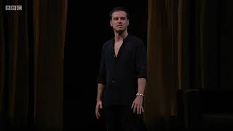
Andrew Scott in Hamlet (Almeida Theatre, 2017)

Slide 14
Modern English Translation of “To be or not to be”
Because who would bear all the trials and tribulations of time—
the oppression of the powerful, the insults from arrogant men,
the pangs of unrequited love, the slowness of justice,
the disrespect of people in office,
and the general abuse of good people by bad—
when you could just settle all your debts
using nothing more than an unsheathed dagger?
Who would bear his burdens, and grunt
and sweat through a tiring life, if they weren’t frightened
of what might happen after death—
that undiscovered country from which no visitor returns,
which we wonder about and which makes us
prefer the troubles we know rather than fly off
to face the ones we don’t? Thus, the fear of
death makes us all cowards, and our natural
willingness to act is made weak by too much thinking.
Actions of great urgency and importance
get thrown off course because of this sort of thinking,
and they cease to be actions at all.
To live, or to die? That is the question.
Is it nobler to suffer through all the terrible things
fate throws at you, or to fight off your troubles,
and, in doing so, end them completely?
To die, to sleep—because that’s all dying is—
and by a sleep I mean an end to all the heartache
and the thousand injuries that we are vulnerable to—
that’s an end to be wished for!
To die, to sleep. To sleep, perhaps to dream—yes,
but there’s there’s the catch. Because the kinds of
dreams that might come in that sleep of death—
after you have left behind your mortal body—
are something to make you anxious.
That’s the consideration that makes us suffer
the calamities of life for so long.
Notes:
Discuss sonnet form and context in Renaissance poetry class.

Slide 15
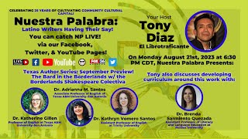
Tara Moses, Hamlet, El Príncipe de Denmark
Ser o no ser, esa es la cuestión.
¿Cuál más digna acción del ánimo:
Sufrir los tiros penetrantes de la fortuna injusta,
U oponer las armas a este torrente de calamidades,
Y darles fin con atrevida resistencia? To die, to sleep —
No more — and by a sleep to say we end
The heartache and the thousand natural shocks
That flesh is heir to — ’tis a consummation
Devoutly to be wished. To die, to sleep —
To sleep, perchance to dream. Ay, there’s the rub,
For in that sleep of death what dreams may come,
When we have shuffled off this mortal coil,
Must give us pause. There’s the respect
That makes calamity of so long life.
Esta previsión nos hace a todos cobardes:
Así la natural tintura del valor
Se debilita con los barnices pálidos de la prudencia;
Las empresas de mayor importancia
Por esta sola consideración mudan camino,
No se ejecutan, y se reducen a designios vanos.
Pero — soft you now,
The fair Ophelia! Nymph, in thy orisons
Be all my sins remembered.

Slide 16
El Hamlet Fronterizo Playas de Tijuana, 1988
Guillermo Gómez-Peña
Rewritten in 2010
Border State Park;
Facing the formidable Pacific Ocean
w/ one foot on each country
I talk to my other self
a dos voces interiores:
me ama/no me ama
me caso/no me caso
me canso/no me canso
chicano/mexicano
que soy o me imagino
regreso o continúo
me mato/no me mato
en Mexico/in Califas
to write or to perform
en Inglés or in Spanish . . .
I hate you; no, I forgive you,
no, I crave for you, mi loca
ansiosamente tuyo,
de nadie más
frontera mediante . . .
te espero, mi chuca,
te sigo esperando . . .
you are it, tu llanto,
tu make-up, tus cicatrices,
(pause)
no, you are definitely not it
you don’t even exist yet

Slide 17
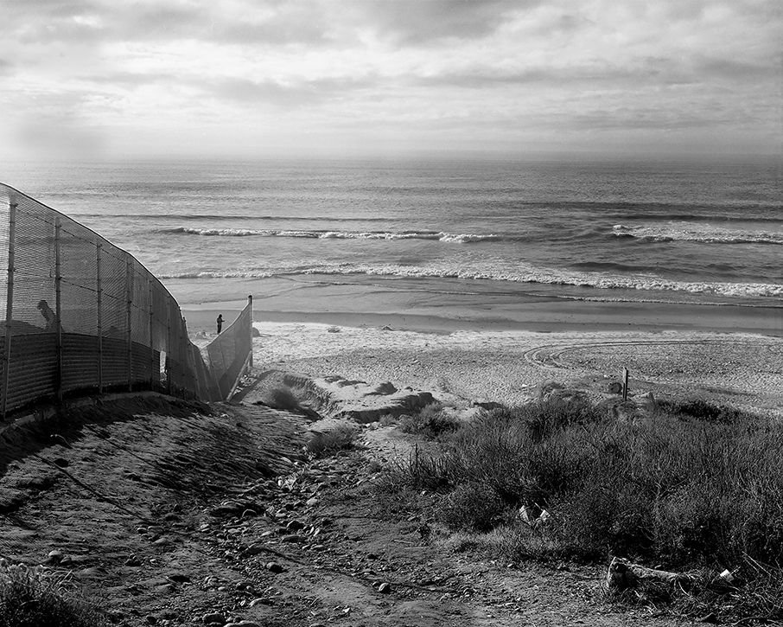
The end of the chain-link border fence in 1987. Peter Goin, Tracing the Line: A Photographic Survey of the Mexican-American Border. Artist Limited Edition. 1987.

Slide 18
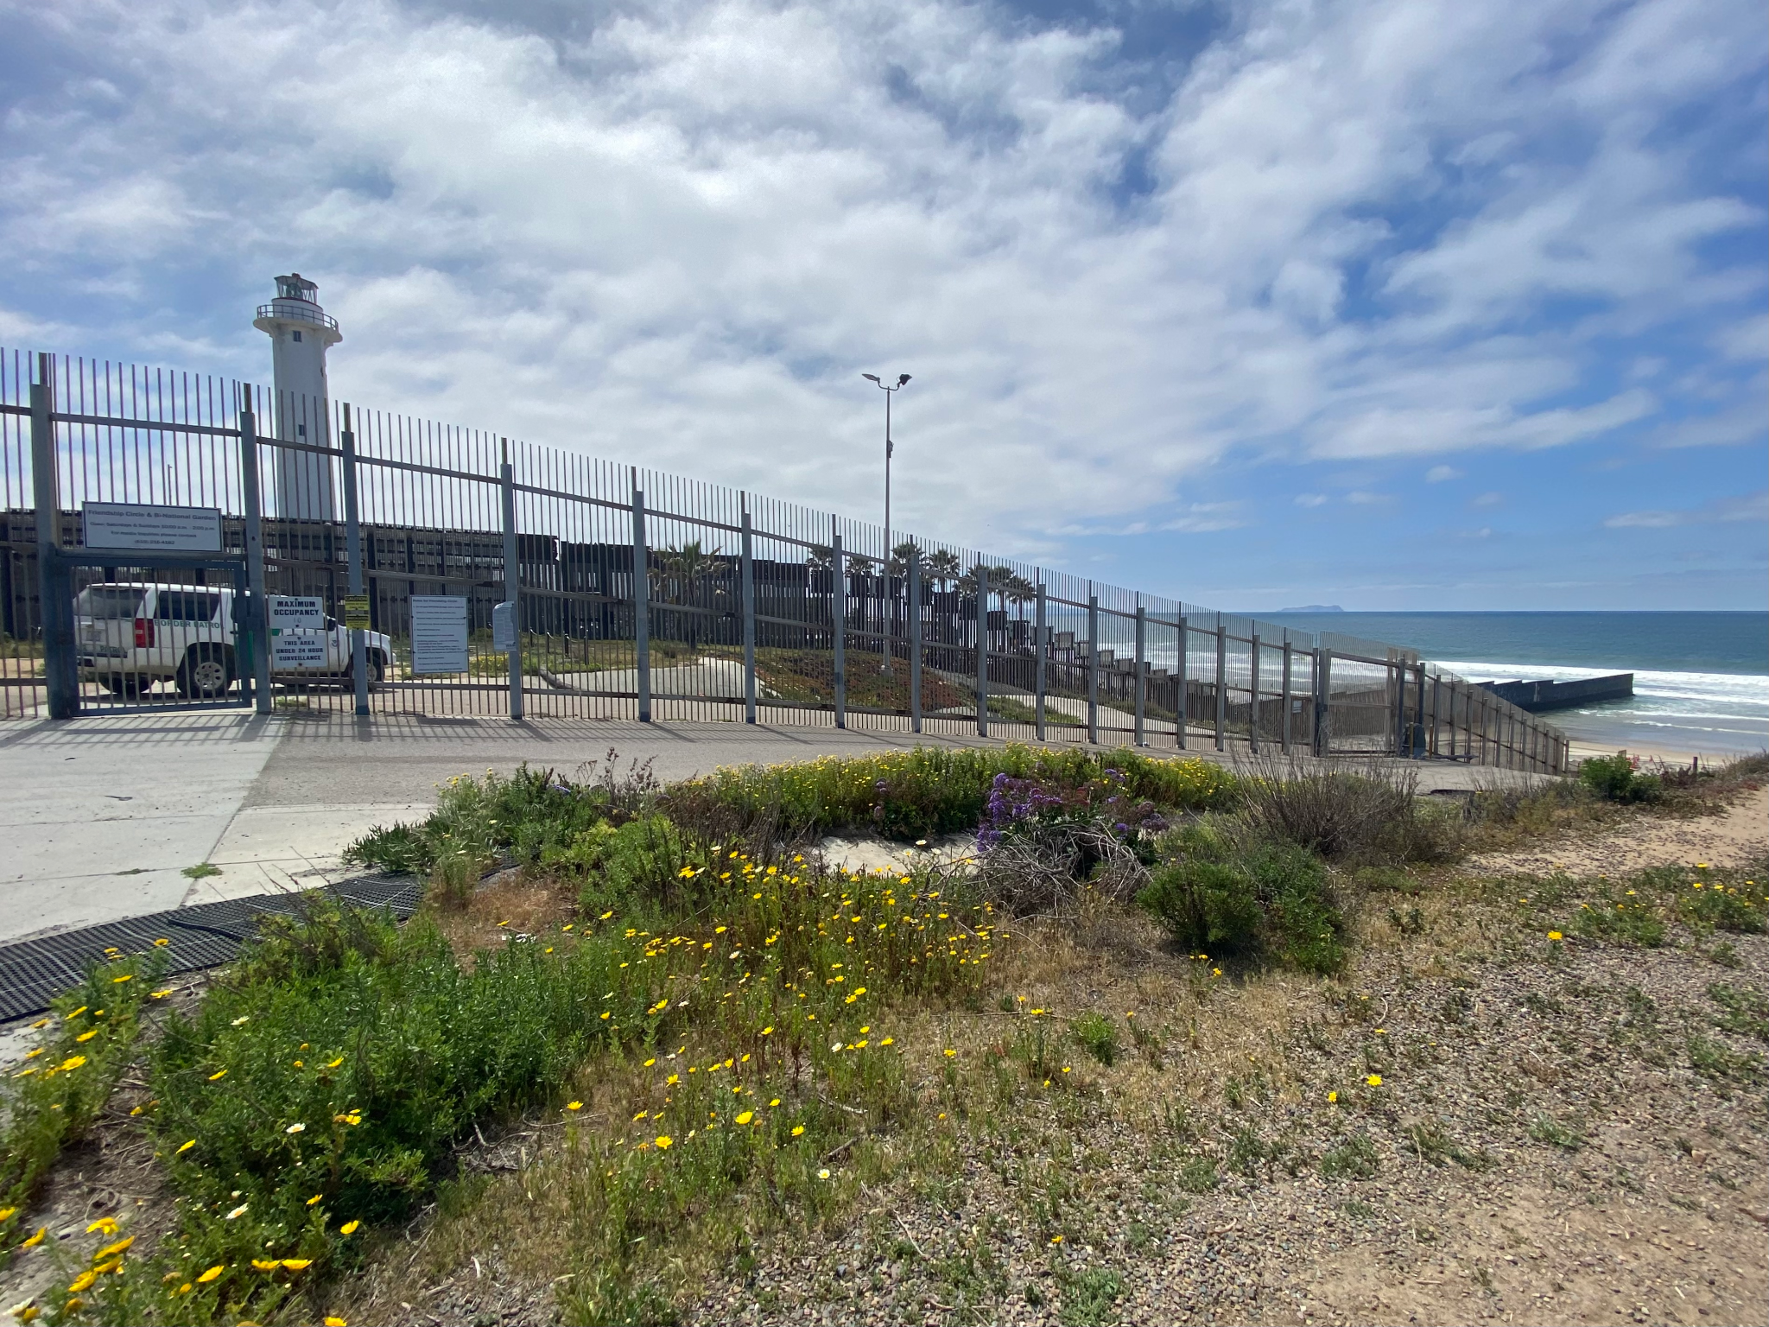
Friendship Park as seen from behind the northern wall on the U.S. side on March 27, 2022.
Photo by Kathryn Vomero Santos.

Slide 19
El Hamlet Fronterizo Playas de Tijuana, 1988
Guillermo Gómez-Peña
Rewritten in 2010
Border State Park;
Facing the formidable Pacific Ocean
w/ one foot on each country
I talk to my other self
a dos voces interiores:
me ama/no me ama
me caso/no me caso
me canso/no me canso
chicano/mexicano
que soy o me imagino
regreso o continúo
me mato/no me mato
en Mexico/in Califas
to write or to perform
en Inglés or in Spanish . . .
I hate you; no, I forgive you,
no, I crave for you, mi loca
ansiosamente tuyo,
de nadie más
frontera mediante . . .
te espero, mi chuca,
te sigo esperando . . .
you are it, tu llanto,
tu make-up, tus cicatrices,
(pause)
no, you are definitely not it
you don’t even exist yet

Slide 20
Guiding Questions
What strategies might help students understand the “To be or not to be” soliloquy and connect it meaningfully to other texts?
What does performance add? What is the effect of hearing/seeing different people, with different identities, perform and adapt this speech speech?
How might translation activities support this work? How does using translation demystify Shakespeare’s language and support linguistic awareness? How might this create opportunities for other kinds of translation and translanguaging in the classroom?
How can incorporating Borderlands texts help students understand Shakespeare’s language in new ways? How can it help students approach Shakespeare in ways that are culturally sustaining rather than alienating?

Slide 21
Bio Break (5 mins)

Slide 22
Activity: Incorporating Young Women’s Voices
Introduction to Iris De Anda’s “To be a Pocha or not to be” and Guadalupe Garcia McCall’s “To be or not to be Mexican” (together)
Analyze the poems (breakout groups)
Design a lesson plan on the poems (breakout groups)
Share out insights and questions (together)

Slide 23
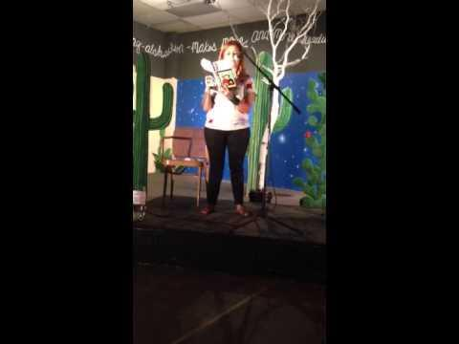
because I’m neither from here or there I speak both languages with a flair born in Los Angeles with roots that extend reaching out to faraway lands faraway sands, faraway from here because I’m my father’s daughter drowning in alcohol seeking the metaphysical calling back in time my family line a forgotten leaf on the familia’s tree to be a Pocha or not to be
because I’m my mother’s daughter drowning in depression seeking a connection recovering memories of a tierra I never knew a forgotten trace of ancestors in me to be a Pocha or not to be
because I’m not good enough for here or there I love to hate my flag & hate to love my creation ashamed of spanish in the 1st grade i'm sorry mami i never meant to hurt you ashamed of english in abuela’s embrace i know you never meant to hurt me because I'm merging culturas every time I breathe crossing borders every time I speak split forever into one at the edge of two worlds at the edge of possibility to be a Pocha or not to be because I’m finding balance of this cosmic raza a fusion of color for this mestiza things to learn and things to teach the little ones in front of me to be a Pocha or not to be
Iris De Anda,
“To be a Pocha or not to be”

Slide 24
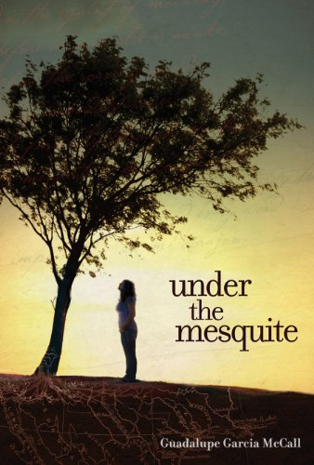
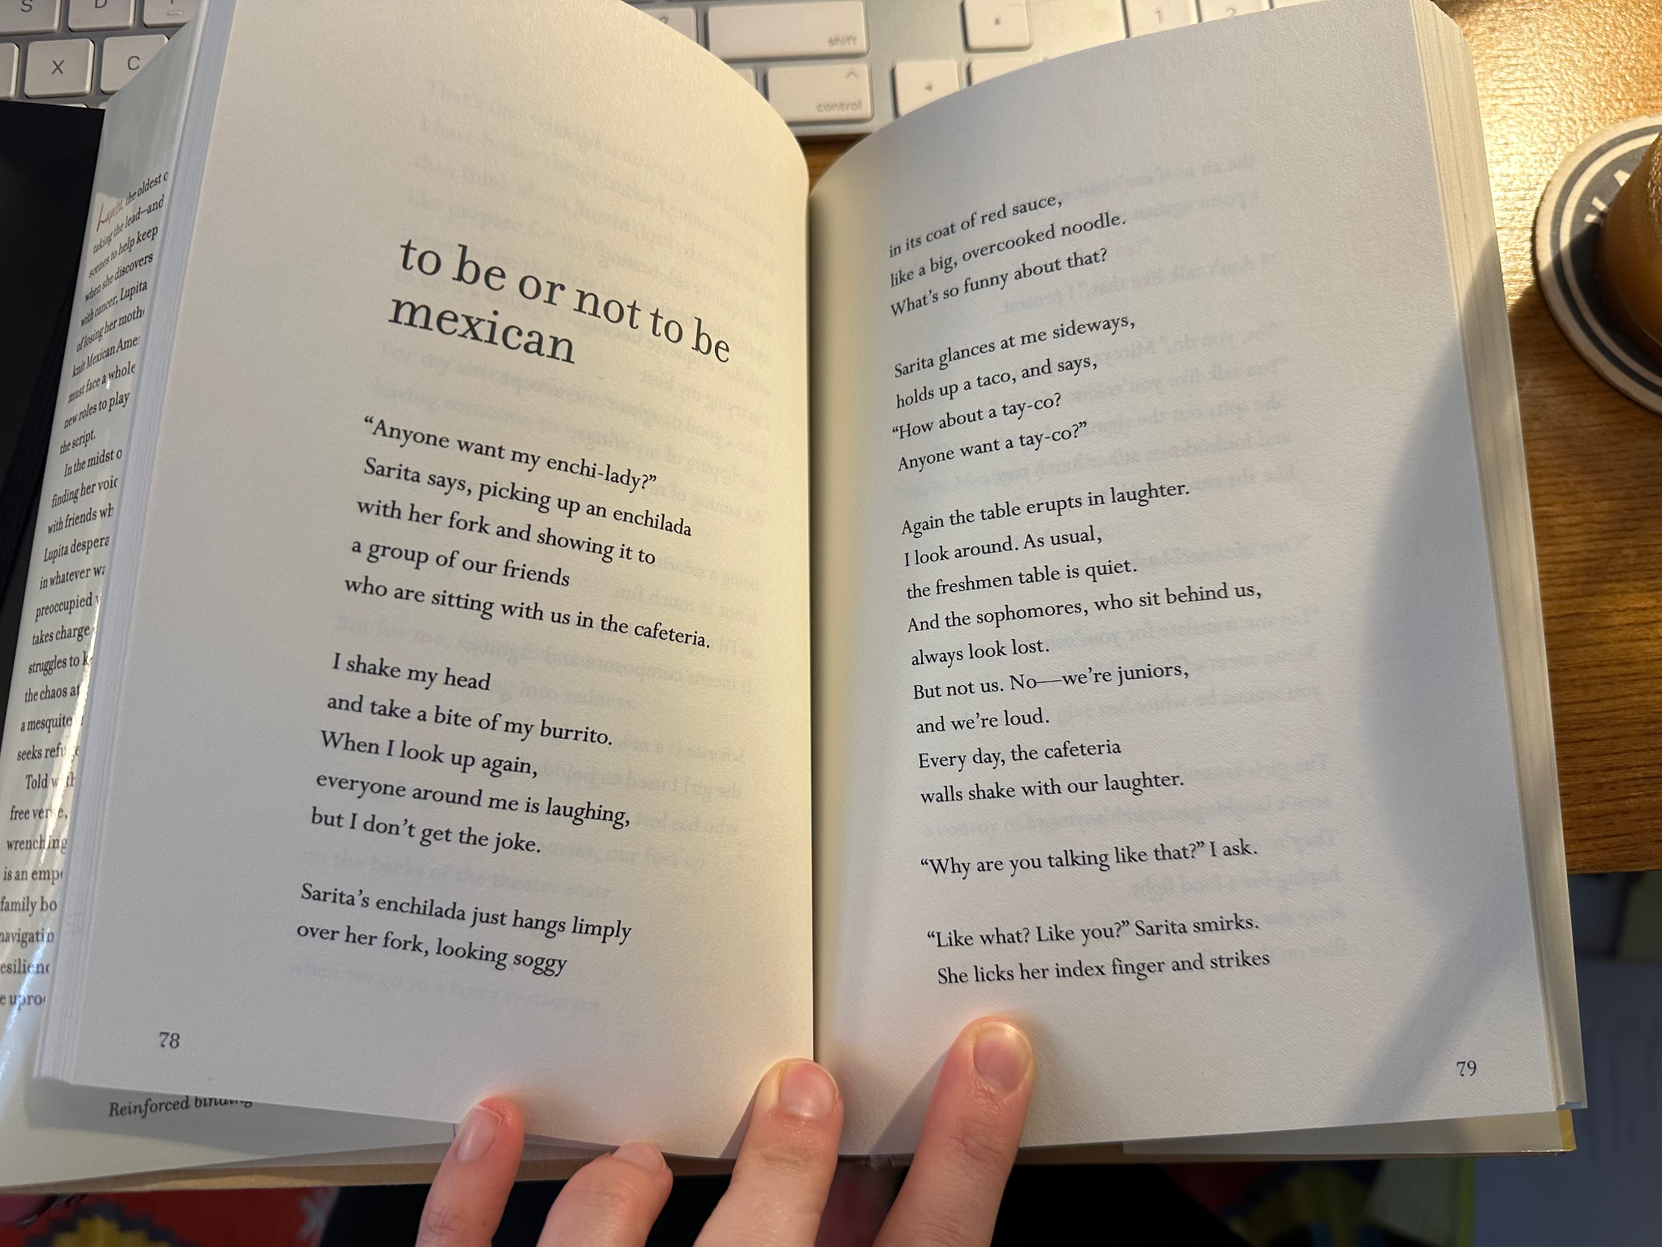

Slide 25
Why do you think De Anda and McCall engage with Hamlet’s famous speech?
What poetic strategies do they use to adapt it to express the lived experiences and existential dilemmas of young Mexican Americans? Examples?
How do their speakers understand their own identities? How do they embrace a “consciousness of the Borderlands”?
pocha/o a pejorative term for
someone of Mexican descent who has been Americanized
tierra land
abuela grandmother
mestiza/o of mixed heritage,
Indigenous, European, and African
raza the people
rebozo Mexican scarf or shawl

Slide 26
Discuss analysis questions
What kind of lesson plan would you develop that accounts for gender, race, place, socioeconomics?
What types of (poetic) literacy questions might these poems help to address? What challenges would you anticipate?
Would you consider pairing these poems with any of the other “To Be or not to be” soliloquies or with Anzaldúa’s “To live in the Borderlands means you”?
Designing a Lesson Plan

Slide 27
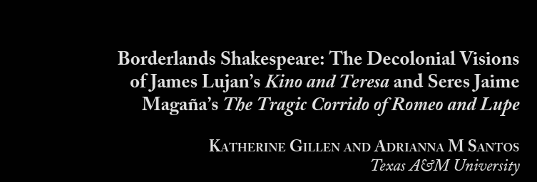
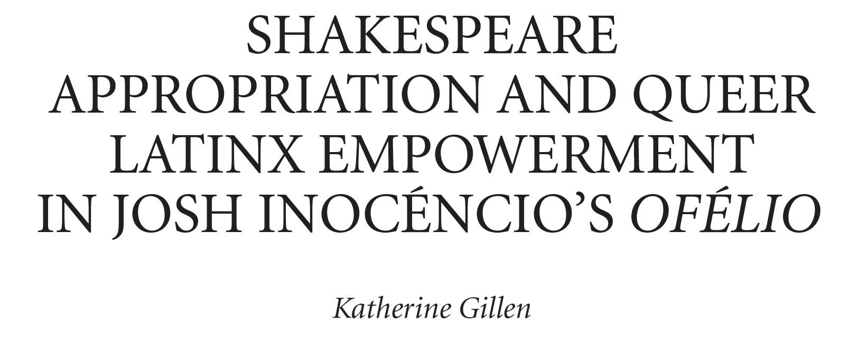
Notes:
ADRI

Slide 28
Y

Slide 30
